Slide 1
General Aviation Weather-Related Accidents, LOC, and Lessons Learned Therein
Paul Suffern
NTSB Meteorologist

Slide 2
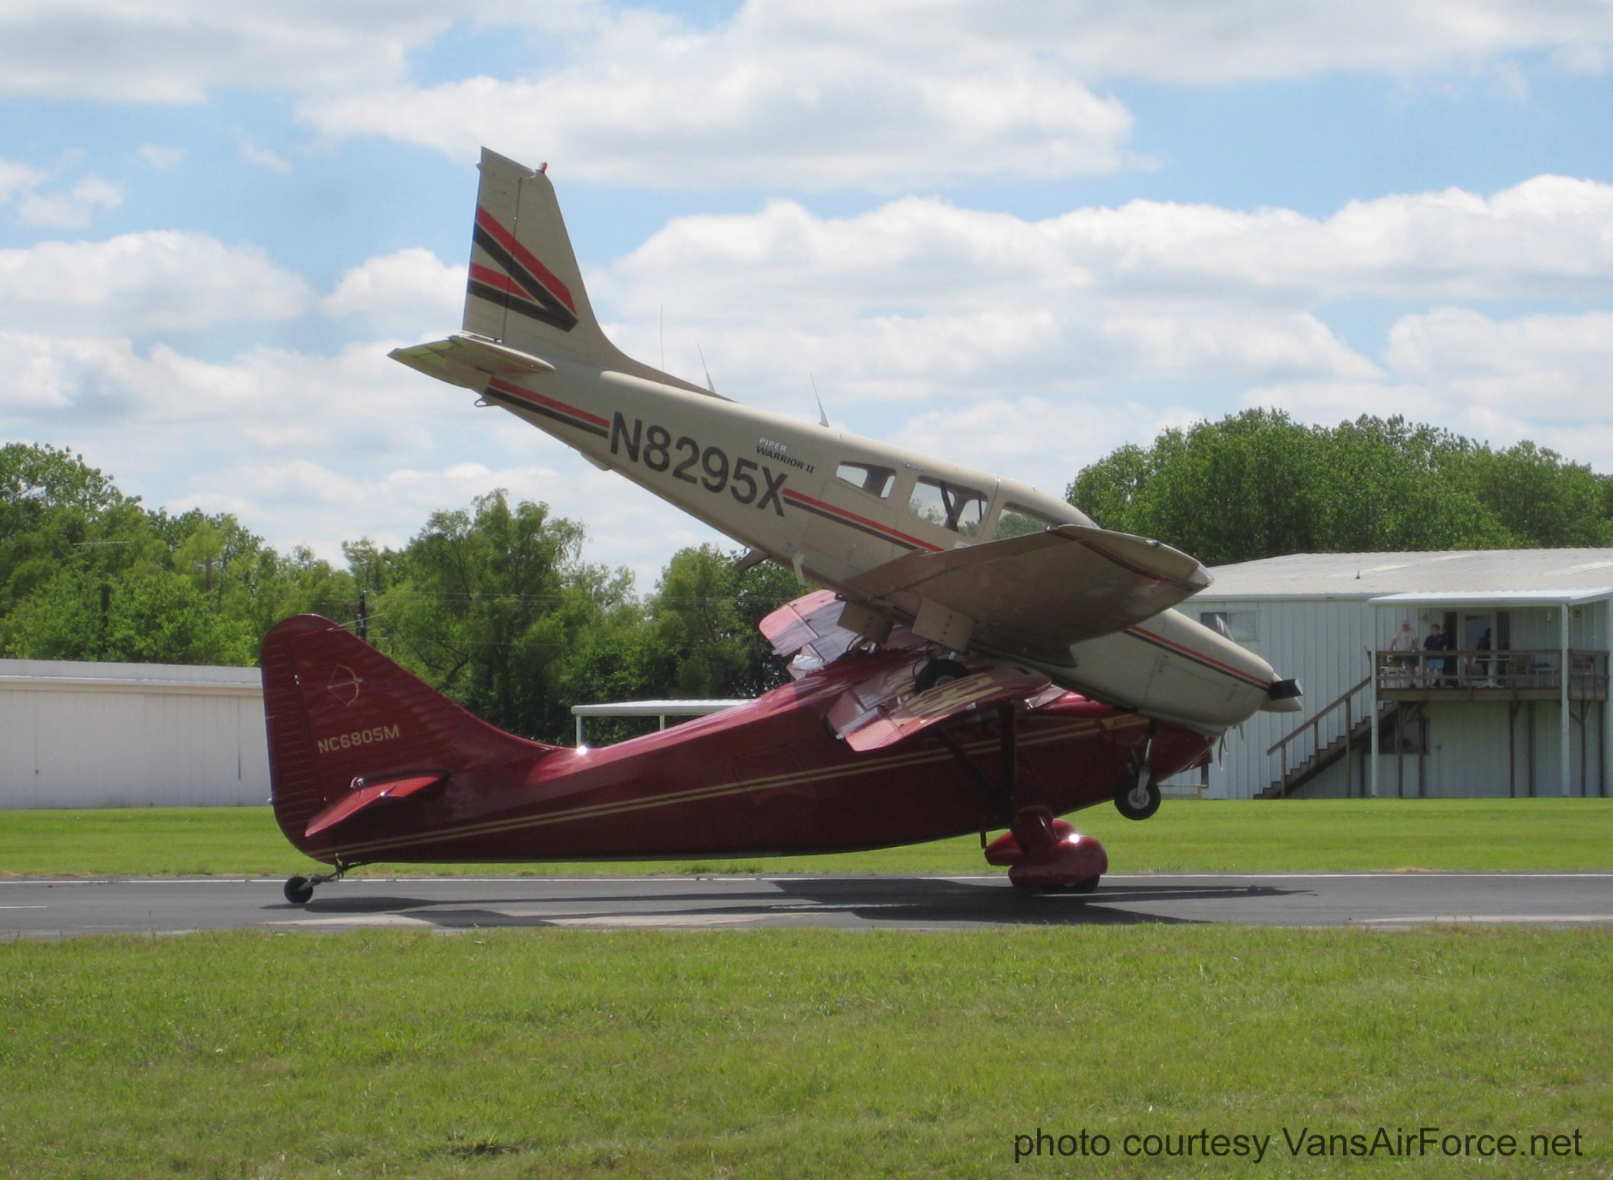

Slide 3
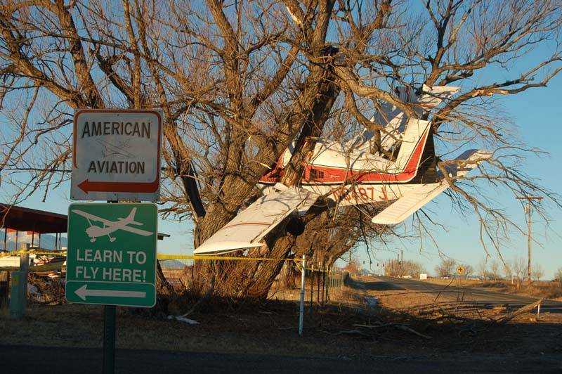

Slide 4
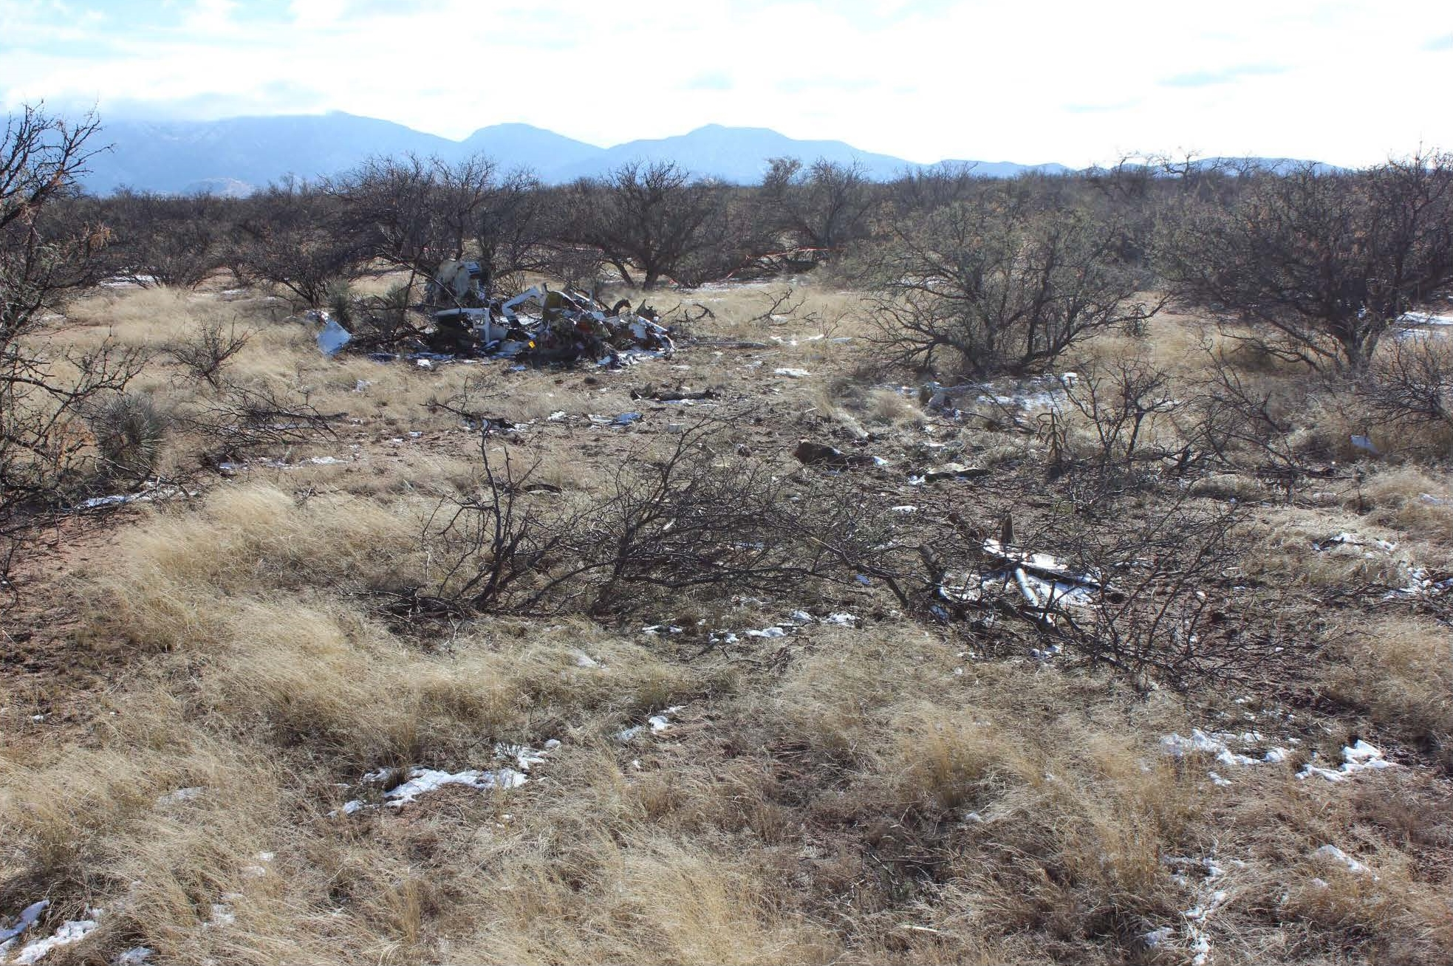

Slide 5
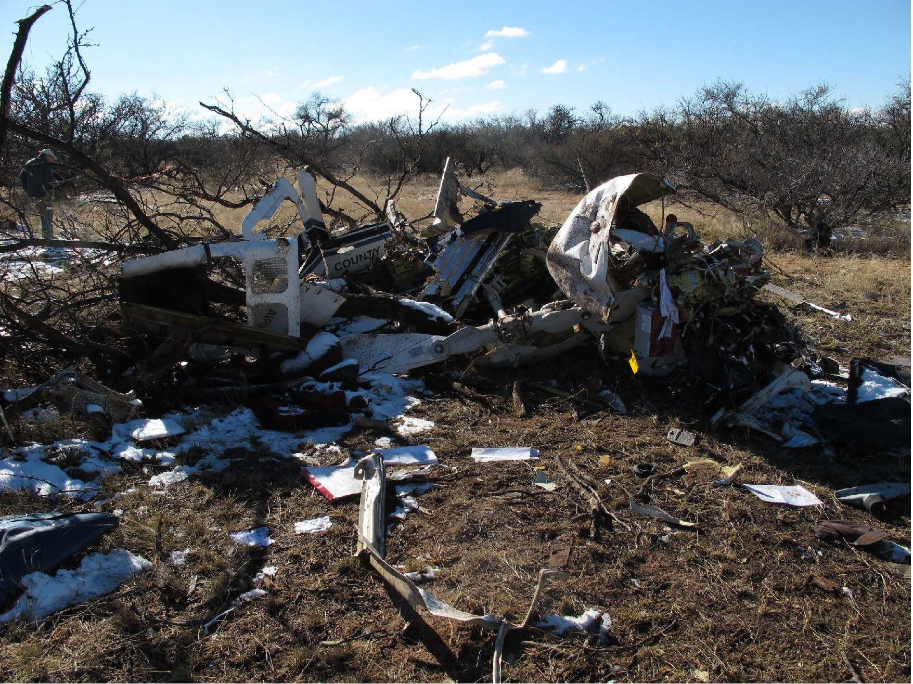

Slide 6
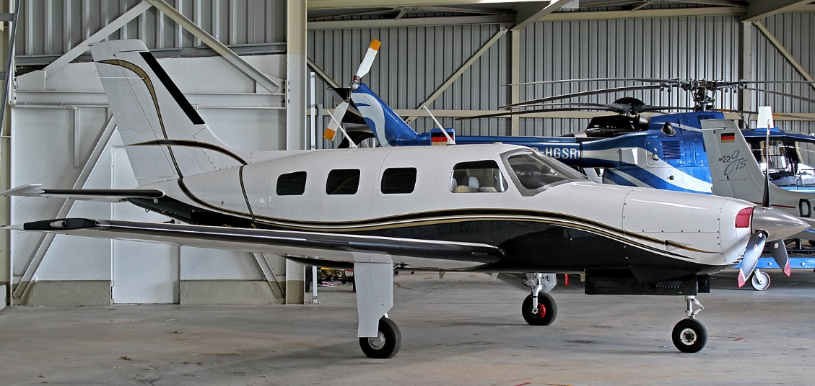
WPR17FA085
Piper PA 46-310P, N123SB
Harrisburg, Oregon
April 2017
IFR Part 91 flight
Pilot, commercial cert >5,060 hrs, 25 hours of IMC in past 6 months
Van Nuys, California (VNY) to Eugene, Oregon (EUG)
ForeFlight weather briefing request
4-Fatal
METAR KEUG 071754Z 20018G26KT 7SM -RA FEW024 OVC035 08/07A2951 RMK AO2 PK WND 18035/1706 RAB1656 SLP992 P0011 6//// T00830067 51046 $=

Slide 7
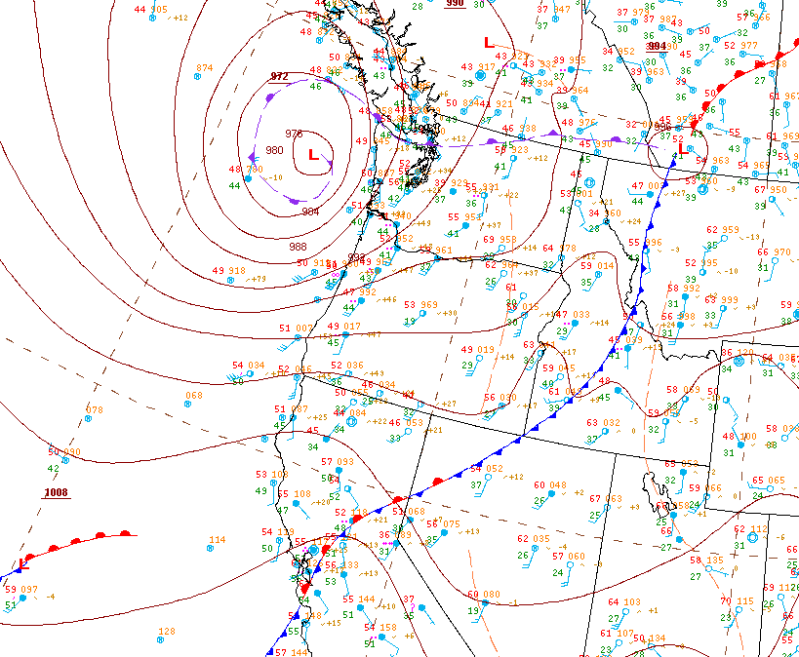
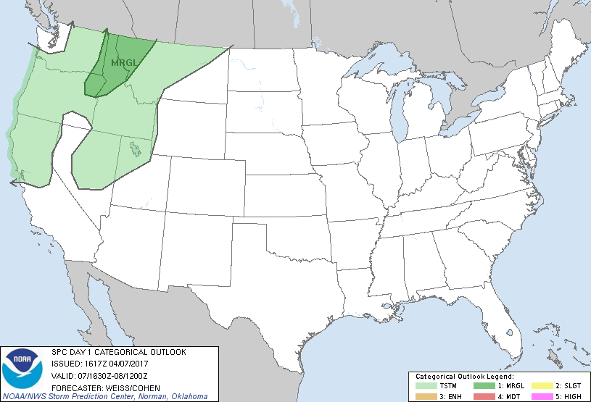
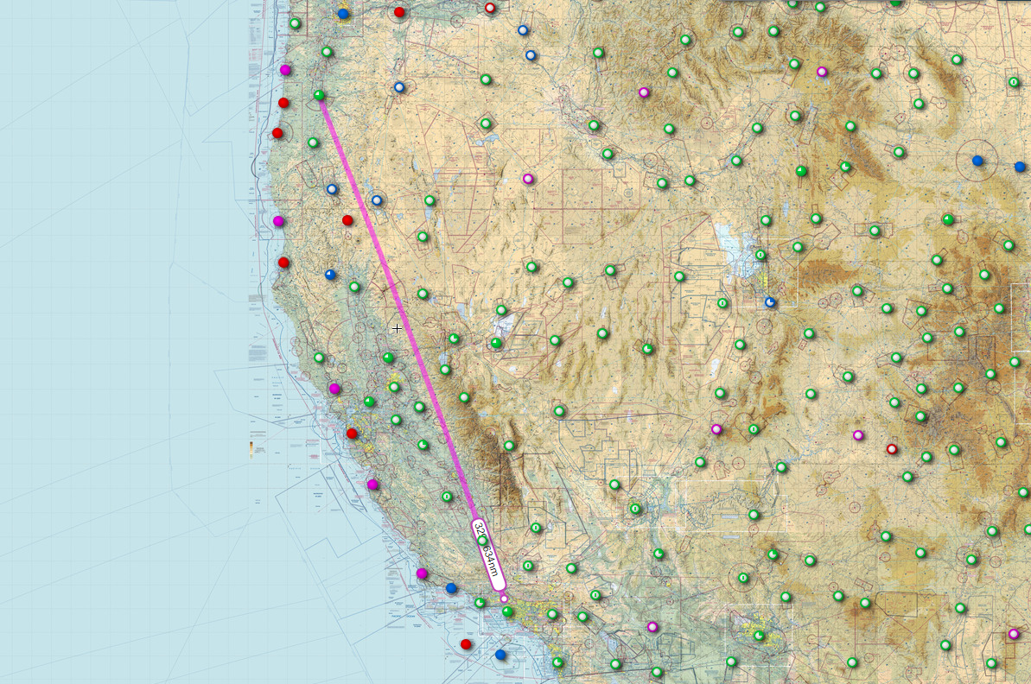
Accident site
Accident site
Flight plan

Slide 8
Pilot requested and received ForeFlight weather briefing package around 0416 PDT and departed by 0721 PDT
After departure climbed to 14,200 ft and leveled off for cruise portion of flight
At 1019 PDT, the pilot began a descent consistent with arrival in the EUG terminal area
At 1038 PDT, the controller instructed the pilot to descend to 4,000 ft and to expect the ILS RWY16L approach. About two minutes later, the controller advised the pilot of an area of moderate to heavy precipitation at his 11-to-2'o-clock position
The pilot reported that the airplane was in heavy precipitation and requested vectors to the localizer and a descent to 2,000 ft
At 1045, Cascade Approach advised the pilot of heavy to extreme precipitation in the area

Slide 9
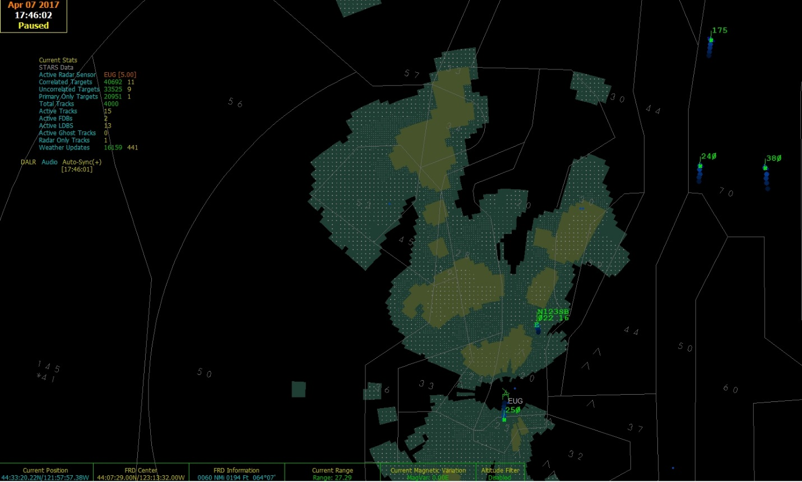
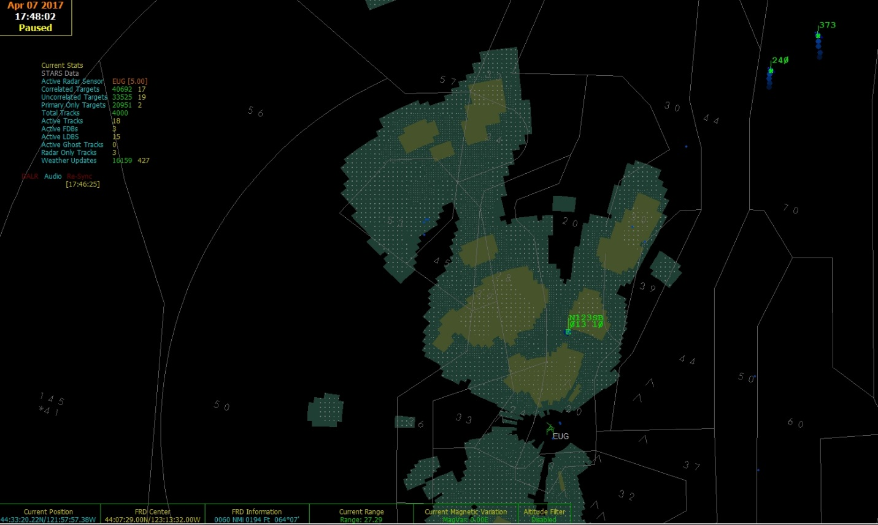

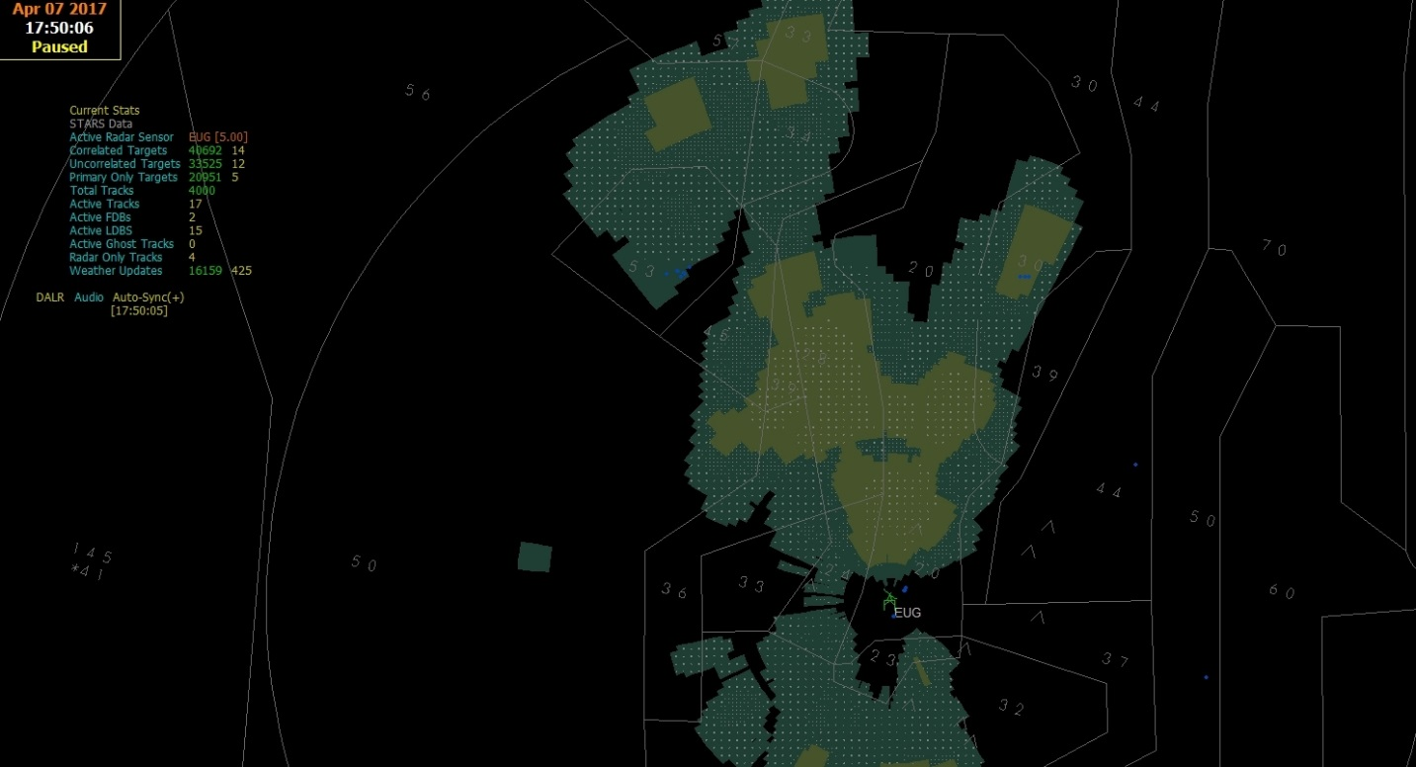
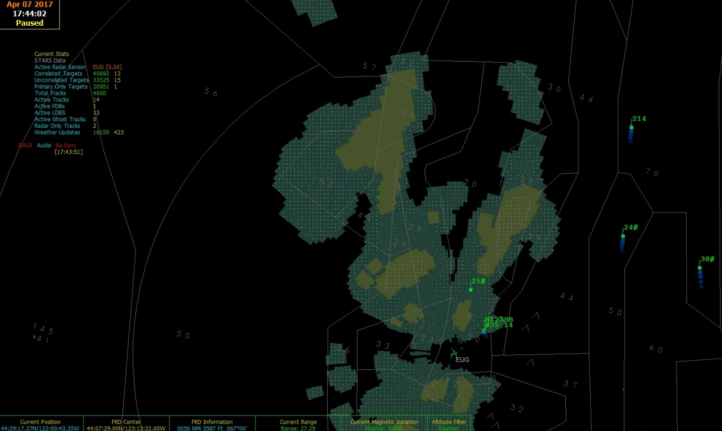
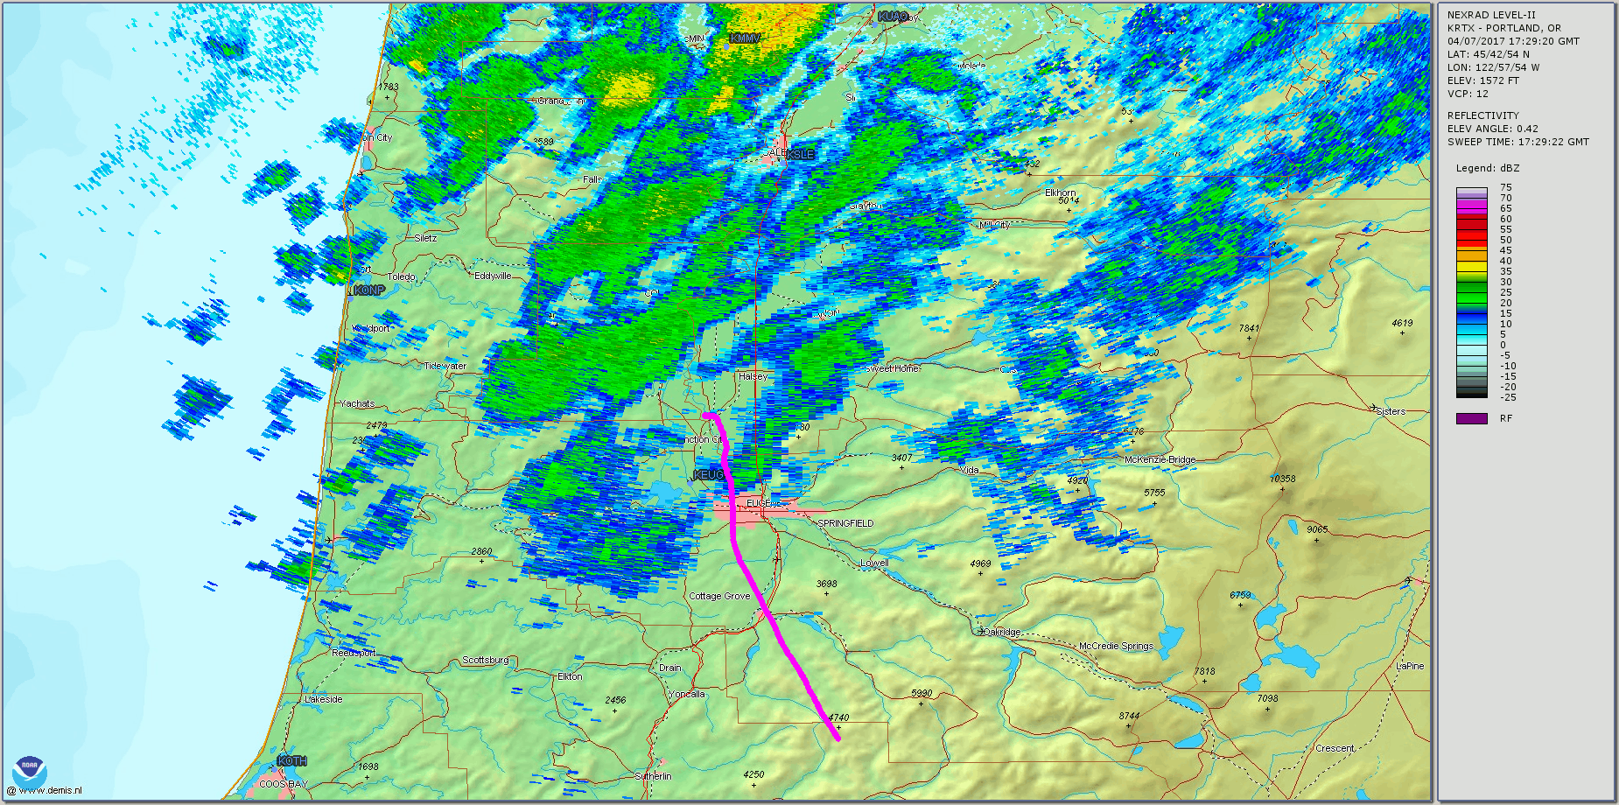
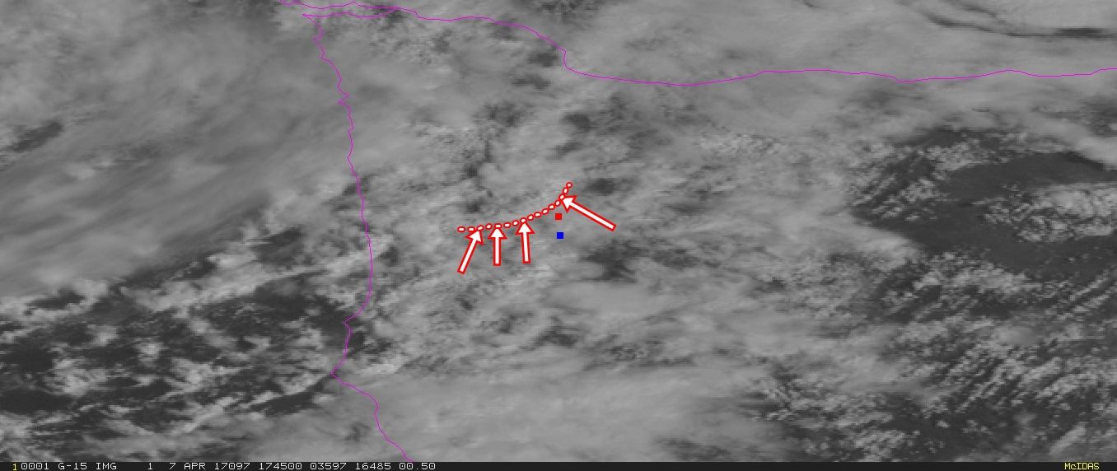
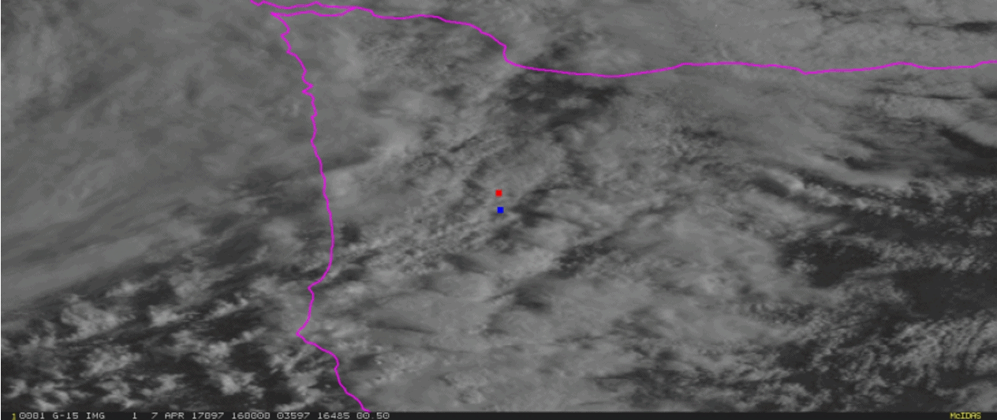

Slide 10
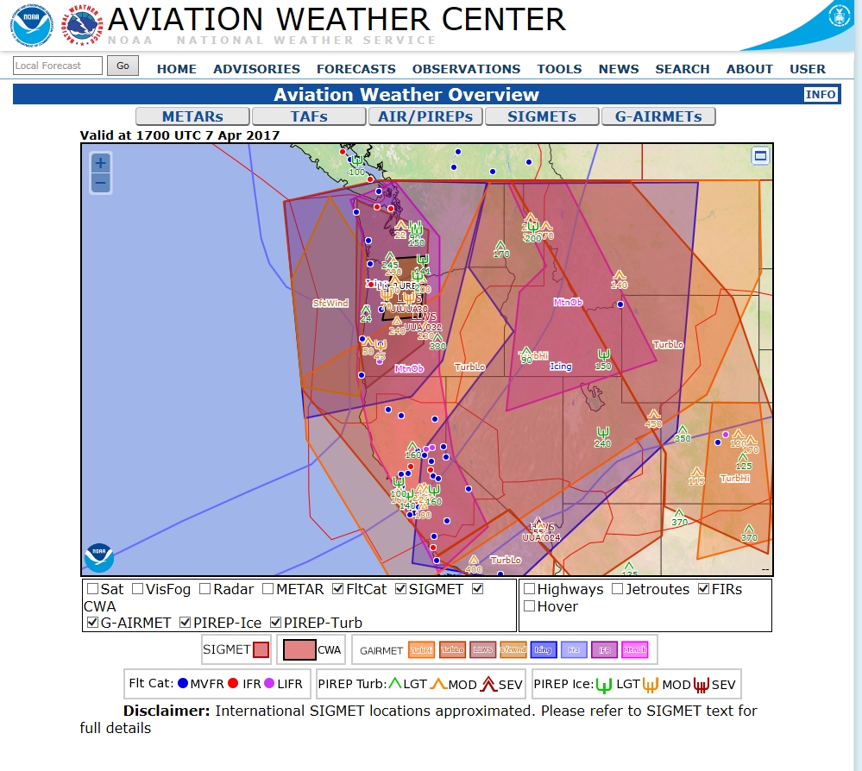
Accident site

Slide 11
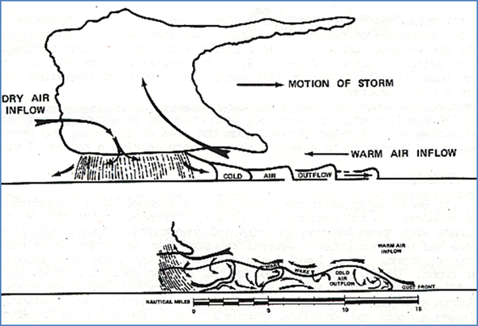
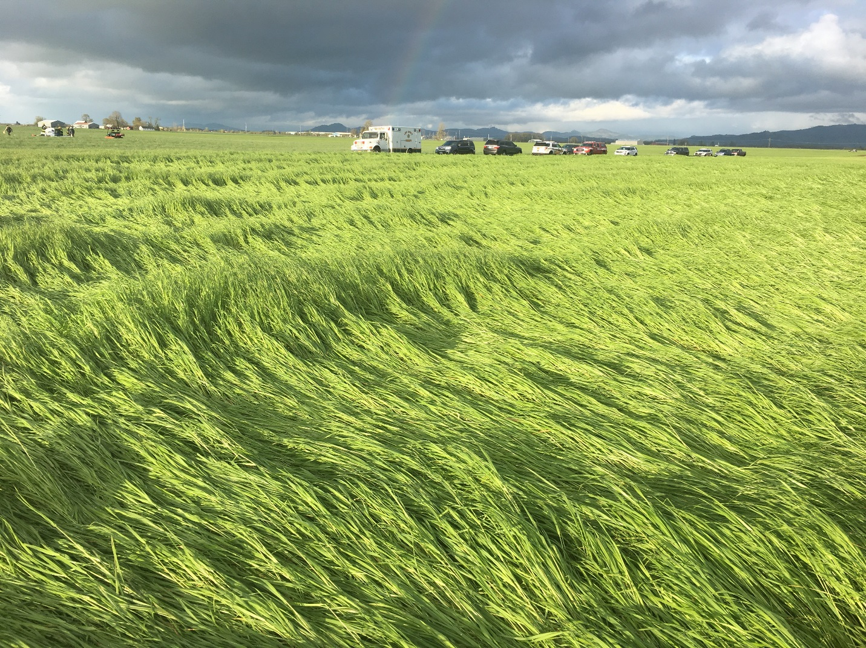
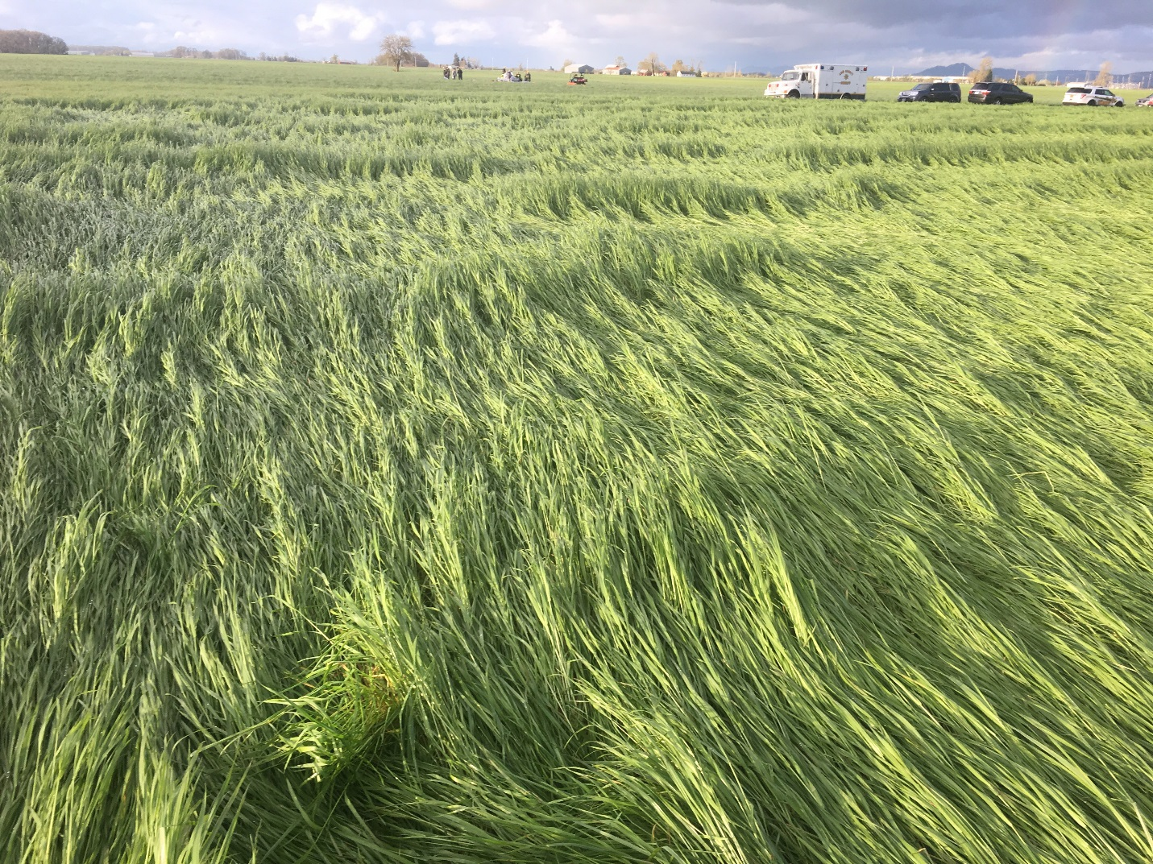
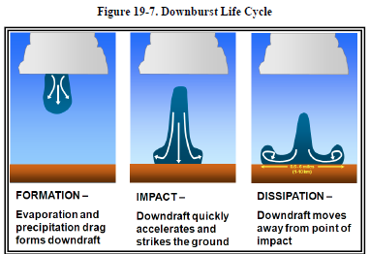
Accident wreckage
Accident wreckage

Slide 12
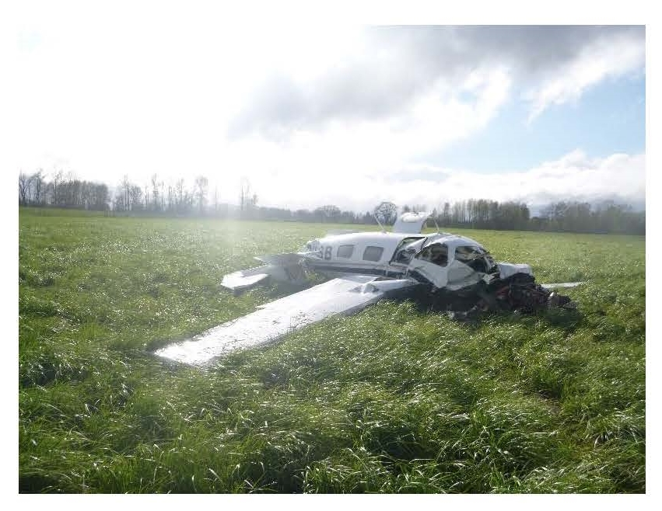
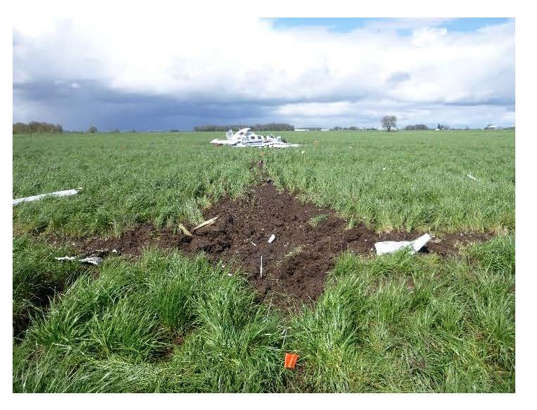

Slide 13
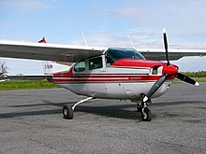
WPR17FA045
Cessna T210K, N272EF
Payson, Arizona
January 2017
VFR Part 91 flight for family vacation
Pilot, >295 hrs, all VFR
Scottsdale, Arizona to Telluride, Colorado
No ForeFlight weather briefing request.. but did enter KSDL to KTEX route
4-Fatal
METAR KPAN 021635Z AUTO VRB04G10KT 10SM OVC003 02/01 A3011 RMK AO2=

Slide 14
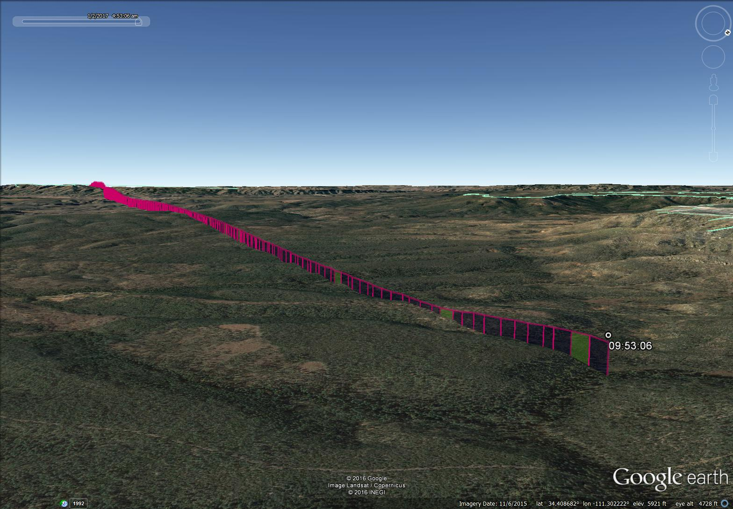
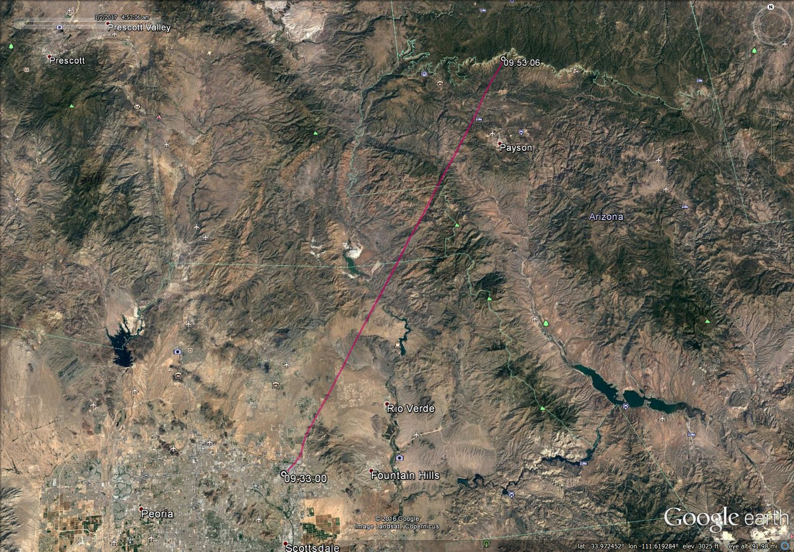
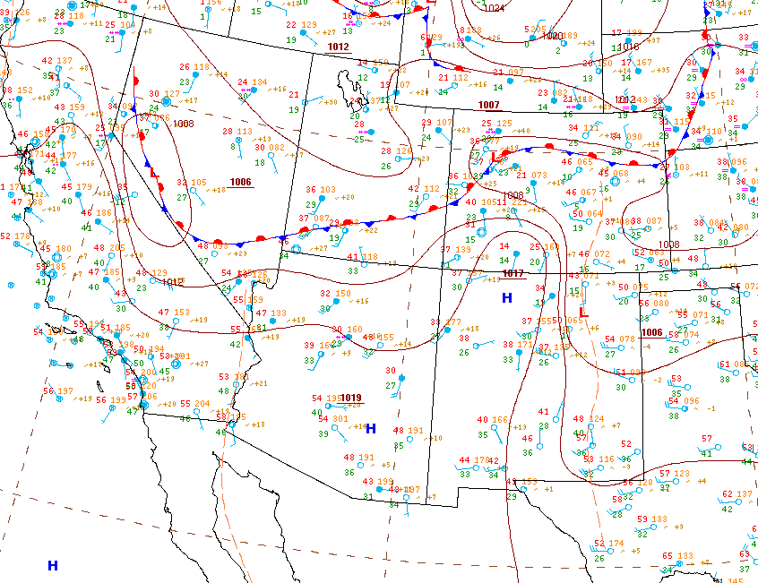
Pilot did enter route information at 08:26:07 MST (about 70 minutes before accident)
Could have checked text wx data but nothing graphical reviewed via ForeFlight before flight
Co-owner of plane (IFR rated) and pilot reviewed weather forecasts 2 days prior to flight and co-owner informed pilot that he should drive
Accident site
Flight plan

Slide 15
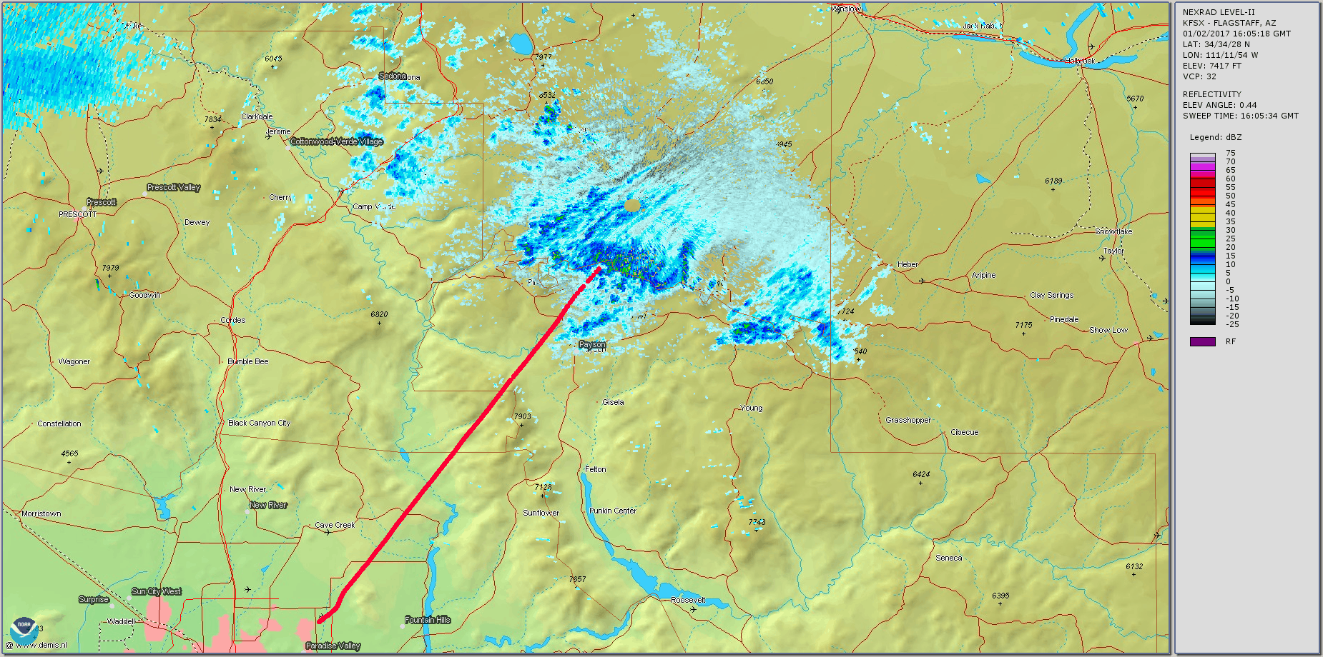
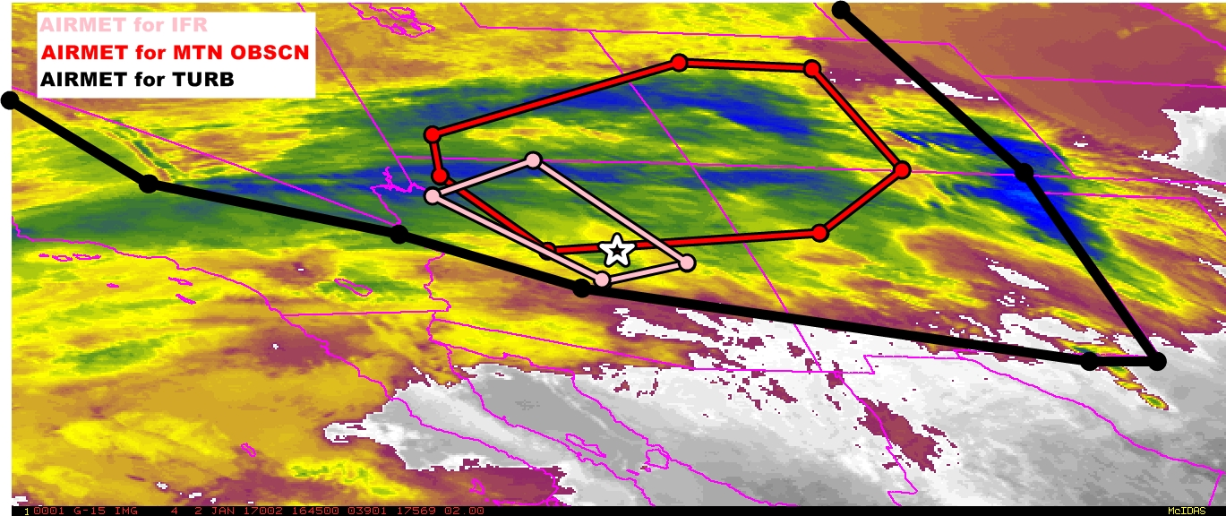
Accident site

Slide 16
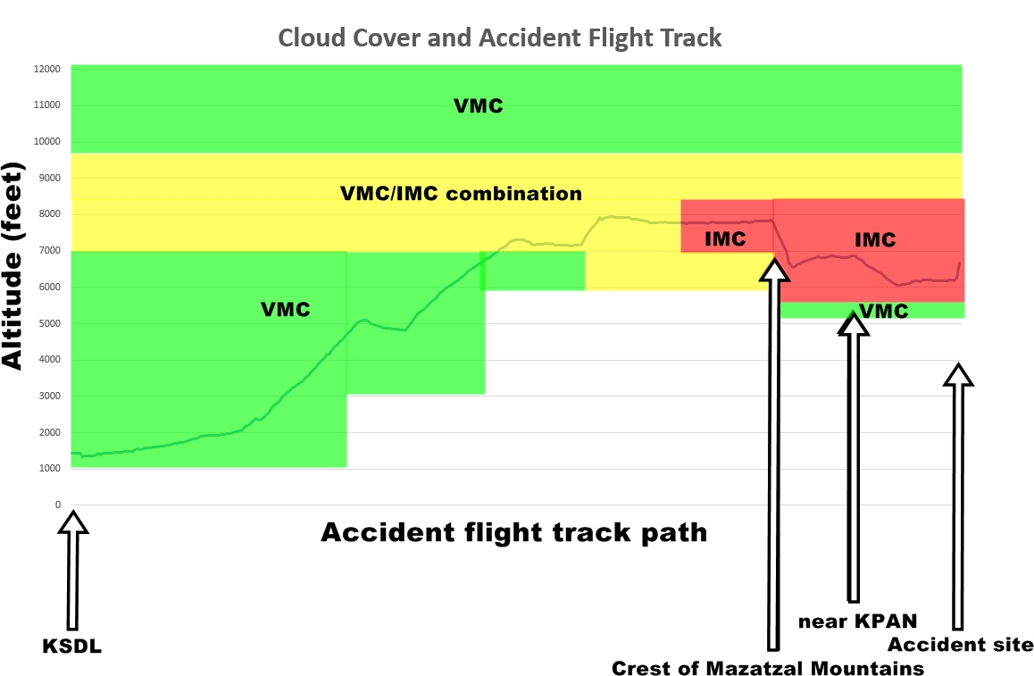
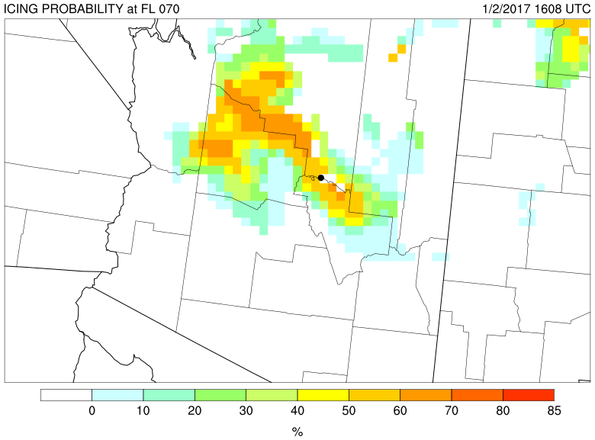
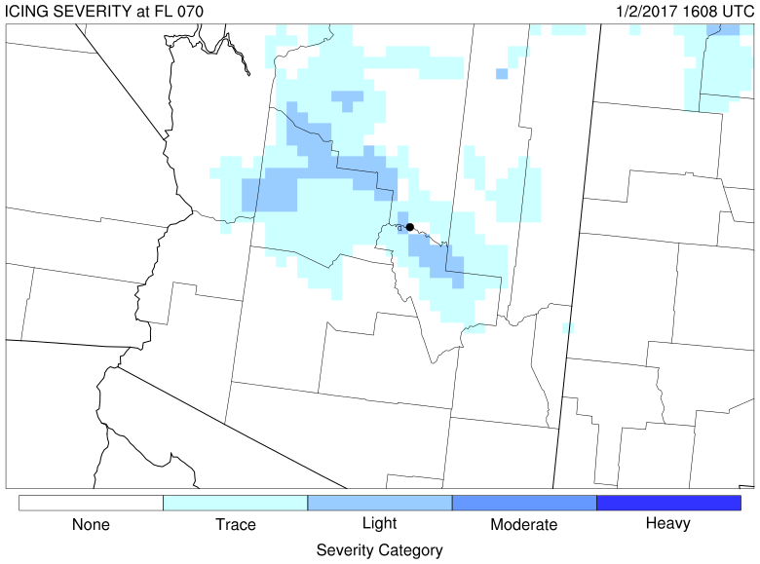
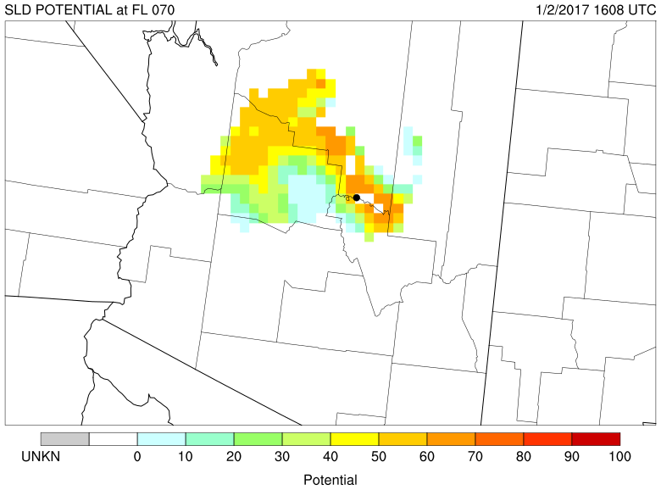

Slide 17
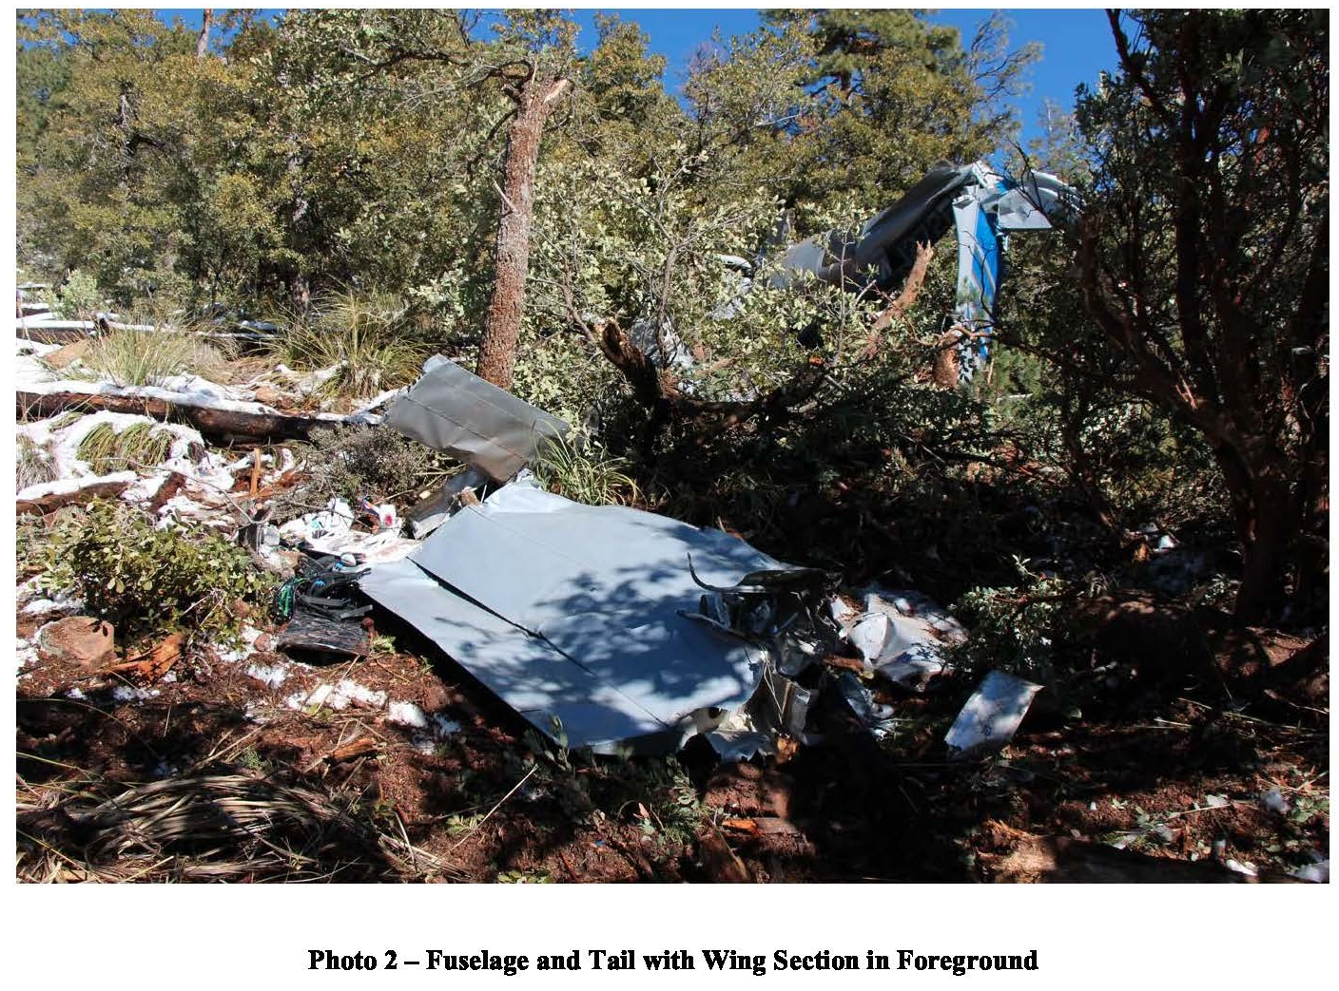
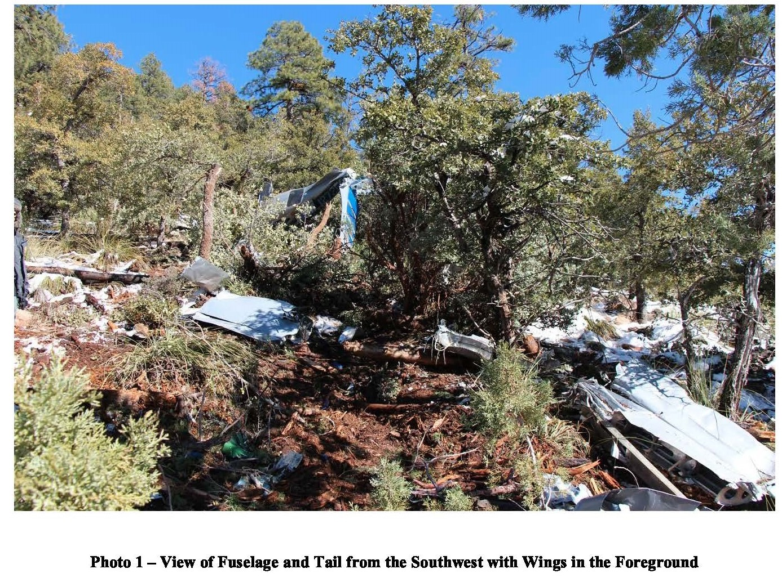
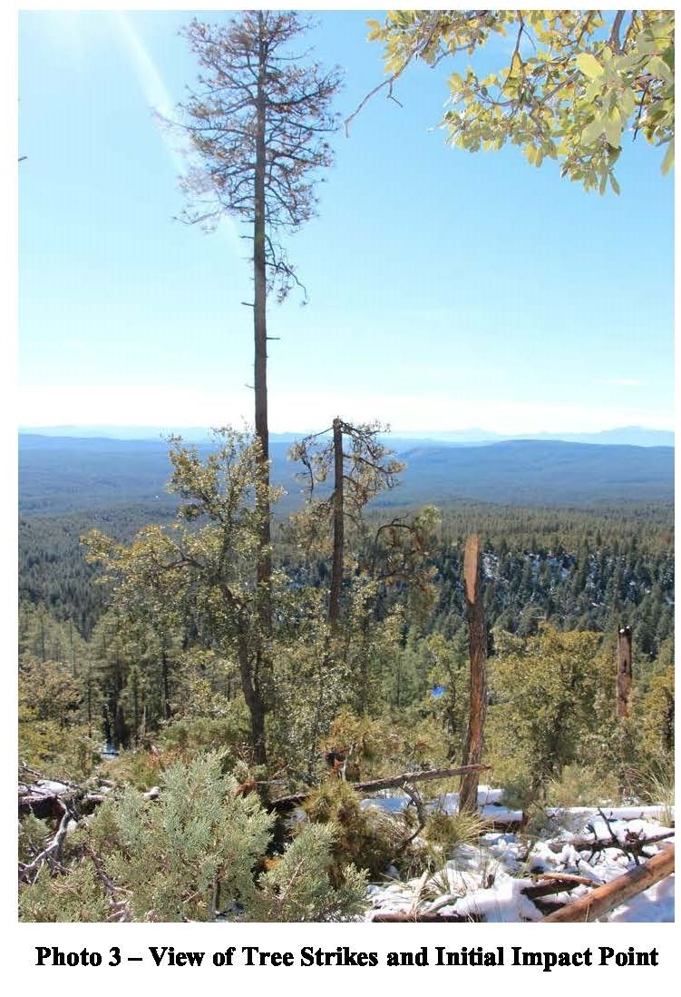
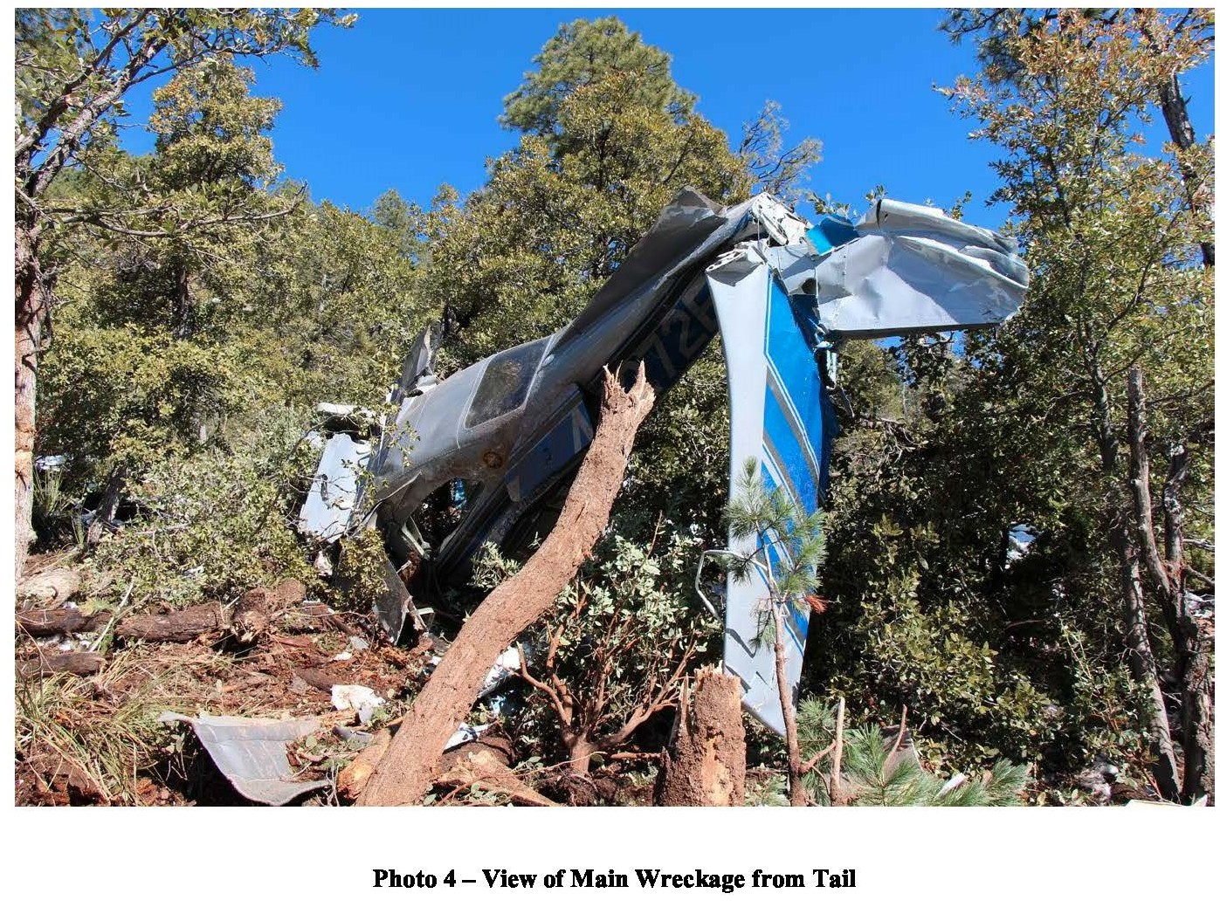
The National Transportation Safety Board determines the probable cause(s) of this accident as follows:
The non-instrument-rated pilot's improper decisions to begin and to continue a flight under visual flight rules into instrument meteorological conditions, which resulted in controlled flight into terrain.

Slide 18
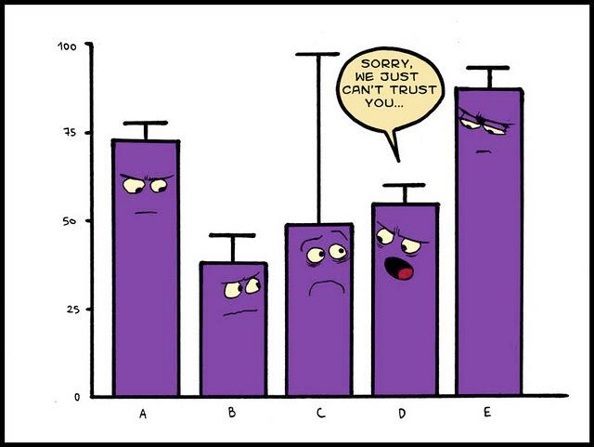
Accident statistics

Slide 19
Part 91 General Aviation Accidents 2012-2016
 | Weather-Related | Non Weather Related | Total | Weather Related
Accidents | 1,349 | 4,492 | 5,841 | 23%
Fatal Accidents | 315 | 715 | 1,066 | 30%

Slide 20
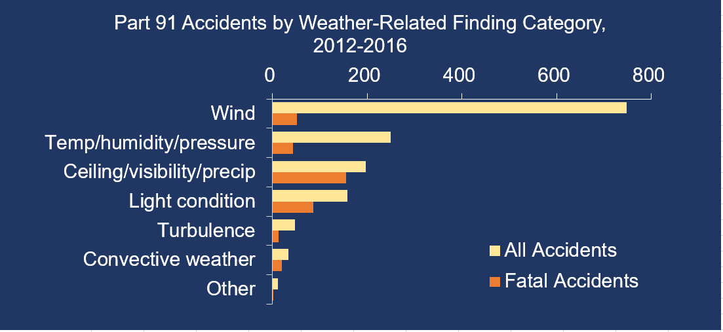

Slide 21
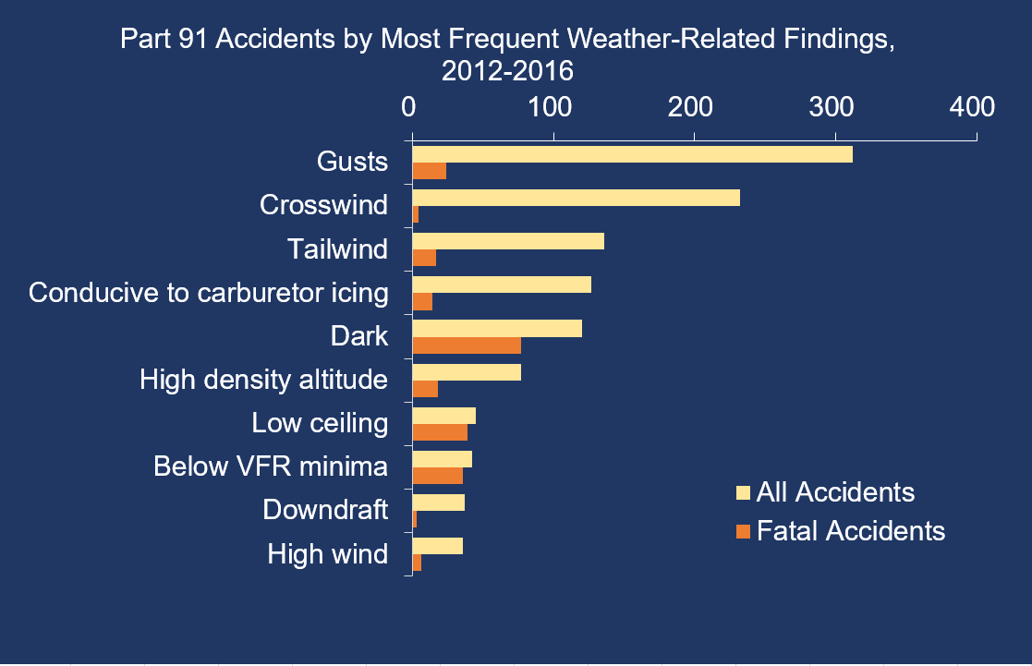

Slide 22
NTSB LOC-I Accident Data
LOC-I involves about 17% of all fixed wing accidents
Of fatal accidents, LOC-I consists of about 45 percent of accidents
Notes:
Accident data from 2008-mid 2017

Slide 23
Notes:
Data from 2008 through 2017 closed cases…

Slide 24
AOPA 2018 Weather Survey Data
AOPA release 2018 wx survey in July
About half of all subjects (54%) were unfamiliar with the NWS Aviation Weather Center (AWC) web-based PIREP submission portal.
Most pilots (79% of CONUS pilots and 60% of Alaskan pilots) said they would use such a tool if it were integrated with their primary inflight application on their Electronic Flight Bag (EFB).
Pilots (and especially pilots from Alaska) often cited a need for more PIREPs, even though few reported routinely providing unsolicited PIREPs to ATC.

Slide 25
AOPA 2018 Weather Survey Data
Alaskan pilots experienced unforecast adverse weather, changed course (diverted, landed, or turned back), and re-evaluated their pre-flight planning due to adverse weather with greater frequency than CONUS pilots.
All pilots re-evaluated their pre-flight planning after experiencing adverse weather more often than they diverted, landed, or turned back as a result of such weather.

Slide 26
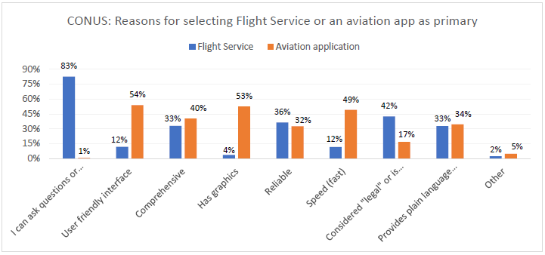
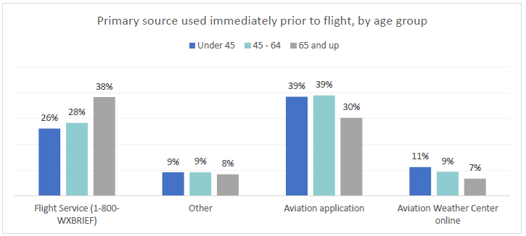
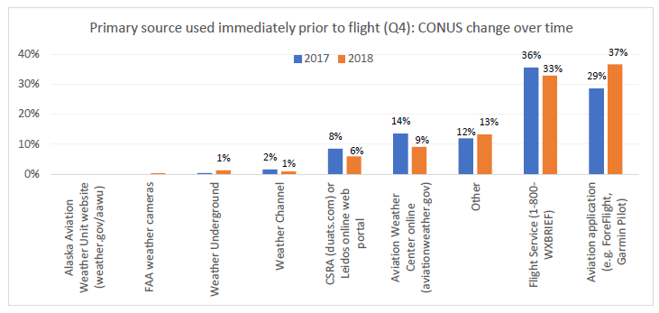
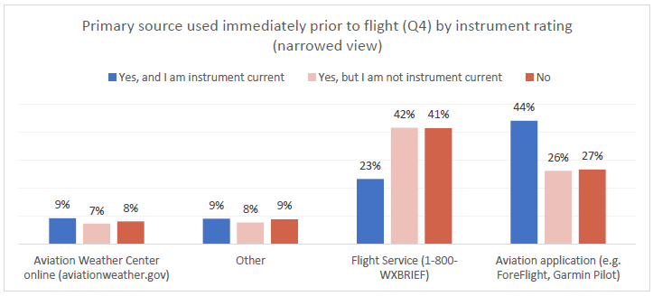
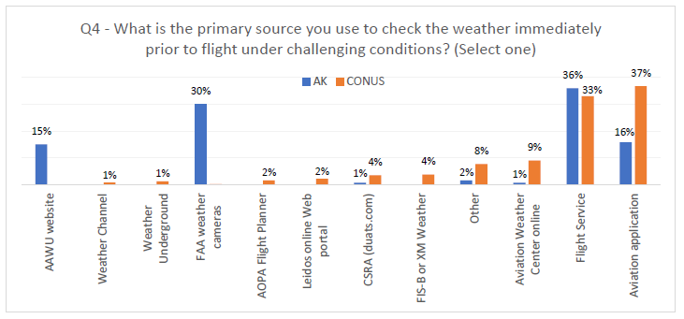
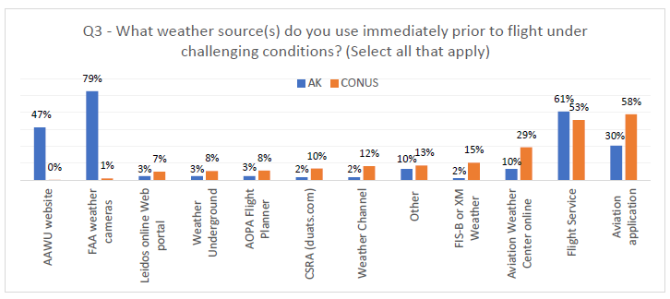
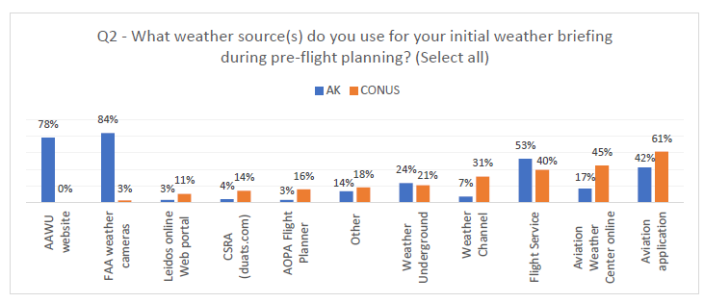
AOPA 2018 Weather Survey Data

Slide 27
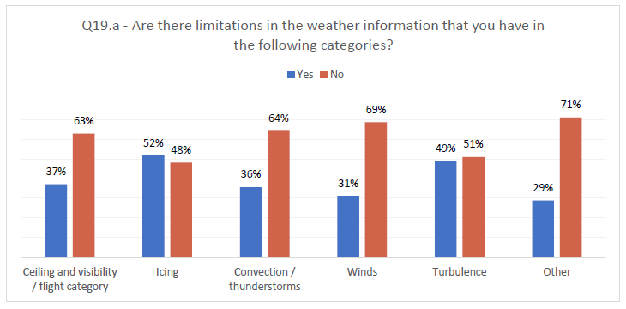
AOPA 2018 Weather Survey Data
If you want the full survey results please just send me an email and I’ll forward you the full report!

Slide 28


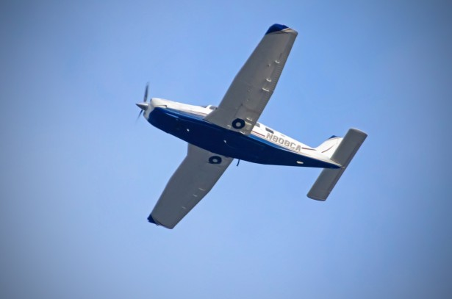
FAA reviewing VFR not recommend (VNR) for safety benefits
Determine if FSS are too conservative in issuing VNR thus reducing its utility
Identify objective criteria for determining VNR so that it can be automated and provided in self-briefings, and to increase its utility and safety benefits
Initial work using 8 wx scenarios with a group of 20 pilots and 20 FSS

Slide 29
VNR
Initial data shows pilots more wx conservative than FSS
When mountainous terrain involved in flight route wx review and decision(s) more complicated
Only 3 out of 20 pilots had some formal wx interpretation training via classroom
12 out of 20 pilots had no wx interpretation training

Slide 30
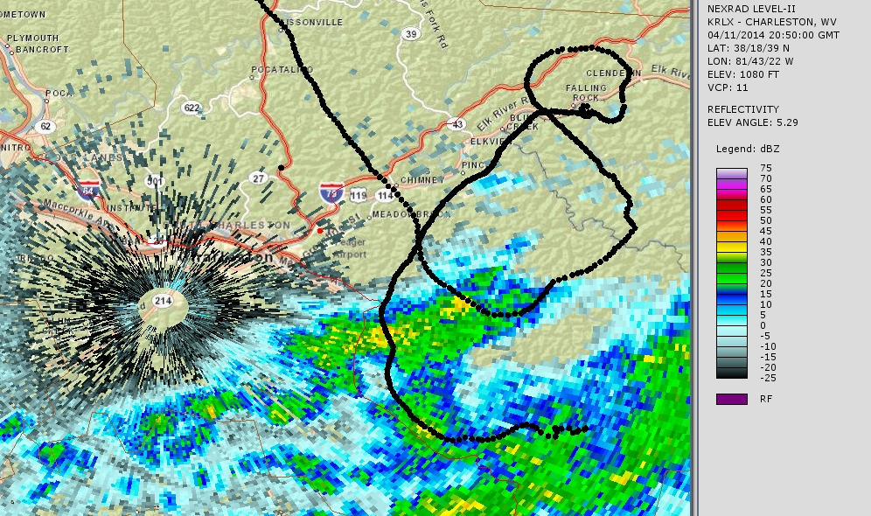
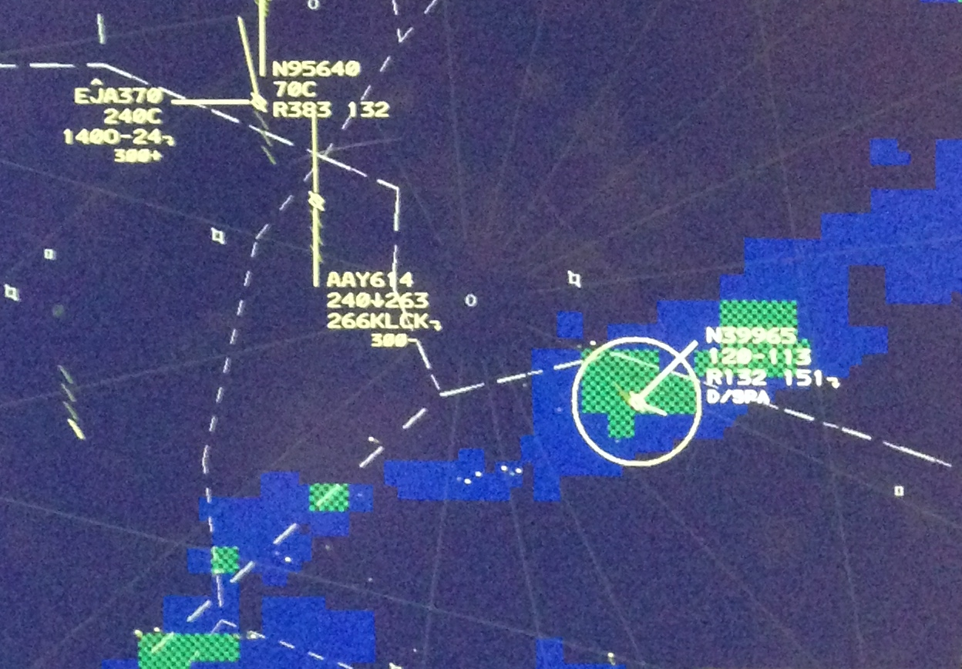

Importance of Clear Communication
What pilots/ATC/wx person see are all different pictures of the same weather conditions
Notes:
Important to communicate in the language the other discipline speaks

Slide 31

Looking Straight Ahead
Notes:
Another example…..this aircraft is flying along at 36,000 feet (upper right)…..2 green blobs off his 1-2 oclock…..only seeing green…..antenna tilt on zero…..

Slide 32

Looking Down
Notes:
Tilt down two degrees……and a much different picture emerges….

Slide 33

3D Modeling in Google Earth
Notes:
Another view…..

Slide 34

ERAM View
Notes:
Here is what ATC had at Center at the same time…….the guy taking the pictures is right here (ASA19)
That’s the same stuff they’re seeing on the airborne radar at that time……showing moderate to heavy….no extreme

Slide 35

NEXRAD View
Notes:
NEXRAD at the time…….
Obviously, even more fidelity.

Slide 36

Out the Window
Notes:
Now as this airplane flies along this way……we’re looking at the last cell in the line….he’s down 3 degrees on the tilt now……a little green and some yellow
About 15 miles away 4500’ below the aircraft (with some math)
Let’s see what the cells actually look like out the window….(press play at bottom of slide)
So….no kidding thunderstorm….there’s the lightning…..remember how 5/8 pilots would fly through a green blob?
His original tilt of zero….all he would’ve seen was green…..could’ve flown right through….

Slide 37







Preflight Planning
Confusion Introduced?
NTSB study - 41% of the weather related accidents the pilot did not obtain or receive an adequate weather briefing

Slide 38

Wildfire smoke

Slide 39


Highest weather related fatalities occurred in Aviation - Part 91 and 135

Slide 40
Any Questions?
Main website: http://www.ntsb.gov
LOC Forum website: www.ntsb.gov/locforum
Preventing LOC through technology and training: https://www.ntsb.gov/news/events/Pages/2018-loc-rt.aspx
My email: paul.suffern@ntsb.gov

