Slide 1
General Aviation Weather-Related Accidents, LOC, and Lessons Learned Therein
Paul Suffern
NTSB Meteorologist

Slide 2
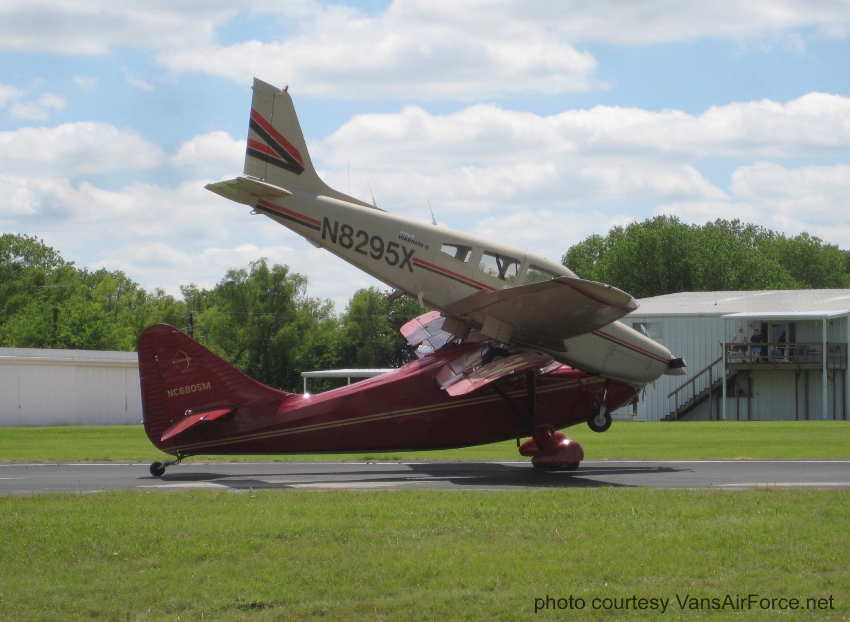

Slide 3
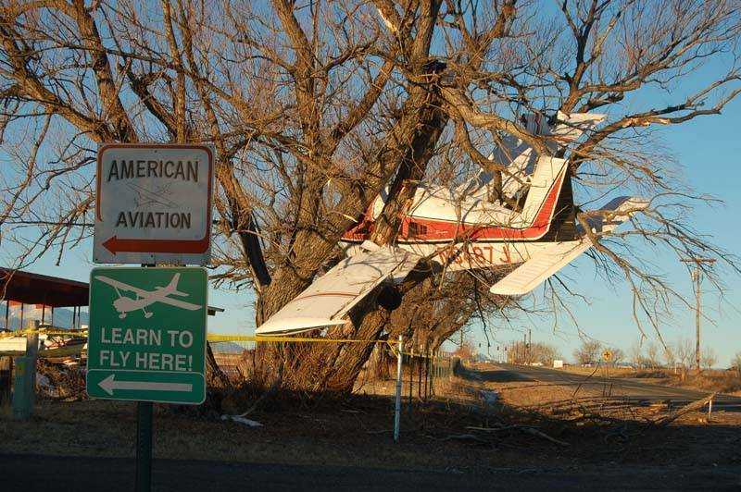

Slide 4
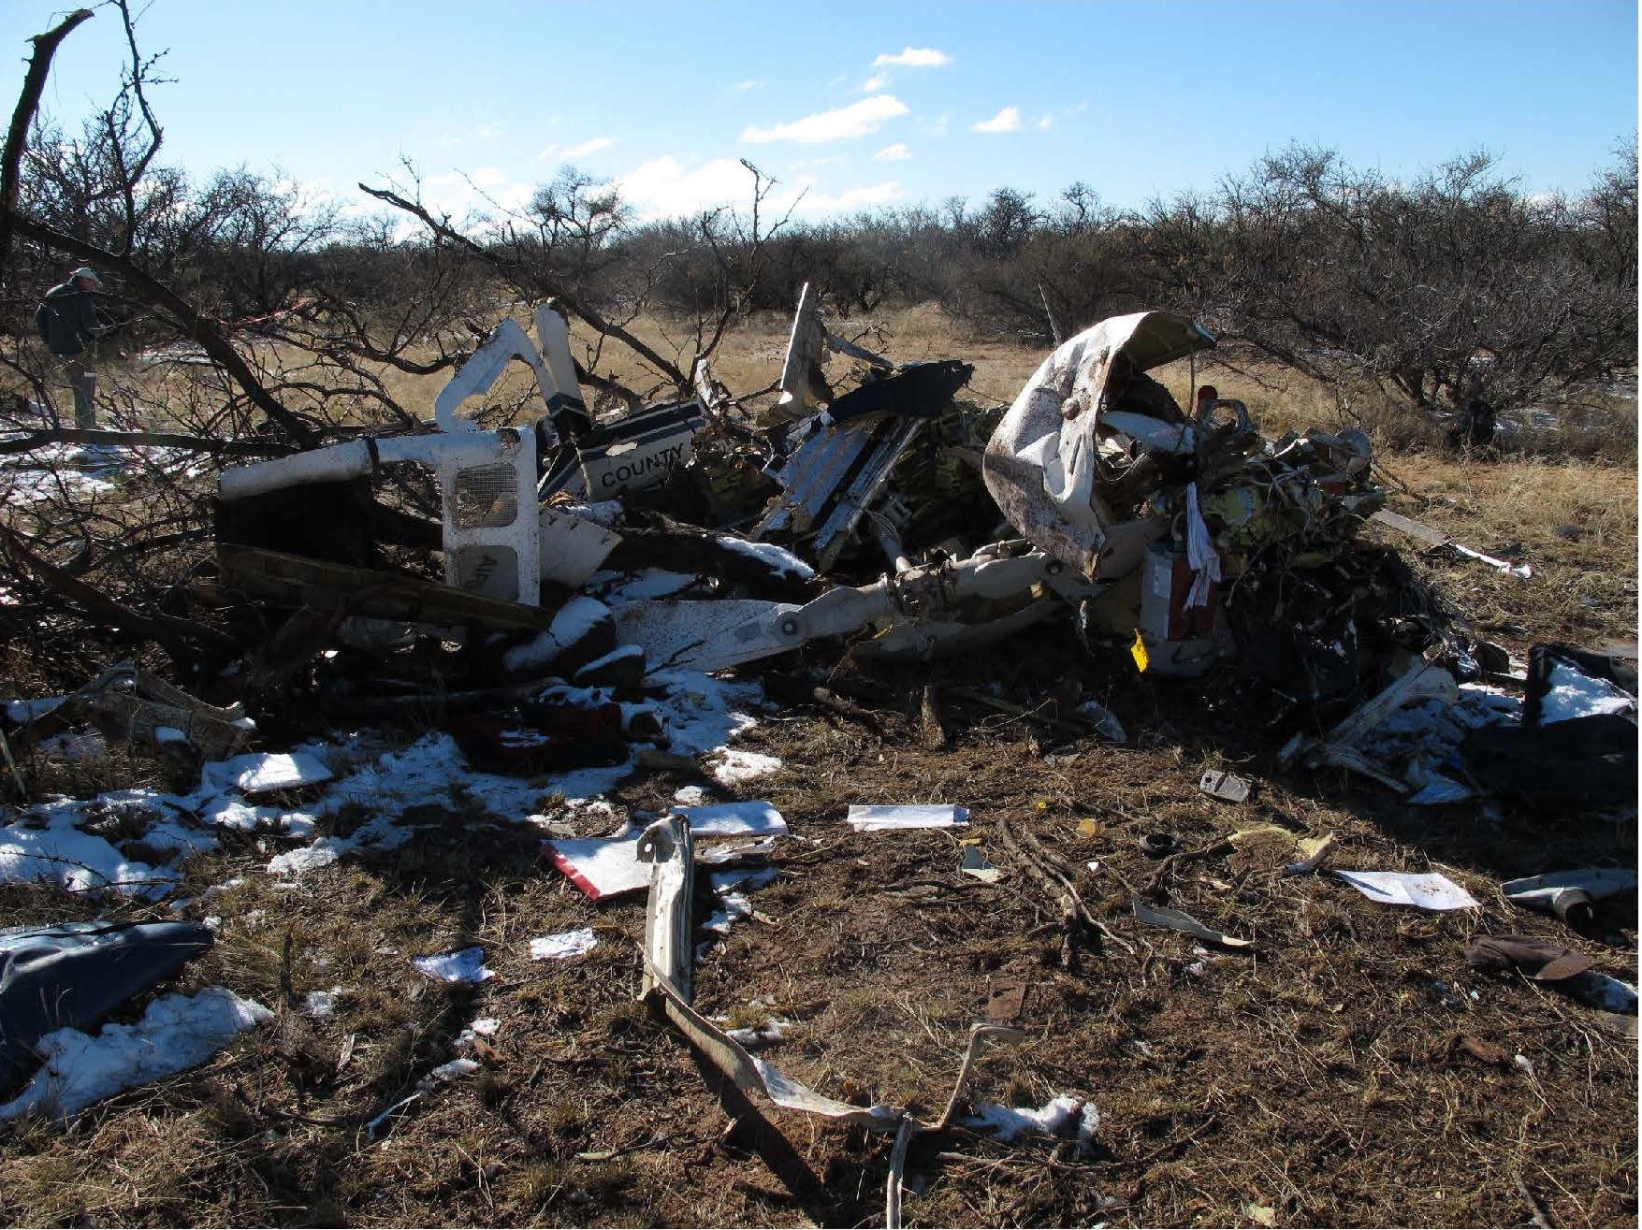

Slide 5
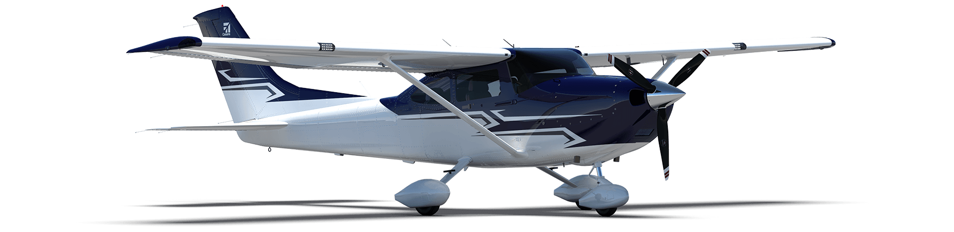
WPR17FA008
Cessna 182D, N8718X
South Lake Tahoe, California
October 2016
VFR Part 91 flight
Pilot >1,100 hrs, no IMC experience
Winnemucca, Nevada (WMC) to Jackson, California (JAQ)
No known weather briefing, but typically used ForeFlight
1-Fatal
METAR KTVL 152253Z AUTO 19017G29KT 4SM RA SCT024 BKN029 OVC034 08/05 A2987 RMK AO2 PK WND 19029/2253 RAB2156 SLP079 P0004 T00830050=

Slide 6
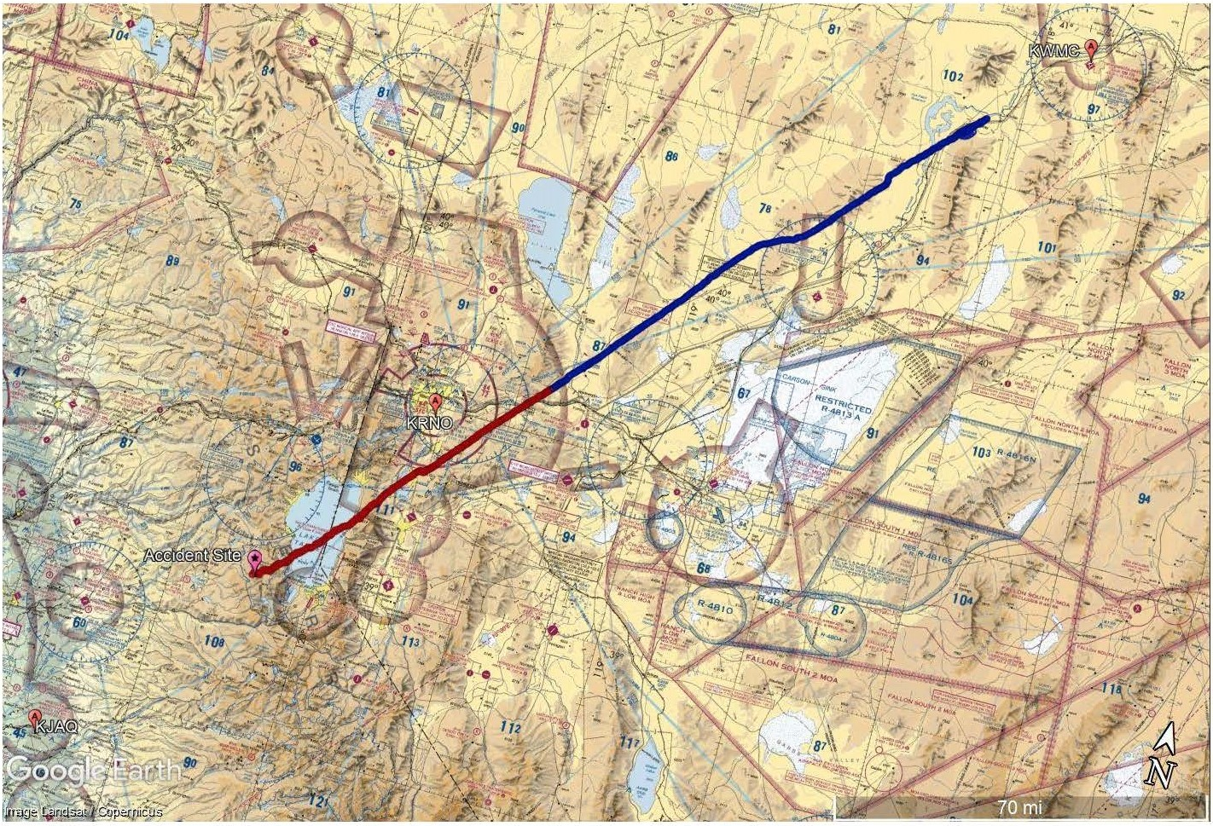
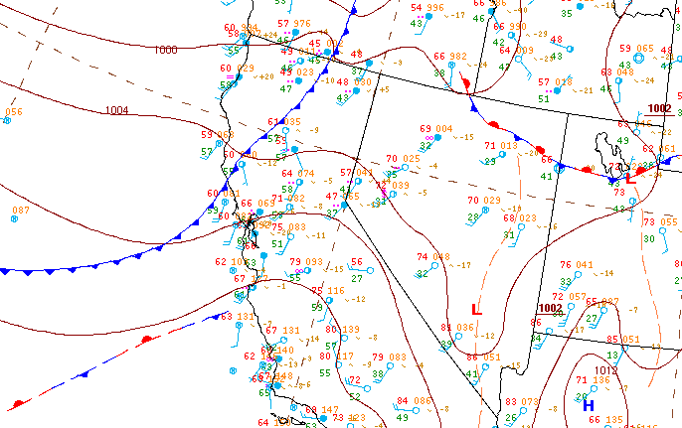
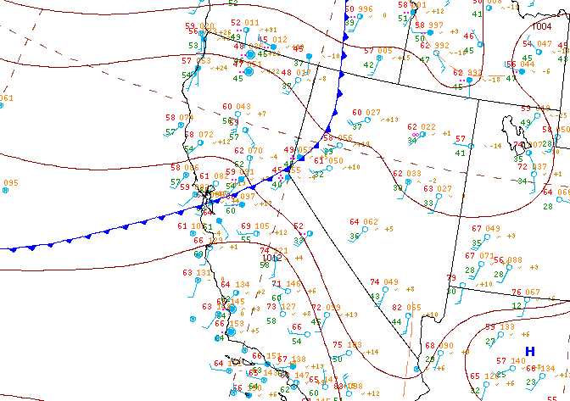
Flight plan
Accident site

Slide 7
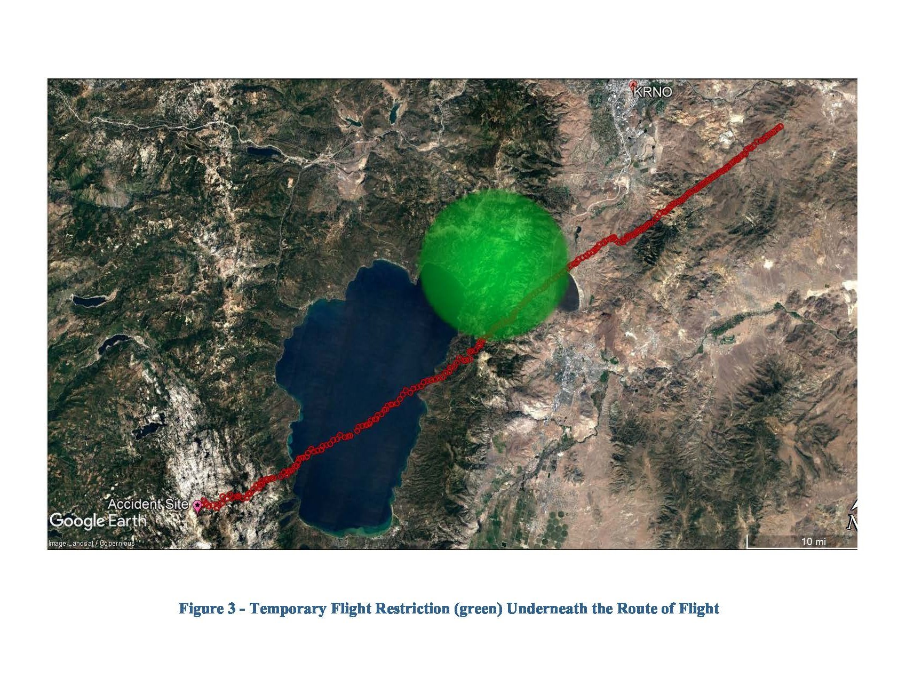
The pilot was returning from a hunting trip, and initially departed Lemhi County Airport (SMN), Salmon, Idaho, on the morning of the accident
Pilot and wife had discussed the approaching weather system the day before the flight, and she had suggested he drive back with a friend, but he felt strongly that he should fly
The pilot typically flew between California and Idaho six or seven times per year, which required crossing the Sierra Nevada mountain range
The pilot of Tanker 874 stated that his intention was to land at Reno/Stead Airport, rather than Reno-Tahoe International Airport, but that the wind was "not good“
At 1507, the accident pilot asked the NCT controller if a temporary flight restriction (TFR) over Carson City, Nevada, was still in effect. The controller responded that it was, but that it should not be a factor because the TFR ceiling was 10,000 ft

Slide 8
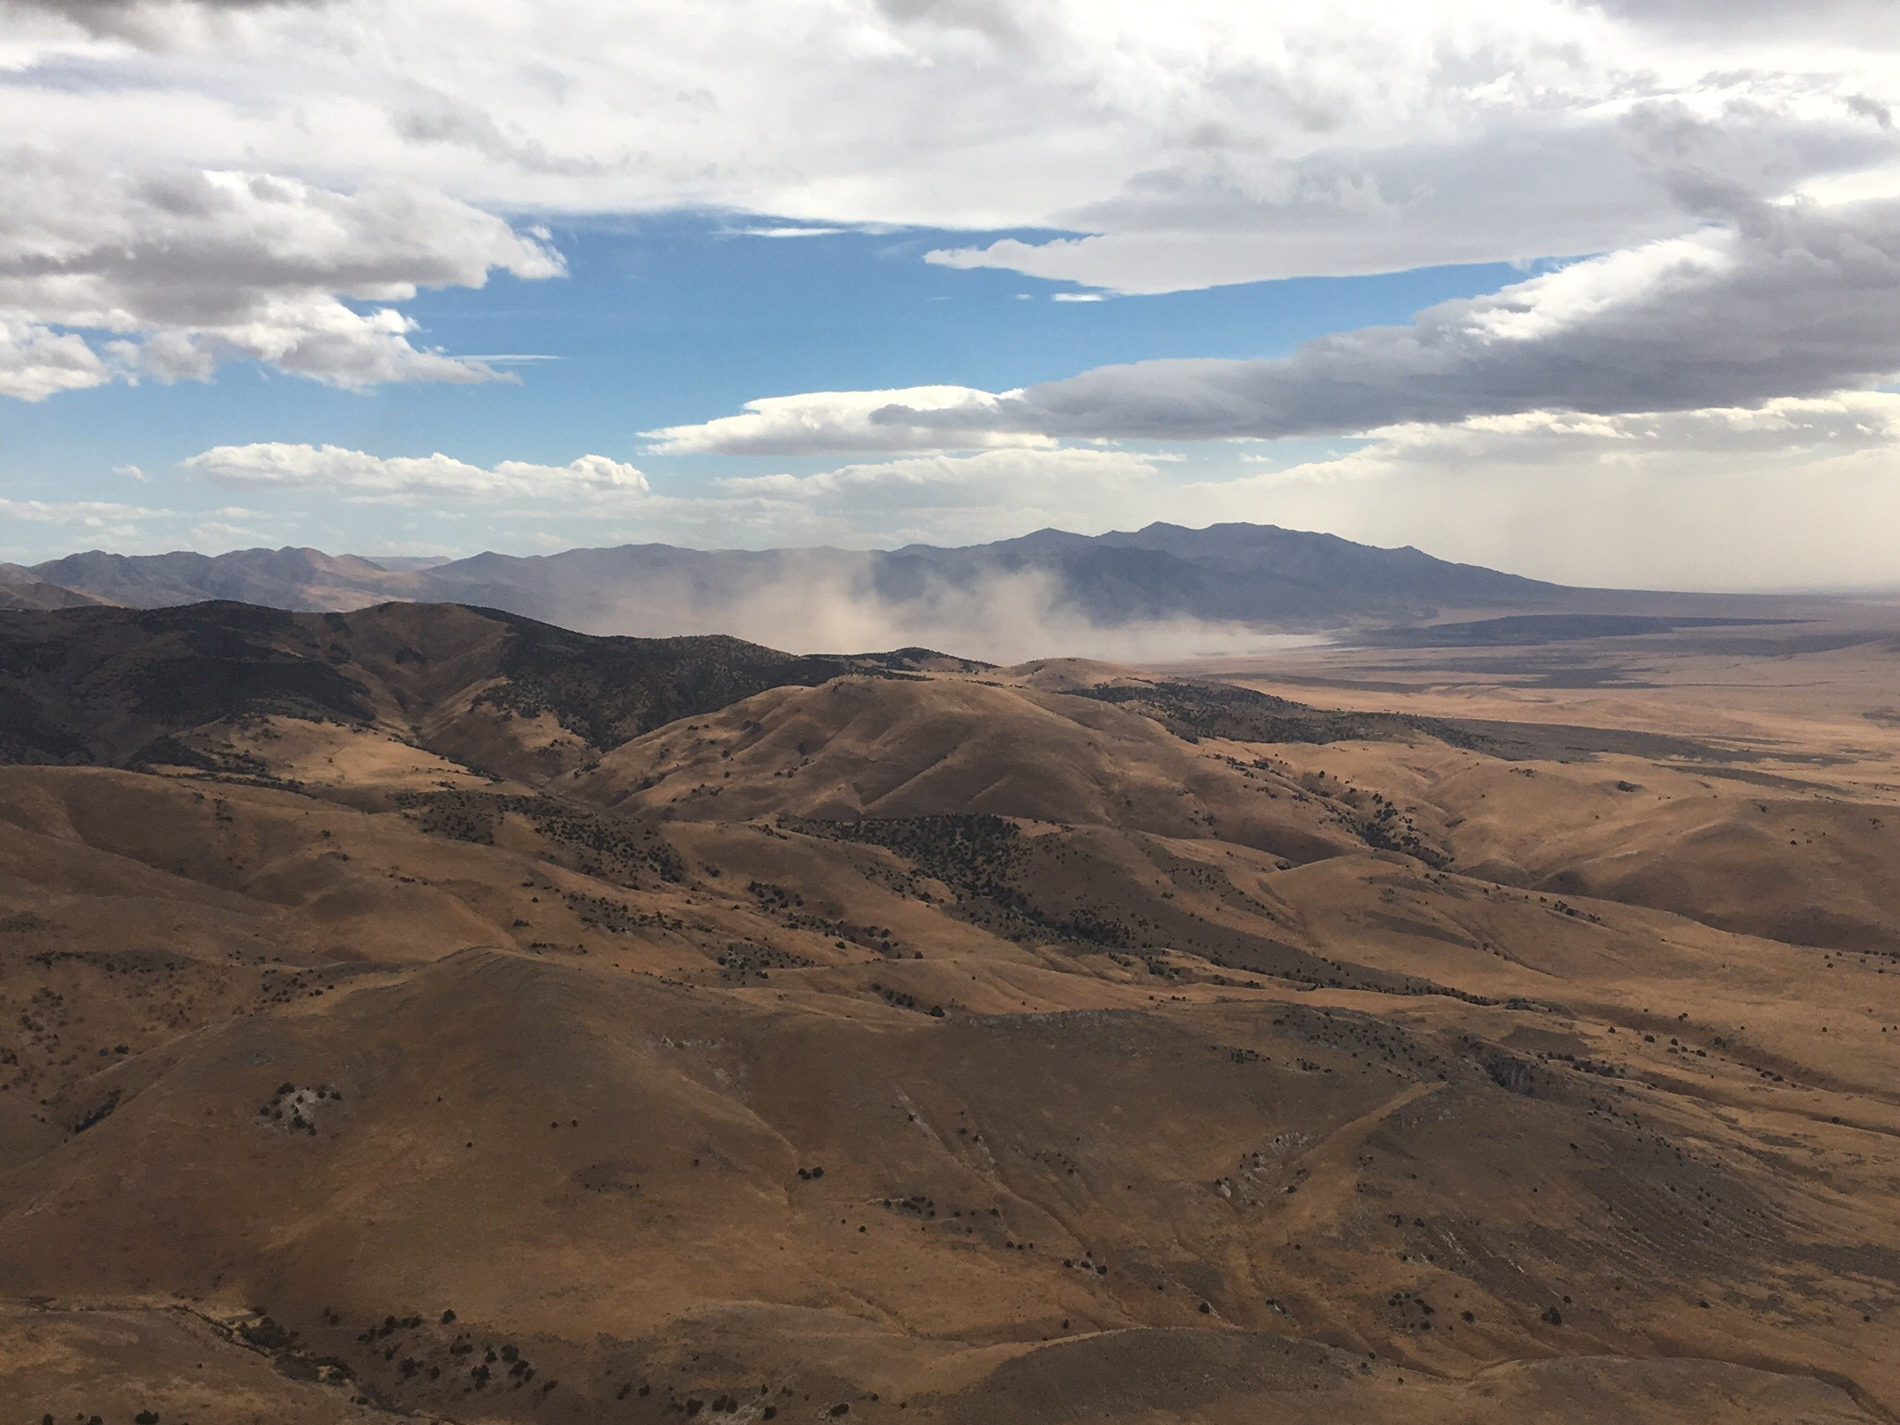
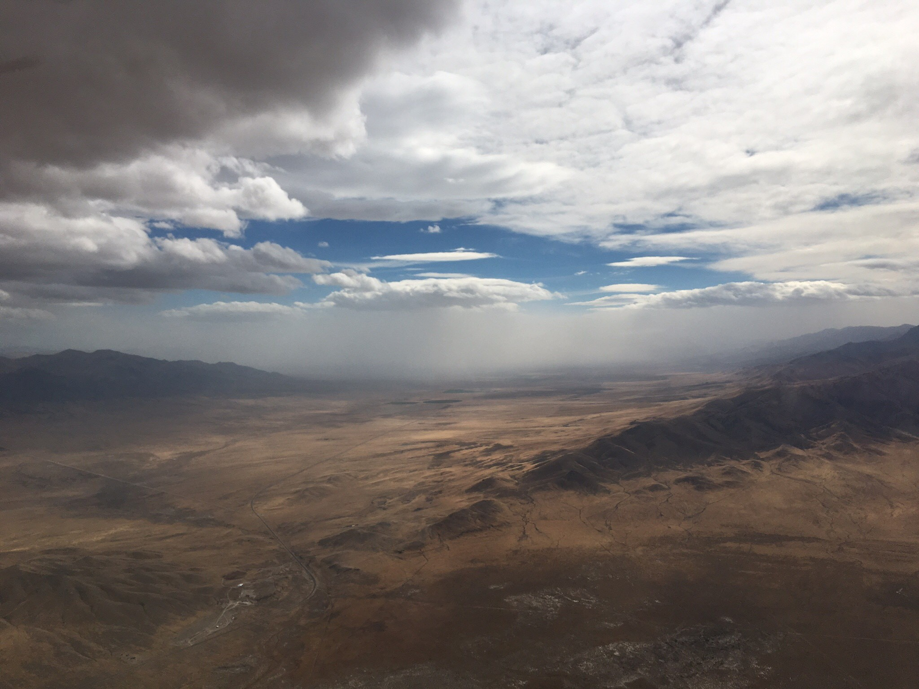
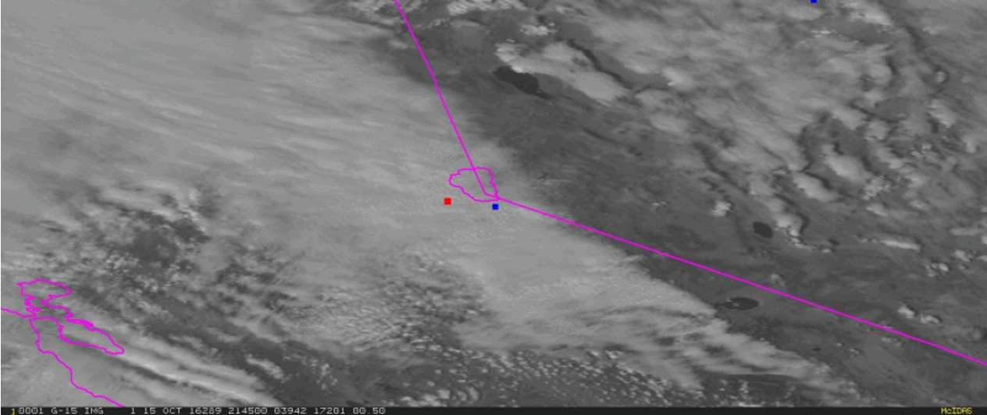
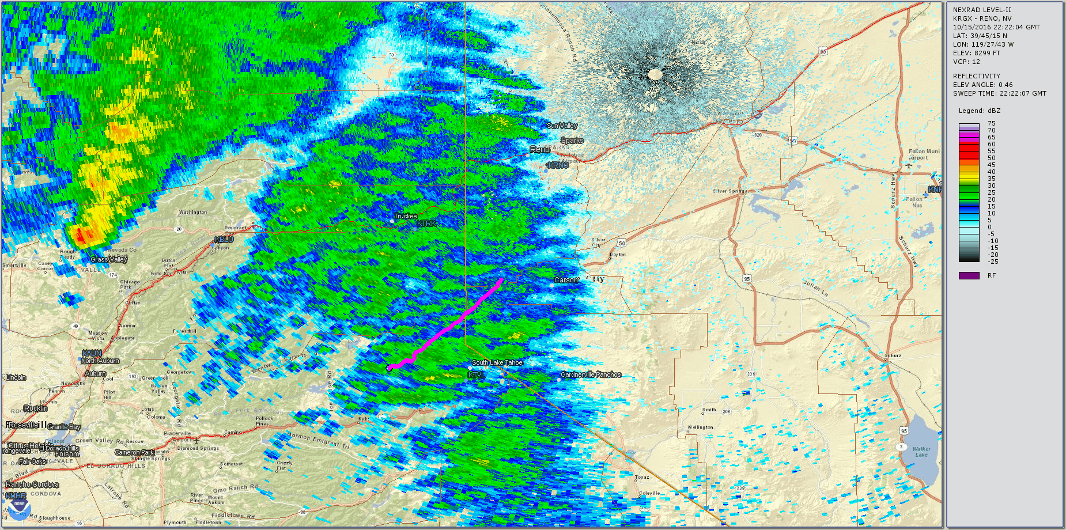

Slide 9
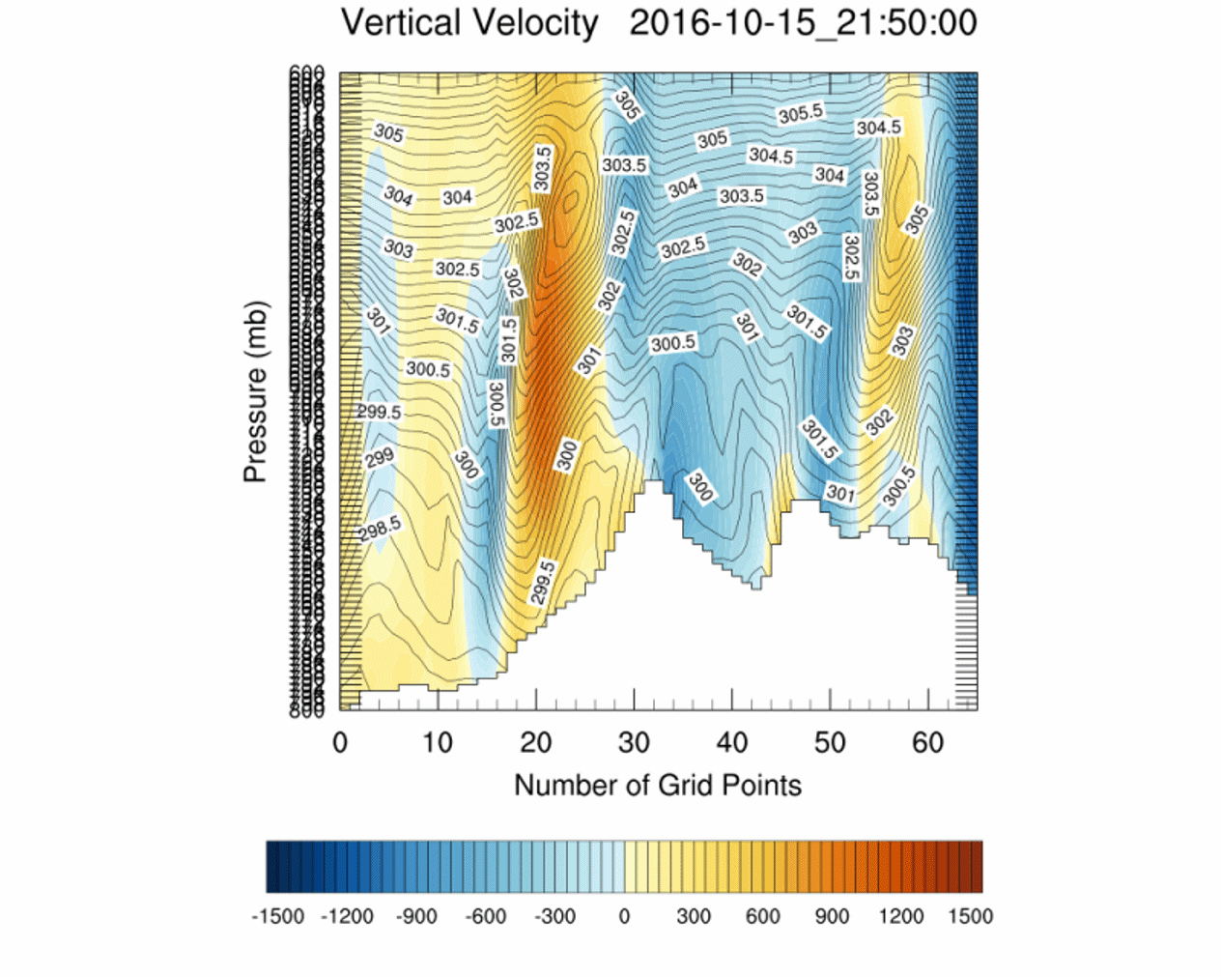
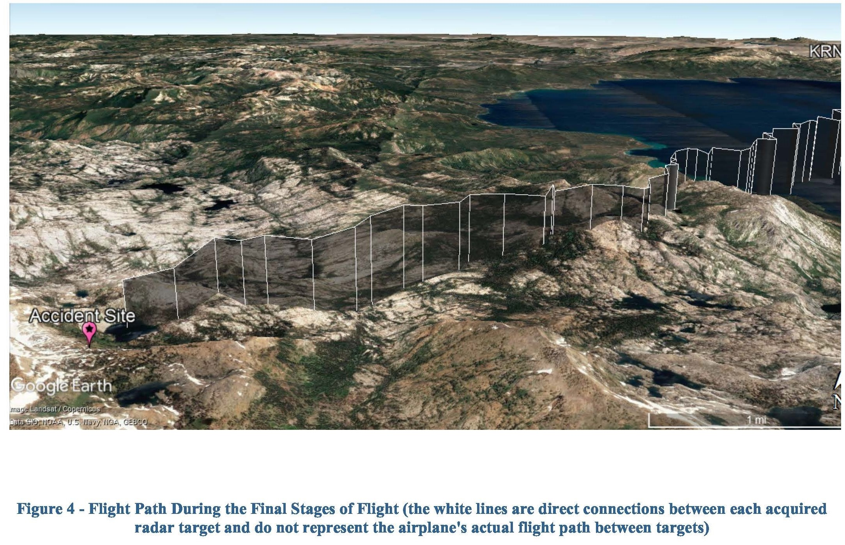
By 1522, the accident airplane was 12 miles south of Reno, and the NCT controller initiated a handoff back to ZOA and provided the pilot with the appropriate frequency

Slide 10
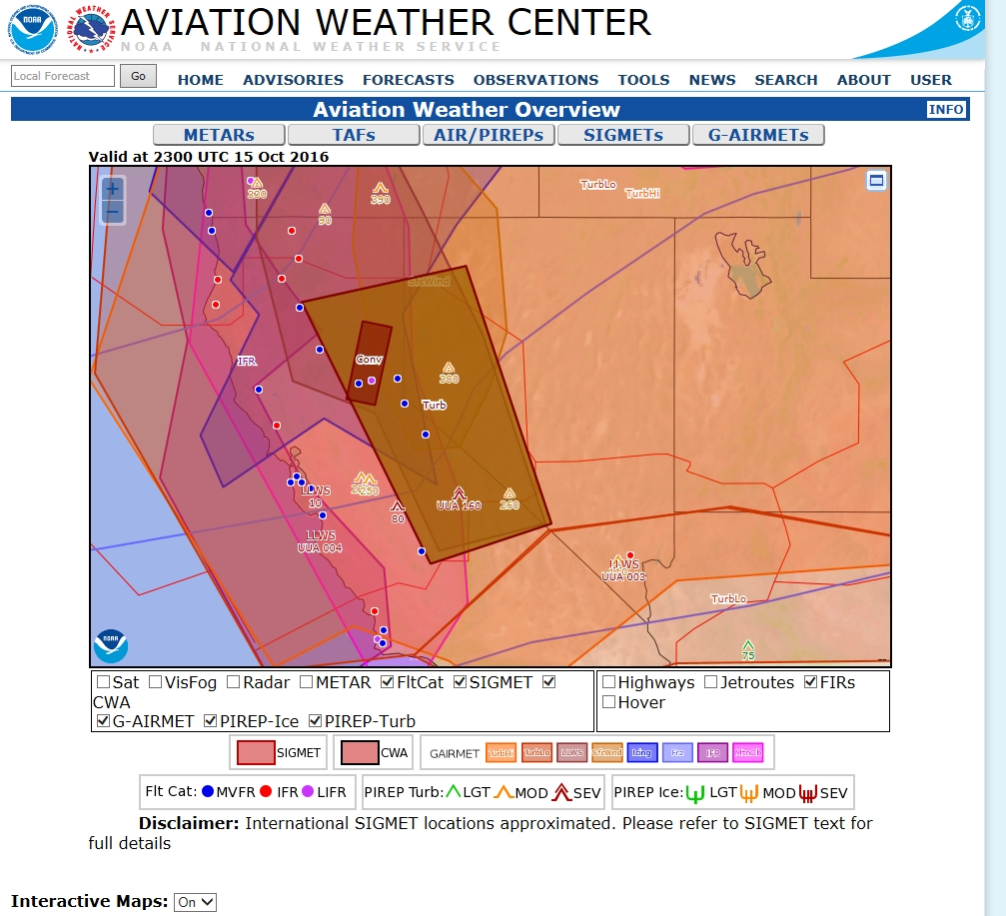
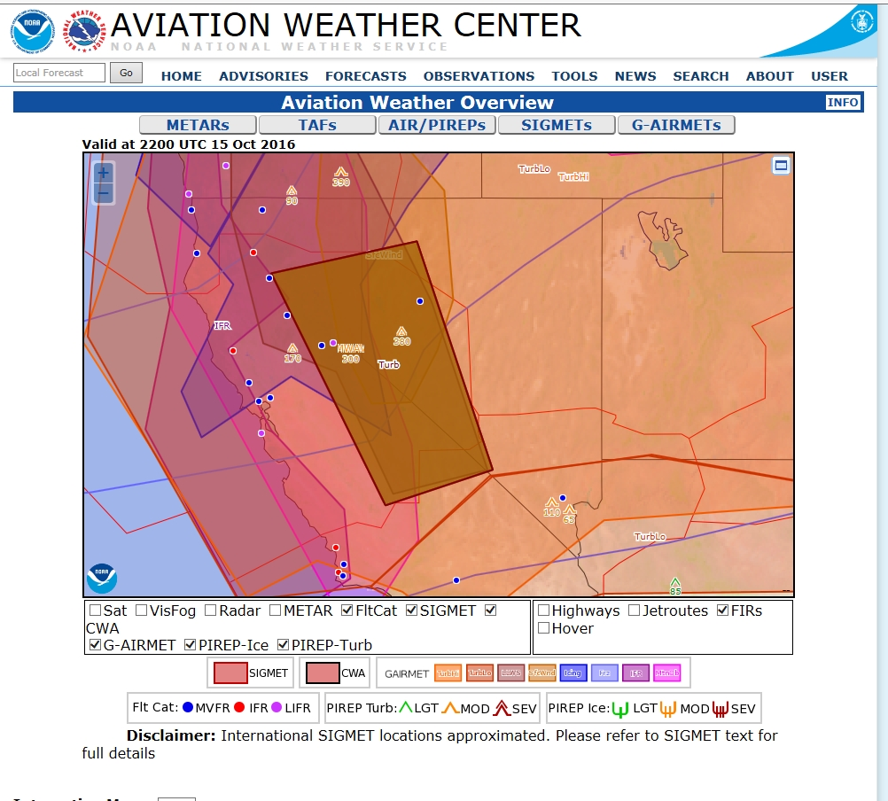
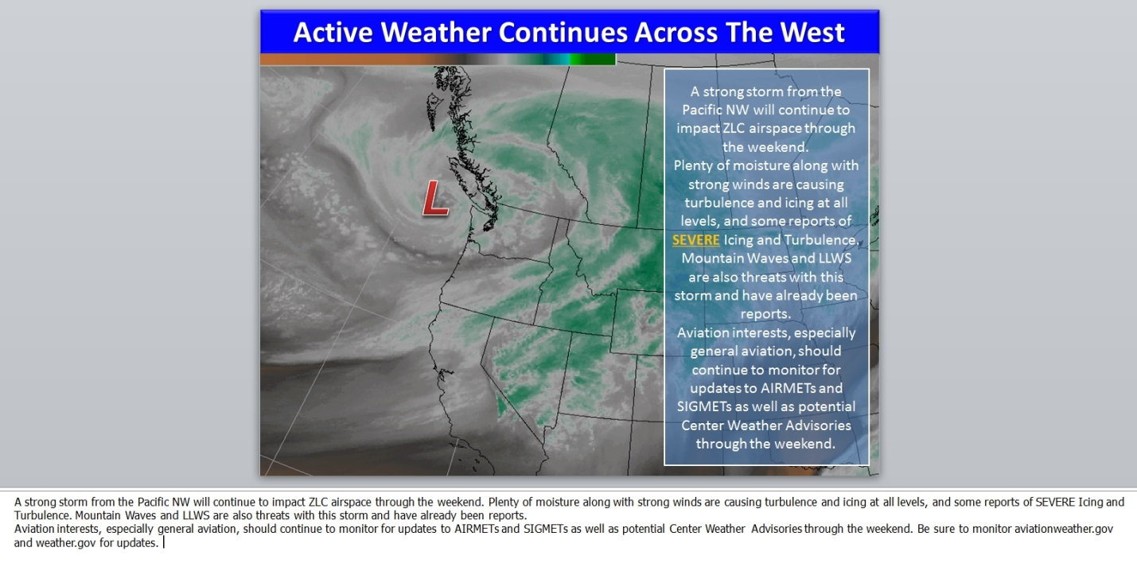
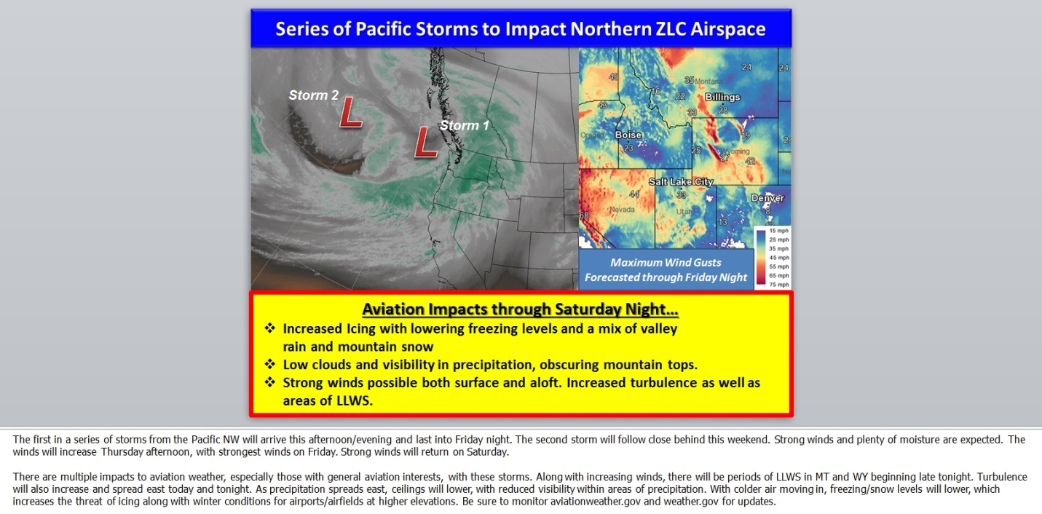
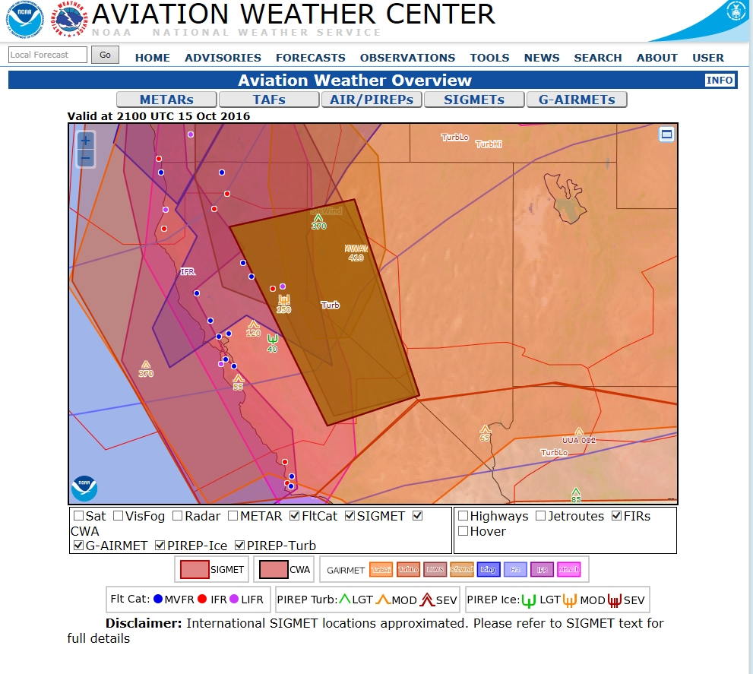
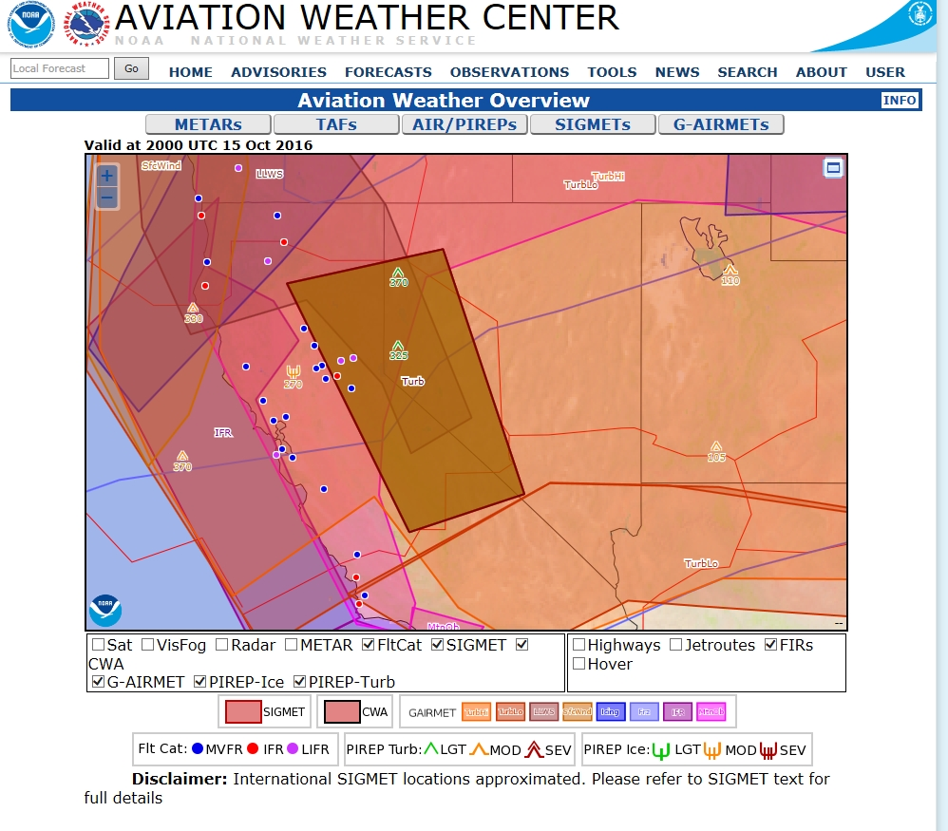

Slide 11
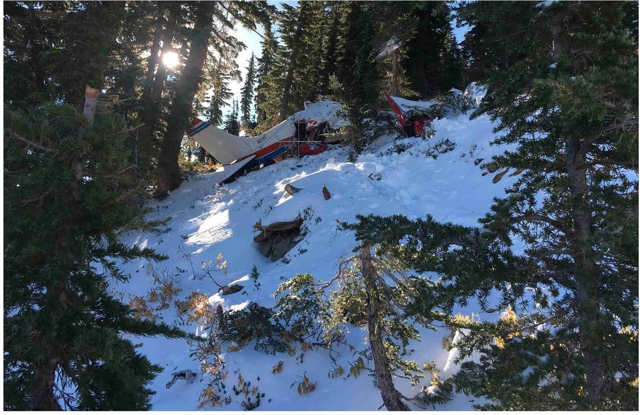
The National Transportation Safety Board determines the probable cause(s) of this accident as follows:
The noninstrument-rated pilot's decision to depart on and continue a flight over mountainous terrain into forecast instrument metrological conditions, icing, and hazardous wind conditions that exceeded the airplanes performance capabilities and resulted in an uncontrolled descent and collision with terrain.

Slide 12
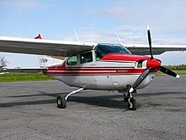
WPR17FA045
Cessna T210K, N272EF
Payson, Arizona
January 2017
VFR Part 91 flight for family vacation
Pilot, >295 hrs, all VFR
Scottsdale, Arizona to Telluride, Colorado
No ForeFlight weather briefing request.. but did enter KSDL to KTEX route
4-Fatal
METAR KPAN 021635Z AUTO VRB04G10KT 10SM OVC003 02/01 A3011 RMK AO2=

Slide 13
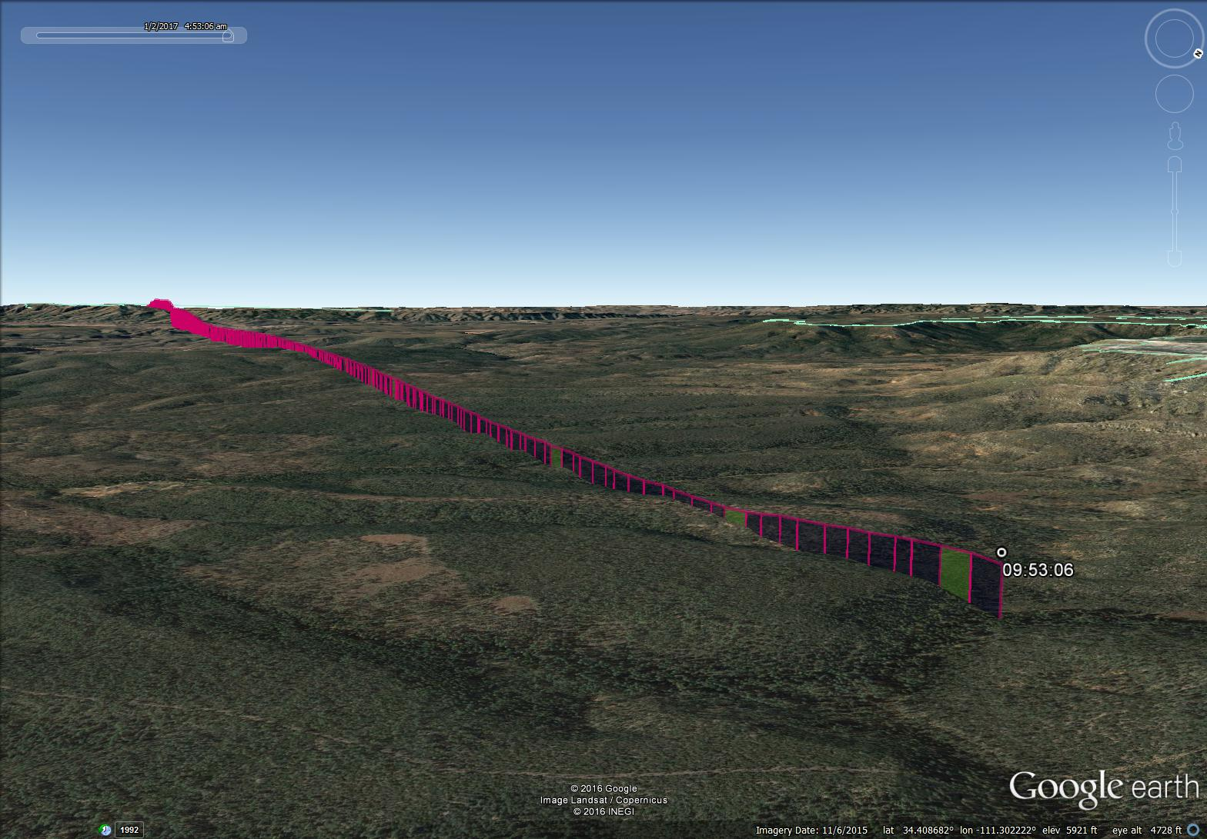
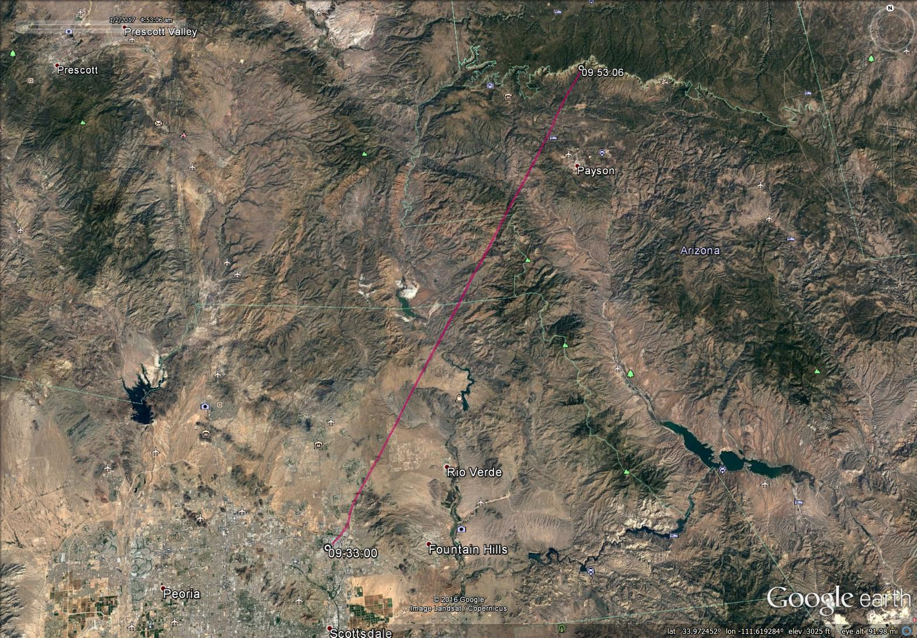
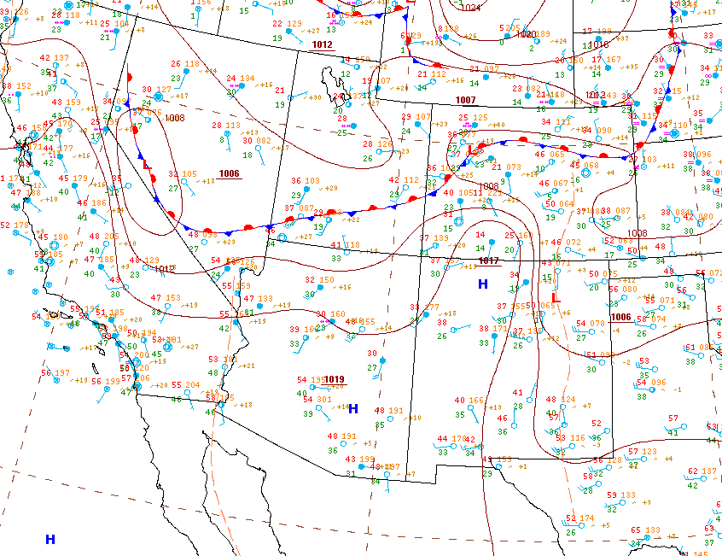
Pilot did enter route information at 08:26:07 MST (about 70 minutes before accident)
Could have checked text wx data but nothing graphical reviewed via ForeFlight before flight
Co-owner of plane (IFR rated) and pilot reviewed weather forecasts 2 days prior to flight and co-owner informed pilot that he should drive
Accident site
Flight plan

Slide 14
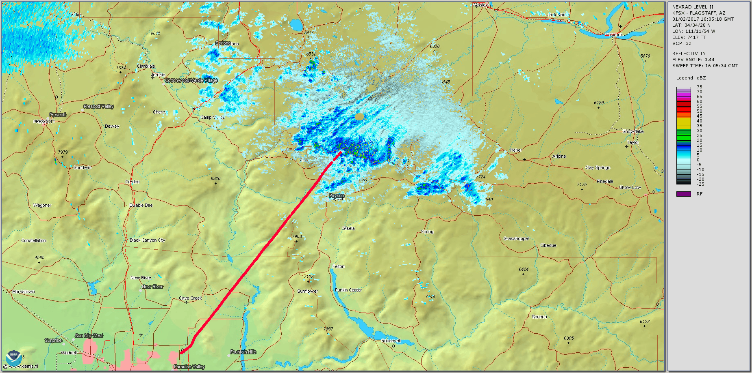
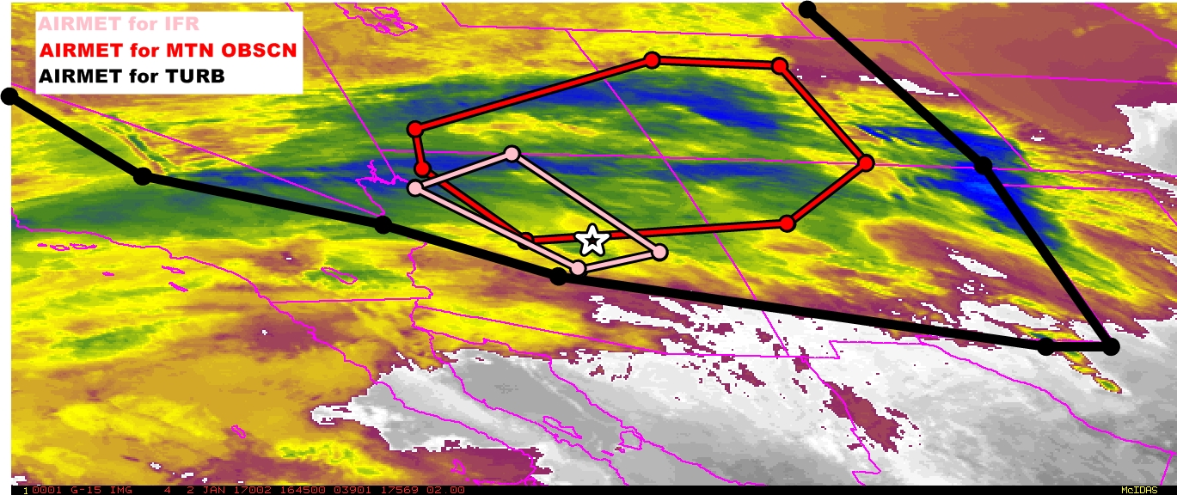
Accident site

Slide 15
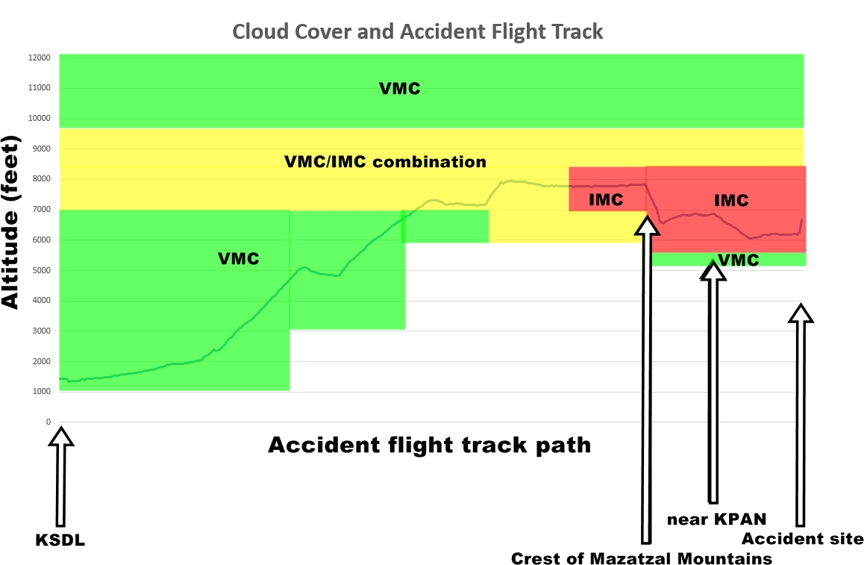
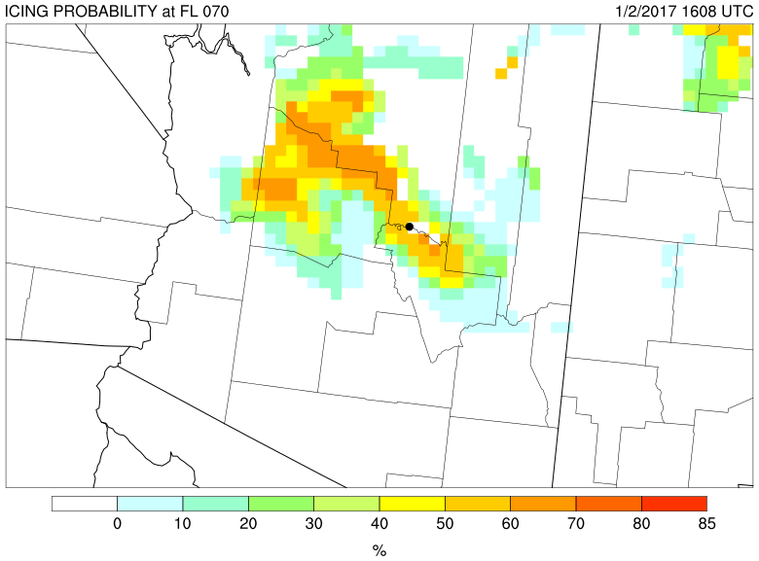
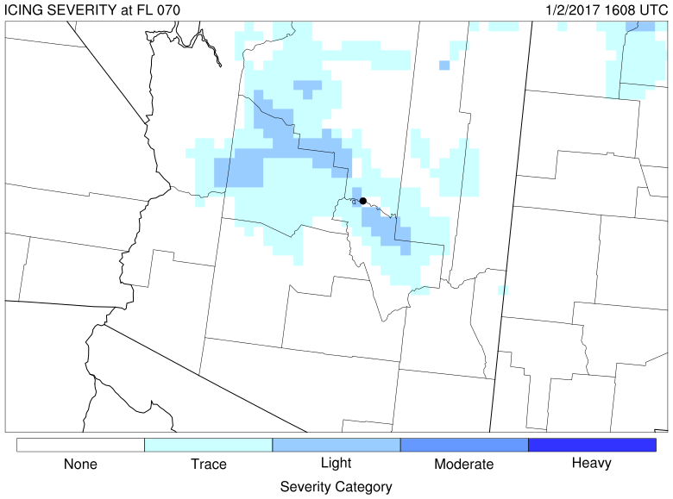
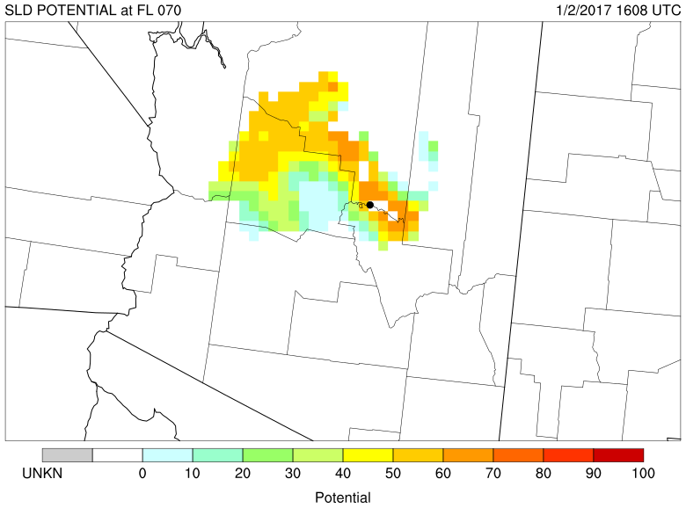

Slide 16
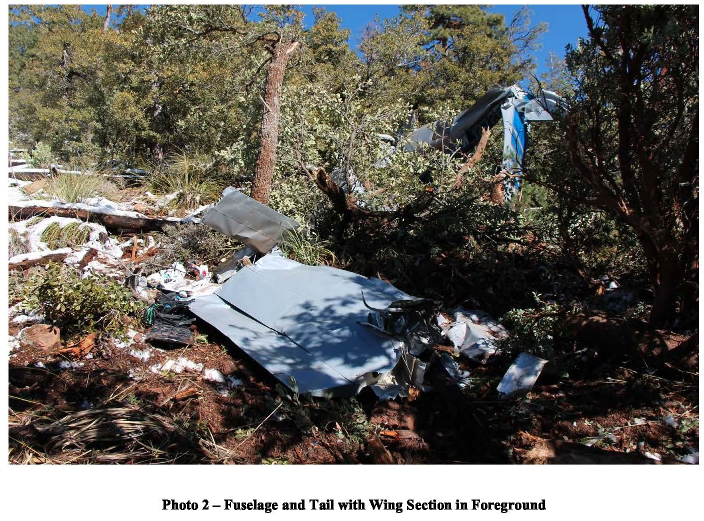
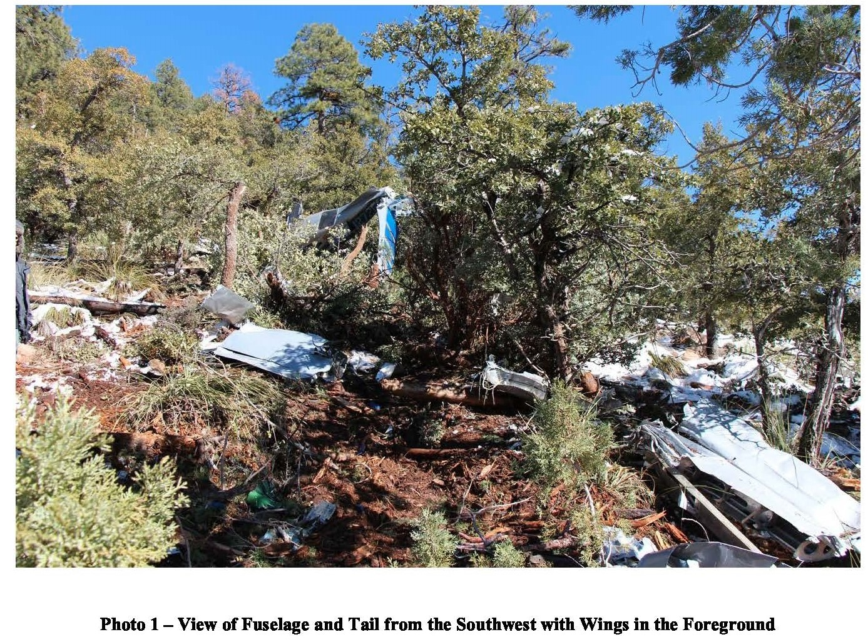
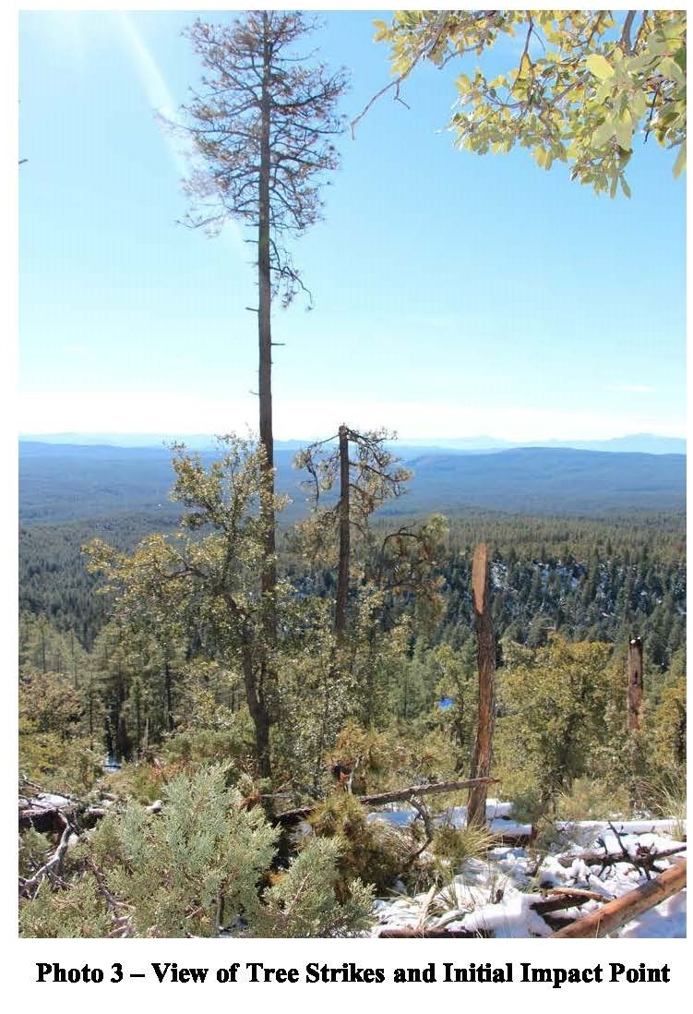
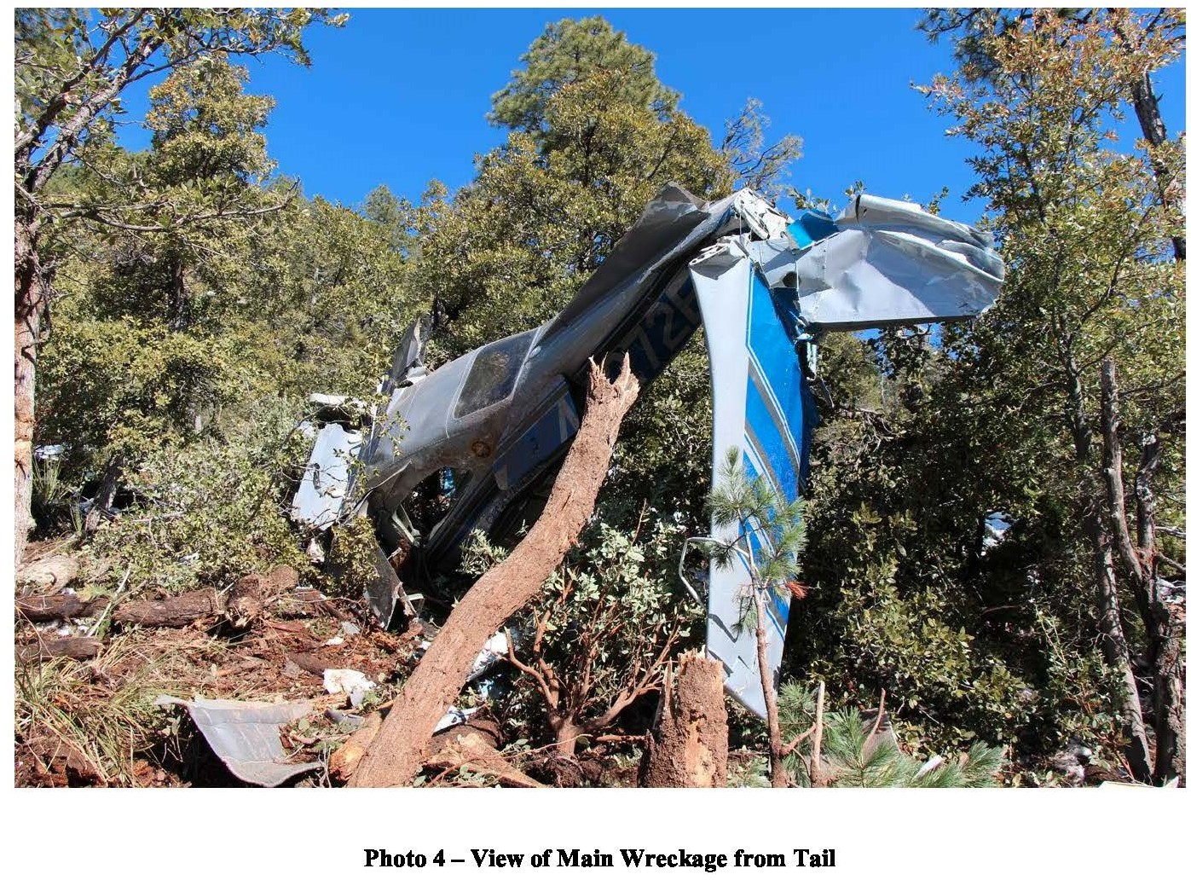
The National Transportation Safety Board determines the probable cause(s) of this accident as follows:
The non-instrument-rated pilot's improper decisions to begin and to continue a flight under visual flight rules into instrument meteorological conditions, which resulted in controlled flight into terrain.

Slide 17
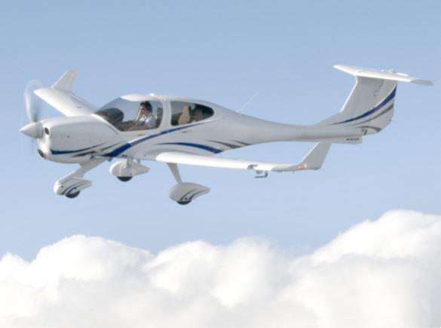
WPR16FA144
Diamond DA40 F, N419FP
Logan, Utah
July 2016
VFR Part 91 flight for practicing maneuvers
Pilot, >100 hrs, all VFR
Local flight from Logan, Utah
No weather briefing request but did check wx at KLGU
1-Fatal
KBMC 181715Z AUTO 18017G24KT 10SM 32/00 A3006 RMK AO1 T03221001=
KLGU 181651Z AUTO 18005KT 10SM CLR 30/05 A3007 RMK
AO2 SLP124 T03000050=
KLGU 181751Z AUTO 23014G31KT 10SM CLR 33/01 A3007 RMK AO2 PK WND 20031/1746 SLP127 T03280006 10333 20089 51001=

Slide 18
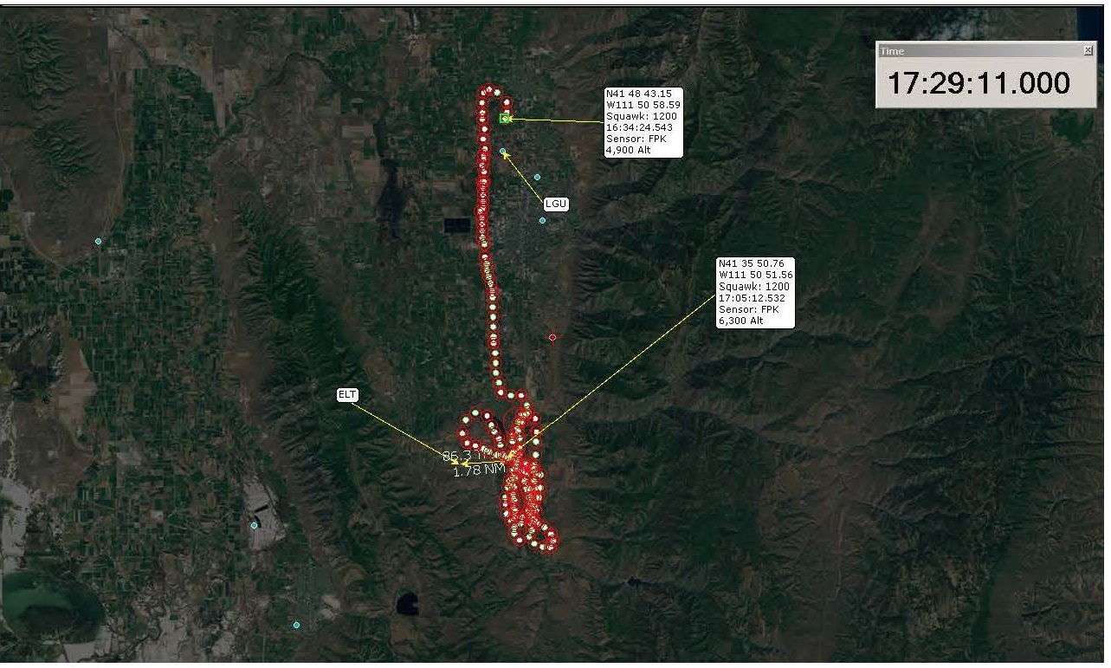
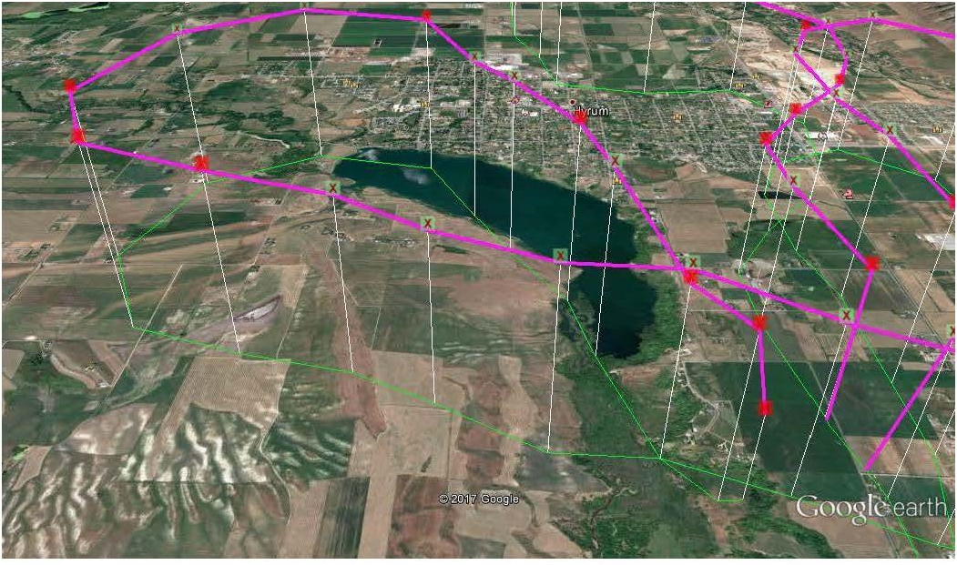
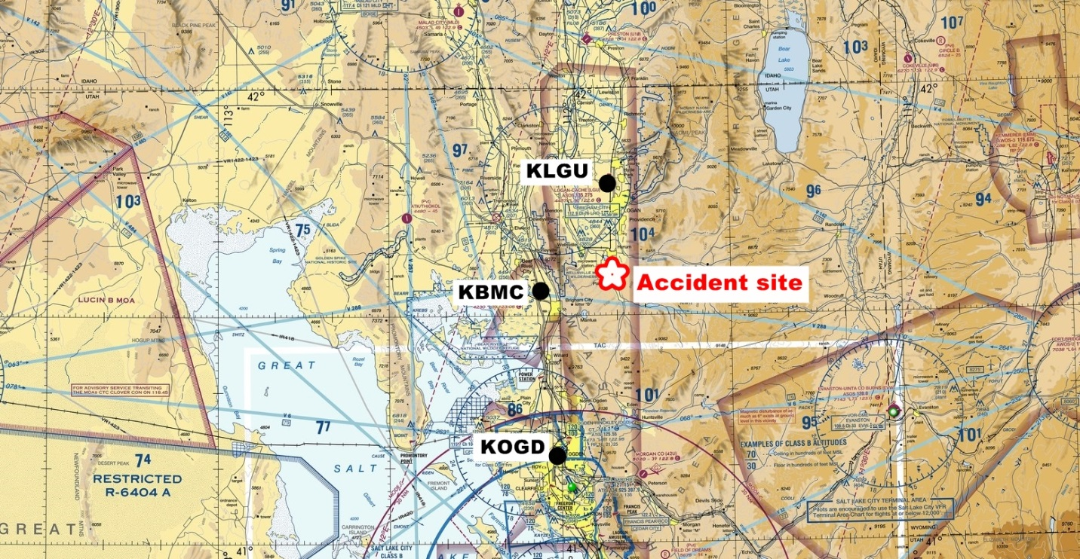
The private pilot was practicing flight maneuvers required to obtain a commercial pilot certificate during daytime visual flight rules weather conditions
According to the flight school's records, the pilot checked the weather observations for LGU. The observation recorded on the weight and balance sheet was made at 0951 and included the following weather information: wind from 330° at 6 knots…
A witness at the accident time reported "unusual" weather that day; the wind was gusting 30-40 mph; however, in between the gusts, it was "dead calm."
Flight plan

Slide 19
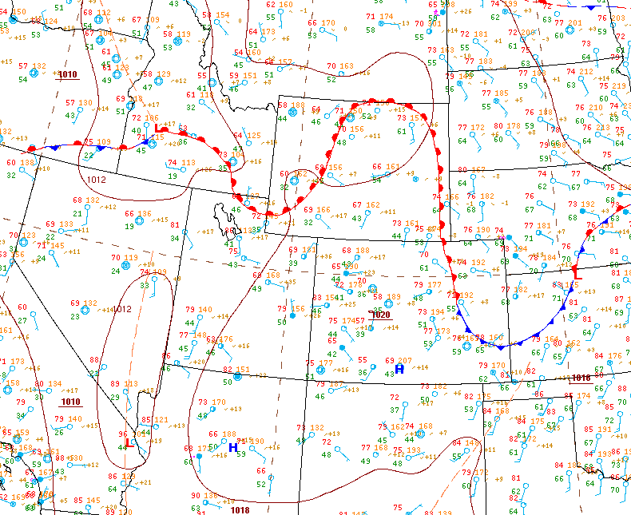
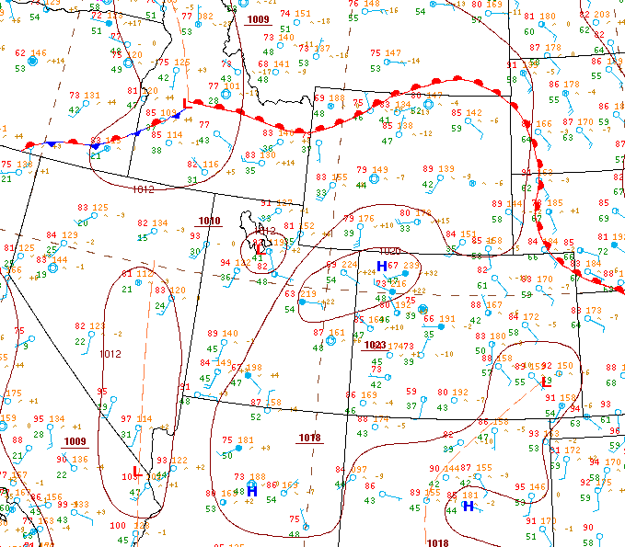

Slide 20
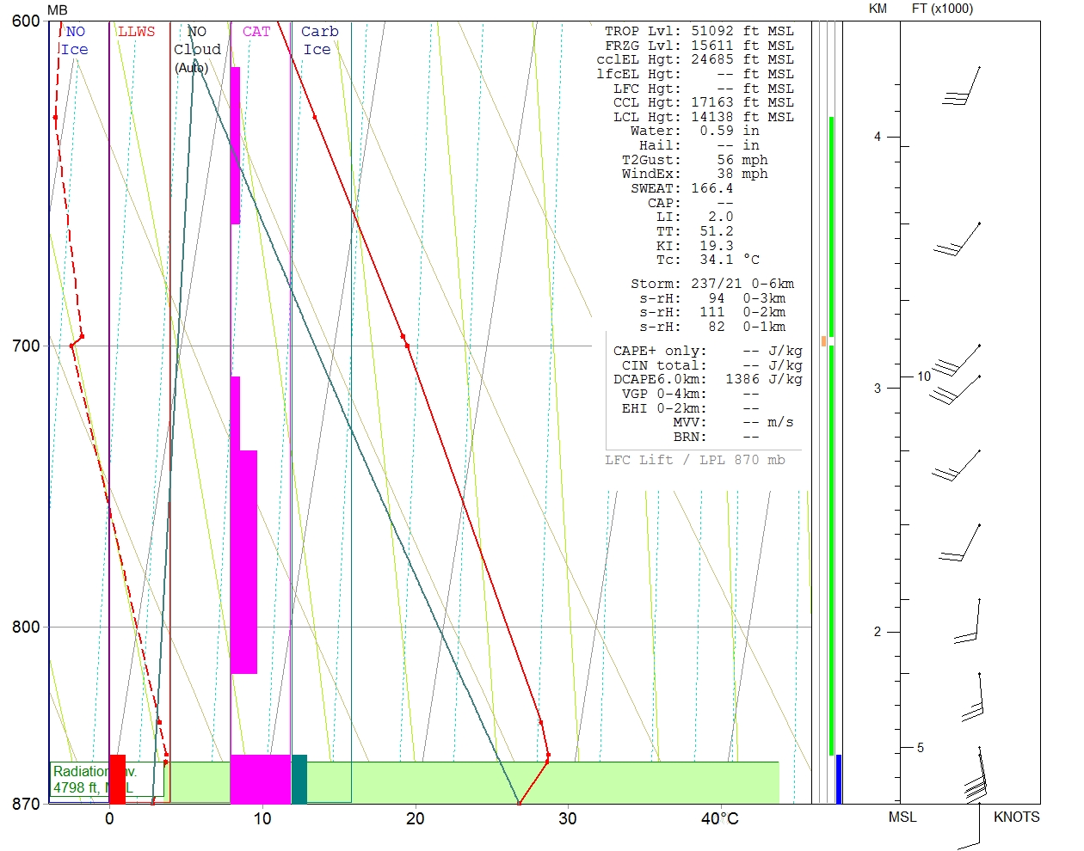
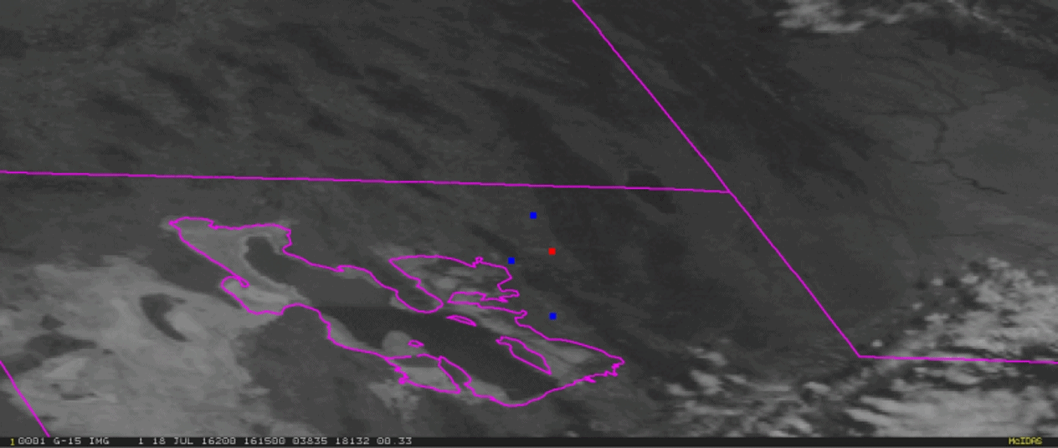
Area Forecast had gusty SW wind in the forecast… closest TAF:
TAF KLGU 181120Z 1812/1912 VRB05KT P6SM SKC
FM182100 22010G16KT P6SM FEW100 SCT120
FM190300 VRB05KT P6SM FEW100 SCT120=
Accident time ~1721 UTC
SLC Area Forecast Discussion:
.AVIATION...Gusty southerly winds will prevail at the SLC terminal
through the forecast period. Periodic gusts above 35 mph remain
possible through 02z this evening. Additionally, there is a 10
percent chance that convection will develop over the Oquirrh
Mountains to the southwest of SLC terminal and bring a threat of
gusty erratic outflow winds between 20z-02z.
&&
Moderate to severe turb PIREP 10 minutes after accident time by Piper PA-34 Seneca east of accident site

Slide 21
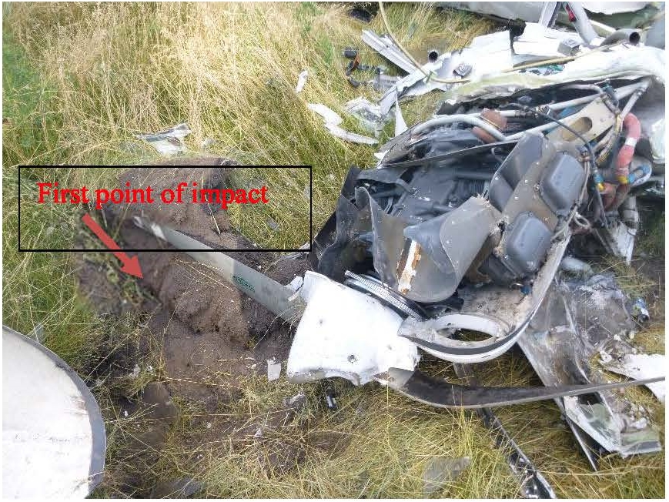
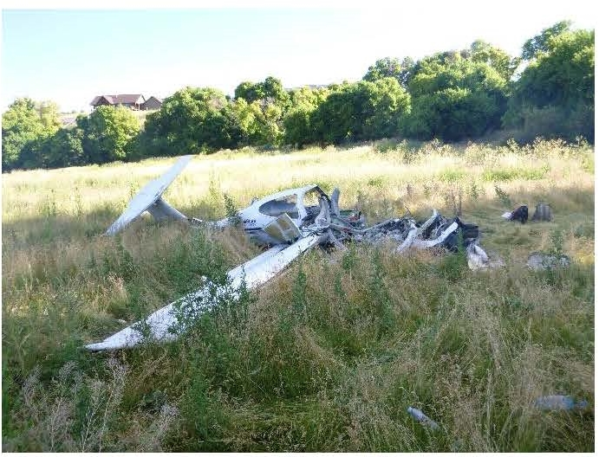
The National Transportation Safety Board determines the probable cause(s) of this accident as follows:
The pilot's exceedance of the airplane's critical angle of attack while maneuvering in turbulence and gusty wind conditions, which resulted in an aerodynamic stall/spin.

Slide 22



Weather considerations surrounding accidents
Departure Destination
What about the en route conditions?
When was the forecast issued?
Any adverse weather predicted?
What’s in the surrounding area?

Slide 23
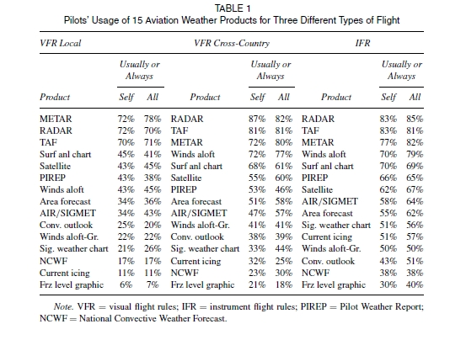
Preflight Planning

Slide 24
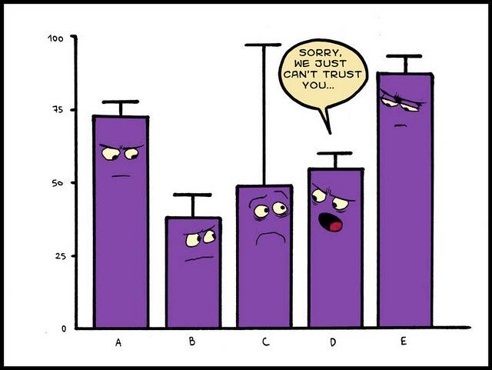
Accident statistics

Slide 25
Part 91 General Aviation Accidents 2012-2016
 | Weather-Related | Non Weather Related | Total | Weather Related
Accidents | 1,349 | 4,492 | 5,841 | 23%
Fatal Accidents | 315 | 715 | 1,066 | 30%

Slide 26
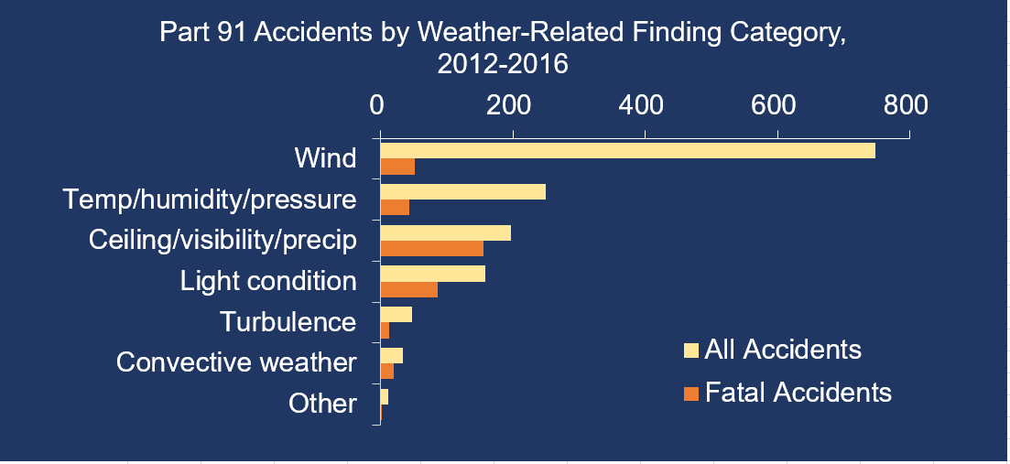

Slide 27
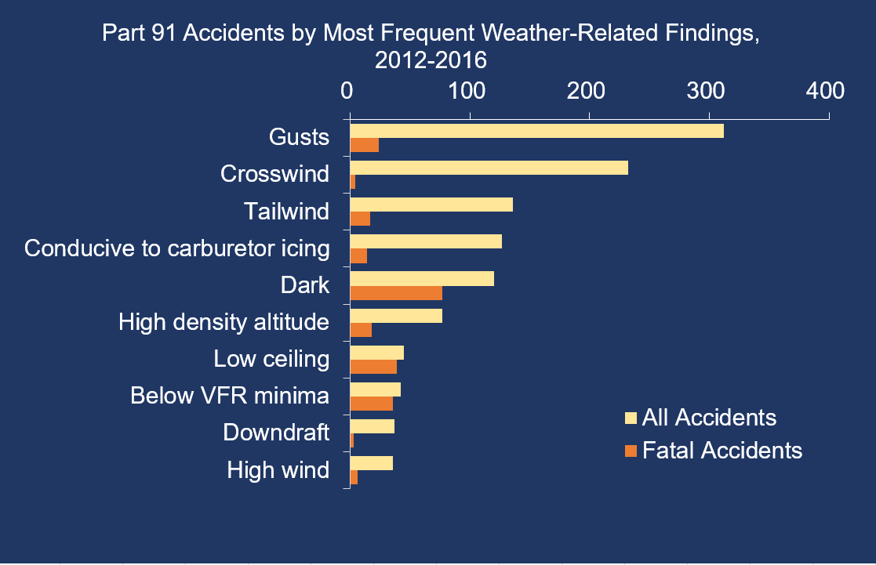

Slide 28
NTSB LOC-I Accident Data
LOC-I involves about 17% of all fixed wing accidents
Of fatal accidents, LOC-I consists of about 45 percent of accidents
Notes:
Accident data from 2008-mid 2017

Slide 29
Notes:
Data from 2008 through 2017 closed cases…

Slide 30
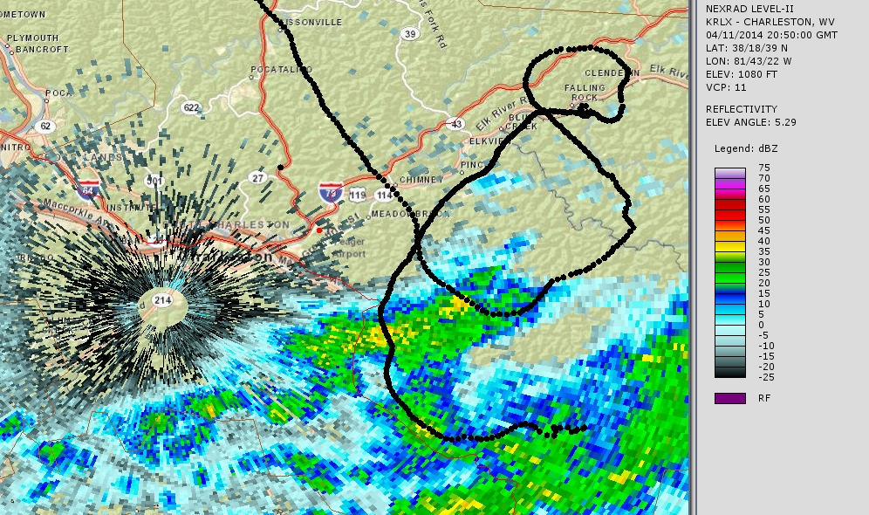


Importance of Clear Communication
What pilots/ATC/wx person see are all different pictures of the same weather conditions
Notes:
Important to communicate in the language the other discipline speaks

Slide 31

Looking Straight Ahead
Notes:
Another example…..this aircraft is flying along at 36,000 feet (upper right)…..2 green blobs off his 1-2 oclock…..only seeing green…..antenna tilt on zero…..

Slide 32

Looking Down
Notes:
Tilt down two degrees……and a much different picture emerges….

Slide 33

3D Modeling in Google Earth
Notes:
Another view…..

Slide 34

ERAM View
Notes:
Here is what ATC had at Center at the same time…….the guy taking the pictures is right here (ASA19)
That’s the same stuff they’re seeing on the airborne radar at that time……showing moderate to heavy….no extreme

Slide 35

NEXRAD View
Notes:
NEXRAD at the time…….
Obviously, even more fidelity.

Slide 36

Out the Window
Notes:
Now as this airplane flies along this way……we’re looking at the last cell in the line….he’s down 3 degrees on the tilt now……a little green and some yellow
About 15 miles away 4500’ below the aircraft (with some math)
Let’s see what the cells actually look like out the window….(press play at bottom of slide)
So….no kidding thunderstorm….there’s the lightning…..remember how 5/8 pilots would fly through a green blob?
His original tilt of zero….all he would’ve seen was green…..could’ve flown right through….

Slide 37




Weather Resources for Aviation
Call: 1-800-WXBRIEF
https://www.1800wxbrief.com/
Start off with larger scale then go to proposed route scale
Large Weather maps
Route of flight scale weather

Slide 38


Weather Resources for Aviation
https://aviationweather.gov/progchart/sfc

Slide 39







Weather Resources for Aviation
https://aviationweather.gov/briefing

Slide 40
Weather Resources for Aviation
https://aviationweather.gov/briefing

Slide 41


Weather Resources for Aviation
https://www.weather.gov/zlc/
Weather Story for the day…
https://aviationweather.gov/briefing
On Twitter @NWSCWSUZLC, @NWSCWSUZOA, @NWSCWSUZSE, @NWSCWSUZAB and Facebook

Slide 42
Weather Resources for Aviation
Surface observations
ASOS/AWOS/AFSS, etc…
KSGH 221456Z AUTO 04004KT 7SM TSRA BKN015 BKN020 OVC033 25/22 A3007 RMK AO2 LTG DSNT ALQDS TSB01RAB53 SLP175 P0000 6//// T02500222 53005=
SPECI KRDU 291709Z 00000KT 1SM R09R/P6000FT BR BCFG OVC005 14/14 A3030 RMK AO2 SFC VIS 3 T01390139=

Slide 43


Resources on how to read METARs:
http://www.dixwx.com/wxdecoding.htm
http://weather.cod.edu/notes/metar.html

Slide 44

Weather Resources for Aviation
TAFs
TAF resources:
http://www.dixwx.com/wxdecoding.htm#taf
https://www.weather.gov/media/okx/Aviation/TAF_Card.pdf
https://aviationweather.gov/taf

Slide 45

Resources for Weather Investigations
What about ForeFlight or other Apps?
https://s3.amazonaws.com/cdn.foreflight.com/weather/prod/pngb/briefs/d9eb1d32-c01b-4791-92c0-2ccdc243995d.html

Slide 46


Weather Resources for Aviation
https://aviationweather.gov/gfa
https://aviationweather.gov/gfa/plot

Slide 47


Weather Resources for Aviation
https://aviationweather.gov/flightpath

Slide 48

Weather Resources for Aviation
https://aviationweather.gov/flightpath
Call: 1-800-WXBRIEF
https://www.1800wxbrief.com/

Slide 49







Preflight Planning
Always go with the most conservative weather forecast
NTSB study - 41% of the weather related accidents the pilot did not obtain or receive an adequate weather briefing

Slide 50

Wildfire smoke

Slide 51

FAA working on OPC
Will have application for mountain west region in areas where weather radar beam blocked

Slide 52


Safety Resources
https://ntsb.gov/safety/safety-alerts/Documents/SA_017.pdf
https://ntsb.gov/safety/safety-alerts/Documents/SA_064.pdf

Slide 53
Any Questions?
Main website: http://www.ntsb.gov
LOC Forum website: www.ntsb.gov/locforum
Preventing LOC through technology and training: https://www.ntsb.gov/news/events/Pages/2018-loc-rt.aspx
My email: paul.suffern@ntsb.gov

Slide 54
Links and Resources
https://aviationweather.gov/progchart/sfc
https://aviationweather.gov/briefing
https://www.weather.gov/zlc/
http://www.dixwx.com/wxdecoding.htm
http://weather.cod.edu/notes/metar.html
https://aviationweather.gov/taf
http://www.dixwx.com/wxdecoding.htm#taf
https://www.weather.gov/media/okx/Aviation/TAF_Card.pdf
https://aviationweather.gov/gfa
https://aviationweather.gov/gfa/plot
https://aviationweather.gov/flightpath
https://www.1800wxbrief.com

