Slide 1
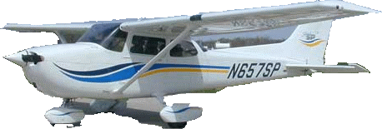
Colorado Windstorm-April 17, 2018
Presented by
Scott Entrekin, Lead Forecaster
National Weather Service
Boulder, CO (BOU)
Yikes, where’d
the airport go?

Slide 2
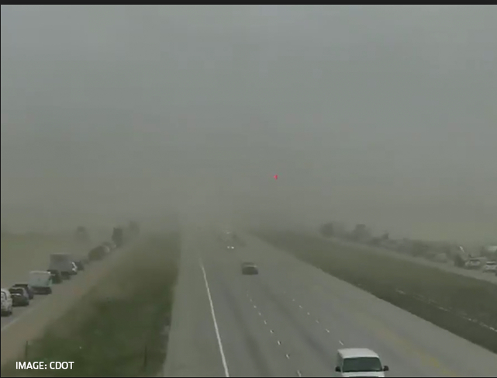
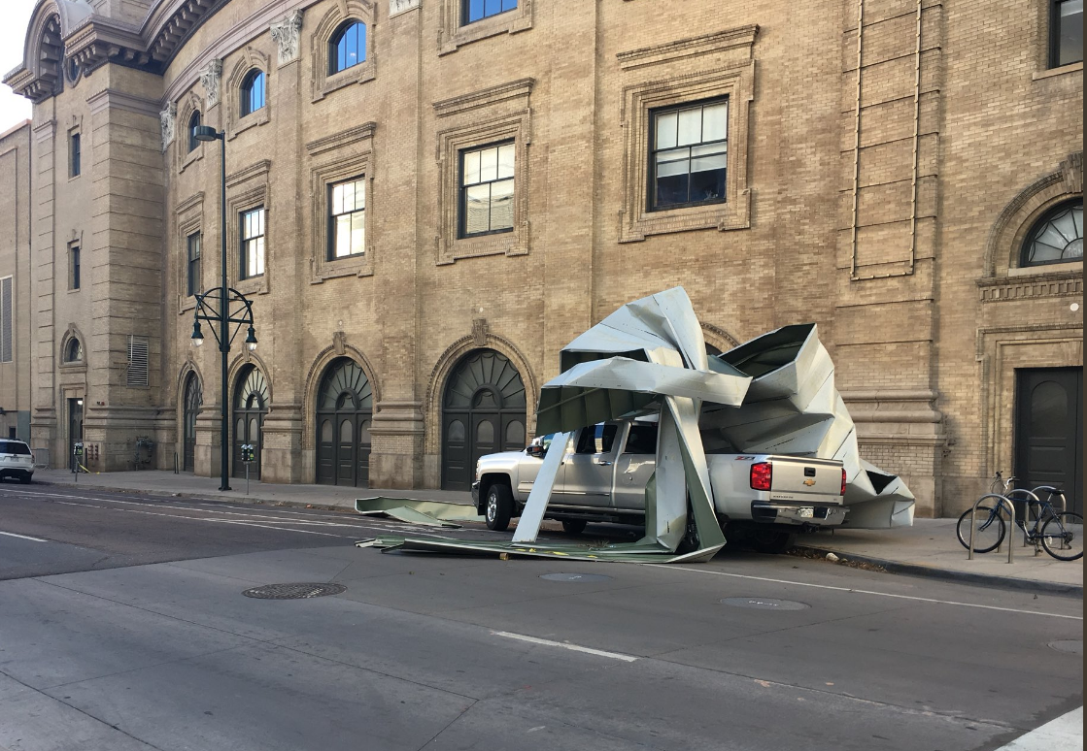
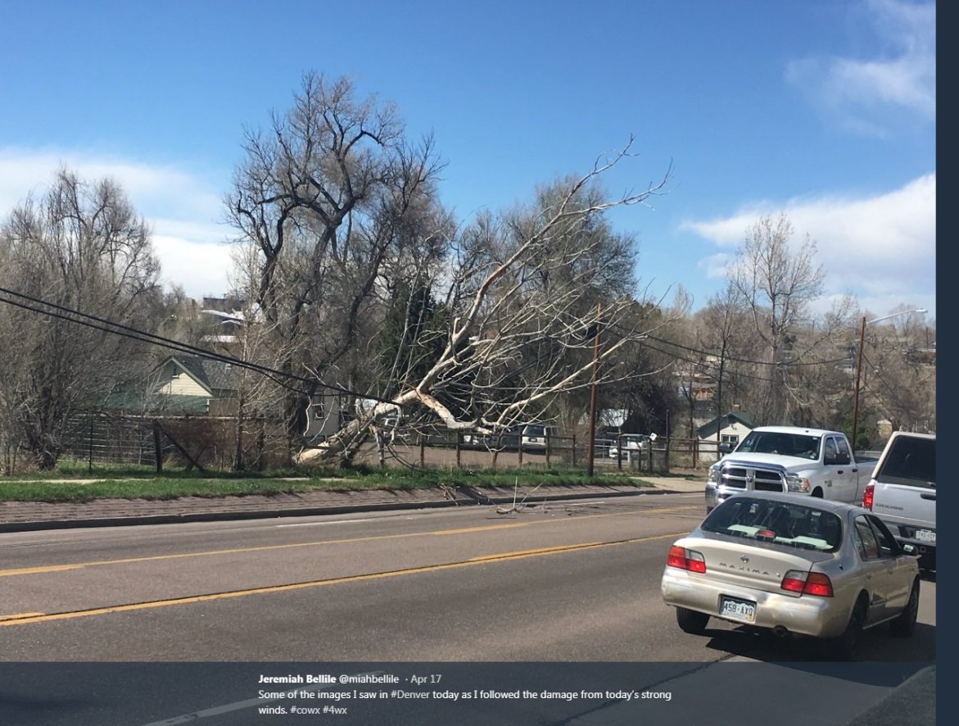
Windstorm Impacts
Denver International Airport
Numerous taxi/gate holds and delays at Denver International Airport
Widespread high winds up to 89 mph
1 fatality-branch struck women on head
trees uprooted, house fires, power poles, electrical outages
Interstates closed-semi trucks overturned
Wind Damage-houses, roofs, cars

Slide 3
300mb heights/winds
Tuesday, April 17, 2018

Slide 4
500mb Analysis
12z-April 17
00z-April 18

Slide 5
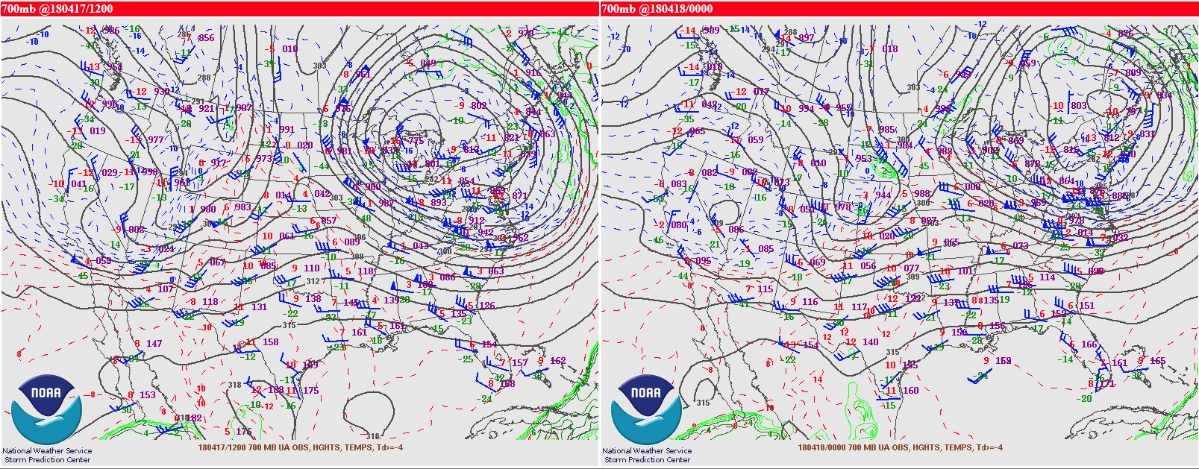
700mb Analysis
12z-April 17
00z-April 18

Slide 6
Downslope High Wind Event
Tightening surface pressure gradient forecasted to be near 16mb from GJT-DEN.
Strong subsident flow developing with CAA behind upper trof/cold front passage
QG omega fields showing (+40 to +60 mb/hr) descent
Expect good mixing from surface to 500mb by Tuesday afternoon.
700mb winds forecast to be ~50kt
Hi Res models GFS,RAP,HRRR supported gusts to 60 mph.

Slide 7
1500m Pressure Gradients (mb)

Slide 8
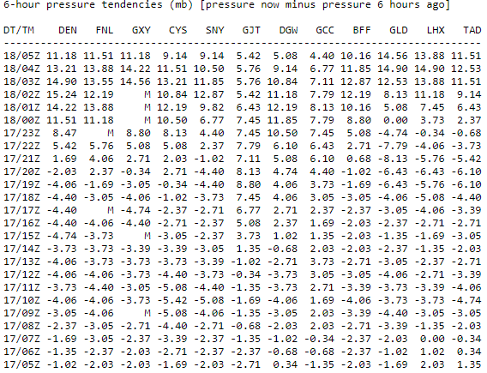
3/6hr Sfc Pressure Tendencies

Slide 9
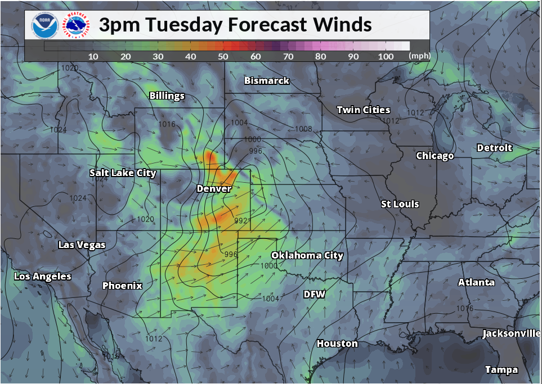
RAP surface pressure/winds

Slide 10
12Z, 17 APRIL 2018-DNR

Slide 11
00Z, 18 APRIL 2018-DNR
CAA

Slide 12
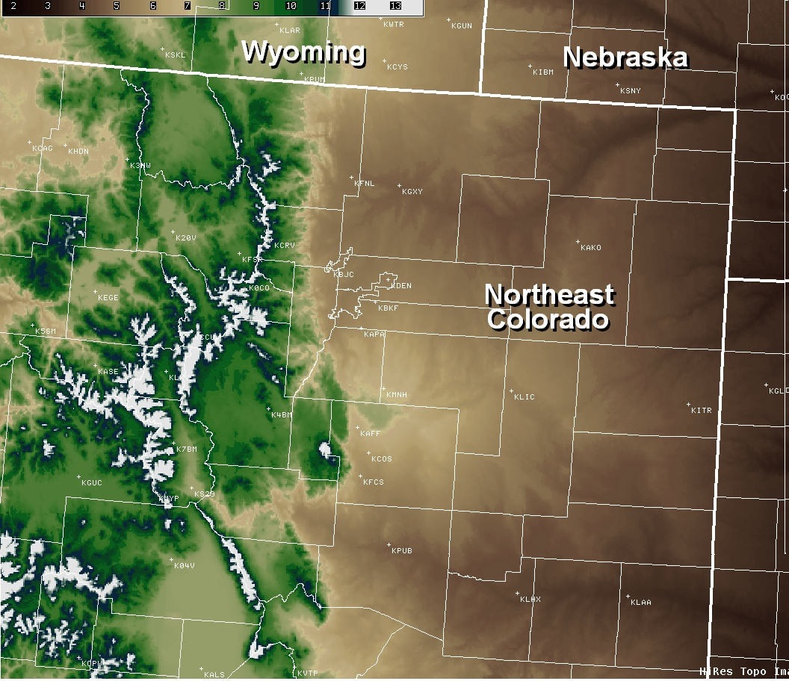
Optimal Wind directions for Mountain waves Peak winds as of 6 am, Tue

Slide 13
Quasi-Geostrophic (QG) Diagnostics
QG Package provides 3 dimensional solutions to
QG omega, height tendency, and Zwack-Okossi equations
Additional fields for deformation, static stability tendency, sfc pressure tendency and frontogensis
Source: Thaler, E.R. , Paul Nutter, “Moving Quasigeostrophic Theory into the 21st Century”

Slide 14
Quasi-Geostrophic (QG) Diagnostics
Advantages:
Complete QG picture of the atmosphere
Allows forecasters to easily diagnose synoptic scale dynamics
Links dynamics and thermodynamics
Helps critically evaluate NWP output
Disadvantages:
Won’t explain mesoscale
Problems near the ground
Troubles when ageostrophic wind is large (jet)

Slide 15
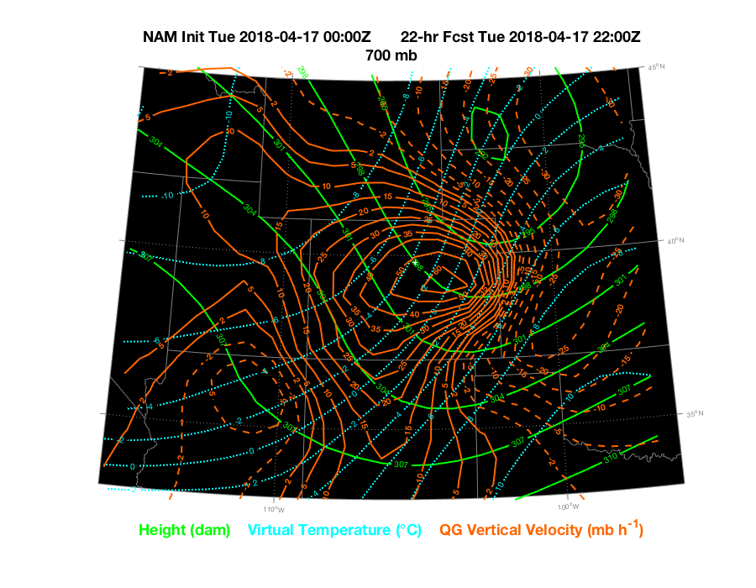
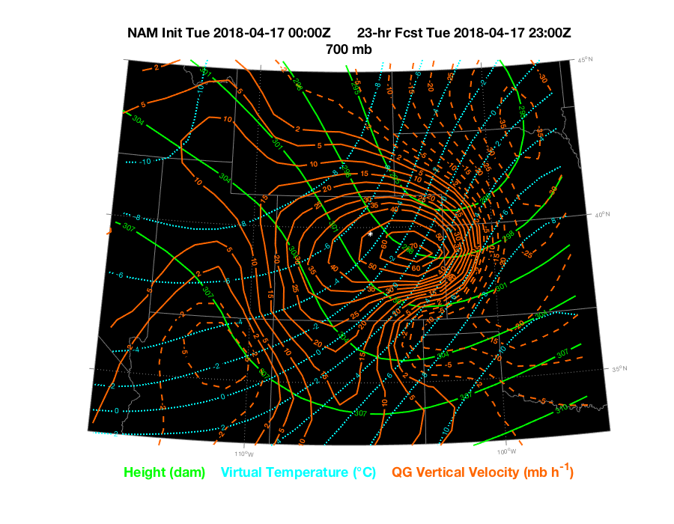
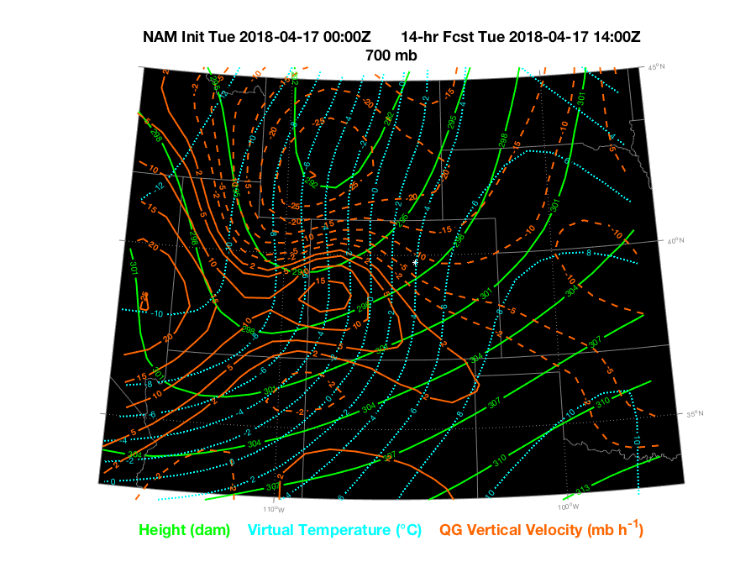
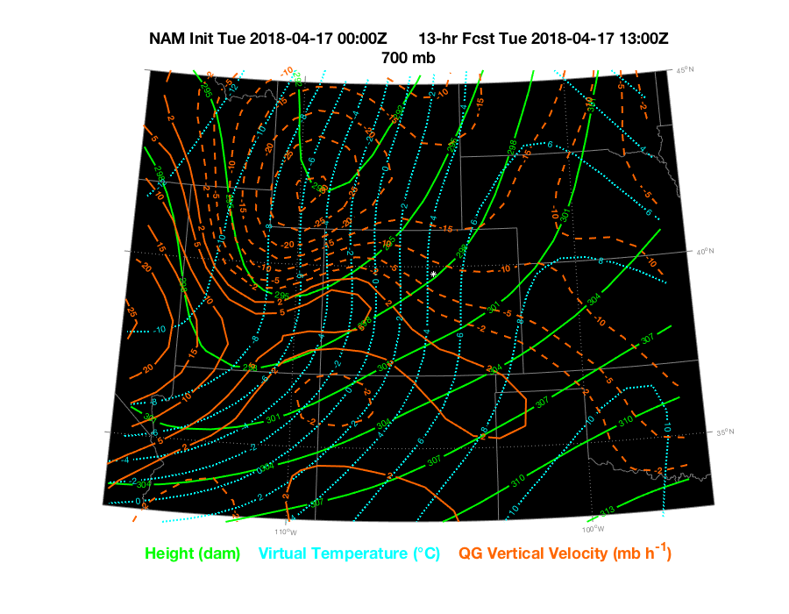
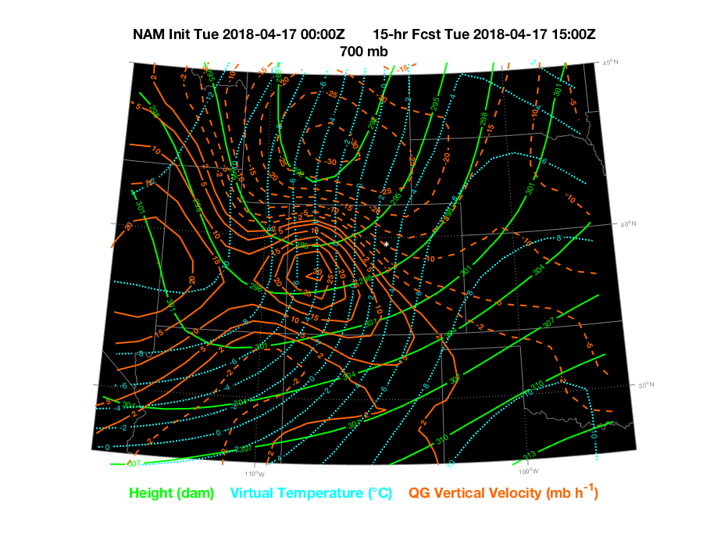
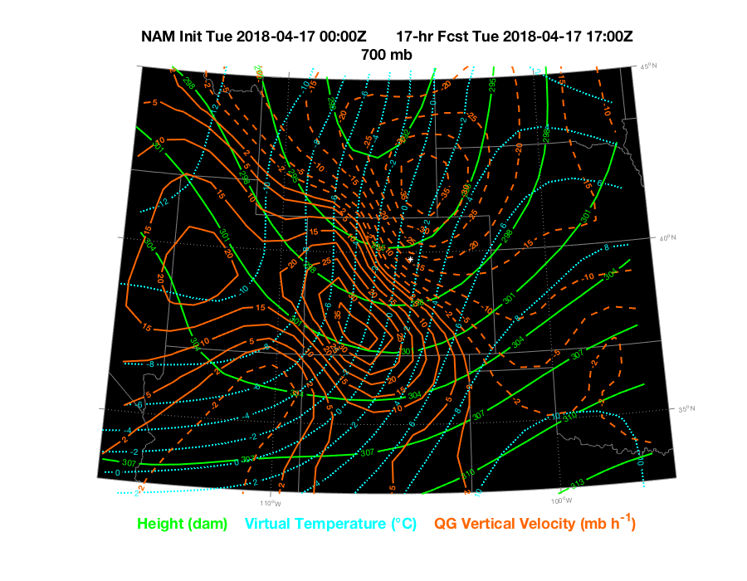
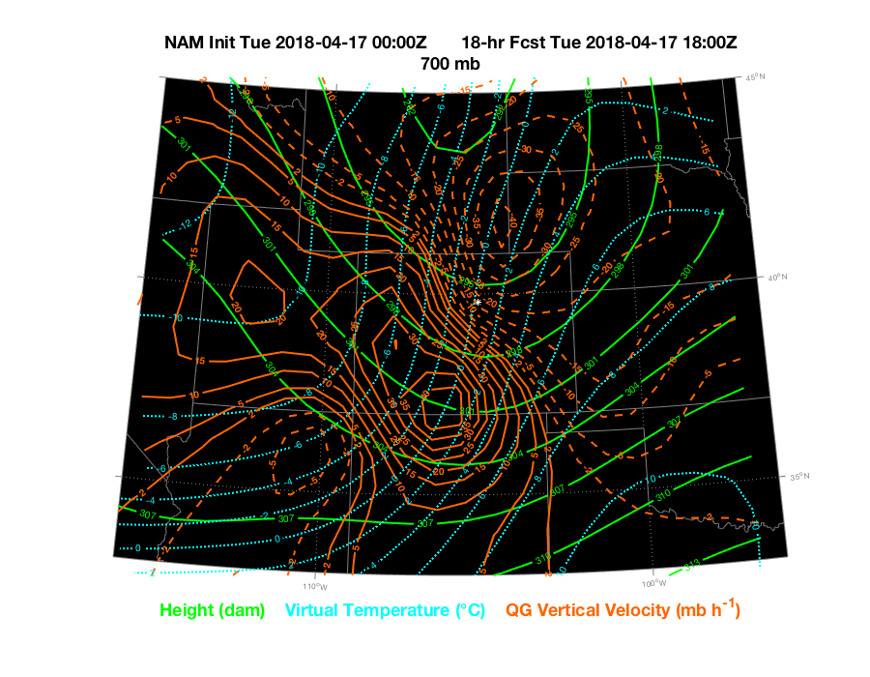
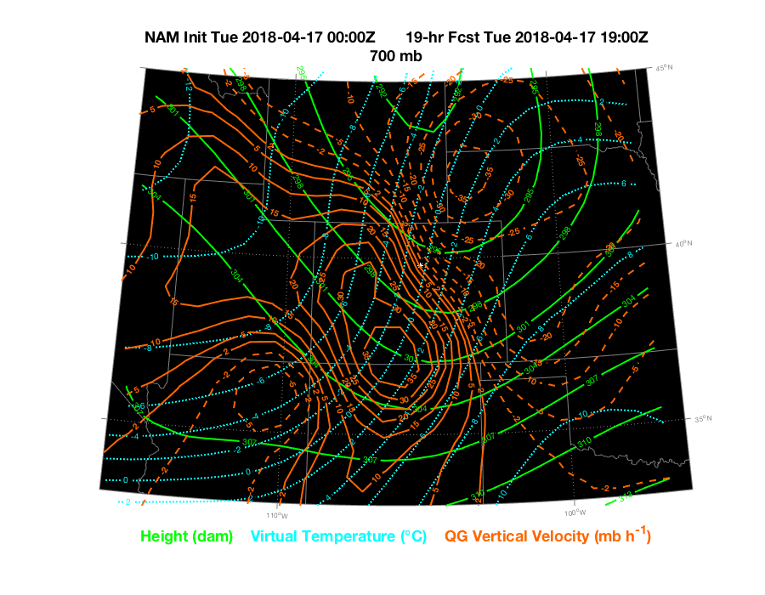
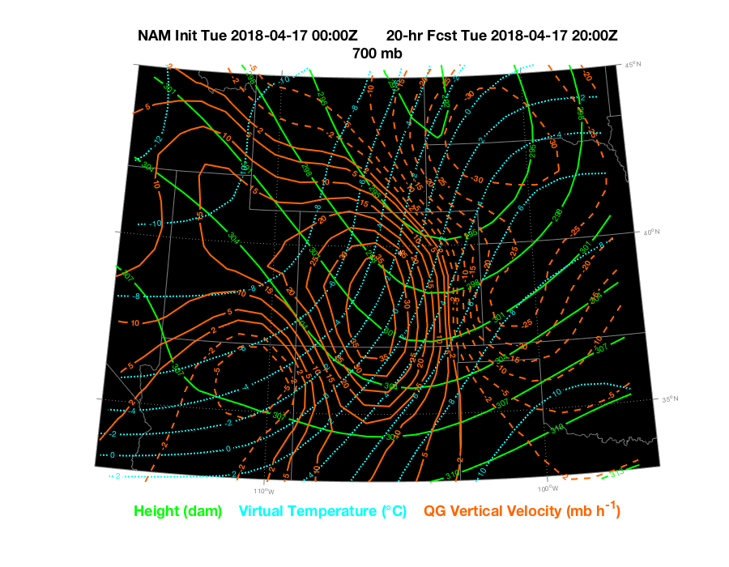
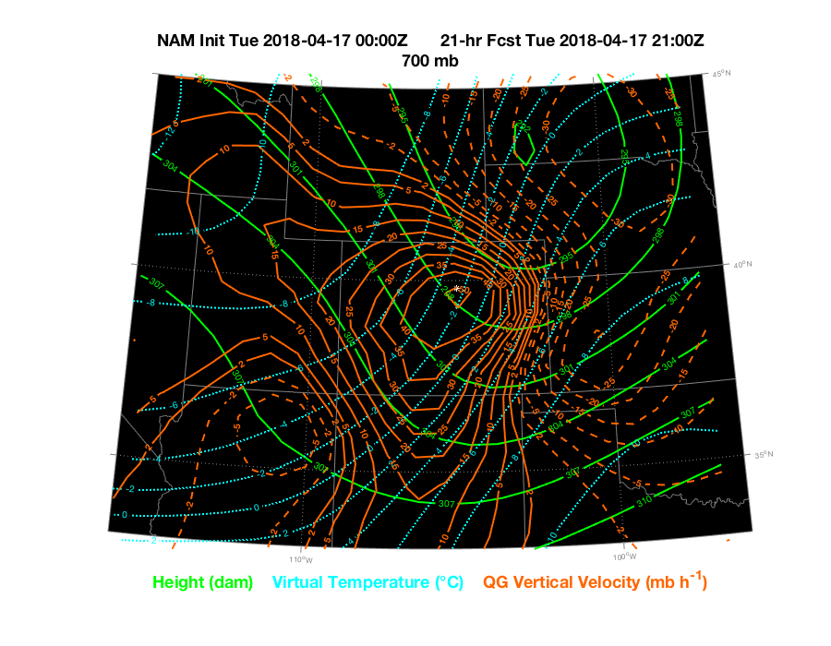
QG Orange dashed (ascent), solid (descent)

Slide 16
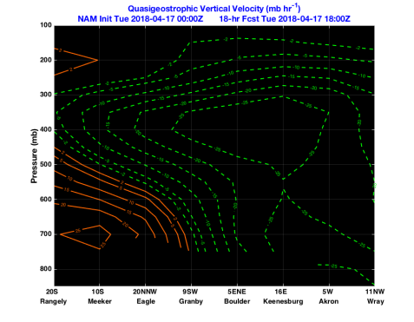
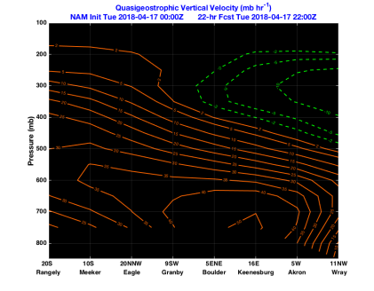
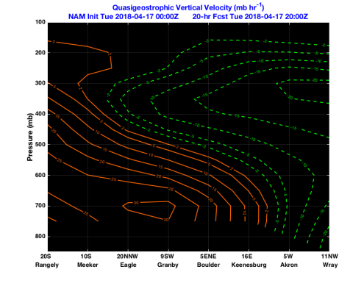
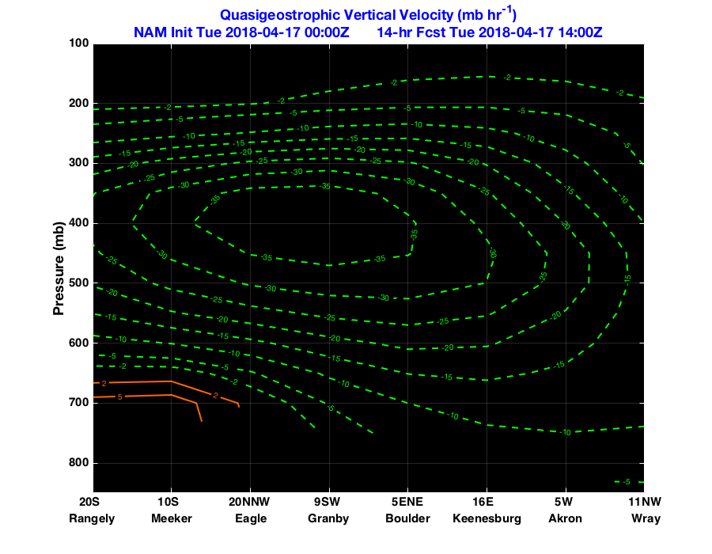
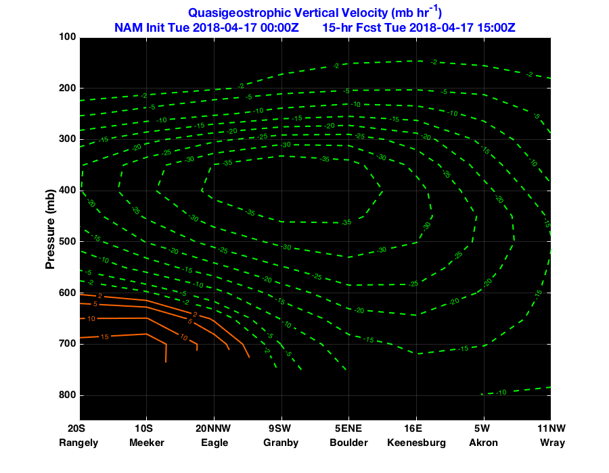
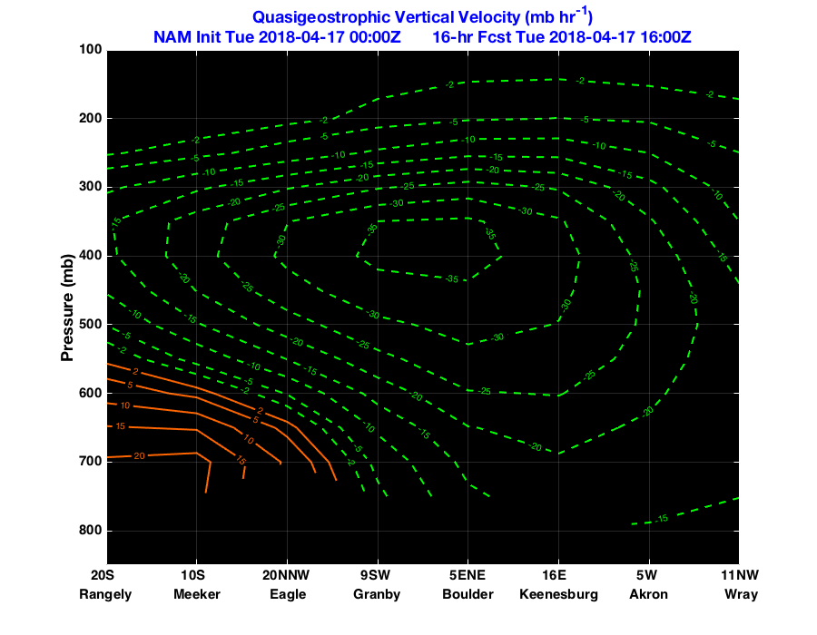
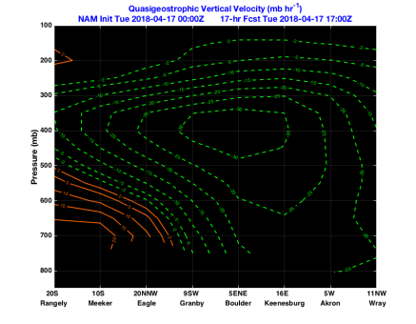
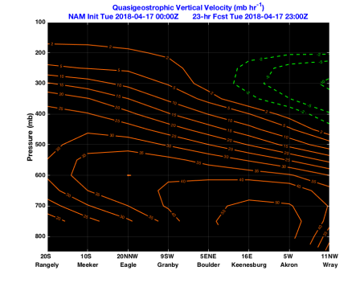
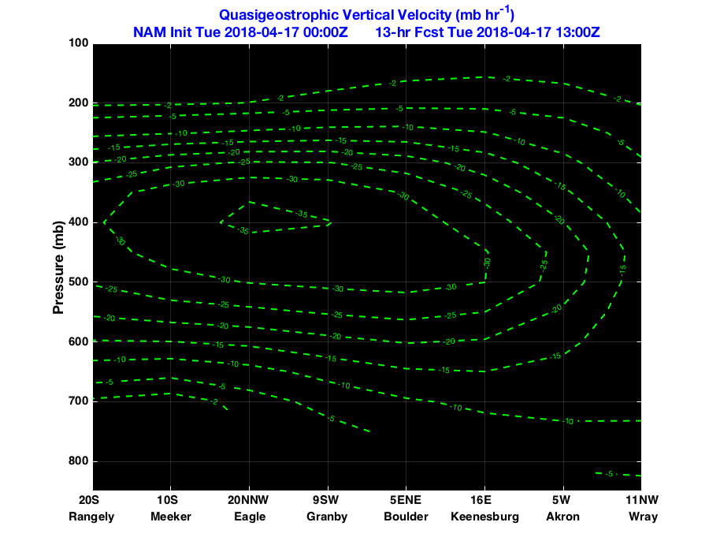
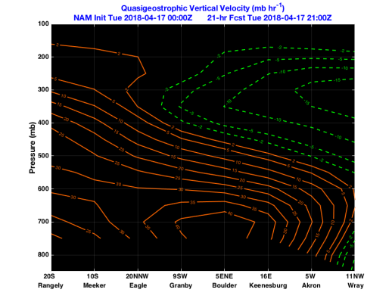
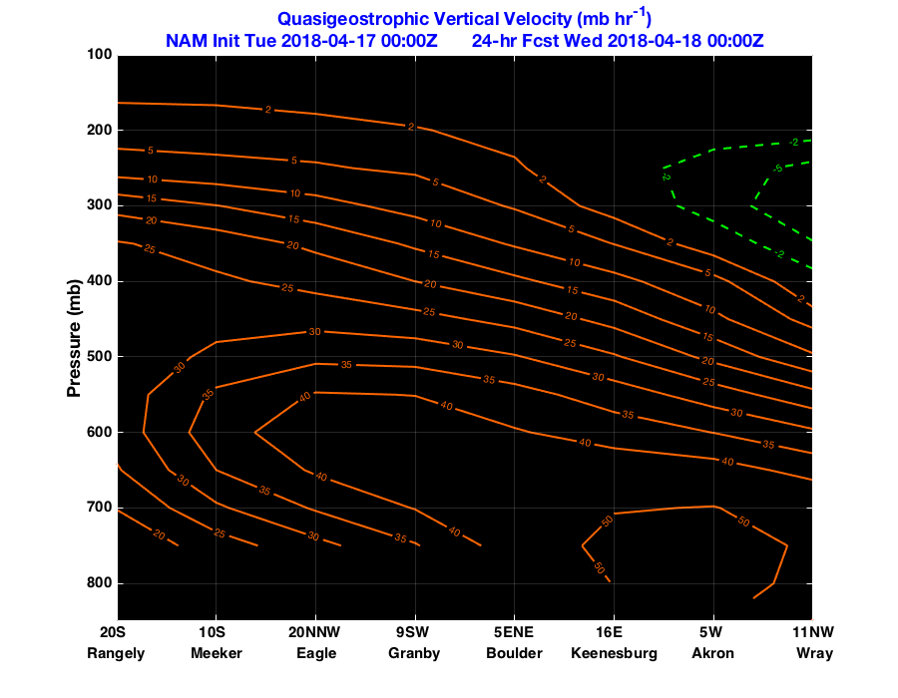
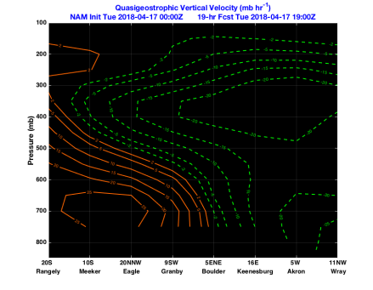
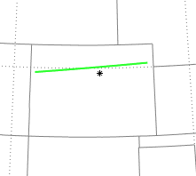
QG Orange dashed (ascent), solid (descent)

Slide 17
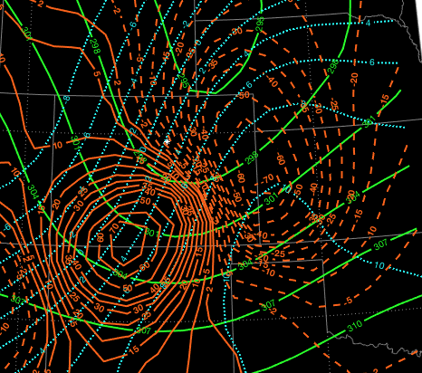
RAP Analysis 700mb QG Height/temp/QG vertical velocity
20z
00Z

Slide 18
QG on AWIPS
VOLUME BROWSER
SOURCES-Local
THALER-QG
QG-ECMWF
QG-GEM
QG-GFS
QG-NAM
QG-RAP
FIELDS-Forcing
Omega

Slide 19
QG Vertical Velocity (mb/hr)
Vertical velocity(µbar s−1)
Yellow dashed (ascent)- solid (descent))
Yellow dashed (ascent)- solid (descent))

Slide 20
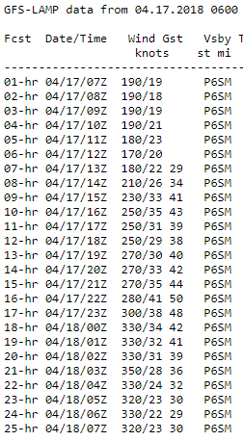
MOS GUIDANCE 4/17-06Z,12Z

Slide 21
Aviation Discussions
820 PM 4/16: “Big impact will be the increasing southwest winds Tuesday morning and then shifting and increasing to the northwest in the afternoon. Potential for high winds close to 50kt at KDEN/KAPA during the afternoon with frontal passage and increasing subsident flow.”
TAF CHANGES MADE: ADDED LLWS TO 00-06Z TAFS, INCREASED SPEEDS 10-15KT
421 AM 4/17: “main concern is winds. By early afternoon expect a more west to northwest component with higher speeds in the 30 to 40 mph range. Gusts from 50 to 60 mph will certainly be possible through 7 pm with some potential for reductions in visibility due to blowing dust.”
907 AM, 4/17: Main weather concern is winds through this evening. Southwest winds gusting to 35 knots will become more WSW late this morning with gusts up to 40 knots. After 18Z, winds turn westerly and are expected to increase with gusts of 40 to 50 knots through 00Z. Due to the strong winds there is a potential for reductions in visibility due to blowing dust. Around sunset winds should gradually decrease to 15 to 30 knots and continue to slowly decrease overnight.

Slide 22
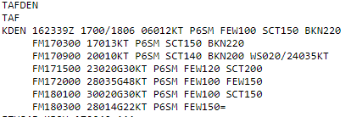
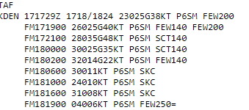
KDEN TAF Progression- Ramping up!

Slide 25
The Visuals
In the Air-Circling DIA
On the Ground-Kansas

Slide 26
2 pm observations

Slide 27
4 pm observations

Slide 28
5 pm observations

Slide 29
Terminal/ASOS Peak Winds
Rocky Mountain Airport (BJC): 86 mph
Denver International Airport(DEN): 70 mph
Centennial Airport (APA): 60 mph
Akron (AKO): 78 mph
Boulder Airport (BDU): 66 mph
Limon Airport (LIC): 76 mph
Greeley (GXY): 59 mph

Slide 30
DIA IMPACTS: 4/17/2018
Diversions: 29
Gate holds/Taxi delays: 45-59 minutes
Average arrival delays: 1 hour and 32 minutes
Faulty LLWAS wind sensor led to erroneous/sustained microburst alerts from 2015-2200z which compounded impacts.
Conditions improved around 0030Z
Data courtesy of CWSU/ZDV

Slide 31
Denver International Airport
This configuration is likely when westerly crosswind component for the North/South runways reaches sustained or gusting winds in excess of 25 kts. “all west ops”
>25kt
>25kt
Reduced AAR with West Flow

Slide 32
Helpful Tips
Don’t under estimate model guidance!
Sometimes it’s right!
Be careful when using blended solutions
Superblend, consall, NBM
CONSMOS/RAW might be better!
Use Quasi-Geostrophic (QG) layered, specific levels and cross sections to determine scope of synoptic event
Use of surface gradients and soundings
Develop local tools and guidance- Discussion???

Slide 33
Acknowledgments
Eric Thaler-provided and re-generated the QG fields for this presentation
Reference Materials:
Thaler, E.R. , Paul Nutter, “Moving Quasigeostrophic Theory into the 21st Century”
Thank You!
Scott Entrekin, WFO BOU

