Slide 1
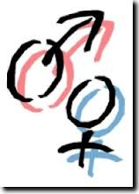
Gender
Best Practices
Webinar – Gender Part 4 – Dec 2013

Slide 2
During 2013 four webinars on gender topics were presented. This canned presentation offers up possible actionable take-aways. - 5 things women could do and 5 things men could do, to enhance their own standing and the standing of their co-gendered teammates.
It is suggested that this be used in local a diversity workshops or brown-bags team lunches to open up a dialog on this subject.
Notes:
During 2013, four webinars on gender topics were presented. This canned presentation offers (deleted “up”) possible actionable take-aways (deleted “.”) - 5 things women could do and 5 things men could do (deleted “,”) to enhance their own standing and the standing of their co-gendered teammates.
It is suggested (deleted “that”) this be used in local a diversity workshops or brown-bags team lunches to open up a dialog on this subject.

Slide 3
Again, what is said about traits is based on research, however these are generalizations, the source of which {biological versus socialization} is subject to much debate. Given the fact that all males have at least some feminine traits and all women have at some masculine traits, and truly any ones person’s makeup varies to the point that broadly spoken suggestions must be caveated by saying applicability is on a personal case by case basis.
Notes:
Again (Suggestion: delete “again” since this is only the second slide, maybe say “Keep in mind”), what is said about traits is based on research, however these are generalizations, the source of which {biological versus socialization} is subject to much debate. Given the fact that all males have at least some feminine traits and all women have at some masculine traits, and truly any ones person’s makeup varies to the point that broadly spoken suggestions must be caveated by saying applicability is on a (delete “personal”) case by case basis.

Slide 4
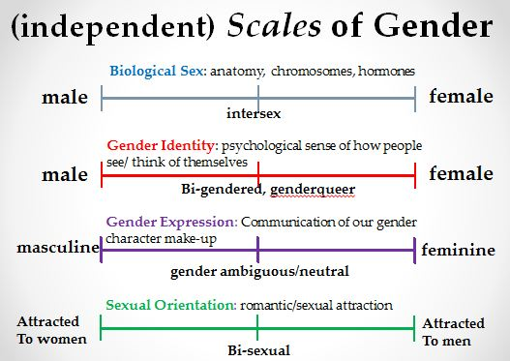
REWIND
Webinar – Gender Part 4 – Dec 2013

Slide 5
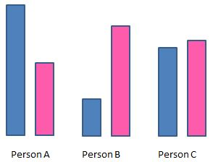
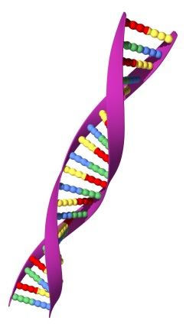
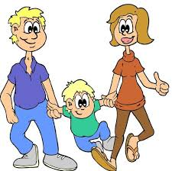
REWIND
Men and Women ARE Different
Humans have a mix of masculine and feminine traits that are not mutually exclusive.
Sources of Differences
Nature (biology) or
Nurture (parental and societal influence)
One’s Trait Set is Malleable !
Webinar – Gender Part 4 – Dec 2013

Slide 6
Women
Recognize your value
Don’t doubt your strengths; and watch for low self-efficacy – the tendency to believe yourself a fraud. You have amazing skills and intellectual gifts. These include: manual dexterity, expressive tasks, verbal fluency, spelling, context, rote memory, cooperation, negotiation, compromise, You are more flexible, better at multi-tasking, better observers (more aware), and have high EQ. And while these skills are still undervalued, don’t become frustrated – be patient. These skills are becoming increasingly more in demand, even in male-centric career environments.
Discuss: What is self-efficacy and what might be its source. What feminine skills are undervalued?
Notes:
Capitalize all of the words in the title.

Slide 7
Women
Stand up
Women twice as often as men turn down speaking events. And women tend to publish only when they have the “whole picture” – again, less frequently then men. Make your voices heard. Boost your confidence and take some risks in putting yourself ‘out there’. Claim your share of the limelight and articulate your expertise at all opportunities.
Discuss: Are opportunities to be front and center equally available to female staff; and why might they not be taken advantage of?
Notes:
Capitalize all of the words in the title.

Slide 8
Women
Volunteering
Choose volunteer committees with care. The goal is to choose worthy endeavors and to be visible, but don’t volunteer if such are distracting to your priorities and goals. Let your voice and your efforts speak for your expertise and success, but don’t get lost in noise.
Discuss: Where is the tipping point in volunteering for committees and such?
Notes:
Suggestion, make “Discuss:” in bold. Change the text in “Discuss” to “Where is the tipping point in volunteering for committees, etc.?”

Slide 9
Women
Execute a plan
Have a plan. Know what you hope to achieve but ensure that your expectations are truly realistic and align with your personal priorities. Balance is key.
Discuss: Why might women be reluctant to plan a specific course; How might women’s expectations differ from reality?
Notes:
Capitalize all of the words in the title. Delete “that”. Suggestion, make “Discuss:” in bold

Slide 10
Women
Get a mentor
Seek mentors; but as Condoleezza Rice once said – don’t expect them to look like you. They do not necessarily have to be females. It is certainly important that you be comfortable with your mentor, as sharing is key, but keep in mind that studies have shown that male mentors are just as effective with female mentees as are female mentors.
Discuss: What are the best attributes of a mentor?
Notes:
Capitalize all of the words in the title. Replace the “;” in the first sentence with a dash.

Slide 11
Men
Acquire new skills
You too have great attributes that are of great value in the workplace. However don’t rest of your laurels. The workplace of tomorrow today requires cross-gender skills! Many skills and traits that might be seen as, or are indeed, more feminine in nature, are becoming a necessity. Don’t fear the ‘f’ word. Those that will succeed the most will have the most going for them in terms of acquisition of a wide variety of skills and traits from across the full breadth of the spectrum.
Discuss: What skills are truly most in demands; What impedes the acquisition of a cross-gender skill set?
Notes:
Capitalize all of the words in the title. Delete “too” in the first sentence.

Slide 12
Men
Become aware
Increase you overall awareness. The masculine strength of focus can at times become a detriment. Remove your blinders periodically and pay more attention to people and situations around you.
Discuss: What important things do we lose sight of when we become ‘too’ focused?
Notes:
Capitalize all of the words in the title. Change “you” to “your” in the first sentence. Change “become a detriment” to “be a detriment”.

Slide 13
Men
Become aware
Likewise, know thyself. Raise your internal awareness. Understand your strengths (and your weaknesses). Men are confident, risk-takers, aggressive, competitive, concise, and unyielding. Men are better at instrumental tasks, spatial tasks; visual comprehension, reasoning, instrumental tasks, mathematics, mazes, maps, speed and accuracy of reaction to visual and auditory stimulation, mechanical aptitude, and problem-solving ability.
Discuss: Are there practices that make a person more self-aware?
Notes:
Capitalize all of the words in the title.

Slide 14
Men
Cooperate
Men are more individualistic in nature. Learning to cooperate and collaborate more often with all members of your teams can be a boon to performance and production.
Discuss: What hinders cooperation and collaboration?

Slide 15
Men
Practice equality
Don’t discriminate against women (or the feminine). Yes it still exists. Women are still hired less often, and paid less to start; their evaluations are lower, These are facts. And that is just the beginning of the discrimination and effect of bias against them. Don’t be a contributing party to it through acceptance.
Discuss: In the government how might discrimination still exist?
Notes:
Capitalize all of the words in the title. Suggested changes to text:
“Don’t discriminate against women (or the feminine). Yes, it still exists. Women are still hired less often, paid less to start, and their evaluations are lower; these are facts. And that is just the beginning of the discrimination and effect of bias against them. Don’t be a contributing party to it through acceptance.” Suggestion, make “Discuss:” in bold and put in punctuation

Slide 16
Both
Practice gender parity
have dialog – improve relationship – find things in common but seek understanding of your differences.
Discuss: What separations still exist between men and women even in a professional environment?
Notes:
Capitalize all of the words in the title. Change text to “Have dialog – it improves relationships – find things in common and seek understanding of your differences.”.

