Slide 1
National Weather Service
Diversity Management
Utilizing our differences to change the future!
Notes:
This powerpoint presentation was developed by the Presentation Team which was chartered under the NWS Diversity Marketing Team. Team Leaders – Jose Garcia, Gena Morrison, Steve Kuhl. Team members – John Haase, Joe Arellano, Gina Tillis-Nash, Kristin Scotten, Jennifer Stark. The team’s charter was the development of a presentation which could be utilized by managers and diversity focals to present to their offices or work units. The presentation is intended to facilitate healthy dialog and conversation about diversity and diversity issues throughout the NWS. Presenters are encouraged to utilize and adapt this presentation to their local office and work units.

Slide 2
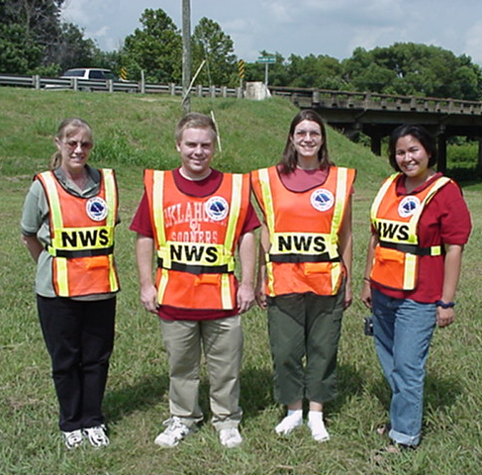

Intended Audience & Customers
All NWS employees
  Management
  Forecasters
  Administrative
  Technicians
  Researchers
Students
Contractors
Volunteers
The communities, partners
and customers that we serve
Notes:
We must improve diversity management knowledge throughout the organization, including every NWS employee, SCEP/STEP students, contractors and student volunteers.

Slide 3


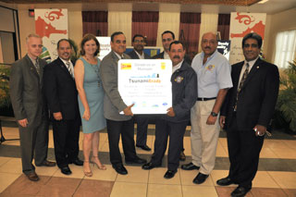

What is Diversity ?
Notes:
What is Diversity?

Slide 4
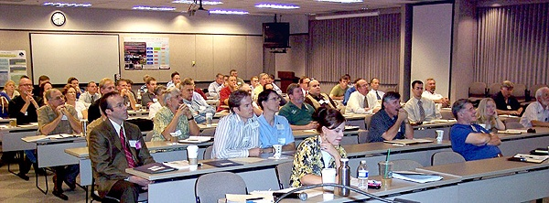
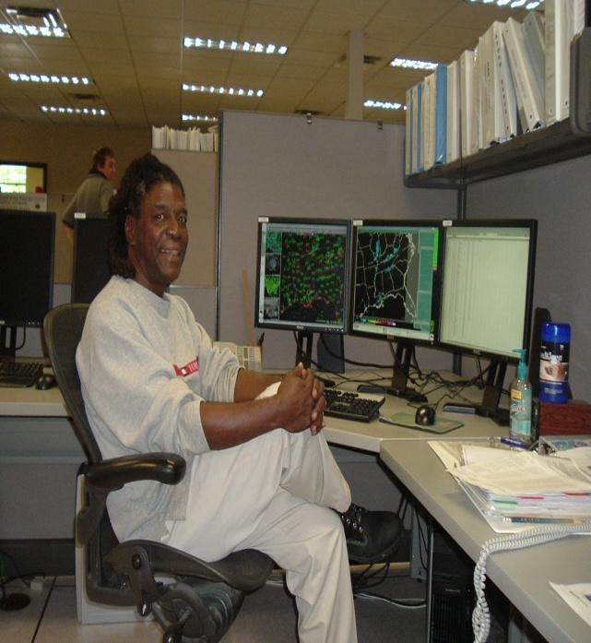
Diversity is the differences that make us unique individuals
Notes:
Diversity is beneficial to both the organization and the members. Diversity brings substantial potential benefits, such as better decision making and improved problem solving, greater creativity and innovation, which leads to enhanced product development, and more successful marketing to different types of customers. Simply recognizing diversity helps link the variety of talents within the organization and allows employees with these talents, to feel needed and have a sense of belonging. This sense of inclusion in turn increases their commitment to the organization and allows each of them to contribute in a unique way. Diversity also provides organizations with the ability to compete in global markets. Diverse organizations will be successful as long as there is a sufficient amount of communication within them. Because people from different cultures perceive messages in different ways, communication is vital to the performance of an organization. Miscommunication within a diverse workplace will lead to a great deal of challenges. Diversity is not only about preventing unfair discrimination and improving equality but also valuing differences and inclusion, spanning such areas as ethnicity, age, race, culture, sexual orientation, physical disability and religious belief.

Slide 5
Remember that Diversity is not the same as Equal Employment Opportunity ( EEO).
EEO is a series of federal laws designed to protect employees from discrimination based on race, sex, creed, religion, color, or national origin.
Diversity vs. EEO
Notes:
Equal employment opportunity was created to prohibit federal contractors from discriminating against employees on the basis of race, sex, creed, religion, color, or national origin.

Slide 6
EQUAL OPPORTUNITY and DIVERSITY: How they Differ
PROGRAM DIFFERENCES
EQUAL OPPORTUNITY: Utilizes representation to promote change
(Exclusion/outcome oriented)
DIVERSITY: Utilizes change to promote representation
(Inclusion/process oriented)
Notes:
Equal Opportunity programs and Diversity programs are uniquely defined by their separate issues of concern, Exclusion vs. Inclusion but are functionally linked to their common goals of equity and organizational success.

Slide 7

Inclusion vs. Exclusion
Early American society was rooted in the concept of exclusion where whole groups of the population were subject to:
  refusal of entry
  censure
  exception
  ejection
Today’s society is based more on the concept of
inclusion where groups of people are:
  allowed entry
  have a sense of belonging
  are valued and accepted
Notes:
When thinking about diversity, it is important to consider the concepts of inclusion vs. exclusion. Early American Society was rooted in the concept of exclusion as entire portions of this society were not allowed to participate in many of the civil liberties we take for granted today. An example of this exclusion was women having the right to vote. It wasn’t until 1920, when the 19th Amendment to the U.S. Constitution was ratified that women received this right.
Today’s society is based more on the concept of inclusion where diversity is more accepted and people have a greater sense of belonging. An example of how inclusion has been adopted by our society was the passage of the Civil Rights Act of 1964, which outlawed racial segregation in public schools, public places, housing, and employment.

Slide 8

What is Diversity Management?
Notes:
Diversity within an organization does not provide a direct benefit to an organization. The organization must commit to managing the diversity of its workforce in order to channel the benefits of a diverse workforce into achieving the organization’s mission and goals. Diversity Management can be a powerful tool for an organization when it is used to capture the problem-solving, decision-making, innovation and knowledge of its workforce

Slide 9
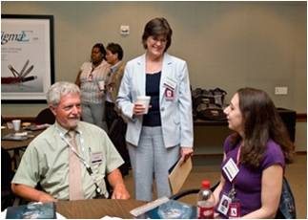
Diversity Management focuses on managing the difference within an organization’s workforce.
By managing this difference, the organization can capitalize on the benefits of diversity and minimize workplace challenges
Notes:
Diversity within an organization does not provide a direct benefit to an organization. The organization must commit to managing the diversity of its workforce in order to channel the benefits of a diverse workforce into achieving the organization’s mission and goals. Diversity Management can be a powerful tool for an organization when it is used to capture the problem-solving, decision-making, innovation and knowledge of its workforce.

Slide 10
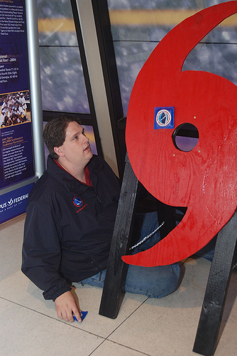
Diversity Management, EEO, and Affirmative Employment
Diversity Management
  creating a culture where employees can reach full potential
EEO
  legal compliance
Affirmative Employment
      agency plans designed to improve the employment prospects for identified protected groups through specific practices.
Notes:
Diversity Management concerns creating an organizational culture where all employees can reach their full potential.
Equal Employment Opportunity (EEO) concerns legal compliance with applicable laws, regulations, and policies.
Affirmative Employment" is a term sometimes used by government agencies, and some private sector companies, which maintain voluntary plans designed to improve the employment prospects for identified protected groups through specific practices, which are often identical to those employed by Federal Contractors required to do so under the Executive Order program.

Slide 11
The Diversity Management Connection
Non-Statutory
Discrimination
Complaints
EEO
Effectiveness
Protected Groups
Civil Rights
Act &
Subsequent
Legislation
Diversity
Management
Programs/Laws
Process
Goals
Inclusive
Action Plans
Affirmative
Employment
Retention
Special Emphasis
Work Environment
Legal compliance
Improve Productivity and Reduce Costs
Notes:
The "business case for diversity" states that an organization that employs a diverse workforce (both men and women, people of many generations, people from ethnically and racially diverse backgrounds etc.) is better able to understand the demographics of the community it serves and is thus better equipped to thrive than a “competing” organization with a more limited range of employee demographics. An organization that supports the diversity of its workforce can also improve employee satisfaction, productivity and retention. The degree of inclusion that an organization utilizes, of its various relevant diversities, is proportional to both the tangible and non-tangible benefits. If a workforce is diverse, but the organization takes little or no advantage of that breadth of that experience, then it cannot monetize whatever benefits background diversity might offer, such as reduced training and recruitment costs, improved employee attendance and productivity, but could actually result in a loss of services and productivity.
It is the responsibility of managers within organizations to use diversity as an influential resource in order to enhance organizational effectiveness.
Equal employment opportunity was created to prohibit federal contractors from discriminating against employees on the basis of race, sex, creed, religion, color, or national origin.
Affirmative Employment refers to agency plans that improve employment prospects for protected groups including "race, color, religion, sex or national origin“.
Diversity is beneficial to both the organization and the members. Diversity brings substantial potential benefits, such as better decision making and improved problem solving, greater creativity and innovation, which leads to enhanced product development, and more successful marketing to different types of customers. Simply recognizing diversity helps link the variety of talents within the organization and allows employees with these talents, to feel needed and have a sense of belonging. This sense of inclusion in turn increases their commitment to the organization and allows each of them to contribute in a unique way. Diversity also provides organizations with the ability to compete in global markets. Diverse organizations will be successful as long as there is a sufficient amount of communication within them. Because people from different cultures perceive messages in different ways, communication is vital to the performance of an organization. Miscommunication within a diverse workplace will lead to a great deal of challenges. Diversity is not only about preventing unfair discrimination and improving equality but also valuing differences and inclusion, spanning such areas as ethnicity, age, race, culture, sexual orientation, physical disability and religious belief.
Reference: graphic from NWS_Diversity_guidance_2007_1-31-2007.pps Slide 11

Slide 12

NWS Business Case for Diversity Management
“To educate the workforce on diversity management and infuse this knowledge throughout the organization to achieve NWS mission and goals”
Notes:
When developing a business case, it is important to remember the real goal is value improvement. In addition, a solid business case must directly align with the strategic objectives and mission of an agency. The NWS Business Case for Diversity Management, shown in this slide, was developed by the Diversity Management Marketing Team. It is intended to deliver value to all NWS employees, contractors, SCEP/STEP students, and student volunteers by improving their diversity management knowledge.

Slide 13
Diversity Management:
Roles and Responsibilities
NWS Assistant Administrator/ Deputy Assistant Administrator
Provide resources and visible support
Ensure accountability
NWS Office of Equal Opportunity and Diversity Management
Develop NWS Policies/Definitions
Consult NOAA’s NWS Regional Offices, HQ and NCEP
Offer Diversity Management guidance
Provide Diversity Management education and training
Evaluate organizational progress
Develop tools and measurements
NWS Offices:
Headquarters, Regional, Local, and NCEP
Oversee planning and implementation
Provide advice and guidance to staff
Provide staff/fiscal resources
Support local Diversity Committee
Evaluate progress
NWS Employee Workforce
Support NWS Diversity Initiative!
Notes:
DIVERSITY MANAGEMENT:
ROLES AND RESPONSIBILITIES - It should be noted that the workforce is an integral part of making Diversity Management work in the NWS!

Slide 14

Leadership in
Diversity Management
Everyone can be a leader in Diversity Management!
Facilitate diversity discussions… make it more “play” based
Increase diversity
management initiatives
Encourage supportive
workplace behaviors
Notes:
Teams that “play” well together work well together. Discussions on diversity do not need to originate from a planned meeting or by managerial decree. It could be as simple as starting a conversation over an interesting factoid. Additionally, tying diversity management metrics to an employee’s performance could encourage and reward supportive diversity behaviors. This could range from simply recognizing someone’s efforts publically to a cash award.

Slide 15
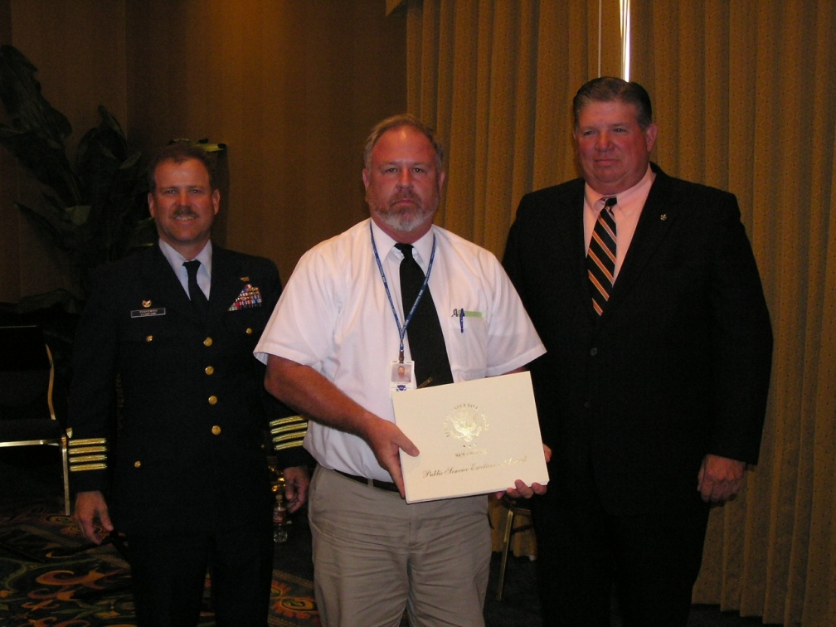
Leadership is a behavior…
Not a position
Diversity management must be supported at
all levels of our organization
Notes:
Leadership is a part of all of us at home, in our business, and our community. Leadership requires flexibility, awareness, and in particular, sensitivity to those with whom we interact. The same could be said for diversity. Diversity is a part of all of us… it helps to define who we are as individuals. Diversity management needs to be an inclusive process that has input, as well as responsibility, from all levels (managers, forecasters, technicians, administrative staff, researchers, interns, and volunteers). Taking ownership to improve diversity within the NWS is being a leader, regardless of your title.
“Process of social influence in which one person can enlist the aid and support of others in the accomplishment of a common task."
Chemers, M. M. (2002).

Slide 16
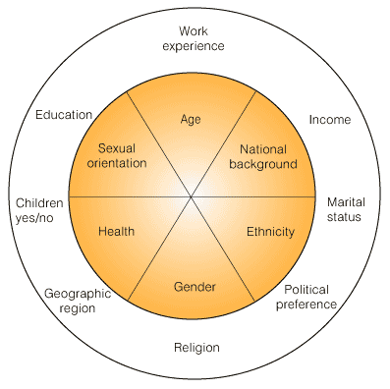
Primary and Secondary Dimensions of Diversity
Notes:
Often, the different aspects of diversity are divided into primary and secondary dimensions. The primary dimensions are basic and can not be changed by the person. Secondary dimensions can be influenced more easily.

Slide 17

Primary and Secondary Dimensions of Diversity
Role of Gender
During 1950’s, more than 65% of the U.S. workforce
included white males
Today, women comprise 50% of the U.S. workforce
Over the next decade this number will continue to rise
The federal government is unique because women earn the same as men
Notes:
Since gender is a primary dimension of diversity, it is a characteristic that is immediately recognizable by others and cannot be changed by the individual. Gender influences the way we see and react to the world and others in it. As a society we recognize that individuals are defined by more than just their gender, however gender plays an important role in the way we define ourselves and the way we view our role in our family, social circle and workplace.

Slide 18
Gender is one of the Primary Dimensions of Diversity. What does the NWS look like today?
* Based on FY2009 Data
Notes:
External perception of gender roles varies by individual, but generally it is the socially determined ideas, beliefs and practices of what it is to be female or male in a society. In different societies, cultures and religions, there are different sets of rules, norms, customs and practices that define the roles of females and males. These culturally defined roles of male and female will influence our perception of what is “appropriate” behavior for each gender and may influence our reaction to males and females in the workplace.
Internal perception of gender roles also varies by individual, but it is inherent to the behavior, beliefs and values of the individual. Different societies, cultures, religions and our upbringing may influence our internal perception of what it is to be male or female.

Slide 19
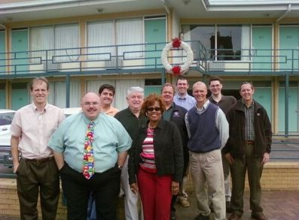
Primary and Secondary Dimensions of Diversity
Role of Race
Race is a challenge for the NWS now and in the future
Number of minorities remains fairly low in the NWS
How do we as an agency change this in the future?
Notes:
The long-term success of the NWS must include a diverse body of talent that brings fresh ideas, perspectives, and views to the agency, along with a corporate mind-set that values these views. A lack of diversity will affect the NWS’s ability to communicate with its many diverse partners and customers. It is important for the agency to align diversity management strategies to specific goals such as retention, sustainability, performance and mission accomplishment.

Slide 20
Looking at a primary dimension of diversity – what does the NWS population look like today?
* Based on FY2009 Data
Notes:
What does the NWS population look like today?

Slide 21
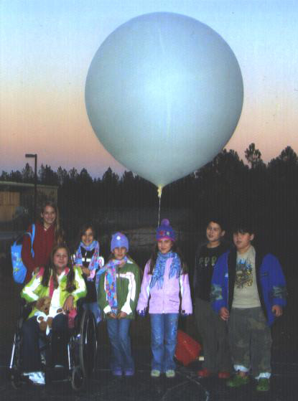
Primary and Secondary Dimensions of Diversity
Role of Physical Qualities/Persons with Disabilities
People with disabilities are nation’s largest minority
20% chance of becoming disabled during your career
People with disabilities cross all racial, gender, educational, and socio-economic lines
Companies employing people with disabilities increase competitive advantage
Notes:
The long-term success of the NWS must include a diverse body of talent that brings fresh ideas, perspectives, and views to the agency, along with a corporate mind-set that values these views. A lack of diversity will affect the NWS’s ability to communicate with its many diverse partners and customers. It is important for the agency to align diversity management strategies to specific goals such as retention, sustainability, performance and mission accomplishment.

Slide 22
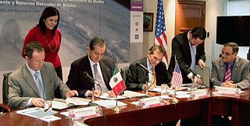
Primary and Secondary Dimensions of Diversity
Role of Ethnicity
Ethnicity refers to cultural and physical characteristics used to classify people into groups different from others
Focusing on traits such as skin color, body shape, hair texture, etc., magnifies differences between people
Must not let personal cultural biases block acceptance of others
Notes:
The long-term success of the NWS must include a diverse body of talent that brings fresh ideas, perspectives, and views to the agency, along with a corporate mind-set that values these views. A lack of diversity will affect the NWS’s ability to communicate with its many diverse partners and customers. It is important for the agency to align diversity management strategies to specific goals such as retention, sustainability, performance and mission accomplishment.

Slide 23

Primary and Secondary Dimensions of Diversity
Role of Sexual Orientation
Diversity means differences. We cannot choose who is included and who is not
Regardless of our sexual orientation, we are all human beings
Gay and Lesbians live and work in all sections of the country
A diverse workforce that reflects our society means recognizing all individuals that bring productivity and talent to our work force
Notes:
The long-term success of the NWS must include a diverse body of talent that brings fresh ideas, perspectives, and views to the agency, along with a corporate mind-set that values these views. A lack of diversity will affect the NWS’s ability to communicate with its many diverse partners and customers. It is important for the agency to align diversity management strategies to specific goals such as retention, sustainability, performance and mission accomplishment.

Slide 24
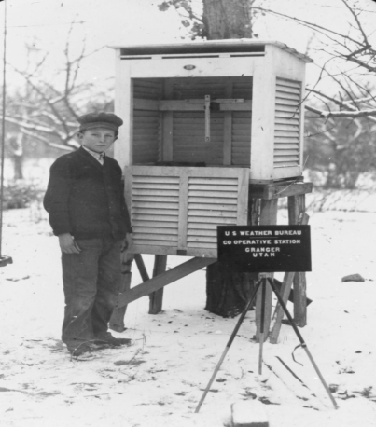
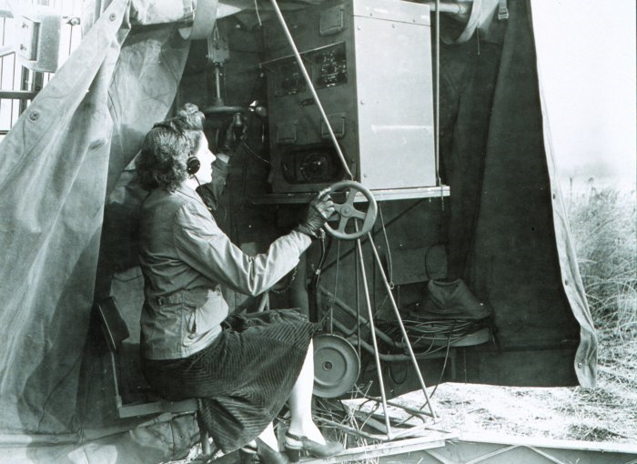
Primary and Secondary Dimensions of Diversity
Role of Generations
Greatest Generation: born 1910-1924
  Fought WWII
  Adults during Great Depression
  Strong work ethic
Silent Generation: born 1925-1945
  Children of Great Depression
  Adults during Korean War
Notes:
Generations are brief periods of time that are connected with pop cultures throughout the world. Many characteristics of these generations are the music, inventions, fads and wars specific to each period of time. Each generation is categorized by the general birth years of the people within the generation.

Slide 25


Primary and Secondary Dimensions of Diversity
Role of Generations
Baby Boomers Generation: born 1946-1964
  People in teens and college formed counter-culture of 1960’s
  Civil Rights and Women’s Liberation Movements
  Vietnam War, Moon Landing, JFK Assassination
Generation X (Xers): born 1965-1981
  1st Generation with widespread use of TV
  1973 Oil Crisis and HIV-AIDS epidemic
Notes:
Generations are brief periods of time that are connected with pop cultures throughout the world. Many characteristics of these generations are the music, inventions, fads and wars specific to each period of time. Each generation is categorized by the general birth years of the people within the generation.

Slide 26


Primary and Secondary Dimensions of Diversity
Role of Generations
Generation Y (Nexters/Millennials): born 1982-1994
  Children of Baby Boomers
  Fall of the USSR and 1st Gulf War
  Rise of Information Age/Internet
Generation Z (Internet Generation): born 1995-present
  Highly efficient with technology
  Use of Internet, Text messaging, YouTube, Facebook
  Children of Gen X, older Gen Y’s, and youngest Baby Boomers
Notes:
Generations are brief periods of time that are connected with pop cultures throughout the world. Many characteristics of these generations are the music, inventions, fads and wars specific to each period of time. Each generation is categorized by the general birth years of the people within the generation.

Slide 27
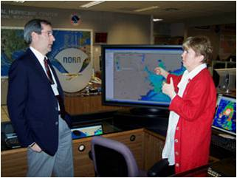
Why Differences Occur
Childhood environment/experiences, words/deeds of parents, teachers, kin, etc.
Education, race, religion, sexual orientation, language, etc.
Interests/roles in society and economic/social status
Notes:
Differences between people occur for many reasons, some of which are shown in this slide. Personal clashes due to these differences can be minimized through understanding, acceptance, and forgiveness.

Slide 28
Resolving Differences
Understanding
  Accepting others point of view helps people communicate and appreciate others
Acceptance
  Crucial to relationships, basic need for healthy self-esteem
  You don’t have to change your beliefs to accept another person
  Can accept someone as having worth, even if we don’t agree with them
Forgiveness
  Often difficult, but works
  A gift to yourself. Not something you do for someone else
  Takes courage to let go. No one benefits more from forgiveness than the person who forgives
Notes:
Differences between people occur for many reasons, some of which are shown in this slide. Personal clashes due to these differences can be minimized through understanding, acceptance, and forgiveness.

Slide 29

Catch the …
Notes:
Catch the vision!

Slide 30
“When you are surrounded by sameness, you get only variations on the same”
--- Kevin Sullivan - VP of HR of Apple Computers
Notes:
“When you are surrounded by sameness, you get only variations on the same.”

Slide 31
The key to successful diversity management is to recognize the differences in others but also to seek our commonalities
Notes:
The key to successful diversity is not to look at the differences in others but find the similarities.

Slide 32
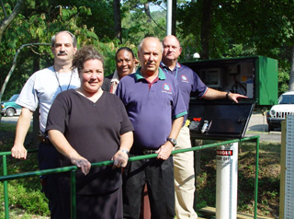
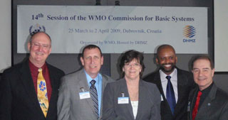
How Do We Achieve a
Diverse
Workplace?
Notes:
How do we achieve a Diverse workplace?

Slide 33
Treat others as you want to be treated
Accept people as the individuals they are
Focus on finding similarities and not differences in others
Take responsibility for your actions
Be sensitive
Celebrate differences by promoting respect through inclusion and valuing others
Notes:
Employees must be able to trust everyone in the agency: leaders and co-workers. Most of the time, trust is measured by how our “gut” feels. Peoples emotions are real and should not be casually measured. Assess the trust level with the same diligence and care as creating a good forecast.
A loss of confidence compromises the faith of the agency and the ability to serve the public.
Respect is of the utmost importance, whether personal or professional. The respect folks have for each other helps to drive the agency in a positive direction. Lost respect can take an incredibly long time to mend.
Dignity is a precious commodity. Without ones dignity, they believe they have no personal self worth and will not be taken seriously. Constant belittlement causes someone to question their dignity. Something as simple as a word of affirmation can restore someone who feels unnoticed and unappreciated.
When working for an agency with equality policies, employees are more likely to consider that opportunities for recruitment, conditions and opportunities for advancement and career development are fair and equal. Where equality is found in an agency there is a lower level of work stress. Equality is strongly associated with higher levels of job satisfaction and commitment.

Slide 34
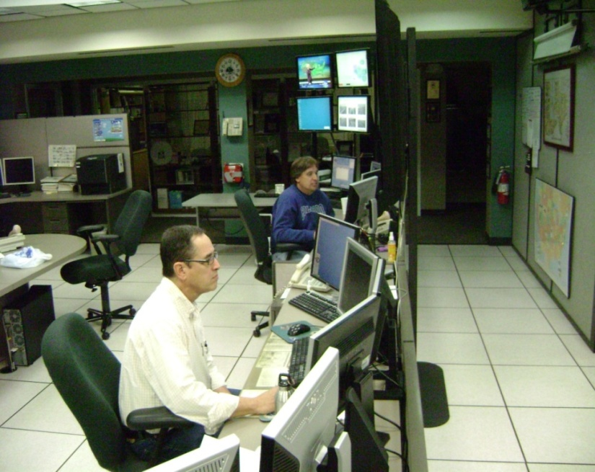
When the NWS is unified, we will enjoy all that a diverse workforce has to offer
Happier, more vibrant workforce
A workplace filled with trust and confidence
Improved productivity
Higher workforce retention
Notes:
When the NWS is unified, we will enjoy all that a diverse workforce has to offer

Slide 35
Striking a Balance
Women, Men, Family and Work
Notes:
Striking a Balance

Slide 36

Over the past decade…
Technology has blurred the lines between work and life
  Access to e-mail, texting, alerts are 24/7
  No leaving “work at work”
Traditional Family Model has also changed
  Two-income households
  Single Parents
Can be overwhelming to still live up to traditional standards while juggling everything else
Notes:
If you think back just ten years ago, how many people had cell phones? And if you did, were you able to check e-mail on it? Were you able to text anyone? Or browse products on the office website?
We have all of this information with just a few clicks on our phone now, and it’s hard after a day of work for some people to leave work behind at the office. We might be in line at the grocery store and sneak a look at our e-mails. We might be giving our kids a bath and check the website to see if your forecast is panning out.
Adding to this always-plugged in mentality, we’ve also seen a dramatic shift in the family model over the past ten to twenty years. Two-income households are becoming the norm…even viewed a necessity for most couples. And in 2006, there were an estimated 12.9 million single parent households…10.4 single mother households and 2.5 million single father households.
All of these new family models can add tremendous pressure to people still trying to live up to the traditional standards of putting everything into your work.

Slide 37
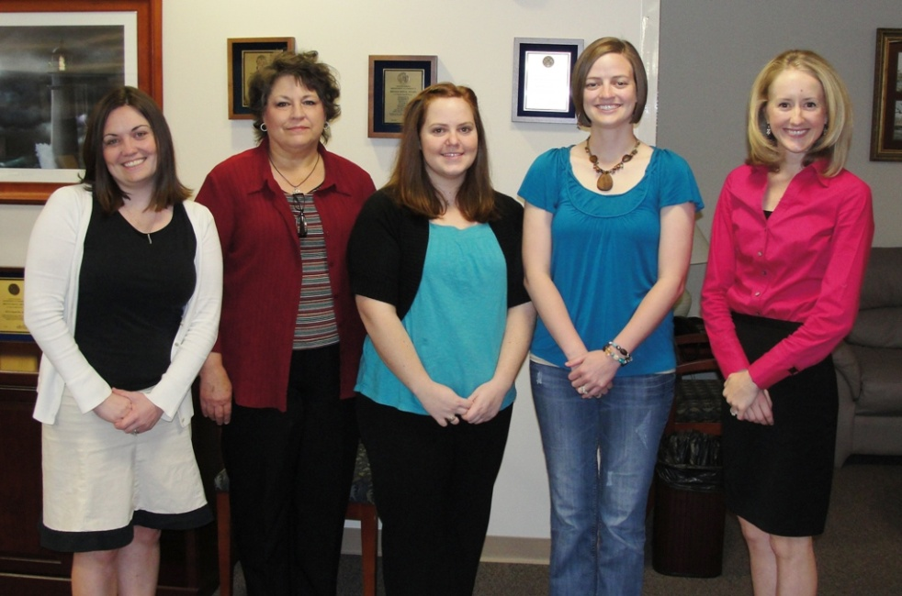
Family-work balance is complex
Issues:
  financial values
  gender roles
  career paths
  time management
  many other factors
Notes:
Family-work balance means something different to each person, and its not something that can be addressed broadly…it involves financial goals and values, gender roles, career aspirations, time management skills and many other factors.

Slide 38
In the NWS, we have…
Single Parents
Two-income households
  With or without children
One-income households
  With or without children
Single individuals
People taking care of their parents or grandchildren
Each
Situation
Comes
With Its
Own
Challenges And Benefits!
Notes:
The National Weather Service has a very diverse group of employees…from single mothers and fathers to two income households…many with one spouse being military…one income households…single men and women and people taking care of their parents or grandchildren.
Each of these situations comes with its own challenges…but there is also a lot we can learn from each of these groups…anything from time management skills to multi-tasking to social interactions.

Slide 39
Do you know the challenges that others around you face?
What obstacles they might have had to overcome before coming to work today
What they might have to deal with when they go home tonight
Not many people in the NWS are able to live near extended family (i.e. – no support networks)
Shift work!!! (enough said)
Notes:
All of us in the NWS have the opportunity to work with some amazing people. We may get the chance to really know some of our co-workers when we work a string of midnight shifts together, or go out on outreach activities with them…but have we ever really sat down and thought about the challenges that others may face outside of work and how that may affect their persona at work?
One of the common themes throughout most of the NWS is the fact that not many of us are able to live near extended family due to the nature of our job. And if we are able to build up a support network of friends and/or family, that might disappear when the next career opportunity comes up.
And the other theme for most of us is the shift work…which brings with it a whole set of challenges but also some additional opportunities.
The following slides contain feedback from some NWS employees, but…it by no means is an all-encompassing list…everyone’s life situation is unique. These slides are meant to get you thinking about those around you.

Slide 40
Single Individuals
Small to no support system
  Especially when new to an area
Difficult to find/make friends around shift work schedule
Often are asked (expected?) to work holidays
  But have family too!
May feel left out of office events geared towards couples
Notes:
A lot of the interns and new forecasters coming into the NWS are single…moving to a new area where they don’t know anyone. Throw in shift work/working on weekends/etc and it makes it very hard to find friends or join any type of social clubs to meet people. And making friends at work isn’t always easy either as days off might not match up.
Holidays were mentioned in several comments. There are many single people that feel that they are expected to work holidays or odd shifts because they are single. However, remember they have family that they would like to see on Christmas too and don’t feel that going to see their parents on a holiday should take second priority to someone else that has kids at home. Many also feel left out of office events that are geared towards couples.

Slide 41
How you can help…
Don’t expect that singles are automatically available to work overtime, holidays, etc.
Try to show new people to the office “around the neighborhood”
  “Sponsor” or mentoring program for incoming personnel
Make sure office activities are geared towards all personnel, not just couples
Notes:
So, what can the office (or you!) do to help? Don’t automatically assume that because people are single that they are available to work on Christmas morning, or the overtime shift that just came up.
Helping someone during the transition period when they are new to an office can also be extremely helpful. You can show a new person around the neighborhood similar to showing them around the office the first time…point out good restaurants, a good gym nearby, a softball league that is looking for team members.
And finally, make sure that office events are geared towards everyone, not just the couples in the office or those people that have kids.

Slide 42

Single Parents
Finding dependable, trustworthy childcare that will adapt to rotating shift work
Being away from extended family/no support
Rotating shift work + a child make it difficult to socialize
Money may be tight
Travel is very difficult
Many people have spouses in the military
  Often are “single parents” for long periods of time
Notes:
There are many single parents in the NWS. With this brings the huge challenge of finding childcare…not only trustworthy, reliable childcare…but also childcare that’s available overnight, on weekends, and flexible enough to take on extra hours during severe weather. Childcare like this can be extremely expensive (if you can even find it) especially if you’re at a location away from any type of extended family or support. A few people commented that parents would fly in from a few states away when they were really in a bind and on midnight shifts, or they’d drive over an hour in order to find someone who could watch their child on weekends.
Imagine being in this type of situation and also trying to have a social life as well? In addition, this type of childcare can be very expensive which could add financial stress to their life. Being able to travel to go to a class or training opportunity might be out of the question for these individuals.
There are also a great number of people that have spouses in the military…and some people are reservists or the national guard themselves. These people may be single parents for a year or more at a time until their spouse returns.

Slide 43
How you can help…
Be understanding when it comes to schedule changes/swaps
Don’t be judgmental if they need to call in sick at the last minute
Offer to help with minor tasks
  Mowing someone’s lawn can be a HUGE gift (how do you take care of a 2 year old and mow the lawn at the same time?)
Notes:
Be understanding!

Slide 44
Quote from an NWS Single Father
“The old saying of Walk a mile in my shoes truly is a good one for single parents. I would never wish this on anyone, but I would do it again in a heartbeat if I had to. My daughter and I are truly stuck to each other like glue!!! There is nothing better than picking her up at school everyday and hearing her yell... DADDDDDYYYYY!!!!!!!!!! or getting that monster hug after being away a whole week or more on a business trip. When I am away I call her every night and I do what I can to spend every minute with her when we are together in the morning, evening, weekends and on holidays as well as vacations.”
Be aware of how precious “off duty” time is to people. Withhold judgment when they aren’t able to come to work for a last minute shift
Notes:
Quote from an NWS Single Father

Slide 45
One-income households
Money may be an issue
  Especially those starting out in the NWS
  May feel pressure to work overtime
Spouse may not be supportive or understanding
  Especially when it comes to shift work
  Difficult to even have a part time job around shifts
Many one-income households involve the wife as sole-breadwinner
  Shift in dynamics
Notes:
In 2006, there was an estimated 5.8 million stay at home parents in the US. 5.6 million mothers and 159,000 fathers.

Slide 46

How you can help…
Hold office outings that don’t involve a large cost to everyone
Understand that last minute schedule changes can be hard for the spouse at home
Invite spouses in for brown bag seminars on shift work challenges, goal planning, etc.
Understand that there may be extra challenges involved when the spouse stays home
Notes:
One woman who sent comments indicated her husband stayed at home…but she still felt a lot of pressure to take sick leave when her kids got sick because she is the “mommy”. A few of the people she worked with had given her a hard time in the past about this…not understanding why she was taking off when her husband was at home to take care of the kids. She said she trusted her husband completely, but said when her kids are sick she feels like she needs to be the one to take care of them.

Slide 47
Two-income households
Childcare for very irregular hours!
Shift work x 2 = limited time as a family
Finding work in the same town may be difficult
  Many people end up living apart or commuting long distances
  Option to move for promotions may not be feasible
One person may have to give up sleep to watch the kids while the other person works
  What if one person is late coming home?
Spouse may not have sick leave to use for when the kids are sick
Notes:
Two-income households

Slide 48
Dual NWS-couples
May always be on opposite shifts!
One person may have to take a downgrade to be in the same location
  Can still contribute to the office in other ways
Notes:
Dual NWS-couples

Slide 49
How you can help…
Numerous women feel pressured to quit working because external pressures are too great
  Women are a valuable part of the work force
    Be supportive of their choice to work!!
Understand the need for advance planning to juggle two schedules
  Last minute changes can be difficult!
Notes:
How you can help…

Slide 50

Caring for Aging Parents
AARP estimates there are 30-38 million adult caregivers in America
A move to a location with an adequate care facility may be a priority
Dr. appointments on scheduled days off
  Difficult to come in at the last minute; work overtime
Notes:
Caring for Aging Parents

Slide 51

Grandparents Caring for Grandchildren
More than 9 percent of children in the U.S. now live with their grandparents, which is an increase of more than 44 percent during the past 20 years.
Grandparents have assumed responsibility for reasons such as substance abuse by the parents, teen pregnancy or divorce.
Stress on grandparents to deal with children’s problems as well as care for grandchildren
Notes:
Grandparents Caring for Grandchildren

Slide 52
How the office can help everyone…
Create a family-friendly environment
  Allow for shift-swapping (within the rules) when possible to accommodate people’s “life” schedules
  Be supportive of each other! Try to put yourself in other people’s shoes and try not to be critical
    Definitely don’t be openly critical in front of co-workers
Make sure focal points have alternates to take conference calls, etc.
  Not having to get up during mid shifts or come in on days off
Encourage exercise
We don’t all need similar backgrounds/family lives in order to provide support
Notes:
How the office can help everyone…

Slide 53
Common theme = understanding!
Your friends will always want to meet up on a Friday night that you have to work
Your child will always get violently ill an hour before you come in for a midnight shift
Your spouse will always have something planned on a day when severe weather is moving in
If we don’t understand these challenges our co-workers face, no one else will – let’s do our best to be understanding, show empathy towards others, and be supportive!
Notes:
If we don’t understand these challenges our co-workers face, no one else will – let’s do our best to be understanding, show empathy towards others and be supportive!

Slide 54

Work Balance Exercise
Under the left hand column “work”, write your top three priorities that pertain to your professional life
Under the right hand column “life”, write your top three priorities that pertain to your personal life
On the bottom, rank these six priorities from most important (#1) to least important (#6)
Notes:
Have everyone grab a sheet a paper to complete this exercise.

Slide 55

Work Balance Exercise
Over the next week or two, keep track of how much time you are devoting to these priorities. Is it out of balance with how you have ranked them?
If so, try to restore some balance by shifting your time to higher priorities
Notes:
Tracking your work balance may be eye-opening!

Slide 56
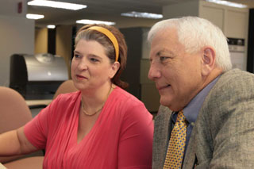
The Role of Office Position in Diversity
Notes:
The next several slides deal with the way we perceive the roles of office staff based on their title or position description.
In reality, our individual expertise, interests, experience and skills will often cross over to other specialties. Role of office position will vary by office and by the individual. Recognizing our differences despite being labeled or assigned to a specific role in the office will enhance our agencies ability to meet the change needs and demands of our customers in the future. Effective management of the diversity of our workforce will enable our agency to grow, change and adapt.

Slide 57
Roles of HMTs, Meteorologists, Hydrologists, Electronics and Information Technology staff and ASAs can vary from office to office and vary based on the talents and skills of the individuals in these roles
Notes:
If you’ve worked in more than one office in the NWS in your career, you are likely to recognize that this is true. If you are new to the agency or have remained in one office, you may not recognize that many staff are cross utilized based on their experience, interests and skills. How many offices pull the ASA or SH into the ops area during a severe weather event? How many HMTs work with cooperative observers?

Slide 58

The traditional roles of staff have changed since modernization of the National Weather Service. Many staff members are cross trained or able to work in many different positions
Notes:
Rather than focusing on the acronym that identifies a workgroup or position, it may help to recognize each individual in your office for the unique abilities and strengths they bring to the job.

Slide 59
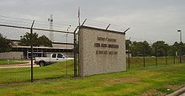




Many employees of the National Weather Service do not work in field offices. They staff regional and national headquarters offices, national centers, and CWSUs. Just by the nature of our agency, diversity is one of our greatest strengths
Notes:
We are diversified in our locations, our expertise, and our abilities. We are a diverse agency that works for a wide range of customers and partners.

Slide 60
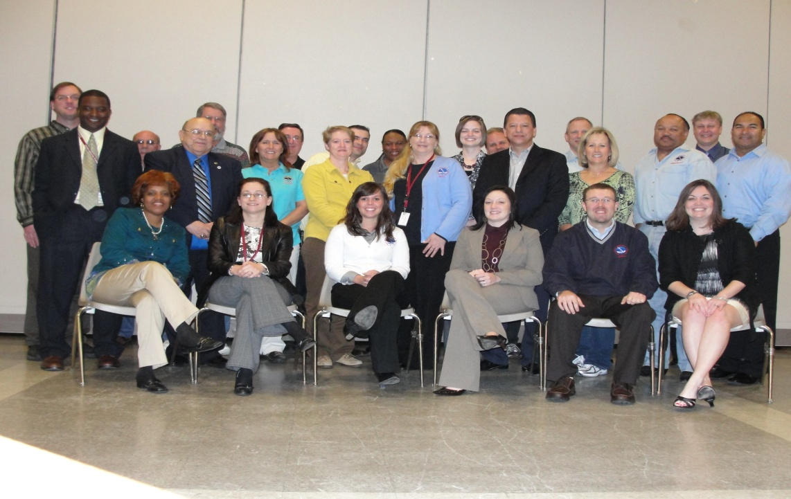
One of the benefits of working for the National Weather Service is the opportunity for individuals to develop and enhance their areas of individualized expertise.
The ability to develop individualized expertise aids in job fulfillment and satisfaction. It may also help our agency to recruit and retain future employees.
Notes:
Perhaps one of the greatest strengths of our agency is the freedom for employees to work in areas that they derive satisfaction from. Staff may be granted opportunities or create their own opportunities to enhance skills through training, research or mentorships.
As our agency looks to the future, how do we ensure that we continue to attract the best and brightest into our workforce. Once they are in the workforce, how do we ensure that they stay with the agency. The business case for Diversity Management shows that employees experience a greater job satisfaction and are less likely to look elsewhere for employment if they are valued for their unique skills, creativity and are empowered to make a difference in their position.

Slide 61

So …What Does All this Mean for Me and the NWS?
Diversity is a fact of life.
Diversity is the reality for a business strategy that will make the NWS more effective.
Diversity enables everyone to perform to potential.
Diversity of thought equals world class results from each person and collective mix of teams.
Diversity in teams results in more creativity and problem-solving meaning better customer service.
Bottom Line-Greater Innovation and Productivity
Notes:
Diversity is a reality that is interwoven into the very fabric of our daily lives. It is not simply a concept or policy. Diversity is a key to the future success of the National Weather Service and we must embrace the value of diversity in order to effectively compete in a worldwide arena. Diversity is critical to the achievement of the NWS mission. Diversity empowers everyone to reach their full potential and removes barriers. It allows us to take advantage of the diversity of thought and ideas that comes from the diversity of experiences, background, and skills. Effective diversity management results in improved individual and overall NWS performance. This is due to the effectiveness of diversity on problem-solving, decision-making, innovation, and creativity.

Slide 62
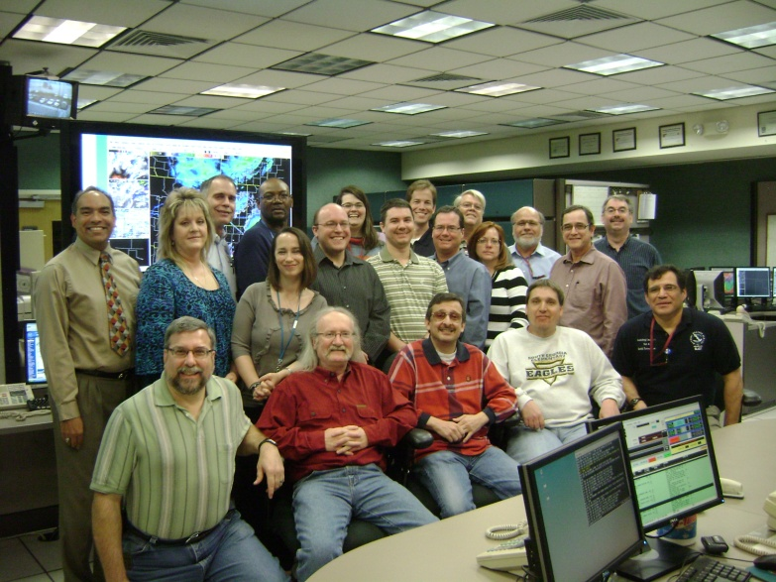

A diverse workforce is not something your NWS office or workgroup ought to have; it’s something your office already has.
The Reality …
Notes:
Simply look around the room and you can see we now have a diverse workforce. However, having a diverse workforce does not, in itself, translate to bottom line benefits for the NWS. Diversity must be managed in order for the NWS to reap the benefits of a diverse work force.

Slide 63

Doesn’t start with learning information about others so you won’t offend them… it starts with you learning to manage YOUR OWN STUFF!
Diversity Management
Notes:
A common tendency in human interaction is that of social categorization. Simply put, people often like to put other people into easily understood pigeonholes. Learning to manage diversity is not you trying to learn about someone else’s generational or culture strengths or weaknesses, race or ethnic beliefs, so that you won’t do or say things that may offend them. Diversity management must start with your own self-assessment and understanding of your perceptions, which sometimes are your truth but not necessarily the real truth. Sometimes you have to take another look at what you think you know.

Slide 64

Diversity Management –
Am I Responsible?
Yes, diversity management has to be a personal responsibility.
Each and every one of us plays a significant role.
Managing diversity is no longer a choice; it is a responsibility that requires everyone’s full support and commitment.
Notes:
Every NWS employee, from an intern to the director, is personally responsible to manage diversity within their own NWS workplace and teams. The failure to manage diversity by even one person within an office or team can have dire consequences for the entire workplace. So it takes everyone’s full support and commitment toward effectively managing diversity with emphasis on what we do with diversity rather than getting diversity. Valuing diversity in all aspects of NWS operations should be a top priority.

Slide 65

Making this work for your NWS office
Important Step!
Understand and respect individual differences:
Keep an open mind toward others who are different from you. Remember that not everyone sees things the same way you do.
Notes:
The workplace will be more harmonious when we all strive to understand each other’s frame of reference and values. By being open to trying new things or doing them differently, we may find more effective ways to manage and co-exist in our NWS workplaces.

Slide 66

Keys to Effective Diversity Management
While valuing diversity is a philosophy, effectively managing diversity is a vast resource and a skill requiring knowledge, sensitivity, patience, flexibility, and training.
Building an inclusive diversity program for all employees involves mentoring, networking, and sponsorship.
Notes:
We must evaluate our cultures and determine what needs to change. Managers need to assess their own readiness to value and embrace differences. Assessments can start by examining historical misconceptions about employee diversity such as otherness is seen as a deficiency, others want to become and should become more like the dominant group, equal treatment means the same treatment, and managing diversity requires changing the people, not the culture. Mentoring, networking, and sponsorship strategies will help the NWS build an inclusive diversity program for all employees. Mentoring provides guidance, sharing of information, and nurturing for personal, career development, and professional growth which are essential to help individual employees overcome workplace challenges and barriers. Networking helps individuals acquire significant exposure that may benefit their career progression. This could be done by making contact one on one or in groups at meetings, conferences, and other critical forums. Sponsorship involves ensuring that individuals get the support and visibility needed to acquire the right opportunities to improve job and career competencies. Sponsorship perhaps more than mentoring and networking can provide opportunities for advancement by providing the individual with visible connections to key organizational stakeholders and power brokers.

Slide 67
Impact of Management on Diverse Team Performance
Well Managed Diverse Teams
Trained
Poorly Managed Diverse Teams
Conflict
Communication Skills
Value Differences
Constructive Conflict
Team Identity
Poor Communication
In-group/out-group Behavior
Isolation
Creativity
Job Satisfaction
High Productivity
Quality Outcomes
New Products & Services
High Turnover
Low Productivity
Poor Solutions
Low Job Satisfaction
Poor Attitude Toward Diversity
Notes:
Managing diversity does not mean trying to control or contain diversity, it means to enable every staff member in a team to perform to their fullest potential. Diversity Management of teams needs to focus on managing the differences within a team, capitalizing on the benefits of the diversity within teams, and also minimizing the workplaces challenges. Effective management of diverse teams will have substantial payoffs. Poorly managed diverse teams will experience difficulties in communication and unproductive conflict. In contrast, well managed diverse teams will overcome communication difficulties and result in creative and high quality productivity.

Slide 68
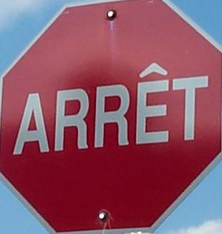
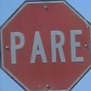

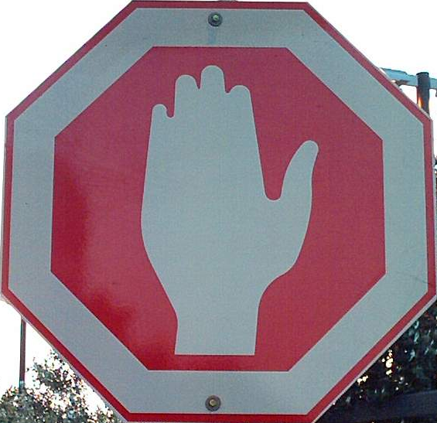



Quebec: french
Colombia: spanish
DISCUSSION TIME
israel
China
InuKtitut
japan
Notes:
This is an opportunity to check in with your audience. They may have questions, comments or ideas for managing diversity.

Slide 69
The Cold Within
Six humans trapped by happenstance
In bleak and bitter cold
Each one possessed a stick of wood,
Or so the story's told.
Their dying fire in need of logs,
The first woman held hers back,
For on the faces 'round the fire,
She noticed one was Black.
The next man looking 'cross the way
Saw one not of his church,
And couldn't bring himself to give
The fire his stick of birch.
Notes:
This poem can be utilized to stimulate discussion on Diversity and diversity issues. The following questions may help stimulate thought and discussion. Describe how this story made you feel. What surprised you about the characters in this story? What assumption did each of the characters make about the others around the fire? What do you feel contributed to each person’s decision not to share his or her log of wood? Have you ever shared any of the thoughts or beliefs of the six characters? Would you have hesitated to share your stick of wood?
Explain the last verse. What impact does this verse have on the way you view others?

Slide 70
The Cold Within
The third one sat in tattered clothes
He gave his coat a hitch,
Why should his log be put to use
To warm the idle rich?
The rich man just sat back and thought
Of the wealth he had in store,
And how to keep what he had earned
From the lazy, shiftless poor.
The black man's face bespoke revenge
As the fire passed from sight,
For all he saw in his stick of wood
Was a chance to spite the white.
Notes:
The Cold Within

Slide 71
The Cold Within
And the last man of this forlorn group
Did naught except for gain,
Giving only to those who gave
Was how he played the game.
The logs held tight in death's still hands
Was proof of human sin.
They didn't die from the cold without,
They died from the cold within.
*- George Kirby*
Notes:
The Cold Within

Slide 72
Reference Material
Notes:
The following slides are intended as reference materials for managers and diversity focals. They can be incorporated into the slide presentation if necessary.

Slide 73

Performance Metrics/
Associated Performance Goals
Align management strategies and goals with broader NWS goals and vision
Determine DM goals
Establish performance indicators
Set a time-line (requires periodic assessment)
Notes:
It is essential to create a metrics system for measuring Diversity Management and how that impacts the efficiency and effectiveness of the NWS. For instance, Heritage Celebration Months help to better educate NWS staff on the diversity of the communities that we serve and help to spring board open lines of communication.
Concrete goals can be established and potential metrics, for gauging the effectiveness and efficiency of Diversity Management can be explored to determine the impact to our agency on new product and service adoptions, net advocacy and loyalty and customer engagement.
Operational performance metrics, primarily provide the organization with a way to rationalize investment, but do not necessarily correlate to business strategy and business performance. Diversity Management measures aligned with business outcomes assess things such as the value an organization provides to customers or the performance of an organization.

Slide 74
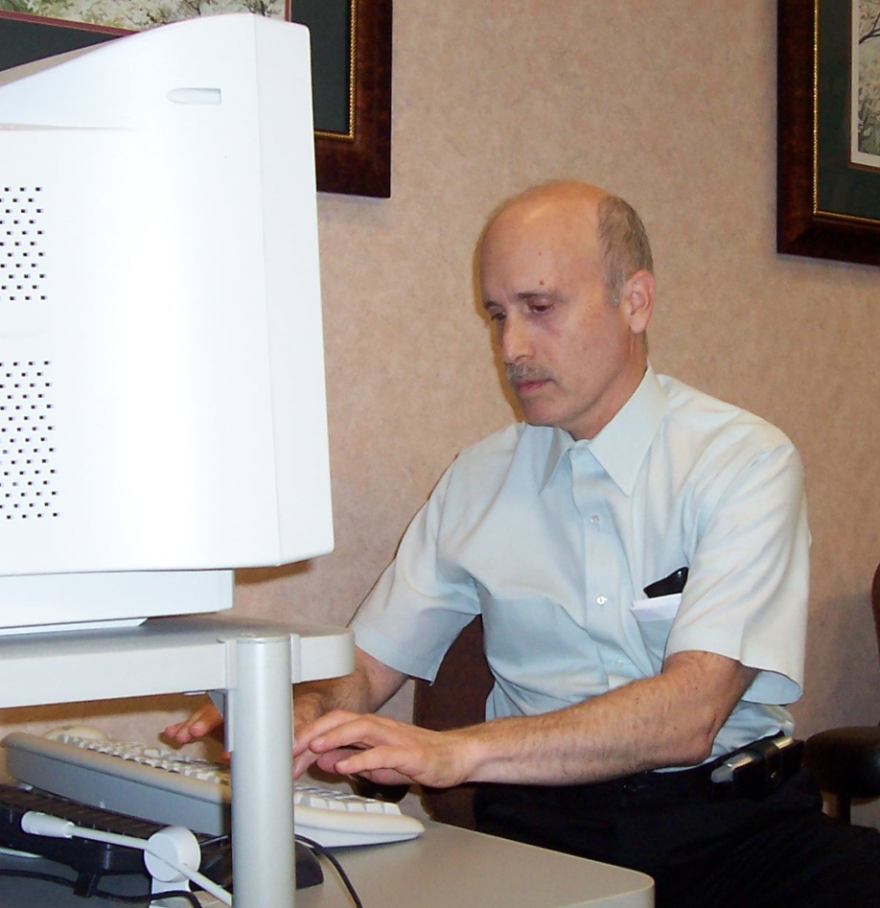
SMART Goals
Metrics for evaluating Diversity Management
Specific
Measurable
Achievable
Realistic
Time-limited
Notes:
Metrics to gauge Diversity Management incorporation
SMART goals - Specific, Measurable, Achievable, Realistic and Time-limited. Some tangible targets include:
A single value (define the event… training, outreach, mentoring, etc.)
An upper limit (should there be one… when is it too much?)
A lower limit (e.g. one diversity training course a year)
A range of values (what weight should an “event” carry, should it be tied to historical behavior?)
A percentage of a specific quantity/value (varies with level)
A scheduled date by which a given task is to be completed, etc.
These goals should be acceptable, understood, meaningful and measurable. For instance, the measure “Training man-days” under the objective “Provide adequate employee training” under the “Learning and Growth” perspective is not very meaningful since the fulfillment of the target in man-days alone does not indicate the usefulness of training. A suitable objective called “Maximize Training Effectiveness”, and a measurable Key Performance Indicator (KPI) may be defined under this new objective. Key Performance Indicators (KPI) are utilized in the private sector to evaluate hard to measure programs and activities, such as service, customer satisfaction, and leadership development. A new KPI might, for instance, be called “Percentage of training programs put to practical use within three months after training”.
Achievement of the objectives of the local manager’s perspective are important in itself, but also as a sort of necessary condition for the achievement of objectives of the overall NWS perspectives. Thus the “lower” objectives need to be aligned with the “higher” ones.
Implement a performance prism/balanced scorecard focused on information relating to the implementation of diversity management. This process takes 4 steps:
Translating the vision into operational goals;
Communicating the vision and link it to individual performance;
Business planning; index setting
Feedback and learning, and adjusting the strategy accordingly.

Slide 75
NWS Diversity Management Marketing Team
Formed January 2009
Chartered to develop National Diversity Management Marketing Plan
Members from NWSHQ, Regions, and WFOs
Plan developed using Baldrige Excellence Criteria
Plan briefed to NWS Deputy Director, April 09
Initial plan rollout at NWS Diversity Summit in Atlanta, GA, April 09
Notes:
The NWS Diversity Management Marketing Team was developed during January 2009 by the NWS Office of Equal Opportunity and Diversity Management (OEODM) at the request of the NWS Deputy Director. The purpose of the team was to develop a comprehensive diversity marketing implementation plan that would improve diversity management knowledge throughout the agency. Customers of this plan include every NWS employee, contractors, SCEP/STEP students, and student volunteers.

Slide 76
NWS Diversity Management Marketing Initiative
Sub-Teams
Diversity Management Poster Design Contest
Web-Based Diversity Clearing House Toolbox
Commerce e-Learning Diversity Management Curriculum
“NWS Diversity Management” Power Point Presentation
Regional Level Excellence Diversity Award
Notes:
Listed are five sub-teams that were identified to implement the plan developed by the NWS Diversity Management Marketing Team. The target date for teams to successfully implement their portion of the plan is FY10.

Slide 77
CONTACT INFORMATION
Regional Diversity Contacts
Cheryl Latif, Eastern Region
Cheryl.Latif@noaa.gov
(631) 244-0162
Gena Morrison, Southern Region
Workforce Program Coordinator
Gena.Morrison@noaa.gov
(817) 978-1111 Ext: 184
Diane McArthur, Western Region
Workforce Program Coordinator Diane.McArthur@noaa.gov
(801) 524-5574
Marie Hoffpauer, Central Region
Workforce Program Coordinator
Marie.Hoffpauer@noaa.gov
(816) 891-7734 Ext: 510
Edward Young (Acting), Pacific Region
Edward.Young@noaa.gov
(808) 532-6412
Ursula Jones, Alaska Region
Ursula.Jones@noaa.gov
(907) 790-6802
Kim Montgomery (Acting) NCEP
Kimberly.Montgomery@noaa.gov
(301) 763-8000 X7008
NWS Office of Equal Opportunity
and Diversity Management (OEODM) (301) 713-0692
Charly Wells, Ext: 201
Director
Charly.Wells@noaa.gov
Hope Hasberry, Ext: 200
EEO and Diversity Management Specialist
Hope.Hasberry@noaa.gov
Sabrina Cook, Ext: 196
EEO and Diversity Management Specialist
Sabrina.Cook@noaa.gov
Patricia Taylor, Ext: 198
Management Analyst
Patricia.Taylor@noaa.gov
Dr. James Su, Ext: 139
Asian American/Pacific Islander
Employment Program Manager
James.Su@noaa.gov
Notes:
Helpful CONTACT INFORMATION

Slide 78
REFERENCES
Striking a Balance – NWS PowerPoint presentation – Jennifer McNatt (WFO Tampa)
American Association of Retired Persons - Facts about raising grandchildren. http://www.aarp.org.
Primary and secondary dimensions of diversity (After Kreitner, R. en Kinicki, A. (1995) Organizational Behaviour, Chicago: R.D. Irwin Inc.)
“Diversity Management: The Key to NWS Continued Success,” Byron N. Kunisawa -Cultural Solutions, 4093 Sutro Street, Napa, CA 94559
NWS Diversity Management Training Seminar "Diversity Management: The Link to Equality and Inclusion,” Byron Kunisawa, November 2009.
Diversity Discussion Starters - Produced by Information and Communication Technologies in the College of Agricultural Sciences, Penn State University
Notes:
REFERENCES

Slide 79
REFERENCES
“Generational Differences in the Workforce,” Jo Ann Lee, PhD, Department of Psychology, University of North Carolina-Charlotte. Career-banding Implementation and HR Innovations Conference. November 8, 2006.
“Grown Up Digital: How the Net Generation is Changing Your World,” Don Tapscott (2008) pp. 15-16. Toronto, Ontario Canada.
“Communication Tools for Understanding Cultural Differences,” Michelle LeBaron. Professor of Law at the University of British Columbia. June 2003.
“Sexual Orientation as an Element of Diversity: Authentic Efforts Toward Inclusive Practices or Don’t Ask, Don’t Tell, Don’t be Recognized?,” Kathy Lechman, Ohio State University Extension. December 2007
Notes:
REFERENCES

Slide 80
REFERENCES
“Forgiveness…What’s it for?,” Larry James. CelebrateLove.com, Dallas, TX.
“Resolving Differences,” Murali Chemuturi, Chemuturi Consultants, India. May 2008.
Chemers, M. M. (2002). Meta-cognitive, social, and emotional intelligence of transformational leadership: Efficacy and Effectiveness. In R. E. Riggio, S. E. Murphy, F. J. Pirozzolo (Eds.), Multiple Intelligences and Leadership.
NWS_Diversity_guidance_2007_1-31-2007 PowerPoint Presentation – NWS Diversity Management Council.
Diversity Working.com – Diversity Employer Zone www.diversityworking.com/employerZone
Notes:
REFERENCES

