Slide 1
National Weather Service
Diversity Management
Utilizing our differences to change the future!
Notes:
This powerpoint presentation was developed by the Presentation Team which was chartered under the NWS Diversity Marketing Team. Team Leaders – Jose Garcia, Gena Morrison, Steve Kuhl. Team members – John Haase, Joe Arellano, Gina Tillis-Nash, Kristin Scotten, Jennifer Stark. The team’s charter was the development of a presentation which could be utilized by managers and diversity focals to present to their offices or work units. The presentation is intended to facilitate healthy dialog and conversation about diversity and diversity issues throughout the NWS. Presenters are encouraged to utilize and adapt this presentation to their local office and work units.

Slide 2
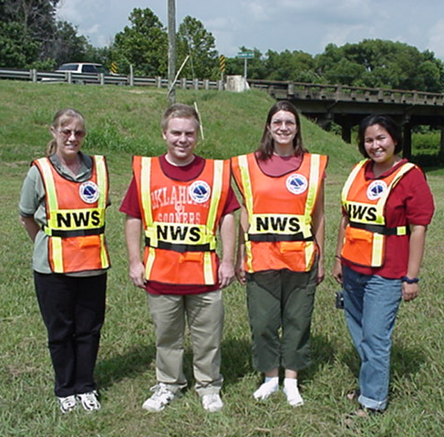

Intended Audience & Customers
All NWS employees
  Management
  Forecasters
  Administrative
  Technicians
  Researchers
Students
Contractors
Volunteers
The communities, partners
and customers that we serve
Notes:
We must improve diversity management knowledge throughout the organization, including every NWS employee, SCEP/STEP students, contractors and student volunteers.

Slide 3
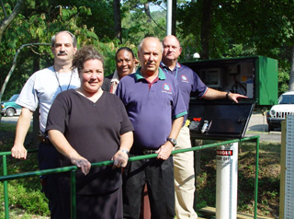
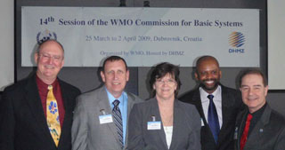
Part 2 - How Do We Achieve a
Diverse
Workplace?
Notes:
How do we achieve a Diverse workplace?

Slide 4
Treat others as you want to be treated
Accept people as the individuals they are
Focus on finding similarities and not differences in others
Take responsibility for your actions
Be sensitive
Celebrate differences by promoting respect through inclusion and valuing others
Notes:
Employees must be able to trust everyone in the agency: leaders and co-workers. Most of the time, trust is measured by how our “gut” feels. Peoples emotions are real and should not be casually measured. Assess the trust level with the same diligence and care as creating a good forecast.
A loss of confidence compromises the faith of the agency and the ability to serve the public.
Respect is of the utmost importance, whether personal or professional. The respect folks have for each other helps to drive the agency in a positive direction. Lost respect can take an incredibly long time to mend.
Dignity is a precious commodity. Without ones dignity, they believe they have no personal self worth and will not be taken seriously. Constant belittlement causes someone to question their dignity. Something as simple as a word of affirmation can restore someone who feels unnoticed and unappreciated.
When working for an agency with equality policies, employees are more likely to consider that opportunities for recruitment, conditions and opportunities for advancement and career development are fair and equal. Where equality is found in an agency there is a lower level of work stress. Equality is strongly associated with higher levels of job satisfaction and commitment.

Slide 5
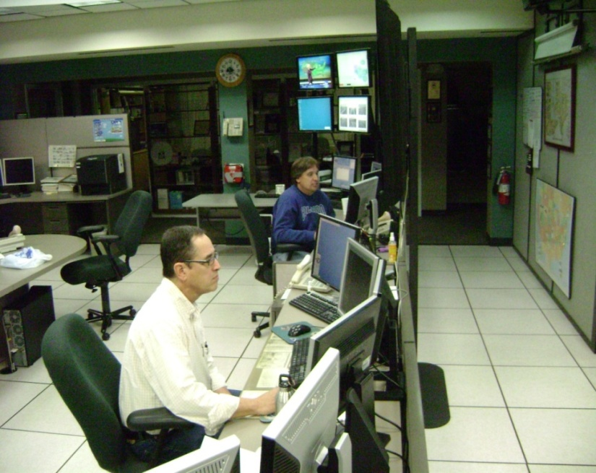
When the NWS is unified, we will enjoy all that a diverse workforce has to offer
Happier, more vibrant workforce
A workplace filled with trust and confidence
Improved productivity
Higher workforce retention
Notes:
When the NWS is unified, we will enjoy all that a diverse workforce has to offer

Slide 6
Striking a Balance
Women, Men, Family and Work
Notes:
Striking a Balance

Slide 7

Over the past decade…
Technology has blurred the lines between work and life
  Access to e-mail, texting, alerts are 24/7
  No leaving “work at work”
Traditional Family Model has also changed
  Two-income households
  Single Parents
Can be overwhelming to still live up to traditional standards while juggling everything else
Notes:
If you think back just ten years ago, how many people had cell phones? And if you did, were you able to check e-mail on it? Were you able to text anyone? Or browse products on the office website?
We have all of this information with just a few clicks on our phone now, and it’s hard after a day of work for some people to leave work behind at the office. We might be in line at the grocery store and sneak a look at our e-mails. We might be giving our kids a bath and check the website to see if your forecast is panning out.
Adding to this always-plugged in mentality, we’ve also seen a dramatic shift in the family model over the past ten to twenty years. Two-income households are becoming the norm…even viewed a necessity for most couples. And in 2006, there were an estimated 12.9 million single parent households…10.4 single mother households and 2.5 million single father households.
All of these new family models can add tremendous pressure to people still trying to live up to the traditional standards of putting everything into your work.

Slide 8
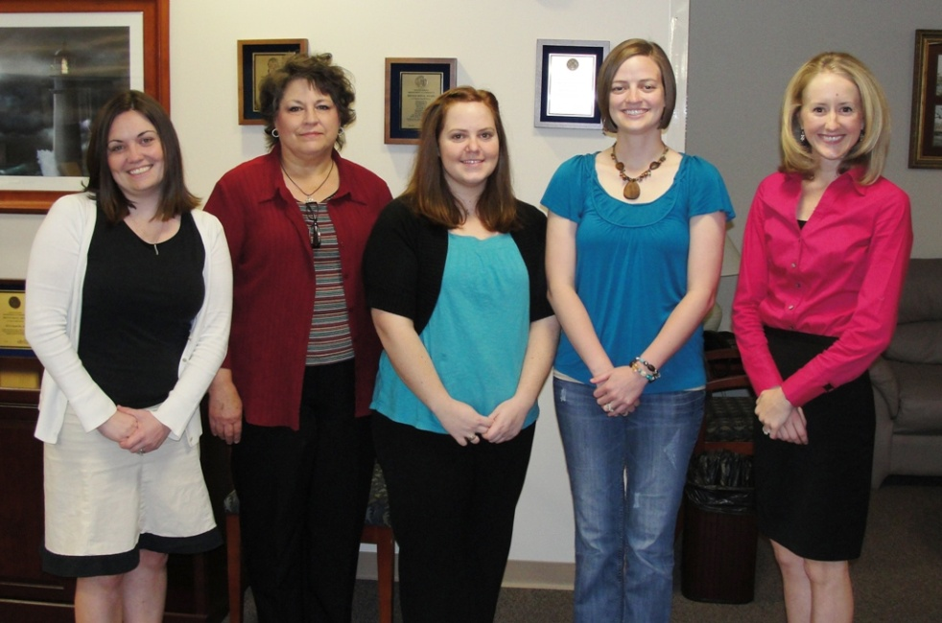
Family-work balance is complex
Issues:
  financial values
  gender roles
  career paths
  time management
  many other factors
Notes:
Family-work balance means something different to each person, and its not something that can be addressed broadly…it involves financial goals and values, gender roles, career aspirations, time management skills and many other factors.

Slide 9
In the NWS, we have…
Single Parents
Two-income households
  With or without children
One-income households
  With or without children
Single individuals
People taking care of their parents or grandchildren
Each
Situation
Comes
With Its
Own
Challenges And Benefits!
Notes:
The National Weather Service has a very diverse group of employees…from single mothers and fathers to two income households…many with one spouse being military…one income households…single men and women and people taking care of their parents or grandchildren.
Each of these situations comes with its own challenges…but there is also a lot we can learn from each of these groups…anything from time management skills to multi-tasking to social interactions.

Slide 10
Do you know the challenges that others around you face?
What obstacles they might have had to overcome before coming to work today
What they might have to deal with when they go home tonight
Not many people in the NWS are able to live near extended family (i.e. – no support networks)
Shift work!!! (enough said)
Notes:
All of us in the NWS have the opportunity to work with some amazing people. We may get the chance to really know some of our co-workers when we work a string of midnight shifts together, or go out on outreach activities with them…but have we ever really sat down and thought about the challenges that others may face outside of work and how that may affect their persona at work?
One of the common themes throughout most of the NWS is the fact that not many of us are able to live near extended family due to the nature of our job. And if we are able to build up a support network of friends and/or family, that might disappear when the next career opportunity comes up.
And the other theme for most of us is the shift work…which brings with it a whole set of challenges but also some additional opportunities.
The following slides contain feedback from some NWS employees, but…it by no means is an all-encompassing list…everyone’s life situation is unique. These slides are meant to get you thinking about those around you.

Slide 11
Single Individuals
Small to no support system
  Especially when new to an area
Difficult to find/make friends around shift work schedule
Often are asked (expected?) to work holidays
  But have family too!
May feel left out of office events geared towards couples
Notes:
A lot of the interns and new forecasters coming into the NWS are single…moving to a new area where they don’t know anyone. Throw in shift work/working on weekends/etc and it makes it very hard to find friends or join any type of social clubs to meet people. And making friends at work isn’t always easy either as days off might not match up.
Holidays were mentioned in several comments. There are many single people that feel that they are expected to work holidays or odd shifts because they are single. However, remember they have family that they would like to see on Christmas too and don’t feel that going to see their parents on a holiday should take second priority to someone else that has kids at home. Many also feel left out of office events that are geared towards couples.

Slide 12
How you can help…
Don’t expect that singles are automatically available to work overtime, holidays, etc.
Try to show new people to the office “around the neighborhood”
  “Sponsor” or mentoring program for incoming personnel
Make sure office activities are geared towards all personnel, not just couples
Notes:
So, what can the office (or you!) do to help? Don’t automatically assume that because people are single that they are available to work on Christmas morning, or the overtime shift that just came up.
Helping someone during the transition period when they are new to an office can also be extremely helpful. You can show a new person around the neighborhood similar to showing them around the office the first time…point out good restaurants, a good gym nearby, a softball league that is looking for team members.
And finally, make sure that office events are geared towards everyone, not just the couples in the office or those people that have kids.

Slide 13

Single Parents
Finding dependable, trustworthy childcare that will adapt to rotating shift work
Being away from extended family/no support
Rotating shift work + a child make it difficult to socialize
Money may be tight
Travel is very difficult
Many people have spouses in the military
  Often are “single parents” for long periods of time
Notes:
There are many single parents in the NWS. With this brings the huge challenge of finding childcare…not only trustworthy, reliable childcare…but also childcare that’s available overnight, on weekends, and flexible enough to take on extra hours during severe weather. Childcare like this can be extremely expensive (if you can even find it) especially if you’re at a location away from any type of extended family or support. A few people commented that parents would fly in from a few states away when they were really in a bind and on midnight shifts, or they’d drive over an hour in order to find someone who could watch their child on weekends.
Imagine being in this type of situation and also trying to have a social life as well? In addition, this type of childcare can be very expensive which could add financial stress to their life. Being able to travel to go to a class or training opportunity might be out of the question for these individuals.
There are also a great number of people that have spouses in the military…and some people are reservists or the national guard themselves. These people may be single parents for a year or more at a time until their spouse returns.

Slide 14
How you can help…
Be understanding when it comes to schedule changes/swaps
Don’t be judgmental if they need to call in sick at the last minute
Offer to help with minor tasks
  Mowing someone’s lawn can be a HUGE gift (how do you take care of a 2 year old and mow the lawn at the same time?)
Notes:
Be understanding!

Slide 15
Quote from an NWS Single Father
“The old saying of Walk a mile in my shoes truly is a good one for single parents. I would never wish this on anyone, but I would do it again in a heartbeat if I had to. My daughter and I are truly stuck to each other like glue!!! There is nothing better than picking her up at school everyday and hearing her yell... DADDDDDYYYYY!!!!!!!!!! or getting that monster hug after being away a whole week or more on a business trip. When I am away I call her every night and I do what I can to spend every minute with her when we are together in the morning, evening, weekends and on holidays as well as vacations.”
Be aware of how precious “off duty” time is to most people…and withhold judgment when they aren’t able to come in to work a last minute shift.
Notes:
Quote from an NWS Single Father

Slide 16
One-income households
Money may be an issue
  Especially those starting out in the NWS
  May feel pressure to work overtime
Spouse may not be supportive or understanding
  Especially when it comes to shift work
  Difficult to even have a part time job around shifts
Many one-income households involve the wife as sole-breadwinner
  Shift in dynamics
Notes:
In 2006, there was an estimated 5.8 million stay at home parents in the US. 5.6 million mothers and 159,000 fathers.

Slide 17

How you can help…
Hold office outings that don’t involve a large cost to everyone
Understand that last minute schedule changes can be hard for the spouse at home
Invite spouses in for brown bag seminars on shift work challenges, goal planning, etc.
Understand that there may be extra challenges involved when the spouse stays home
Notes:
One woman who sent comments indicated her husband stayed at home…but she still felt a lot of pressure to take sick leave when her kids got sick because she is the “mommy”. A few of the people she worked with had given her a hard time in the past about this…not understanding why she was taking off when her husband was at home to take care of the kids. She said she trusted her husband completely, but said when her kids are sick she feels like she needs to be the one to take care of them.

Slide 18
Two-income households
Childcare for very irregular hours!
Shift work x 2 = limited time as a family
Finding work in the same town may be difficult
  Many people end up living apart or commuting long distances
  Option to move for promotions may not be feasible
One person may have to give up sleep to watch the kids while the other person works
  What if one person is late coming home?
Spouse may not have sick leave to use for when the kids are sick
Notes:
Two-income households

Slide 19
Dual NWS-couples
May always be on opposite shifts!
One person may have to take a downgrade to be in the same location
  Can still contribute to the office in other ways
Notes:
Dual NWS-couples

Slide 20
How you can help…
Numerous women feel pressured to quit working because external pressures are too great
  Women are a valuable part of the work force
    Be supportive of their choice to work!!
Understand the need for advance planning to juggle two schedules
  Last minute changes can be difficult!
Notes:
How you can help…

Slide 21
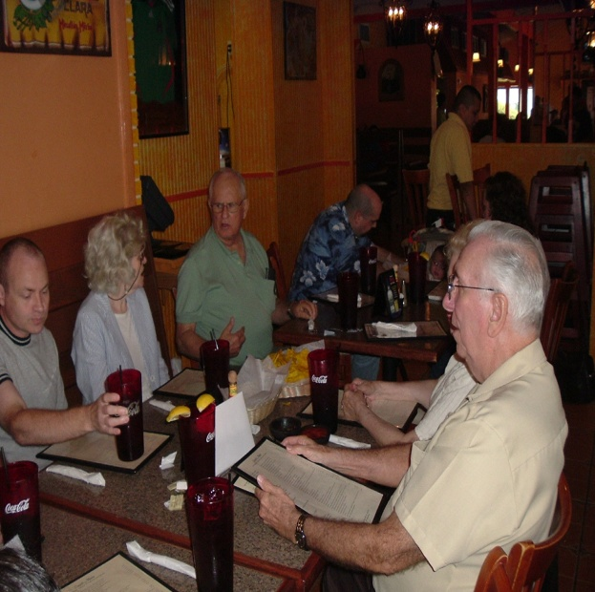
Caring for Aging Parents
AARP estimates there are 30-38 million adult caregivers in America
A move to a location with an adequate care facility may be a priority
Dr. appointments on scheduled days off
  Difficult to come in at the last minute; work overtime
Notes:
Caring for Aging Parents

Slide 22

Grandparents Caring for Grandchildren
More than 9 percent of children in the U.S. now live with their grandparents, which is an increase of more than 44 percent during the past 20 years.
Grandparents have assumed responsibility for reasons such as substance abuse by the parents, teen pregnancy or divorce.
Stress on grandparents to deal with children’s problems as well as care for grandchildren
Notes:
Grandparents Caring for Grandchildren

Slide 23
How the office can help everyone…
Create a family-friendly environment
  Allow for shift-swapping (within the rules) when possible to accommodate people’s “life” schedules
  Be supportive of each other! Try to put yourself in other people’s shoes and try not to be critical
    Definitely don’t be openly critical in front of co-workers
Make sure focal points have alternates to take conference calls, etc.
  Not having to get up during mid shifts or come in on days off
Encourage exercise – find a treadmill, exercise bike for storage room?
We don’t all need similar backgrounds/family lives in order to provide support
Notes:
How the office can help everyone…

Slide 24
Common theme = understanding!
Your friends will always want to meet up on a Friday night that you have to work
Your child will always get violently ill an hour before you come in for a midnight shift
Your spouse will always have something planned on a day when severe weather is moving in
If we don’t understand these challenges our co-workers face, no one else will – let’s do our best to be understanding, show empathy towards others and be supportive!
Notes:
If we don’t understand these challenges our co-workers face, no one else will – let’s do our best to be understanding, show empathy towards others and be supportive!

Slide 25

Work Balance Exercise
Under the left hand column “work”, write your top three priorities that pertain to your professional life
Under the right hand column “life”, write your top three priorities that pertain to your personal life
On the bottom, rank these six priorities from most important (#1) to least important (#6)
Notes:
Have everyone grab a sheet a paper to complete this exercise.

Slide 26

Work Balance Exercise
Over the next week or two, keep track of how much time you are devoting to these priorities. Is it out of balance with how you have ranked them?
If so, try to restore some balance by shifting your time to higher priorities
Notes:
Tracking your work balance may be eye-opening!

Slide 27
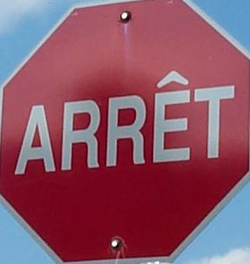


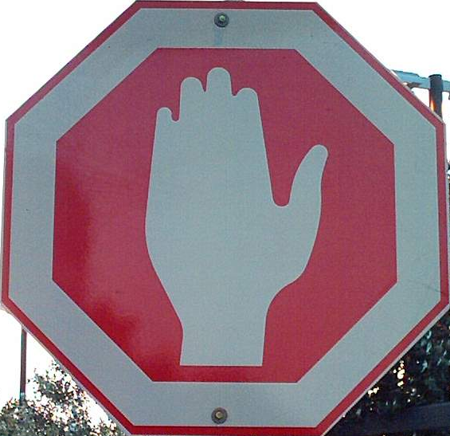

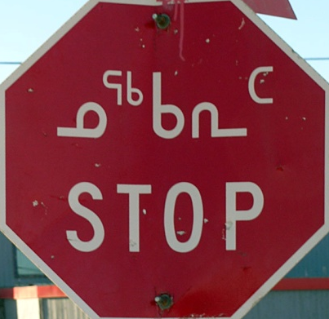

Quebec: french
Colombia: spanish
DISCUSSION TIME
israel
China
InuKtitut
japan
Notes:
This is an opportunity to check in with your audience. They may have questions, comments or ideas for managing diversity.

Slide 28
The Cold Within
Six humans trapped by happenstance
In bleak and bitter cold
Each one possessed a stick of wood,
Or so the story's told.
Their dying fire in need of logs,
The first woman held hers back,
For on the faces 'round the fire,
She noticed one was Black.
The next man looking 'cross the way
Saw one not of his church,
And couldn't bring himself to give
The fire his stick of birch.
Notes:
This poem can be utilized to stimulate discussion on Diversity and diversity issues. The following questions may help stimulate thought and discussion. Describe how this story made you feel. What surprised you about the characters in this story? What assumption did each of the characters make about the others around the fire? What do you feel contributed to each person’s decision not to share his or her log of wood? Have you ever shared any of the thoughts or beliefs of the six characters? Would you have hesitated to share your stick of wood?
Explain the last verse. What impact does this verse have on the way you view others?

Slide 29
The Cold Within
The third one sat in tattered clothes
He gave his coat a hitch,
Why should his log be put to use
To warm the idle rich?
The rich man just sat back and thought
Of the wealth he had in store,
And how to keep what he had earned
From the lazy, shiftless poor.
The black man's face bespoke revenge
As the fire passed from sight,
For all he saw in his stick of wood
Was a chance to spite the white.
Notes:
The Cold Within

Slide 30
The Cold Within
And the last man of this forlorn group
Did naught except for gain,
Giving only to those who gave
Was how he played the game.
The logs held tight in death's still hands
Was proof of human sin.
They didn't die from the cold without,
They died from the cold within.
*- George Kirby*
Notes:
The Cold Within

