Slide 1
Clouds
Meteorologist Aaron Treadway
National Weather Service Austin/San Antonio

Slide 2
Part of the water cycle

Slide 3
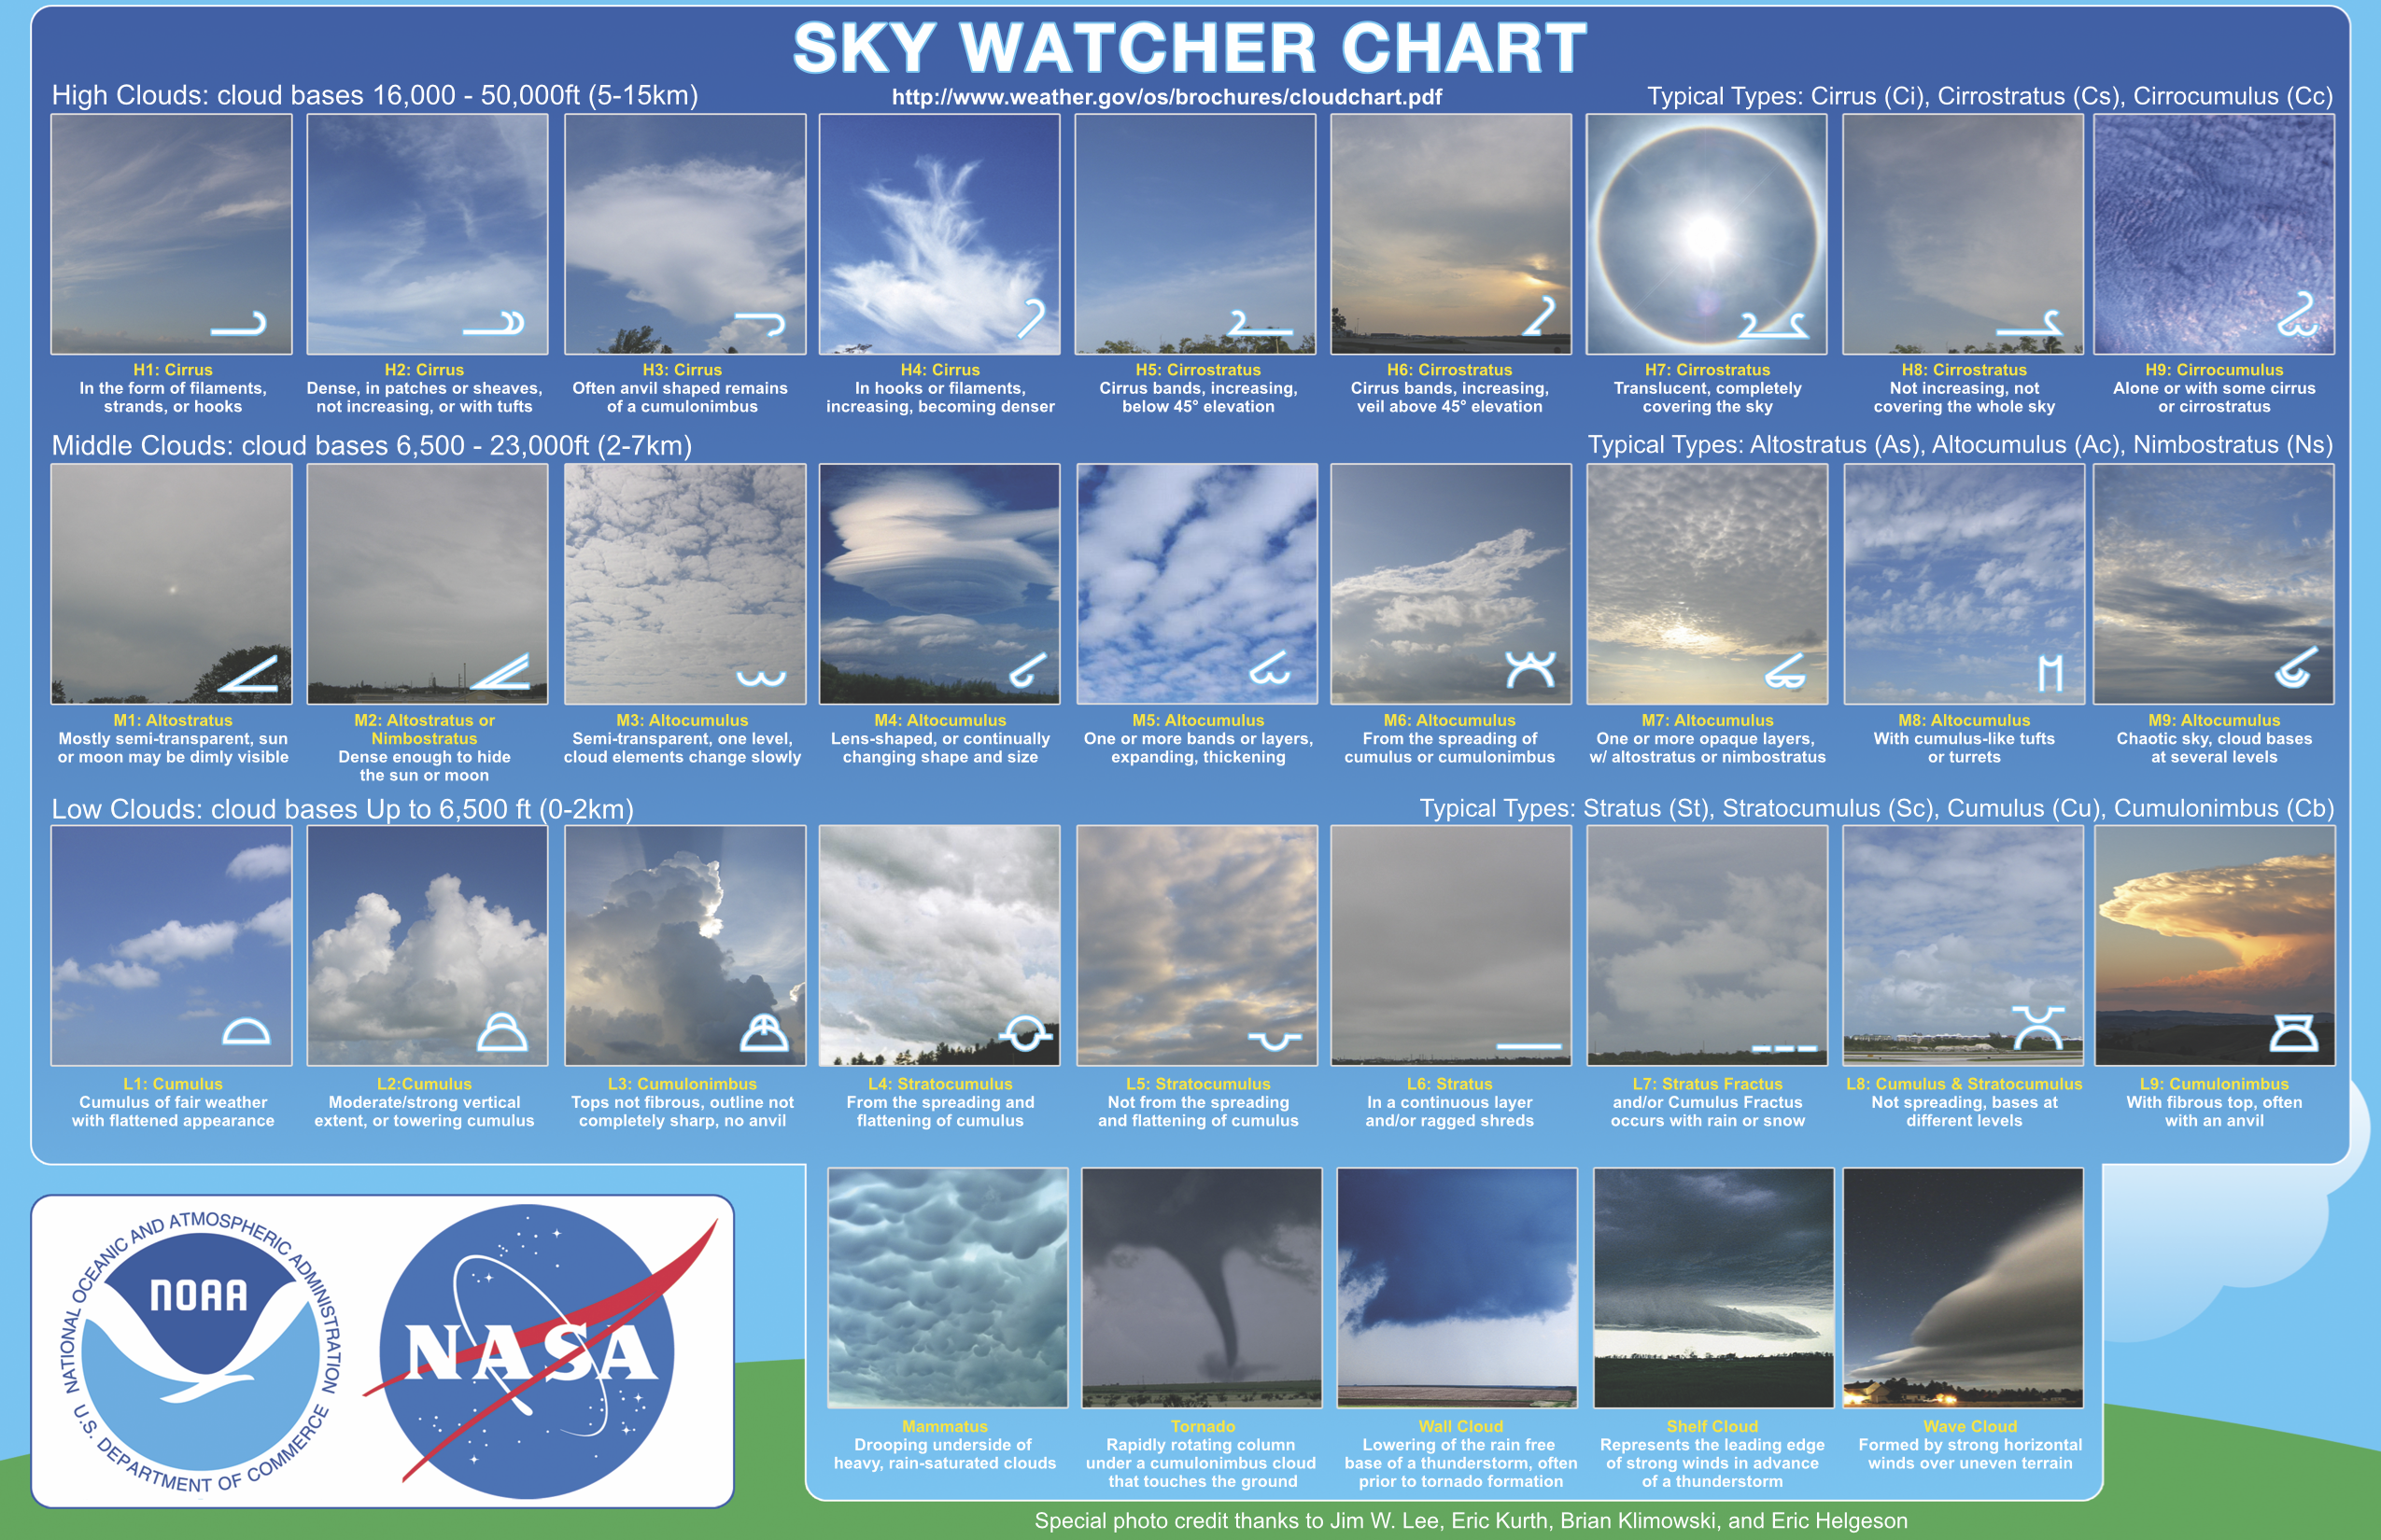

Slide 4
11 New Cloud Types Added
Asperitas Clouds
Cavum Clouds
Fluctus Clouds

Slide 5
Broken Down by Height

Slide 6
All about the Roots
Latin Root | Translation
cumulus stratus cirr- nimbus Alto- | heap layer curl of hair/high clouds rain mid level
Nimbostratus
A flat layer cloud, that produces rain

Slide 7
Lets Try another!
Latin Root | Translation
cumulus stratus cirr- nimbus Alto- | heap layer curl of hair/high clouds rain mid level
Cumulonimbus
A tall heap of clouds that products rain and thunderstorms.

Slide 8
Name that cloud
https://www.youtube.com/watch?v=tWhFWiH9upI

Slide 9
What about these?

