Slide 1
The Atmosphere
Meteorologist Aaron Treadway
National Weather Service Austin/San Antonio

Slide 2
Layers of the
Atmosphere
The Troposphere is where all the weather happens!
  Strong updrafts can punch into the lowest part of the Stratosphere
Temperature decreases/increases in each later
  Warms in Stratosphere due to Ozone
  Increases in Thermosphere due to radiation

Slide 3
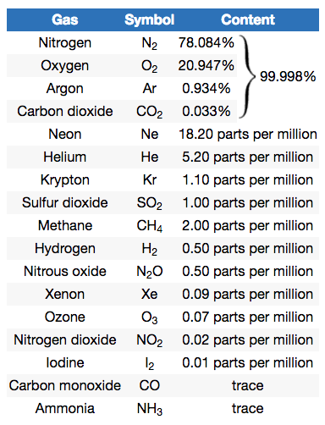
Composition of
The Atmosphere
Mostly Nitrogen!
  Dilutes the Oxygen, prevents rapid burning at the surface
  We need Nitrogen to make proteins
Oxygen
Argon and Carbon Dioxide
Water Vapor! ~ 4% of the total volume

