Slide 1
High and Low Pressure
Meteorologist Aaron Treadway
National Weather Service Austin/San Antonio

Slide 2
Air Pressure
The number of molecules in the atmosphere decreases with height
Pressure can change by adding or taking away air
Temperature also impacts pressure
Adding Heat Increases pressure
Subtracting Heat Decreases pressure

Slide 3
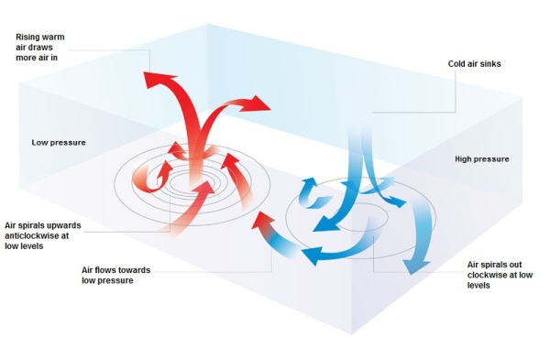
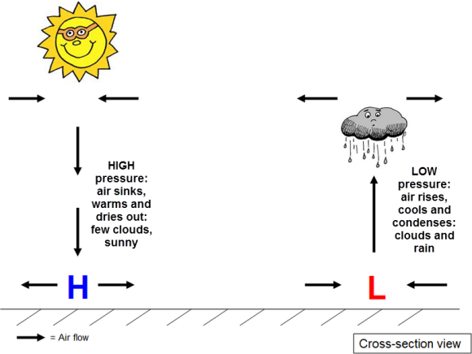
H and L
High Pressure
Sinking air
Clockwise rotation at low levels
Warm and dry air
Few clouds, sunny Skies
Low Pressure
Rising air
Counter-clockwise rotation at low levels
Air cools and condenses
Clouds, rain, bad weather

Slide 4
Trough and Ridge
Trough
Cooler air mass
Lifting air
Low Pressure
Ridge
Warmer air mass
Sinking air
Higher Pressure

Slide 5
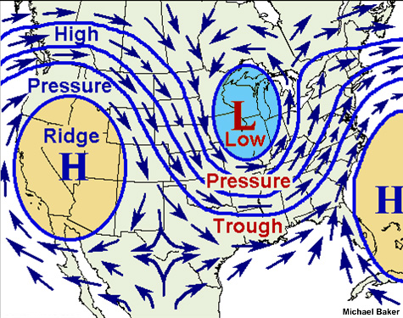
On the Map

