Slide 1
Meteorology Jobs
Meteorologist Aaron Treadway
National Weather Service Austin/San Antonio

Slide 2
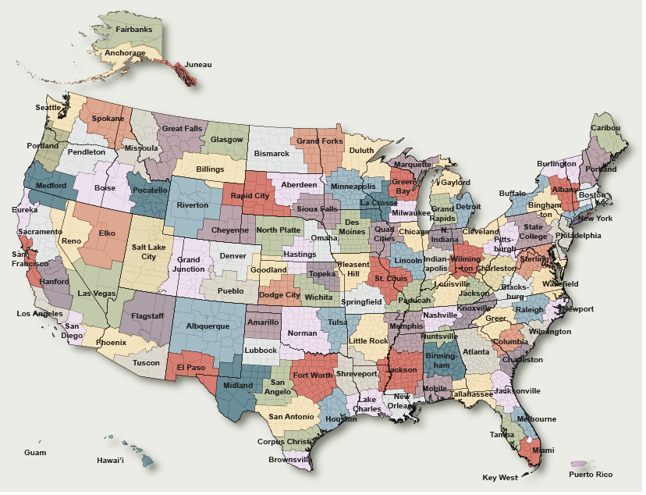
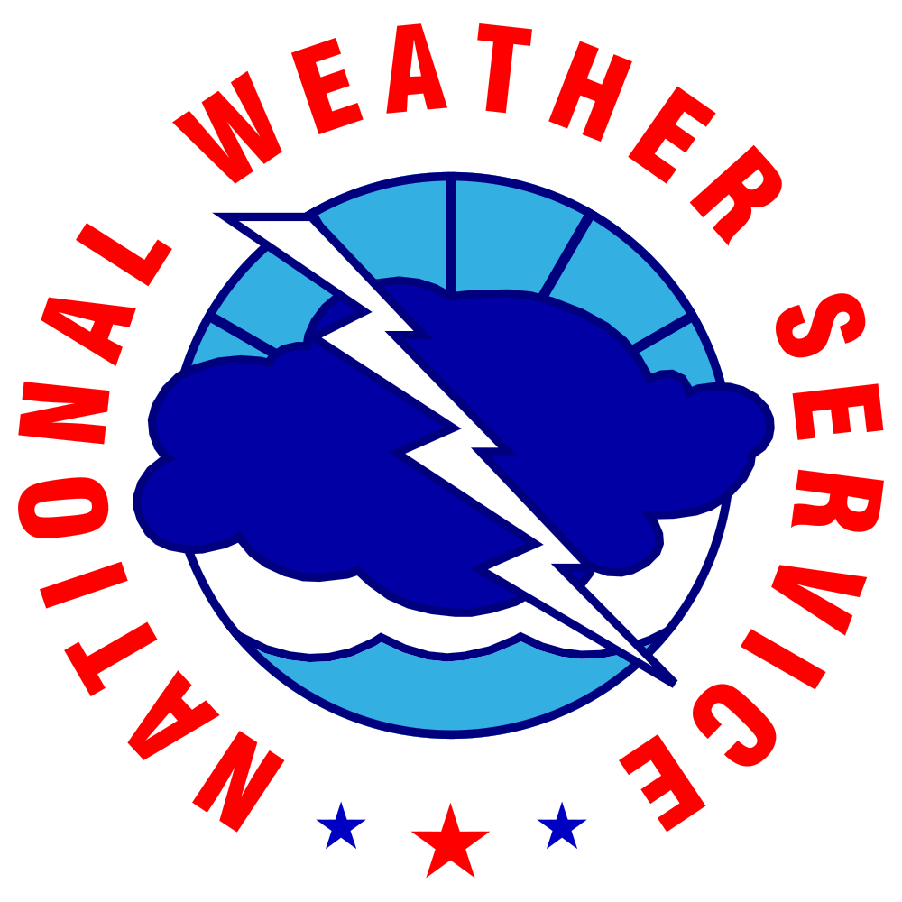
National Weather Service

Slide 3
County Warning Areas
Forecasts
Watches/Warnings
Decision Support
Local Research
Outreach

Slide 4
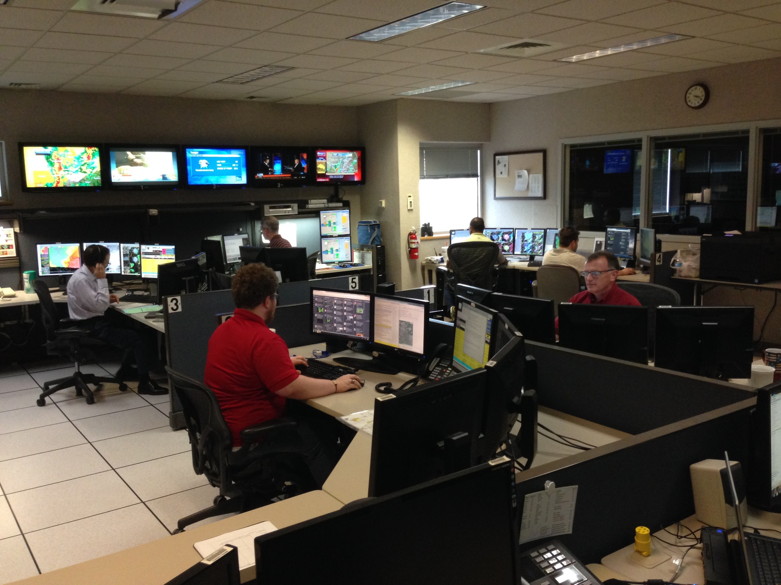
7 Day Forecast
Severe Weather Warnings
Aviation Forecasts
Answer Phones & Storm Reports
Social Media

Slide 5
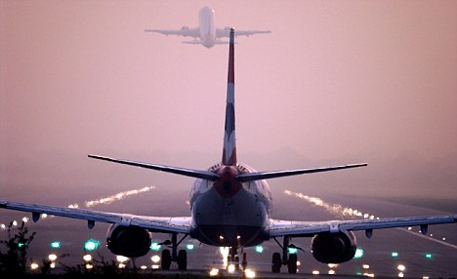
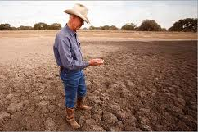
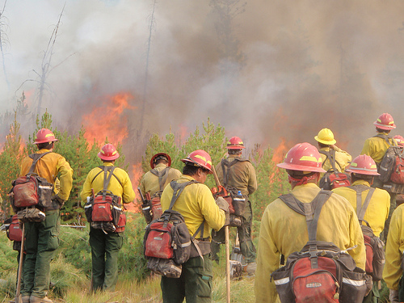
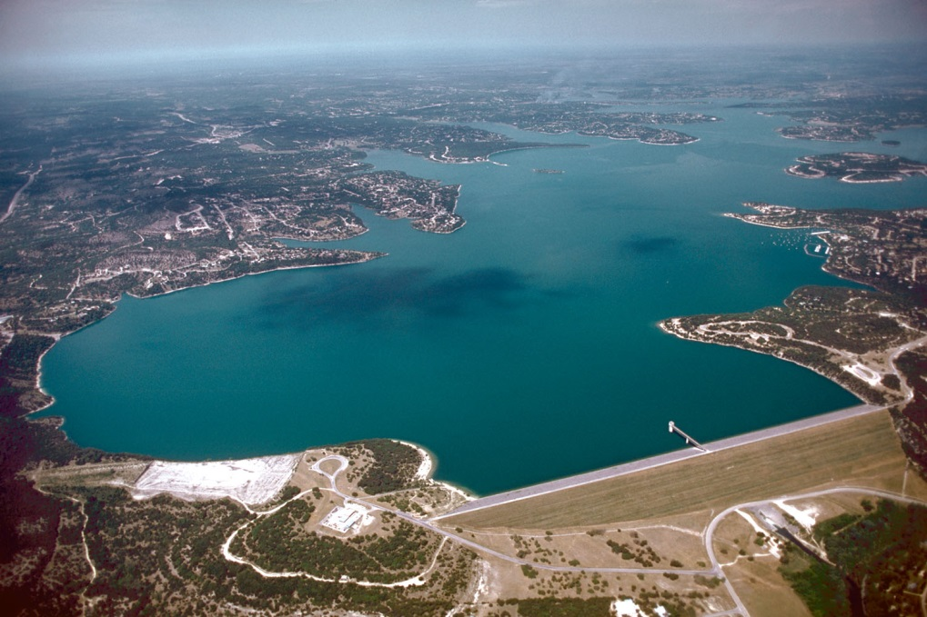
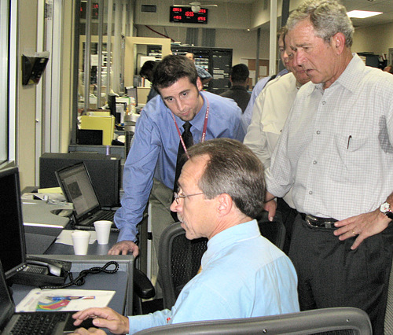
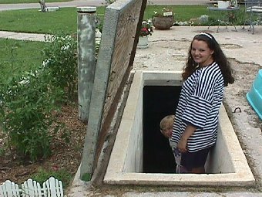
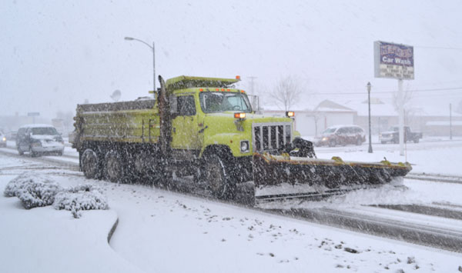
Who Uses NWS Forecasts?
Aviation Interests
Farmers
Transportation Organizations
Firefighters
Government Officials
Water Management
You the Public!

Slide 6
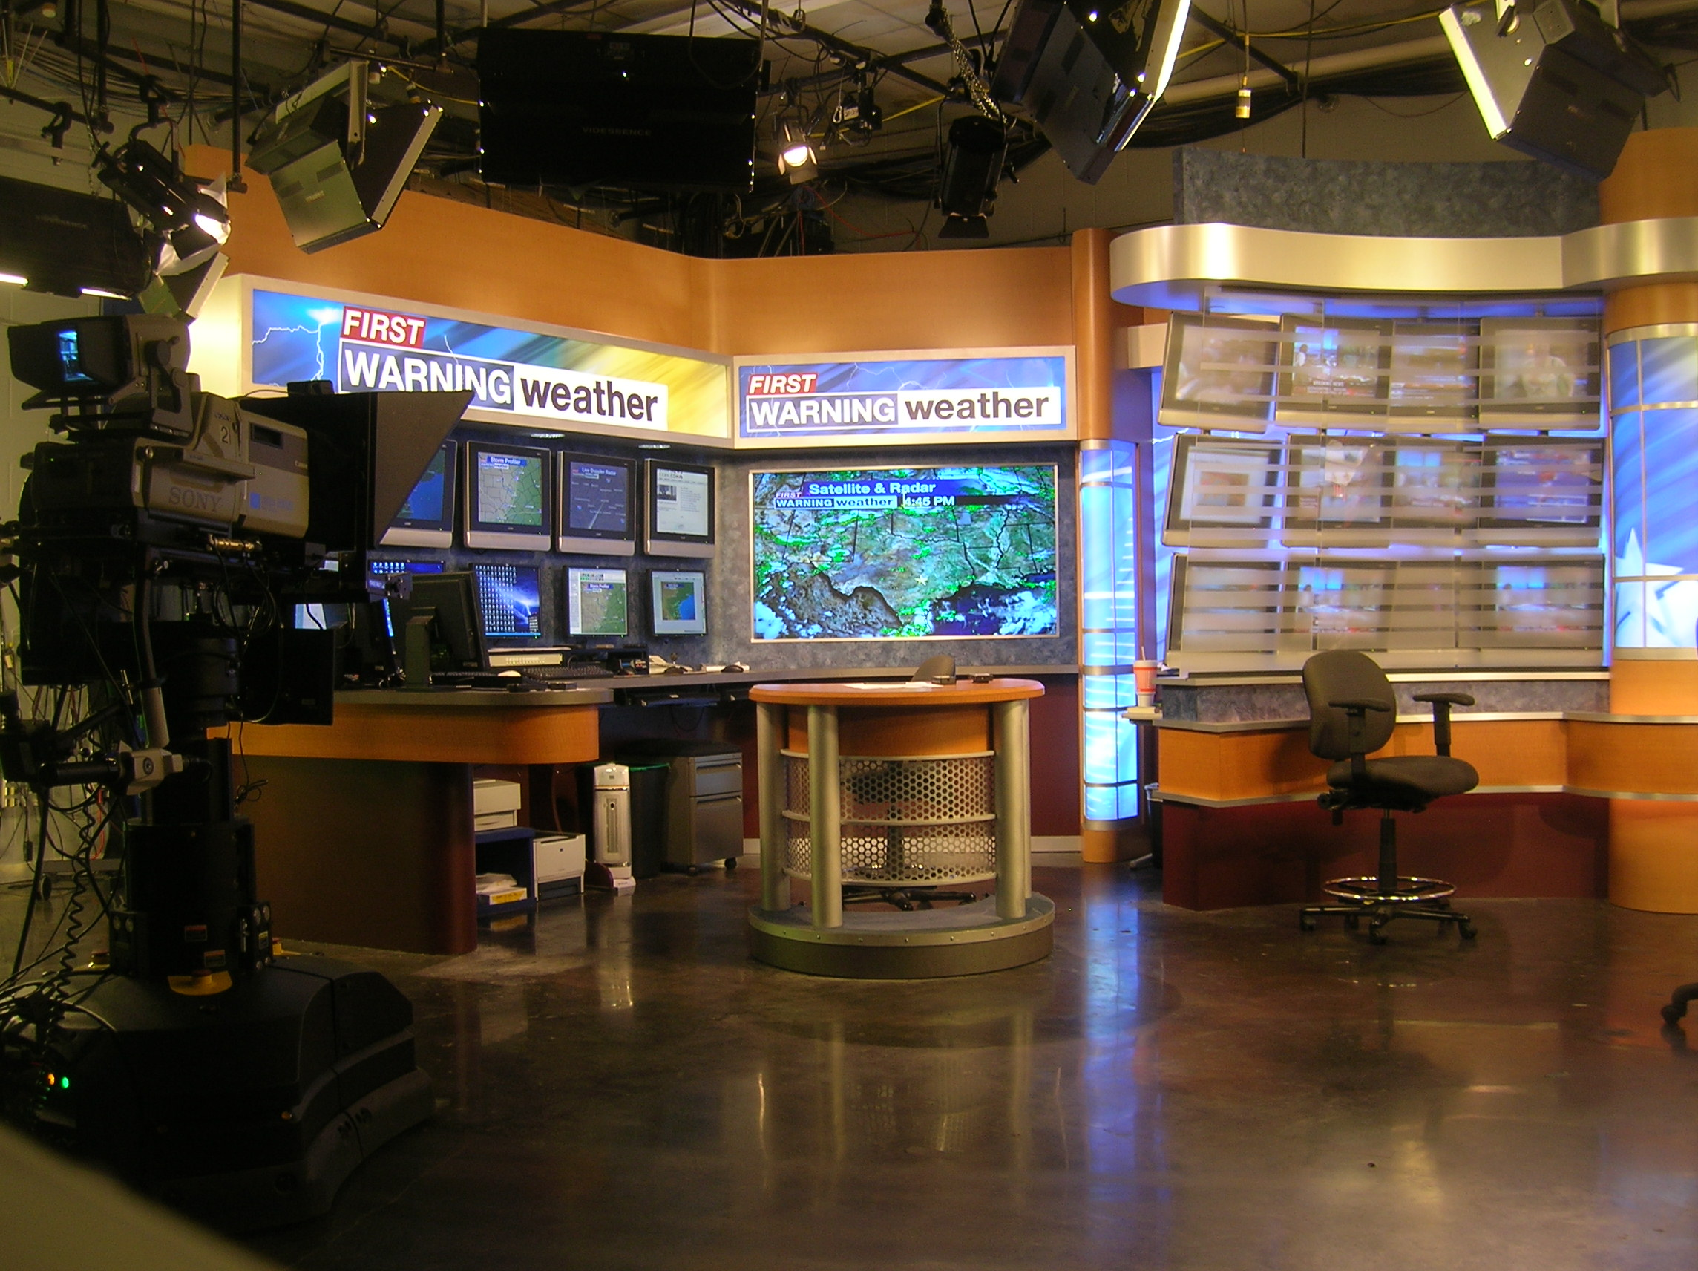
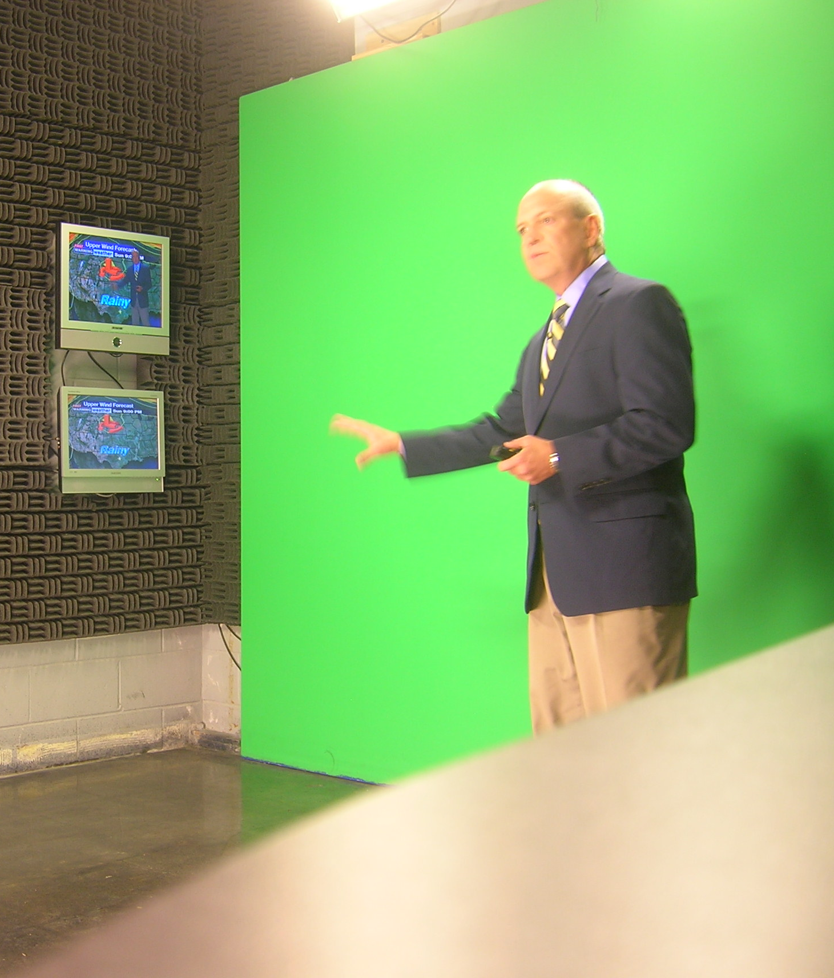
TV Meteorologists
Help get the Severe Weather Warnings and forecasts out
Another 24/7 job. Morning, Evening, Night & Weekends
Outreach with viewers
Work with the NWS
Local and National Stations

Slide 7
Private Sector Meteorologists
Help Companies/Businesses with forecasts:
Trains
Ships
Crop Growing
Develop Apps and Hazard Services
Customized Forecasts
Warning Apps

Slide 8
Other Jobs
Airlines Employ Meteorologists
Insurance Companies
Sports Teams
Climatologists
Computer Programmers, Radar Techs
Emergency Managers
Researchers

Slide 10
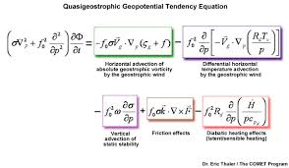
Classes on My College Transcript
1 Chemistry
2 Physics
2 Statistics
6 Calculus
2 Basic Meteorology
2 Dynamic Meteorology (Fluids)
2 Thermodynamic Meteorology (Temps)
1 Syntonic Meteorology (Forecasting)

