Slide 1
Wind!
Meteorologist Aaron Treadway
National Weather Service Austin/San Antonio

Slide 2
Notes About Wind
  Wind is almost always horizontal
    Biggest exception: Thunderstorm Updrafts
  Wind is a force!
    We measure it by the force it applies on other objects
  Instrument called an anemometer used to measure the wind.
  Planes like taking off and landing into the wind.
  Flags point in the opposite direction of the wind.

Slide 3
The Pressure Perspective
In general wind flows from high pressure to low pressure
Pressure gradient is the difference in pressure between high and low pressure areas
As the change in pressure increases the speed of the wind will also increase

Slide 4
The Three Forces
Pressure Gradient Force
  Force that tries to equalize pressure differences
  Earth just wants to be in a temperature/pressure balance
Coriolis Force
  Force that causes objects in the northern hemisphere to turn right
  Due to earth’s rotation
Friction
  Cause wind to slow down
  Diverging wind from highs/converging wind near lows

Slide 5
The Temperature Perspective
Remember high and low pressure also associated with temperature difference.
Areas of warm air rise (low pressure) and colder air (high pressure) moves in to take the place.
Wind generally greater during the day when there is differential heating of the earth.

Slide 6
Localized Wind – Sea/Land Breeze
Caused by temperature/pressure differences between the land and the water
Process reverses at night
Can help cause showers and/or thunderstorms along the coast

Slide 7
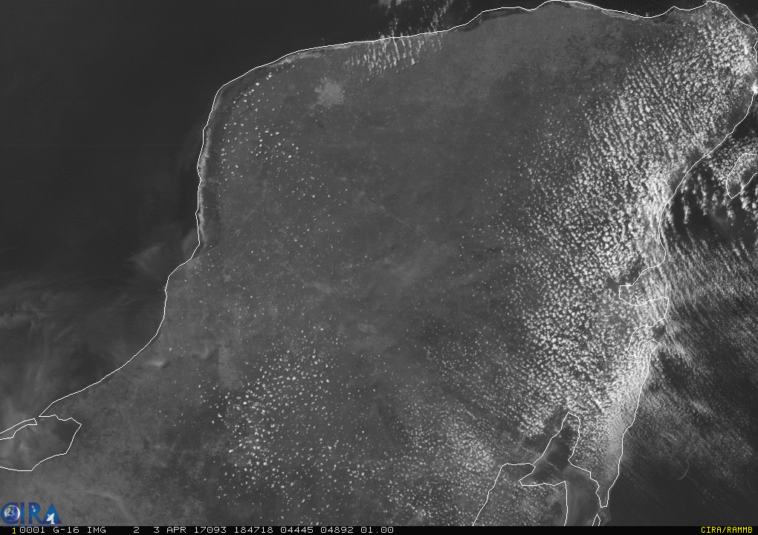
H
L
H

Slide 8
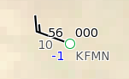
Wind on a Weather Map

Slide 9
Wind on an Upper Air Map

Slide 10
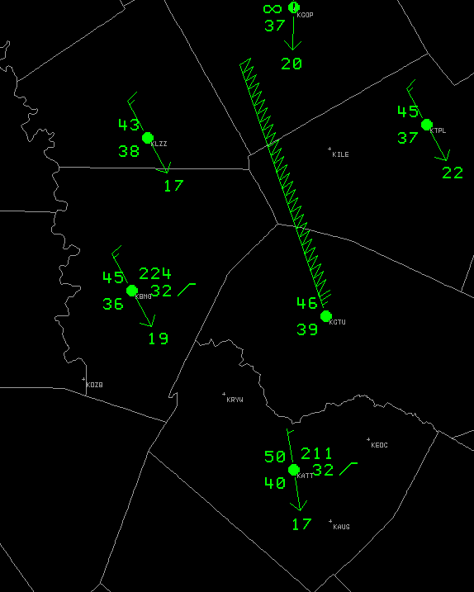
Wind on a Surface Map

