Slide 1
NWS Foreign Travel Process
International Affairs Office
Revised: January 7, 2016

Slide 2
Agenda
NWS Foreign Travel Process
  Role of NWS/IA in foreign travel
  Role of Foreign Travel Contact (FTC)
  Role of NOAA Travel Office
  Role of NWS/IA when processing foreign travel packages, passport and visa application requirements
  Lead Time for NWS foreign travel packages, passport and visa application requirements
  NWS foreign travel package administrative enclosures/requirements
  eCountry Clearance
  Trip report requirements
  Reminders and resources
Notes:
Take a moment to thank my home office (NMFS) & supervisor Wand Cain and the host office (NWS) & supervisor Joe Mros for selecting me to participate on the detail in NOAA’s NRAP program. Remember – you’re talking to TRAVELERS & PREPARERS!

Slide 3
NWS/IA Role in Foreign Travel
IA provides support for foreign travel of all NWS employees.
Support includes:
  Processing official passport and visa requests from NWS employees through to the NOAA Travel Office.
  Coordination and routing of NWS Foreign Travel Packages to NWS/IA Program Analysts and NWS DAA.
  Providing guidance on NOAA Travel Regulations (NTR) and the Federal Travel Regulations (FTR).

Slide 4
What is the role of the NWS Foreign Travel Contact (FTC)?
The FTCs responsibility is to ensure that ALL required documents are completed and included in the foreign travel package prior to submission to the DAA and NTO. In addition, the foreign travel contact will:
  serve as a liaison between NWS Line Office and the NTO
  answer basic questions on foreign travel procedures
  advise on lead times for passport and visa applications
  advise on proper forms to use
  check status of passport and visa applications with NTO
  ensure that instructions are included on the foreign travel checklist on where to return the package.

Slide 5
Who should work with the NWS FTCs?
NWS DAA
NWS Traveler
NWS Traveler
NWS Foreign Travel Contact
(Darlene Roberts / Ethan Jessup)
FMC Foreign Travel Preparer
NWS Traveler
NWS Traveler
NOAA NTO
Please NOTE: travelers should not be contacting the NWS FTC or NTO Office directly.

Slide 6
What is the NOAA Travel Office’s (NTO) role regarding foreign travel?
  It is the NOAA Travel Office’s (NTO) responsibility to ensure
  that NOAA employees traveling abroad on official business have
  all required travel documentation submitted, approved and
  issued prior to travel. Required documents include:
  an approved travel authorization
  a valid official passport
  visas when applicable
  a foreign travel briefing
  eCountry Clearance

Slide 7
NWS/IA Role in Foreign Travel
- Travel Packages -
Travel Preparer sends a complete package to
International Affairs Office
The Foreign Travel Contacts (FTCs) (Darlene Roberts or Ethan Jessup) receives the package, reviews it for completeness and logs it into the system for tracking.
The package is forwarded on to NWS/IA Program Analyst (Desk Officer) to review from a programmatic/international mission/regional standpoint and clears.
NWS/IA Administrative Officer Reviews
DAA (only person with approval authority for NWS foreign travel) reviews then electronically approves in Travel Manager

Slide 8
NWS/IA Role in Foreign Travel
- Visas and Passports -
Travel Preparer sends complete passport and/or visa applications to International Affairs Office
FTCs review contents for completeness and logs into system for tracking.
Application(s) are then forwarded to NOAA Travel Office
NOAA Travel Office will process request and send back to NWS/IA for return to originating office.
Always work directly with NWS/IA FTCs instead of working with NOAA Travel.

Slide 9
What happens when an incomplete foreign travel package is submitted?
NWS FTCs will notify the preparer via e-mail of the missing documents or information. The package will not be processed until receipt of missing information.
NOTE: Omissions will cause delays in the processing of your travel package which may result in trip delay and or cancellation.

Slide 10
What can I do to ensure timely processing of a foreign travel package?
  Know the resources available: NWS IAO Foreign Travel and Visitors web page located at: http://www.nws.noaa.gov/iao/ia/hom/index.php; NOAA Travel Regs; DOC Travel Handbook; and the FTR.
  All travel packages and visa and passport requests route through NWS IA (no direct submissions to NOAA travel office).
  Planning – determine travel dates and required documents.
  Act promptly – allow the proper processing time.

Slide 11
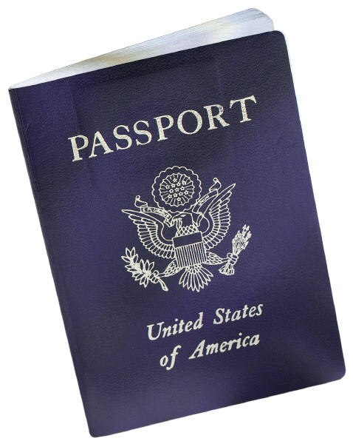
Official Passports

Slide 12
As a NOAA employee traveling to a foreign country on official business, am I required to obtain an official passport?
Yes. All NOAA employees traveling OCONUS on official
business must obtain an official passport and official visas,
if required, before leaving the United States.
Note: Official passports are not issued for travel to Taiwan (personal passports must be used).

Slide 13
Is there a charge for official passports?
No. There is no charge for official passports since they are considered no-fee passports. However, applicants who use the “DS-11, First Time Passport Application” may be charged a processing fee which is reimbursable via a travel voucher.

Slide 14
“First Time Passport Application”, (DS-11) Process
The following documents MUST be submitted to the National Weather Service International Affairs Office (NWS/IA) for processing:
NOAA Foreign Travel Checklist
DS-11 completed on-line and printed on one-sided sheets of paper and cannot be signed until appearance in front of a certified passport agent. Note: there is no charge for official passports, but there may be a processing fee charged by the agent. When completing the on-line application, select passport book as the type of passport being applied for and when asked for payment just select next and continue.
Passport Letter
Certified Birth Certificate (raised seal)
Photos (two 2” x 2” photos with plain white background)

Slide 15
DS-11 Process (continued)
Foreign Travel Briefing
Travel Authorization
Emergency Letter (if passport is required in less than 6 weeks lead time)
Once received the NWS FTC will submit the documents to NOAA Travel Office (NTO), Germantown, MD
NTO will review the contents and send the traveler (via NWS FTC) a “complete application package” to the address listed on the NOAA Foreign Travel Checklist which will include:
      the DS-11,
  birth certificate
  photos, and
  an original and photocopy of a “Letter of Authorization”

Slide 16
DS-11 Process (continued)
You will take the “complete application package” to the nearest Passport Office, Clerk of the Circuit Court, or Federal District Court. You will present the package to a certified passport agent along with a photo ID. Once the agent verifies the information they will administer the oath of allegiance
Once you have repeated the oath and signed your application, the “complete application package” will be express mailed to the Dept. of State (DOS), Washington, D.C. for processing (approximately 6 weeks). When processed, DOS will forward the passport to the NTO.
NTO will send the new official passport to you (via NWS FTC) for signature using the address listed on the foreign travel checklist. Once signed the passport must be returned to your FTC who then forwards it to NTO. The NTO will proceed in obtaining all necessary visas. Once visas are obtained and we have a travel authorization signed by the DAA along with an up-to-date Foreign Travel Briefing on file, the official passport with visas will be returned to the traveler (via the FTC). The passport must be returned to NTO (via the FTC) for safekeeping when the trip is completed.

Slide 17
Requesting an Official Passport with personal passport in possession or renewing an Official Passport “Apply for a Passport by Mail,” (DS-82) Process
The following documents MUST be submitted to the National Weather Service International Affairs Office (NWS/IA) for processing:
NOAA Foreign Travel Checklist
DS-82 completed on-line and printed on one-sided sheets of paper and must be signed and dated. Note: there is no charge for official passports. When completing the on-line application, select passport book as the type of passport being applied for and when asked for payment just select next and continue.
Passport Letter
Personal U.S. Passport or previous Official Passport
Photos (two 2” x 2” photos with plain white background)
Foreign Travel Briefing
Travel Authorization
Emergency Justification Letter (if passport is required in less than 4 weeks lead time)

Slide 18
DS-82 Processing (continued)
Once received the NWS FTC will submit the documents to NOAA Travel Office (NTO), Germantown, MD
NTO will submit your passport package to the Dept. of State (DOS). It will take approximately 4-6 weeks to process an official passport. Once the passport is processed, DOS will return the passport to the NTO.
NTO will send the new official passport to you (via NWS FTC) for signature using the address listed on the foreign travel checklist. Once signed the passport must returned to your FTC who then forwards it to NTO. NTO will proceed in obtaining all necessary visas. Once visas are obtained and we have a travel authorization signed by the DAA along with an up-to-date Foreign Travel Briefing on file, the official passport with visas will be returned to the traveler (via the FTC). The passport must be returned to NTO (via the FTC) for safekeeping when the trip is completed.

Slide 19
For both DS-82 and DS-11
Note: NWS employees must annotate in section 8 Mailing address: Line 1 - “CROA”; Line 2 – NTO, 20020 Century Blvd, Suite 1C; City and State – Germantown, MD 20874. All employees will indicate their home address in section 18 of the application.

Slide 20
Additional passport forms
“How to apply for a Lost or Stolen U.S. Passport,” (DS-64)’
“Adding Extension Pages to a U.S. Passport,” (DS-4085) and
“Updating Identifying Information in a U.S. Passport,” (DS-5504)
Must be completed on line and printed on one sided sheets of paper. The applicant must sign and date the application. Non-compliant applications will be returned. Additional passport applications can be found at www.travel.state.gov/passport. Each on-line passport application contains a 2-D Barcode which allows for encryption of data provided by the applicant into DOS system.

Slide 21
What are the passport photo requirements?
Passport photos must be 2" x 2" (excluding white borders), and must have a white or off-white background. The applicant’s image must be centered in the photograph with a 1/2" space between the top of the applicant’s head and the top edge of the photograph. Pictures must be cut down to correct size and must match the template
provided on the passport application. Pictures not in conformation will be rejected. See the following DOS website for further information:
www.travel.state.gov/passport.

Slide 22
What do I do with my official passport when I return from official travel?
DOS security requirements stipulate that all official passports be retained at the NTO in the passport repository for safekeeping. Upon completion of travel the passport must be returned to the FTC for forwarding to NTO to be secured in the repository. The OAA and IA are exempt and may retain their official passports in a locked safe in their offices. Official passports are the property of the Government, and are not the personal property of the traveler. Official passports should never be kept at home.

Slide 23
How do I dispose of my official passport when leaving Government service?
Employees must return their official passport to NTO via NWS IA for invalidation. If you wish to retain it as a souvenir, submit a letter of memorandum along with the passport to the NTO via NWS IA requesting such. It will be invalidated and returned to you.

Slide 24
VISAS

Slide 25
What is a visa?
A visa is a stamp or sticker affixed in a passport which allows you to enter and exit a foreign country.

Slide 26
How do I obtain a visa(s) in my official passport?
You will submit your official passport and any applicable visa documentation to the NWS, IAO for processing. Visa requirements vary for each country. Some countries may require a visa application, and some may require visa photos or letters of invitation. Most countries require that the passport be valid at least 6 months or longer beyond the dates of travel before a visa can be issued.

Slide 27
Where do I obtain visa requirements and applications for official travel?
Current visa applications can be found at:
http://www.corporateservices.noaa.gov/~finance/FT.html
Click on Official Visa Applications and Instructions.

Slide 28
How do I read the “Visa Requirements for Official Travel” listing?
You should note the following when reading the “Visa
Requirements for Official Travel:”
“No visa required” indicates the employee travels on their official passport only; and
“Visa required” with amplifying, explicit instructions listed to right of country that visa is required for. Countries listed in blue text = hyperlink taking user to current visa application. Paperwork will be submitted to FTC, who in turn forwards to NTO. The NTO will submit applicable paperwork with official passport to the appropriate embassy for visa. Please note, pictures must be recent 2”x2” color photos (not photocopied) unless otherwise specified; and
Original signatures are required on each visa application.
Note: Blue text = hyperlink taking user to current visa application.

Slide 29
Does NOAA obtain official passports and visas for invitational travelers on foreign travel?
No. NOAA is not responsible for processing official passports and visas for invitational travelers planning foreign travel. Invitational travelers are expected to obtain personal passports and visas. However, NOAA will reimburse passport and visa fees for invitational travelers on foreign travel when approved on the travel authorization.

Slide 30

NWS, IAO Lead Times for Packages
When do travelers submit foreign travel packages to IAO?
NWS/IA developed lead times based on the following NOAA Travel Regulations: NTR 306-3.7, 306-3.8, 306-5.4, and 306-6.2

Slide 31
Lead Times for Packages
When do travelers submit foreign travel packages to IA?
Scenario A
  Traveler does not have an official passport and requires a visa.
6 to 8 weeks prior to departure
Allows IA to process and submit package to NOAA Travel Office within the required lead time of 4 to 6 weeks. (NTR 306-5.4)
Notes:
Categorized into four different scenarios.

Slide 32
Lead Times for Packages
When do travelers submit foreign travel packages to IA?
Scenario B
  Traveler does not have an official passport and does not require a visa.
6 to 8 weeks prior to departure
Allows IA to process and submit package to NOAA Travel Office within the required lead time of 4 to 6 weeks. (NTR 306-5.4)

Slide 33
Lead Times for Packages
When do travelers submit foreign travel packages to IA?
Scenario C
  Traveler has an official passport and will require a visa.
4 weeks prior to departure
Allows IA to process and submit package to NOAA Travel Office within the required lead time of 2 to 3 weeks. (NTR 306-6.2)

Slide 34
Lead Times for Packages
When do travelers submit foreign travel packages to IA?
Scenario D
  Traveler has an official passport and will not require a visa.
3 weeks prior to departure
Allows IA to process and submit package to NTO not later than 7 business days before traveler departs. (NTR 306-3.8)

Slide 35
Lead Times for Packages
When does the Deputy Assistant Administrator need to approve the foreign travel authorization?
Scenarios A, B, C and D
Not later than 7 business days prior to departure.

Slide 36
Packages with less than required lead time for processing
Assemble the package to include all required documents
An emergency justification letter to NTO (via NWS IAO) MUST be included if passport/visa processing is required
An explanation for submission outside of processing lead times must be included in the Travel Justification Memo submitted to the DAA

Slide 37

NWS Foreign Travel
Packages
Must be submitted to IA in a blue folder.
  Send to the attention of Darlene Roberts at NWS/IA.
  Foreign Travel Packages should not be submitted to the NOAA Travel Office. This will cause a delay in processing your travel package.
  No piecemeal submissions, PLEASE.
  Emergency cases only: PDFs of travel documents are acceptable.
Incomplete packages may be returned and/or will cause a delay in processing the package and possible disapproval of the foreign travel request.

Slide 38
Front Cover of Travel Package
On the front cover of the foreign travel package, clip a CD-15 Transmittal Form.
Complete as shown in the example.
The first two lines should have the employee’s name and the employee’s supervisor.
The remaining five lines have the routing that will apply to all foreign travel packages submitted to NWS/IA.
Additional routing can be added between the employee’s supervisor and IA depending on each FMC’s internal process for routing travel packages.
Please include the traveler’s name, destination and travel authorization number in the comments section.
The Travel Preparer’s name and contact information is added at the bottom.
See Handout for Latest Version

Slide 39
Inside Left
of Travel Package
On the inside left of the travel package, please clip the Foreign Travel Justification Memo.
The memo is from the traveler through their supervisor AND Office Director or Regional Director to the Deputy Assistant Administrator.
Key Points:
Memo must follow NWS Correspondence format.
Spell out all acronyms.
Ensure travel dates are consistent with travel authorization, letter of invitation and travel itinerary.
Official record for the file.
Mistakes on memo are reflection of FMC.

Slide 40
Foreign Travel Package
Include the following in the Travel Justification Memo:
• Name, purpose, dates, and location of meeting;
• Indicate whether any annual leave will be taken;
• Indicate if there are additional side meetings or prep meetings
that are outside the dates of the primary meeting that may or may not be reflected in the invitational letter;
• Identify other NOAA and NWS personnel who will be attending
the same meeting(s);
• List three to four objectives for the meeting, what NOAA/NWS
gains from traveler’s attendance, linkage to bilateral
agreements and/or WMO Programs;
• Indicate and provide specific details if NOAA or the traveler will
be reimbursed for any expenses;
Indicate whether a visa is required and if traveler already has an official passport
• Indicate whether the package is being submitted within IA’s recommended lead times and if prior coordination with IA has occurred. If travel package is being submitted late, explain the circumstances why.

Slide 41
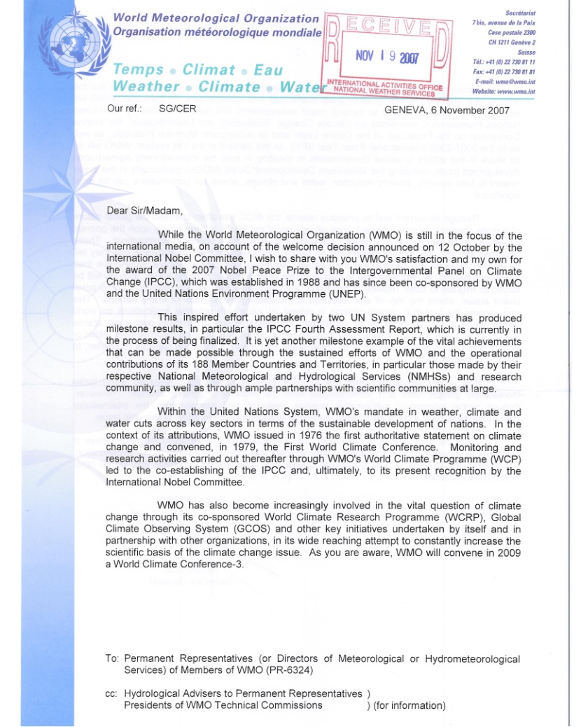
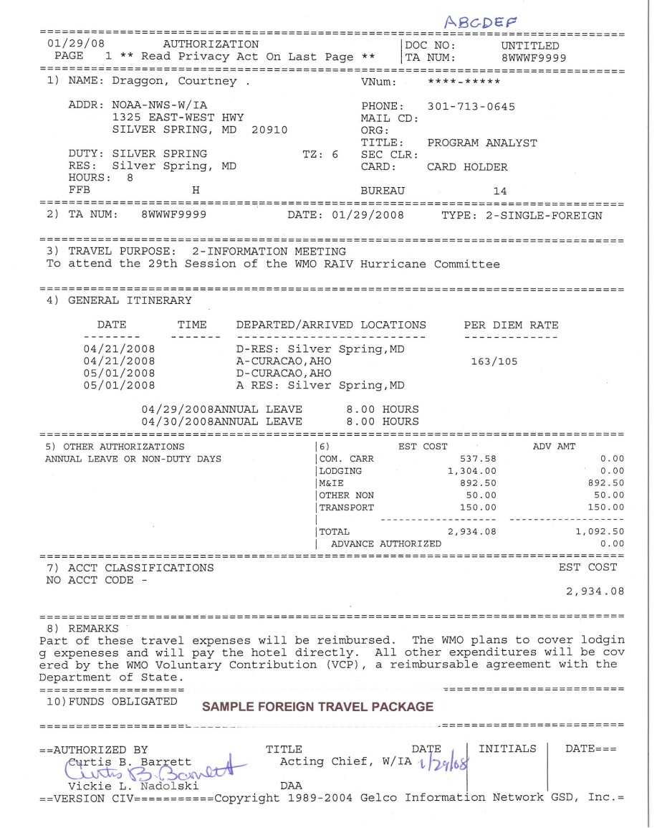
Inside Right
of Travel Package
On the inside right of the travel package, please clip:
The travel authorization;
An invitation letter ** from the foreign entity which shows the meeting dates and details any travel costs (air fare, ground transportation. lodging and/or meals) that may be reimbursed to either the traveler, NOAA/NWS or to the vendor. If the foreign entity will be reimbursing travel expenses, please add this information to the justification memo and in the “Remarks” section of the travel authorization.
Depending on when reimbursement will take place, it might be necessary to zero out some of the cost on the authorization prior to the traveler’s departure.
Travel Itinerary from CWTSato or each region’s Travel Management Center (TMC).
** For operations maintenance travel and NWS initiated foreign travel (i.e. CHAT Tour) an invite letter is not necessary.

Slide 42
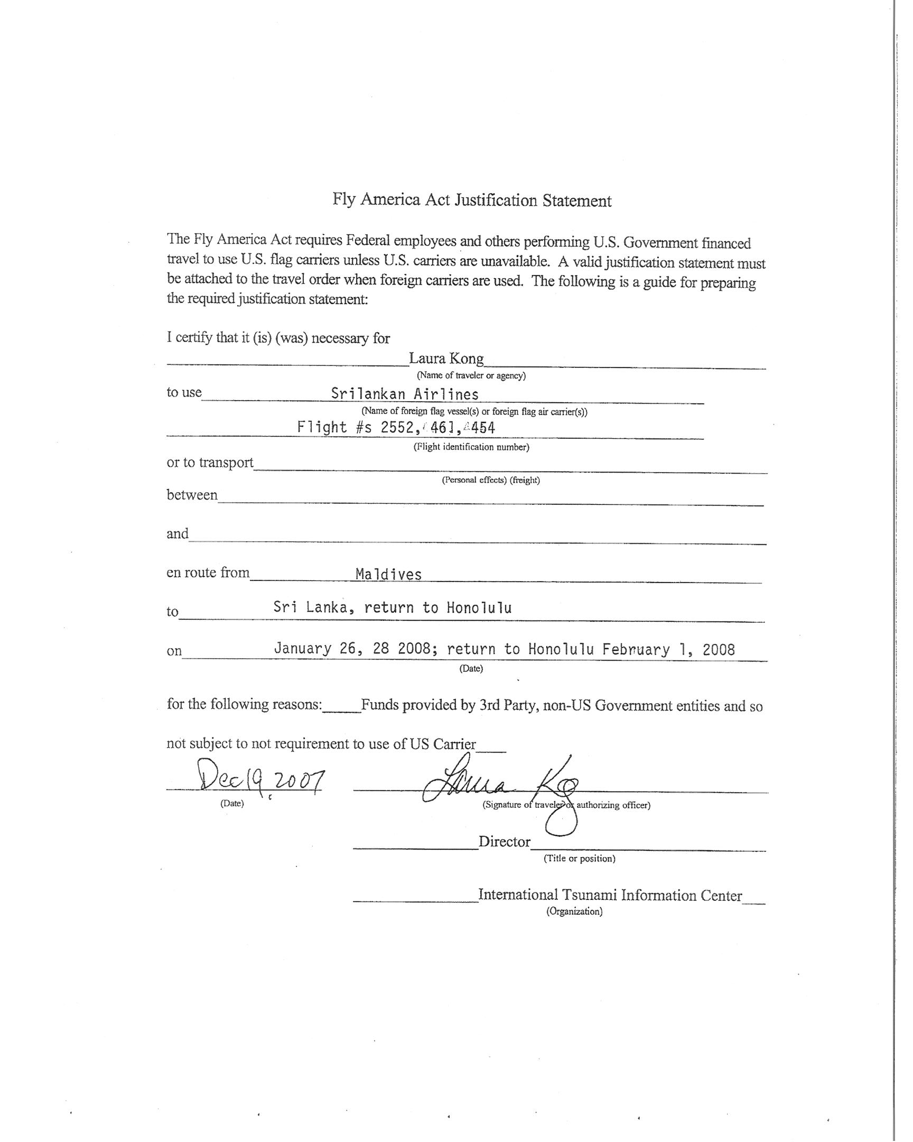
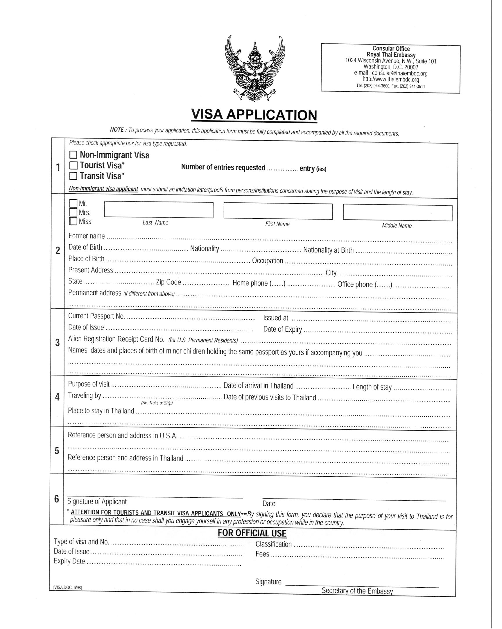
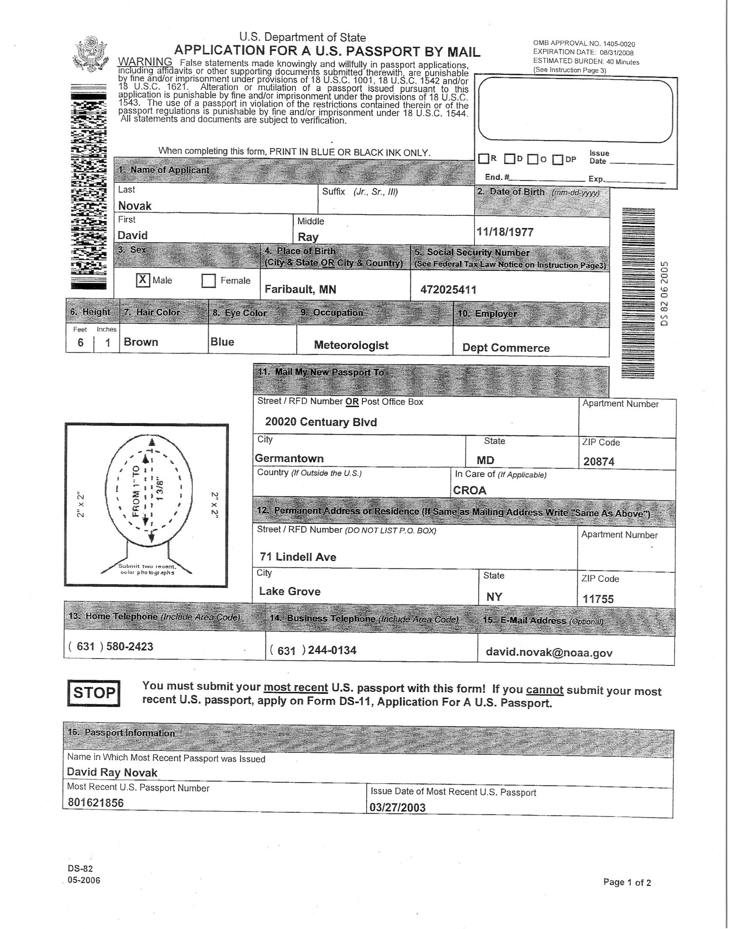
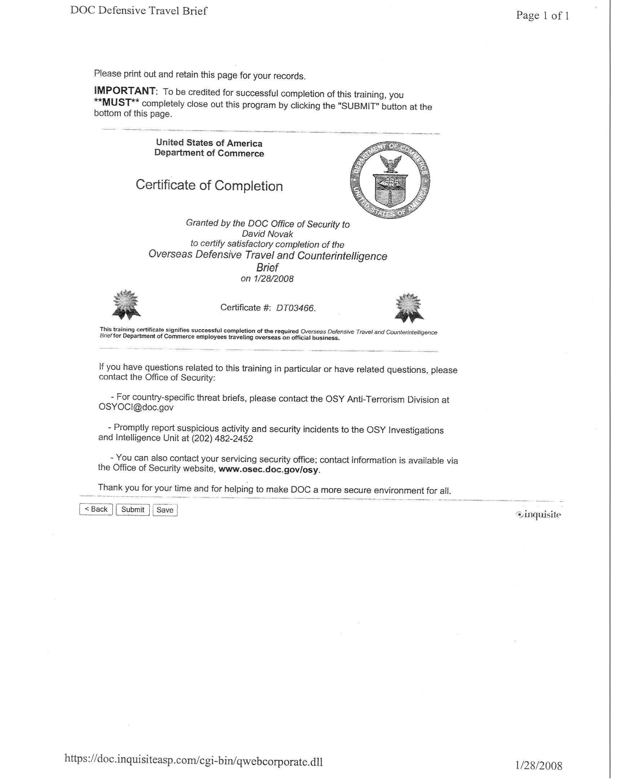
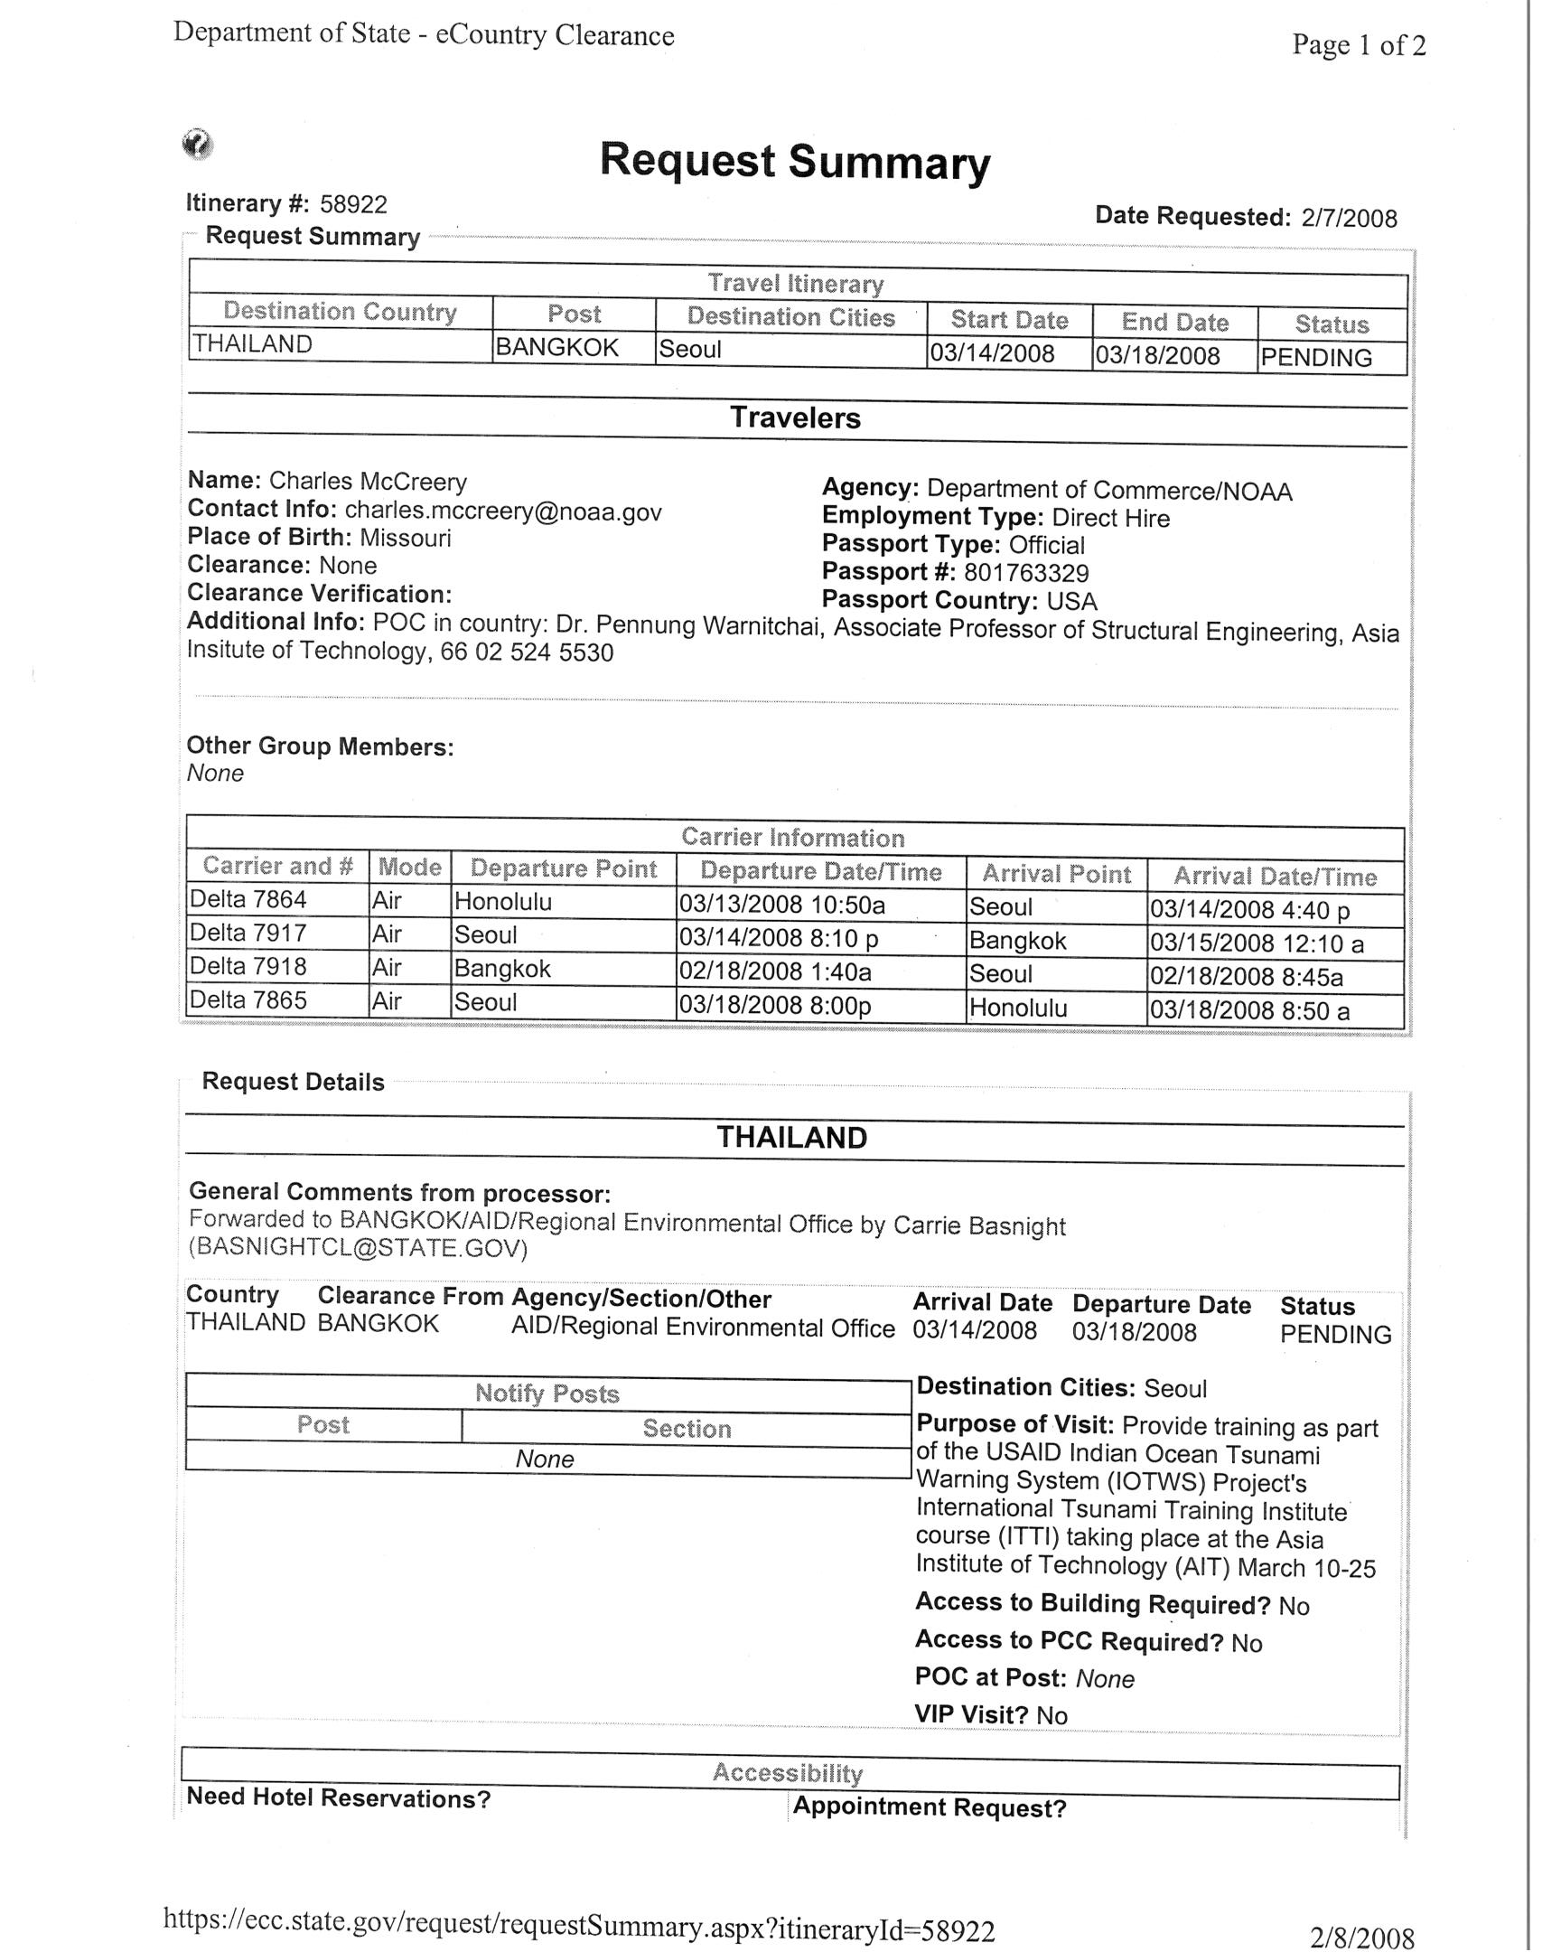
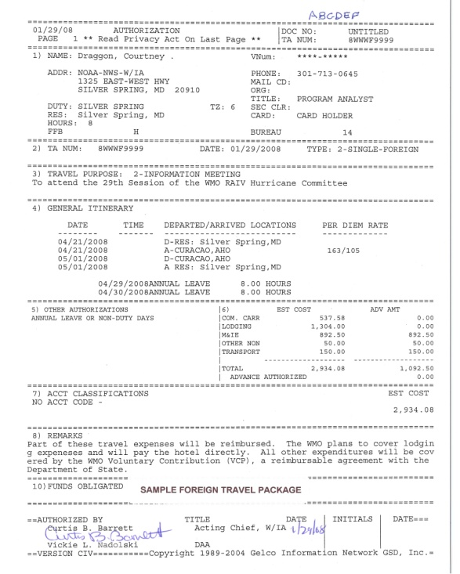
Inside
Travel Package
Inside the package, place:
A duplicate copy of the travel authorization;
A copy of the submitted eCountry Clearance request completed by either the Traveler or the Travel Preparer;
A copy of the traveler’s DOC Foreign Travel Brief completion certificate.
Foreign Travel Checklist (NTR 306-3.2)
and if required:
Visa application with photos
Passport Application
Fly America Act Justification Statement
These items should be clipped together for easy removal and processing by IA staff allowing for a simple review of the package before forwarding to the Deputy Assistant Administrator for approval.

Slide 43
Wait! What do you mean I need to zero out per diem and/or lodging??
If the foreign entity is paying for any travel costs upfront, zero out the specific costs they are paying for on the travel authorization prior to approval and note in remarks section.
If the foreign entity will reimburse NOAA/NWS after travel is completed, leave the costs so that the traveler can be reimbursed via a voucher upon return.
Be sure to complete a CD-210 and submit with the voucher to your servicing finance office.

Slide 44

eCountry
Clearance (eCC)
is a web-based application that provides access to a country clearance request and approval process for clearance to travel to foreign countries on official government business.
https://ecc.state.gov
The traveler or travel preparer is responsible for preparing and submitting the eClearance request via the Department of State’s eClearance system. (NTR 306-4.4)
At least a two week lead-time is required for processing eClearance requests (NTR 306-4.5)

Slide 45

eCountry Clearance
Creating an account is easy!
When establishing an account be sure to select:
  Department of Commerce/NOAA

Slide 46
eCountry Clearance
In order to complete a clearance
request…..
You will need to know
  The complete flight itinerary and the hotel (address and phone number) where the traveler will be staying.
  The purpose of the visit.
  Destination city (or cities).
  At times you will need to notify the US consulate nearest to the traveler’s destination.
  Point of contact in host country .
After submitting a clearance request, a pop-up screen appears asking users to enter in additional email addresses to be notified when the request is sent.
  Always include: ia.cables@noaa.gov
Notes:
ia.cable@noaa.gov is the mailbox for NWS country clearance cables.

Slide 47
eCountry Clearance
Notifying the Post
In some countries, the US has an embassy and several consulates.
  - You will need to notify both the embassy and the consulate nearest the traveler’s destination.
  http://usembassy.state.gov
In choosing which section of the embassy and consulate to notify.
    Science and Technology Office
    Economic Section
    Political Section

Slide 48
eCountry Clearance
Notifying the Post
If a US Embassy or DoS Desk Officer responds with questions or seeks additional information, please reply back in a timely manner.
If there are changes with travel dates, hotel, and/or flights, an amended clearance request must to be sent
Under no circumstances should a
traveler depart without clearance from
the US Embassy.
Notifications of NWS’ failure to request country clearance are sent to the Senior Advisor for NOAA, IA from the Department of State.

Slide 49
Trip Reports: Required and monitored by NWS/IA
A trip report must be submitted
within 5 business days
Should cover:
  Details of the meeting
  Any pertinent US issues
  Impact on NWS mission
  Decisions made
Submitted to the traveler’s supervisor and to IA at nws.tripreports@noaa.gov
Subject line for email: Travelers last name, TA number, TDY location.
Notes:
Template or handout

Slide 50
Trip Report Template
DATE: <insert date of trip
LOCATION: <insert TDY location>
PURPOSE: <insert purpose of trip (e.g. WMO meeting, bilateral meeting, conference)>
FROM: <Name and office of Traveler>
THINGS YOU MUST KNOW:
Any pertinent U.S. issues
Impact on our mission or operations
Decisions made
DISCUSSION:
Short summary of meeting to provide broader context to the above “Things you must know” items
Briefly describe how you prepared for participation; what role you played on the trip and how you fulfilled that role.
FOLLOW-UP ACTIONS:
Provide bullets on what actions are required as follow-up to your trip and what offices you need to coordinate with in implementing follow-up actions
PARTICIPANTS:
<Names of other meeting attendees from U.S. or other countries if relevant to outcomes of meeting>
PRESS:
Include if you participated in a press event and/or there was a press event associated with the trip

Slide 51
Reminders Regarding Official Passports
Using the electronic Travel Manager approval process, the travel preparer or traveler must fax a copy of the approved/data linked Travel Authorization and a copy of their Foreign Travel Briefing certificate directly to the NOAA Travel Office. NTO will then UPS the official passport to the traveler or travel preparer (via FTC). Please include a complete mailing address along with your office’s UPS account number.
DOS security requirements stipulate that all official passports be retained at the NTO in the passport repository for safekeeping. Upon completion of travel the passport must be returned to the FTC for forwarding to NTO to be secured in the repository. The OAA and IA are exempt and may retain their official passports in a locked safe in their offices. Official passports are the property of the Government, and are not the personal property of the traveler. Official passports should never be kept at home.

Slide 52
Reminders
When travel dates change – remember to amend eCountry Clearance to notify DOS and Embassy.
Be sure to check “Annual Leave” in Travel Manager or “Non-Duty Leave” when traveler is staying over at their own expense. If Shift Employee – add in remarks section.
Ensure invitational letter spells out how NOAA or traveler will be reimbursed and identify the specific items.
If the authorization needs to be revised for whatever reason (dates, errors, etc.) it will need to go through each FMC’s approval process again.

Slide 53
more reminders
Ensure that the Travel Preparer’s name, phone number and fax number are on the authorization.
After the DAA electronically signs the Travel Authorization and initials off travel package, IA will notify the travel preparer. The travel preparer can then print a copy of the approved travel authorization from Travel Manager and submit to CWTSato or Panda for ticketing. Note: the TA must have a CBA Obligation Number and the DAA as the final approving official for ALL foreign travel.
Justification memo will be retained within IA. Provide a copy in package if you would like original back.
Provide a return shipping label so that travel packages and passports can be returned via UPS.

Slide 54
some more reminders
Invitational Foreign Travel Authorizations must adhere to the same process and lead times.
- Foreign Country to Foreign Country considered as foreign travel
  - Foreign Country to United States is considered domestic travel.
For attendance at foreign conferences initiated by NWS; include a copy of agenda, registration and provide justification in memo on why attendance is important.

Slide 55
and more reminders
Only prepare the CD-210 for gifted/reimbursable (in-kind) travel. DO NOT use the CD-342. 342’s are used when accepting tangible gifts such as a vase, plaque, statuette, etc.
Prepare an SF 326 to categorize actual expenses when using the CD-210.
Be sure that travel authorization accurately reflects overnight flights. Most flights to Europe leave on one day and arrive the next day. Most flights to Asia leave on one day and arrive on the second day.

Slide 56
Travel Manager Routing
For all non-bargaining unit employees, ensure that the DAA is listed in their routing list and the authorization electronically routes to them.
For all bargaining unit employees, NWS/IA is manually adding each employee the DAAs group. DAA manually looks up each TA and approves.
Under no circumstances should a traveler depart without having their travel authorization electronically signed by the DAA.

Slide 57
Ideal resource for NWS Preparers and Travelers to use…?
for NWS foreign travel requirements the NWS, IAO Foreign Travelers and Visitors homepage:
http://www.nws.noaa.gov/iao/ia/hom/IAOForeignTravel.php
Contains links to:
Federal Travel Regulations (FTR)
NOAA Travel Regulations (NOAA Travel Regulations)
NOAA Foreign Travel Website
Foreign Travel Forms
Relevant Travel Websites

Slide 58
Additional Resources
  www.gsa.gov/citypair - city pair airline flights
  http://www.osec.doc.gov/oas/OCS/Travel_Regulations.html - Dept. of Commerce Travel Regs
  http://travel.state.gov - Dept. of State Travel Information
  http://aoprals.state.gov/web920/per_diem.asp - Foreign Per Diem Rates
  https://ecc.state.gov - eCountry Clearance
  http://www.corporateservices.noaa.gov/~finance/TR.html - NOAA Travel Regs
  http://www.corporateservices.noaa.gov/~finance/Travel_Home.html - NOAA Travel Office Home Page

Slide 59
NWS Foreign Travel Routing Flow Chart
Originating Office (FMC)
NWS FTC
NWS Analyst
NOAA NTO
NWS FTC
NWS Deputy Ass’t Administrator
A/O & Director/IA

Slide 60
IA Points of Contacts
Darlene Roberts (Contr)
International Technical Specialist
301-427-9052
darlene.roberts@noaa.gov
Ethan Jessup
International Travel Specialist
301-427-9047
ethan.jessup@noaa.gov
Courtney Draggon
International Affairs Director
301-427-9046
courtney.draggon@noaa.gov
Daniel Muller
International Affairs Deputy Director
301-427-9814
daniel.muller@noaa.gov
Fax number: 301-587-4524

