Slide 1
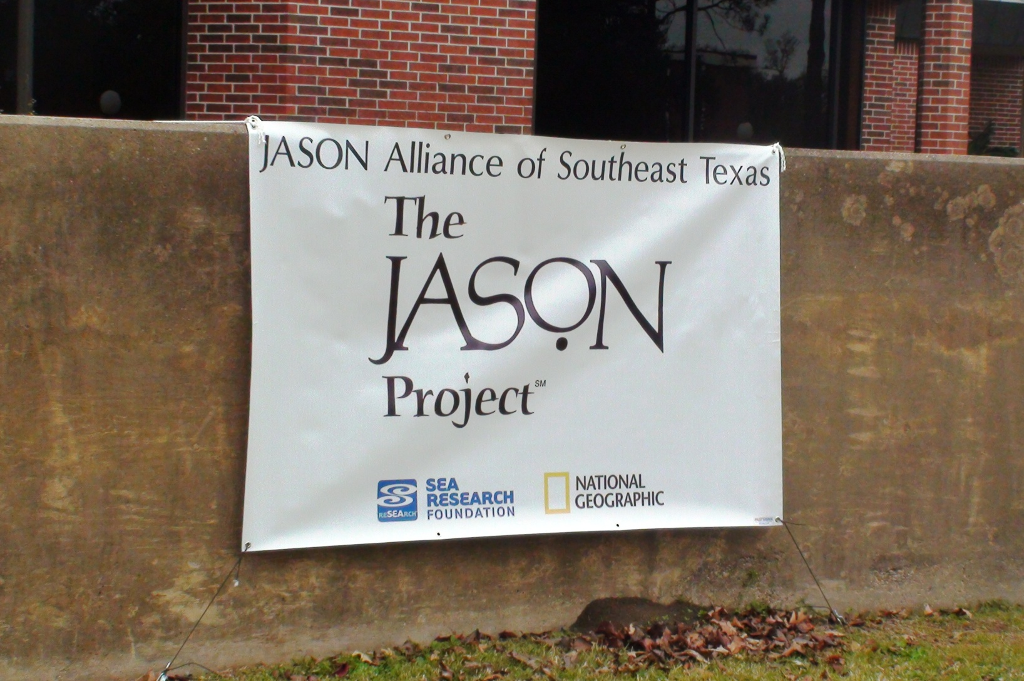
2011 LAMAR UNIVERSITY
JASON PROJECT

Slide 2
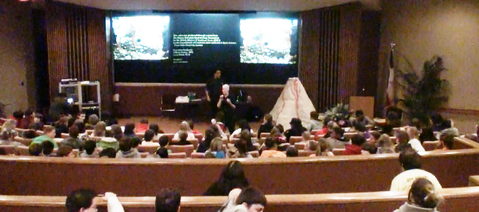
JASON PROJECT DIRECTOR INTRODUCES NWS LAKE CHARLES, LA

Slide 3
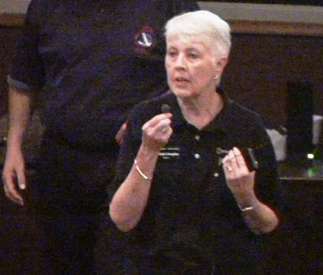
LAMAR UNIVERSITY JASON PROJECT DIRECTOR D’ANN DOUGLAS

Slide 4
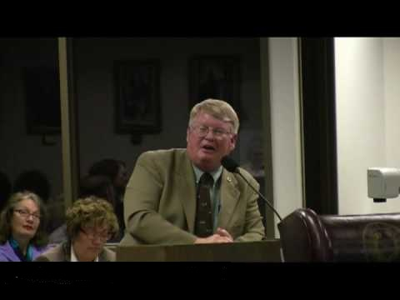
DR. JAMES WESTGATE
Dr. James Westgate, Professor of Earth & Space Sciences

Slide 5
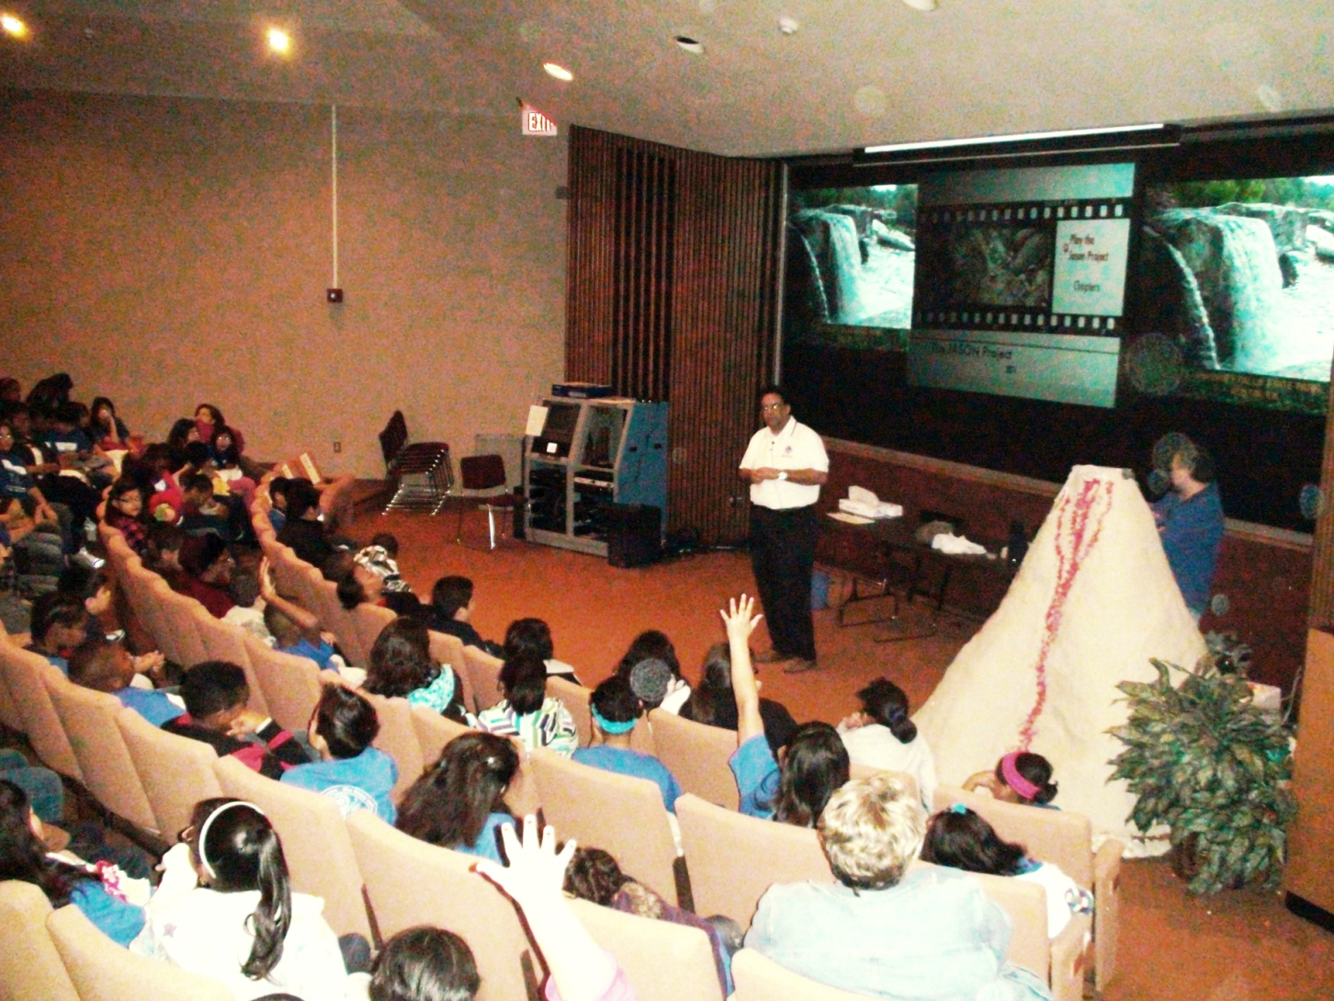
NWS LCH SCIENCE OFFICER DISCUSSES THE VOLCANO WITH LOCAL STUDENTS

Slide 6
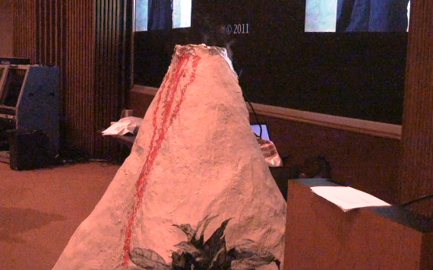
6’ FUNCTIONING VOLCANO MODEL

Slide 7
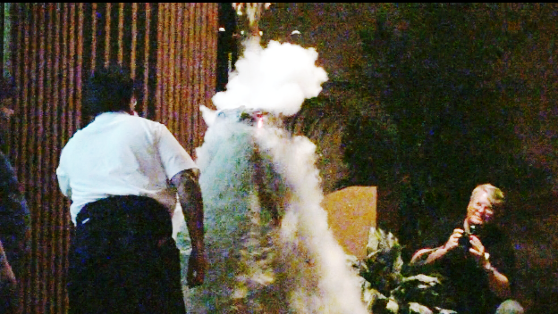
VOLCANO ERUPTION SIMULATION

Slide 8
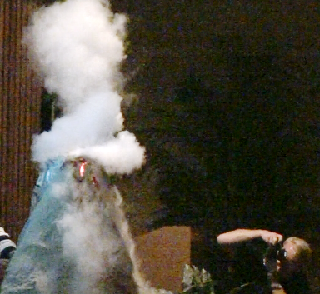
DR. JIM WESTGATE CAPTURES VARIOUS ERUPTION PHOTOS

Slide 9
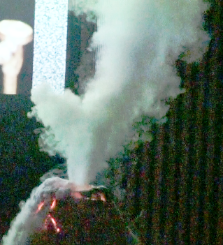
PLUME

Slide 10
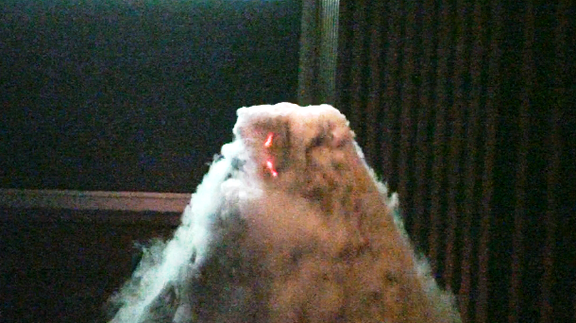
PYROCLASTIC FLOW BEGINS

Slide 11
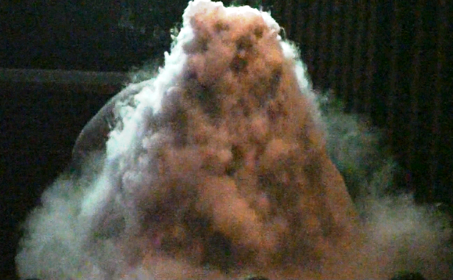
PYROCLASTIC FLOW FALLS DOWNWARD DURING ERUPTION

Slide 12
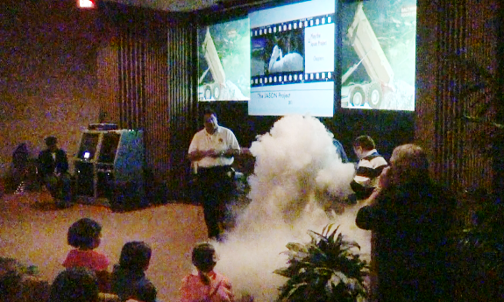
PYROCLASTIC FLOW BEGINS TO REACH AUDIENCE

Slide 13
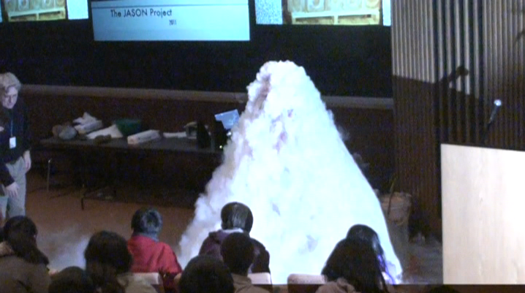
VOLCANO IS FULLY CONCEALED BY PYROCLASTIC FLOW

Slide 14
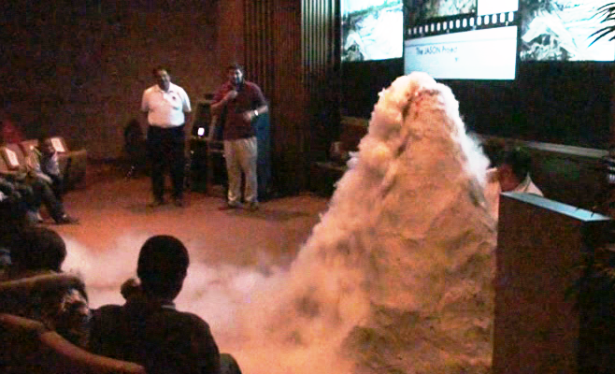
AUDIENCE IS THRILLED AS FLOW REACHES INTO FRONT ROWS

Slide 15
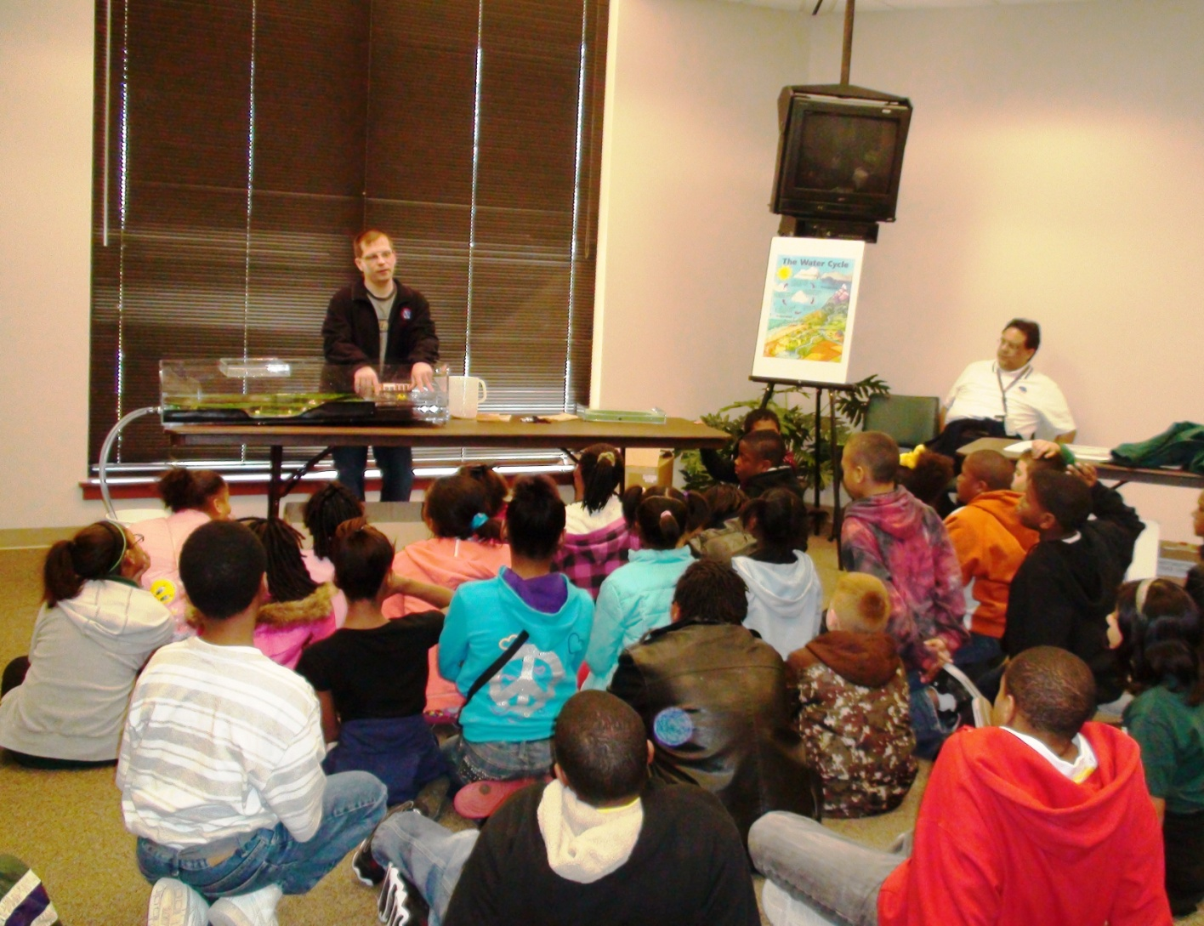
WFO LCH SERVICE HYDROLOGIST PRESENTS RIVER MODEL

Slide 16
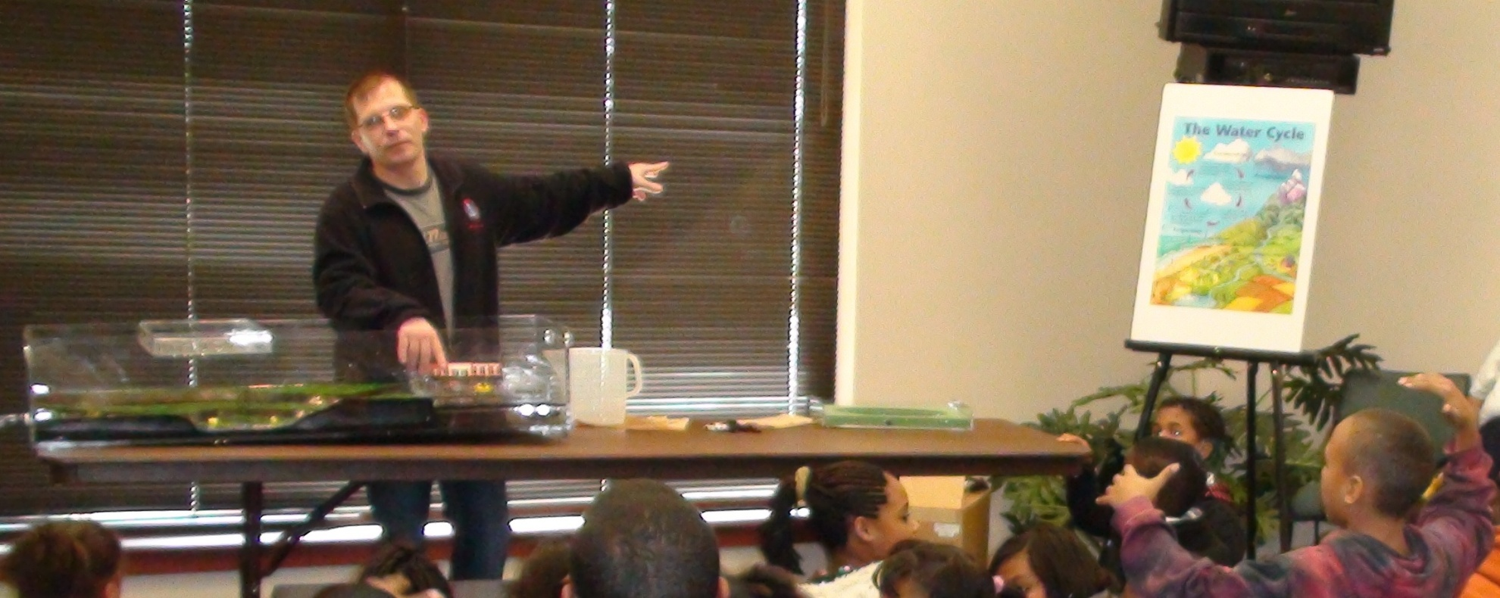
WFO LCH EXPLAINS RIVER MODEL AND WATER CYCLE RELATIONSHIP

