Slide 1
Roadmap to the NWS:
How to become a Meteorologist
Heather Sheffield and Isha Renta
NOAA’s National Weather Service
Baltimore/Washington DC
heather.sheffield@noaa.gov
isha.renta@noaa.gov

Slide 2
Roadmap to a Career in Meteorology
Definition of a Meteorologist
Why become a Meteorologist?
Career Opportunities
What does an Operational Meteorologist or Forecaster do?
Colleges and Universities
  “What kind of degree do I need?” “Where should I go to school?”
Degrees in Meteorology
Notes:
In this presentation, I am going to go over what a meteorologist is and why would someone choose meteorology as a career. This presentation is going to go through how most professionals enter the field and are titled a meteorologist. Then we’ll go over some career opps for meteorologists. We’ll then talk about the career ops someone can take to enter the field and what kind of schooling someone would need. Like myself, most meteorologists have heard the questions ‘are you on tv?’ after your title is revealed. If you start to hear these questions, ‘are you a storm chaser?’ then you’re on your way to a career in meteorology!

Slide 3
What is a Meteorologist?
“A person with specialized education who uses scientific principles to explain, understand, observe, or forecast the earth's atmospheric phenomena and/or how the atmosphere affects the earth and life on the planet.” (AMS Definition)
Notes:
The American Meteorological Society or the AMS, is a society that promotes research and education in the meteorology field. They define a meteorologist as “ .“ In other terms, a meteorologist analyzes data and current observations to make a forecast that will affect the earth and people.

Slide 4
Why Meteorology?
Overall interest
Experienced a significant past weather event
  “I saw a tornado” “My friend lost her home during Katrina” “I was stuck on the Beltway for 9 hours during a snow storm” “Snowmageddon was awesome”
Strength in math & science
  You want a challenging job that is constantly changing
Notes:
So why choose to become one? Well, maybe you have an overall interest in the weather. I know there are a lot of people out there that not only check the weather on the TV or internet but are storm spotters, have weather stations at home, jump for joy when snow is in the forecast. Another reason would be a significant past wx event made you interested in the weather. I know for myself since I grew up in Buffalo, NY and went to college in Oswego, NY I loved snow and waterspouts on the Great Lakes. The roots of the field of meteorology are in math and science. Math and science are important skills to have. Math including calculus are needed to understand the dynamics of the atmosphere as well as many science courses including physics.

Slide 5

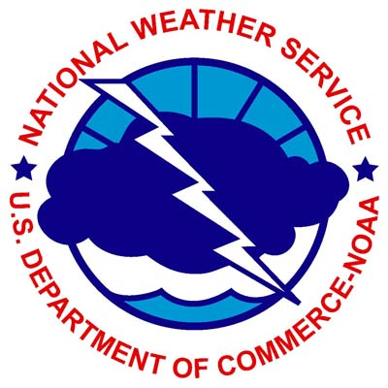
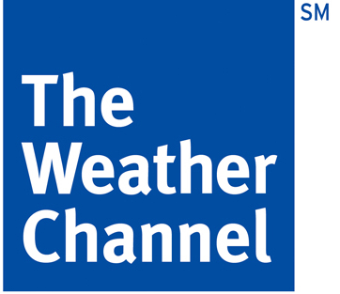
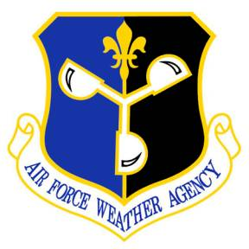




Career Opportunities
Public
Military
Media
Private-sector
Aviation
Research
Notes:
Alright, so who wants to be a meteorologist? There are many different paths to take in meteorology. The NWS serves the public but there are other sectors that dedicate their products to certain groups of people/users. We maintain great relations with all sectors and communicate with them frequently. The media is one of our sources to get our products out to the public and it is important that we are on the same page. Commercial pilots retrieve our aviation forecasts. So there is a lot of overlap.

Slide 6
Career Opportunities
Other Opportunities Include…
  Consulting (Covers everything)
  Air Quality (Environmental)
  Forensic (Legal matters and police investigations)
  Support (Decision Makers)
  Marketing and Sales
  Atmospheric Observation and Instrumentation
  Technology Development
Notes:
Here are more routes people can take in the field of meteorology. The AMS (what does it stand for?), has seals of approval for tv and radio meteorologists. They also have “certified consulting meteorologists” or CCM stamps for meteorologists who have a in-depth understanding of the atmosphere and its behavior.

Slide 7
Career Ops in the
National Weather Service
Meteorologist Intern
General Forecaster
Lead Forecaster
Forecaster ladder at the WFO
  Meteorologist Intern
  General Forecaster
  Senior Forecaster
Other directions in a WFO
  Hydrologist (SSH)
  Incident Meteorologist (IMET)
  Information Technology Officer (ITO)
  Observation Program Leader (OPL)
Managers
  Science Operations Officer (SOO)
  Warning Coordination Meteorologist (WCM)
  Meteorologist in Charge (MIC)
Notes:
The government employs the most meteorologists so let’s hone in on the career opps of the NWS. A meteorologist in the NWS enters as a meteorologist intern and their goal is to become a operational forecaster. It is all about getting involved in the forecast process. While a operational forecaster there are different paths you can strive to become a expert in and some of those positions are hydrologist…

Slide 8
Career Ops in the National Weather Service
  National Centers for Environmental Prediction (NCEP)
    Aviation
    Aviation Weather Center
    FAA Command Center
    TRACONN
    Center Weather Service Unit (CWSU)
  Environmental Modeling Center (EMC)
  NCEP Central Operations
  Ocean Prediction Center (OPC)
  Climate Prediction Center (CPC)
  Weather Prediction Center (WPC)
  Space Weather Prediction Center
  Storm Prediction Center (SPC)
  National Hurricane Center (NHC)
Warning Decision Training Branch (WDTB)
Hydrology
  River Forecast Centers (RFC)
  National Water Center (NWC)
Notes:
From the local forecast office like Sterling to the regional and national offices… at these offices there are experts like the river forecast center and the storm prediction center

Slide 9
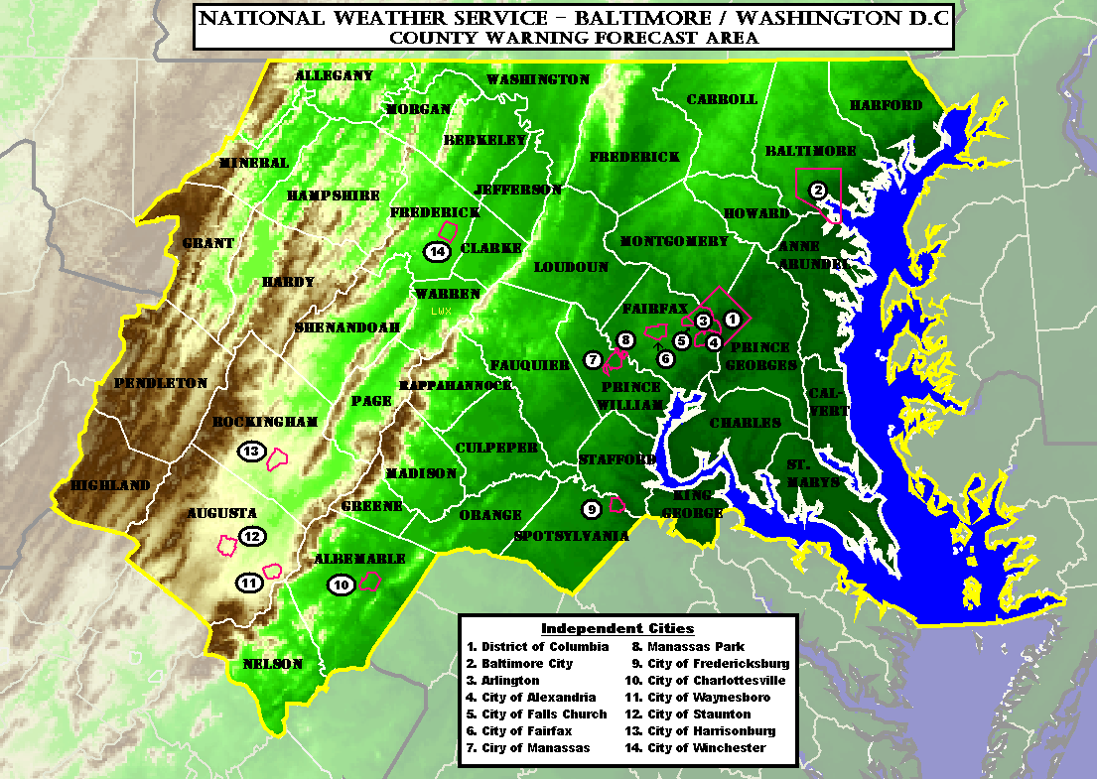
Operational Meteorology
What does an operational meteorologist or weather forecaster do?
  Create a basic prediction of a variety of weather parameters for a specified region
An area of responsibility can include:
  Mountains and Valleys
  Marine
  Aviation
Notes:
A forecaster or operational meteorologist are the same thing but what they do is create a basic prediction of a variety of weather parameters for a specified region. Like our region which include mountains valleys marine and aviation.

Slide 10
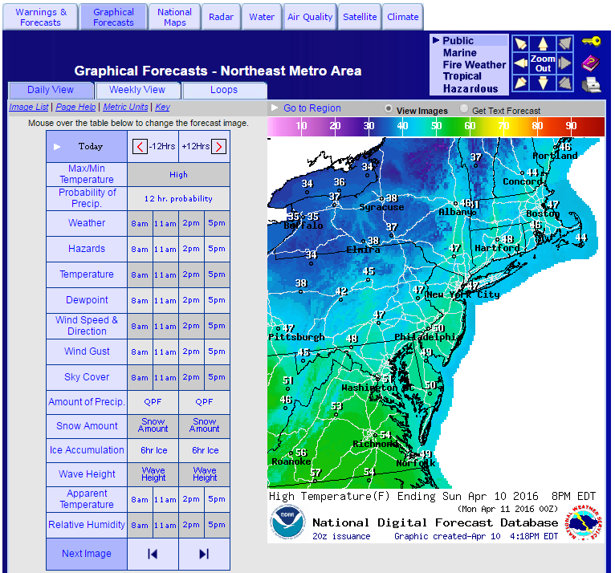
Operational Meteorology
Weather Parameters for next 7 days include:
  Hazardous Weather
  Temperature
  Wind and Wind Gusts
  Sky Cover
  Weather Type
  Probability of Precipitation
  Amount of Precipitation
  Relative Humidity
Notes:
They predict many different weather parameters which include

Slide 11
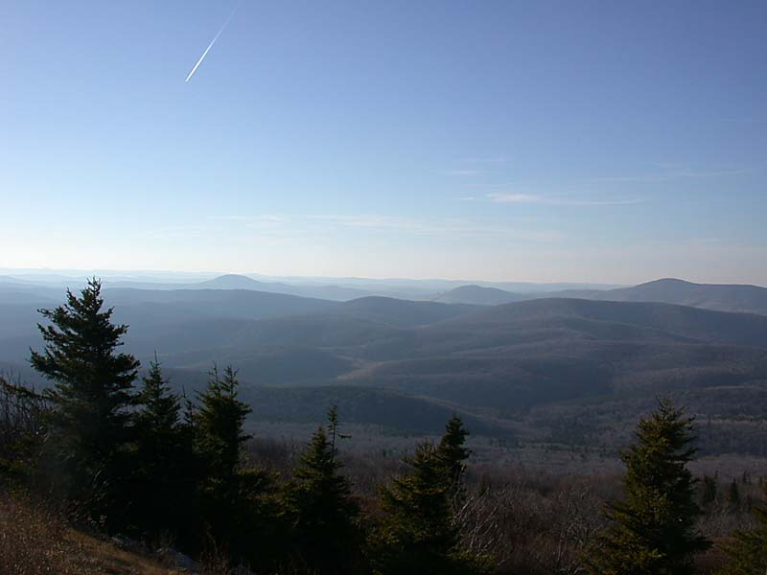
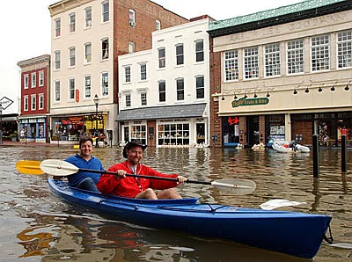
NWS Hazards
Spruce Knob,
Pendleton County, WV
Elevation 4,861 feet
Severe Weather
  Tornado
  Damaging Winds and Hail
Tropical Systems
  Hurricanes
  Tropical Storms
Non-Precipitation
  Heat Waves
  High Wind
  Wind Chill/Excessive Cold
  Dense Fog
Hydrological
  Flash Floods
  River Floods
  Small Stream & Tributaries
Winter Storms
Coastal Flooding
Wildfires
Marine
Annapolis,
Anne Arundel, MD
Elevation 39 feet
Notes:
And deal with a lot of hazards that can damage property and cause lose of life.

Slide 12
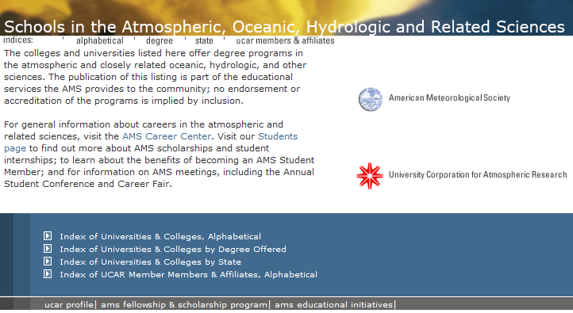
Colleges & Universities
http://www.ametsoc.org/AMSUCAR_CURRICULA/index.cfm
Notes:
There are many colleges and universities that carry meteorology as a degree. This website is very useful if you want search a school to see if they have meteorology. Also, you can search by degree offered or state.

Slide 13
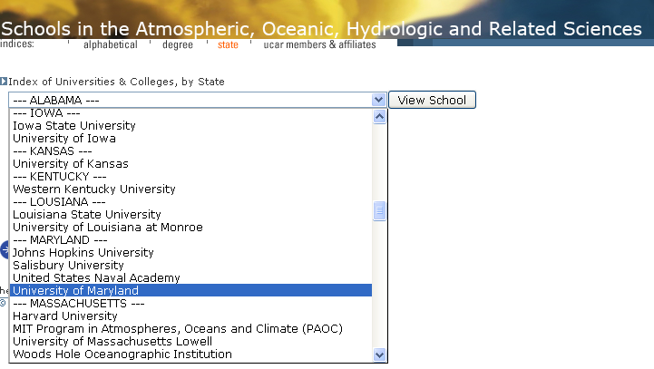
Colleges & Universities
http://www.ametsoc.org/atmoscareers/
Notes:
In MD, there are 4 schools that offer a degree

Slide 14




















Colleges & Universities
http://www.ametsoc.org/atmoscareers/
Notes:
Here are some I put together… they stretch all across the country as well as the world. Here are all the universities that the forecasters here went to.

Slide 15
Education
NWS Employment Requirements for a
Entry-Level Intern Position
  Degree: meteorology, atmospheric science, or other natural science major that included:
    24 semester hours of meteorology/atmospheric sciences
    6 semester hours of physics
    3 semester hours of physical meteorology
    3 semester hours of ordinary differential equations
    9 or more semester hours of course work appropriate for a physical science major
      Study what interests you
        Air pollution, statistics, computer science, oceanography, etc
Notes:
Here are the NWS employment requirements for a meteorologist intern position

Slide 16
Experience
Like starting any new career, it is important to gain experience
This can be achieved through many different programs:
  Student Internships & Volunteer Positions (Paid and Unpaid)
  Independent Research
  Attending Conferences
  Becoming a NWS Skywarn Spotter
Notes:
This can be achieved through many different programs such as internships, paid or unpaid. Our office has a unpaid student volunteer program every summer. It is competitive for college students.

Slide 17
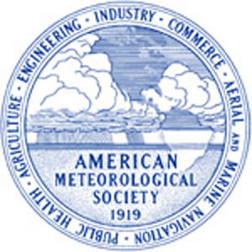
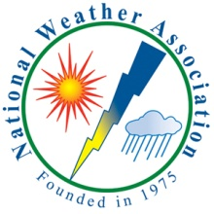
Professional Organizations
American Meteorological Society (AMS)
  http://www.ametsoc.org/
National Weather Association (NWA)
  http://www.nwas.org/
Notes:
Getting involved with the latest news and research is also helpful for a career in meteorology. Here are two accredited organizations in the field.

Slide 18
More Information
University of Oklahoma- School of Meteorology Page
  Prospective Undergraduate Students
AMS Education and Careers
  https://www.ametsoc.org/ams/index.cfm/education-careers/
National Science Foundation REU
  http://www.nsf.gov/crssprgm/reu/list_result.jsp?unitid=10020
NWS Baltimore/Washington DC Student Volunteer Program
    http://www.weather.gov/lwx/student

Slide 19
Questions ? / Remember…
Career opportunities for meteorologist are in many sectors including public, private, military and media
The NWS hires the most meteorologists across the United States and U.S. territories
Meteorologist degree programs are offered at many universities including many in MD and VA
  Math and science are critical skill levels to have
  Try and gain experience
  Heather Sheffield – Heather.Sheffield@noaa.gov
  Isha Renta – Isha.Renta@noaa.gov

