Slide 1
The signal in the Noise – Strong El Niño and the Mid-Atlantic
Open House – April 30-May 1 2016

Slide 2
What we’ll cover
Patterns from last winter
Forecast for the summer

Slide 3
El Niño/Southern Oscillation
NDJ 2015-16: 2.30
Notes:
There is a weak positive correlation between ENSO and precipitation during the cool season over the Mid-Atlantic. There is little to no correlation for temperature during the cool season over the Mid-Atlantic.

Slide 4
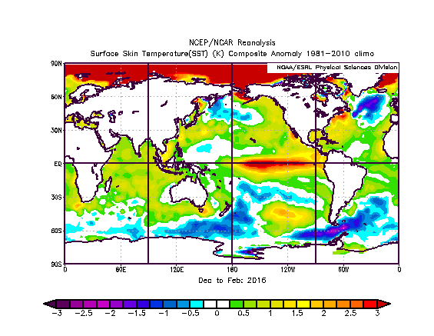
Winter Time Sea Surface Temperature Anomalies

Slide 5
North Atlantic Oscillation (NAO)
A measure of the jet stream pattern over the north Atlantic.

Slide 6
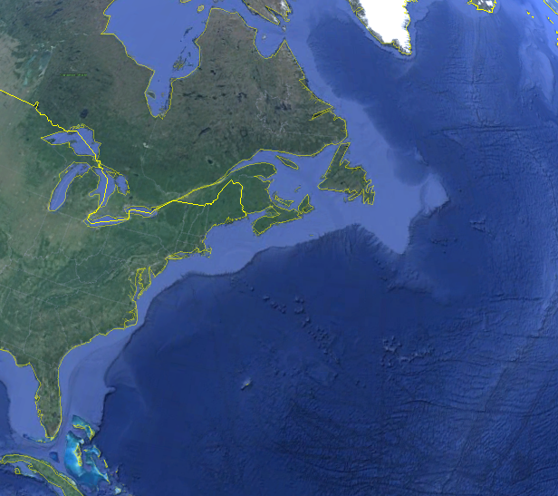
NAO – Positive Phase
L
bye….

Slide 7
NAO – Negative Phase
L
Uh oh….

Slide 8
North Atlantic Oscillation
2.751 (5-Dec-2015)
Notes:
There is a strong positive correlation between the NAO and temperature during the cool season over the Mid-Atlantic (i.e. a negative phase favors cooler than normal conditions). There is little to no precipitation correlation during the cool season over the Mid-Atlantic.

Slide 9
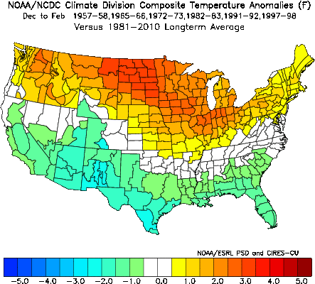
temperature anomalies during strong El Niño Events (Dec-Feb)
Above normal (50%): 1982-83, 1991-92, 1997-98
Near normal (17%): 1972-73 Below normal (33%): 1957-58, 1965-66
Rank (strongest Los Niños): 1) 1997-98 2) 1982-83 3) 1972-73 4) 1965-66 5) 1957-58 6) 1991-92
Notes:
2 below normal (1957-58, 1965-66); 1 near normal (1972-73); 3 above normal (1982-83, 1991-92, 1997-98); the years with below normal DJF temperatures had a –AO at least 1 SD below normal.

Slide 10
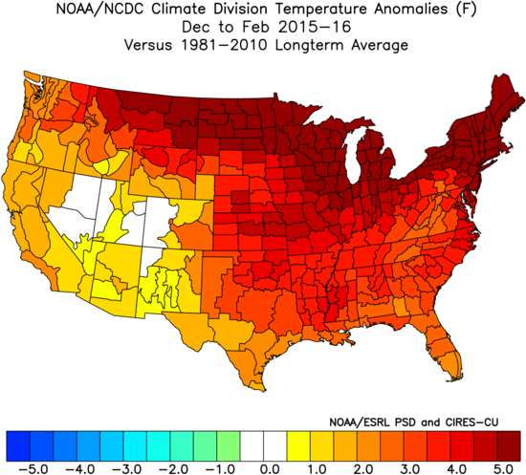
temperature anomalies Dec 2015-feb 2016
Notes:
3 above normal (1957-58, 1972-73, 1997-98), 1 near normal (1991-92), 2 below normal (1965-66, 1982-83)

Slide 11
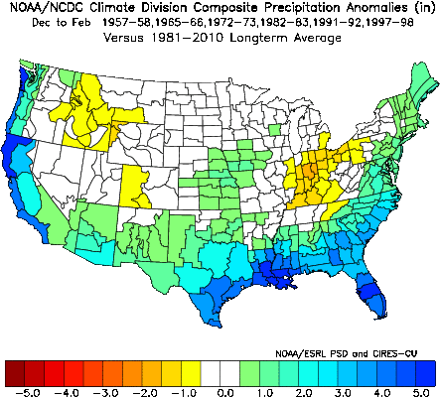
precipitation anomalies during strong El Niño Events (Dec-Feb)
Above normal (50%): 1957-58, 1972-73, 1997-98
Near normal (17%): 1991-92 Below normal (33%): 1965-66, 1982-83
Rank (strongest Los Niños): 1) 1997-98 2) 1982-83 3) 1972-73 4) 1965-66 5) 1957-58 6) 1991-92
Notes:
3 above normal (1957-58, 1972-73, 1997-98), 1 near normal (1991-92), 2 below normal (1965-66, 1982-83)

Slide 12
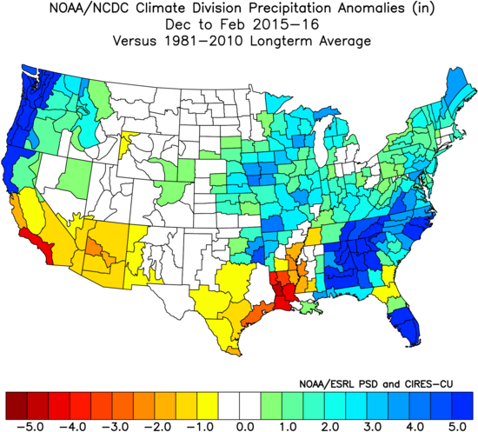
precipitation anomalies Dec 2015-feb 2016
Notes:
3 above normal (1957-58, 1972-73, 1997-98), 1 near normal (1991-92), 2 below normal (1965-66, 1982-83)

Slide 13
Strong El Niño Snowfall

Slide 14
Strong El Niño Snowfall

Slide 15
This winter featured…
A record warm December
One enormous blizzard
A few cold snaps, but overall well above normal temperatures

Slide 16
Summer 2016 Outlook
From CPC

Slide 17
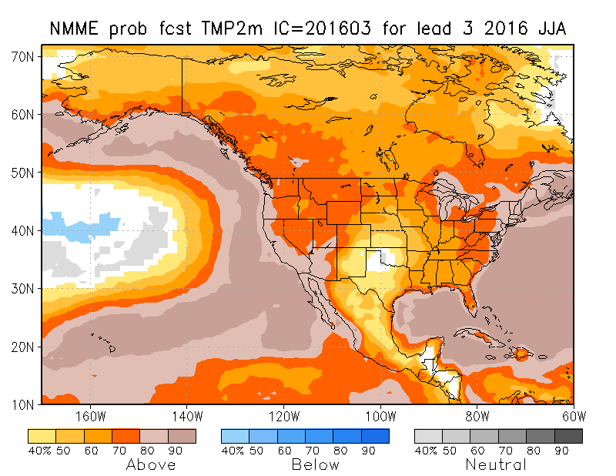
Summer Temperature Probabilities (model forecast)

Slide 18
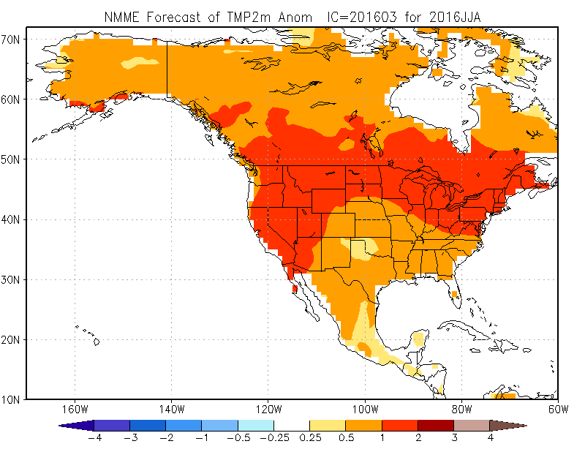
Summer Temperature Anomaly Forecast (Model Forecast)

Slide 19
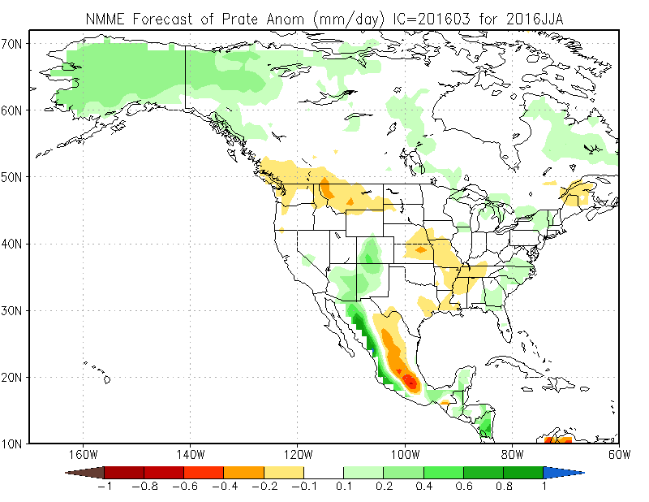
Summer Precipitation Forecast (Model Forecast)

Slide 20
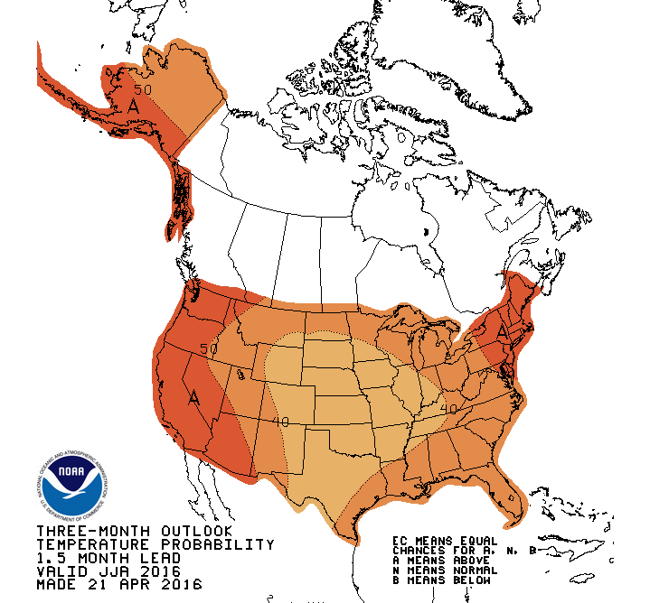
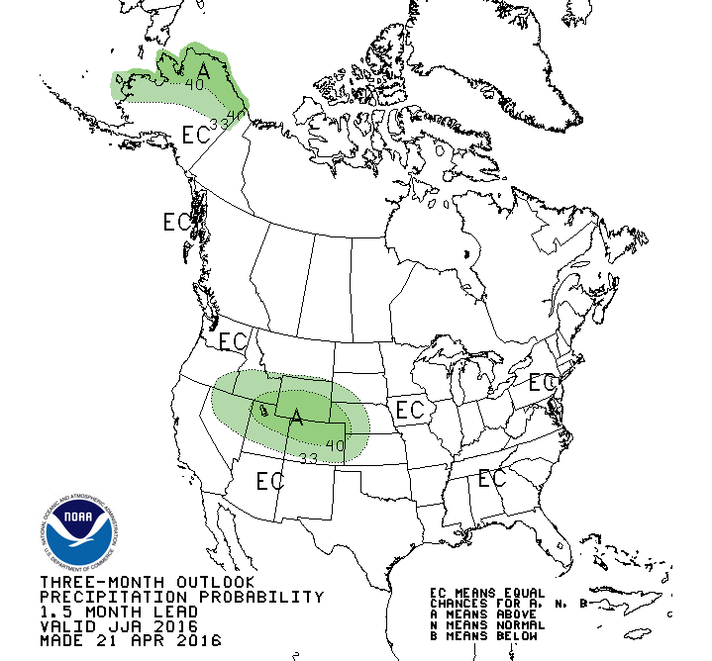
CPC Final Summer Outlook will be released in mid-May

Slide 21
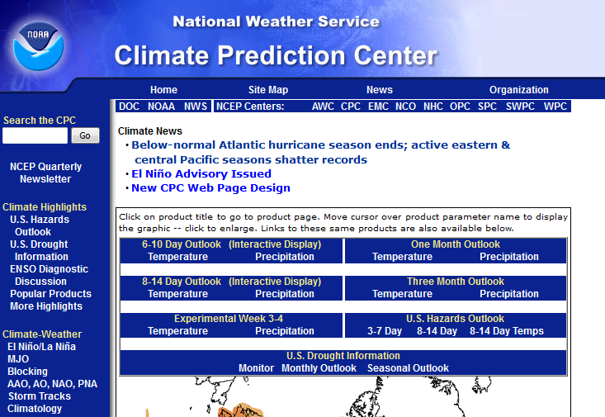
Climate Prediction Center www.cpc.ncep.noaa.gov
Climate headlines

Slide 22
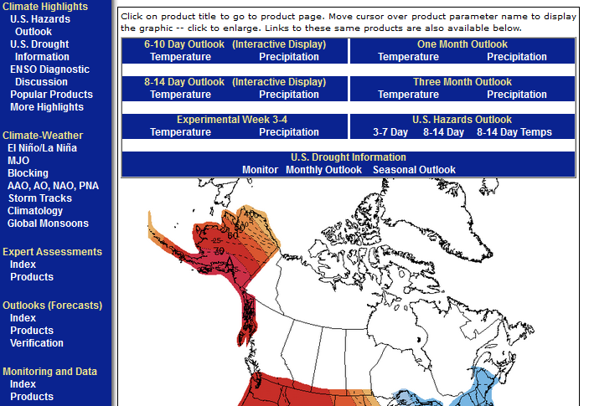
Climate Prediction Center www.cpc.ncep.noaa.gov
Climate outlooks
Climate patterns

Slide 23
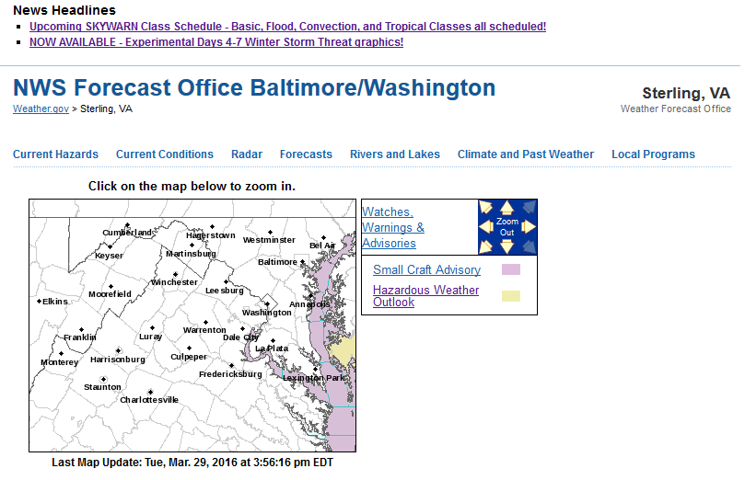
Our Local Climate Page www.weather.gov/lwx

Slide 24
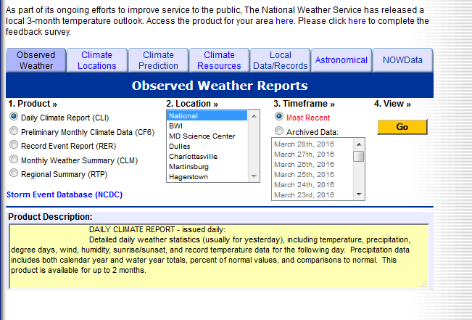
Our Local Climate Page www.weather.gov/lwx

Slide 25
Things to remember
Last winter was abnormally warm with one big blizzard
Trend for above normal temperatures may continue through summer
www.cpc.noaa.gov : National climate forecasts
www.weather.gov / washington : Local climate information

