Slide 1
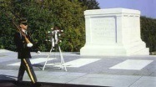
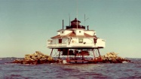
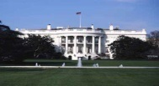
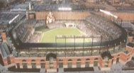
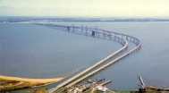
NOAA National Weather Service Baltimore/Washington
Weather Forecast Office
"Building Community Awareness
to
Reduce Hazardous Weather Impacts”
April 30, 2016
Jim Lee
Meteorologist-in-Charge

Slide 2
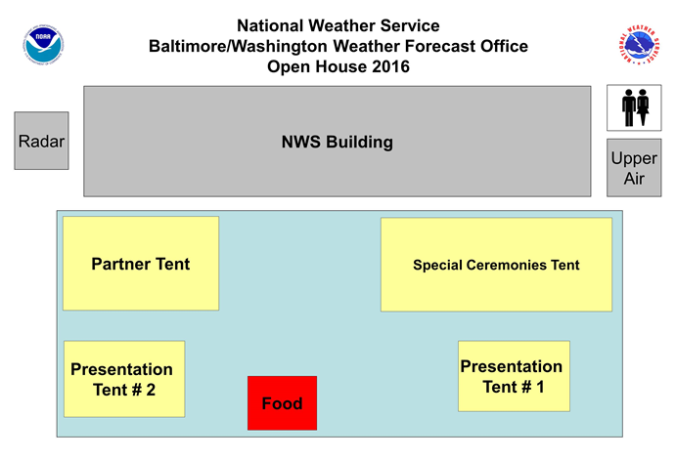
Welcome!

Slide 3
Overview
Introduction to NOAA & the National Weather Service
Weather Forecast Office Responsibilities
Operations & Services
Open House Highlights
Summary
Forecast Operations Area
NWS Baltimore/Washington
Sterling, VA

Slide 4
National Oceanic and Atmospheric Administration (NOAA)
NOAA is an agency within the U.S. Department of Commerce
NOAA Research
NOAA Satellite & Information Service
NOAA Oceans & Coasts Service
NOAA Fisheries
NOAA Marine & Aviation Operations
NOAA Program Planning and Integration
NOAA National Weather Service

Slide 5
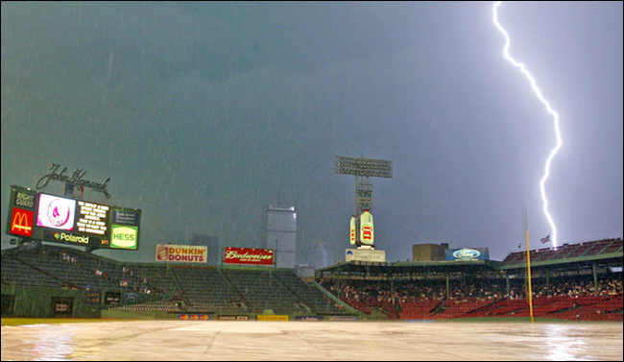
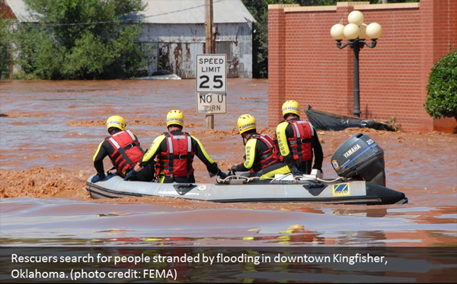
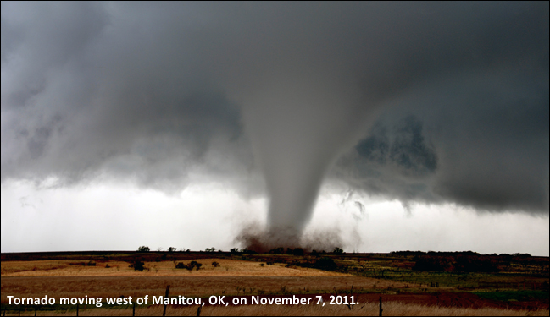
NWS Mission
Provide weather, water, and climate data, forecasts and warnings for the protection of life and property and the enhancement of the national economy
“Building community awareness to reduce hazardous weather impacts”

Slide 6
National Weather Service Overview
The average person only sees the tip of the iceberg
TV
Internet
Cell phone
Radio
NWR
Private Weather Companies
National Centers for
Environmental Prediction
Model Simulations/Space Weather
Climate & Seasonal Outlooks Aviation & Marine Forecasts
Storm & Tornado Prediction Hurricane Tracks
Weather Forecast Offices Local Forecasts & Warnings
NATIONAL WEATHER SERVICE
River Forecast Centers
River Forecasts, Hydropower, Flood warnings
Irrigation, River Navigation
Observations
Radar Network, Satellites, Weather Balloons, Ground-level observations at airports, Aircraft, Lightning Network, Data Buoys, Stream Gauge Network, 11,000 Volunteer daily-data collectors, Thousands of Volunteer storm spotters

Slide 7
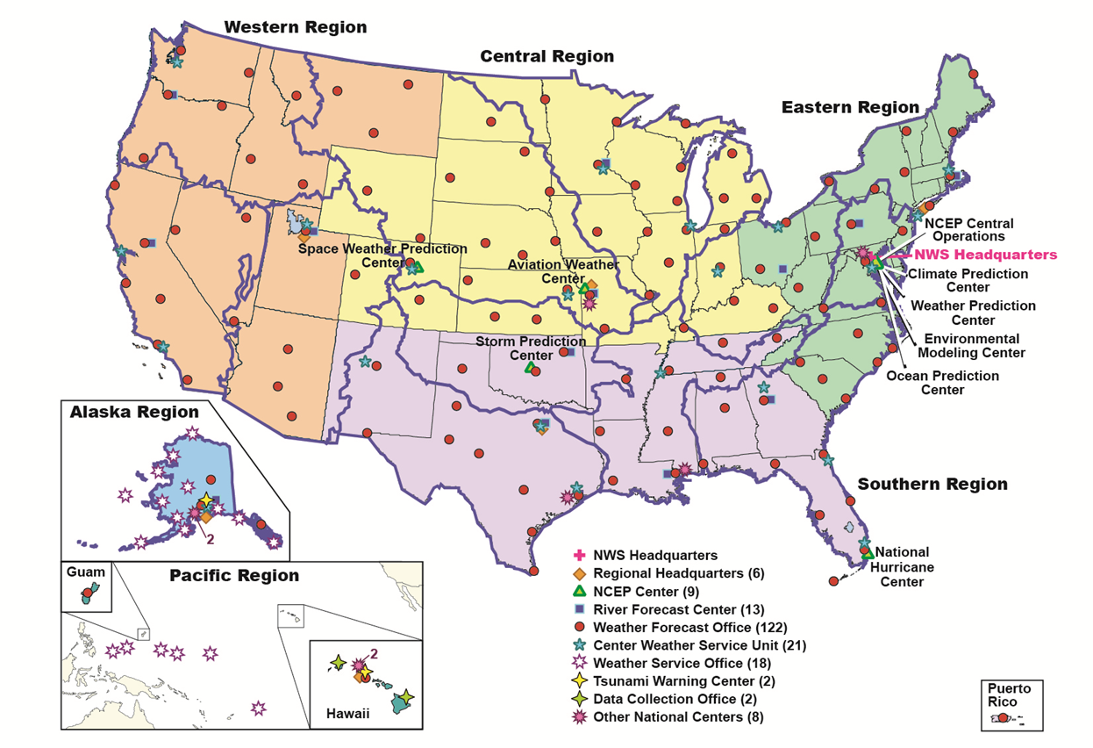
NWS Facilities

Slide 8
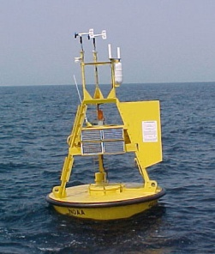
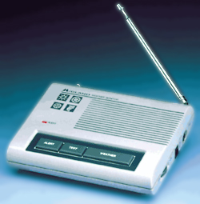
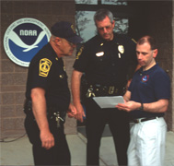
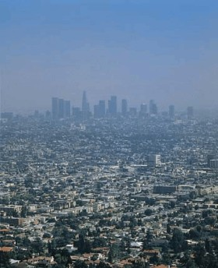
NWS Service Delivery
Observe
Distribute
Respond & Feedback
Products & Services
Process
Central
Guidance
Local
Offices
Feedback

Slide 9
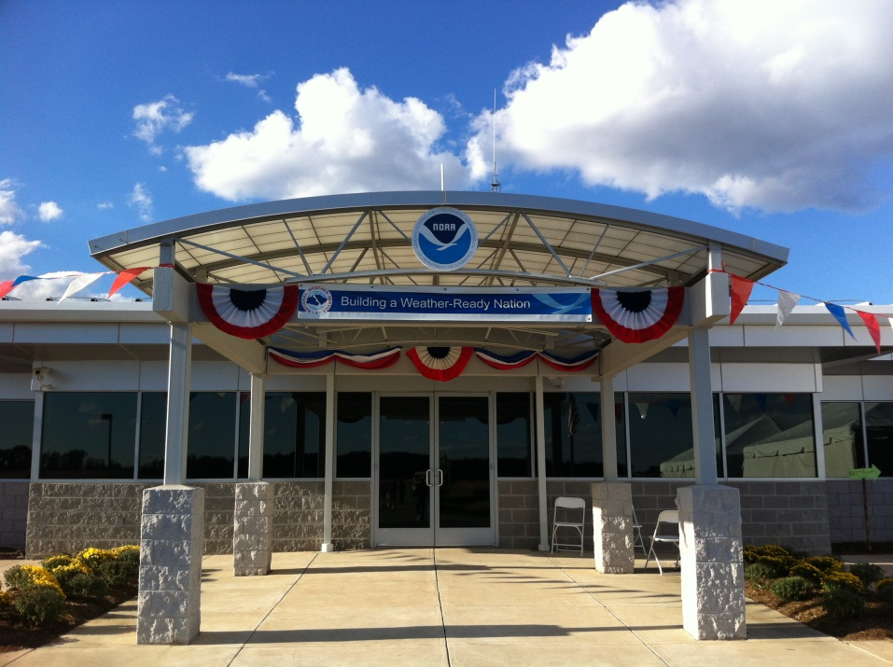
Weather Forecast Office (WFO) Responsibilities
Issue all local forecasts and warnings
Build and maintain relationships with local and state governments
Provide expert advice to emergency managers and other decision makers
Conduct community awareness and education programs
Train volunteer observers and storm spotters
NWS Baltimore/Washington
Sterling, VA

Slide 10
Key Partnerships
Emergency managers
Other government agencies
Broadcast and print media
Sky Warn Spotters
Amateur Radio Operators
Cooperative Observers
U.S. Capitol
Washington, DC

Slide 11
WFO Area of Responsibility
Approximately 27,000 square miles
Serving 9.3 Million People
Maryland
13 Counties
City of Baltimore
Chesapeake Bay
West Virginia
8 Counties
Virginia
22 Counties
11 independent cities
District of Columbia
Region is prone to all weather hazards
Notes:
River Basins
Potomac
Shenandoah
Rappahanock
16,200 square miles
Registered Boaters: ~ 200,000
Avg. Daily Flights: ~ 3,200
Population (2000): ~ 8,500,000

Slide 12
WFO Hydrologic Area of Responsibility
River Basins
Potomac
11,600 square miles
22 forecast points
Shenandoah
3,050 square miles
6 forecast points
Rappahannock
1,580 square miles
2 forecast points
Notes:
Registered Boaters: ~ 200,000
Avg. Daily Flights: ~ 3,200
Population (2000): ~ 8,500,000

Slide 13
Operations & Services
Warnings
Convective
Tornado
Severe Thunderstorm
Tropical Systems
Hurricanes
Tropical Storms
Non-Precipitable
Heat Waves
High Wind
Wind Chill/Excessive Cold
Hydrological
Flash Floods
River Floods
Small Stream & Tributaries
Winter Storms
Coastal Flooding
Wildfire (Red Flag)
Spruce Knob, Pendleton County, WV
Elevation 4,861 feet
Notes:
I am very glad to be here, and feel privileged to be your MIC
Research

Slide 14
Operations & Services (cont.)
Forecasts
Public
Marine
Aviation
Fire Weather
River
Support Services
Homeland Security
Data Collection
Climate
Cooperative Observers
Tomb of the Unknown Soldier
Arlington, VA
Notes:
I am very glad to be here, and feel privileged to be your MIC
Research

Slide 15
Communicating Weather Information: How Do We Get Our Message Out?
NOAA Weather Radio
National Warning System
Emergency Alert System
Wireless Emergency Alerts
Broadcast, print, & internet media
Private sector meteorologists
Internet
Great Falls of the Potomac
Potomac, MD
Notes:
Schedule – ET/ITO integration

Slide 16
Staffing
24x7 staffing, comprising a total of 25 people:
5 Senior Forecasters
5 General Forecasters
5 Meteorologist Interns & Hydro-Meteorological Technicians
3 Electronic Technicians
1 Administrative Support Assistant
1 Information Technology Officer
1 Service Hydrologist
1 Electronic Systems Analyst
1 Warning Coordination Meteorologist
1 Science and Operations Officer
1 Meteorologist-in-Charge
Jefferson’s Monticello
Charlottesville, VA

Slide 17
NWS Baltimore/Washington Home Page http://weather.gov/washington

Slide 18
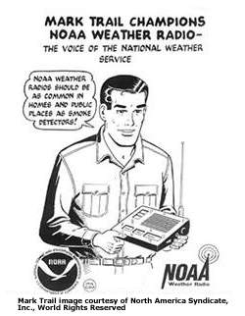
NOAA Weather Radio All Hazards
Nationwide network of radio stations broadcasting continuous weather and emergency information
Our office runs stations at:
Manassas, VA
Covesville, VA
Fredericksburg, VA
Pikesville, MD
Frostburg, MD
Hagerstown, MD
Moorefield, WV
Washington, DC
Every home should have one!

Slide 19
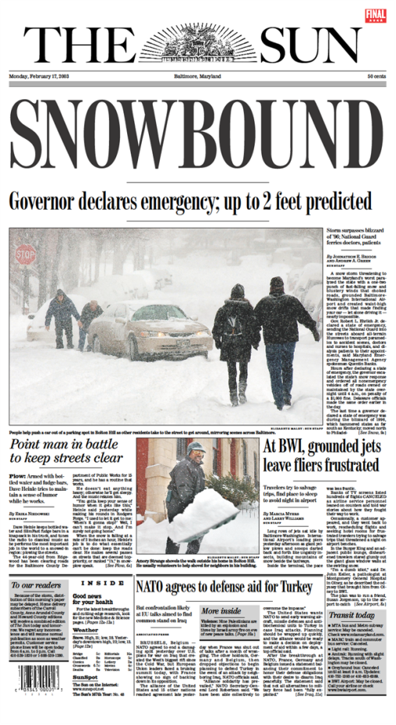
You Can Help Build a Weather-Ready Nation
HOW?
Make an action plan for extreme weather
Become weather-aware
Take action when needed
Spread the news of being weather-aware with friends and family
“Become weather-aware to make better decisions”

Slide 20
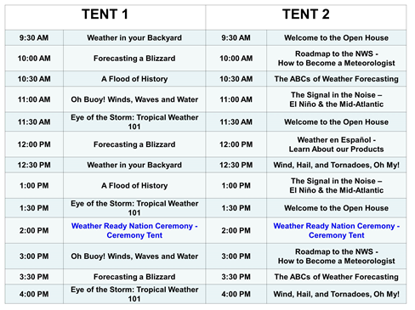
Open House: Saturday Schedule

Slide 21
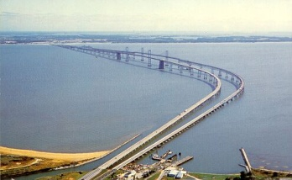
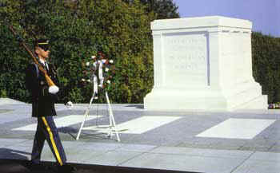
Summary
We are glad you are attending our Open House!
Baltimore/Washington WFO serves about 9.3 million people
Diverse geographic area that is prone to all weather hazards
Become weather-aware to lessen impacts from hazardous weather!
Notes:
I am excited and privileged to be here
Goal is to have 100% of staff in their “sweet-spot”
Competent
Focused
Confident
Organizational sweet-spot: “Focus and Execution”
Why/Who? Clear mission and values
How/When? Line-of-sight strategy on how to accomplish mission

