Slide 1


Oh Buoy!
Bryan A. Jackson
LWX Marine Program Leader

Slide 2
Baltimore/Washington Office Marine Operations

Slide 3

Our Goal
Danger!
People dying on the water due to weather is the biggest “weather killer” in our region
Through our marine forecasts & warnings…
  Keep everyone on the waters safe and informed
    Prepared through our forecasts
    Ready to seek a harbor quickly when warned
Works both ways:
  We provide forecasts & warnings
  You need to receive and monitor them

Slide 4
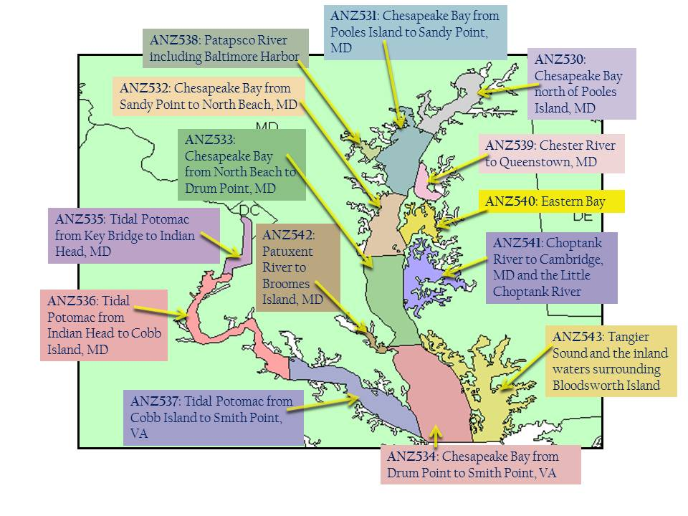
Marine Zones
Notes:
14 zones

Slide 5
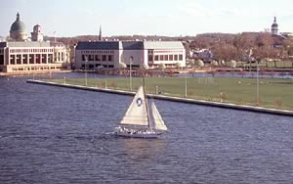
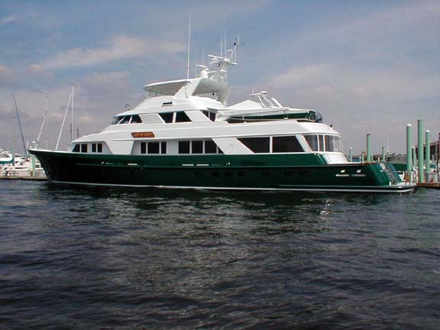
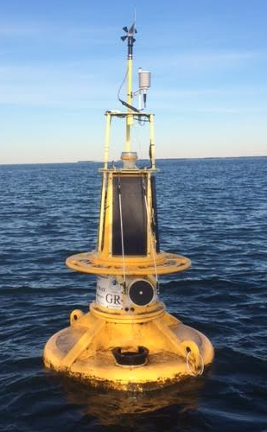
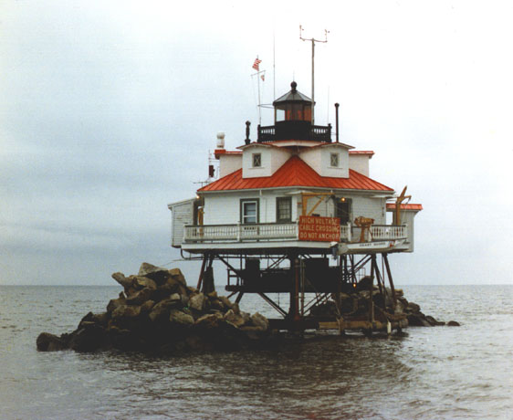
Coastal Waters Forecast
Issued every 3 hours - amended as necessary
5 day forecast, two periods per day (6am, 6pm)
Synopsis, Long-Fused Headlines
Wind – from 8 compass points (knots)
Waves – wave heights (feet)
Weather – thunderstorms, rain, snow and fog

Slide 6
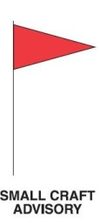

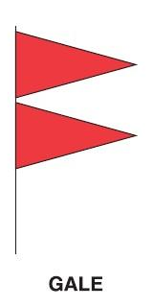

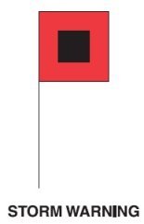


Long-Fused Marine Wind Headlines
Hazard/Signal | Conditions | Night Signal
 | Small Craft Advisory Sustained winds or frequent gusts 18-33 kt
 | Gale Warning Sustained winds or frequent gusts 34-47 kt
 | Storm Warning Sustained winds or frequent gusts 48-63 kt
 | Hurricane Force Wind Warning Sustained winds or frequent gusts > 64 kt
Issued when expected within 36 hours
Notes:
Hurricane Force Wind Warning: >= 64 kt.

Slide 7
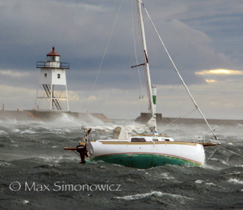
Short-Fused Marine Headlines
Special Marine Warning (< 2 hours)
- Showers/Thunderstorms with gusts > 34 kt
Waterspouts
Penny Hail (or larger)
If storms with > 34 kt winds will repeatedly affect waters, Gale Warning issued.
Marine Weather Statement
Update a Special Marine Warning
Winds or gusts of 18-33 kt < 2 hours.
Advance alert to warning conditions (i.e. Derecho)
- Hazards: dense fog, low water levels
Notes:
Hurricane Force Wind Warning: >= 64 kt.

Slide 8
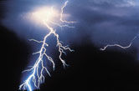
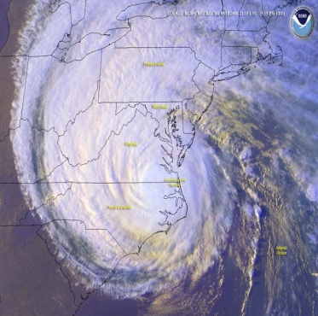
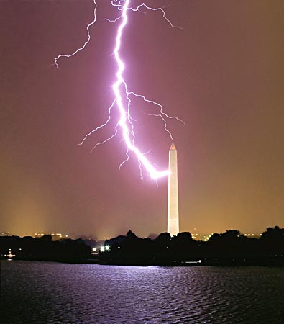
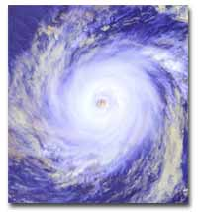
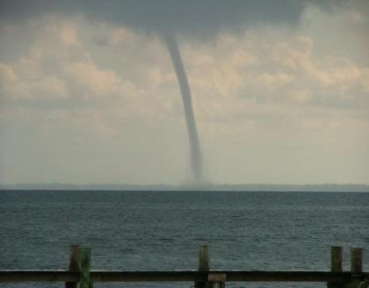
Tropical and Convective Storms
Convective Watches (SPC)
Tornado Watch
(tornadoes are considered water spouts for marine areas)
Severe Thunderstorm Watch
(note the expected wind speed in SMW; it could be > 50 kt)
Tropical Watches/Warnings (NHC)
Tropical Storm (sustained winds 34 to 63 kt / 39 to 73 mph)
Hurricane (sustained winds > 64 kt / > 74 mph)

Slide 9
Marine Forecast Grids
We forecast for 10-meter (33’) wind & wind gust
Nearshore Wave Prediction System (NWPS)
  State of the art wave forecast model
    High resolution shoreline, bathymetry
  Implemented in March 2015
  Graphically shows wave heights
    Our marine webpage:
    www.weather.gov /washington /marine

Slide 10
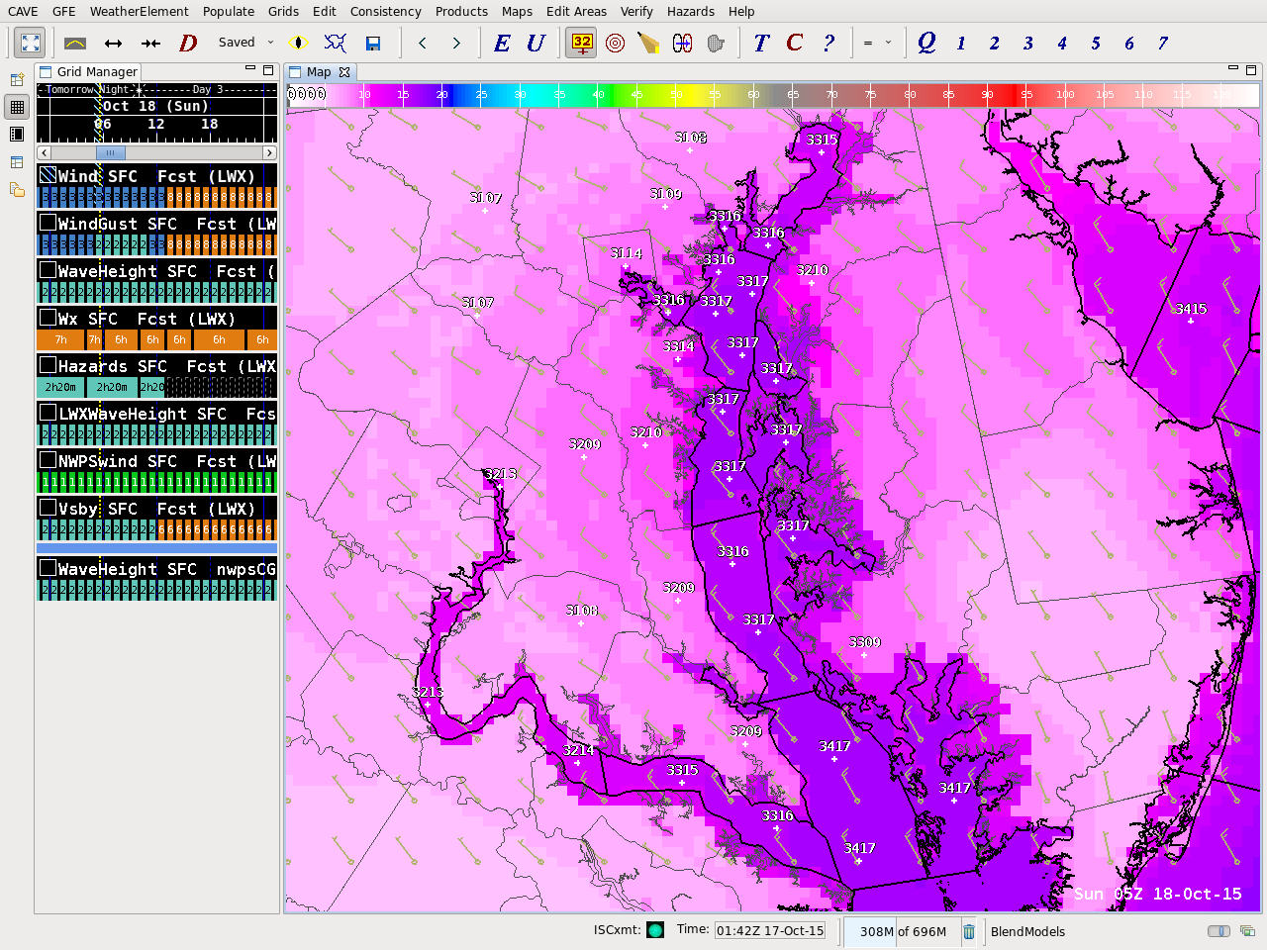
Sustained Wind
NW 13-17 knots

Slide 11
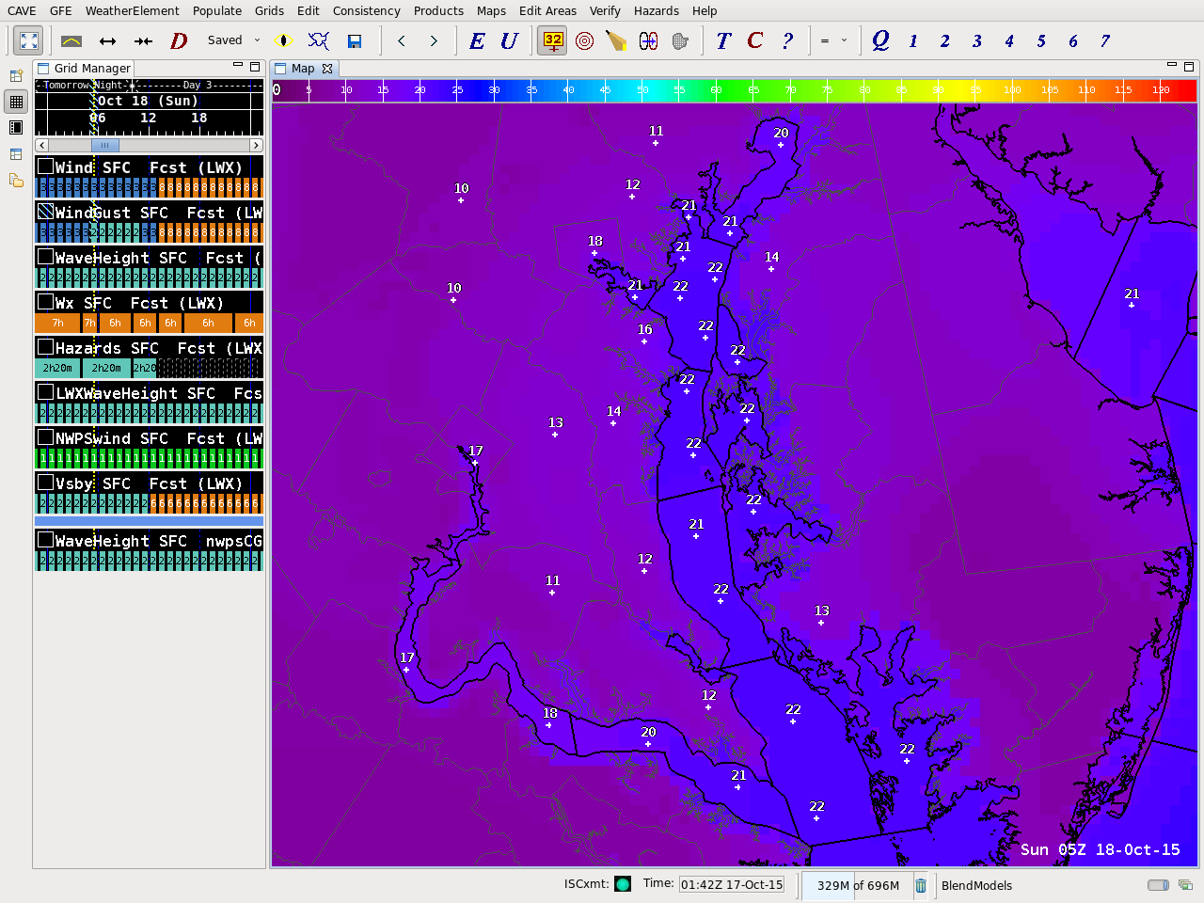
Wind Gusts
NW 18-22 knots

Slide 12
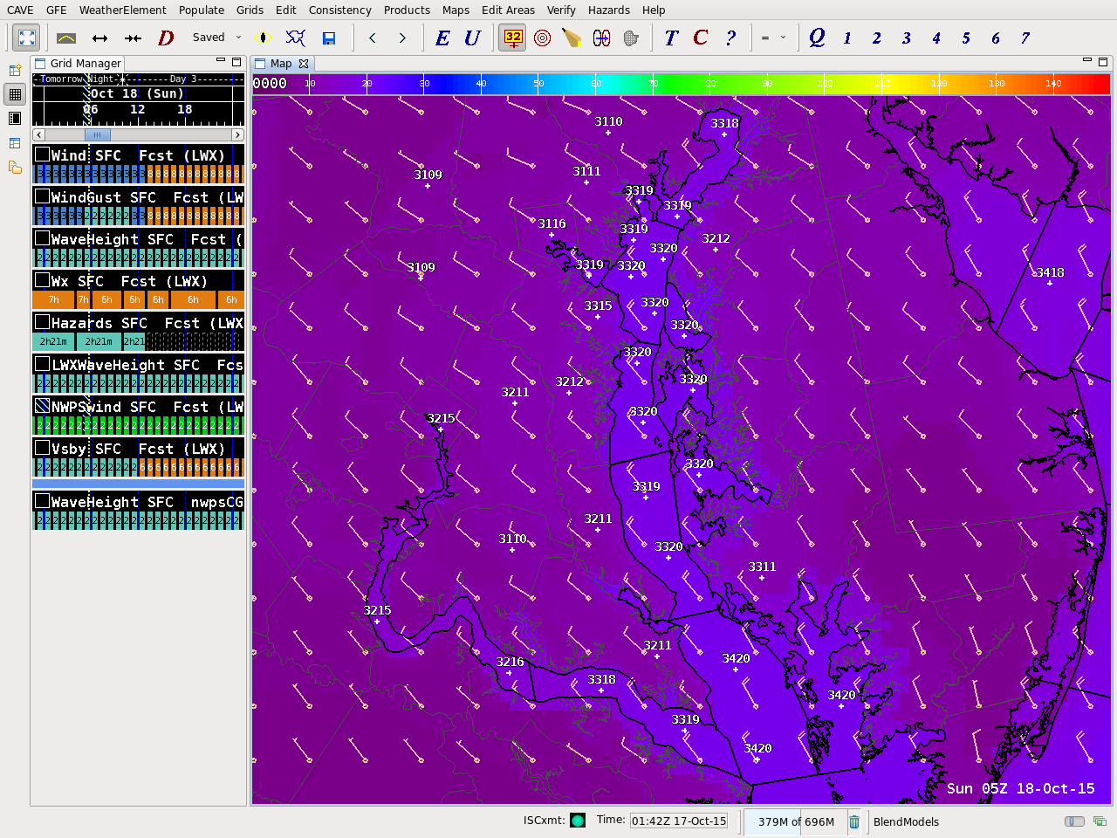
NWPS Wind
NW 15-20 knots

Slide 13
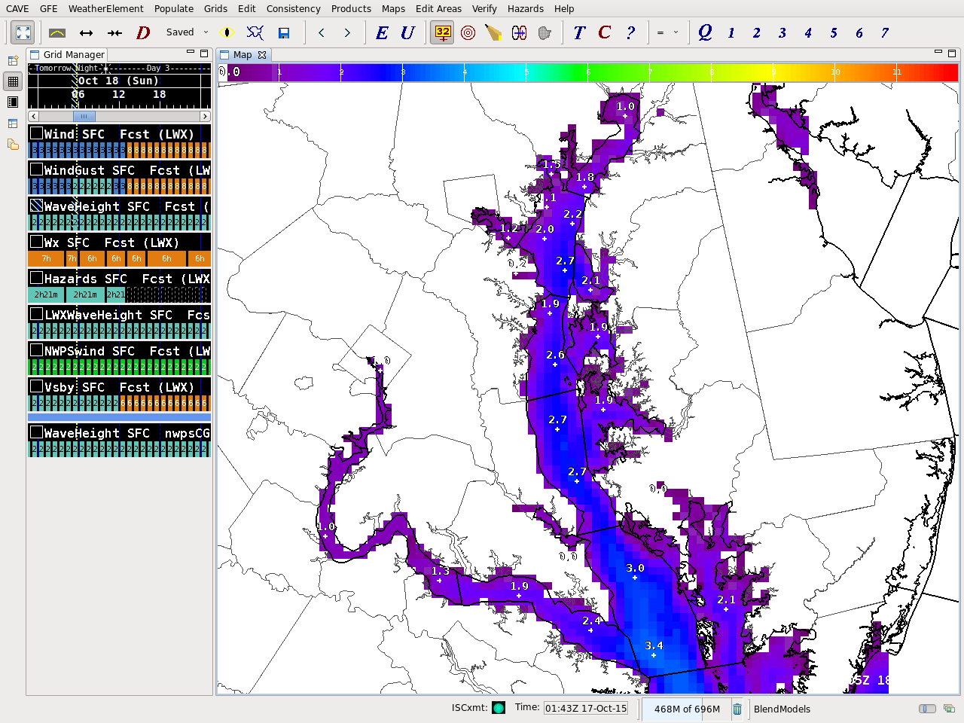
Wave Heights
1 to 3 feet

Slide 14
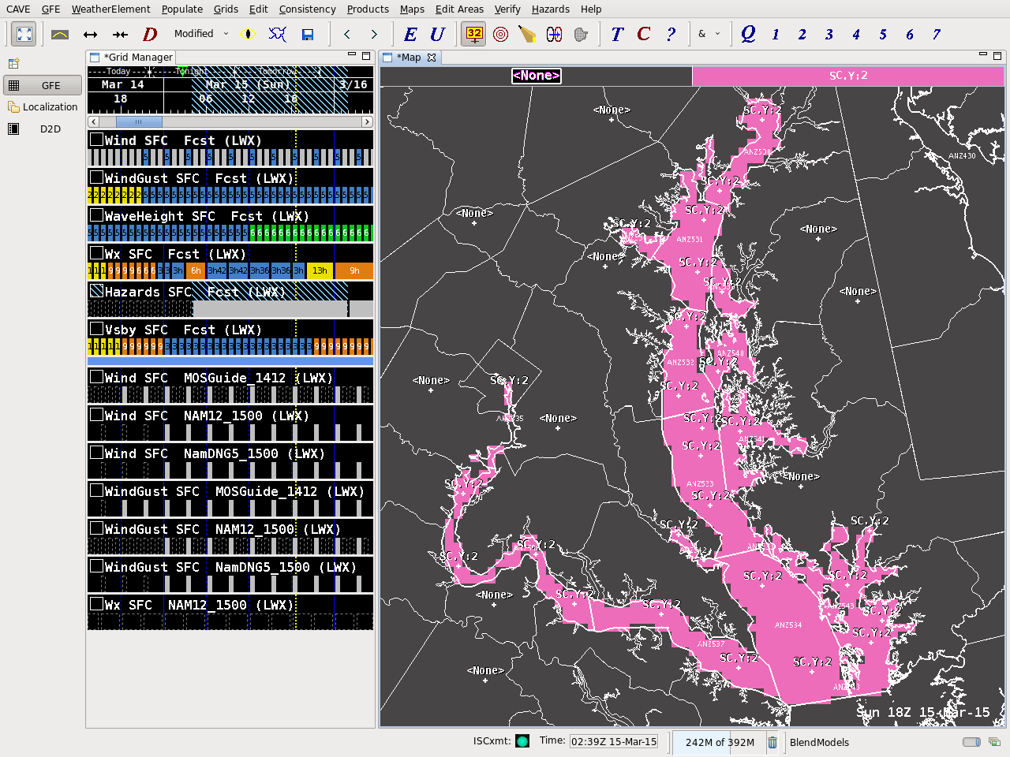
Small Craft Advisory

Slide 15
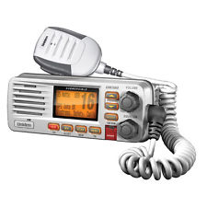
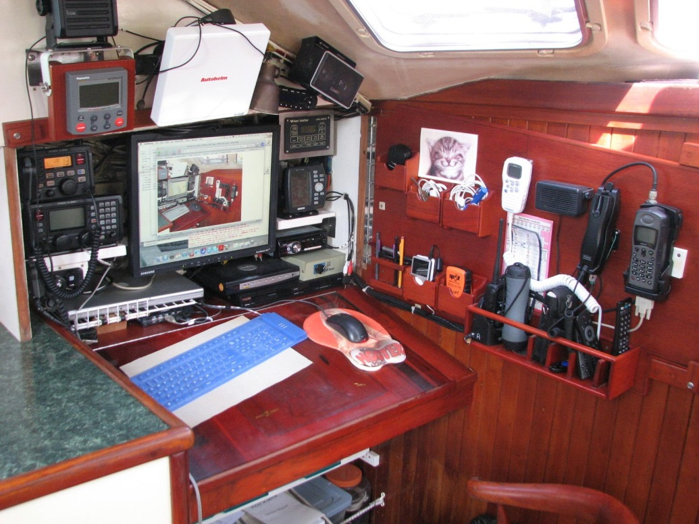
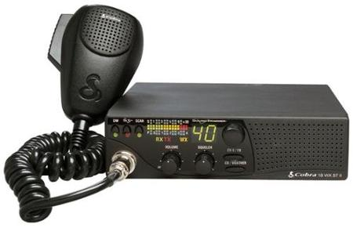
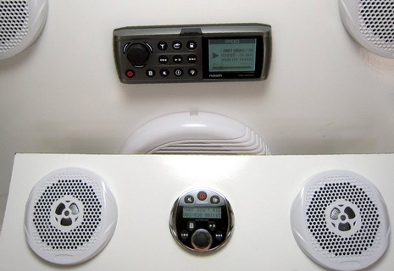
NOAA Weather Radio

Slide 16
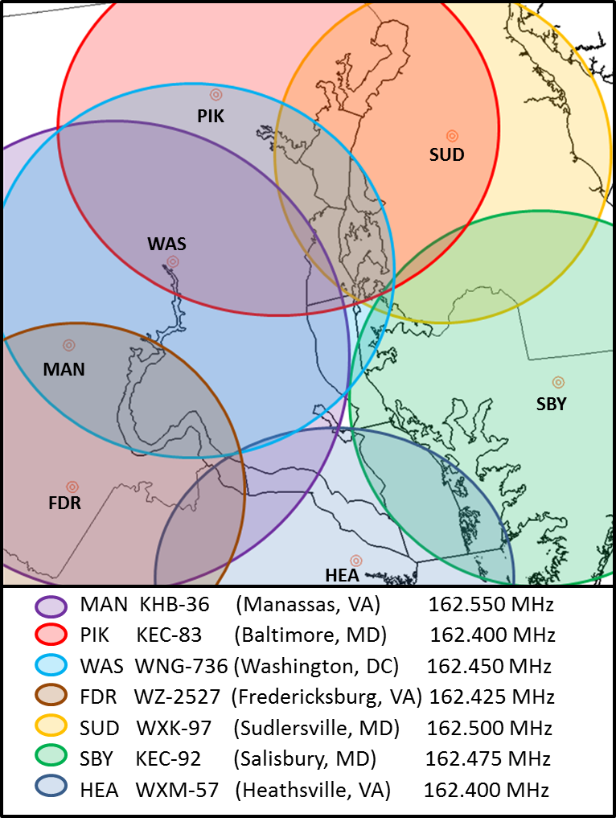
NOAA Weather Radio
Mariners are a top NWR user group
Seven transmitters cover our marine area
  Tone Alert
    Special Marine Warnings
  Coastal Waters Forecast
  Marine Wind Headlines
  Observations

Slide 17
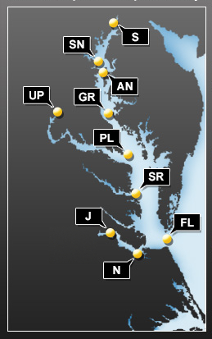
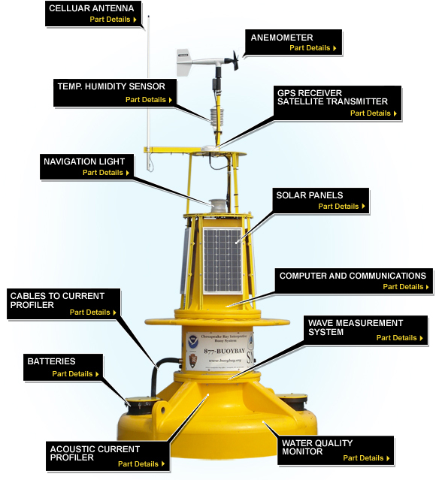
Buoys
Chesapeake Bay Interpretive Buoy System (CBIBS)
  Launched 2007-2010
The only wave sensors on the Bay
Access Data at buoybay.noaa.gov
Dial-A-Buoy
  877-BUOY-BAY
  877-2869-229
“SmartBuoys” App

Slide 18

Questions? / Remember This…
No weather threat kills more people in our area than strong (often sudden) winds on the waters
We warn for dangerous marine weather
  Weather Ready Nation includes marine safety/awareness
Poor Awareness > capsize > can easily turn fatal quickly
Know the forecast ahead, have access to updates out there

Slide 19
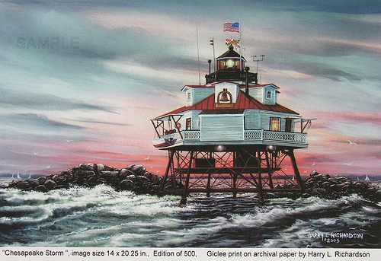
Thank You
Contact Me…
Bryan.Jackson@noaa.gov
Marine Program Leader
Marine Reports:
1-800-253-7091
Notes:
Freezing Spray

