Slide 1
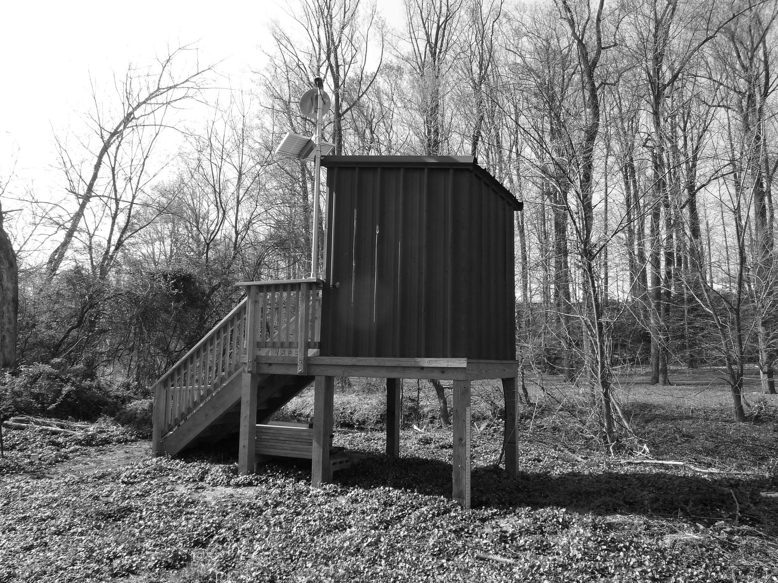
A Flood of History: The Past, Present, and Future of Flooding in the Mid-Atlantic
Jason Elliott Senior Service Hydrologist
NWS Baltimore/Washington Open House
April 30 – May 1, 2016

Slide 2
It’s True!
“Those who cannot remember the past are condemned to repeat it.” -George Santayana (1905)

Slide 3
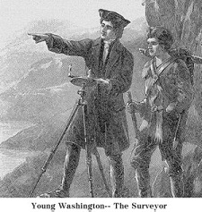
Flood History
Did you know? Flood History in this region dates back to at least 1748!
Per historical accounts, as a young surveyor, George Washington was “blocked by flooding of the Potomac, which had been caused by the sudden runoff of snowmelt high in the Appalachians” (Randall, 1998).

Slide 4
Flood History
Did you know?
Five of the seven biggest floods in the Potomac region have decadal anniversaries within a one year period (Nov 2015 – Oct 2016):
October 1896 120 years ago March 1936 80 years ago November 1985 30 years ago
January 1996 20 years ago
September 1996 20 years ago
Also major anniversaries this year:
June 2006 (flash flood) 10 years ago September 2011 (flash flood) 5 years ago

Slide 5
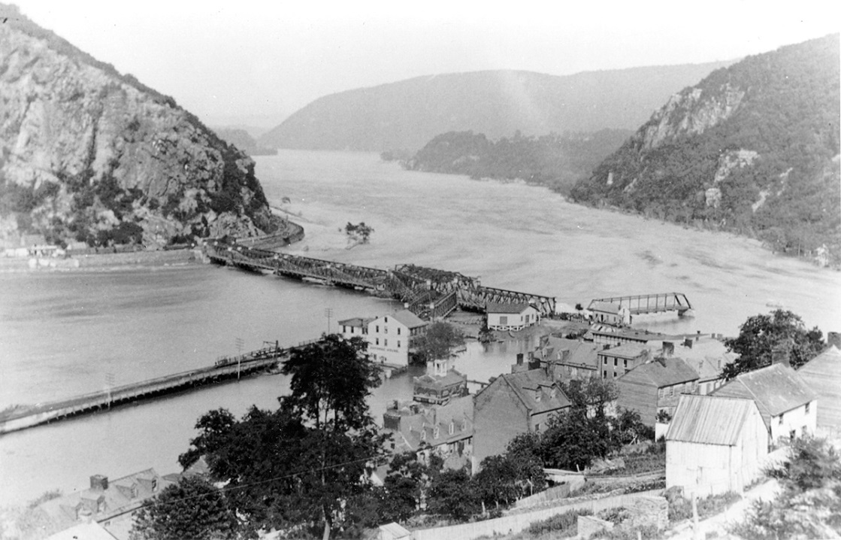
September 30 – October 1, 1896
Twenty-sixth anniversary (to the day) of another major flood in 1870
Caused by a tropical storm / hurricane
Rivaled the 1889 flood in Harpers Ferry
Flood of June 1, 1889 in Harpers Ferry. The Bollman Bridge across the Potomac River survived the flood, but the Shenandoah wagon bridge was swept away. John Brown’s Fort is all that’s left of the old Armory. (Photo courtesy David T. Gilbert; from the Historic Photo Collection of Harpers Ferry National Historical Park)

Slide 6
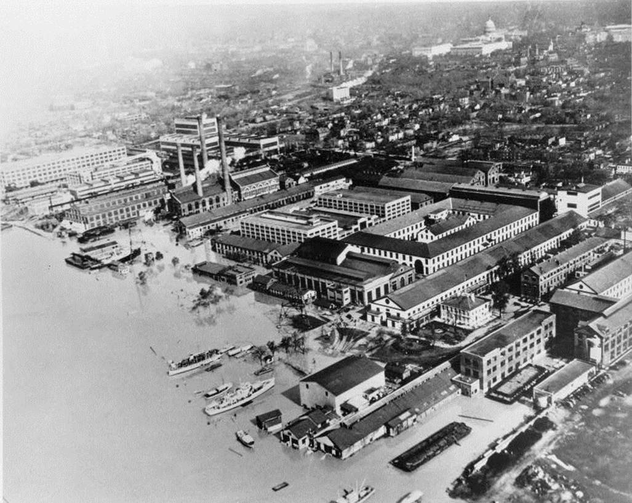
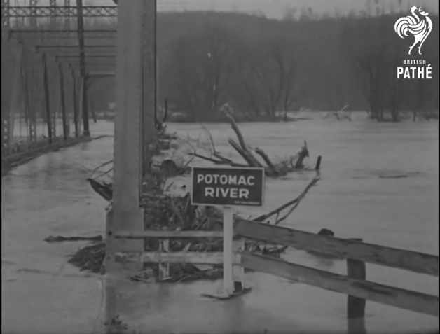
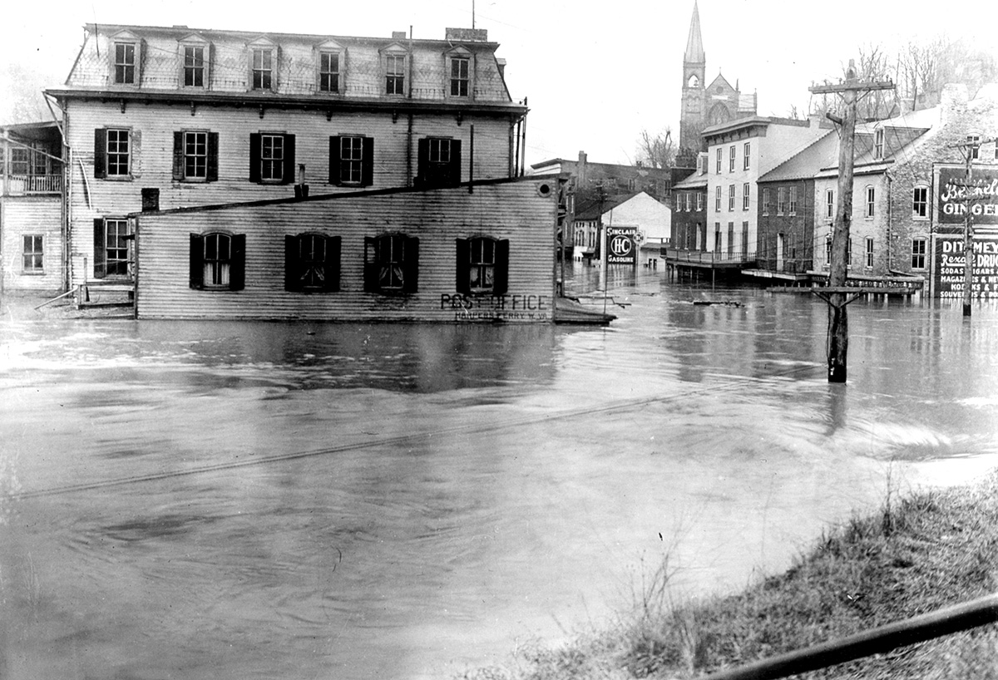
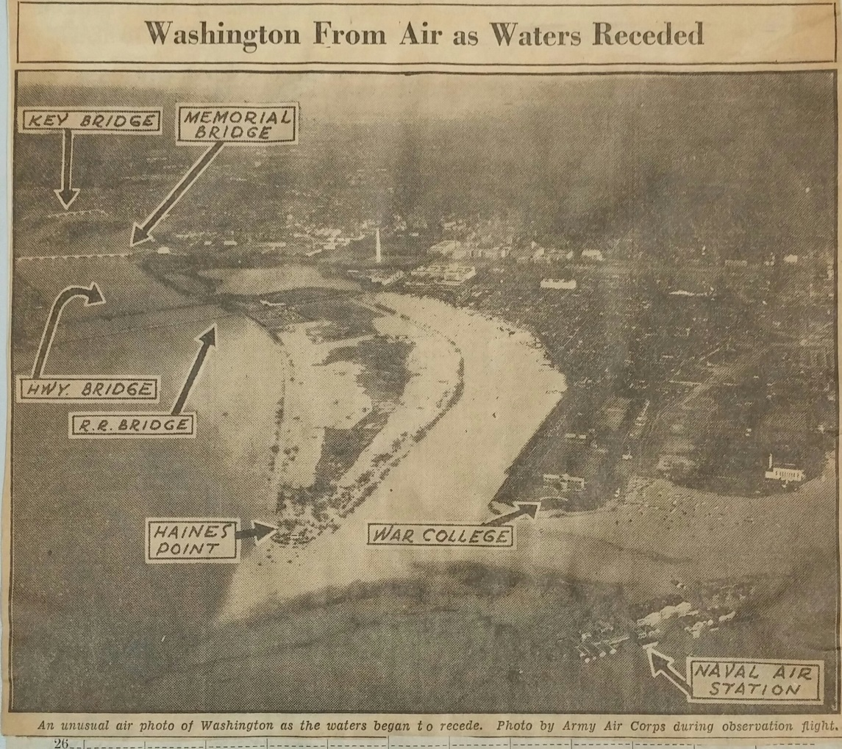
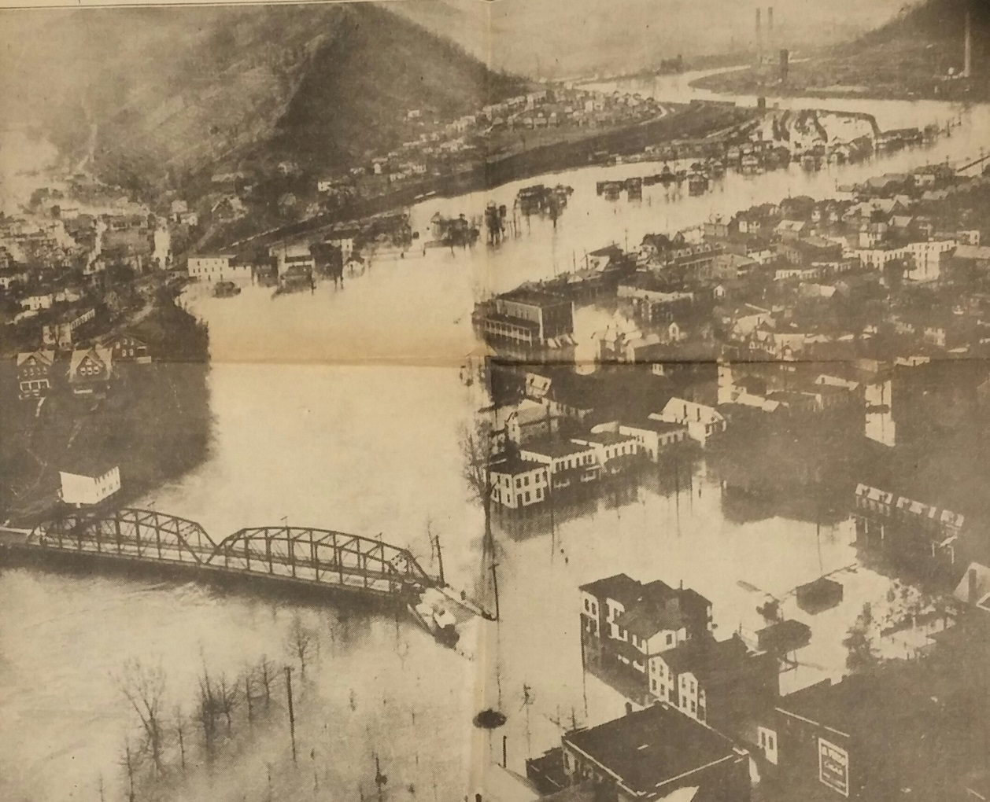
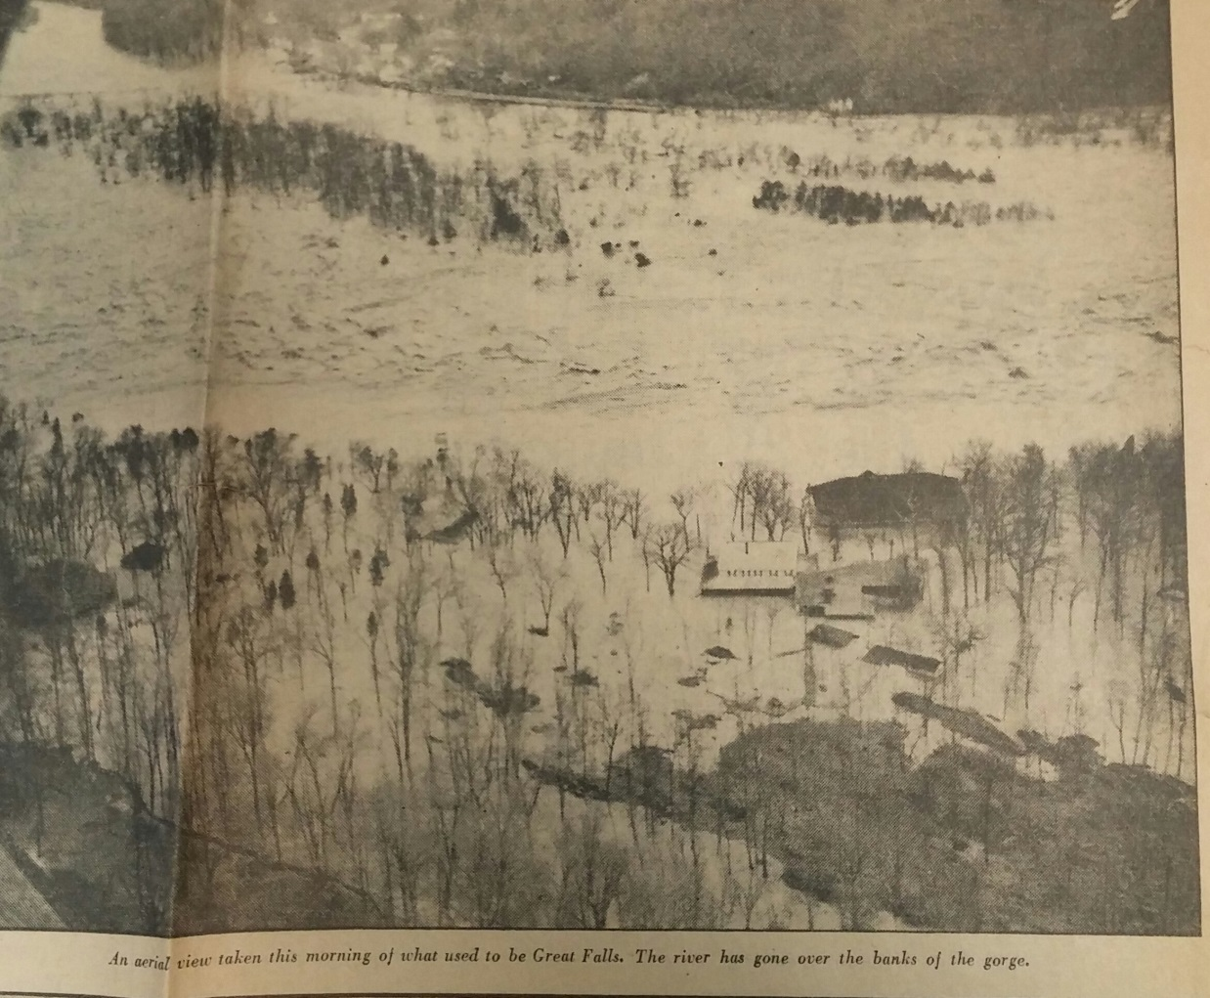
March 17-19, 1936
Still, to this day, the record flood on the Potomac.
Led to the “Flood Control Act of 1936”
Photos from Washington Evening Star, Library of Congress, and Harpers Ferry Archive

Slide 7
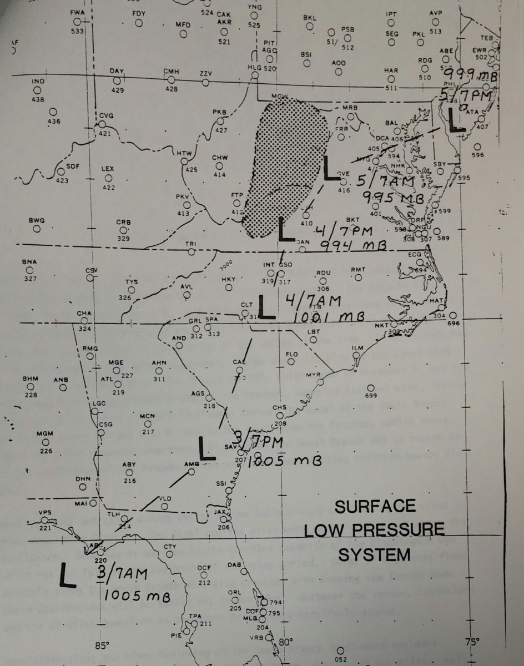
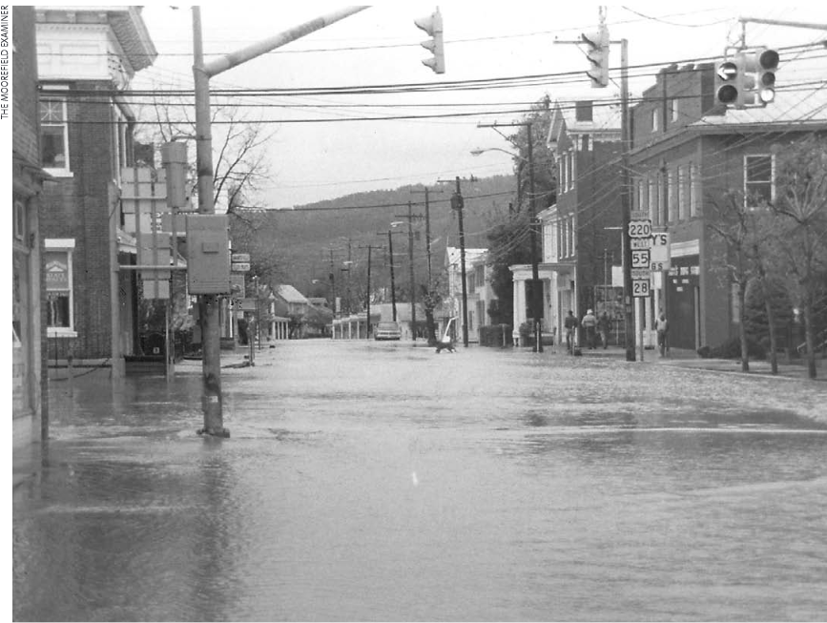
November 1985 “Election Day”
Significant flood on the Potomac
Flood of record on SB Potomac and headwaters of Shenandoah
Moorefield, WV – 1985
Photo courtesy Moorefield Examiner

Slide 8
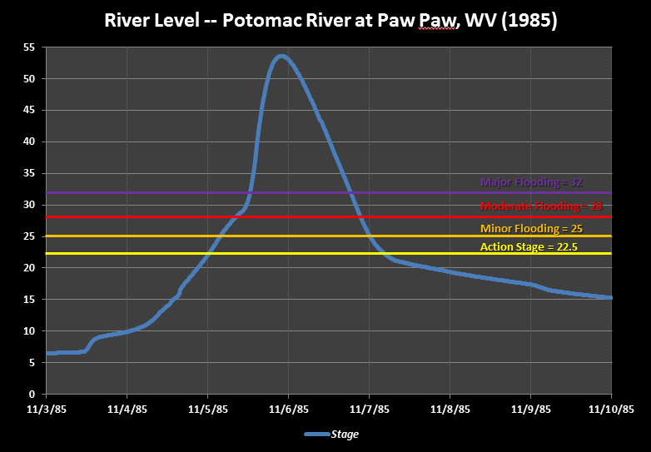
November 1985 “Election Day”
Moorefield, WV – 1985

Slide 9
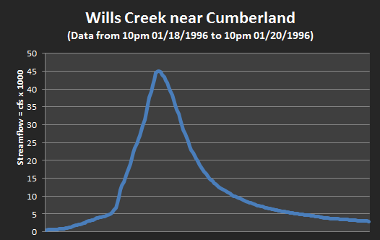
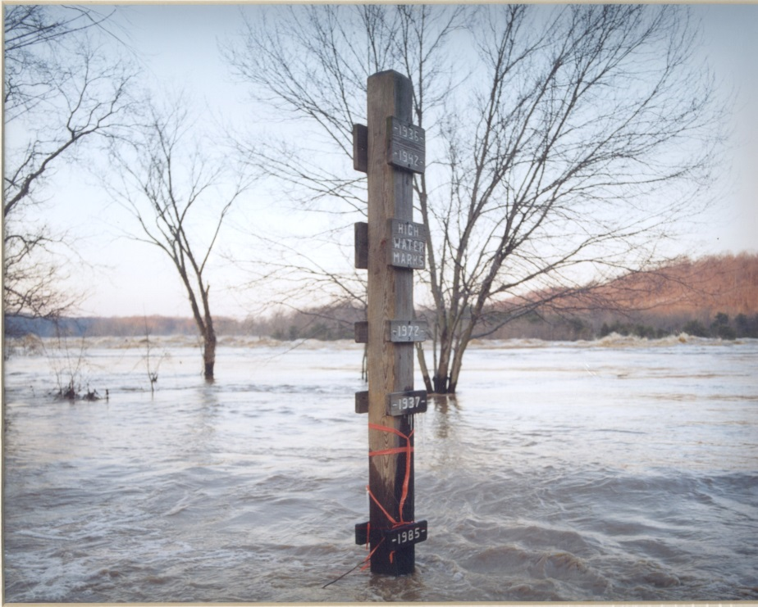
January 1996
Last significant snowmelt flood in our area
Flood of record in Cumberland, MD on Wills Creek
Major Flood Flow
Moderate Flood Flow
Minor Flood Flow
The high water mark pole at Great Falls Park (VA) gets a new mark during the 1996 flood. (Photo: NPS)

Slide 10
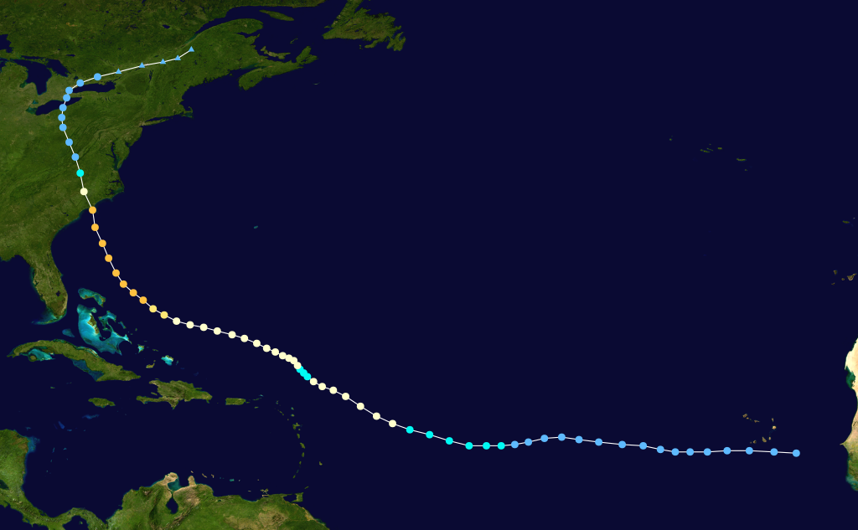
September 1996 – “Fran”
Last significant (major) Potomac River flood
Flood of record on much of the Shenandoah

Slide 11
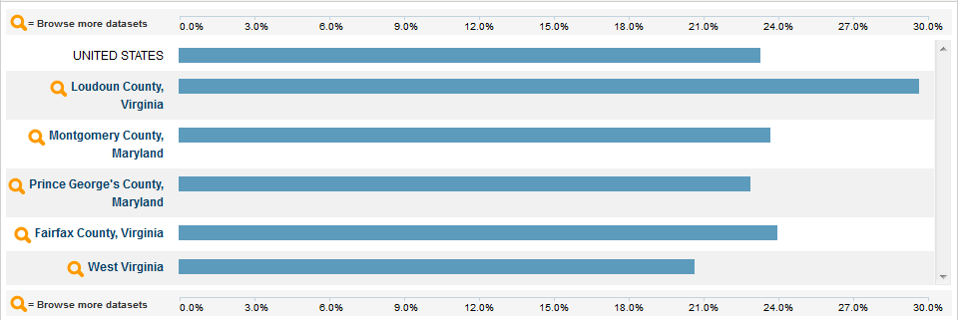
Generation Lost?
20 – 30 percent of people in this area are under the age of 18, according to census data. These people have never seen the Potomac in a major flood.
Additionally, hundreds of thousands of adults have moved into this area during that time.

Slide 12
Are we “overdue”?
Flood Frequency Study conducted by NWS Baltimore/ Washington shows major floods are fairly frequent:
Location & Stream Frequency Last Major
Cumberland (NB Potomac) Every 11 years 1996
Franklin (SB Potomac) Every 11 years 2003
Petersburg (SB Potomac) Every 13 years 1996
Springfield (SB Potomac) Every 13 years 1996
Paw Paw (Potomac) Every 7 years 1996
Hancock (Potomac) Every 11 years 1996
Point of Rocks (Potomac) Every 7 years 2010*
Little Falls (Potomac) Every 7 years 1996
Lynnwood (SF Shenandoah) Every 6 years 2003
Front Royal (SF Shenandoah) Every 6 years 2003
Millville (Shenandoah) Every 6 years 2003

Slide 13
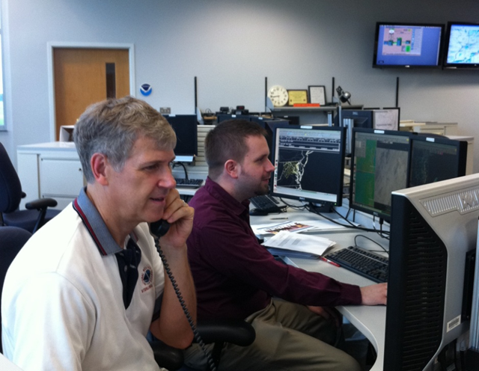
Determining Flood Potential
Monitor overall conditions
Has it been dry or wet recently?
Is there snow to be melted?
How much moisture is available?
Forecast rainfall
How much rain is expected?
How quickly will it fall?
Determine flood potential

Slide 14
Our Products
Outlook
Hazardous Weather Outlook
Days 3 – 7
Watch
Flood/Flash Flood/River Flood Watch
Up to 48 hours (up to 72 for rivers)
Warning
Flood/Flash Flood/River Flood Warning
Occurring or imminent
50% or greater likelihood of flooding
75% or greater likelihood of flooding

Slide 15
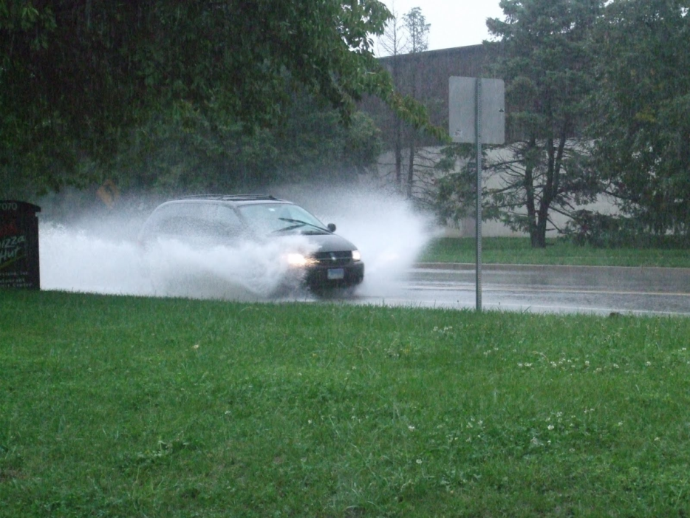
Types of Flooding
Flash Flood – A flood which follows within 6 hours of heavy or excessive rainfall, a dam or levee failure, or ice jam break.
(Areal) Flood – Most other floods, including those which last beyond 6 hours after the heavy rain. Includes small stream flooding.
Coastal Flooding – the inundation of land areas caused by sea waters over and above the level of normal tidal action.

Slide 16
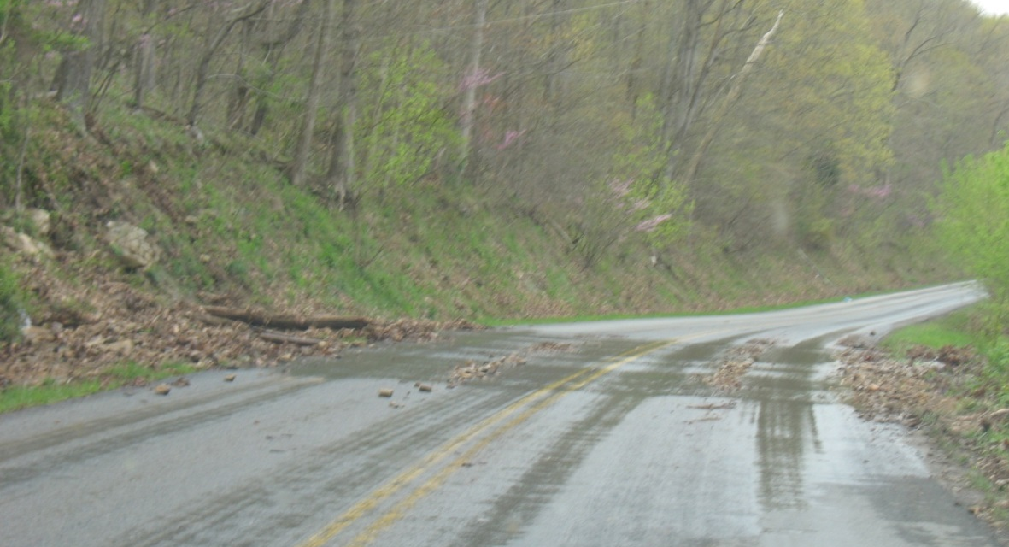
What makes a flash flood?
Typical Flash Flood Characteristics
Caused by convection (thunderstorms or intense showers)
More isolated compared to flooding
Response time is short, usually 1-2 hours, but as little as 15 mins. in urban areas (compared to 6-12 hours for flooding)
Swift Water Rescues, road closures (especially major roads), creeks and streams flood within an hour or two of the causative event
Occurs more frequently in urban areas and in terrain
Flash Flood debris near Front Royal, VA – 2011

Slide 17
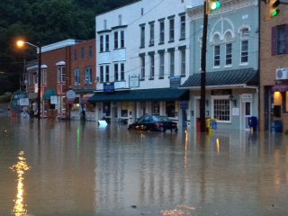
When does flash flooding occur?
Can occur anytime – day or night.
Approximately two-thirds of all flash flooding occurs during the night.
Most flash flood fatalities occur at night!
Most flash flood fatalities occur in cars.
Most flash flood fatalities are avoidable!
Berkeley Springs, WV flash flood – September 1, 2012

Slide 18
Floods – a major weather killer
On a long-term basis, floods are the #2 cause of death in the U.S. when weather plays a role, behind heat.
2011: 553

Slide 19
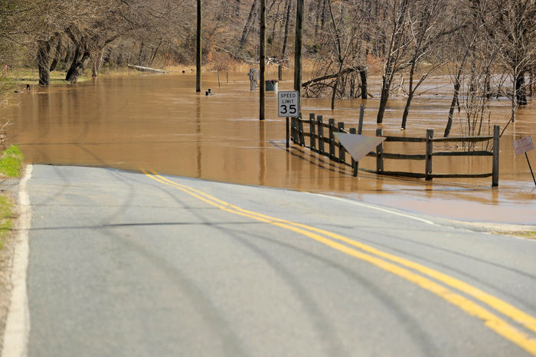
What can you do?
Take Appropriate Action!
Better forecasts and earlier warnings won’t help prevent loss of life and property unless people act.
Know your area’s flood risk!
Plan ahead – Identify where to go if told to evacuate. Choose several places (a friend’s home or a motel, or a designated shelter)
Never try to drive, swim, walk, or run through a flooded area
Children should not play in flooded areas
River Road, Falmouth, VA March 2011

Slide 20
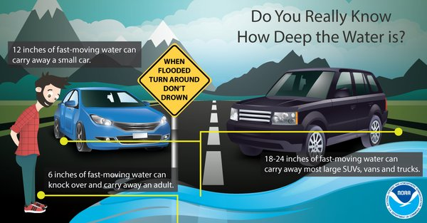
Turn Around, Don’t Drown!
If you come upon flood waters, STOP! TURN AROUND AND GO ANOTHER WAY!
Bottom line: never assume there is a safe way to drive through water

Slide 21
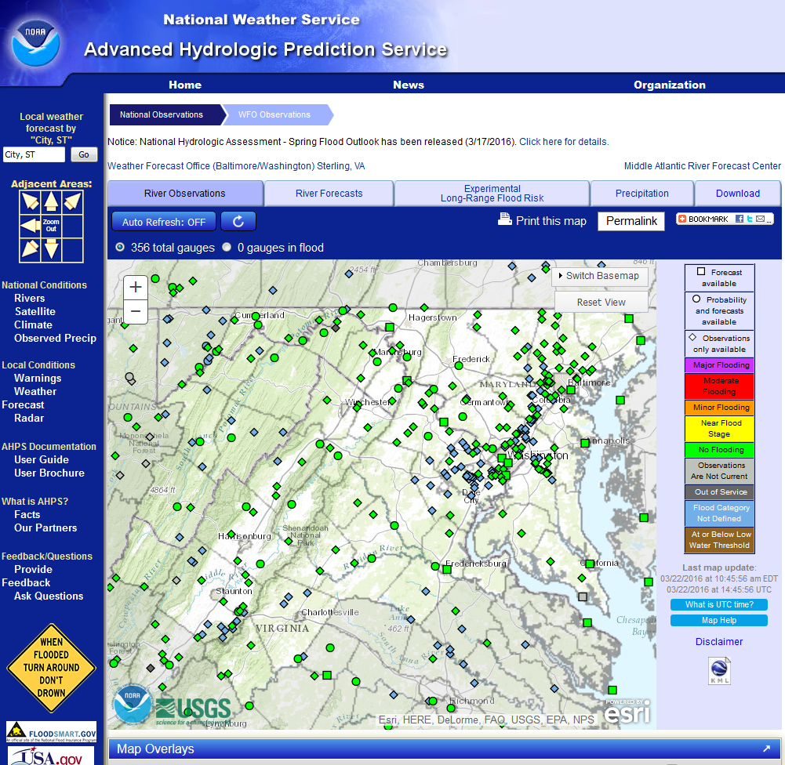
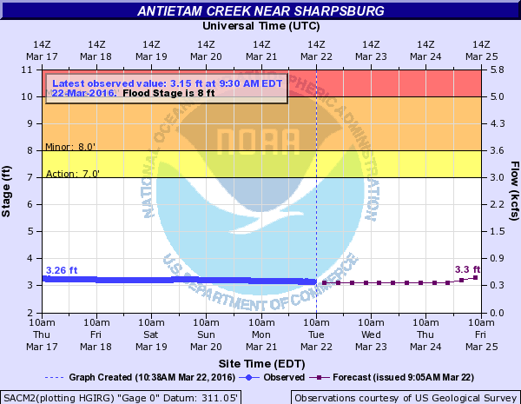
Advanced Hydrologic Prediction Service (AHPS)
http://water.weather.gov

Slide 22
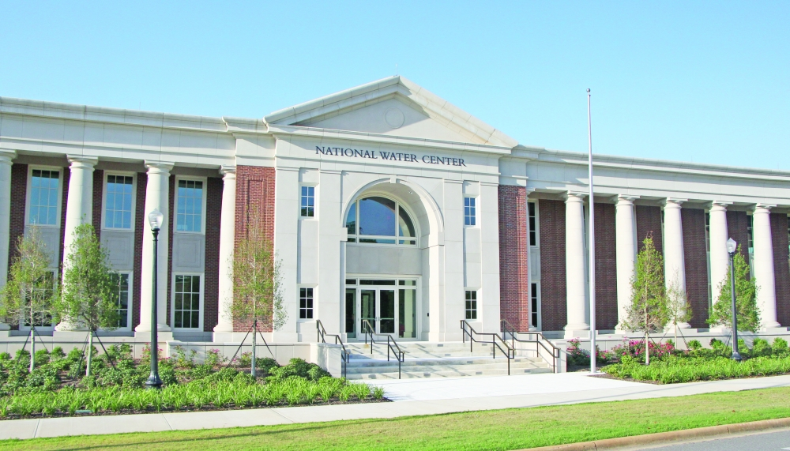
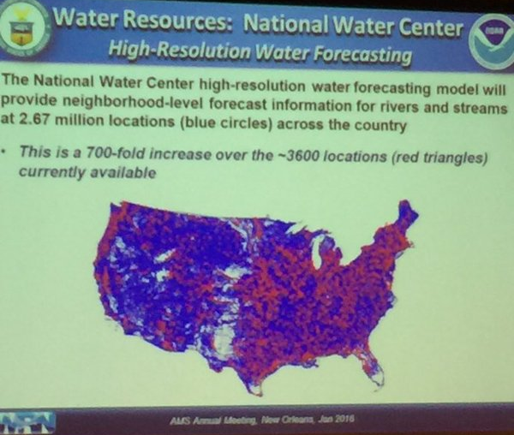
The Future
Technology is advancing rapidly in water/flood forecasting!

Slide 23
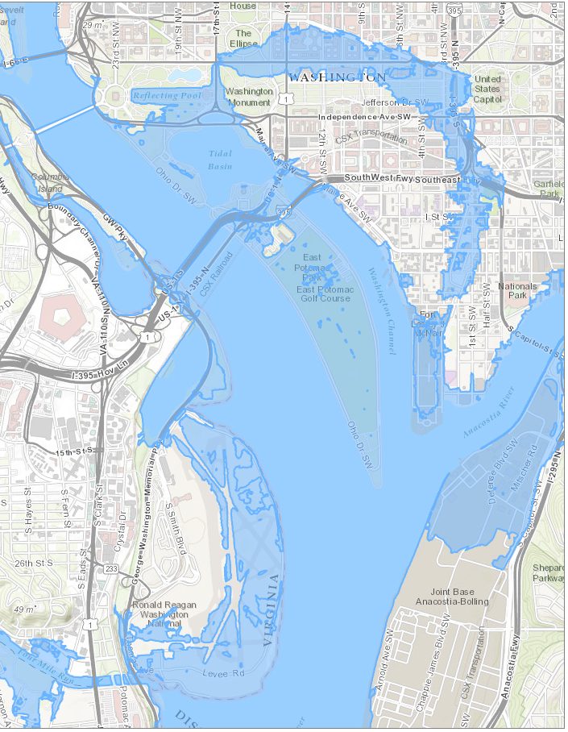
Inundation Maps
Late this spring or early this summer, we plan to offer inundation maps for the Potomac & Anacostia rivers in and near Washington, DC.
Very important to show the true power of the river to those who’ve never seen it!

Slide 24
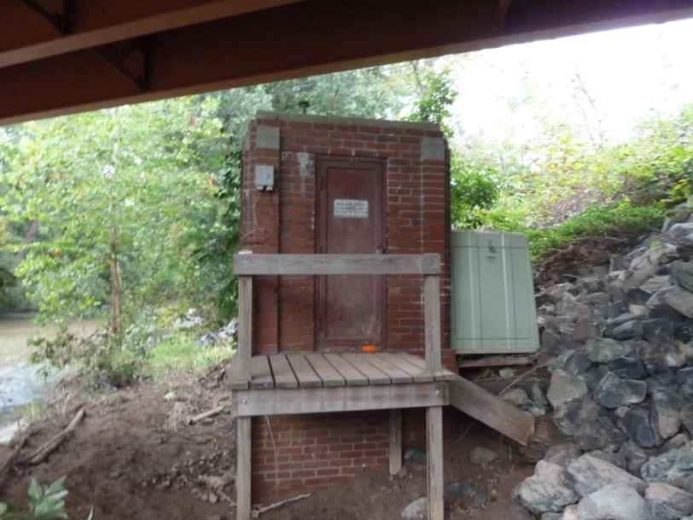
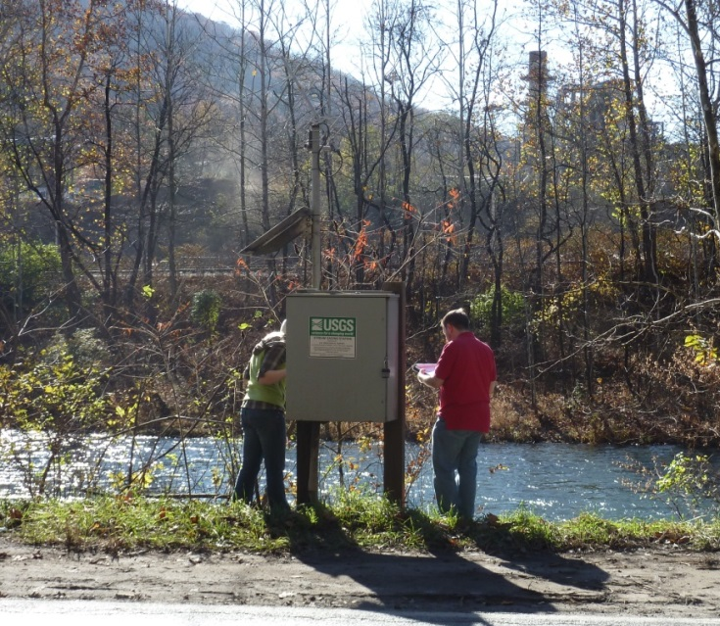
Questions? / Remember…
Floods are a major weather killer
Turn Around – Don’t Drown
Don’t let your kids play near flooded areas
A major flood on the Potomac is overdue
Know your home’s flood risk
Watch – Possible / Planning
Warning – Happening / Action!
Jason Elliott – Senior Service Hydrologist jason.elliott@noaa.gov

