Slide 1
Wind, Hail, and Tornadoes
Oh My!
Matthew Elliott
Meteorologist

Slide 2
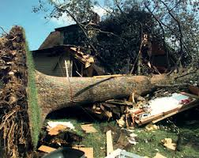
Severe Storms Topics
Thunderstorm Basics
Severe Storm Types
Wind
Hail
Tornado
Climatology
Safety

Slide 3
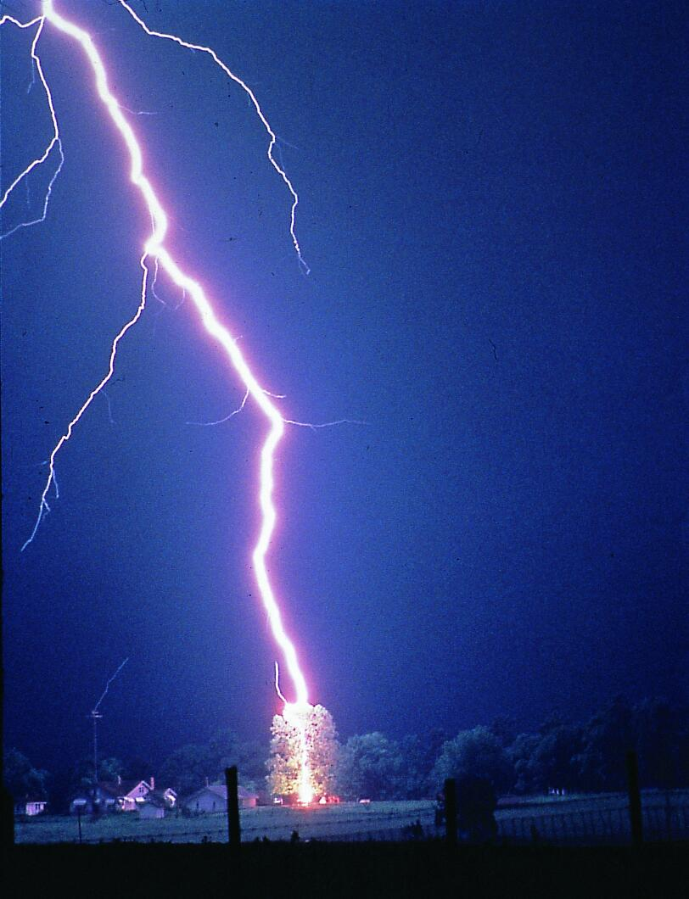
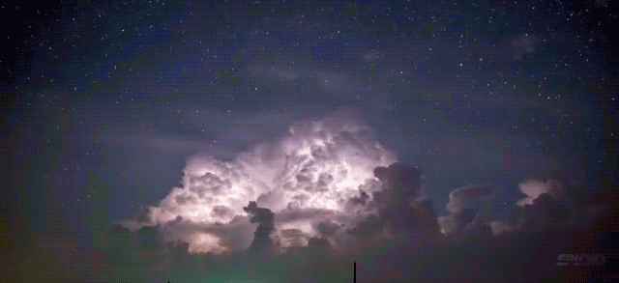
Thunderstorm Basics
Ingredients
Moisture
Lift
Instability

Slide 4
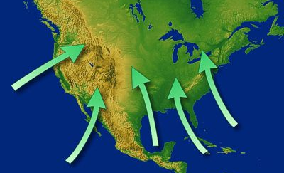
Thunderstorm Ingredients #1 Moisture
Our moisture sources:
Atlantic Ocean Gulf of Mexico Chesapeake Bay

Slide 5
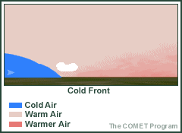
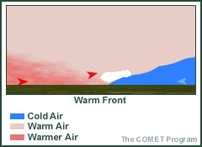
Thunderstorm Ingredients #2 Lift
When air is forced upward along a front, it cools/condenses & precipitation forms
Notes:
When two air masses collide such as a warm or cold front, there is vertical transport of moisture which can result in thunderstorm development assuming other factors are met. Other examples of lifting mechanisms include a sea breeze.
Differential Heating
This heating of the ground and lower atmosphere is not uniform. For example, a grassy field will heat at a slower rate than a paved street. The warmest air, called thermals, tends to rise. In the image (right) a wildfire provided the differential heating for a cumulus cloud to form over the smoke plum.
Fronts, Drylines and Outflow Boundaries
Fronts are the boundary between two air masses of different temperatures. Fronts lift warm moist air. Cold fronts lift air the most abruptly. If the air is moist and unstable thunderstorms will form along the cold front. Drylines are the boundary between two air masses of different moisture content and separate warm moist air from hot dry air. While the temperature may be different across the dryline, the main difference is the rapid decrease in moisture behind the dryline. It is the lack of moisture which allows the temperatures to occasionally be higher than ahead of the dryline. However, the result is the same as the warm moist air is lifted along the dryline forming thunderstorms. This is common over the plains in the spring and early summer. Outflow boundaries are a result of the rush of cold air as a thunderstorm moves overhead. The rain-cooled air acts as a "mini cold front", called an outflow boundary. Like fronts, this boundary lifts warm moist air and can cause new thunderstorms to form.

Slide 6
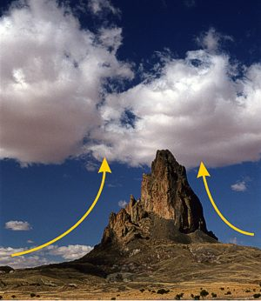
Thunderstorm Ingredients #2 Lift

Slide 7
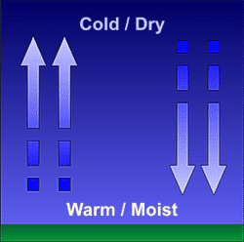
Thunderstorm Ingredients #3 Instability
Air accelerates upward/downward when nudged upward/downward
Notes:
We generally think of west to east or north to south movement of air masses, that is fronts. We need to think in the vertical as well. Think of the atmosphere heating up during a summer day. Air parcels in the boundary layer will begin to rise into the atmosphere as heating takes place. The greater the contrast in temperature between two air masses the greater the instability. As you look at the lava lamp, imagine the colored parcels that are rising and sinking as air parcels in the atmosphere. The greater the instability, the faster these parcels will move.

Slide 8
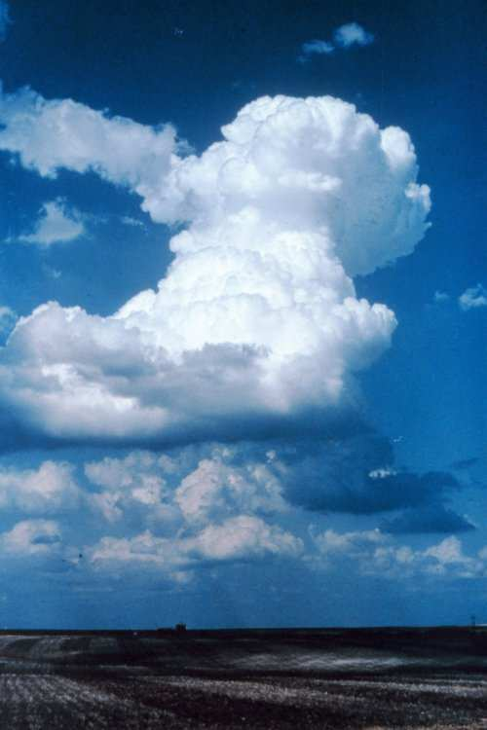
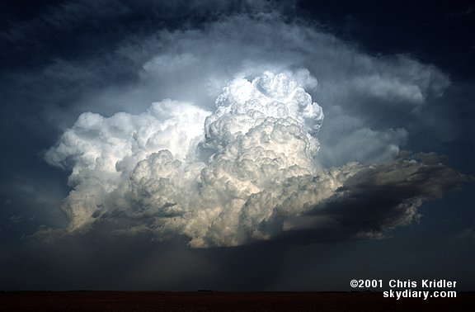
Thunderstorm Lifecycle
Cumulus Stage
Mature Stage
Dissipating Stage
Notes:
A thunderstorm is simply a rain shower with lightning. Sounds simple, but it really isn’t. Thunderstorms are a fairly complex entity. In order to develop, a thunderstorm needs moisture, instability, and a lifting or trigger mechanism.
During the initial stage, a developing thunderstorm begins as a cumulus cloud with upward air motion (the updraft) throughout most of the cloud. This is called the cumulus or towering cumulus stage. If the air temperature in this cloud is warmer or more buoyant than the surrounding atmosphere, it can continue to rise, produce precipitation, and grow into a thunderstorm. The cumulus or towering cumulus cloud can grow vertically, perhaps to a height of 20,000 feet. Air within the cloud is dominated by updraft with some turbulent eddies around the edges.
A thunderstorm reaches its mature stage when the updraft develops a counterpart; sinking rain-cooled air. This is known as the downdraft. The storm has considerable depth, often reaching 40,000 to 60,000 feet This is usually when the thunderstorm is strongest and has the highest potential to produce severe weather.
When the downdraft begins to dominate the thunderstorm, it has reached its dissipating stage. A thunderstorm needs a supply of fuel (relatively warm and moist air) to survive. When the cool downdraft begins to spread out and cut off this fuel supply, the thunderstorm will dissipate. It should be noted that severe weather can still occur in the dissipating stage. The life cycle for an individual thunderstorm cell is about 30 minutes. During its life cycle, the two main components of a thunderstorm are the updraft and downdraft.

Slide 9
Thunderstorm Types
Multi-cell
Notes:
Multi-cell Although there are times when a thunderstorm consists of just one ordinary cell that transitions through its life cycle and dissipates without additional new cell formation, thunderstorms often form in clusters with numerous cells in various stages of development merging together. Unlike ordinary single cells, cluster storms can last for several hours producing large hail, damaging winds, flash flooding, and isolated tornadoes.

Slide 10
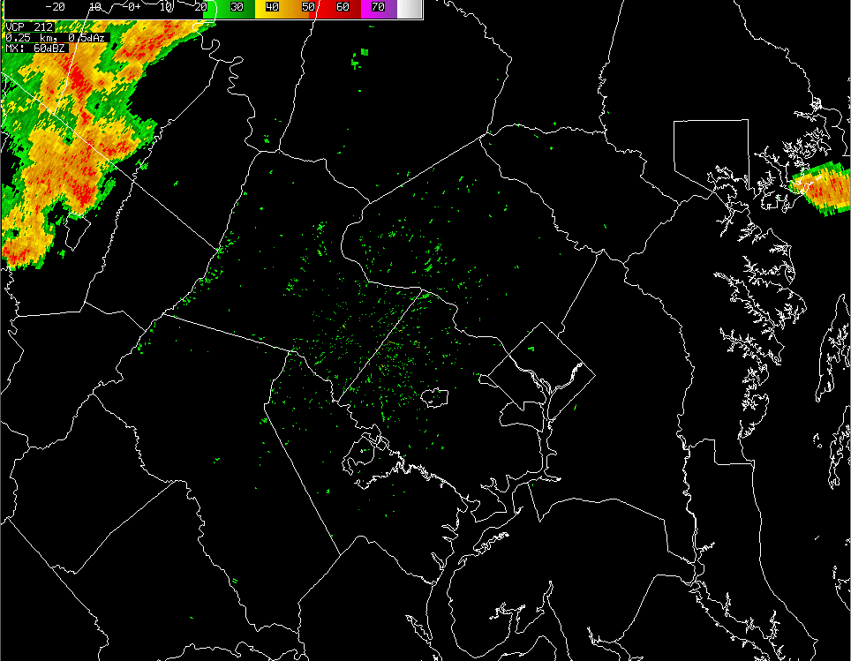
Thunderstorm Types
Squall Lines
motion
(Cross section)
Notes:
Squall Lines
Squall lines are simply a continuous or nearly continuous line of thunderstorms. The are common along, or in advance, of cold fronts. All types of severe weather can occur with squall lines. However, they are particularly known for producing strong straight-line winds. In the above illustration, storm motion is from left to right. Warm moist air flows up into the updraft (as represented by the red arrows) while rain-cooled air (blue arrows) descends through the downdraft. The leading edge of this rain cooled air is called the gust front and is often times accompanied by an abrupt wind change and sharp temperature drop. Along the gust front a distinct cloud formation often times occurs. This is called a shelf cloud. It demarks that area where the warm moist air meets and is lifted over the rain cooled gust front air.
These "squall lines" can persist for many hours and produce damaging winds and hail.

Slide 11
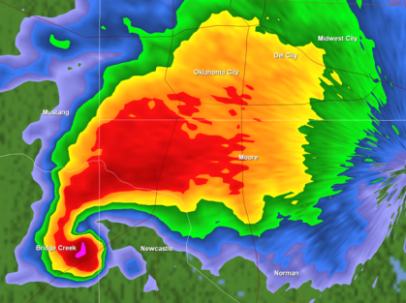
Thunderstorm Types
Super Cell Thunderstorms
downdraft
Tornado
Notes:
Supercell Thunderstorms
Supercell thunderstorms are a special kind of single cell thunderstorm that can persist for many hours. They are responsible for nearly all of the significant tornadoes produced in the U.S. and for most of the hailstones larger than golf ball size. Supercells are also known to produce extreme winds and flash flooding.
They are characterized by a rotating updraft (usually cyclonic - above left) which results from a storm growing in an environment of significant vertical wind shear. Wind shear occurs when the winds are changing direction and increasing with height. The most ideal conditions for supercells occurs when the winds are veering or turning clockwise with height. For example, in a veering wind situation the winds may be from the south at the surface and from the west at 15,000 feet (4500 m). Beneath the supercell, the rotation of the storm is often visible as well (above right).
Most tornadoes are spawned from supercell thunderstorms. Supercell thunderstorms are characterized by a persistent rotating updraft and form in environments of strong vertical wind shear.

Slide 12
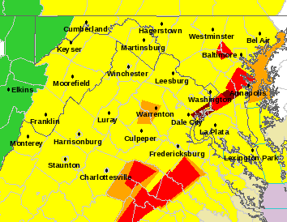
NWS Terminology
Watch vs. Warning
WATCH - “It’s possible” - Lets you Plan Ahead - Stay Connected - Be Ready to Act
WARNING - “It’s happening” - Take Action!

Slide 13
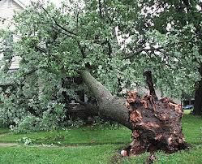
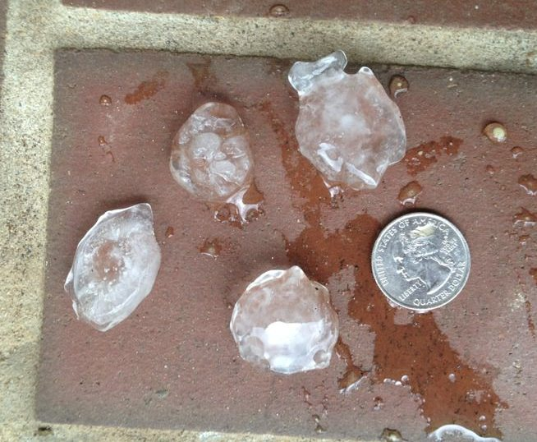
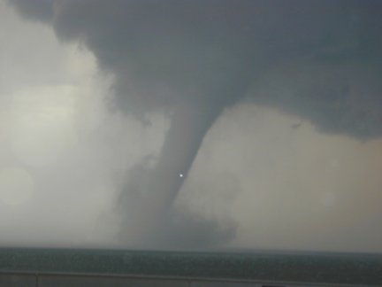
NWS Terminology
“Severe Thunderstorms”
A Damaging Thunderstorm
Damaging Wind Gusts 58+ mph
Large Hail 1” + diameter
Note: The NWS does not issue SVR Thunderstorm
Warnings for lightning

Slide 14
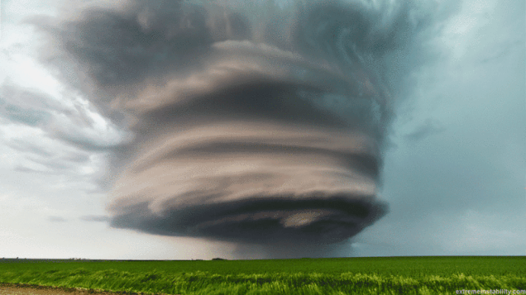
Thunderstorm Basics
What makes a thunderstorm “severe”?
“Max-out” the 3 ingredients
Very UNSTABLE air
Plenty of MOISTURE
Strong LIFT
Also, increasing & shifting winds with height
Tilts storm & allows it to continue for a longer time
May cause storm to rotate

Slide 15
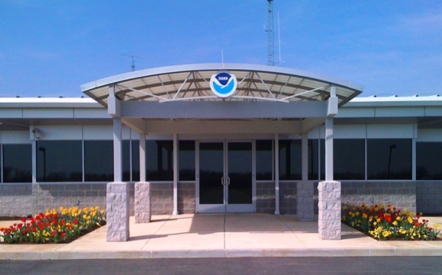
What Happens When We Issue a Warning?
Partners
NWS
PUBLIC
Notes:
If we haven’t already issued a warning, your report could help trigger the warning. If a warning is already out, your report helps us to determine if it needs to continue.

Slide 16
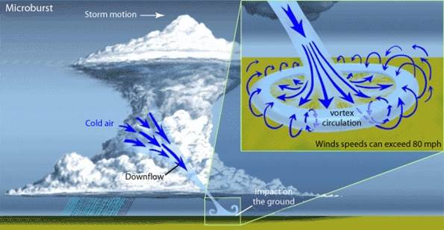
Microburst / Downburst / Straight-line Winds
.
Small, targeted shaft of rapidly sinking air in the storm
Updraft no longer capable of holding up core of rain/hail
Core plummets to ground
Hits ground & spreads out

Slide 17
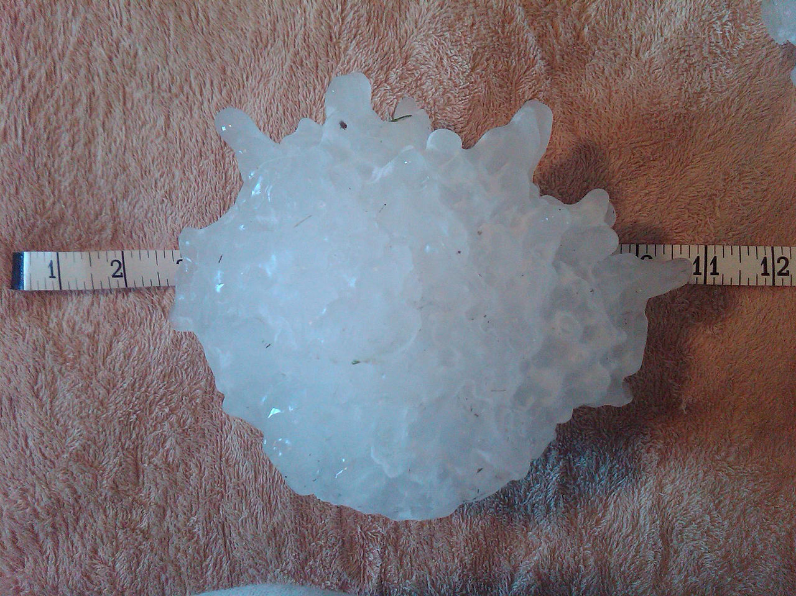
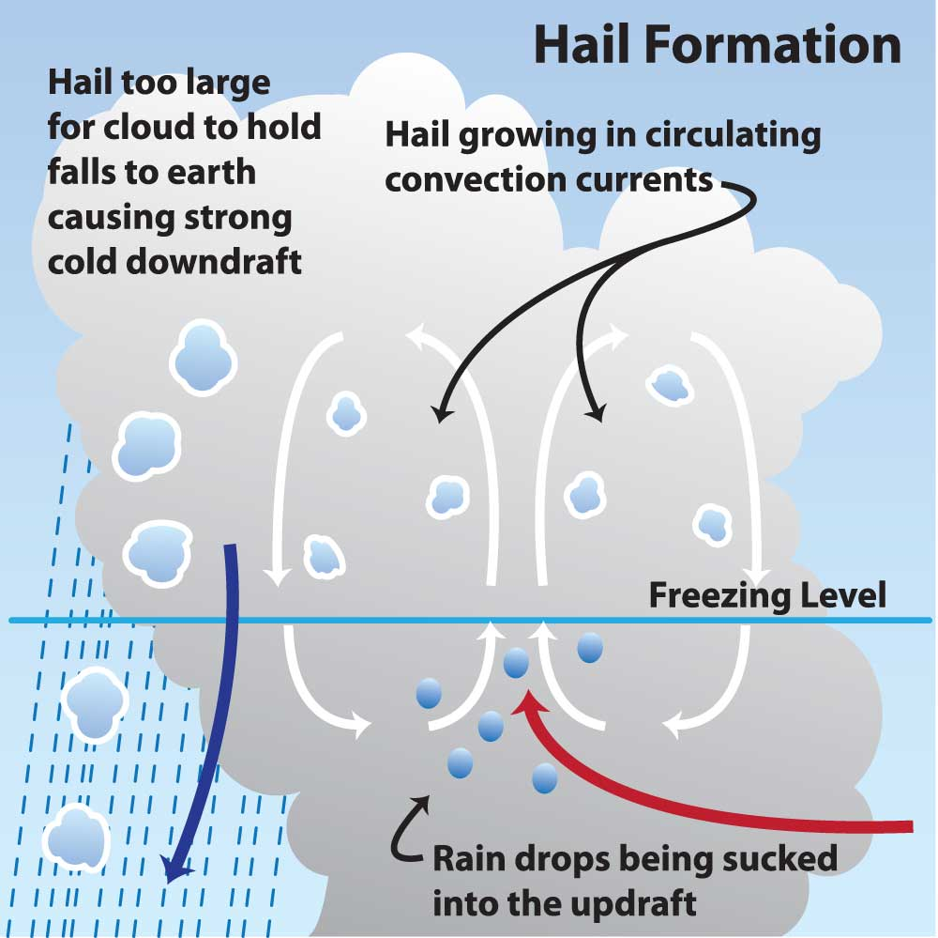
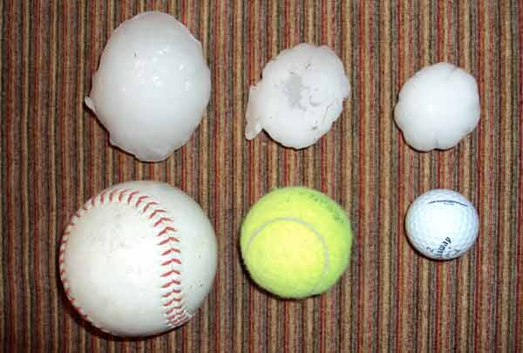
Severe (Large) Hail
8” diameter, 1lb 15oz
Notes:
Hail forms aloft in the thunderstorm where it is very cold. The main updraft will keep the hail stones aloft until they become too large for the updraft to support or the storm begins to decay.
Hail stones grow in size by a process called aggregation
Inside the thunderstorm are strong updrafts of warm air and strong downdrafts of cold air.
Water droplets are picked up by the updrafts and carried well above the freezing level. The water droplet freezes.
The water droplet gets caught in a cold downdraft and is carried downwards. The water droplet may thaw as it moves into the warmer air near the bottom of the storm.
The water droplet can get caught in another updraft and is carried above the freezing level again.
The process repeats itself and the hail stone grows larger and larger. Each time this process is repeated another layer of ice is added to the stone.

Slide 18
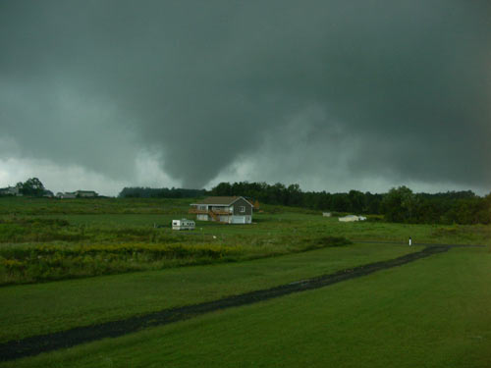
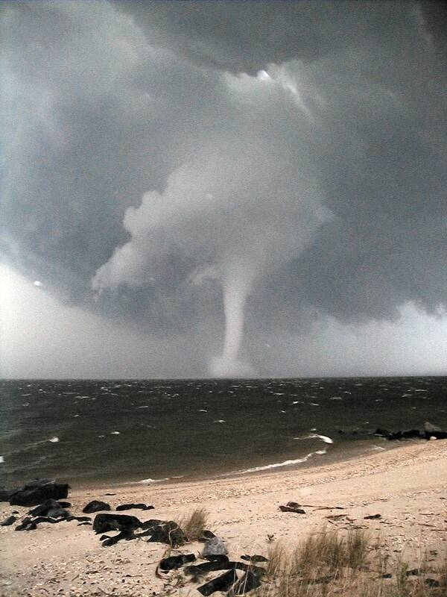
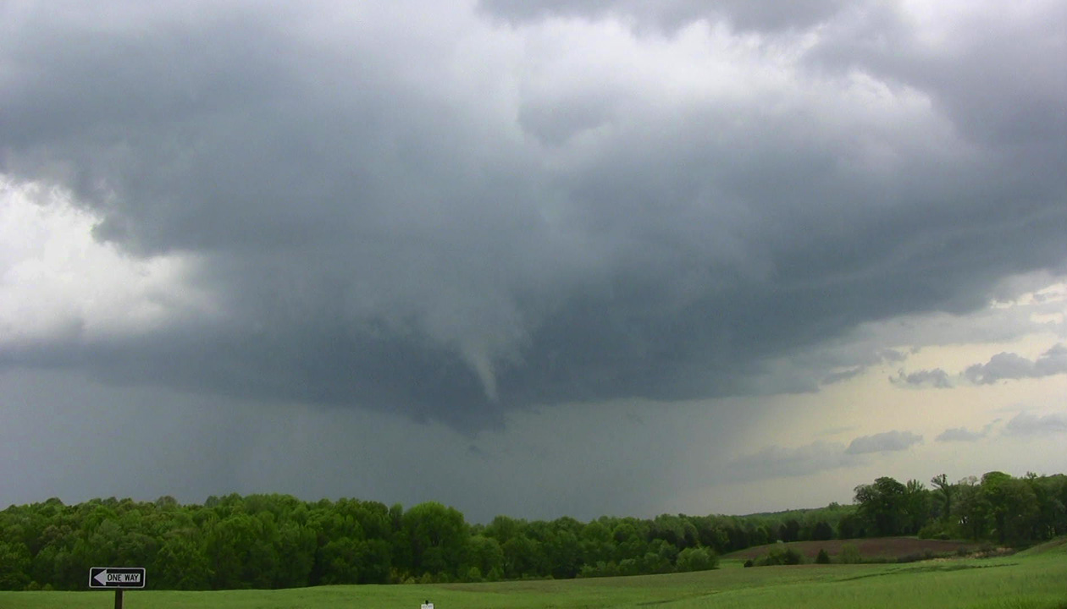
Tornadoes, Funnel Clouds, & Waterspouts
Tornado: Violently rotating column of air attached to a cloud base & in contact w/ the ground
Waterspout: Tornado over water
Funnel Cloud: Rapidly rotating column of air NOT in contact w/ the ground. Some funnel clouds go on to become tornadoes, others do not.
Notes:
Funnel Clouds and tornadoes are both defined as violently rotating columns of air, but there is one major difference. To be called a tornado, the column of air has to be in contact with the ground. Some funnel clouds go on to become tornadoes but others do not. Can you spot the funnel in the picture on the lower right? <CLICK>`

Slide 19
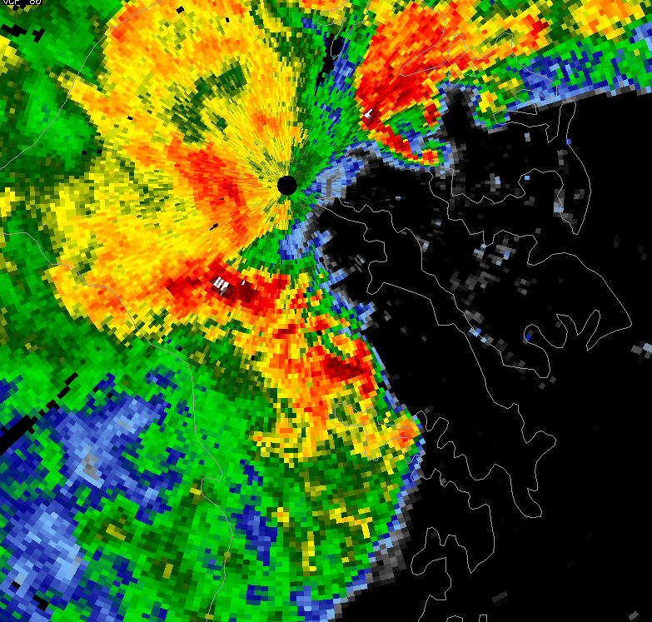
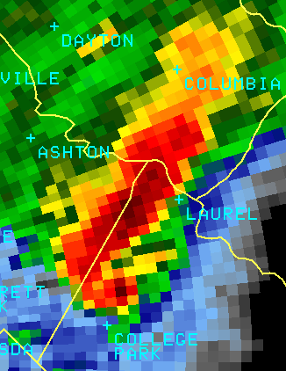
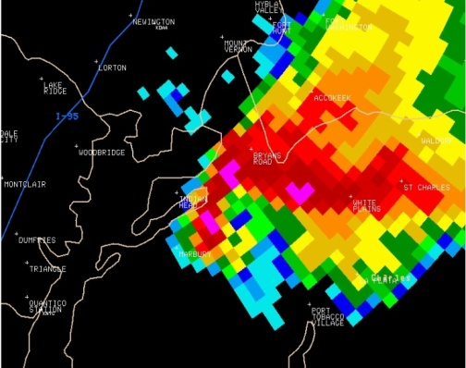
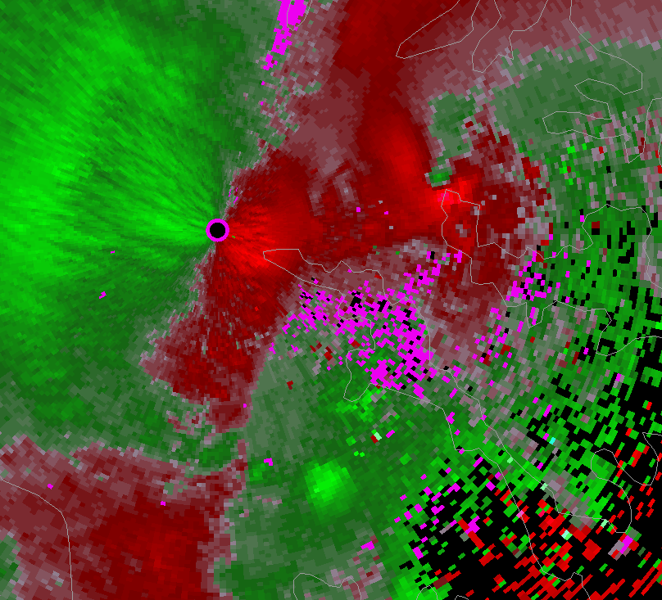
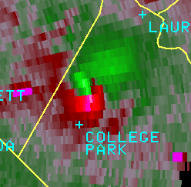
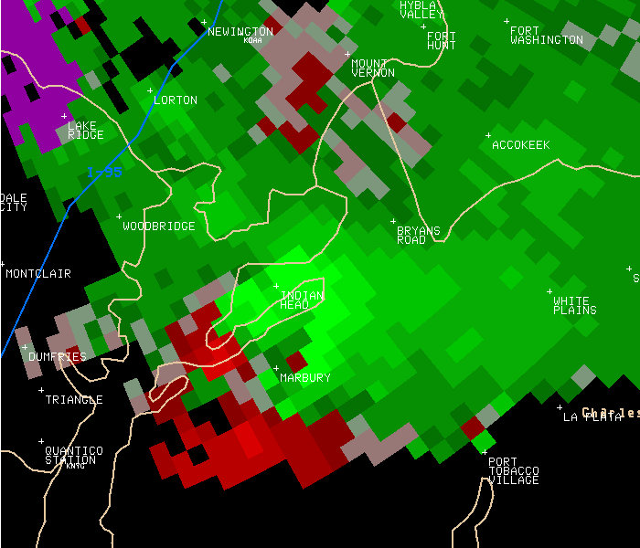
Tornado Rating Done “After-the-Fact”
Weak (EF-0/1)
Strong (EF-2/3)
Violent (EF-3/4)
Most frequent (90%)
Brief
Winds < 111 MPH
Few Fatalities
More difficult to detect
Much less frequent
Typically lasts longer
Winds to 165 MPH
Some Fatalities
Easier to detect
Rare
Long lived
Winds > 165 MPH
Many Fatalities
Nearly always detected
Notes:
In the weather service, we typically classify tornadoes into three groups: Weak, Strong and Violent. Around 90% of all tornadoes are classified as weak. These tornadoes are usually on the ground for brief periods of time and can be difficult to detect. They can still snap and uproot large trees and pick away at siding and roofing from your house. About 10 percent of all tornadoes are classified as strong. These tornadoes can last up to 20 minutes or longer on the ground and can have paths over 15 miles. These start to pick up and throw vehicles, and can do significant damage to homes. Less than one percent of all tornadoes end up being classified as violent. These tornadoes can last an hour or longer on the ground and have paths of 50 miles or greater. These are the killer tornadoes that literally cut a trench of devastation across the communities they affect. Strong and violent tornadoes are typically easier to detect on radar and cause greater numbers of injuries and fatalities. Unfortunately, tornado intensity can only be determined after the fact. So, all tornado warnings need to be taken very seriously.

Slide 20
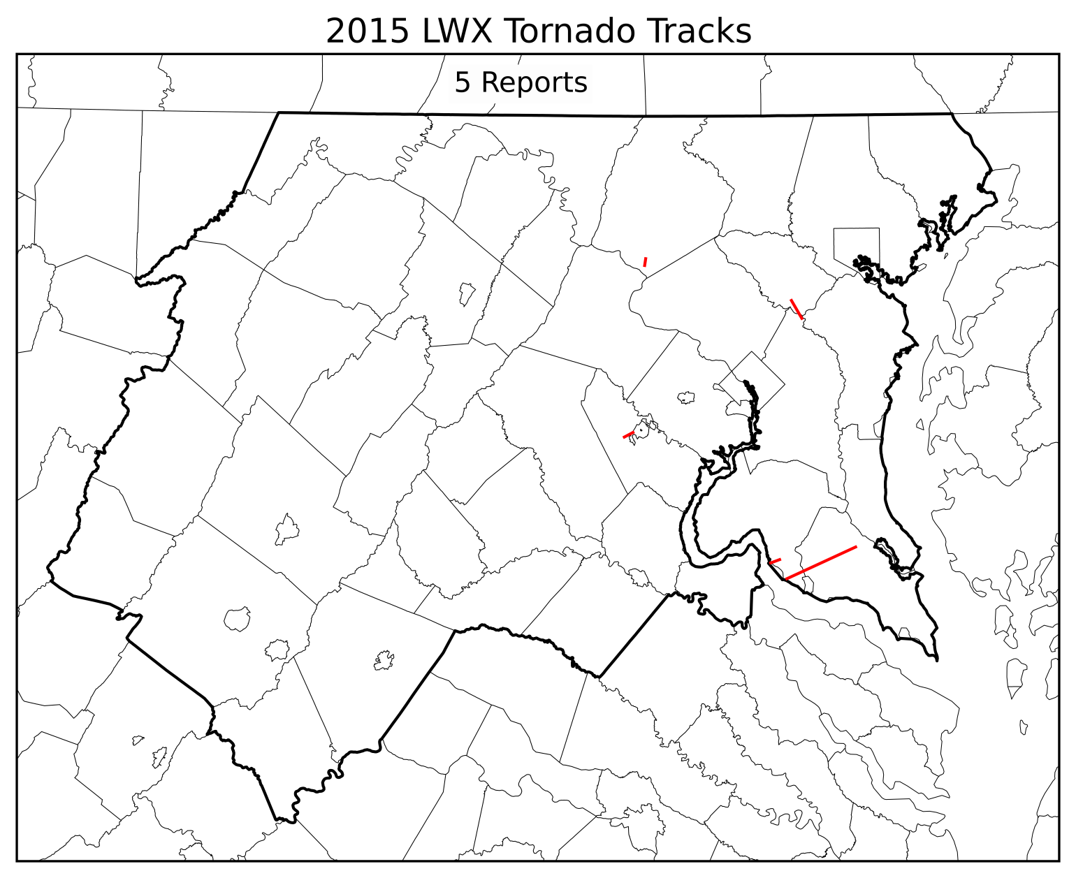
2015 Tornado Reports
EF0
EF0
EF0
EF1
EF1
Strongest tornado occurred on 27 June, from a supercell thunderstorm over S MD.
Peak wind speed of 90 mph
Maximum width of 800 yards
On ground for 35 minutes

Slide 21
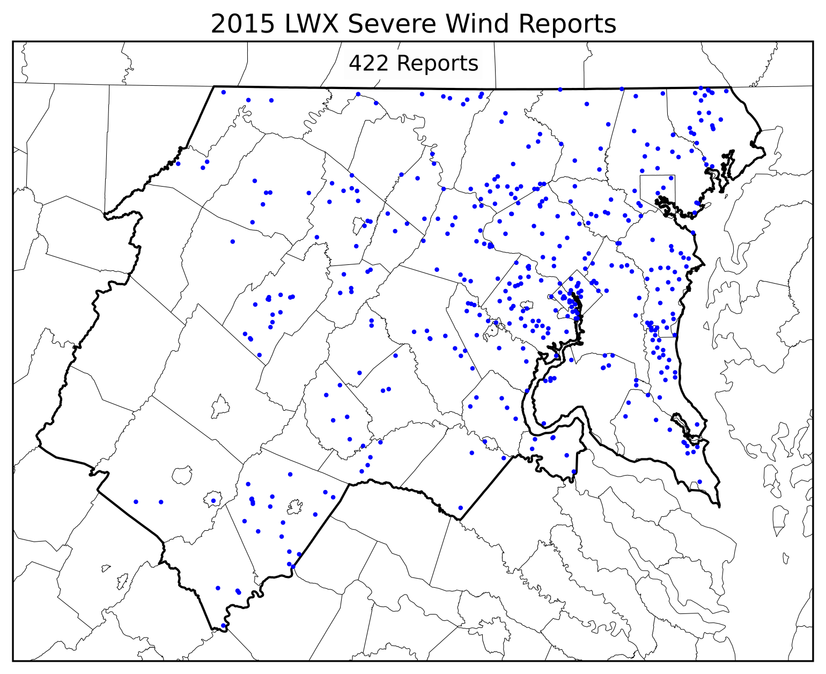
2015 Wind Reports

Slide 22
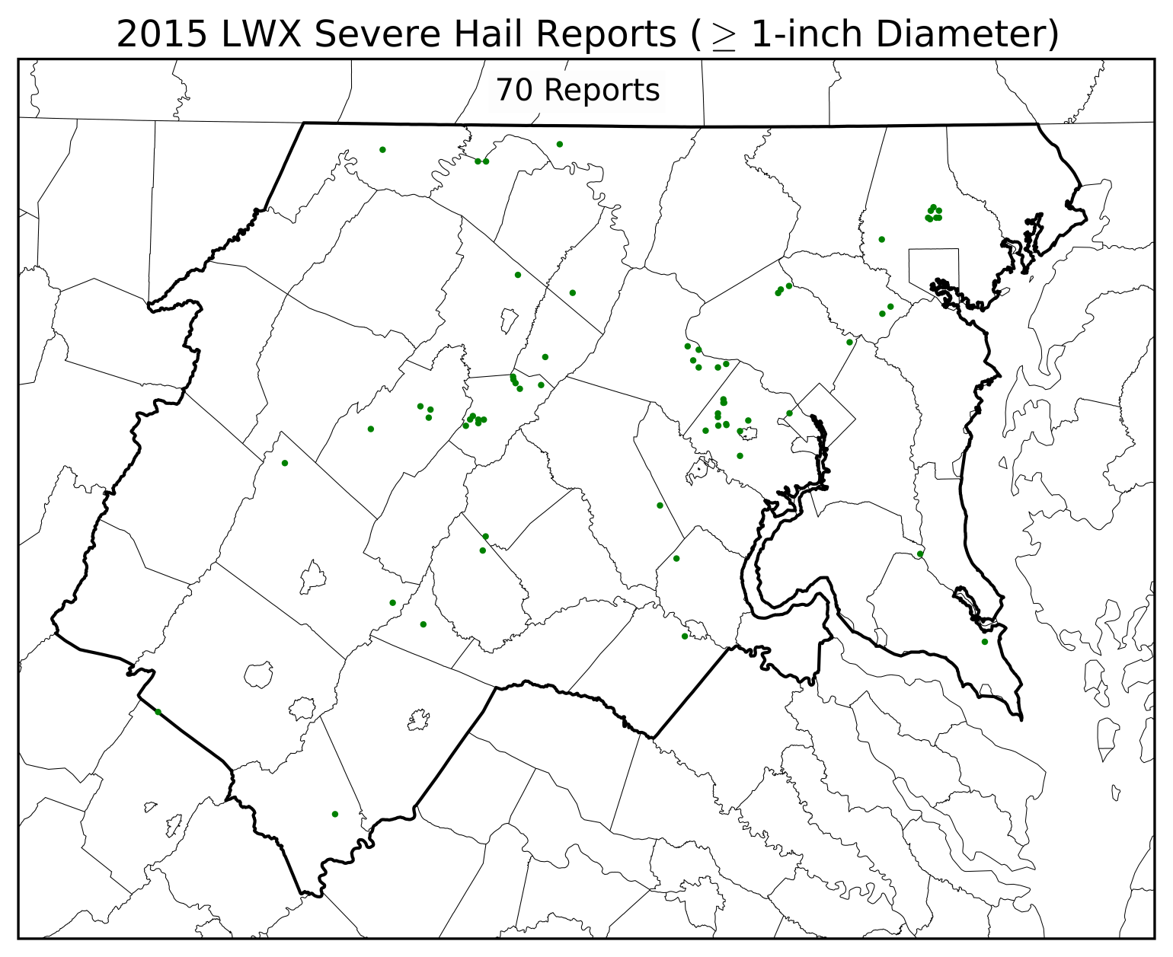
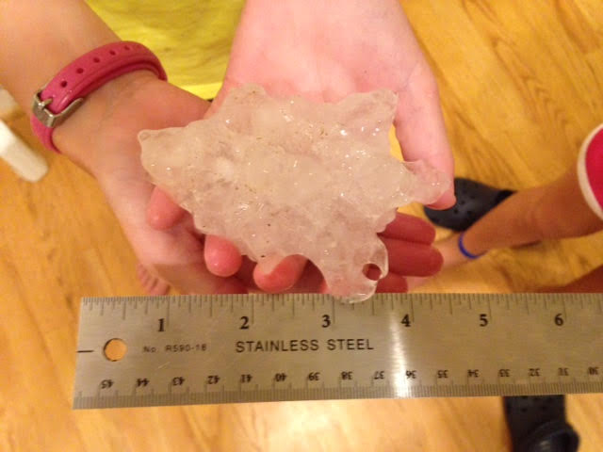
2015 Hail Reports
4-inch Hailstone!

Slide 23
2015 Severe Weather Reports
39 days with at least one report of SVR WX
497 reports of SVR WX
No reports: Page & Highland County in VA or Pendleton & Grant County in WV
Max (45): Fairfax County, VA

Slide 24
Local Tornado Climatology
21 deaths have occurred due to tornadoes over past 60 years
411 tornado-related injuries have occurred since 1950
Tornadoes
1950 –Present
82% EF0 & EF1
13% EF2
3% EF3
< .05% EF4
0 EF5
College Park Tornado (EF3)
September 24, 2001

Slide 25
Local Tornado Climatology
Notes:
The tornado frequency by month also looks fairly standard with the peak months for tornadoes occurring in the summer months of June, and July. Please note that the September data could be inflated due to Tropical Storm Ivan’s tornado outbreak on Sept 17, 2004. A decrease in August is possibly due to high capping inversions from the higher temperatures and a more northerly jet stream location.

Slide 26
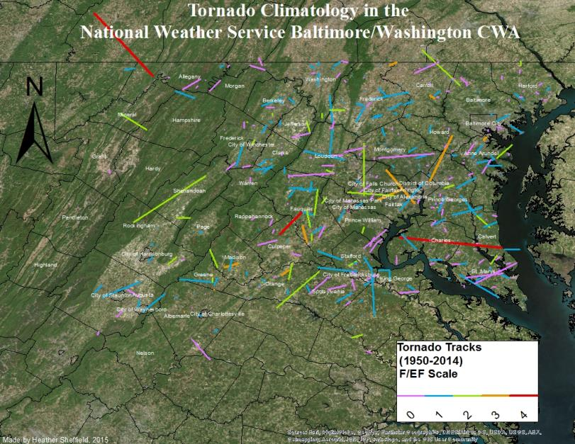
Local Tornado Climatology
Notes:
One tornado that was particularly powerful and a very long tracked tornado occurred in Charles County (La Plata). This tornado occurred on April 28, 2002 and created a large path of destruction for 38 miles through Charles, St. Mary’s, and Calvert counties. It was categorized as an F-4, causing 3 deaths, 122 injuries, and costing about $124 million in damage loss.
Another F-4 occurring just the year before on September 24, 2001, passing through Culpepper and Fauquier counties.
The Frostburg tornado occurred in June 2, 1998. $ 5 Million 125 homes, 3 businesses, 1 school, 1 church. F4 Frostburg , otherwise F2-F3. On ground 10 min. Path length 8 miles. 250 yards wide.

Slide 27
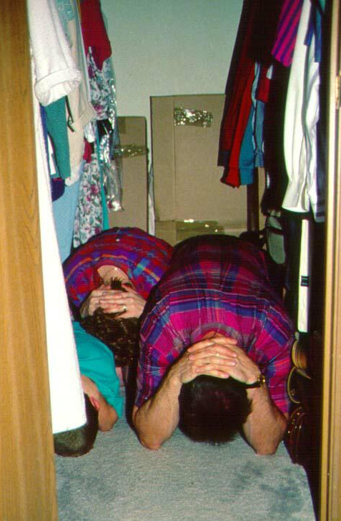
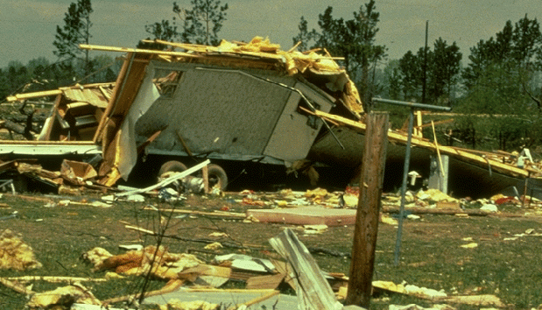
High Wind / Tornado Safety
Basement or interior room on lowest level away from windows.
Put as much structure between you and the outside
If in a camper or mobile home, seek shelter in a substantial house

Slide 28
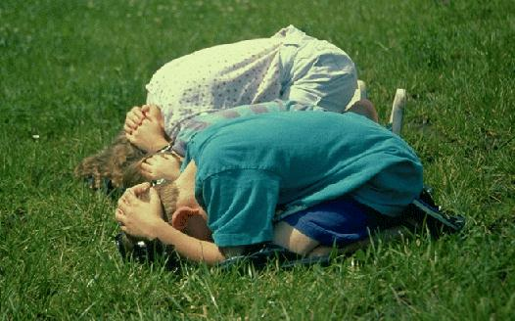
Tornado Safety Outdoors
Do not take shelter in an underpass
If no structurally strong buildings are available, find a ditch or low area
Take position shown in picture to the right
Get away from your car and into a low area!

Slide 29
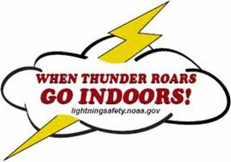
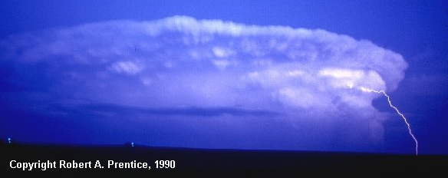
Lightning Safety
Lightning can come from upper part of storm & strike miles away
OR into your hard-topped vehicle
with the windows up...
There is NO safe place to be outside in a thunderstorm!

Slide 30
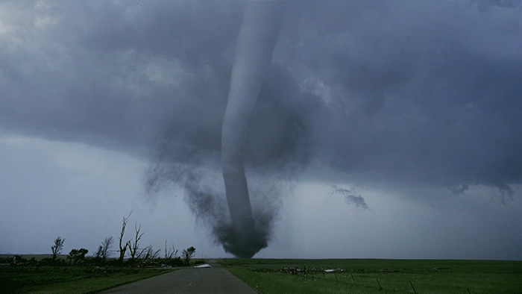
Questions? / Remember…
Severe thunderstorm = Damaging thunderstorm
How we alert: Watch: Possible / Plan Ahead Warning: Happening / Take Action!
Our region is prone to all types of severe storms Damaging Winds Large Hail Tornadoes
Safety Put as much building between you and the outside (low) When thunder roars – Go indoors
Stay connected & informed
Contact Info
matthew.elliott@noaa.gov

