Slide 1
Eye of the Storm: Tropical Weather 101
Luis Rosa and Ashlie Sears
Meteorologists

Slide 2
Topics
Tropical Cyclones
Definitions
Science
Classification
The 4 Threats
National Hurricane Center & Forecast Office Products
Hurricane Safety

Slide 3
Definitions
Tropical Cyclone:
Rotating, organized system of clouds & t’storms
Forms & derives its energy from warm tropical waters
Winds rotate fully about the center
In the Northern Hemisphere; counterclockwise
Extratropical cyclone:
a storm system that primarily gets its energy from temperature contrasts in the lower atmosphere.

Slide 4
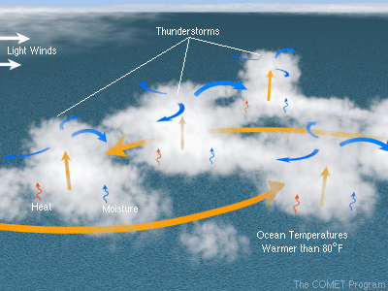
Tropical Weather Science
To survive/strengthen, storm needs:
Warm waters of 80°F +
Pre-existing disturbance / kicker
Unstable atmosphere
High pressure above it
A tranquil atmosphere around it
Allows it to organize

Slide 5
Tropical Weather Science
To survive/strengthen, storm needs:
Warm waters of 80°F +
Pre-existing disturbance / kicker
Unstable atmosphere
High pressure above it
A tranquil atmosphere around it
Allows it to organize
As long as these are in place…
…the storm will strengthen.

Slide 6
Classification
Stage | Max sustained wind speed (mph)
Tropical Depression | Less than 39 mph (must have a closed surface circulation)
Tropical Storm | 39-73 mph
Hurricane | 74 mph or greater
Major Hurricane (Cat 3 or greater) | 111 mph or greater

Slide 7
4 Threats
Tropical cyclones / tropical storms / hurricanes
Not just a wind threat (wind is often a lesser threat)
The 4 threats:
Rainfall Flooding
Tidal Flooding / Storm Surge
Winds (what it is rated upon)
Tornadoes
Each storm / remnant has a different combination of these threats at different levels of intensity.

Slide 8
Threat #1 Rainfall Flooding
Not directly related to intensity of tropical cyclone
Related to speed & size of storm, as well as the geography to the area affected.
Often 2 main areas of flooding
1) Along the coast near the landfall
2) Well inland, many times near mountains
Away from the coast, flooding due to heavy rain is by far the leading cause of tropical cyclone deaths.

Slide 9
Threat #2 Tidal Flooding/Storm Surge
Storm Surge:
Abnormal rise of tidal water generated by storm’s winds.
Along the coast, “The greatest potential for loss of life related to a hurricane is from the storm surge.”
Isabel’s 2003 Storm Surge Flooding in Annapolis, MD (pics from the Baltimore Sun)

Slide 10
Threat #3 Winds
Winds:
The Saffir-Simpson scale for intensity of a land falling hurricane is expressed in terms of categories that relate wind speeds to potential damage.
Each time you go up a category the damage factor increases by a factor of five. A category four hurricane will produce 25 times more damage than a category 2 hurricane.
Winds increase with height one category (30 mph) as you go up 500 ft. High rise buildings are very vulnerable.
Threat is greatest for those at sea & near landfall area
Wind rapidly decrease after landfall

Slide 11
Saffir-Simpson Hurricane Wind Scale
Category | Winds | Damage
One | 74-95 mph | Some Damage
Two | 96-110 mph | Extensive Damage
Three | 111-129 mph | Devastating Damage
Four | 130-156 mph | Catastrophic
Five | Greater than 156 mph | Catastrophic
The max sustained surface wind speed (peak 1-min) anywhere in the storm.
The scale is solely based on wind speed and does not:
account for the storm’s size
address the potential for other 3 threats.
Notes:
No relation between storm surge and winds!

Slide 12
Threat #4 Tornadoes
When they occur, typically on the right side of the storm because of an influx of very warm, moist air.
Most often occur embedded in rain bands well away from the center.
Hurricane based tornadoes
Don’t often have hail or lot of lightning.
Can occur for days after landfall.

Slide 13
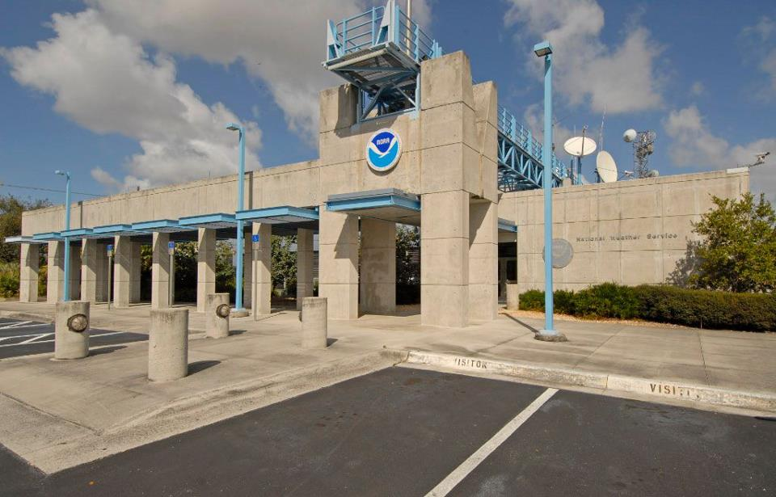
A Team of Experts
NWS National Hurricane Center Miami, FL
Forecasts the track
Forecasts the intensity
All tropical cyclones around North America!
NWS Forecast Office Sterling, VA
Forecasts the impacts
Forecast the threats
For everyone in our local area
Building has 10-inch thick walls made from 3000 cubic yards of concrete, reinforced with 45 miles of steel reinforcing rods
We work together!
To decide where & when to issue WATCHES & WARNINGS

Slide 14
National Weather Service hurricane forecast and warning products are like a mosaic…
The National Hurricane Center paints the “big picture”...
and the local Weather Forecast Offices tell the local story

Slide 15
National Hurricane Center Products
Tropical Weather Outlooks (text & graphical)
Looks out 2 & 5 days
Significant disturbances
Potential for development

Slide 16
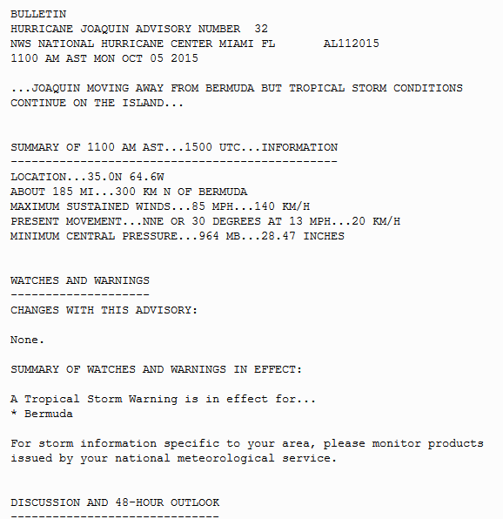
National Hurricane Center Products
For Active Storms:
- Public Advisory
- Forecast Advisory
- Tropical Cyclone
Discussion

Slide 17
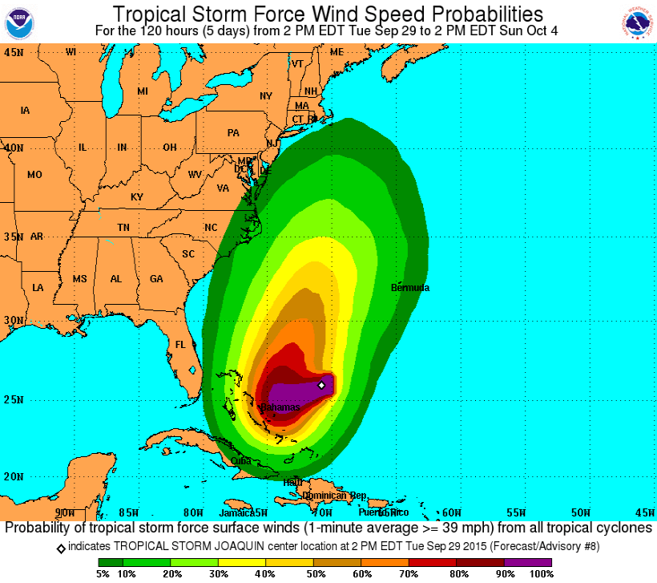
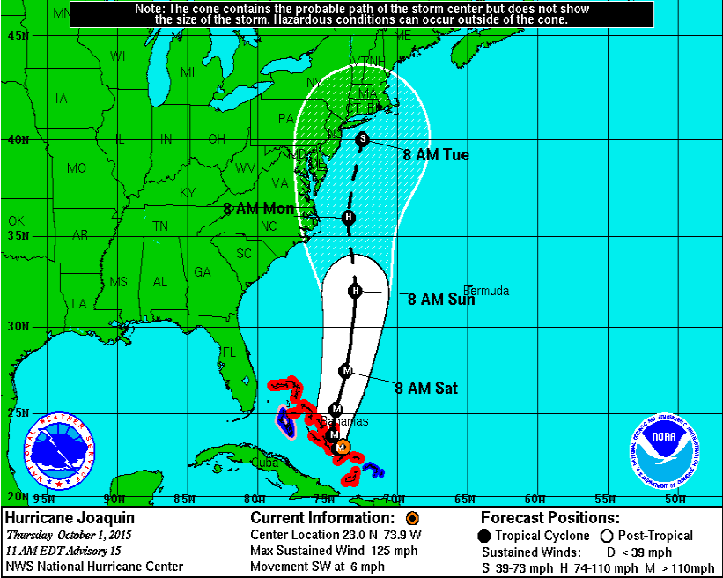
National Hurricane Center Products
For Active Storms:
Wind Speed
Probabilities
Cone of Uncertainty

Slide 18
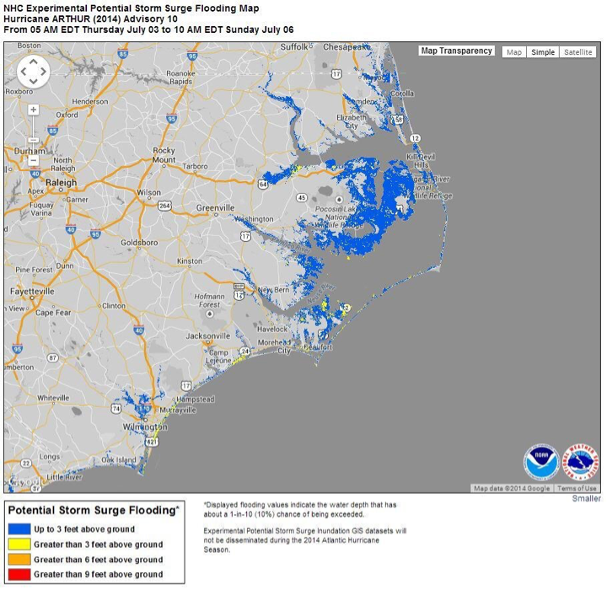
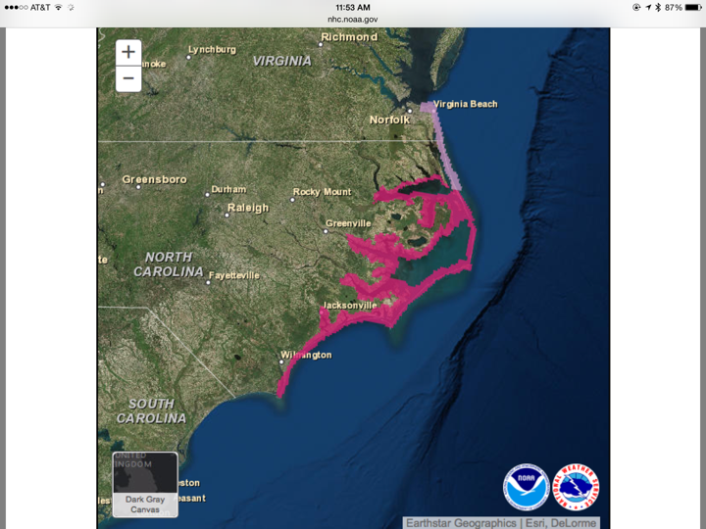
National Hurricane Center Products
For Active Storms: (once 24-72 hours out)
Potential Storm Surge Flooding Map
Storm Surge Watches/Warnings

Slide 19
Forecast Office Products
Hurricane Local Statements:
Text summary of ALL significant impacts
Local details for your area, what to expect
Good source of info for media & public who require a “big picture” & local details.

Slide 20
Forecast Office Products
Hurricane Threats & Impacts Graphics:
Graphically shows the 4 threats on 4 maps
How bad each threat will be for your area

Slide 21
Hurricane Threats & Impacts Graphics
Storm Surge Threat
Wind Threat

Slide 22
Hurricane Threats & Impacts Graphics
Flooding Rain Threat
Tornado Threat

Slide 23
Where?
All National Hurricane Center & Forecast Office Products
Can be accessed thru our page
weather.gov / washington / tropical
-END-

Slide 24
Safety Tips
Prepare a disaster supply kit:
2 flashlights
Non-perishable food & water for at least 3 days
Blankets / Clothing
First-aid kit
Hygiene items
Non-electric can opener
Spare batteries
Remember ready.gov which you can visit for this info

Slide 25
Safety / Preparedness Tips
Collect medicines/prescription drugs
Fuel your vehicle
Get extra cash
Charge cell phones
Follow instructions by local officials Leave immediately if told to do so
Leave mobile homes
Take pictures of the damage for insurance claims

Slide 26
Questions? / Remember…
We are prone to hurricanes & remnants!
4 potential threats
Flooding from heavy rainfall
Tidal Flooding / Storm Surge
Winds
Tornadoes
Team: National Hurricane Center & Forecast Office
Be prepared: ready.gov
All info found at:
weather.gov / washington / tropical

