Slide 1
An Investigation of the Skill of Week Two
Extreme Temperature and Precipitation Forecasts at the NCEP-WPC
Lance F. Bosart¹, Daniel Keyser¹, and Andrew C. Winters²
¹Department of Atmospheric and Environmental Sciences University at Albany, State University of New York, Albany, NY 12222
²Department of Atmospheric and Oceanic Sciences University of Wisconsin–Madison, Madison, WI 53706
NGGPS Annual Meeting and External FFO PI Meeting College Park, MD
Friday 17 July 2015

Slide 2
Project Summary (1)
Improve temperature and precipitation forecasts on the 8–10 day time range at the WPC in collaboration with WPC personnel.
Develop a methodology for identifying extreme temperature and precipitation events over the CONUS for all seasons during 1979–present.
Perform an evaluation of operational NCEP GFS week two forecast skill for the extreme events with an emphasis on the 8–10 day time range.

Slide 3
Project Summary (2)
Construct climatologies of forecast temperature and precipitation distributions and stratify these distributions in a manner that will allow classification of various extreme events into characteristic event types.
Perform composite analyses of characteristic event types in order to determine the multiscale evolution of the governing atmospheric flow patterns that culminate in these event types.
Perform illustrative case studies of individual extreme temperature and precipitation events identified through the composite analyses.

Slide 4
Project Summary (3)
Conduct verification studies of GFS model and associated human forecasts for the illustrative case studies.
Test methodology and new forecast formats under development at WPC in the WPC Hydrometeorological Testbed and incorporate them into forecast operations.

Slide 5
Project Outcomes
Provide forecasters with a “first alert” to the possibility of the occurrence of extreme temperature and precipitation events during week two on the basis of current conditions and model forecasts.
Provide forecasters with an indication of the character and flavor of the possible extreme events as inferred from where the events lie in the PDFs of the anticipated event types.
Provide forecasters with knowledge that allows them to make science-based adjustments to model guidance and add value to week two forecasts of temperature and precipitation.

Slide 6
Supertyphoon Nuri (2014)

Slide 7
Super Typhoon Nuri (2014): Extratropical Transition, Explosive Reintensification as an Extratropical Cyclone, and Downstream Predictability Impacts
STY Nuri reaches 910 hPa on 2–3 Nov 2014
ET begins on 6–7 Nov as storm weakens to 984 hPa
Explosive reintensification as an EC on 7–8 Nov
Storm deepens 60 hPa in 30 h down to 924 hPa by 0600 UTC 8 Nov
Storm at 924 hPa ties all-time record for deepest North Pacific EC
Omega block subsequently forms over western North America
Multiple arctic air masses invade the CONUS
CPC forecast for a greater chance of a warm November is toppled
Global models exhibit poor 5- and 10-day predictability of STY Nuri ET/EC
Global models exhibit good 5- and 10-day predictability of omega block

Slide 8
Motivation
Supertyphoon Nuri
31 Oct – 7 Nov 2014
(ET/EC Phase: 7 – 9 Nov 2014)

Slide 9
Super Typhoon Nuri: 31 Oct – 7 Nov 2014
JMA: Best Track
JMA: Minimum SLP (hPa)
Digital Typhoon (http://agora.ex.nii.ac.jp/digital-typhoon/index.html.en)

Slide 10
NCEP-OPC Surface Analysis: 0600 UTC 8 November 2014

Slide 11
Motivation
A Forecast Perspective

Slide 12
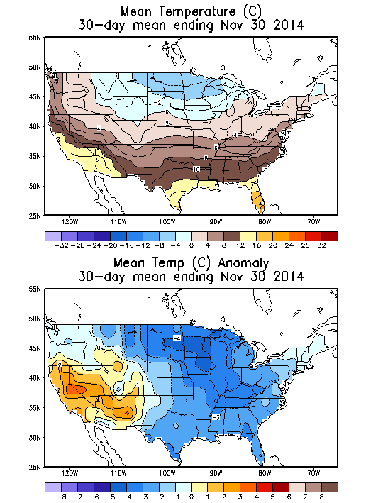
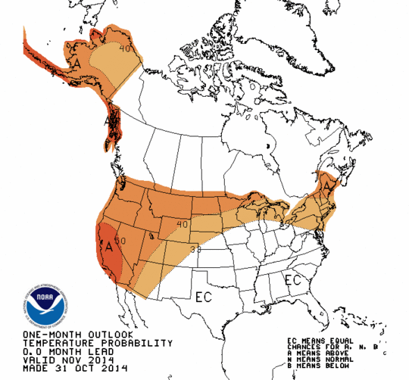
November 2014 CPC Forecast Temperature Anomaly Probability (Left); Mean and Observed Temperature Anomaly °C (right)

Slide 13
NCEP Comparison of Global Operational Model Forecasts of 120 h (Top) and 240 h (Bottom) Anomaly Correlation (AC) Skill for NPAC/NAMER: 28 October – 27 November 2014
0.8
AC
0.6
Time >
924 hPa
0.8
AC
0.6

Slide 14
ECMWF Ensemble Mean 200-hPa Geopotential Height (dam) Forecasts and Ensemble Standard Deviation (dam)
144 h: 0000 UTC 15 Nov 2014
240 h: 0000 UTC 15 Nov 2014

Slide 15
ECMWF Ensemble Mean 200-hPa Geopotential Heights: 00 h 0000 UTC 15 November 2014

Slide 16
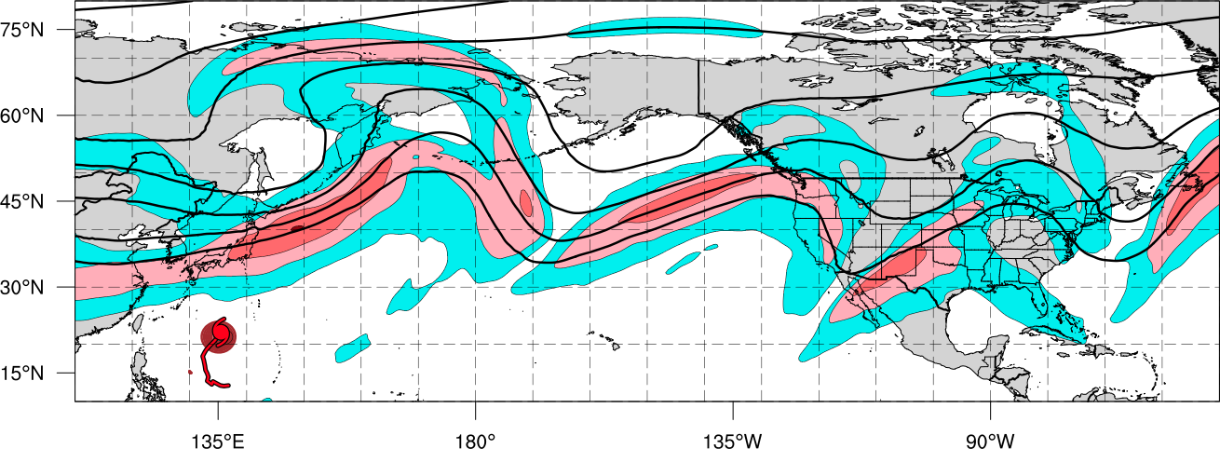
Schematic – Synoptic Evolution November 2014
0000 UTC 4 November 2014
Polar Cold Outbreak
Polar Jet
TC Outflow
STY Nuri
Legend
L
Extratropical low pressure center
H₁
High pressure center
Sea level pressure < 1000-hPa
Cold front
Arctic air
200-hPa geopotential heights
Tropical Cyclone
200-hPa Isotachs

Slide 17
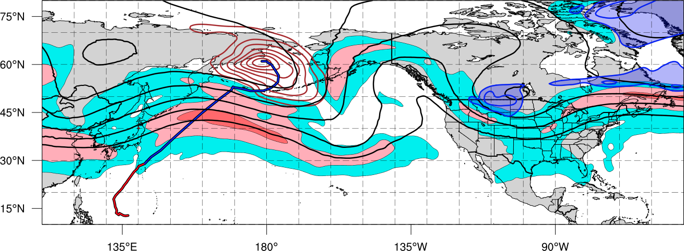
Schematic – Synoptic Evolution November 2014
1200 UTC 11 November 2014
Ex Nuri
L
H₁
Building Omega Block
1st Cold Surge
Polar Jet
Tropical Moisture
Legend
L
Extratropical low pressure center
H₁
High pressure center
Sea level pressure < 1000-hPa
Cold front
Arctic air
200-hPa geopotential heights
Tropical Cyclone
200-hPa Isotachs

Slide 18
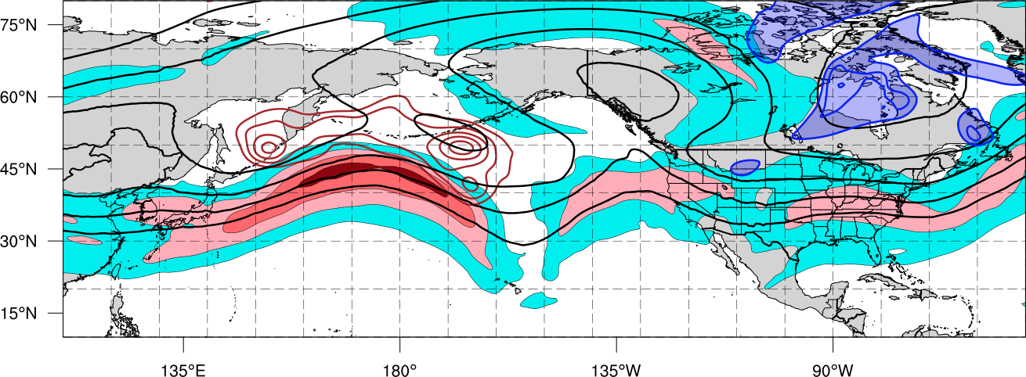
Schematic – Synoptic Evolution November 2014
1200 UTC 15 November 2014
H₃
Omega Block
Ex Nuri
2nd Cold Surge
L
H₂
Polar Jet
H₁
Legend
L
Extratropical low pressure center
H₁
High pressure center
Sea level pressure < 1000-hPa
Cold front
Arctic air
200-hPa geopotential heights
Tropical Cyclone
200-hPa Isotachs

Slide 19
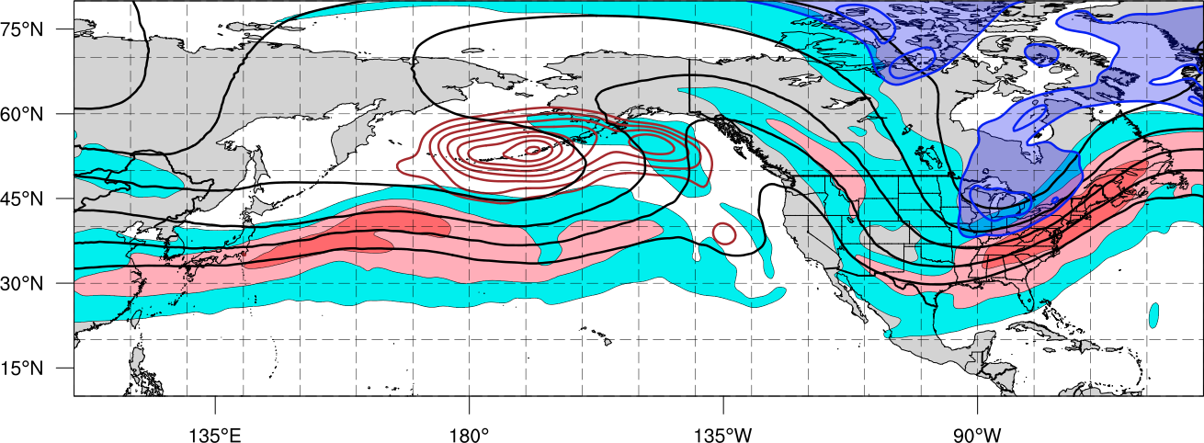
Schematic – Synoptic Evolution November 2014
1200 UTC 18 November 2014
Blocking Ridge
L
Ex Nuri
3rd Cold Surge
L
Polar Jet
H₂
H₂
H₃
H₁
Legend
L
Extratropical low pressure center
H₁
High pressure center
Sea level pressure < 1000-hPa
Cold front
Arctic air
200-hPa geopotential heights
Tropical Cyclone
200-hPa Isotachs

Slide 20
Impacts: Buffalo Snow Blitz and CONUS Record Cold

Slide 21
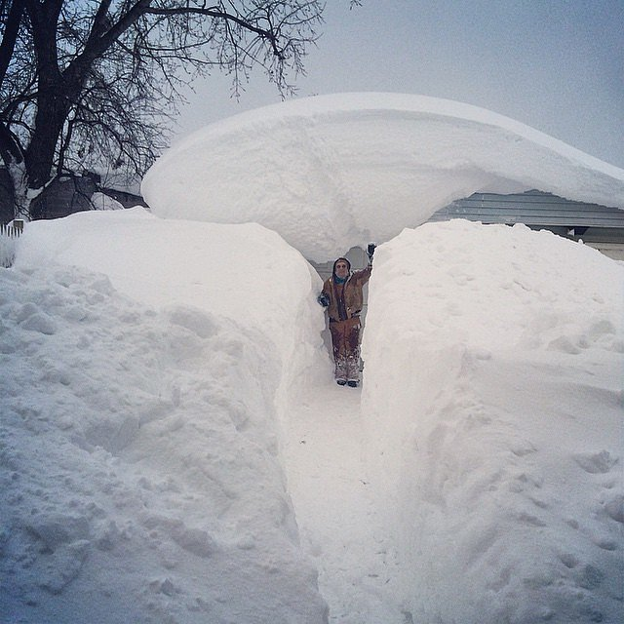

Slide 22
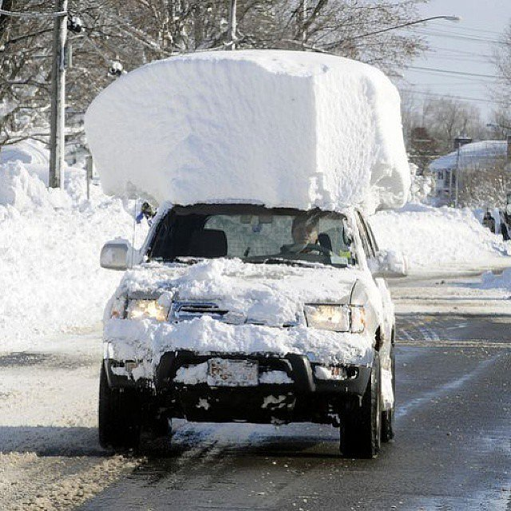

Slide 23
Buffalo (72528) Soundings 0000 UTC 18 and 19 Nov 2014
1000–500 hPa thickness: 5034 m
T (500 hPa) -42.1 °C; T (850 hPa) -15.1°C
LWT–850-hPa temperature difference: ~27°C

Slide 24
NCDC CONUS Temperature Rankings for November 2014 (left) and Mean Temperature Anomalies (°F) for 16–22 November 2014 (right)

Slide 25
Minimum Temperature Records Broken: 16–22 November 2014 (N = 2677) Source: NCDC

Slide 26
Conclusions (I)
An upper-level baroclinic disturbance creates a strong baroclinic zone and jet stream across the western North Pacific prior to STY Nuri’s ET
The interaction of STY Nuri with a second baroclinic disturbance of arctic origin during ET leads to its explosive reintensification as an EC
Downstream high-latitude ridge building and omega block formation over Alaska and NW Canada follows Nuri’s explosive reintensification as an EC

Slide 27
Conclusions (II)
Omega block persistence (~10 days) enables multiples surges of early-season arctic air to encompass much of the CONUS
Impacts of the arctic air surges include a near-epic lake effect snowstorm south of Buffalo and a failed CPC November 2014 seasonal temperature forecast
North Pacific and North American atmospheric predictability maximizes one to two weeks after STY Nuri’s ET and explosive reintensification as an EC

Slide 28
Abrupt Regime Change
over Northeast U.S. in Late May and Early June 2015
Notes:
When starting talk, define education–research interface and introduce Alicia and Kyle as current and previous TAs in upper-division thermodynamics and introductory graduate dynamics that I presently teach at UAlbany.

Slide 29
Abrupt Regime Change from Much Above to Much Below Temperatures over the Northeast in Late May and Early June 2015
Largest CONUS positive temperature anomalies were found over the Northeast in May
Reversal from positive to negative temperature anomalies occurred at the end of May
Temperature reversal was driven by surface anticyclogenesis over eastern Canada
Canadian anticyclogenesis occurred beneath a confluent poleward jet-entrance region
Surface anticyclone over eastern Canada drove chilly Atlantic air southwestward
Did a record-breaking snowpack over southeastern Canada exacerbate the chill?
Did below normal SSTs over the northwest Atlantic contribute to the chill?
Did relatively dry air over southeastern Canada allow for evaporative chilling?
GFS deterministic forecast did not catch on to the cool down until the 6–7 day forecast
Note: GFS forecast grids have aged off and would have to be retrieved

Slide 30
Mean and Anomaly 850-hPa Temperature (°C): April 2015

Slide 31
Mean and Anomaly 850-hPa Temperature (°C): May 2015

Slide 32
Mean (m) and Anomaly (m) 1000-hPa Geopotential Heights: April 2015

Slide 33
Mean (dam) and Anomaly (m) 500-hPa Geopotential Heights: May 2015

Slide 34
Mean (m) and Anomaly (m) 1000-hPa Geopotential Heights: May 2015

Slide 35
Mean (mm) and Anomaly (mm) Precipitable Water: May 2015

Slide 36
Sea Level Pressure (hPa) 30 and 31 May 2015

Slide 37
Sea Level Pressure (hPa) 1 and 2 June 2015

Slide 38
NOAA NCEP-EMC Sea-Surface Temperature (°C) 3 June 2015

Slide 39
A Final Thought:
One or several EWEs during a single season can contribute disproportionately to temperature and precipitation anomaly statistics for a particular season. This disproportionate contribution suggests that EWEs need to be considered in describing and understanding the dynamical thermodynamical processes that operate at the weather-climate intersection in order to apply that knowledge to making operational probabilistic temperature and precipitation forecasts for the 8-10 day time period.

