Slide 1
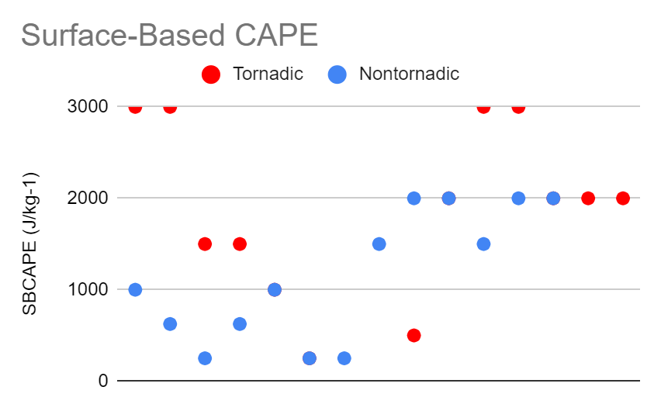
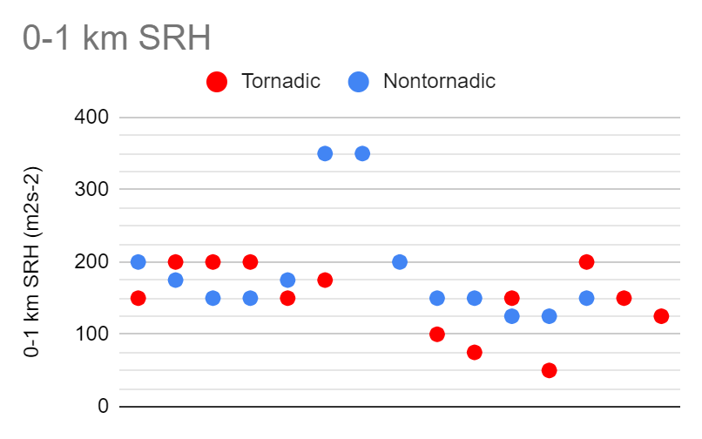
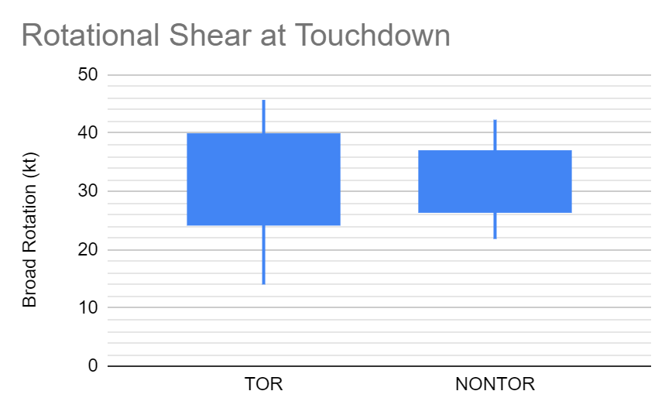
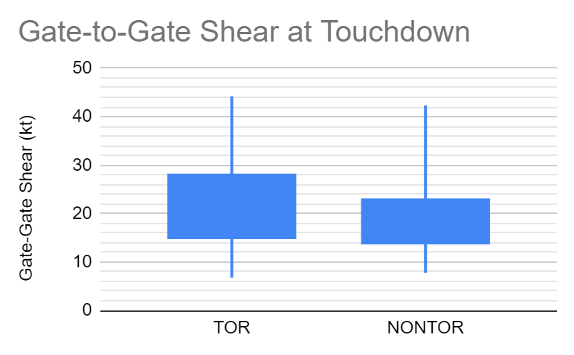
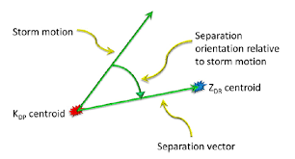
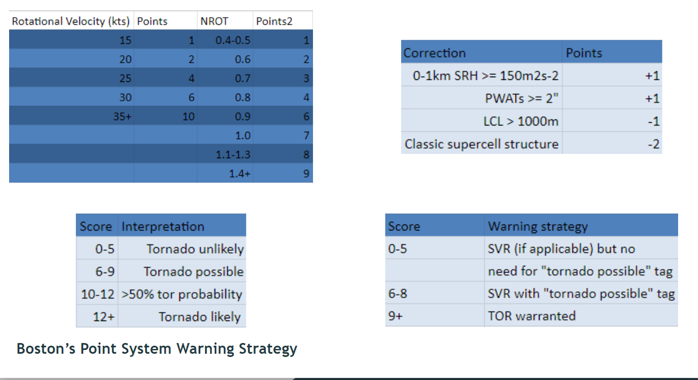
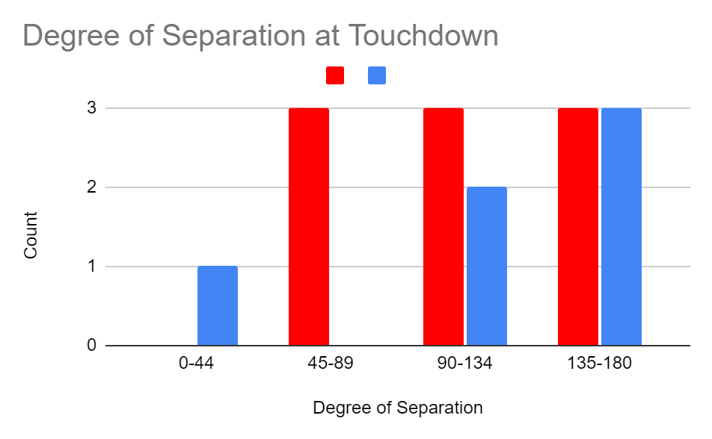
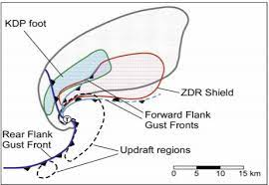
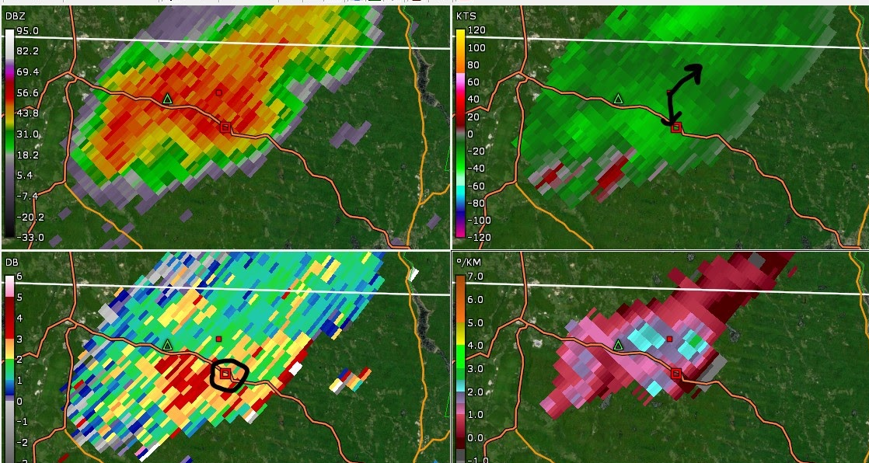
The Use of Radar-Based Techniques to Warn for Tornadoes in the Albany Warning Area
Hailey Culwell, Michael Evans (Mentor)
NOAA, Albany NWS
BACKGROUND
METHODS
RESULTS
CONCLUSIONS
The National Weather Service has been aiming to create a way to increase effectiveness of tornado warnings.
The organization has collaboratively been researching methods for decreasing the amount of false alarms and increasing the probability of detecting tornadoes.
This is the Tornado Warning Improvement Project (TWIP).
The Boston NWS researched ways to improve tornado forecasting in their warning area.
They focused on synoptic and mesoscale environment and radar data of tornado cases from 2007 to 2017.
They put together a point system warning strategy.
There were 14 tornadic and 14 non-tornadic cases in 2020
For each, the mesoscale environment and rotational radar data for each case were examined and storm modes classified.
Boston’s warning strategy was applied.
The radar techniques demonstrated by the Tornado Warning Improvement Project for QLCS’s and supercells at touchdown, 10 minutes prior, and 20 minutes prior were analyzed.
Environment
Rotation
There was also little discrepancy between tornadic and non-tornadic cases regarding rotation.
Boston NWS Warning Strategy
9/14 tornadic cases scored possible or above, with 4/9 exhibiting ideal TWIP signatures
9/14 non-tornadic cases scores possible or above, but 4/9 supported no tornadogenesis
QLCS TWIP
2/3 tornadic cases exhibited all 3 ingredients at all times
2/4 non-tornadic cases did not exhibit all 3 ingredients at all times
Supercell TWIP
For all three times, TOR cases showed a majority over NONTOR cases in ideal range of 45-135 degrees.
Boston’s warning strategy proved accurate during tornadic events, but it exhibited a high false alarm rate.
The TWIP supercell and QLCS signatures significantly improved warning confidence in the tornadic cases, but yet again proved unsuccessful for the non-tornadic cases.
The TWIP radar signature theories overall exhibited variable accuracy in tornadic events, but they are prone to false alarms.
OBJECTIVES
The northeast US generally sees few tornadoes, but the 2020 year produced more than usual.
I aimed to test the radar-based warning techniques, including Boston’s warning strategy, on tornadic cases of 2020.
By the end, we should be able to implement more accurate and more timely tornado warnings.
FUTURE WORK
Applying these methods to a large sample size
Exploring higher radar tilts
With false alarms still an issue, more research into discriminatory features should be continued
Supercell TWIP signature diagnosis would work best if it could be automated.
REFERENCES
O’Brien, J. E. (2017, July 28). Improving the Detection of New England Tornadoes [PowerPoint Slides].
www.weather.gov
ACKNOWLEDGMENTS
Albany NWS meteorologists Michael Evans and Christina Speciale for mentoring.
Boston NWS meteorologist Joseph Dellicarpini and Plymouth State University graduate Jonathon E. O’Brien for use of O’Brien’s warning strategy.

