Slide 1
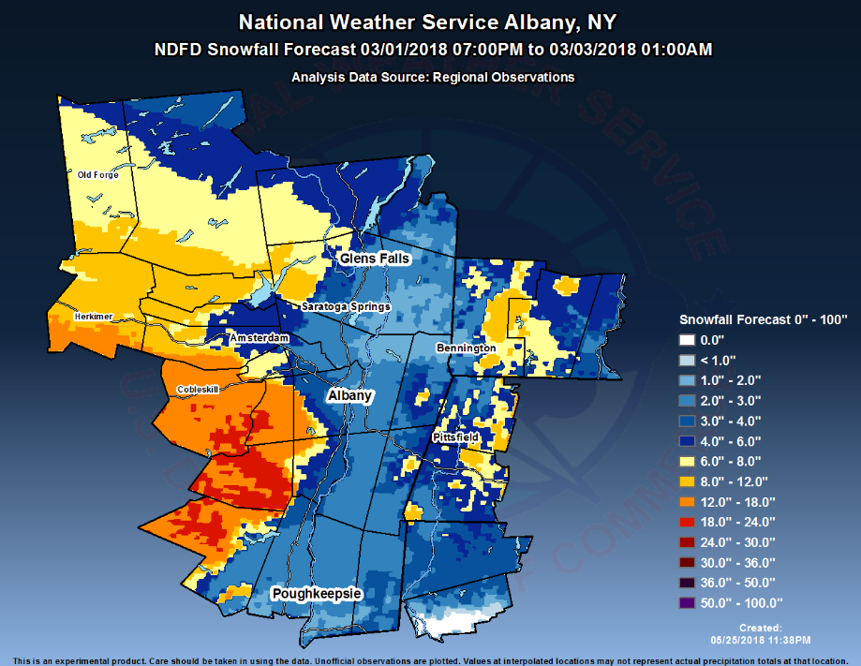
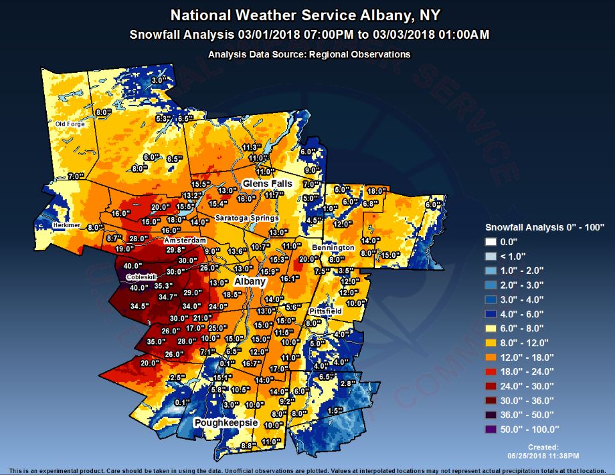
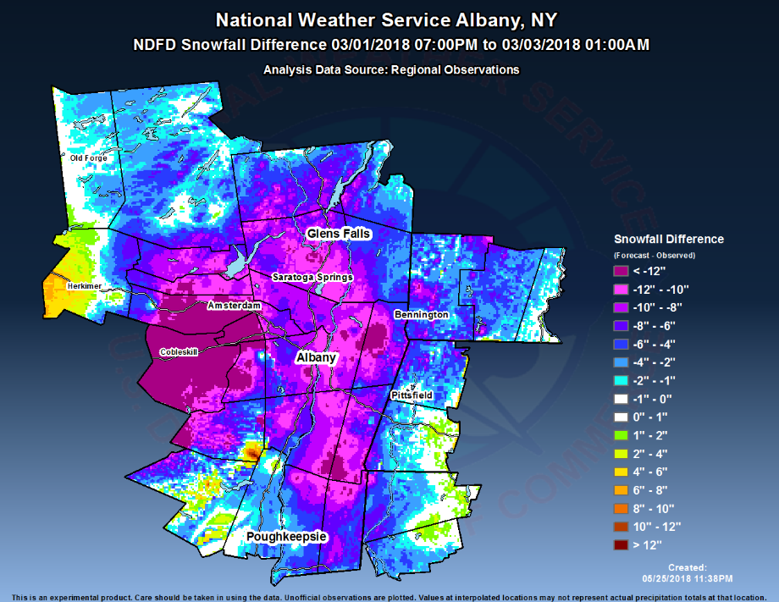
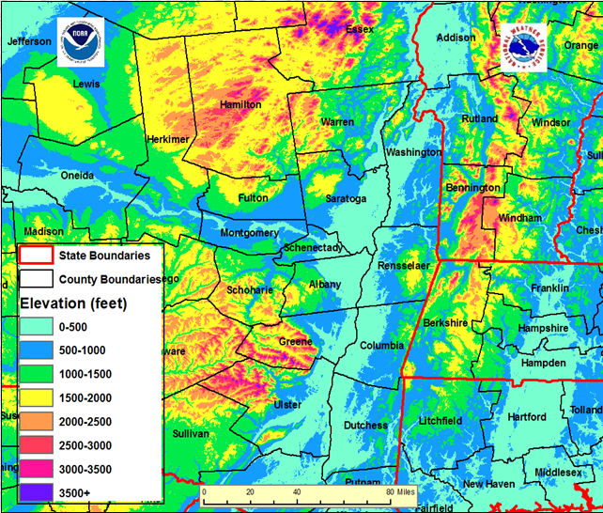
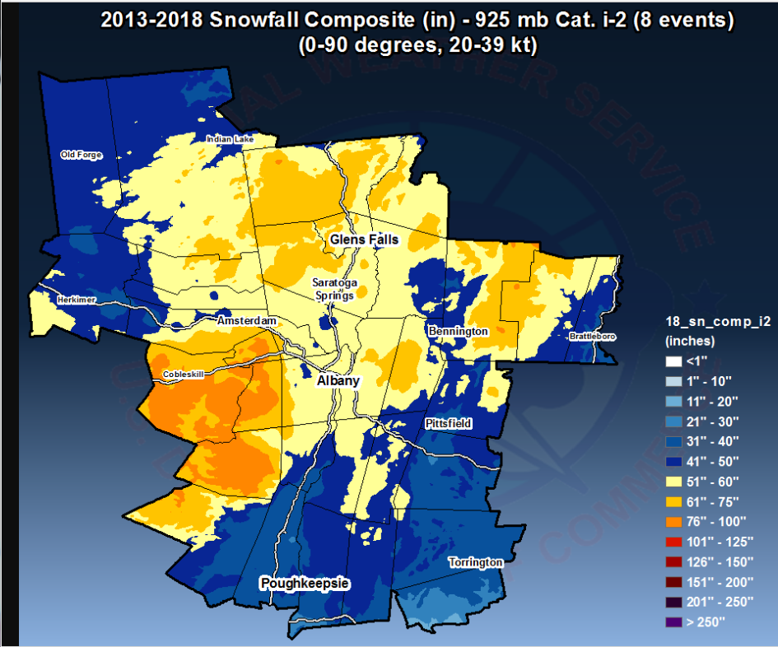
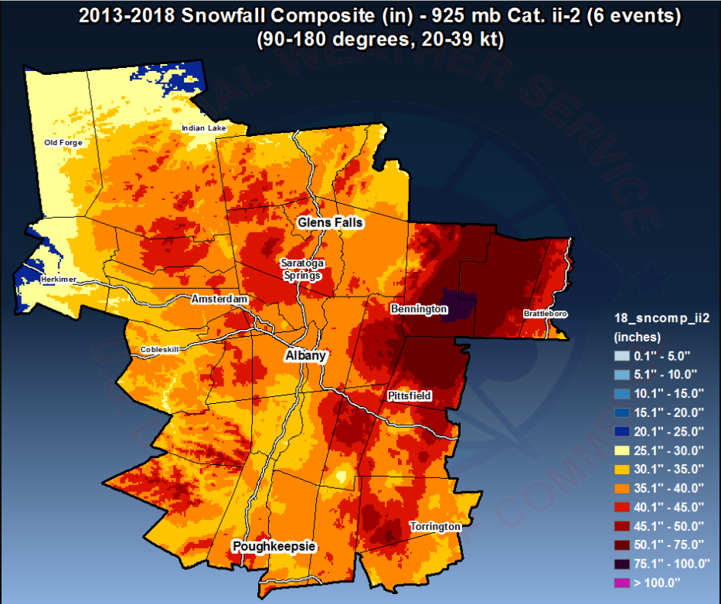
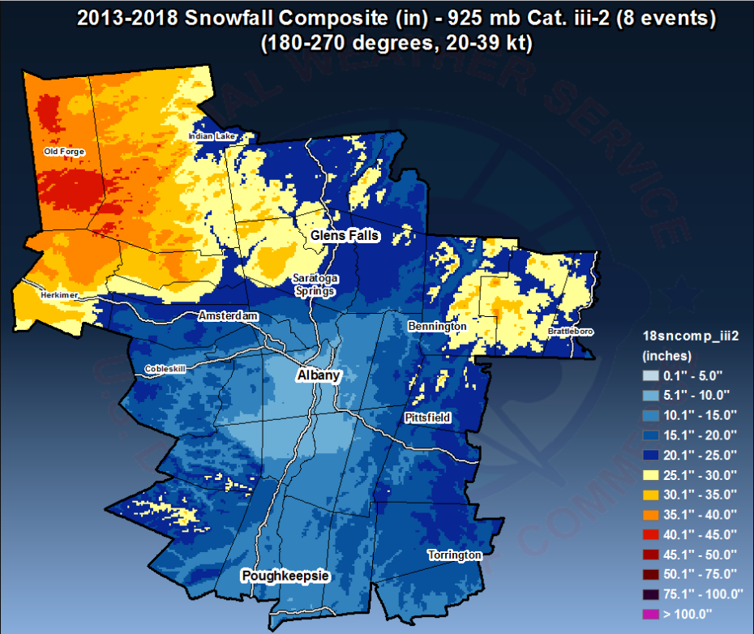
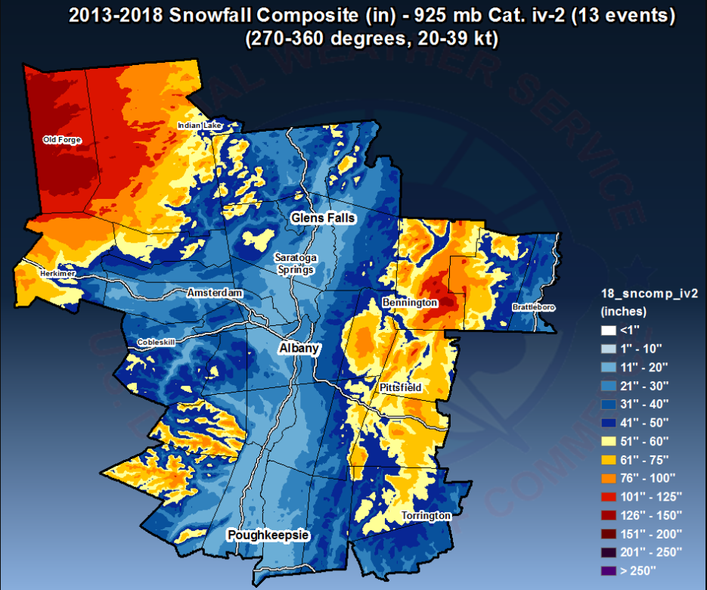
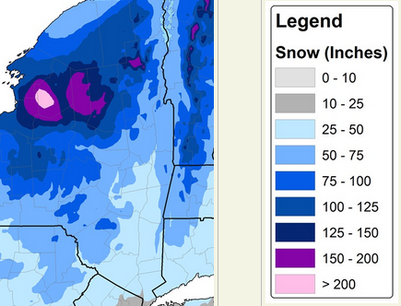
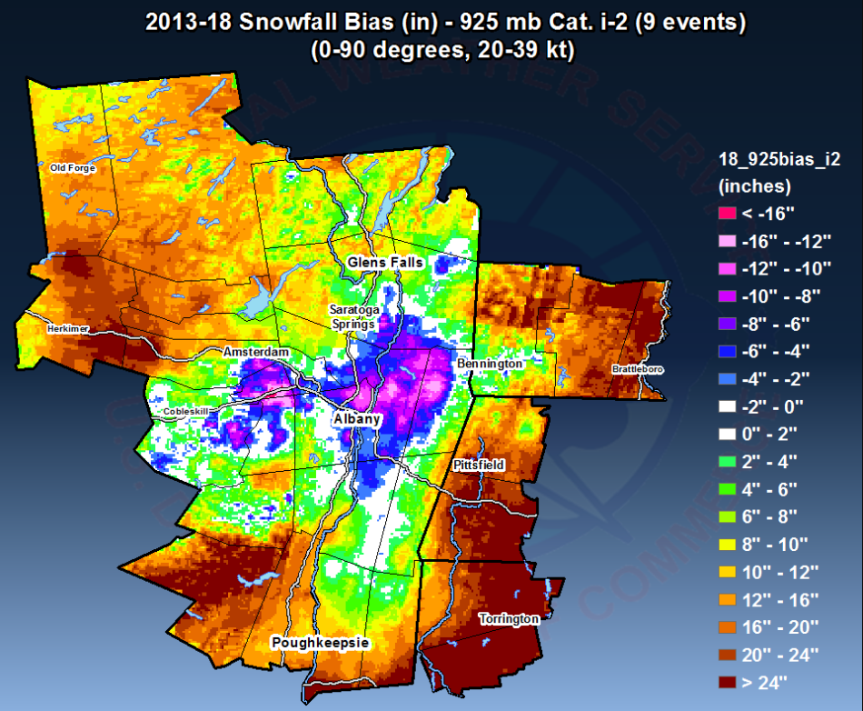
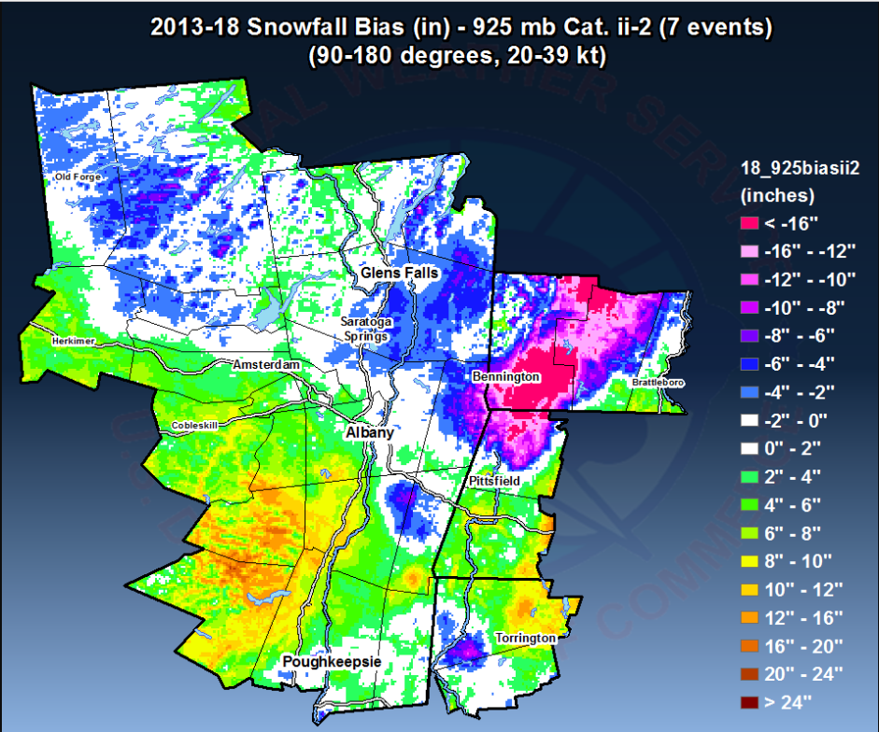
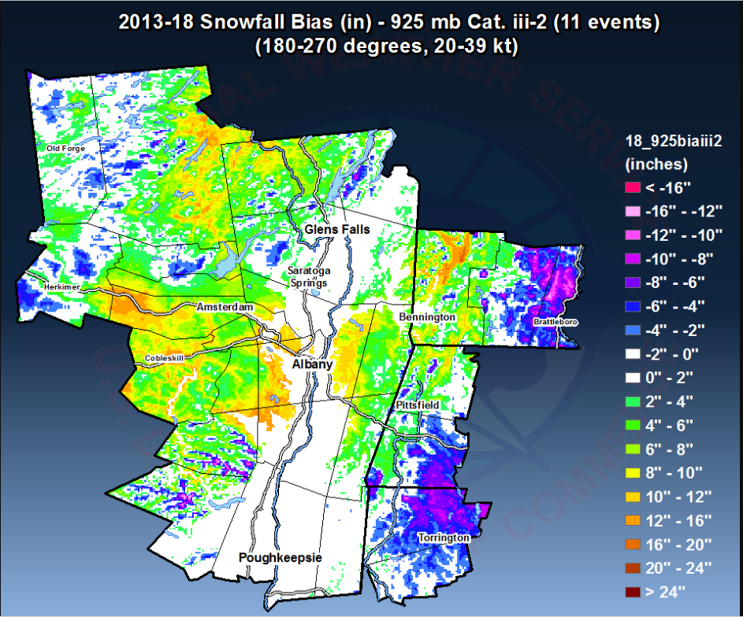
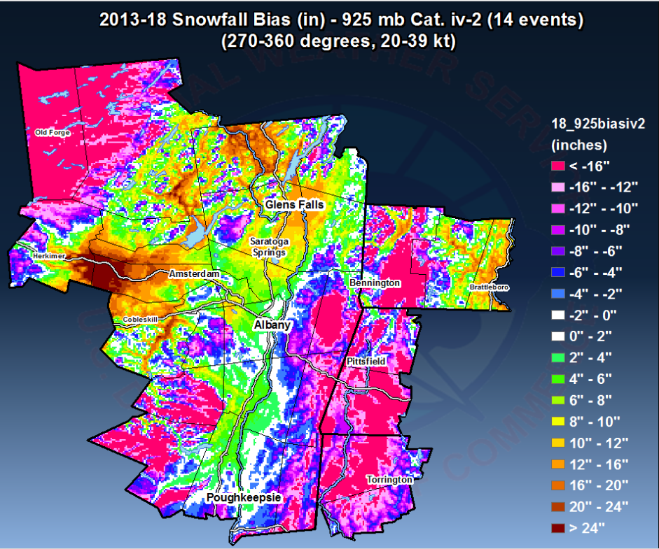
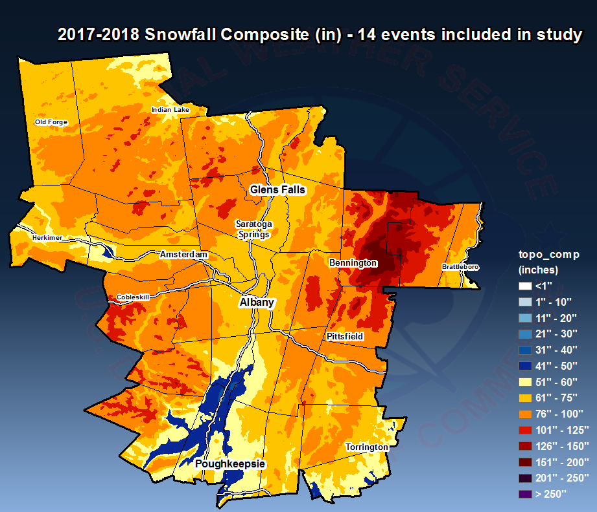
Use of a GIS application to evaluate snowfall patterns and the accuracy of forecaster and model predictions of snowfall in eastern New York and western New England
Joe Villani NWS WFO Albany, NY
Vasil Koleci NWS Albany, NY
Mike Evans NWS Albany, NY
Charles Gant NWS Greenville-Spartanbug, SC
GAZPACHO – Gridded Automated Zonal Precipitation and Complete Hi-resolution Output. An automated program to assist with snowfall verification
Runs on a PC with ArcGIS 10.5 installed via a GUI.
Ingests a list of observed snowfall reports, plus the NOHRSC snowfall analysis.
Observed snowfall reports are plotted on a map with high-resolution terrain.
Observed snowfall analysis is turned into a gridded field by interpolating between observations and by weighting observations based on elevation.
The snow analysis can be blended with the NOHRSC.
Gridded forecasts can be compared to gridded observations.
Example – March 2, 2018 – Snowfall under-forecast in many areas, very heavy snow in higher terrain west of Albany
Snowfall forecast for 3/2/2018
Observed snowfall 3/2/2018
Difference between the forecast and observed snowfall
Examination of snowfall patterns based on 925 hPa wind direction (from ALB sounding near the event mid-point; 20-39 kt events only)
Eastern NY / western NY terrain
Examination of snowfall forecast errors based on 925 hPa wind direction (from ALB sounding near the event mid-point; 20-39 kt events only)
Average annual snowfall
Additional work:
Compare observations to high-resolution model forecasts for the 2017 –
2018 winter season.
- Discriminate events by wind and stability (Froude numbers).
- Determine environmental data from time-averaged model sounding data.
Summary
- An application has been developed that allows for objective evaluation of snowfall forecasts.
- The application has allowed forecasters to identify the impacts of terrain on snowfall and snowfall forecast biases in the ALY county warning area.
- Additional work will identify biases of model forecasts, allowing forecasters to adjust high resolution models and blends using “targets of opportunity”.

