Slide 1
An overview and verification of two terrain-influenced snowstorms in eastern New York
Mike Evans
Joe Villani
NOAA / NWS Albany, NY

Slide 2
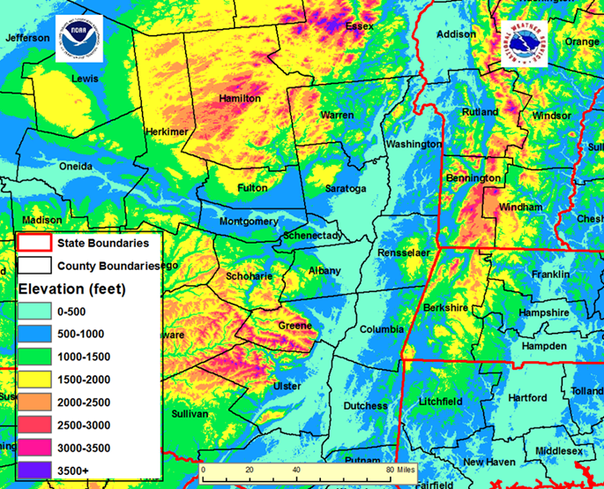
Terrain in eastern NY and western New England

Slide 3
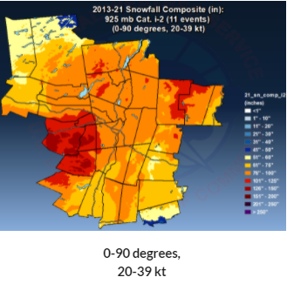
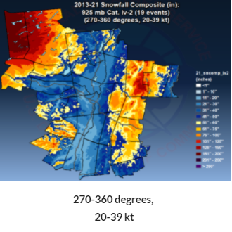
Snowfall patterns by wind direction

Slide 4
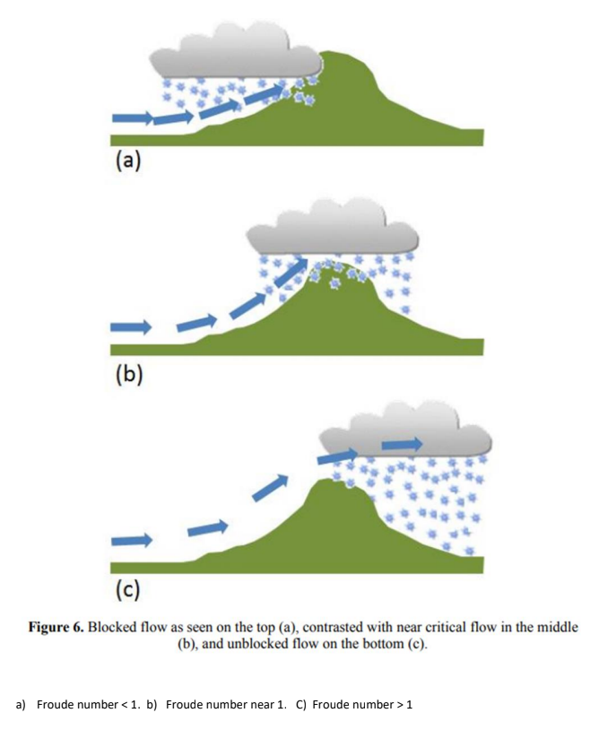
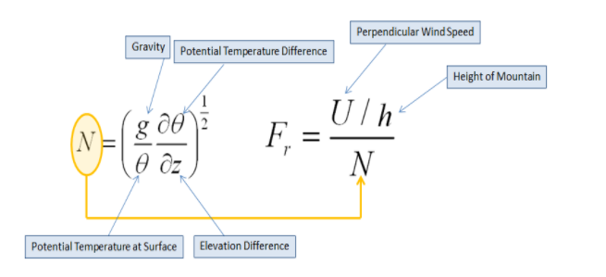
More research on topography and enhanced snowfall
Low Froude number
weak flow perpendicular to ridge
Stable
High Froude number
Strong flow perpendicular to ridge
Less stable
From: Muccilli, 2015

Slide 5
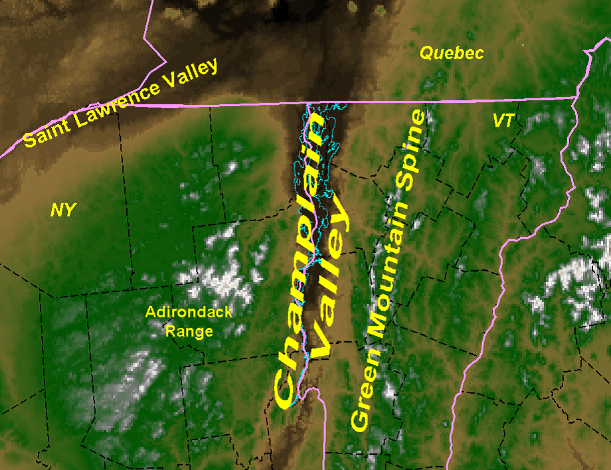
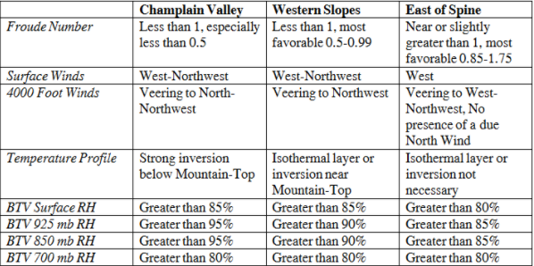
More research on topography and enhanced snowfall
From: Mucilli, 2015

Slide 6
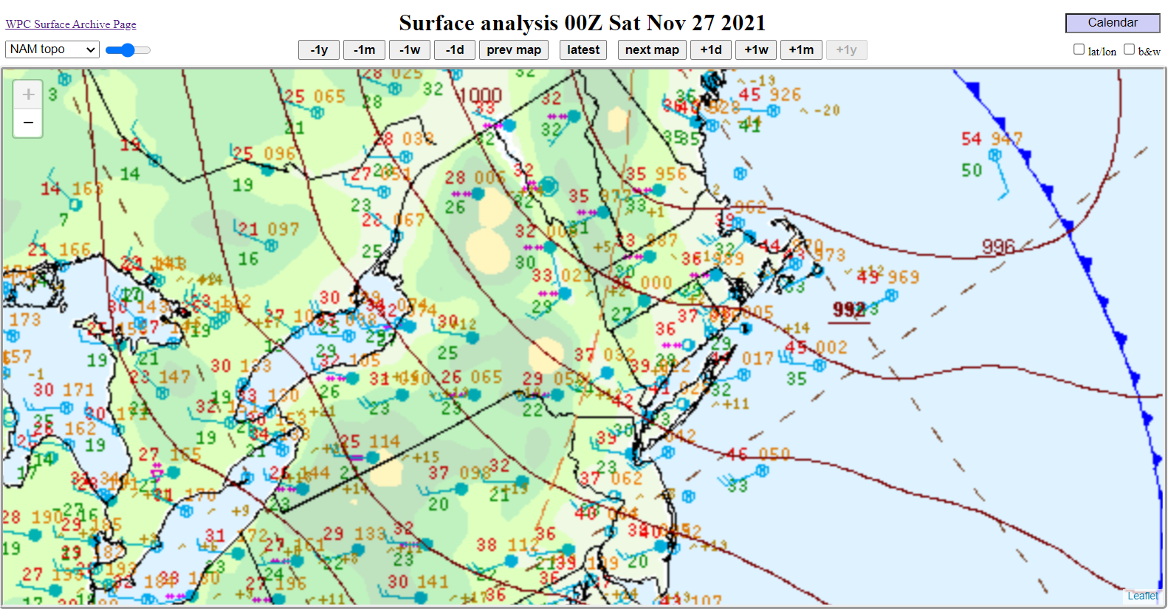
November 27, 2021

Slide 7
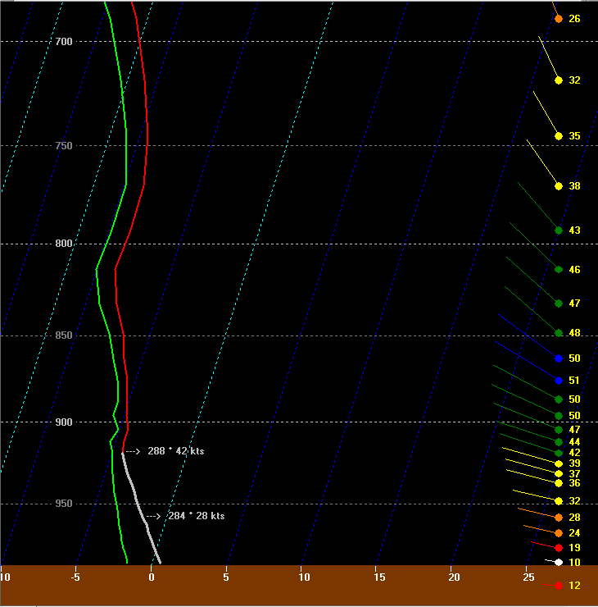
Valid 00z, November 27, 2021
Conditions for snow to be enhanced in relation to the Taconic Hills east of the Hudson River?
Froude number 1.9
Ridge-top winds – Northwest / Weak veering
Surface winds – west-northwest
Small lapse rates (no inversion) near ridge top (favors min at lower elevations).
RH generally greater than 80 percent
Surface temperatures near freezing (favors min at lower elevations).
Ridge Tops

Slide 8
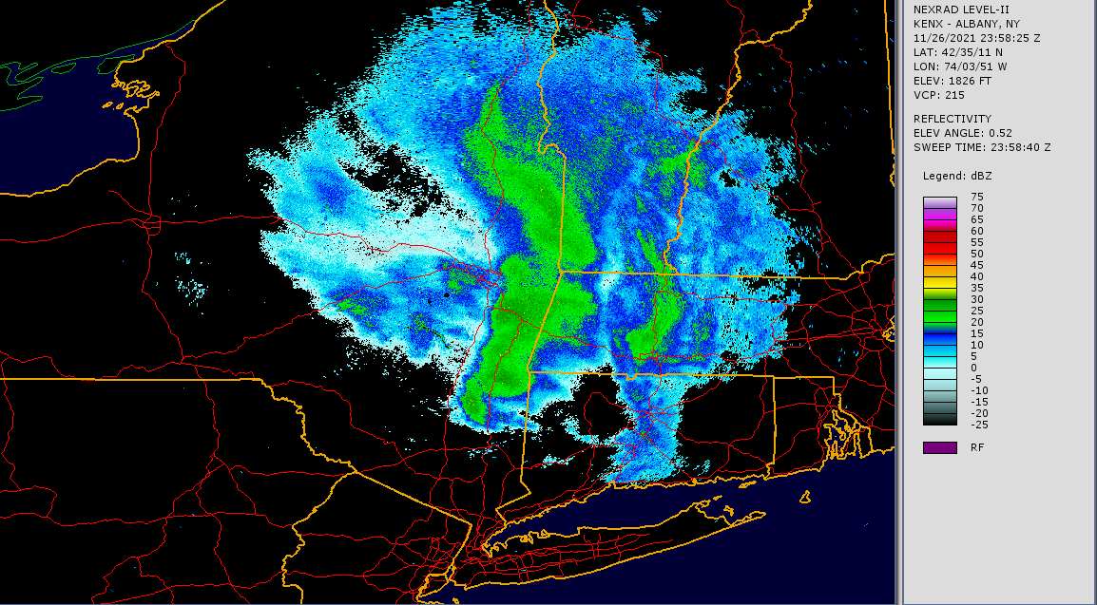
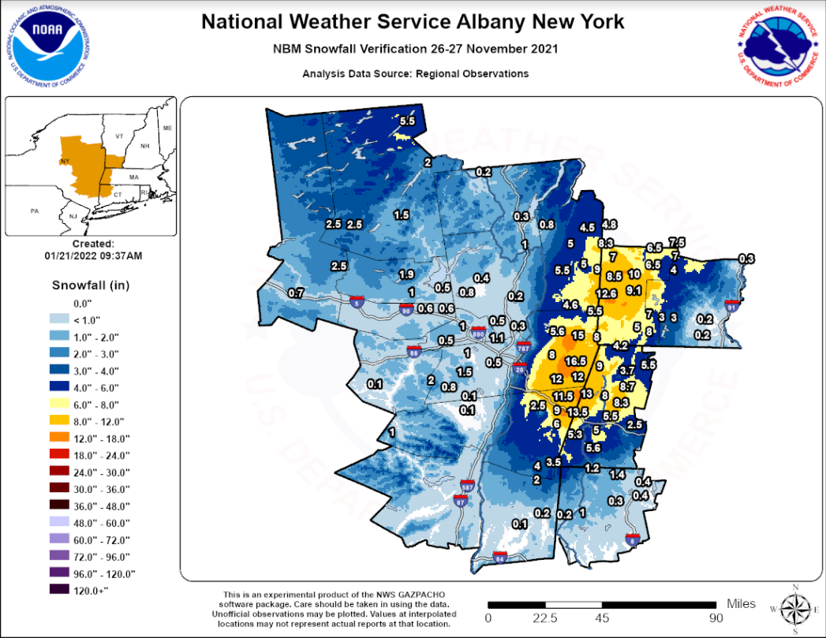
November 27, 2021
Enhanced snowfall east of the Hudson Valley

Slide 9
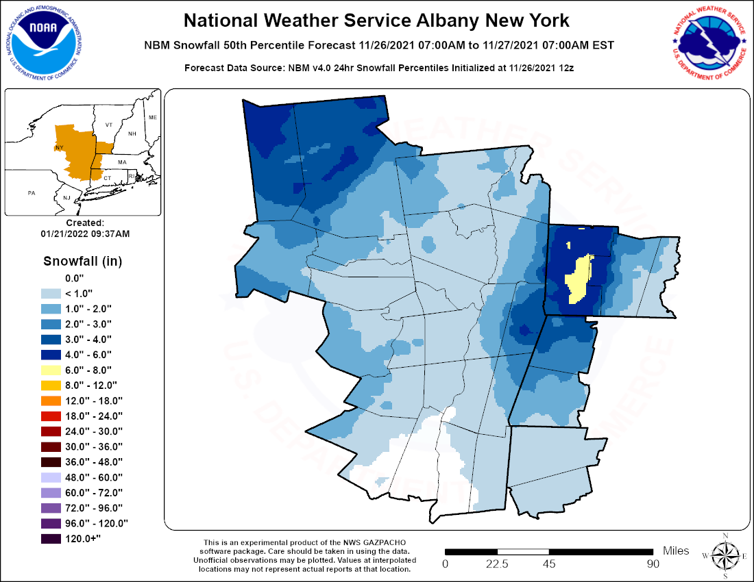
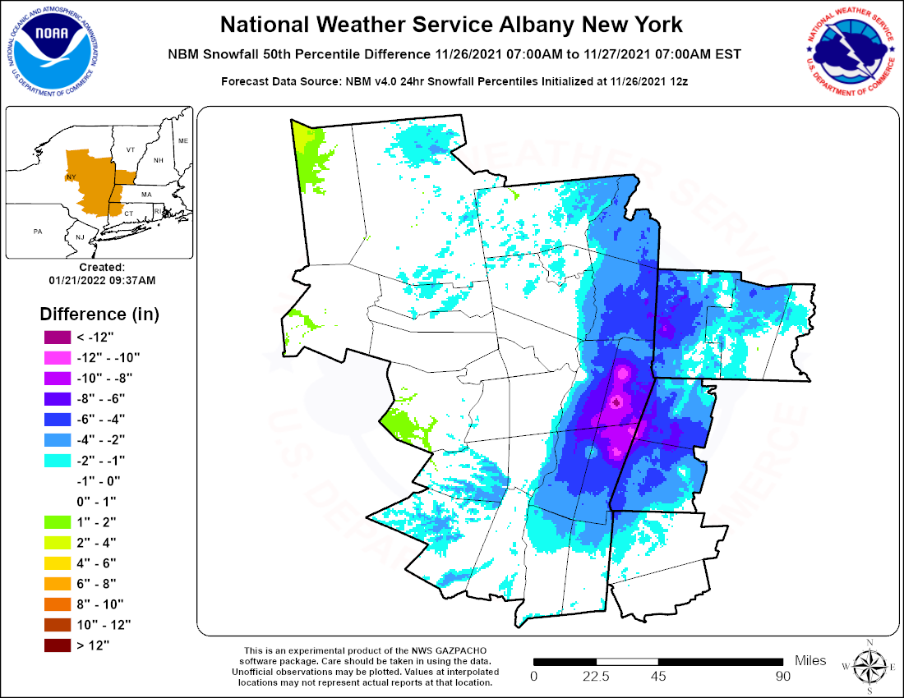
November 27, 2021 – NBM forecasts and errors

Slide 10
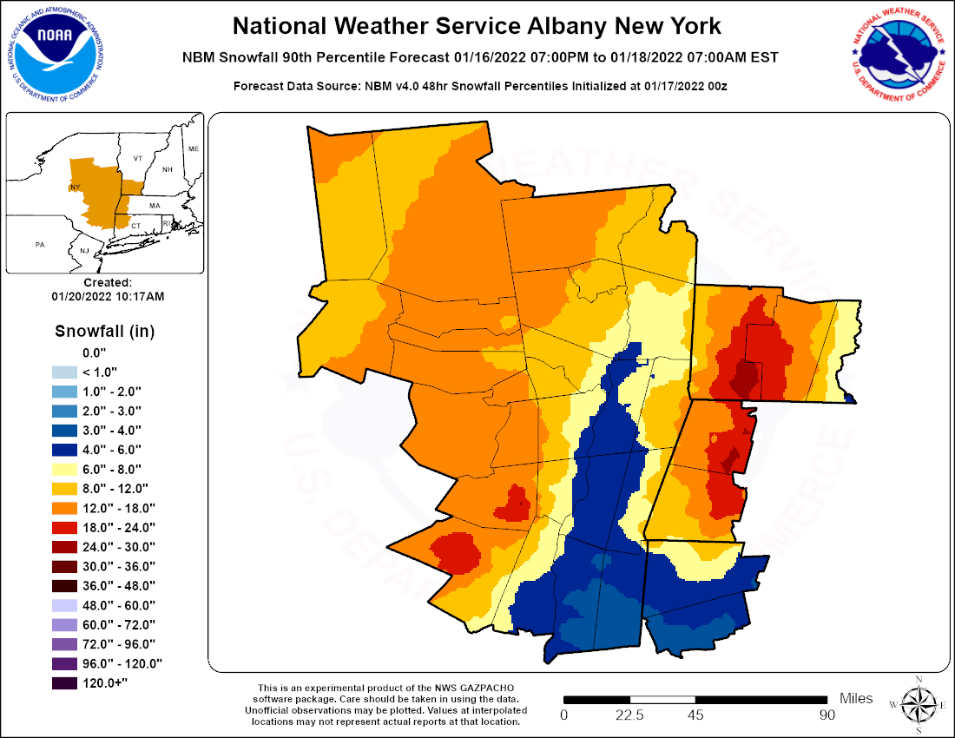
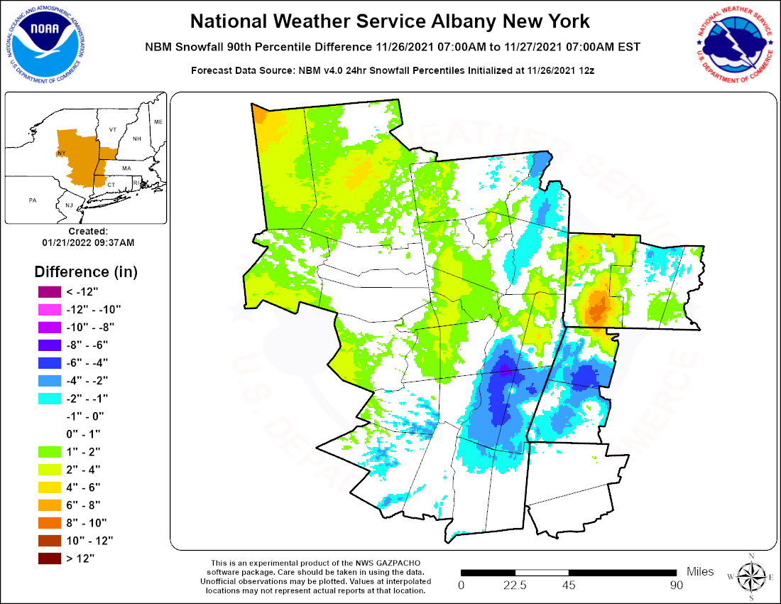
November 27, 2021 – 90th percent NBM

Slide 11
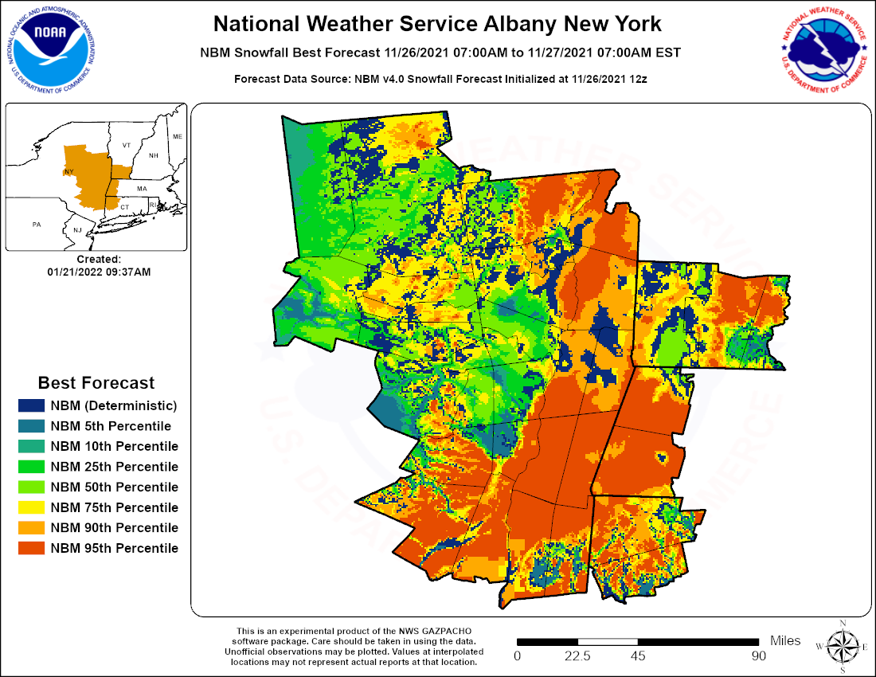
November 27, 2021 – best NBM forecast

Slide 12
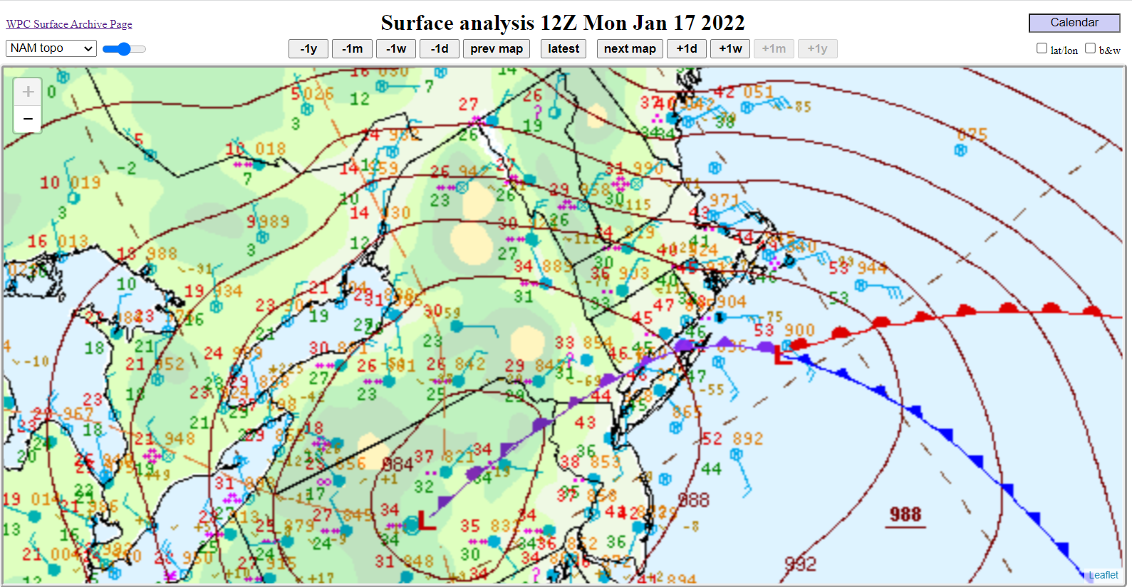
January 17, 2022

Slide 13
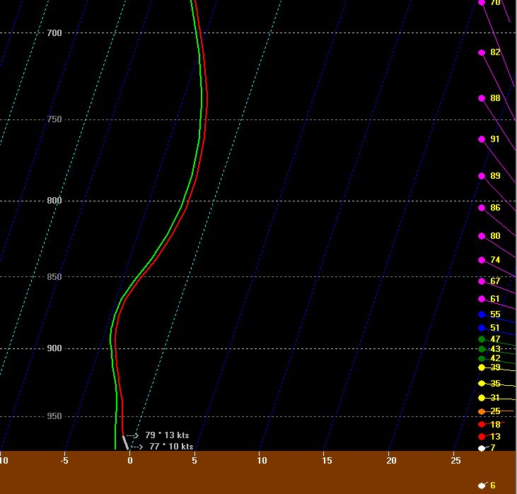
Valid 12z January 17, 2022
Conditions for snow to be enhanced at higher elevations west of the Hudson (Catskills / Helderbergs).
Froude Number – 1.5
Ridge-top winds – East / Slight veering
Surface winds – northeast
Weak inversion near ridge-top (favors upwind slopes)
RH greater than 90 percent
Surface temperatures near freezing (favors min at lower elevations)
Ridge Tops

Slide 14
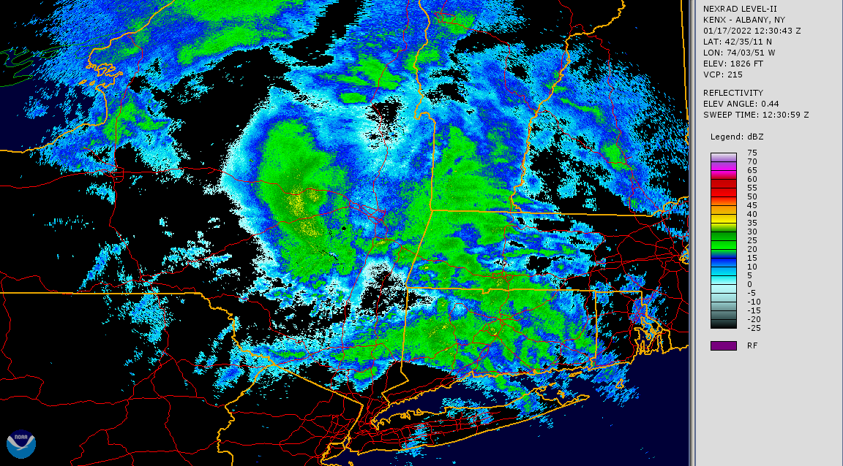
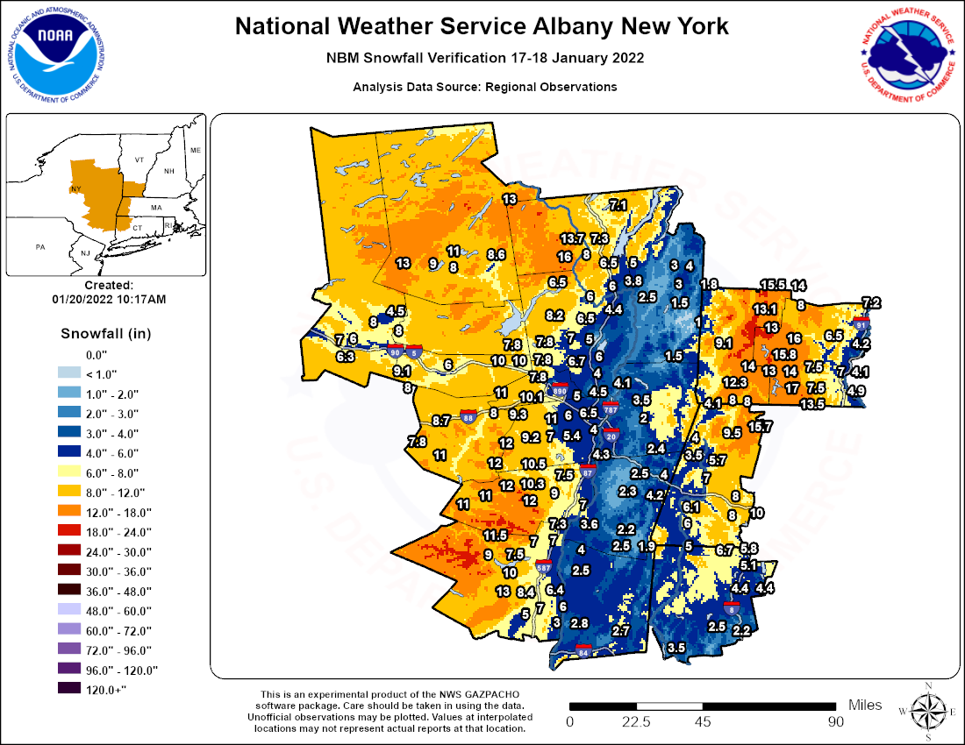
January 17, 2022 observations
Enhanced snowfall west of the Hudson Valley

Slide 15
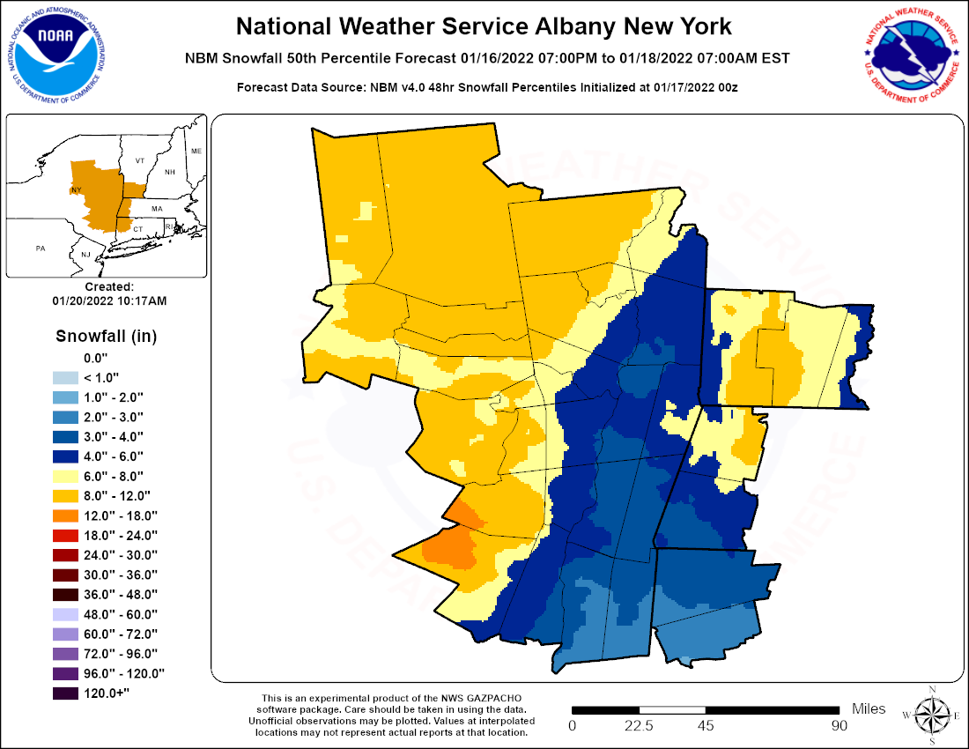
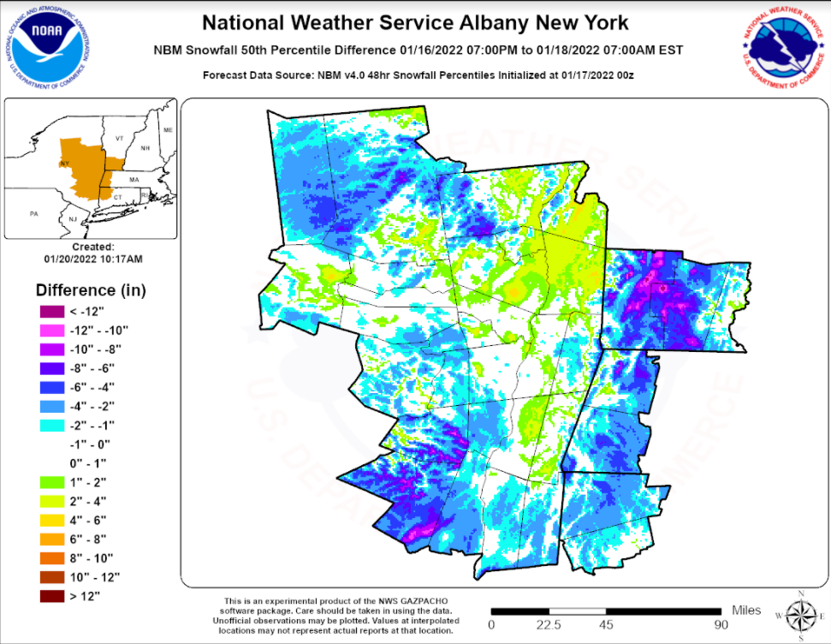
January 17, 2022 – NBM forecasts and errors

Slide 16
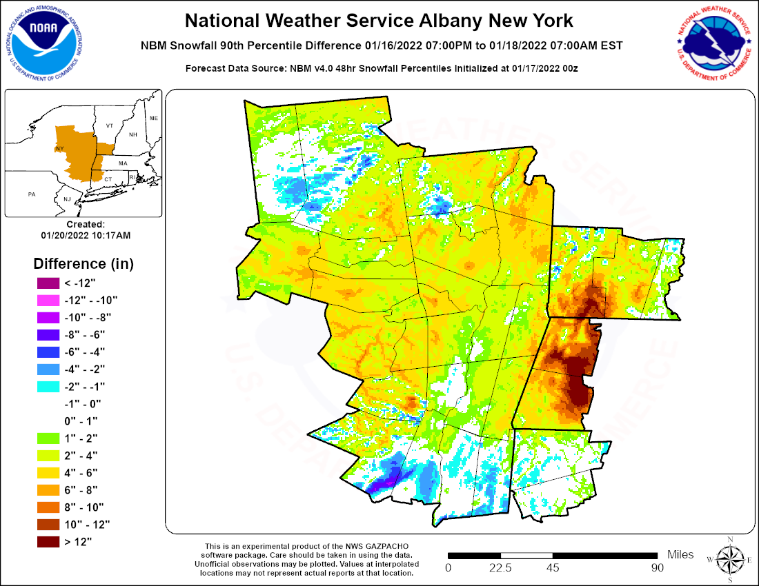
January 17, 2022 – 90th percent NBM

Slide 17
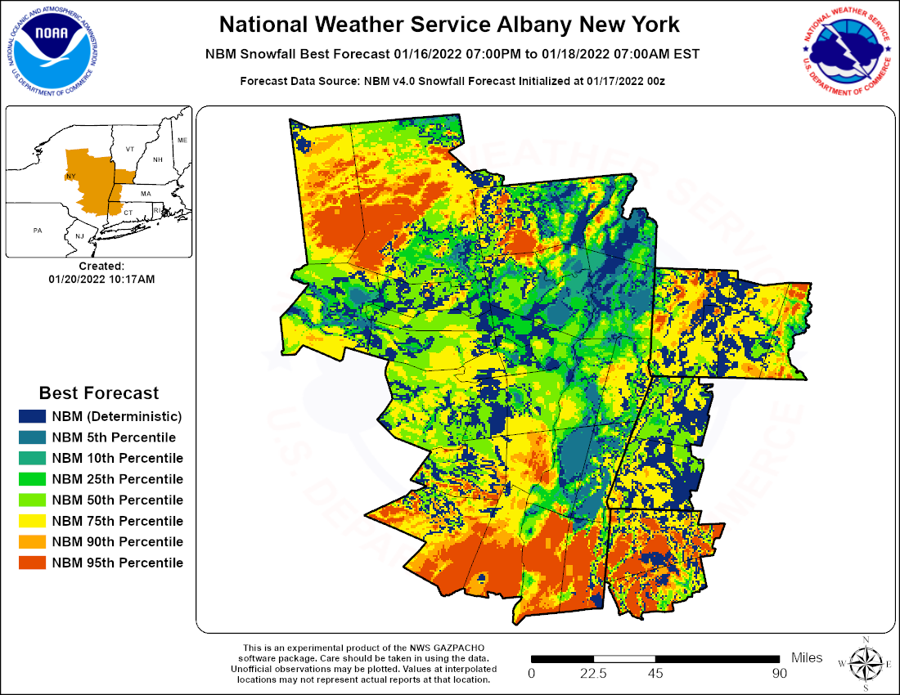
January 17, 2022 – best NBM forecast

Slide 18
Summary and conclusion
Two winter storms during the winter of 2021 – 2022 were shown; one with heaviest snow over terrain east of the Hudson Valley, and one with heaviest snow over terrain west and far east of the valley.
Factors favoring snow at higher elevations included near freezing surface temps, no strong inversion, Froude numbers above 1.0.
90th percentile NBM forecasts were the best forecast over terrain enhanced snowfall to the east of the valley in the first storm, although still underdone in some areas, particularly the west slopes.
50th percentile NBM forecasts were good over terrain enhanced snowfall to the west of the valley in the second storm.
Results show that no single percentile forecast from the NBM would work over the entire forecast area.
Perhaps one technique could be to start with 50-90 percent NBM forecasts over favored terrain areas, with 50 percent or lower NBM forecasts for the remainder of the area?

Slide 19
References
Mucillli, M, 2015: Using the Froude number to improve orographic snow forecasts in the Green Mountains of Vermont, ER Tech Attachment.
Evans, M.S, M.L. Jurewicz and R. Kline, 2017: The elevation dependence of snowfall in the Appalachian ridge and valley region of northeastern Pennsylvania, Journal of Operational Meteorology.

