Slide 1
ATM-480 Lecture:
Hydrology in the
National Weather Service
Britt Westergard
Senior Service Hydrologist
NWS @Albany, NY

Slide 2
Water flows downhill.
Any questions?

Slide 3
Hydrology in the
National Weather Service
Why NWS forecasts rivers & what causes flooding in the Albany NWS forecast area
Fundamentals of hydrologic modeling
NWS flood forecasts & warnings
The future of NWS hydrology

Slide 4
Why Forecast Rivers?
Protection of life and property
  Each year, countless lives are saved due to accurate forecasts of rising rivers
  Millions of dollars in property are also saved by accurate forecasts
For Hydro Power Production/Industry
Recreation
Dam Operations
Navigation
The National Weather Bureau Organic Act of 1890 (U.S. Code title 15, section 311) mandates that the National Weather Service is the responsible agent for "the forecasting of weather, the issue of storm warnings, the display of weather and flood signals for the benefit of agriculture."

Slide 5
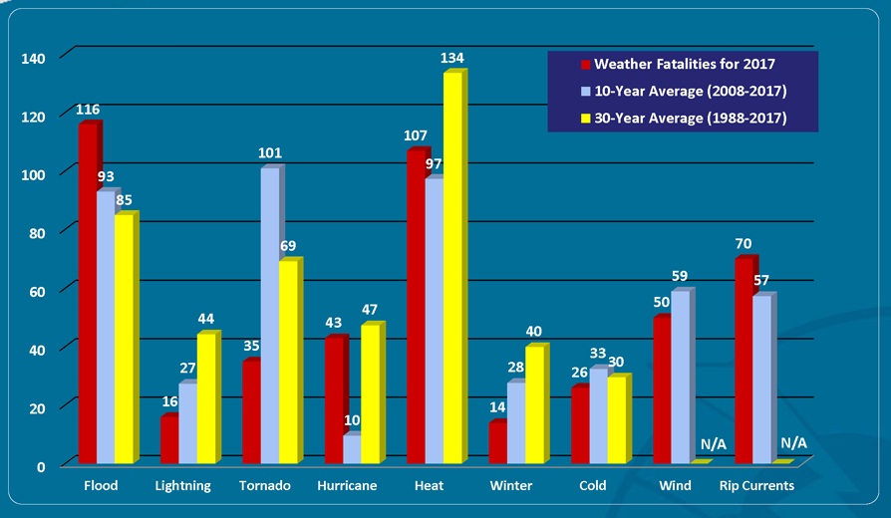
Flooding is the #1
Severe Weather Hazard in U.S.
About three quarters of federally declared disasters in NYS are flood-related

Slide 6
Common Causes of
Northeast Floods
Floods can occur any time of year:
  Winter/Spring –
    Rain plus snowmelt
    Heavy rain with large storm systems
  Spring/Summer - Thunderstorms
  Summer/Fall - Tropical Storms

Slide 7
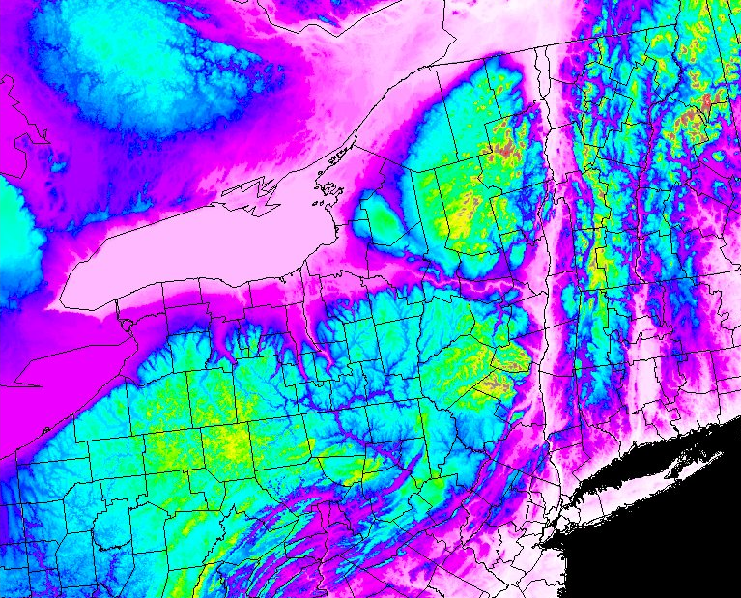
Topography drives Hydrology

Slide 8
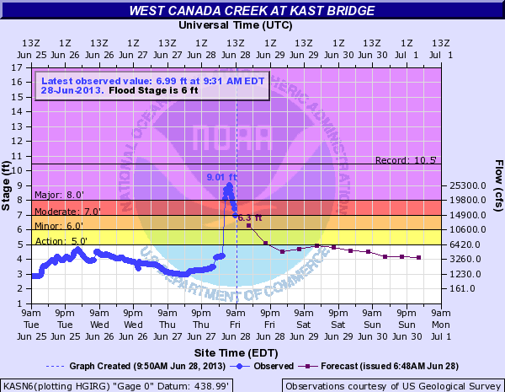
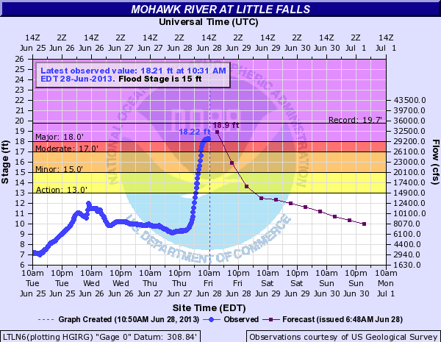
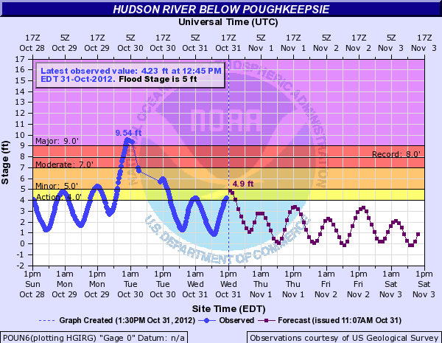
Varied Topography makes for
Varied Hydrology

Slide 9
Antecedent Conditions
How dry or wet is the soil?
  Wet soils increase runoff
  Dry ground can absorb rainfall and decrease runoff
Is the ground frozen?
  Frozen ground reduces infiltration of rainfall into ground (increases runoff)
  Large increase in urban/basement flooding when heavy rain or snow melt on frozen/partially frozen ground
  Mud slides possible in steep terrain during thaws
Late Spring/Summer vs. Late Fall/Winter
  Trees/plants/crops absorb a significant portion of total rainfall when leaves are on trees

Slide 10
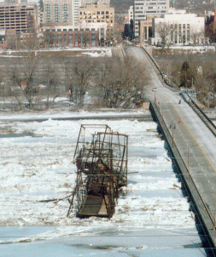
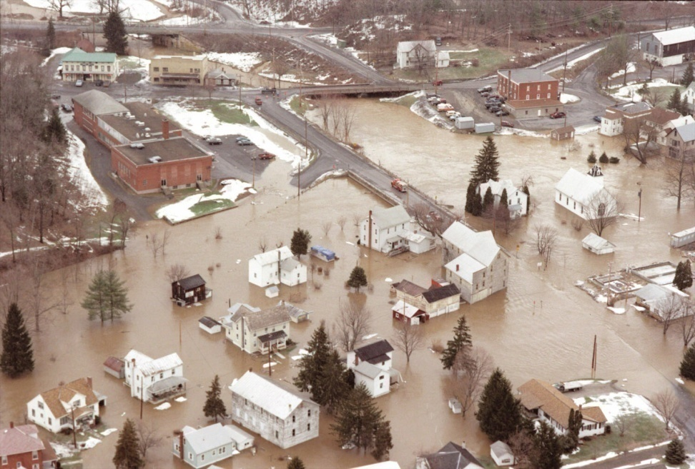
Antecedent Conditions:
Is there any snow melt or river ice?
Heavy rain + warm temperatures + strong wind + large snow pack + river ice can be a deadly combination
January 1996

Slide 11
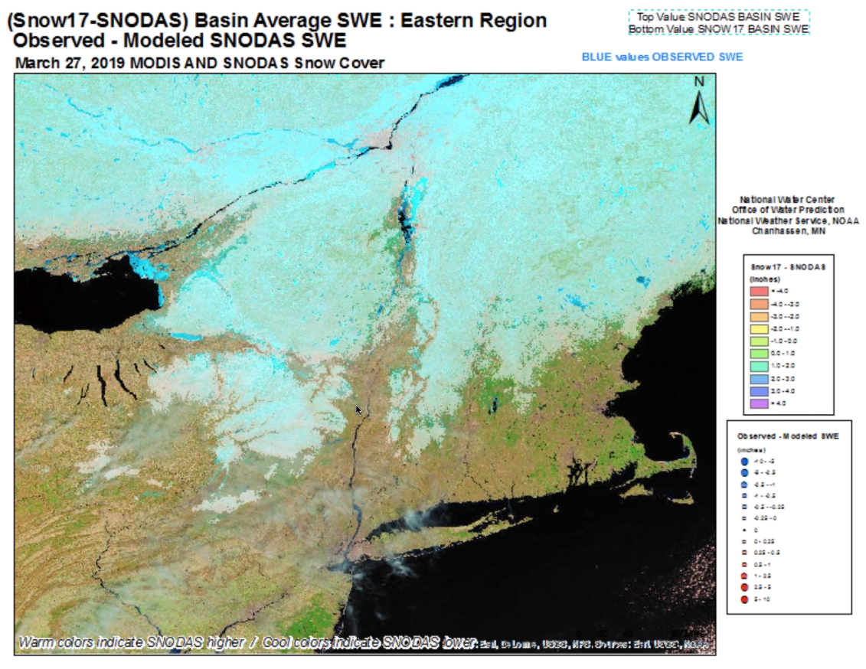
Monitoring Snowpack
National Operational Hydrologic Remote Sensing Center (NOHRSC)

Slide 12
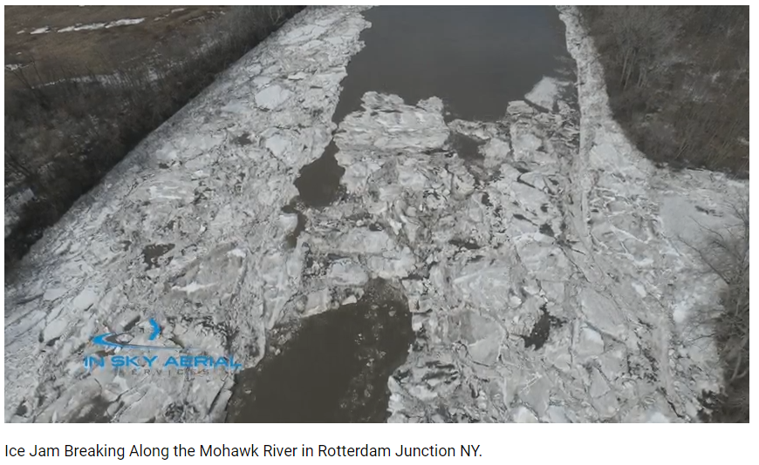
River Ice Jams

Slide 13
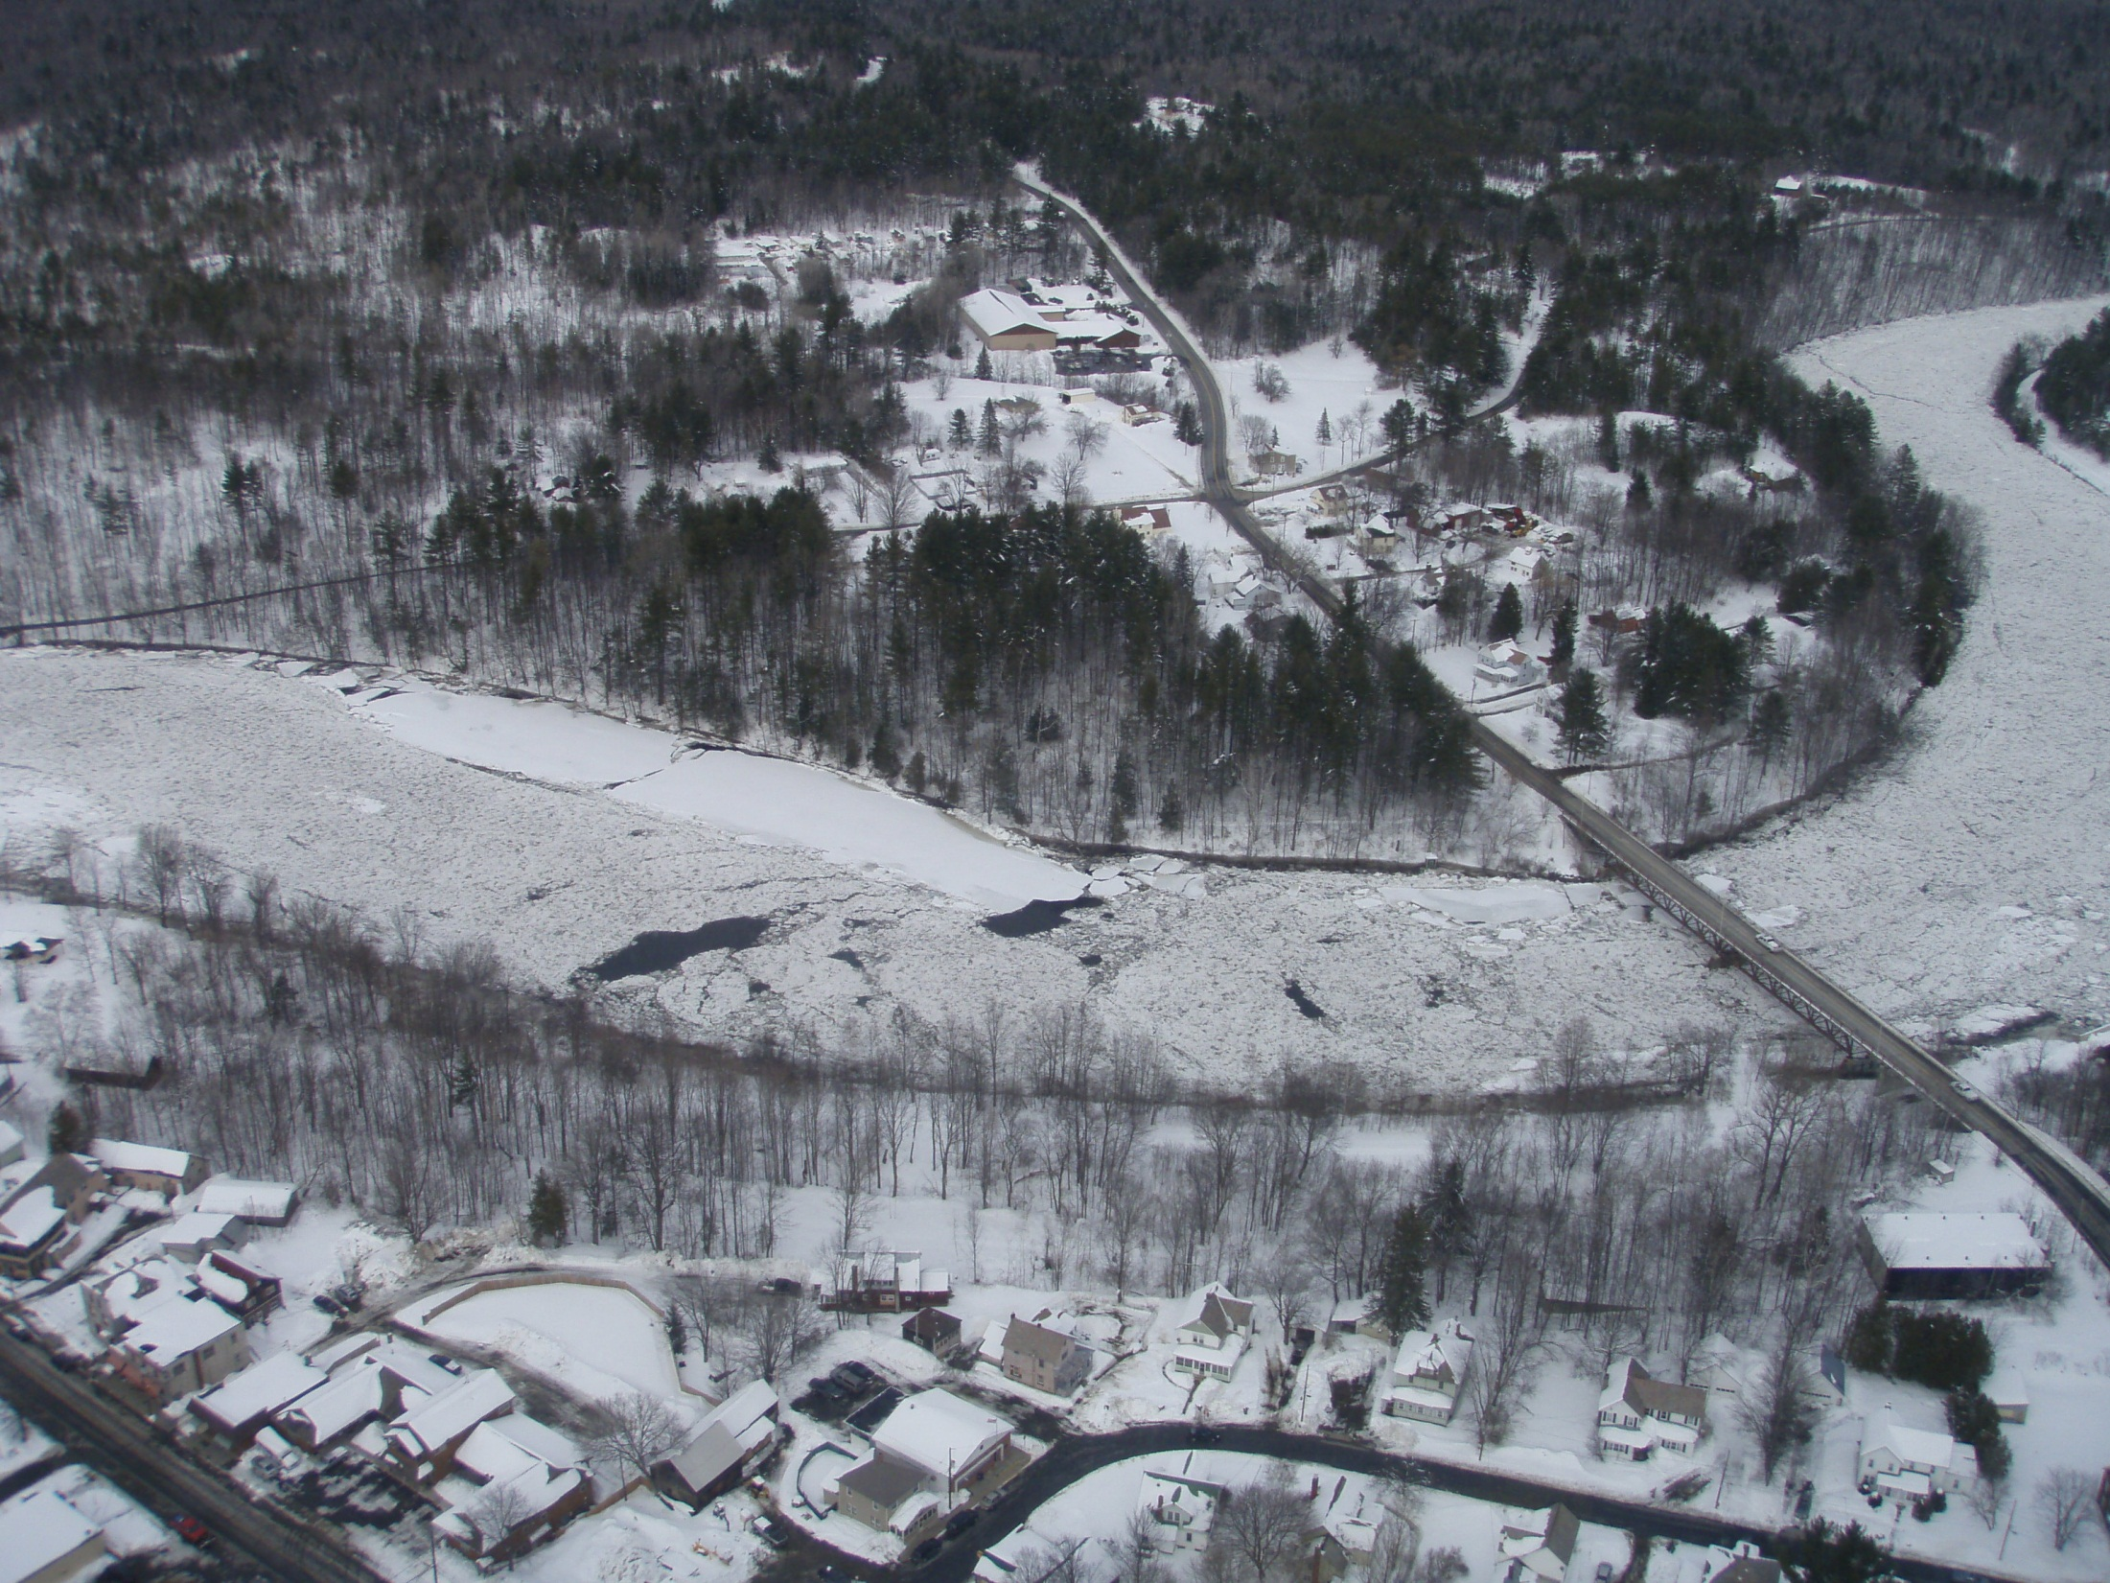


North Creek Bridge : the road on the top left is Old River Road, which was under 3 – 4’ of water in the low areas at time of photo, March 2011; photo courtesy of Warren County Emergency Management

Slide 14
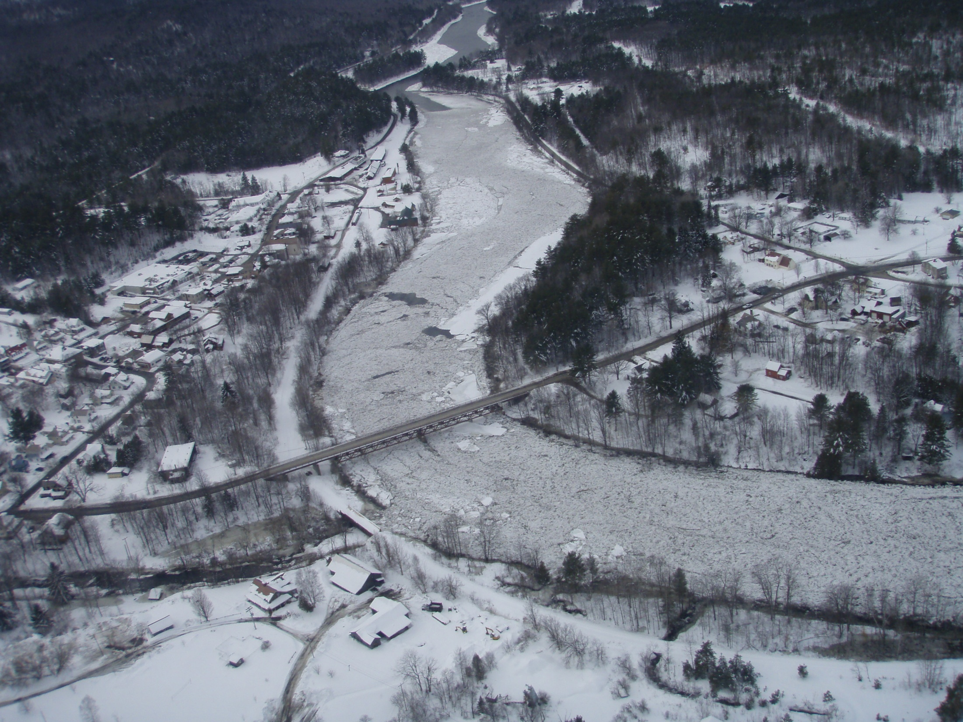
Looking northwest at the North Creek Bridge, March 2011; photo courtesy of Warren County Emergency Management

Slide 15
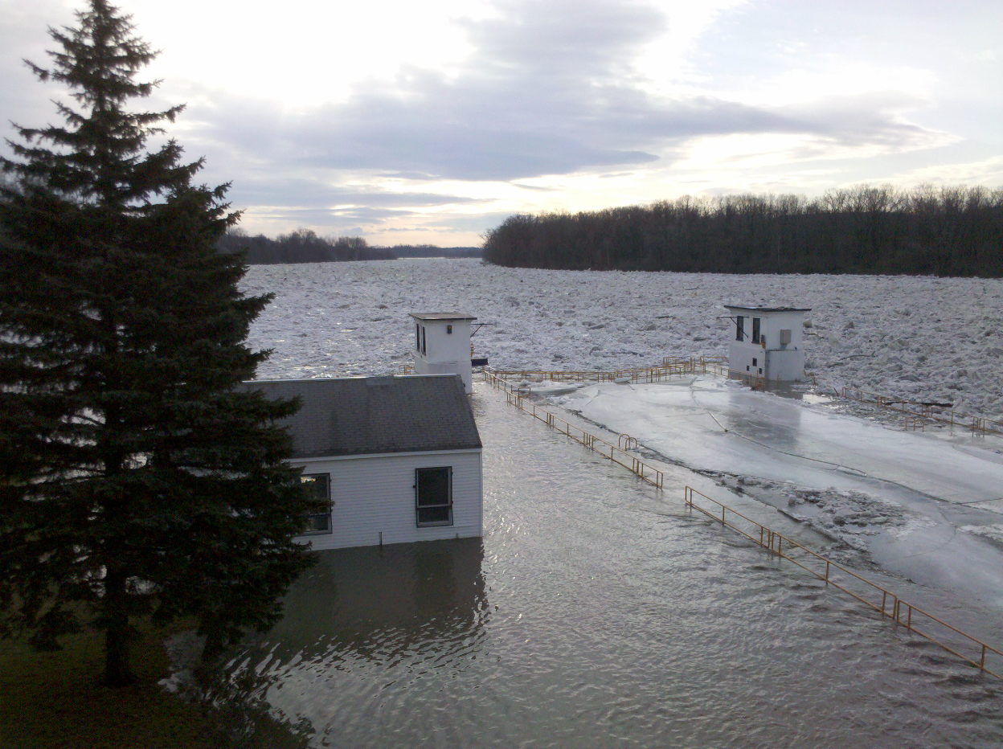
River Ice Jams
River rise needs to be about 3 times the thickness of the river ice to break up the ice
So...ice a foot thick needs about a 3 foot rise in stream level to break up the ice
Ice jams cause localized flooding and can quickly cause serious problems
Rapid rises behind the jams can lead to temporary lakes and flooding of homes and roads along rivers
A sudden release of a jam can lead to flash flooding below with the addition of large pieces of ice in the wall of water which will damage or destroy most things in its path

Slide 16
Hydrology in the
National Weather Service
Why NWS forecasts rivers & what causes flooding in the Albany NWS forecast area
Fundamentals of hydrologic modeling
NWS flood forecasts & warnings
The future of NWS hydrology

Slide 17
A River Basin is a Funnel
The volume of these 3 things determines how much water passes through that outlet (flows downstream):
Runoff – water flowing across the ground surface (incl. runoff from rain + snowmelt)
Base Flow – water from groundwater
Routed Flow – water from upstream
Runoff
Base flow
Volume of water
flowing downstream in the river
Routed flow

Slide 18
Runoff
Rainfall runoff is estimated based on:
  Slope of the land
  Amount of urbanization
  Soil types (clay vs. sand)
  Amount of the last rainfall
  Time since the last rainfall
  Amount of evaporation occurring
  Whether or not the ground is frozen
Snowmelt runoff is estimated based on air temperature

Slide 19
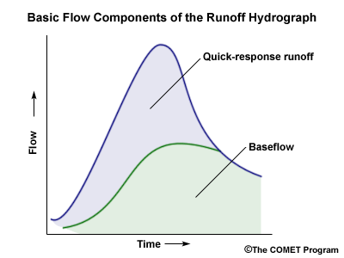
Runoff + Base Flow
Base Flow is water entering the river from groundwater
Not a constant value
Peaks after surface runoff begins to decrease
Slowly decreases until the next rainfall
Delay between onset of rain and runoff entering river
Amount of delay depends upon where in the basin rain falls, the slope of the basin, and the amount of impervious surface in basin
Runoff Peak
Rainfall Peak

Slide 20
Routed Water
Routed Flow = the water that is coming downstream from the previous (upstream) river basin
All of the water that passed through the upstream point must eventually pass through the downstream point, barring human intervention (dams/diversion)
Heavy rains upstream can cause flooding downstream where rainfall was less

Slide 21
For more details…
COMET MetEd Basic Hydrologic Sciences Distance Learning Course
(free but you have to create an account)

Slide 22
Hydrology in the
National Weather Service
Why NWS forecasts rivers & what causes flooding in the Albany NWS forecast area
Fundamentals of hydrologic modeling
NWS flood forecasts & warnings
The future of NWS hydrology

Slide 23
Inputs to River Forecasts
Estimated (past) rainfall
  Automated rain gages w/telemetry
  Radar rainfall estimates
  Cooperative weather observer & CoCoRaHS rainfall reports
Forecast rainfall
Observed river heights
  Automated river gages w/telemetry
  Cooperative weather observer staff gage or wireweight gage readings
Temperatures / snow pack

Slide 24
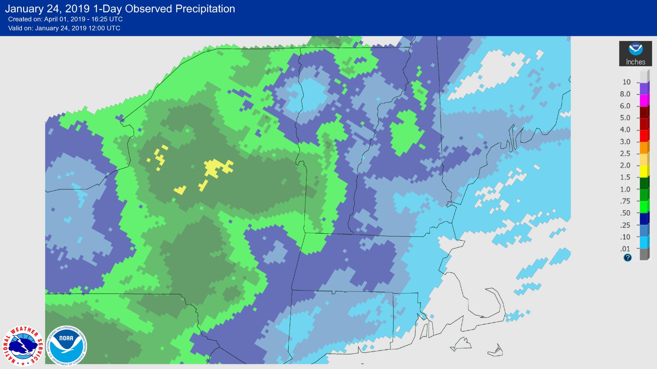
Estimated (past) Rainfall

Slide 25
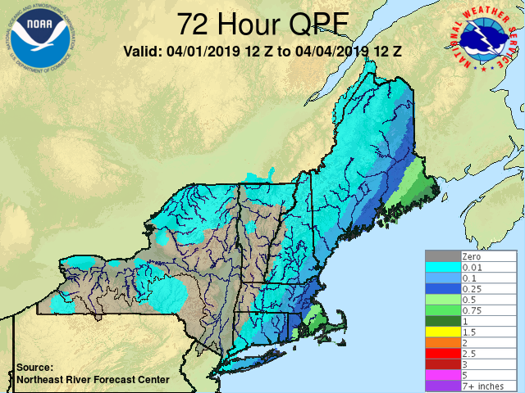
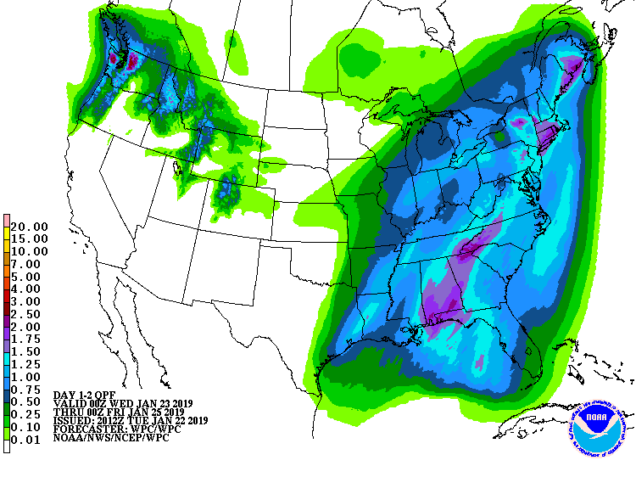
Forecast Rainfall
Weather Prediction Center
Northeast River Forecast Center

Slide 26
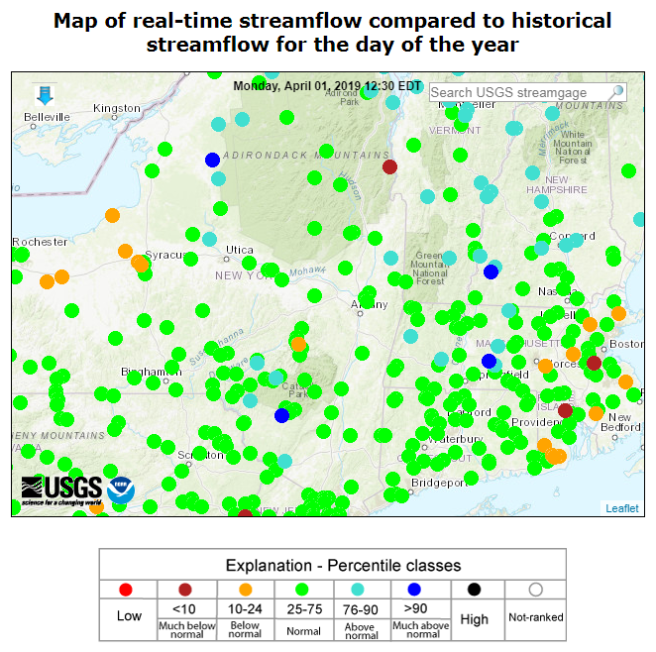
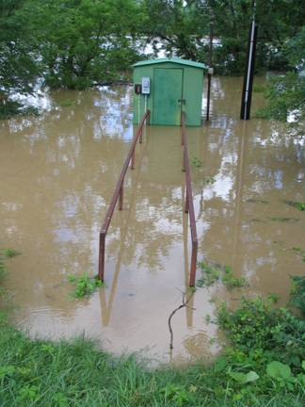

Observed River Heights
    The USGS operates and maintains more than 85% of the nation's stream-gaging stations, which includes 98% of those that are used for real-time river forecasting

Slide 27
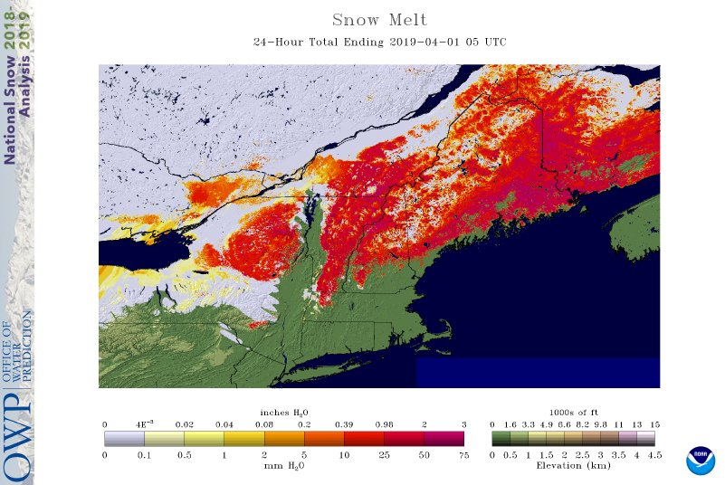
Temperature / Snowpack
National Operational Hydrologic Remote Sensing Center
https://www.nohrsc.noaa.gov/

Slide 28
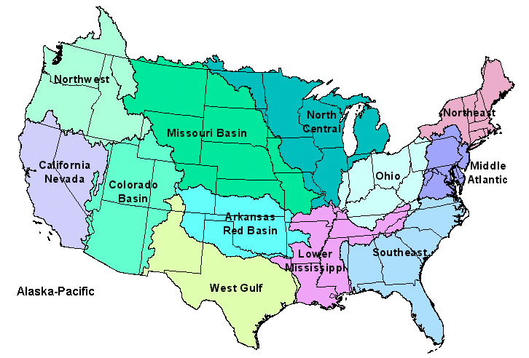
NWS River Forecast Centers
13 River Forecast Centers (RFCs)
generate daily river forecasts and additional forecasts during flood events

Slide 29
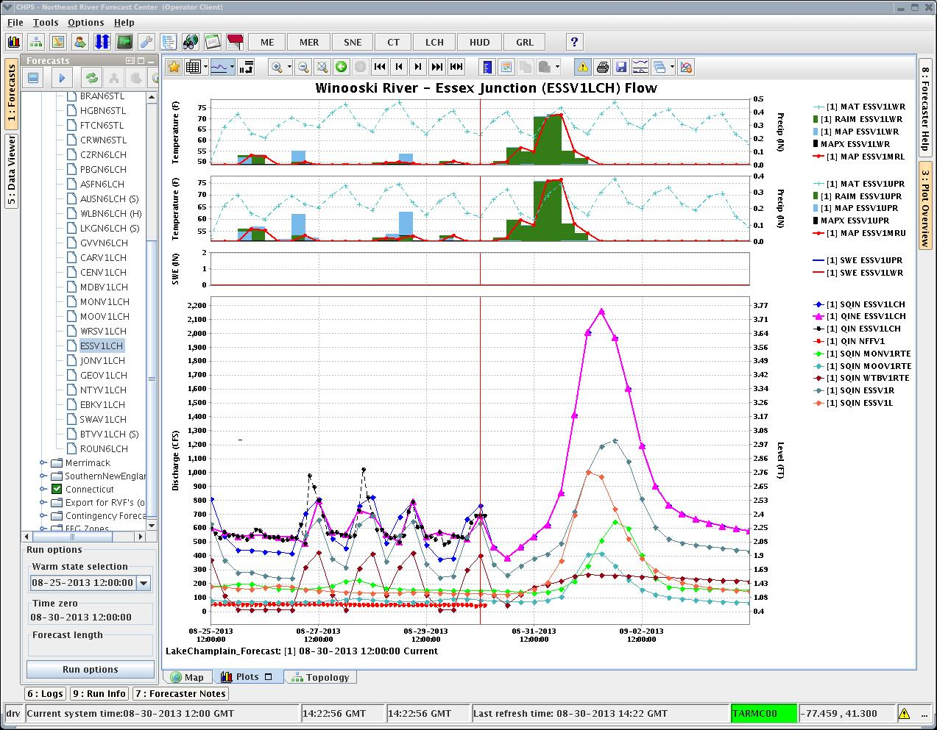
River Forecast Center Model
Temperatures
Past precipitation & melt
Future precipitation & melt
RFC Forecast Simulation
Observations
Contributing inflows

Slide 30
After RFC issues forecast:
If the forecast is over flood stage (determined by the local Weather Forecast Office - WFO), a warning is needed:
  software automatically creates a “first draft”
  warning can be sent in under 1 minute if needed
  activates the Emergency Alert System
Most forecasts are also sent to our website
water.weather.gov/ahps/

Slide 31
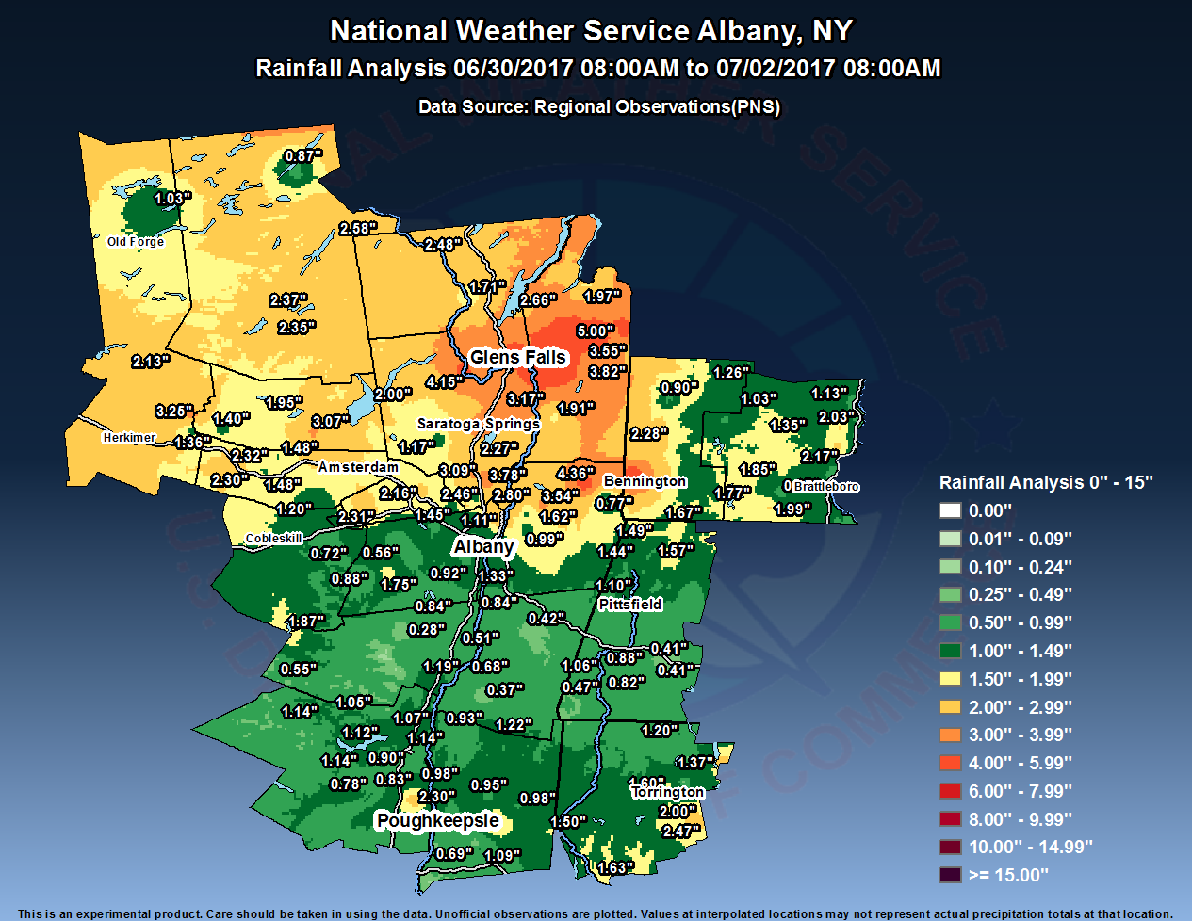
July 2017 Flood Event

Slide 32
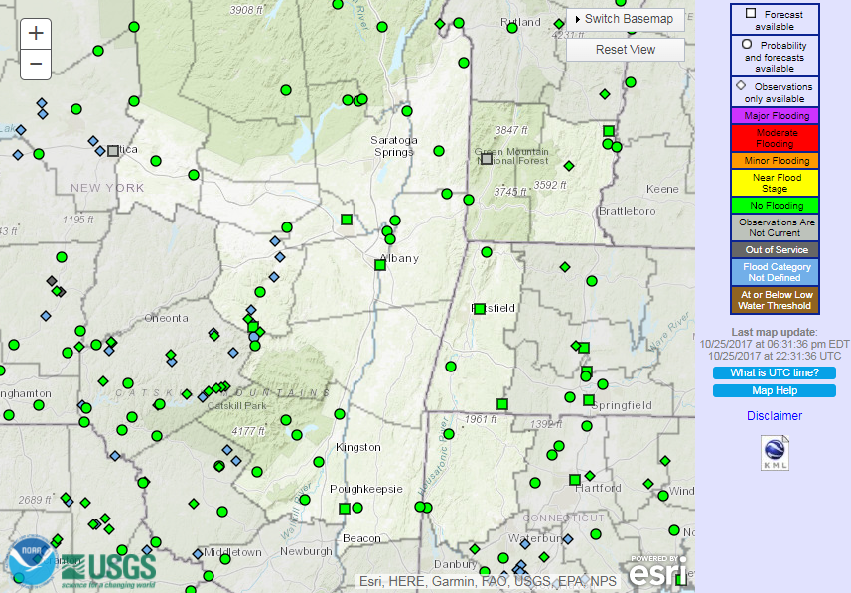
West Canada Cr @Kast Bridge

Slide 33
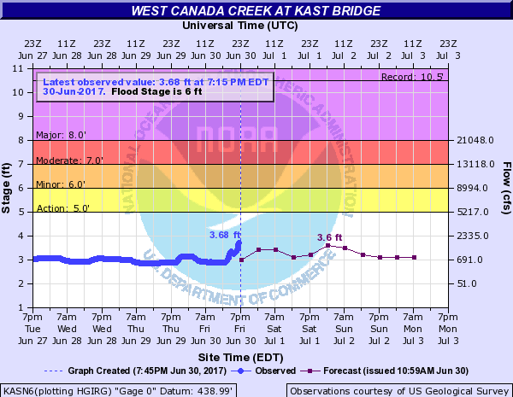
West Canada Cr @Kast Bridge

Slide 34
Walloomsac R nr N Bennington

Slide 35
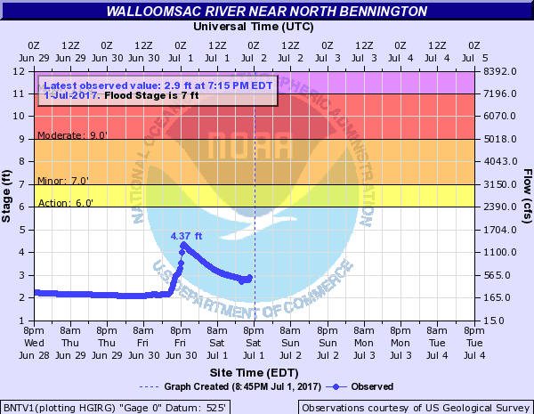
Walloomsac R nr N Bennington

Slide 36
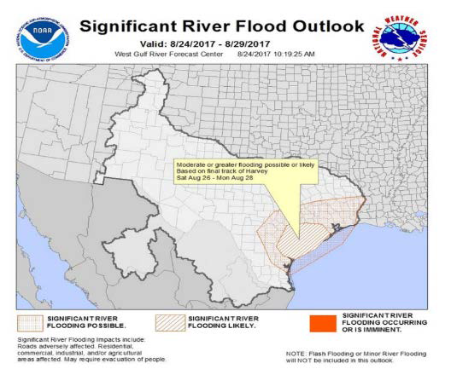
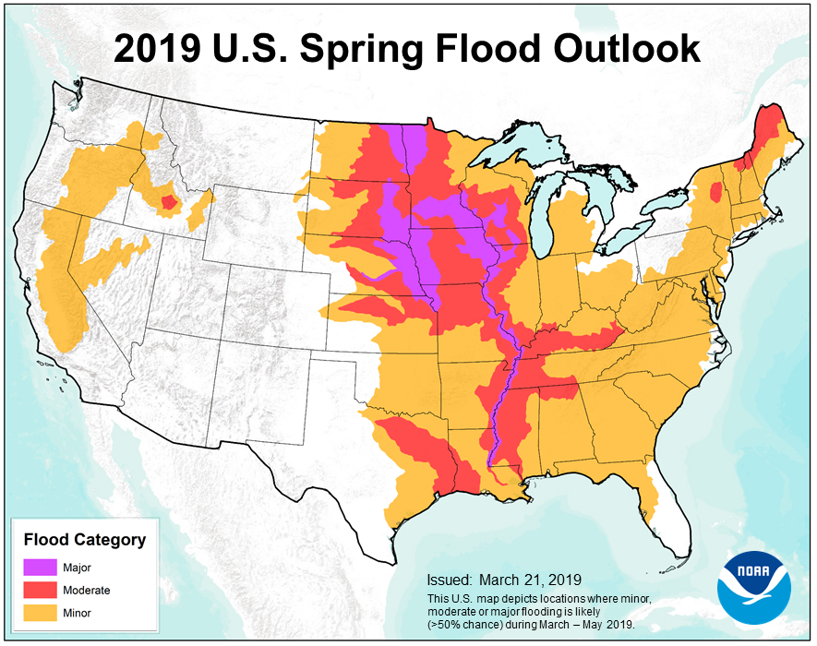
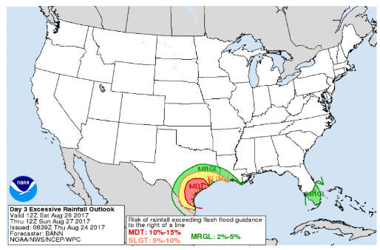
Other Forecasts & Outlooks…
Above: current spring flood threat
Right side of slide: pre-Hurricane Harvey flood outlook products

Slide 37
Hydrology in the
National Weather Service
Why NWS forecasts rivers & what causes flooding in the Albany NWS forecast area
Fundamentals of hydrologic modeling
NWS flood forecasts & warnings
The future of NWS hydrology

Slide 38
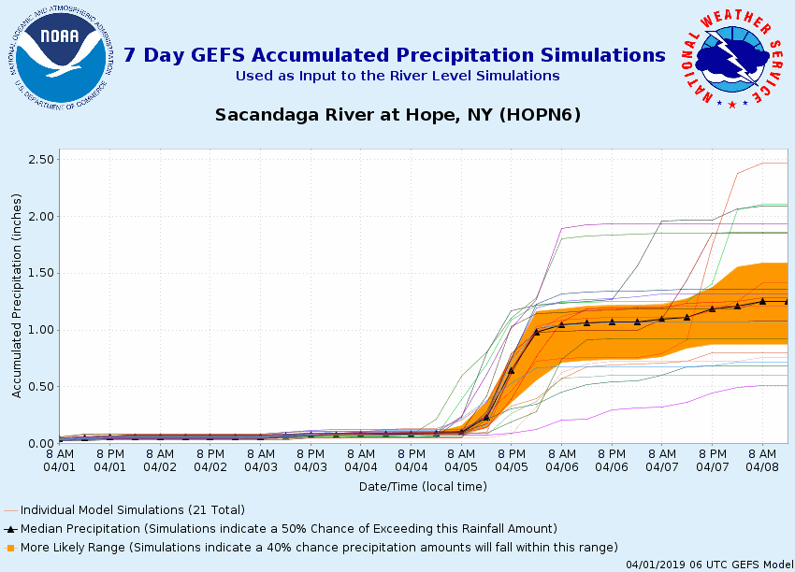
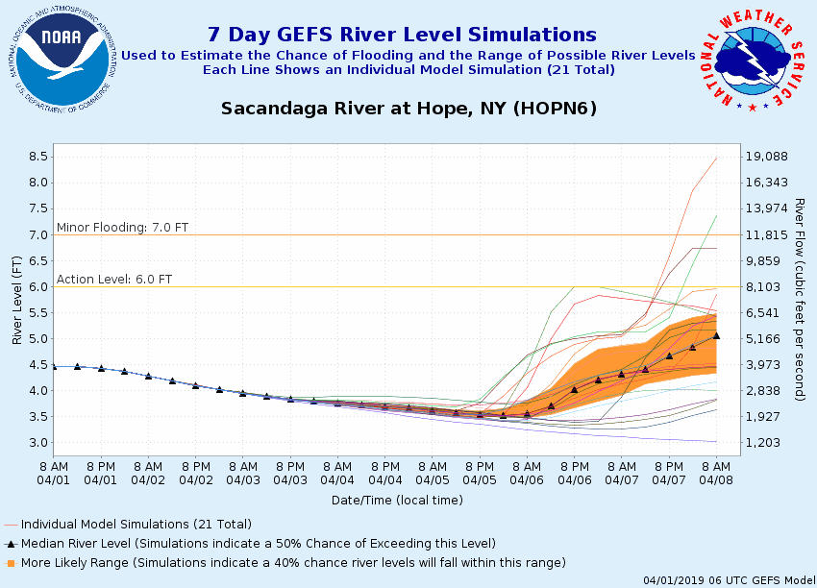
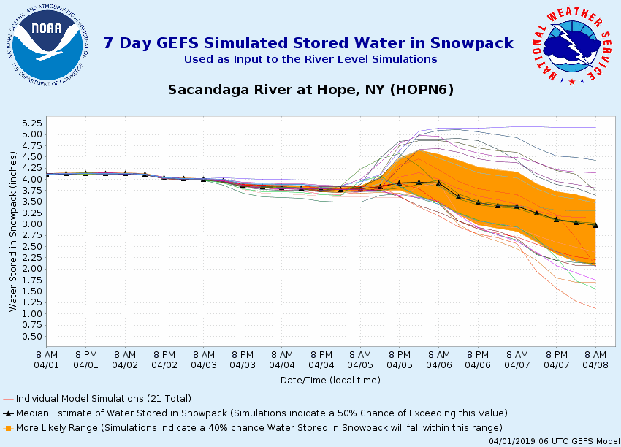
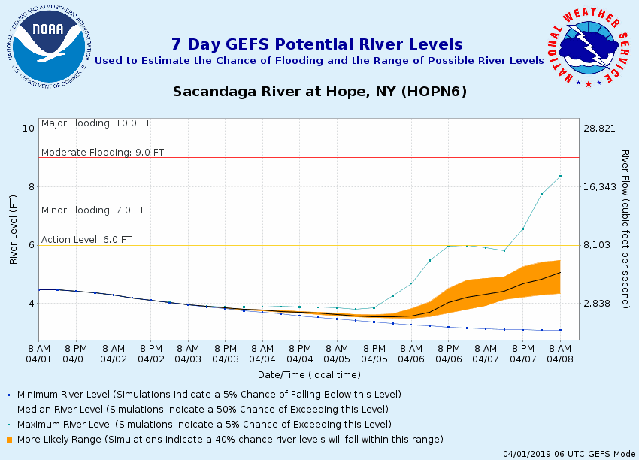
Ensemble Streamflow Forecasts
https://www.weather.gov/erh/mmefs

Slide 39
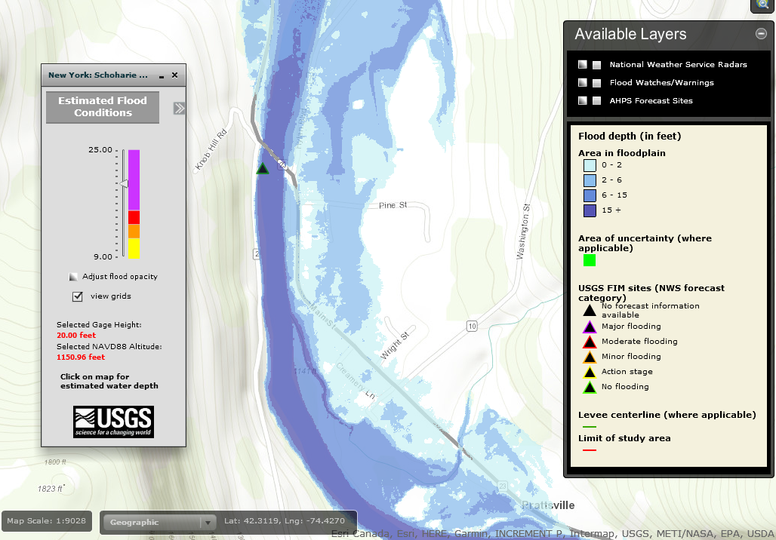
Inundation Mapping
https://fim.wim.usgs.gov/fim/?site_no=01350000

Slide 40
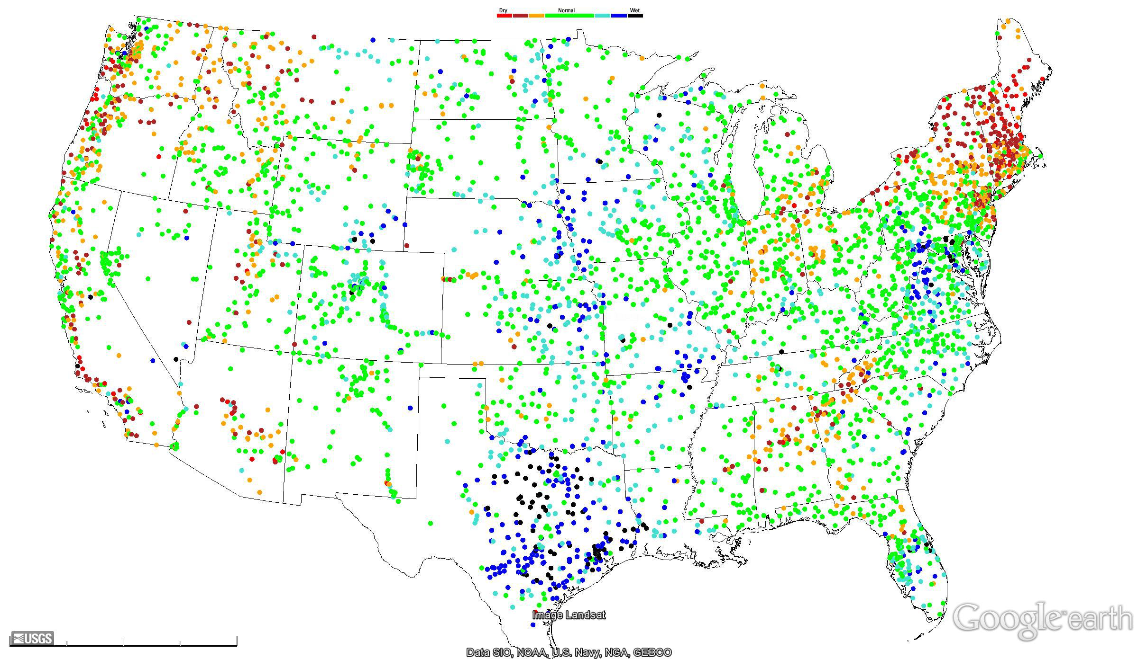
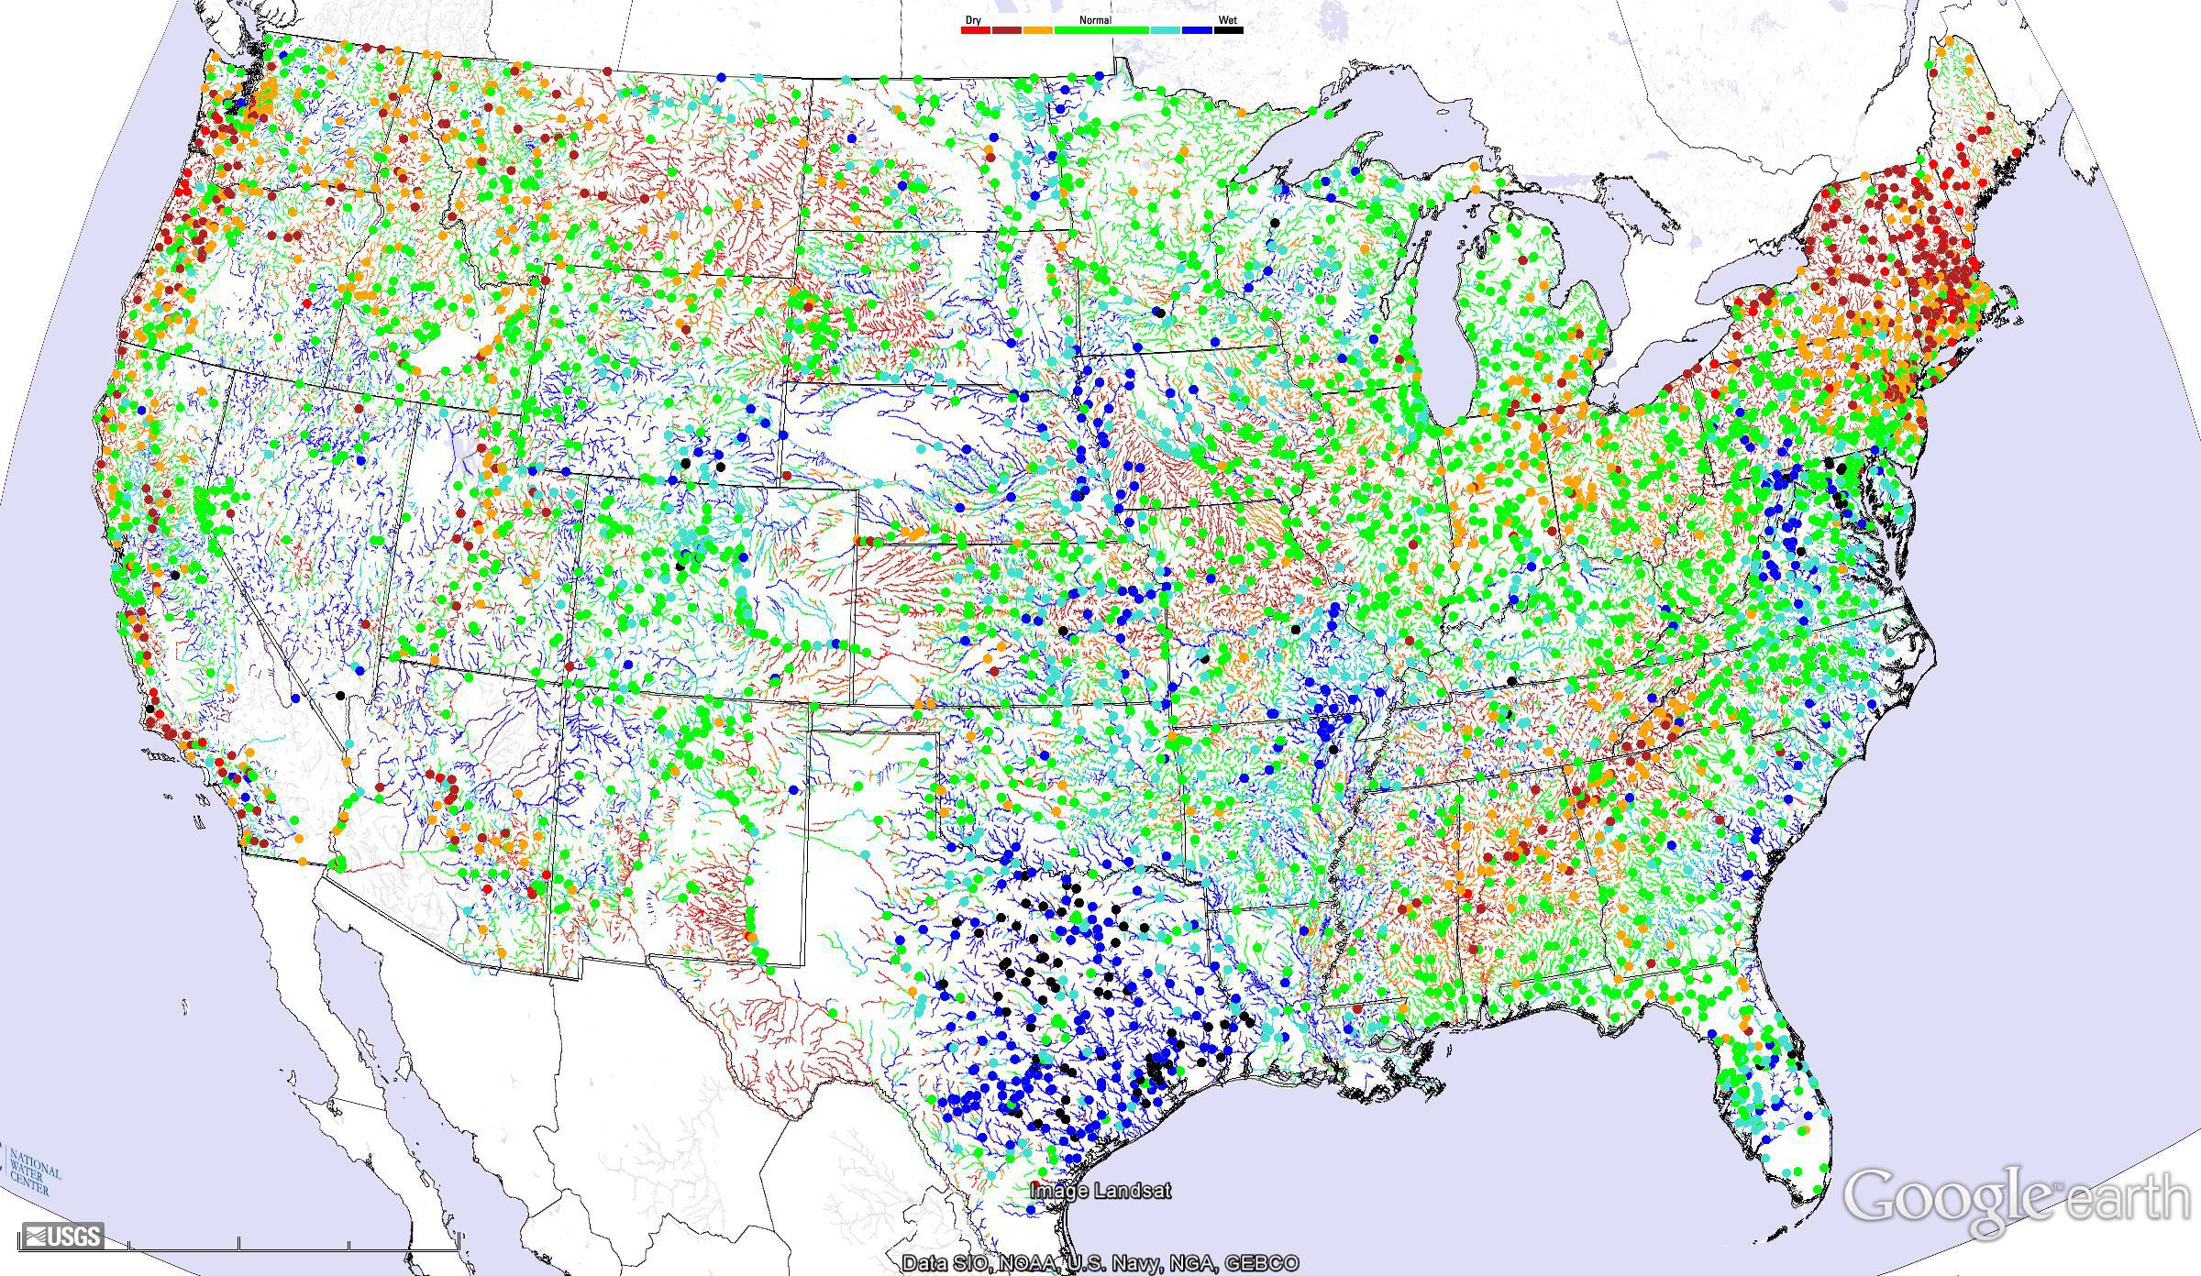
National Water Model
USGS Observed Streamflow Anomalies (dots)
NWM Analysis Streamflow Anomalies (lines)
Notes:
https://water.noaa.gov/about/nwm

Slide 41
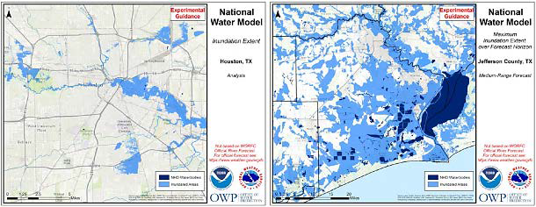
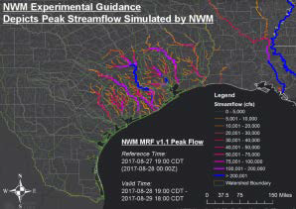
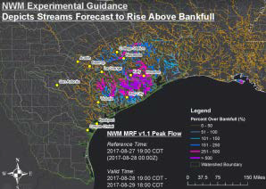
National Water Model
Experimental flood inundation and streamflow guidance from Hurricane Harvey

Slide 42
Hydrology in the
National Weather Service
What we discussed:
Topics we didn’t cover:
Why NWS forecasts rivers & what causes flooding in the Albany NWS forecast area
Fundamentals of hydrologic modeling
NWS flood forecasts & warnings
The future of NWS hydrology
Flash flood operations
Details of hydrologic modeling
Hydraulic modeling
Drought operations
Dam failure operations
Extreme event operations
Hydrologic component of IDSS, outreach and education
Careers in Hydrology
So many more…

Slide 43
What questions do you have?
Always happy to discuss more about hydrology as a science and as a career.
Please be in touch: britt.westergard@noaa.gov

