Slide 1


Local Extreme
Weather Events
Potential for Societal Disruption
Steve DiRienzo
Warning Coordination Meteorologist
NWS Albany

Slide 2


Speaker
Warning Coordination Meteorologist:
Responsible for weather related decision support services to emergency managers and first responders
For evaluating forecast office products and services
For ensuring that people in the Albany forecast area are aware of local weather hazards by conducting hazardous weather preparedness and education.

Slide 3
Overview
What is a disaster?
Local Weather related disaster declarations/FEMA.
NWS Warning Process.
What is a credible threat?
Local Examples.

Slide 4
Disaster
Definition:
Wikipedia: A disaster is a serious disruption, occurring over a relatively short time, of the functioning of a community or a society involving widespread human, material, economic or environmental loss and impacts, which exceeds the ability of the affected community or society to cope using its own resources.
Various phenomena like earthquakes, landslides, volcanic eruptions, floods, hurricanes, tornadoes, blizzards, tsunamis, and cyclones are all natural hazards that kill thousands of people and destroy billions of dollars of habitat and property each year.

Slide 5
Federal Emergency Management Agency (FEMA)
FEMA Mission Statement: Helping people before, during, and after disasters.
The Robert T. Stafford Disaster Relief and Emergency Assistance Act (Stafford Act) is a United States federal law designed to bring an orderly and systemic means of federal natural disaster assistance for state and local governments.
Stafford Act, signed into law November 23, 1988
This Act constitutes the statutory authority for most Federal disaster response activities especially as they pertain to FEMA and FEMA programs.
https://www.fema.gov/media-library-data/1519395888776-af5f95a1a9237302af7e3fd5b0d07d71/StaffordAct.pdf

Slide 6
WFO Albany Forecast Area
Weather Related Disaster Declarations
Types of weather and hydrologic events that cause disaster declarations ( NY, VT, MA, CT declarations since 1953):
Tropical Storms/Hurricanes, Thunderstorms, Tornadoes, Blizzards, Snow Storms, Winter Storms, Ice Storms, Heavy Rains/Flooding, Flash Flooding, Land Slides, Ice Jams, Fire Suppression Authorization, Fire Complex, Water Shortage (drought)

Slide 7
National Weather Service (NWS)
Warning Process
1. Detection of the Threat
- Computer models and pattern recognition (days in advance)
- Radar, Satellite and Observations (as happening)
- Reports or observations sent to NWS from partners, HAMS, spotters
2. Warn on the Threat/Forecast with Message to Take Action
- Decision Support Briefings
- Emergency Alert Messages
- NWS warning products
3. Message is Received and Understood
- Warning message received by radio, TV, mobile device, siren?
- Is the threat message understood enough to take necessary actions?
4. Appropriate Action is Taken
- Actions are taken in a timely fashion to protect life and property

Slide 8
National Weather Service
Warning Process
The NWS has concentrated on sections 3 and 4 above: Did the general public get the message? And did they take action?
Social scientists have been employed to help the NWS craft the message.
However: The warning process is also highly dependent on forecasters recognizing the scale or severity of an event.

Slide 9
National Weather Service
Warning Process
There is a breakdown in the warning process when the scale of an event is not recognized by forecasters.
Much work has been done on forecasters using meteorological field anomalies (eg. GEFS/SREFS/HREF) to help recognize a potential high-impact event.
What happens when an event is so large, it dwarfs previous high impact events in scale?
This work makes the case for historical research into past weather, water and climate events as a method for scaling events, highlighting impacts and determining credible threats.

Slide 10
Weather Ready Nation –
Cataloging High Impact Events
Goals:
  Provide Credible Threats (Models say it will rain 20” – Can this happen?)
  Assign a probability to the threat
  Manage high-impact events more effectively
  Separate high-impact events from Disasters
  Historic Storms Can Shed Light On Possible Impacts

Slide 11
What is an Extreme Event - Rainfall?

Slide 12
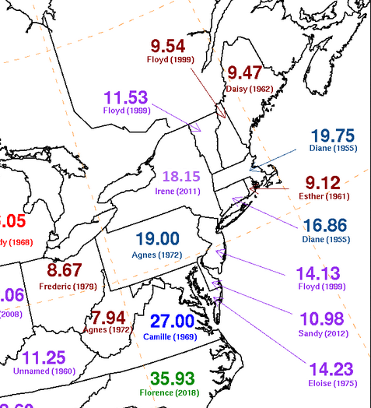
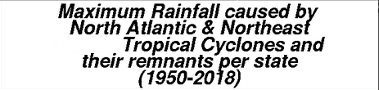
Tropical Storms
Maximum Rainfall

Slide 13
What is an Extreme Event - Flooding?
What happens to rivers and streams when you get 15-20 inches of rainfall from one storm?

Slide 14
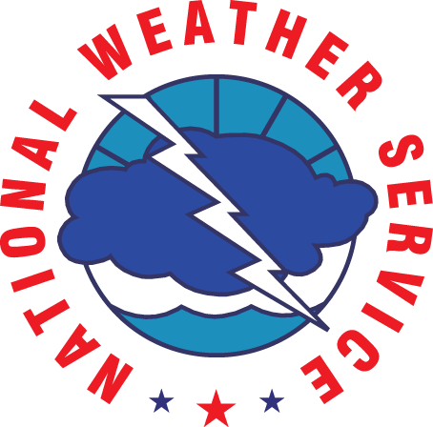
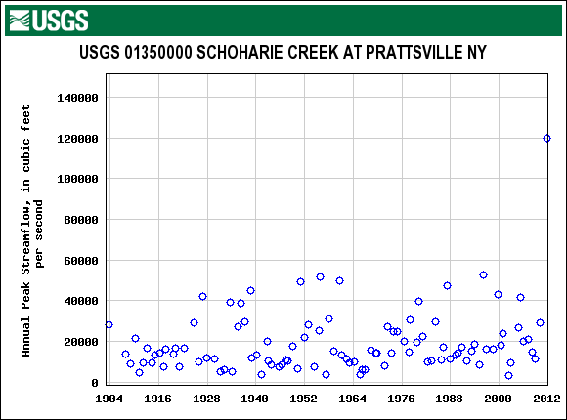
Peak River Flows
Schoharie Creek at Prattsville, New York – Irene 2011 – 18+ inches of rainfall in Catskills
120,000cfs/237 sq mi = 506 cfs/sq mi
Notes:
Whoa! Has this ever happened before?
Public and Forecasters: “We didn’t know it was going to be this bad”.

Slide 15
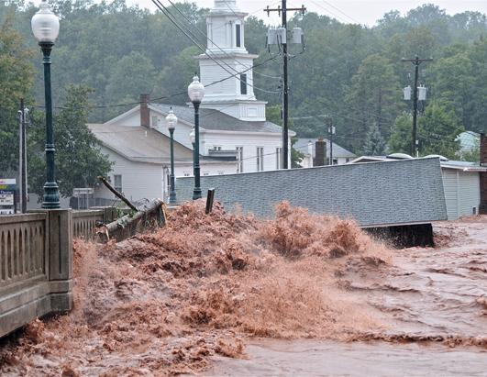
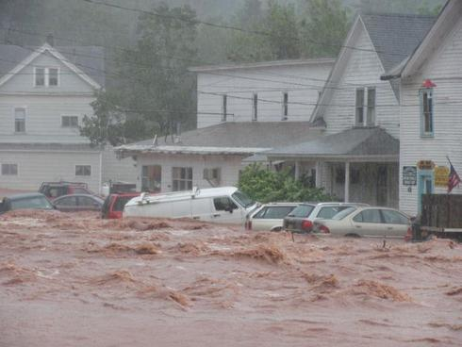
Catskills – August 2011 - Irene
Windham, NY
Tannersville, NY

Slide 16
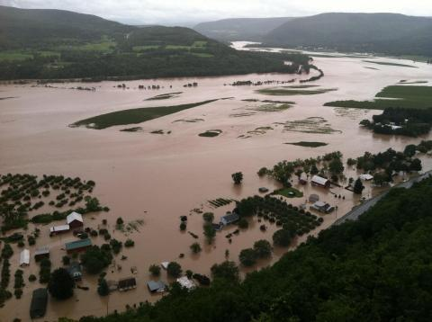
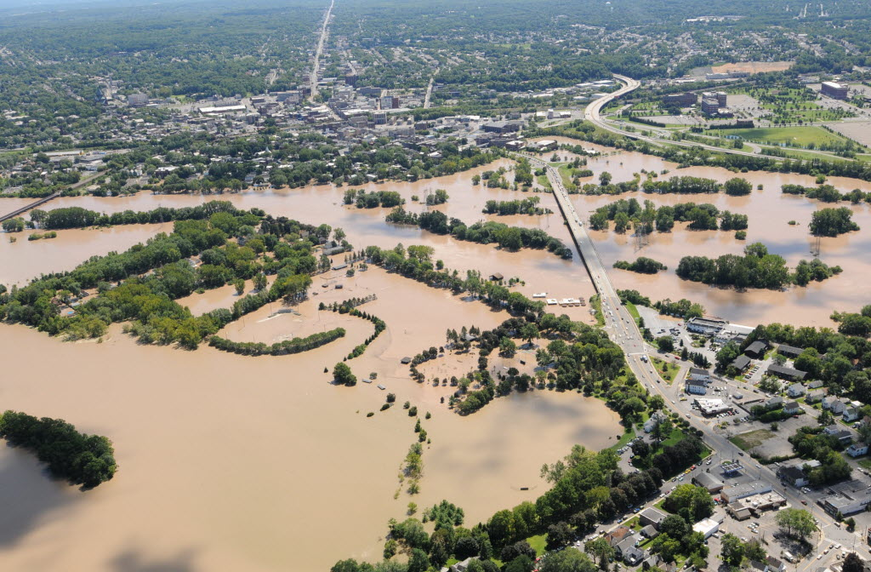
Catskills/Mohawk –
August 2011 - Irene
Schoharie Valley, NY
Amy Colyer Fogerty
Schenectady, NY
Times Union

Slide 17
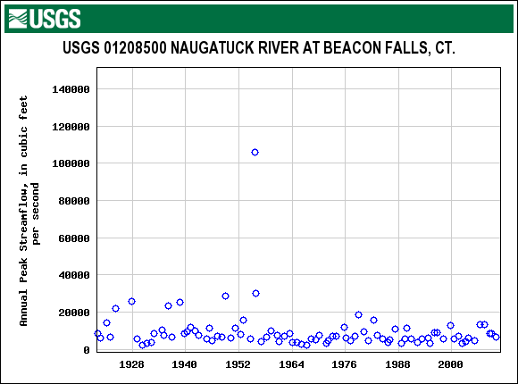
Peak River Flows
Naugatuck River at Beacon Falls, CT – Diane 1955
106,000 cfs/260 sq mi = 408 cfs/sq mi

Slide 18
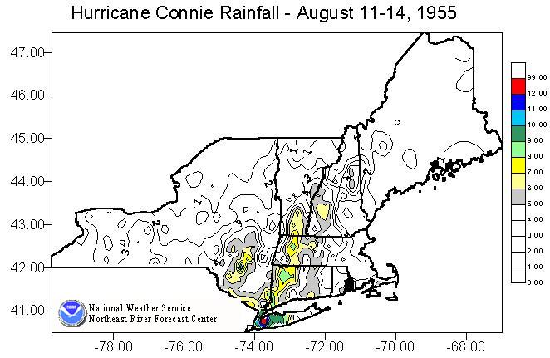
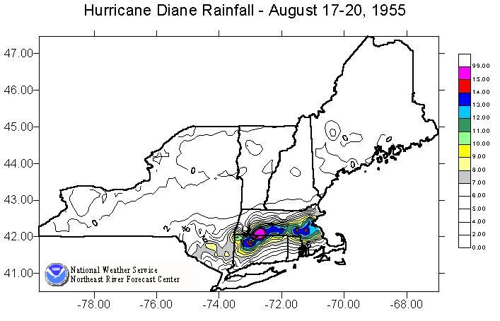
Northwest Connecticut-
1955 Rainfall

Slide 19
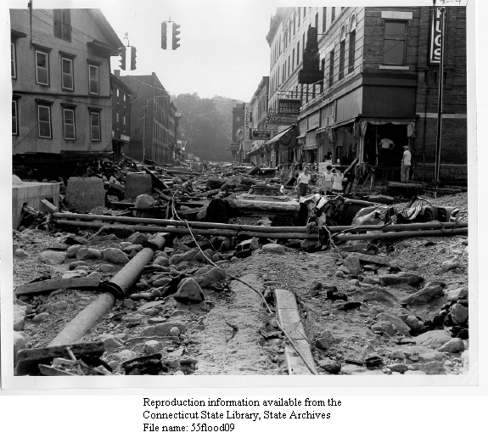
Mad River –
Winstead, Litchfield County, CT
Notes:
Litchfield County, Albany County Warning area

Slide 20
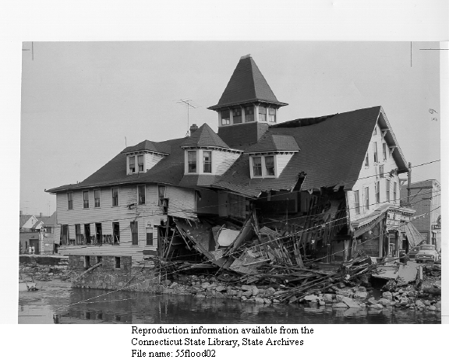
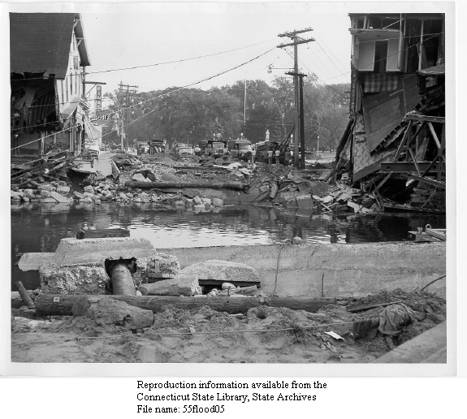
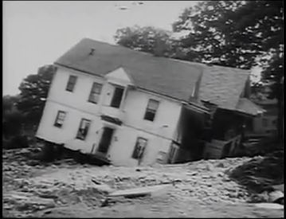
Naugatuck River,
Torrington, CT – August 1955
Notes:
Litchfield County, Albany County Warning area

Slide 21
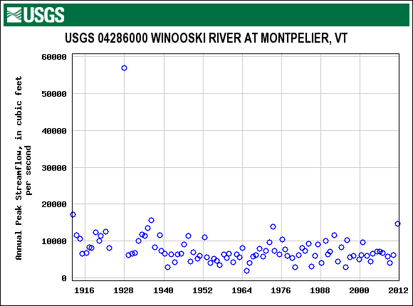
Peak River Flows -Winooski River, Montpelier, VT
57,000 cfs/397 sq mi = 143 cfs/sq mi

Slide 22
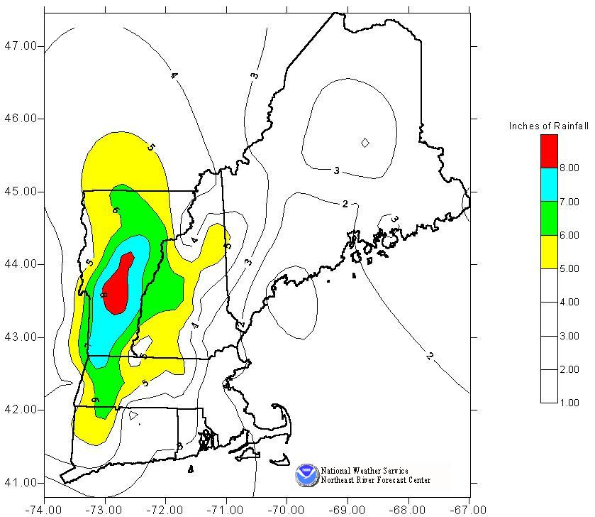
1927 Flood Rainfall
Winter Rainfall Event
October rainfall was 150% of normal.

Slide 23
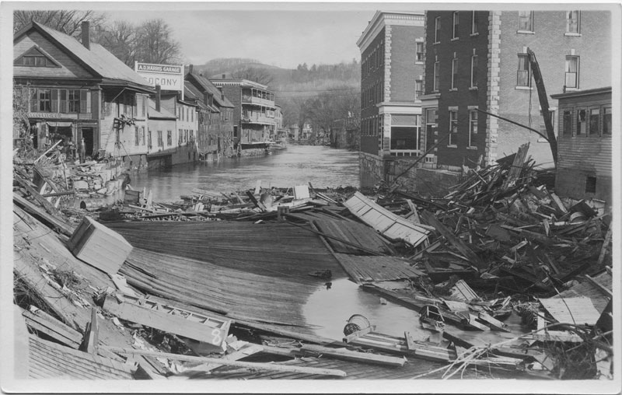
Montpelier, VT 1927

Slide 24
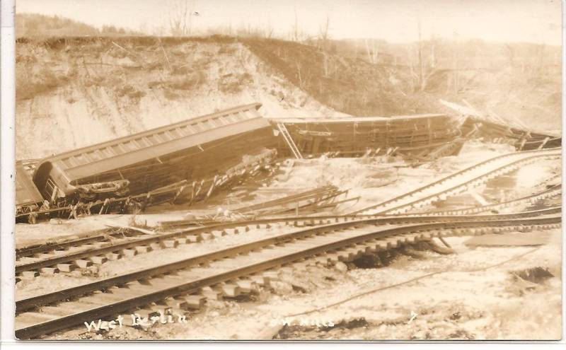
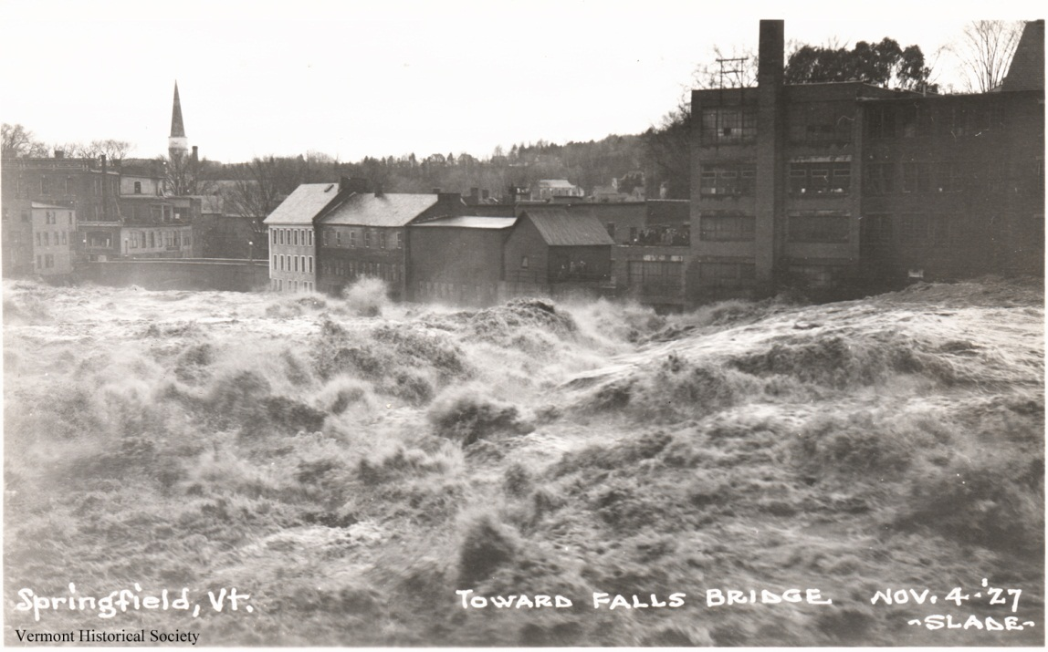
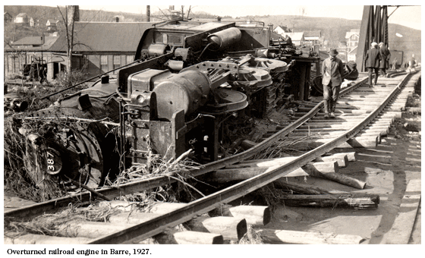
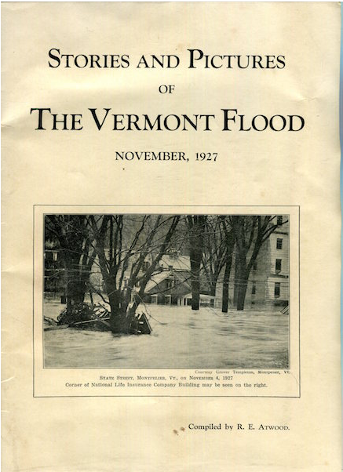
Springfield, Barre, Berlin, VT - 1927

Slide 25
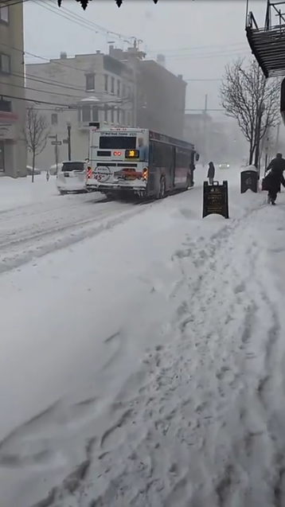
Winter - Impacts of Snow
Impacts of Snow:
Transportation issues: Slippery driving and walking conditions, airport closures, rail lines shut down.
High Snowfall Rates: Rapid accumulation and near zero visibility
( 2”/hr = ¼ mile visibility or less).
Early/Late Season Snows (Oct/Nov/May) : 3+” of snow with leaves on
trees = downed trees and widespread power outages.
Wind Driven Sticky Snow: 6” of heavy, wet snow with strong winds can lead to downed trees and power outages (March 2018 Nor’easter).
Snow squalls: Biggest cause of pileups in interstate highways(NWS now issues snow squall warnings).
Blowing Snow: Drifting snow blown back onto previously cleared and treated roads causing slippery driving conditions.
Prolonged accumulation periods (1-2 months) can lead to weight buildup on roofs and roof collapses.
Blizzard, Albany, March 14, 2017

Slide 26
Snow With Leaves On Trees
May 10, 1945 Snowstorm:

Slide 27
May 10, 1945 Snowstorm
May 10, 1945 Snowstorm:
The 5.4 inches of snow recorded at Albany is the largest May snowstorm to date.
60,000 power outages were reported across the Capital District of NY from downed trees and wires. Some locations were without power for a few days.
Largest number of power outages since ice storm of 1929.
In the City of Albany alone, 10 DPW trucks were assigned to debris removal.
Also, devastating fall snowstorms with leaves on trees in Oct 1987 and Oct 2011

Slide 28
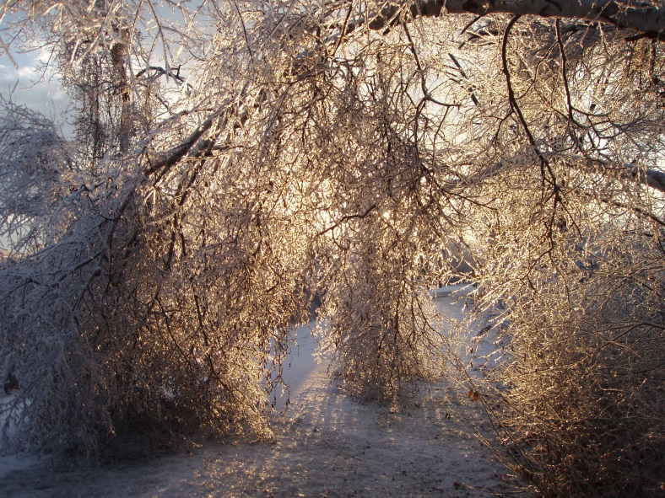
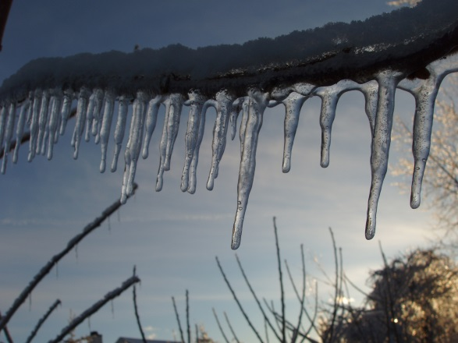
Winter – Impacts of
Freezing Rain (Glaze)
Impacts of Ice:
A trace of ice will cause slippery driving and walking conditions.
One quarter inch of ice glaze accumulation on trees will start to bring down small branches.
One half inch of ice glaze accumulation on trees and wires will cause numerous power outages (outages last a day or two).
One Inch or more of ice glaze accumulation on trees and wires causes widespread power outages (outages may last a week – Dec 2008).
Any wind with the ice will make matters worse.
Ice Storm, North Colonie, NY, Dec 2008

Slide 29
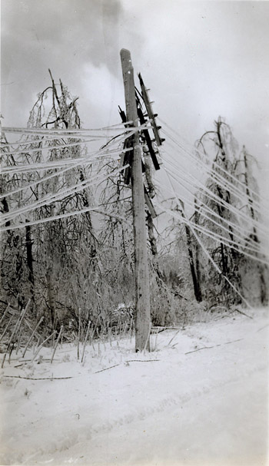
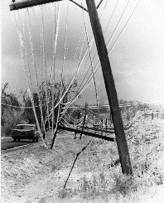
Ice Storms
Berkshires - 1942
1964
Schenectady County Historical Society
University of Massachusetts

Slide 30
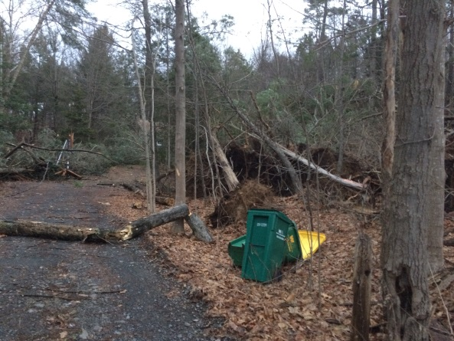
Winter Hazards –
Impacts of Wind
Impacts of Wind:
Winter storms are usually large and powerful.
Winter storms have the potential to
cover large areas with strong winds
and cause widespread power outages.
- Summer wind storms (on average) tend to be more localized and isolated.
February 2017 High Winds

Slide 31
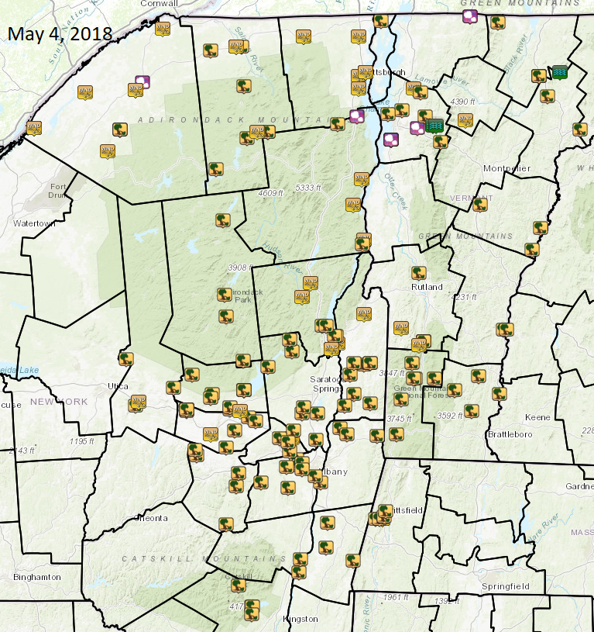
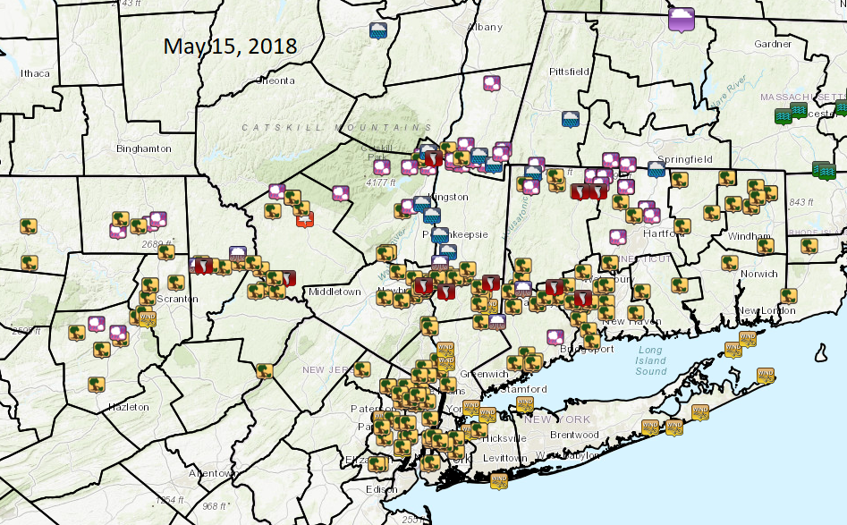
Severe Weather
Damaging Winds: Usually isolated from individual thunderstorm downbursts, but can be more widespread (May 4 and May 15, 2018).
Impacts: Power outages and debris removal. Some structural damage possible from stronger wind gusts.

Slide 32
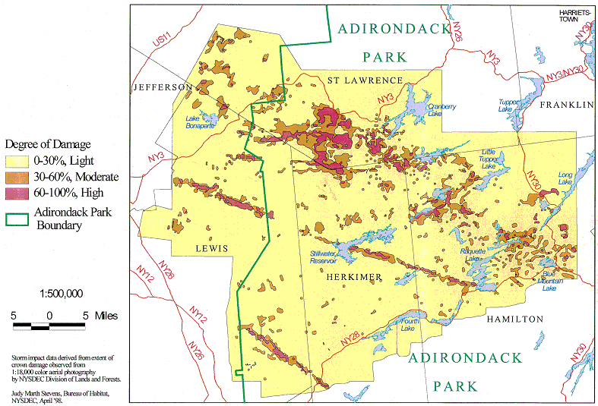
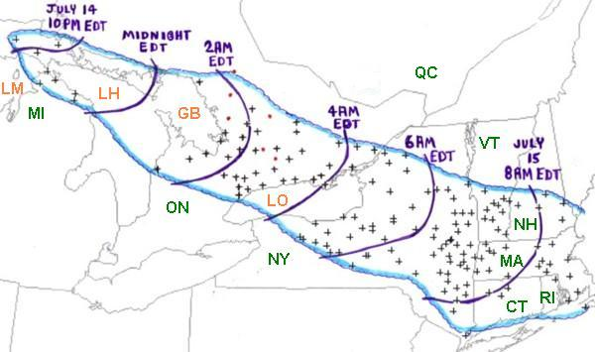
Historic Storms –
July 15, 1995 Derecho
July 15, 1995 Derecho:
Widespread wind damage
Large timber blowdown in Adirondacks
At the Syracuse Airport, a wind gust of 76 mph was measured at 5:30 AM EDT. Less than an hour later, a gust of 77 mph was recorded at the Albany airport. Several hundred thousand people lost electrical power due to the powerful derecho winds.

Slide 33
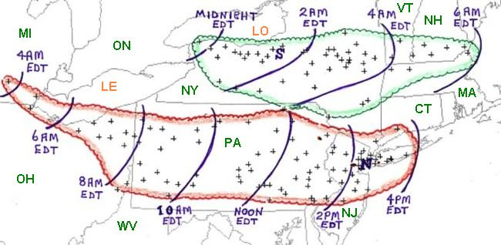
Historic Storms –
Labor Day, 1998 Derechos
September 7, 1998 Derechos:
Widespread wind damage.
Three people were killed and 10 were injured in Syracuse.
Measured wind gusts of 89 mph at the Rochester Airport and 77 mph at the Syracuse airport were recorded. Several hundred thousand people lost electrical power due to the powerful derecho winds some remaining without power for a week.
PA, NJ, NYC:
4 people were killed and
62 were injured.
Over 300,000 customers lost power, and
some did not get power restored until
5 days after the event.

Slide 34
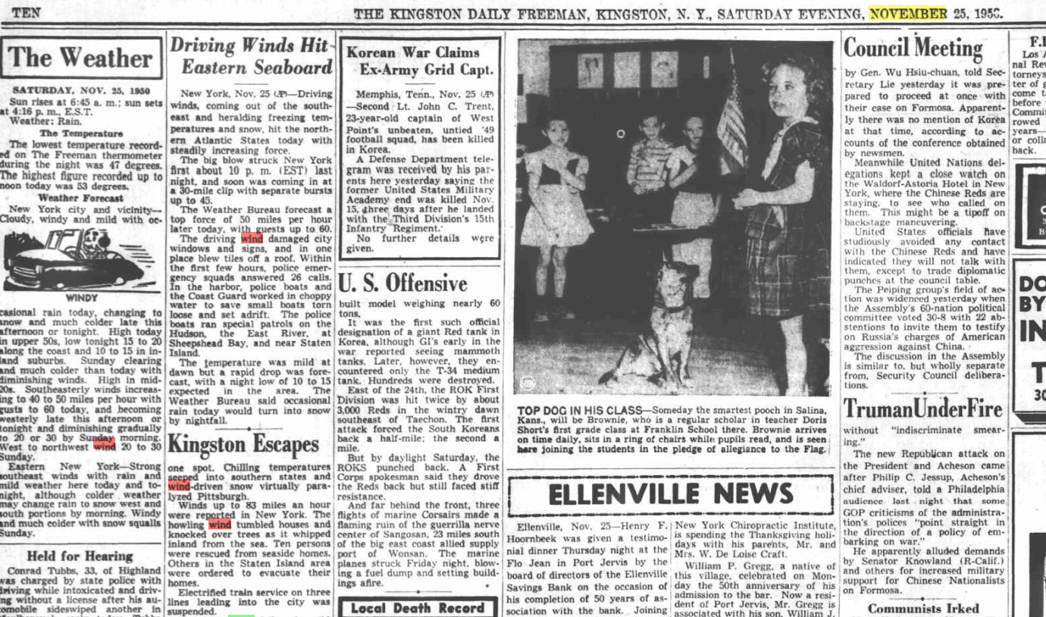
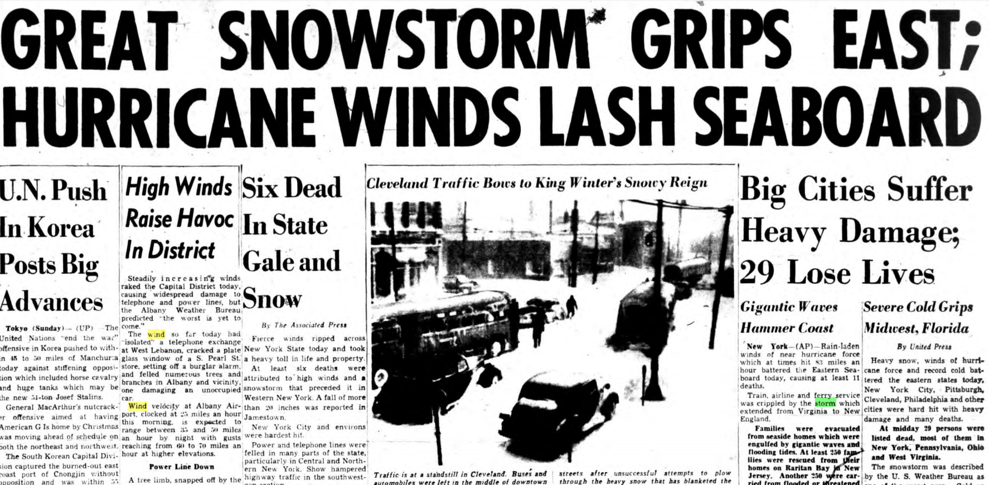
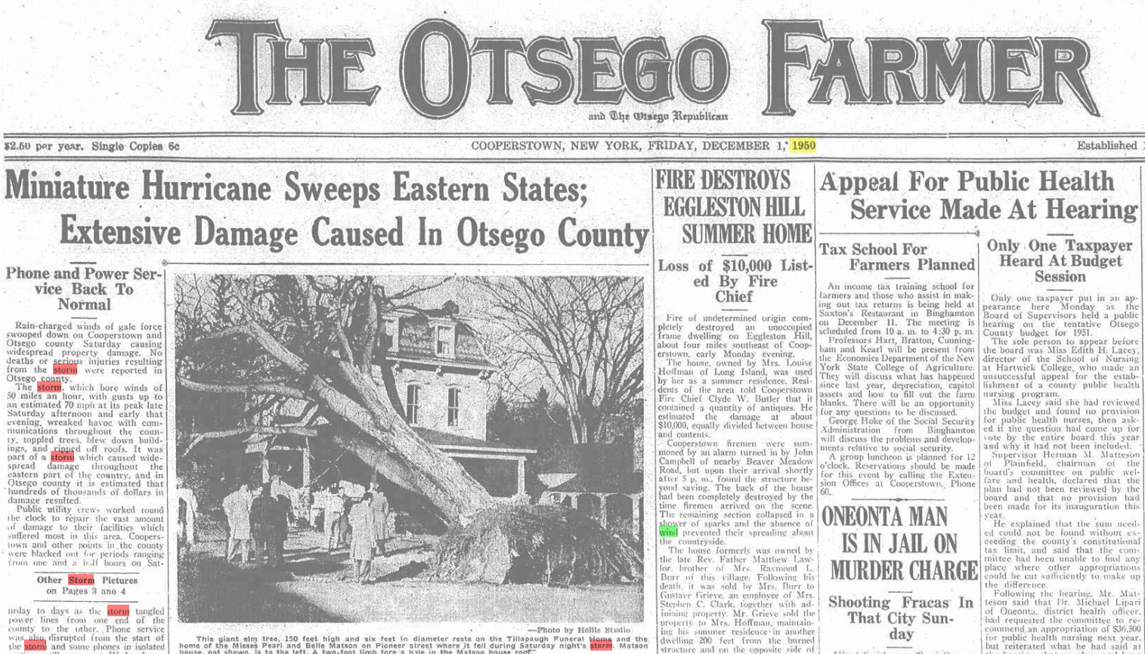
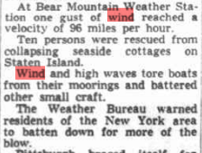
Historic Storms –
Great Appalachian Storm 1950

Slide 35
Historic Storms –
Great Appalachian Storm
Great Appalachian Storm, November 24-27, 1950:
Winter Storm
Mainly a wind storm for the Albany Forecast Area although heavy rain fell in the eastern Catskills. Snow in southwestern NY.
Sustained winds of 50-60 MPH with a gust to 83 MPH here at Albany. Measured gust of 94 MPH at New York City and Hartford, Connecticut gusted to 100 MPH.
Wind damage was extensive with many trees and power lines were blown down across New York State and the region.

Slide 36
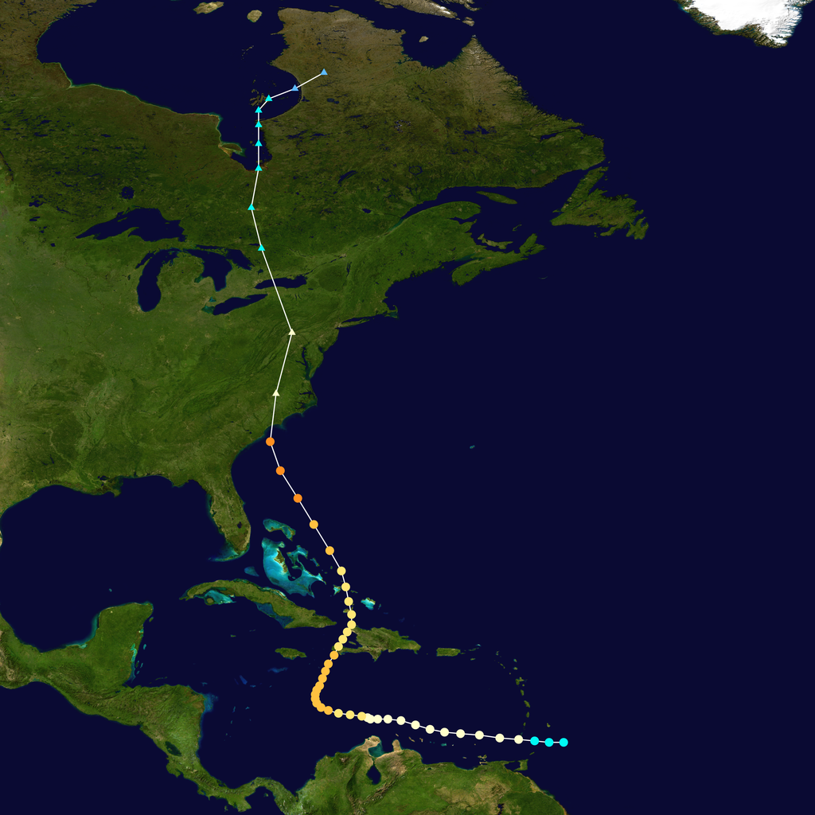
Historic Storms –
Hurricane Hazel - 1954
In New York, power was knocked out and trees were
downed. Wind gusts throughout the area reached
99 mph. A gust of 113 mph was recorded in
Battery Park, the highest wind speed ever recorded
within the municipal boundaries of New York City.
Track of Hurricane Hazel – October 1954

Slide 37
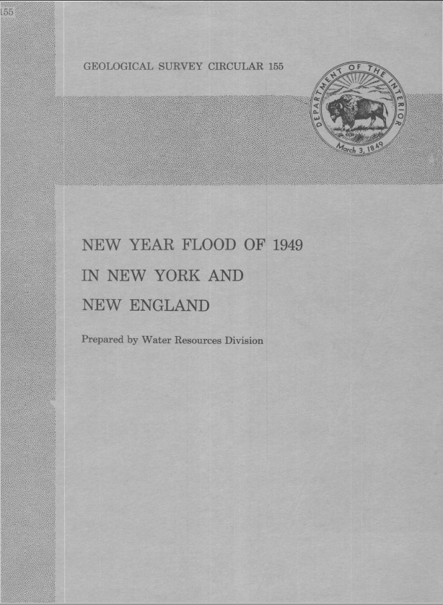
Multihazard Storm 1948-1949
“Precipitation ranging from 5 to 12 in. in depth fell on a 4,500 square-mile area in eastern New York and southwestern New England during the period December 29, 1948 to January 1, 1949.”
“Most of this precipitation fell as rain. On the morning of December 31 the rain began to freeze; later in the day the rain changed to snow.”

Slide 38
Liquid Equivalent Precipitation
Dec 29, 1948 - Jan 1, 1949
Norfolk, CT: 10.63”
Slide Mountain, NY: 8.92”
Conklingville Dam, NY: 8.61”
Pittsfield, MA: 8.35”
Mohonk Lake, NY: 7.56”
North Creek, NY: 6.70”
Glens Falls, NY: 6.36”
Albany, NY: 5.80”
Poughkeepsie, NY: 4.47”
Westfield, MA: 4.47”

Slide 39
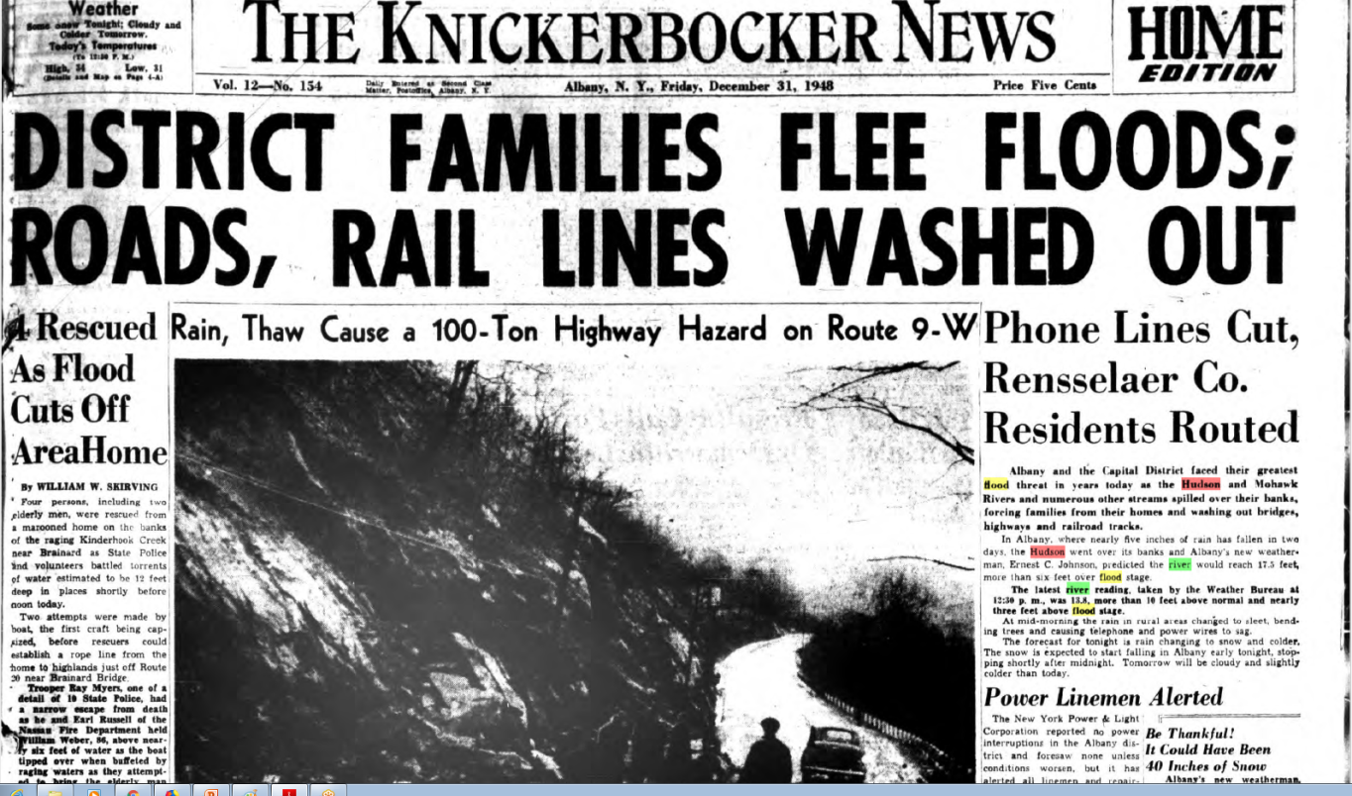

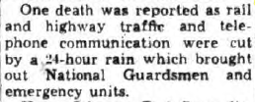
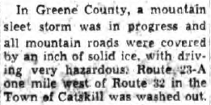
1948-1949 Storm Impacts

Slide 40
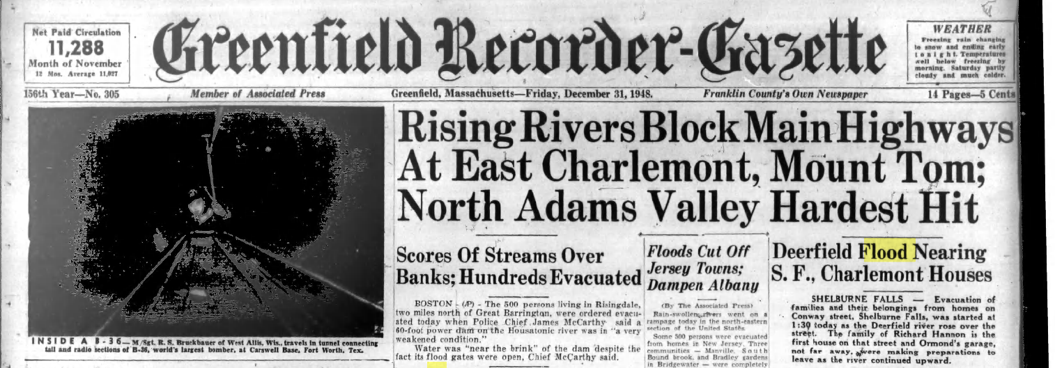
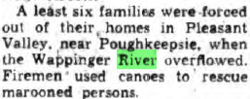
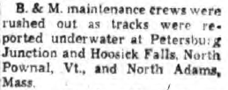
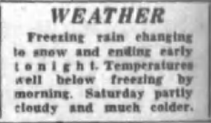

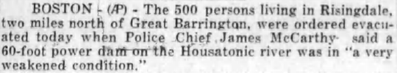

1948-1949 Storm Impacts

Slide 41
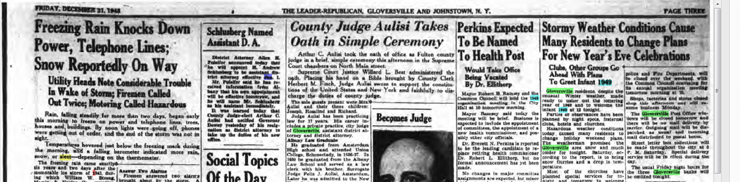
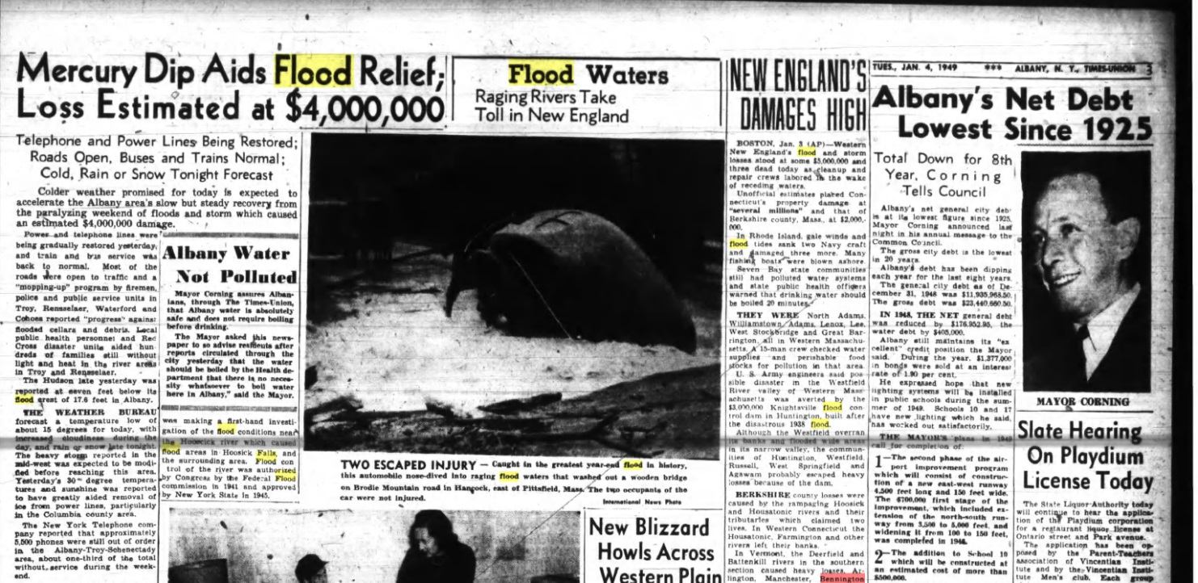
1948-1949 Storm Impacts

Slide 42
Messaging Impacts
Timeline can be useful to message multihazard storm impacts?
Freezing
Rain to snow
Heavy Rain
Dec 29 Dec 30 Dec 31 Jan 1 Jan 2 Jan 3 Jan 4
Flooding
Power Outages
Schools Remain closed due to roads closed for washouts/bridge inspections

Slide 43
Historic Storms –
Forest Fires
Adirondack Fires, 1903.

Slide 44
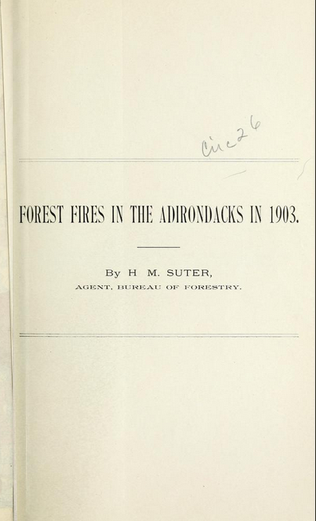
Forest Fire
The Camp Fire in 2018 was the deadliest and most destructive wildfire in California history to date. It covered an area of 153,336 acres (62,053 ha) (almost 240 sq. miles)
Adirondack NY Fires, 1903: Fires began in April and lingered into June. Between April 20 and June 8, 1903, over 600,000 acres of timberland in northern New York were burned over.
Winter snow was less than normal and valleys were bare of snow by early March. Rain in March was plentiful, but from April 17th through June 7th, average precipitation over the area was only 0.2 inches. The fires were extinguished by heavy rains in June.
https://archive.org/details/forestfiresinadi26sute/page/n4

Slide 45
Conclusion
Goal of NWS warning process is to communicate impacts/hazards that will result from weather events so that people can take protective measures.
Extreme events can cause serious disruption of the functioning of a community or a society involving widespread human, material, economic or environmental loss and impacts
Information about impacts from past significant/extreme weather events can shed light on possible impacts from future events.

Slide 46
References
Atwood, R.E. (1927). Stories and pictures of the Vermont flood November, 1927. Burlington, VT: Free Press Printing Co.
U.S. Department Of Commerce Weather Bureau (1956). Hurricane Rains and Floods of August 1955 Carolinas to New England (Technical Paper No.26). Washington D.C.: U.S. Government Printing Office.
U.S. Department of The Interior (1952). The New Year Flood of 1949 in New York and New England (Geological Survey Circular 155). Washington D.C.: U.S. Government Printing Office.
U.S. Department of The Interior U.S. Geological Survey (1998). Flood of January 19-20, 1996 in New York State (Water-Resources Investigations Report 97-4252). Albany, NY: U.S. Geological Survey Branch of Information Services.
http://www.fultonhistory.com/Fulton.html (Newspaper search engine.)

