Slide 1


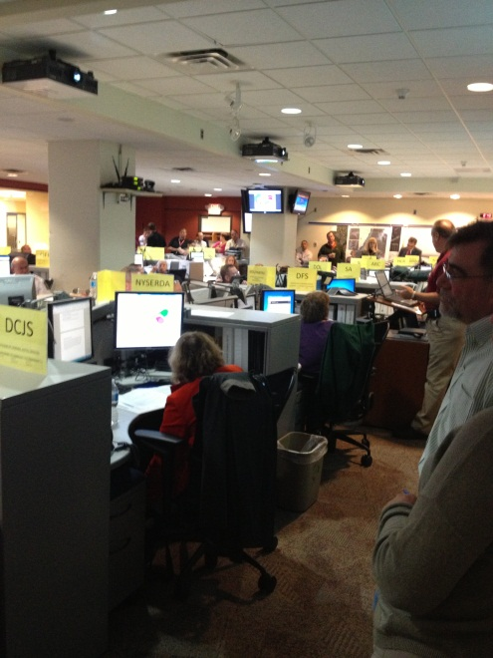
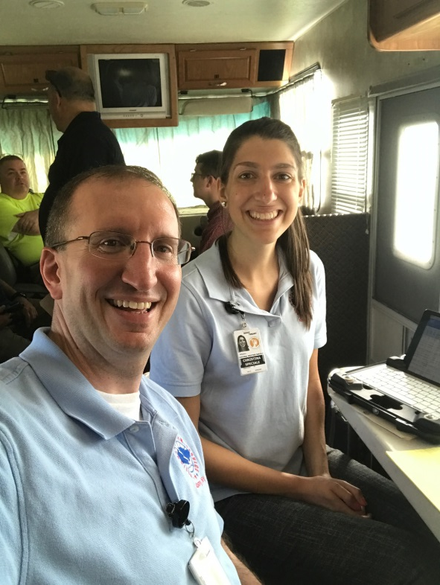
Impact Based Decision Support
Crisis Communications & Challenges
Brian Montgomery
NWS Albany
SUNY Albany – March 25, 2019
Notes:
Picture Inset (left):
Inside NYS OEM as Hurricane Sandy made landfall October 29 2012. Provided critical weather support with wind forecasts, tidal information and rainfall forecasts.
Picture Inset (right):
Christina Speciale and I deployed during Maybe Farms July 4th 2018 festival in Schenectady County

Slide 2
Objectives
Decision Support Services (DSS) as a state liaison office
Training initiatives
Examples of state liaison activities
Benefits of DSS
Crisis Communications
NWS Future
Notes:
Objectives for this presentation.
DSS, @EOC’s, Ways to Communicate

Slide 3


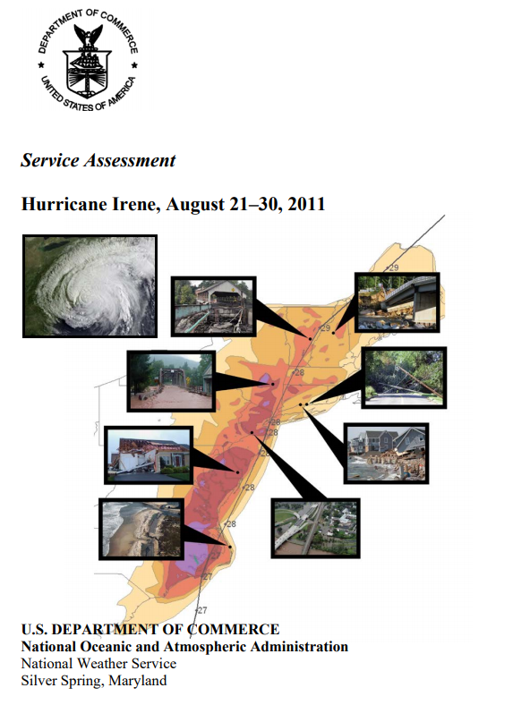
Transparent Communications
Decision Support Services (DSS)
Notes:
Per the Hurricane Irene service assessment, Recommendation 20:
(Strategic): NWS should ensure meteorologists and hydrologists selected for deployment in an EOC are required to be sufficiently trained in ICS, including ICS 100, 200, *300, *400, 700, and 800 courses.
Training for Meteorologists
Incident Command System (ICS)
National Incident Management System (NIMS)
ICS 100, 200, 300*, 400*, 700, 800
State Agency Training Seminars
State Emergency Operations Center Training, Planning Section, Disaster-LAN, Hurrivac
These training courses offer us to understand their mindset, effective listening.
TALK ABOUT STATE LIASION STUFF AND HOW WE COORDINATE WITH SURROUNDING NWS OFFICES! (ex. how we work with surrounding WCMs on criteria for briefings, sharing of briefings during deployments – NWSChat)

Slide 4
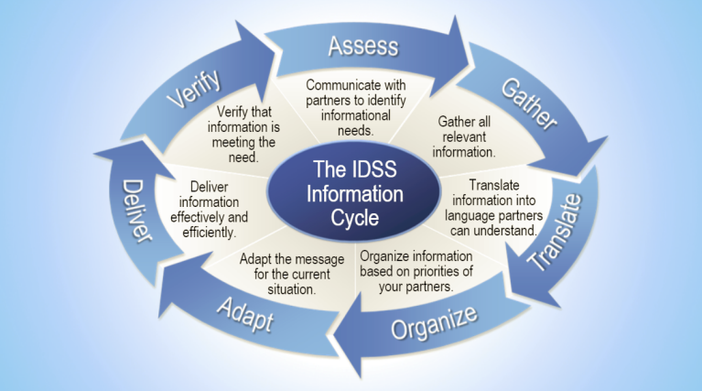
IDSS Information Cycle
Notes:
As a DSS Trained Meteorologist, you will take your meteorological skills and effectively communicate impacts to partners. This is related to the forecast funnel!

Slide 5



DSS Communication Channels
Email
Telephone
Social Media
OEM/EOC
NWSChat
*Also coordinate with surrounding NWS offices in NY state (BUF, BTV, OKX, BGM)
BTV
BUF
ALY
BGM
OKX
Notes:
NOAA’s National Weather Service generates about 90 percent of EAS activations, primarily for short-duration weather warnings and watches.
Nine out of ten “Presidential Disaster Declarations” result from natural phenomena
Emails
Conference Calls
Social Media
Dispatch to EOC
Wireless Emergency Alerts
NWSChat
NY-Alert*
Consistency and consolidation

Slide 6
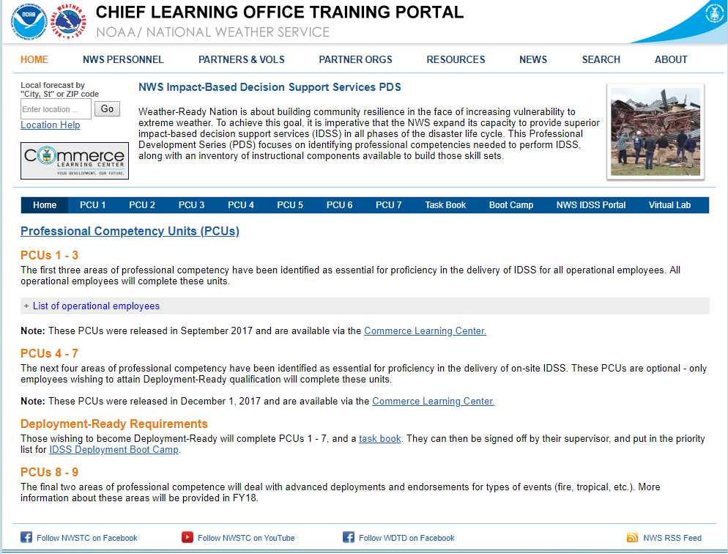




NWS DSS Training Plan
Incident Command courses (ICS)
New York State Emergency Operations Courses*
NOAA/NWS Courses
Hurricane Support
Notes:
This training was a result of input from NY-OEM and county Emergency Managers
ICS 100, 200, 300, 400, 700, 800
Dispersion Basics
HYSPLIT Applications for Emergency Decision Support
Basic Briefing Training for Incident Support
Crisis Communication Module 1&2
Media Training
2018 the NWS invested into national training initiative with modules known as Professional Competency Units (PCU’s) to enhance your DSS experiences, including deployments.

Slide 7
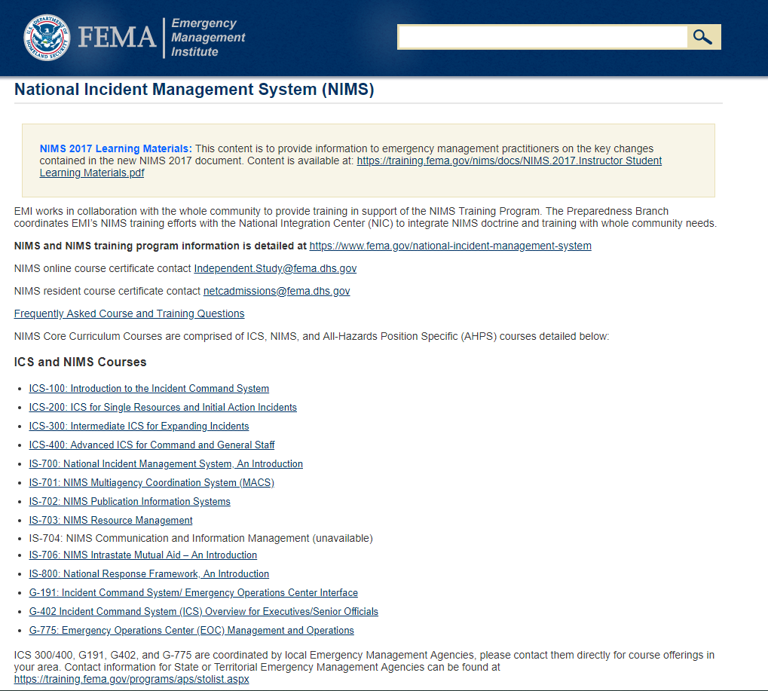
NWS DSS Training Plan
https://training.fema.gov/nims/
Notes:
This training was a result of input from NY-OEM and county Emergency Managers
ICS 100, 200, 300, 400, 700, 800
Dispersion Basics
HYSPLIT Applications for Emergency Decision Support
Basic Briefing Training for Incident Support
Crisis Communication Module 1&2
Media Training
2018 the NWS invested into national training initiative with modules known as Professional Competency Units (PCU’s) to enhance your DSS experiences, including deployments.

Slide 8
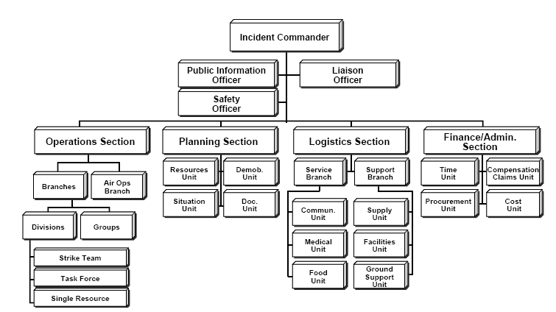
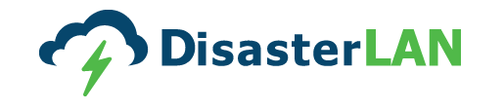
NYSOEM On Site Support
For major events (partial or full activations)
Usually embedded in the Planning Section*
ICS 700
Notes:
Per ICS 700: The Planning Section collects, evaluates, and disseminates incident situation information and intelligence for the Incident Commander/Unified Command and incident management personnel. This Section then prepares status reports, displays situation information, maintains the status of resources assigned to the incident, and prepares and documents the Incident Action Plan, based on Operations Section input and guidance from the Incident Commander/Unified Command.
The Demobilization Unit - is responsible for developing the Incident Demobilization Plan. On large incidents, demobilization can be quite complex, requiring a separate planning activity. Note that not all agencies require specific demobilization instructions.
Examples of on-site support – coordinating with various agencies in the ops area, producing and providing briefings, assisting in creating Executive Situation Reports (ESRs), providing and relaying critical weather information, working with DLAN, using ThinClient, coordinating products that may not be readily available to EOC personnel

Slide 9
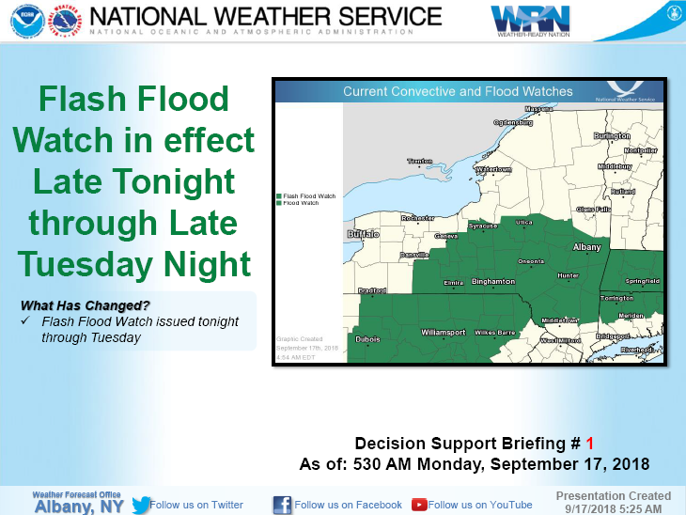
State Liaison DSS Briefings…
Created for a large range of users (e.g. utilities, DOH, DOT, police, Red Cross, Military, Elected Officials)
Keep briefings brief – focus on the highlights
  BLUF – Bottom Line Up First
STAY ON MESSAGE
Alb.stormreport@noaa.gov
Notes:
Want to keep briefings to less than 10 slides normally
There are other new ways of delivering information as well through technology such as YouTube and Skype
STAY ON MESSAGE – want to do a reverse funnel (not top down but down top) – what we mean is that each office produces their detailed forecast, as state liaison, we have to be able to effectively take each of those local, detailed forecasts and summarize it and apply as a whole, single, highlighted forecast across the entire state
PowerPoint designed templated with updated graphics with macros have been implemented to easily relay to partners with briefings.

Slide 10
What Should The Briefing Contain?
Start with an Overview
Focus on the “3 W’s” of impacts
  What are the impacts
  When will the impacts occur
  Where will the impacts occur
Always important to incorporate confidence as well
  Use probabilistic guidance when available!
Use regional-based graphics
  GIS allows for greater customization and appealing graphics
  Enhanced Digital Display (EDD) and GIS

Slide 11
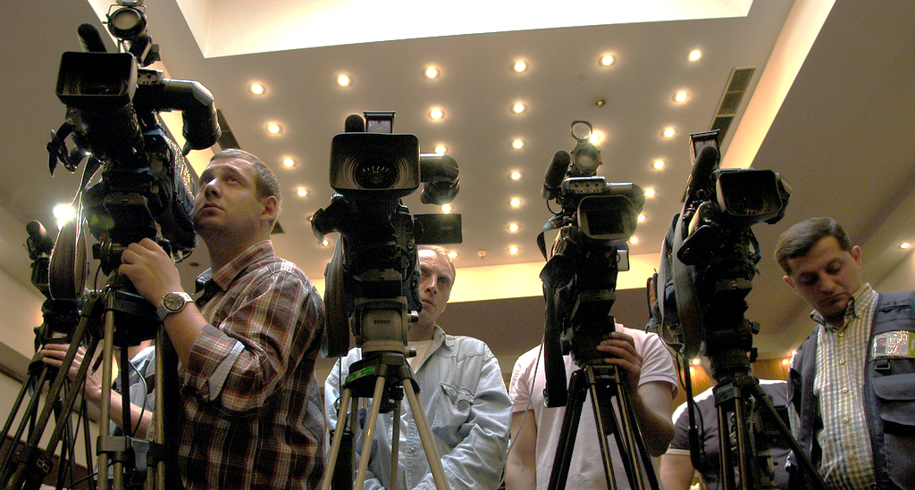

Crisis Communications
Meet and develop partnerships
Clear and Concise
Stay in your lane
Only speak facts
No science jargon or acronym's
Prepare two key points to communicate
Show empathy
PRACTICE!

Slide 12

Information Gathering
87% of your audience will determine your credibility by body language alone!
The 5 Senses
Percentage | Sense
1%
1.5%
3.5%
7%
87%
Taste
Touch
Smell
Hearing
Seeing
Notes:
Name the 5 senses.
One of my news directors said, “if you look good on mute, you will do great in broadcasting”

Slide 13

Richard Brundage Technique
1
2
3
4
5
6
7
8
9
10
1
2
3
4
5
6
7
8
9
10
Bridge with
Reporter Name
Theme #1
4 Seconds
Answer
Question
Theme #2
4 Seconds
4 Seconds
8 Seconds
Total Sound Bite Running Time = 12 seconds
Notes:
To help with your visual on-camera presence, vital to get camera person and reporters name before the interview!
Then utilize this technique
Look at the diagram again. The left side, the first four seconds – your answer to each different question – will be different, because it’s a different question being asked.
But, your two themes will be the same.
Answer the new question and then bridge to your themes again by saying, “and, John, once again the most important things, etc., etc.”
There’s your 12-second sound bite. And, it can’t be edited! You just insured that you wouldn’t be taken out of context.

Slide 14
Exercise Time
1
2
3
4
5
6
7
8
9
10
1
2
3
4
5
6
7
8
9
10

Slide 15
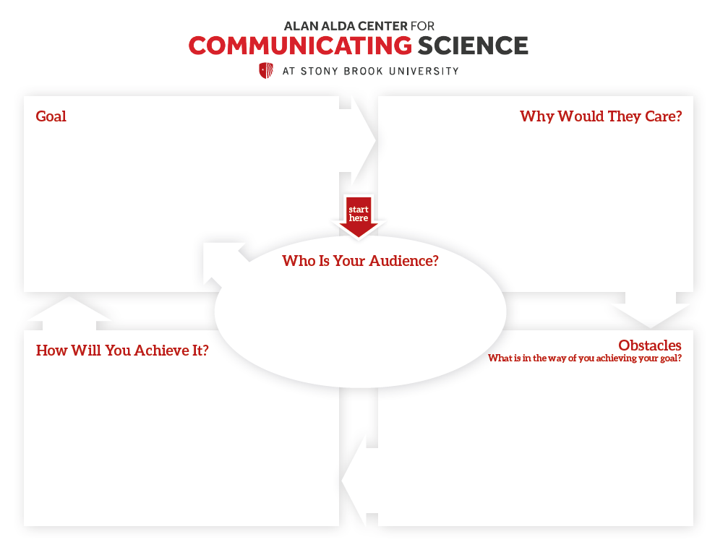
Alan Alda Center for
Communicating Science
Introduce DSS
Crisis Communications
Training Opportunities
Future NWS Plans
Career Opportunities
Passion for communications
Love of Weather
Brilliant SUNY Albany Students
Show them the NWS Plans
Be passionate about communications
Engage them with examples
Hand out free food
Will they like communications of science?
Do they want to expand their science education?

Slide 16

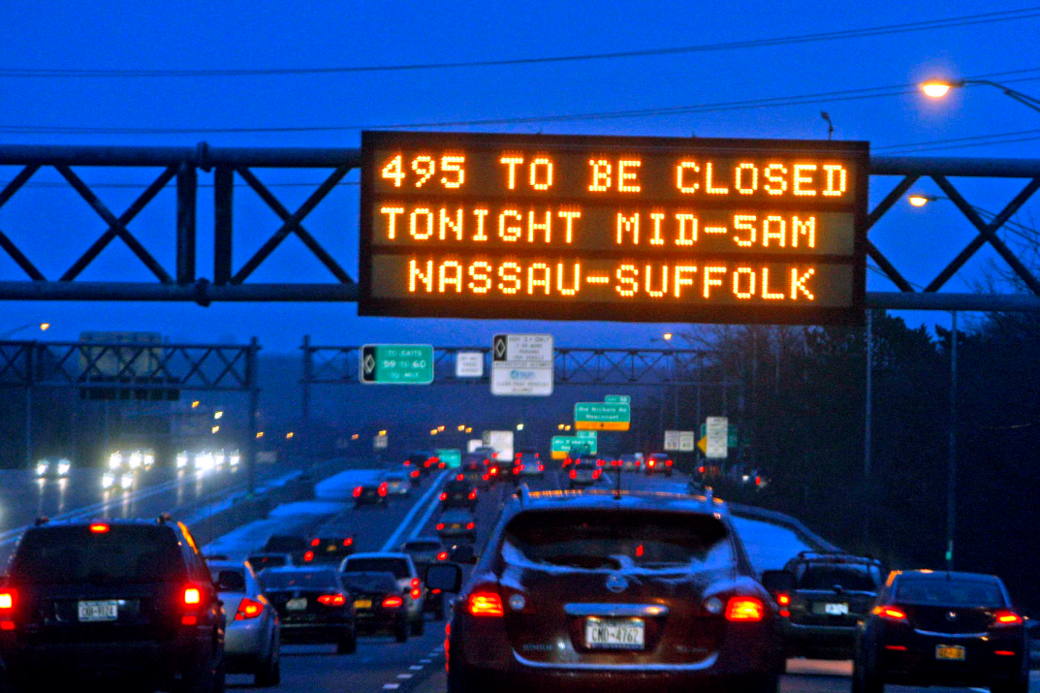
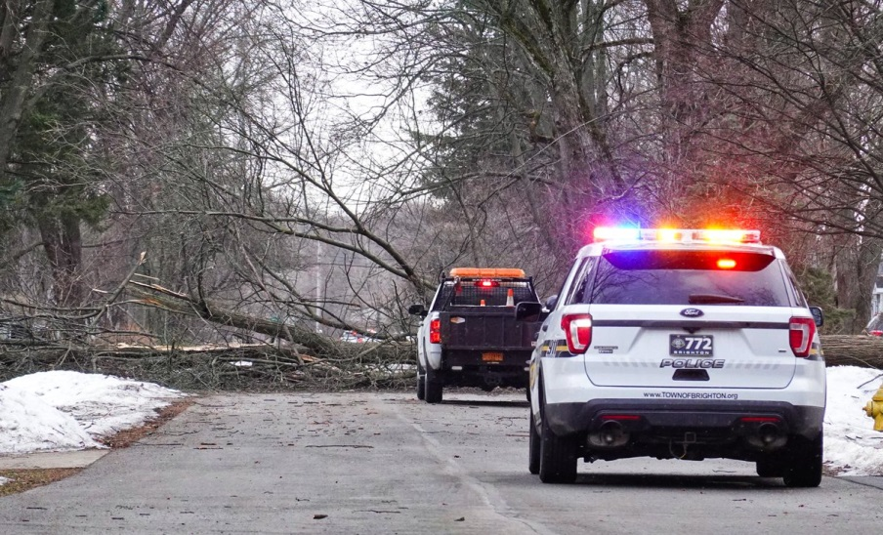
Recent DSS Activations
Downtown Schenectady – July 2018
Blizzard Warnings for Long Island - January 2014
Record High Wind Event – February 24, 2019
Notes:
Nearly 20,000+ people arrive downtown for a free concert with many vendors and activities. Provided special HYSPLT runs for Emergency Management and hourly temperature with heat index updates and forecast due to the above average temperatures.
Large impact from a winter storm/blizzard across NY state January 2014. Our briefings assisted with the Governors decision to “soft close” interstates to reduce stress on the roadways and allow for the DOT and emergency vehicles to respond.

Slide 17
State Liaison DSS Benefits
Consolidated and coordinated message allows for
1 forecast voice
On-site deployments to state EOC allow for person to person interactions with various state agencies
Personally interact with agency and media representatives and share information to the public and other NWS offices (regional and national)
Co-learning opportunities with FEMA and State Officials

Slide 18

Summary
DSS critical to fulfilling the WRN initiative
Communication Transparency
Co-learning Incident Command Courses
Building Core Partnerships
Integration within Emergency Management
Deployments (physical and virtual)
Crisis Communications
From the Governor's Office during Hurricane Sandy:
“Brian, thank you for taking a complex science and breaking it down to simplistic standards”

Slide 19






Thank You!!
Questions?
Brian.Montgomery@noaa.gov | Lead Meteorologist | DSS Lead

