Slide 1
Dual Polarization Radar Interpretation, Applications and Examples
Thomas A. Wasula & Brian J. Frugis
NWS Meteorologists
ATM 362: Forecasting and NWS Operation Course
March 9, 2020

Slide 2
Outline
Conventional vs. Dual Pol radars (differences)
Dual Polarization base products, uses, and examples
Differential Reflectivity (Z_{DR})
Correlation Coefficient (CC)
Specific Differential Phase (K_{DP})
Dual Pol Algorithm/Derived product: (Hydrometeor Classification Algorithm)

Slide 3
Dual Polarization Radar
The KENX radar was upgraded to Dual-Pol: 23-27 April 2012
The radar now has the ability to transmit and receive both horizontal and vertical pulses
Helps forecasters gain more info. about particle (droplet) size and distribution and helping to more accurately determine precipitation type and rate

Slide 4
Difference between Conventional WSR-88D Radar & Dual-Pol Radar

Slide 5
Impacts of Dual-Pol Radar
We still receive the 3 legacy base products
Reflectivity (in the horizontal), Velocity and Spectrum Width (determines turbulent flow)
The Dual Polarization Radar now gives us 3 brand new additional base products
Also, several new derived and precipitation products as well (We will not have time to review Precip/QPE products in great detail)
Gives us more physical data to use during storm interrogation (Warm and Cool season) for Warning Decision Making

Slide 6
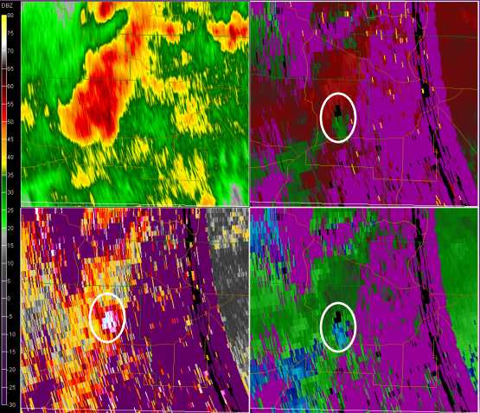
Spectrum Width Severe Example
May 2, 2010 Distant supercell example
Base REF
SRM
Spectrum Width
Velocity
EF-0 tornado tied to circulation in white circle is 10-15 mins before touchdown. Spectrum width showed high values due to turbulent flow.

Slide 7
Dual Pol Base Products
Differential Reflectivity (Z_{DR})
Correlation Coefficient (CC)
Differential Phase (Φ_{dp})
We will use this product as Specific Differential Phase (K_{DP})
Info. Dual Polarization Products:
https://training.weather.gov/wdtd/courses/rac

Slide 8
Z_{DR} – Differential Reflectivity (dB)
Z_{DR} is a ratio of the horizontal and vertical power returns
Z_{DR} will give the forecaster a good idea of the mean droplet size and shape

Slide 9
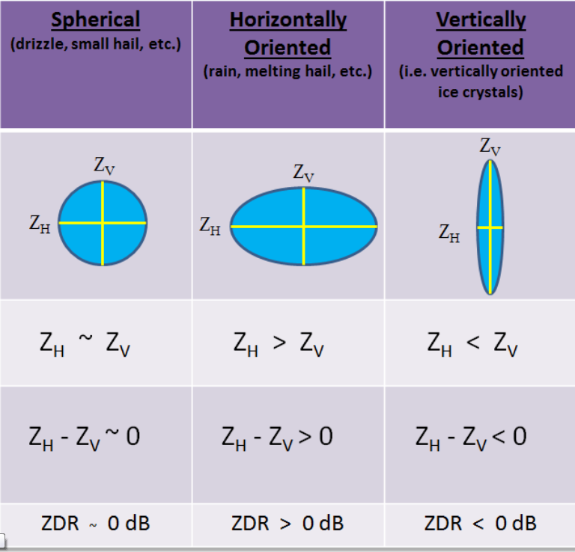
Z_{DR} (dB) Interpretation
Key: Indicator of dominant drop shape

Slide 10
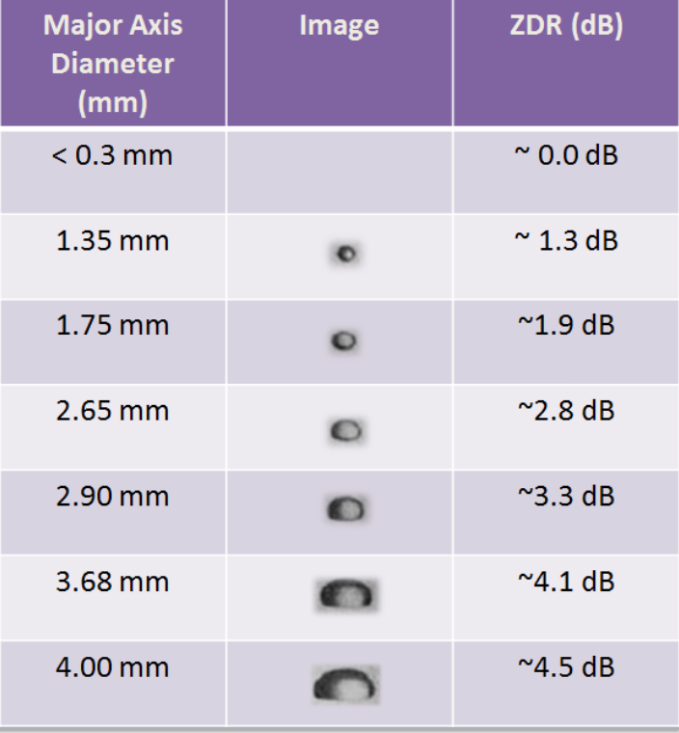
Z_{DR} (dB) for Rain
Direct Relationship: The larger the droplet size, the larger the ZDR
https://training.weather.gov/wdtd/courses/rac/products/zdr

Slide 11
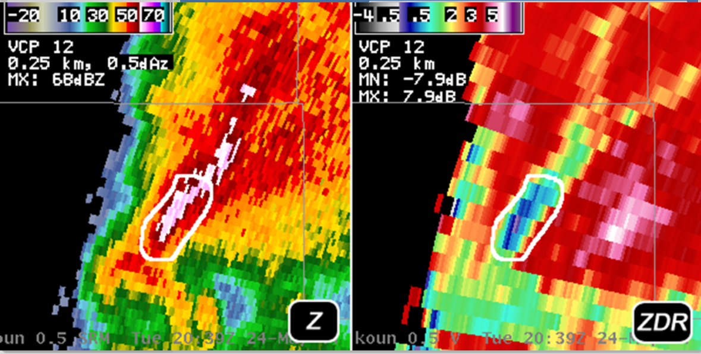
Z_{DR} (dB) for Hail
Hail has a high Z (dBZ) and low ZDR (~0 dB), especially if falling or tumbling
Small hail that is melting has a high ZDR, like giant rain drops (5-6 dB’s)

Slide 12
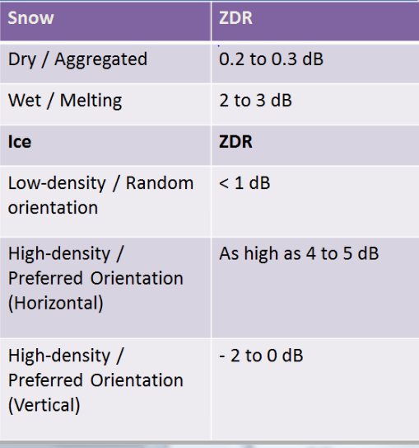
Z_{DR} (dB) for Snow or Ice
Interpretation is more involved :
Wet or dry snow?
Low or high density?
What is the preferred orientation?

Slide 13
Z_{DR} Uses/Applications
Locations of hail shafts if the Z_{DR} ~ 0 dB (near spherical hydrometeors) coincident with high Z (REF)
Z_{DR} much greater than 0 dB indicates large rain drops
Identification of strong updraft area in thunderstorms (Z_{DR} columns) with liquid drops well above freezing/melting Layer
Determination of Wet vs. Dry Snow in Cool Season
Areas of small hail mixed with rain could have high Z_{DR} (water covered hail stones)

Slide 14
Severe Weather Example of Z_{DR} for a Supercell
Differential Reflectivity (Z_{DR})
Reflectivity (Z)
Values of Z_{DR} near zero along with high values of Z indicate a hail shaft.

Slide 15
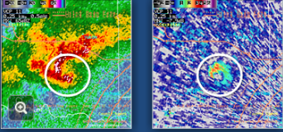
Z_{DR} Applications/Uses: ZDR Columns
ZDR Columns: strong/intense updraft identification
ZDR is usually > 1 above the melting layer/freezing layer
*Brian F. will review more examples in the next presentation*
High Z (dBZ) above the FZL
ZDR greater than > 1 dB above FZL

Slide 16
Tornadic Debris Signature (TDS) Use
Insulation and shingles lofted
SRM
Base REF
Differential Reflectivity
Corr. Coeff
Low Z_{DR} ~ 0 dB in area of possible tornado

Slide 17
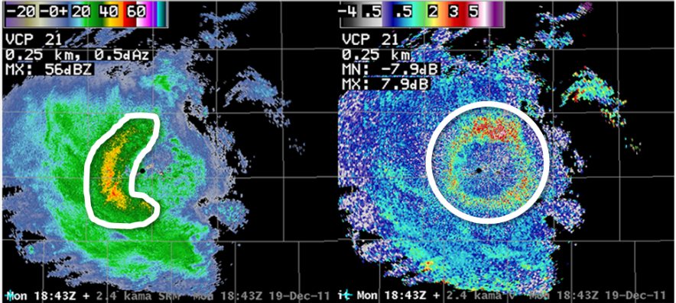
Melting Layer Identification
Identified as region of high Z_{DR} (dB)

Slide 18
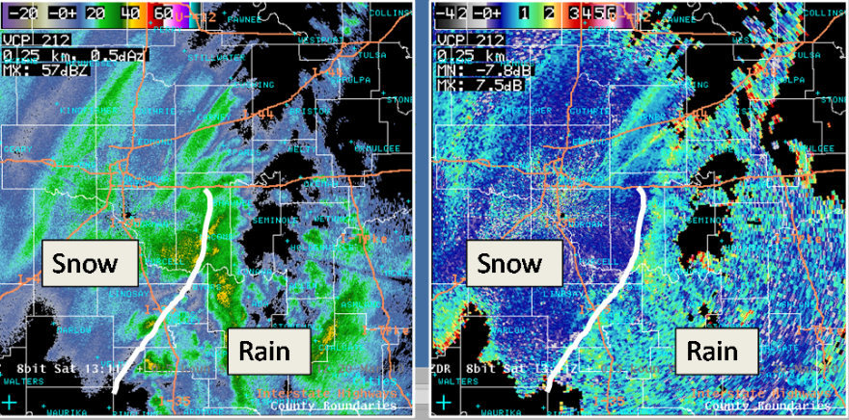
Rain vs Snow Usage (Z_{DR})
Z (dBZ)
Z_{DR} (dB)
Rain vs Snow lines or transition zones: (1) Rain area – > ZDR > 1 dB
(2) Snow area – > ZDR ~ 0 dB

Slide 19
Correlation Coefficient (CC)
A measure of the correlation between the horizontal and vertical back-scattered pulses from the scatterers within a sample volume scan of the radar (some similarities to spectrum width)
Mathematically known as ρ_{hv (unit less)}
Can determine precipitation type, meteorological vs. non-meteorological echoes

Slide 20
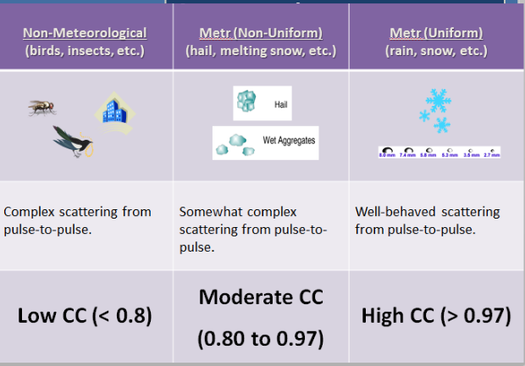
CC Interpretation Table
* Hydrometeors more uniform with high CC values in the right column
Han Carbonite –
Non-met target (sort of)

Slide 21
Correlation Coefficient
Values > 0.97 indicate a consistent size, shape, orientation, and/or phase of hydrometeors
CC 0.80 to 0.97 indicates a mixture of the size, shape, and orientation and/or phase of hydrometeors
CC < 0.80 is usually non-meteorological scatterers (birds, insects, buildings) and sometime large hail
Values of greater than 1.00 are possible in areas of noisy data at a far range and low SNR (signal to noise ratio) and these values should just be ignored.

Slide 22
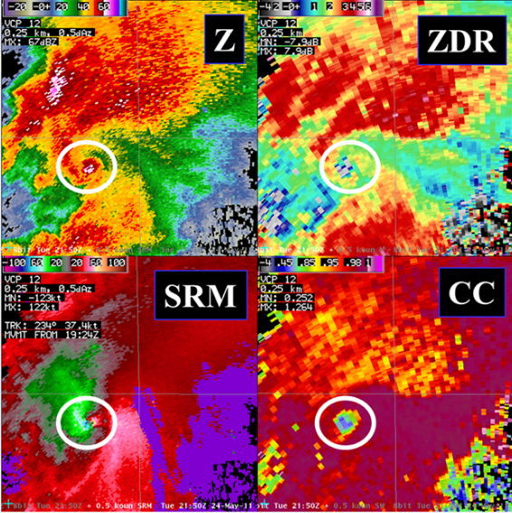
CC Uses/Applications: TDS
Z > 30 dBZ
ZDR ~ 0 dB
CC < 0.80
Tornadic velocity couplet in SRM
Tornadic Debris Signature (TDS) has low CC due to shingles, leaves, and other non-meteorological debris lofted

Slide 23
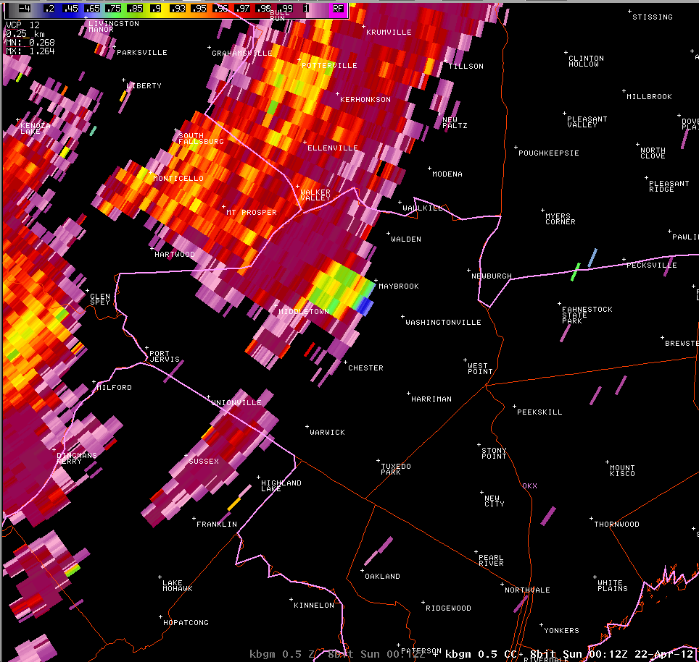
CC Uses/Applications: Severe Hail
Severe Hail Guidance: (1) CC < 0.90 is 2”+ diameter hail
(2) CC < 0.75 can be large, spiky hail
Z (dBZ)
CC
Radar images from KBGM from the evening of April 21, 2012 with Z (REF) on the left and CC (Correlation Coefficient) on the right. Notice the area of lower CC values (0.85-0.90) along with high Z values indicate hail aloft.

Slide 24
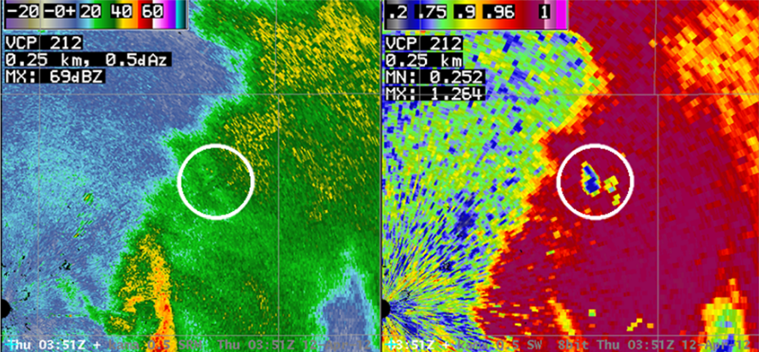
CC Uses/Applications: Meteorological vs. non Meteorological Echoes
General rain, but a tower or some non-meteorological target picked up.
Recall: CC > 0.80 meteorological targets, and CC < 0.80 non-meteorological echoes.

Slide 25
CC Use/Applications: Melting Layer Detection
Good for detecting the melting layer (ring of lower CC)
Look at a higher radar elevation angles for values around 0.90 or less

Slide 26
CC Use/Applications: Snow vs Rain/Mixed Precipitation
Identification of Precipitation transition zones:
- In the example all snow ptype where CC > 0.97
- Rain/Icy mix where CC < 0.97

Slide 27
Differential Phase (Φ_{dp})
We are concerned more with Specific Differential Phase

Slide 28
Differential Phase Shift
Phase shift refers to how much the vertical and horizontal difference in wavelength of the propagating beam (due to the beam slowing down as it passes through scatterers)
Since large rain drops are larger in the horizontal direction, the Φ_{DP} will be positive since the beam will pass through more in the horizontal than the vertical direction
Since hail is usually spherical, its vertical and horizontal phase shift would cancel each other out. Large rain droplets in the same volume may still allow for a positive Φ_{DP.}
This will greatly help estimating rainfall in areas where rain and hail are mixed together.

Slide 29
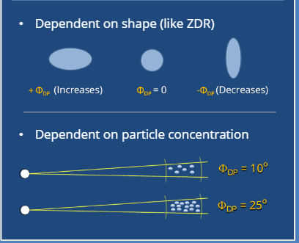
Differential Phase (Φ_{dp}) Interpretation

Slide 30
Specific Differential Phase (K_{DP})
A derived product display what we learn from Φ_{DP.}
Since Φ_{DP} is cumulative, we use K_{DP}
It’s basically the range derivative Φ_{DP} , but integrated along a radar radial
Increasing values of K_{DP} imply significant amounts of liquid water regardless of ice content in a radar cross section
Cannot be calculated for areas of very low CC (<0.90)

Slide 31
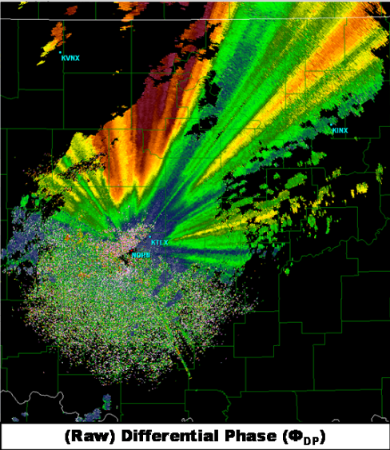
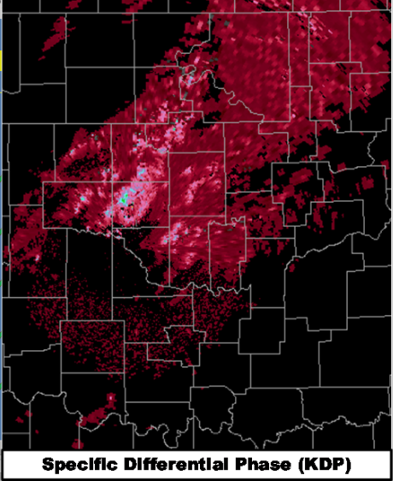
Φ_{dp} vs. K_{DP} (deg/km)
We use KDP since rain from a thunderstorm is easily able to be identified

Slide 32
A Radar Example of K_{DP}
The higher the values of K_{DP}, the higher the concentration of large liquid raindrops.

Slide 33
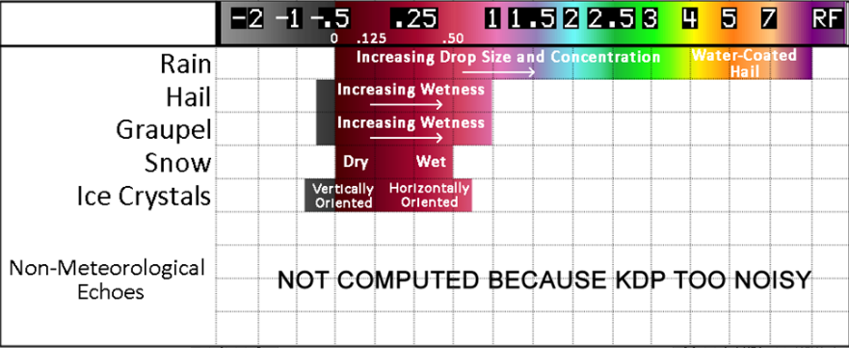
Values of K_{DP} (deg/km)
- Wide range of values for rain
- CC <0.90 ,then no KDP calculation

Slide 34
KDP Uses/Applications
Heavy Rain (examples shown)
Rain/Hail Mixtures
Small Hail Caveat (high KDP with rain, and melting hail or small hail stones)
Warm vs Cold Rain (example next slide)

Slide 35
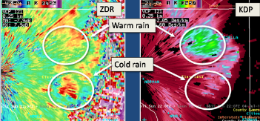
Warm vs Cold Rain Example
Identification of warm (efficient) rain processes vs. Cold (inefficient) processes

Slide 36
Hydrometeor Classification Algorithm (HCA) Example
Hail-Rain
Reflectivity (Z) image on left vs. HC Algorithm output on right

Slide 37
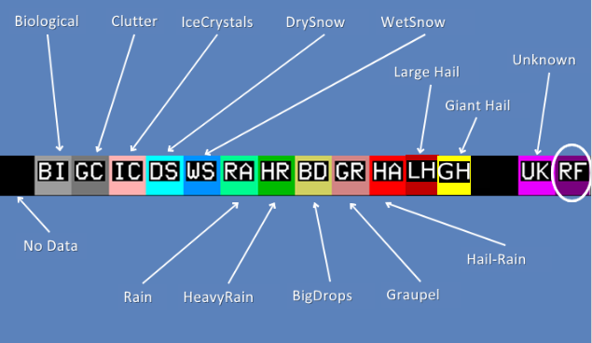
Hydrometeor Classification

Slide 38
Visualization of the HC Types

Slide 39
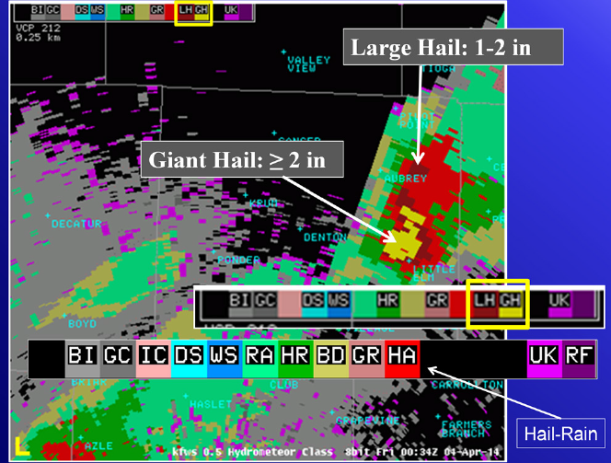
Hail Size Discrimination Algorithm (HSDA)
2 New Hydrometeor Classifications
Large Hail: 1-2”
Giant Hail: ≥ 2”
Displayed on the HCA Product
HC is a key dual pol benefit
Requires height of the 0ºC & -25ºC Wet bulb zero height
R(KDP): Hail hydro Classes (HA, LH & GH)
From: WDTB Build 17.0 training

Slide 40
HCA Application/Strengths
Safety net for base data analysis (use in conjunction with Dual Pol products)
Key Input for precipitation algorithms
“Quick look” for areas of concern (i.e. where the most intense storms are located in a severe weather event)
Can help an individuals situational awareness rapidly. Remember first guess only!

Slide 41
HCA Limitations/Weaknesses
Overlapping polarimetric characteristics between classes
Subjective and empirical fuzzy-logic membership functions and weights
Uncertainty not given
It is an algorithm (garbage in = garbage out)
Ground Truth(below the beam radar effects)
Limited ptype characteristics: no sleet, ash, etc.

Slide 42
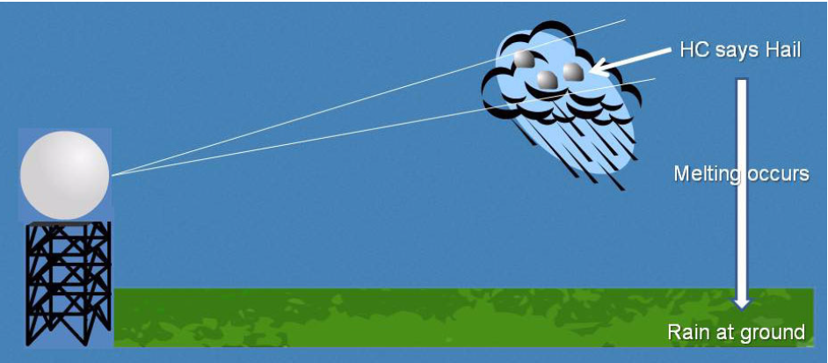
Ground Truth Example: HC Weakness
Below the radar beam effects are illustrated here !!!

Slide 43
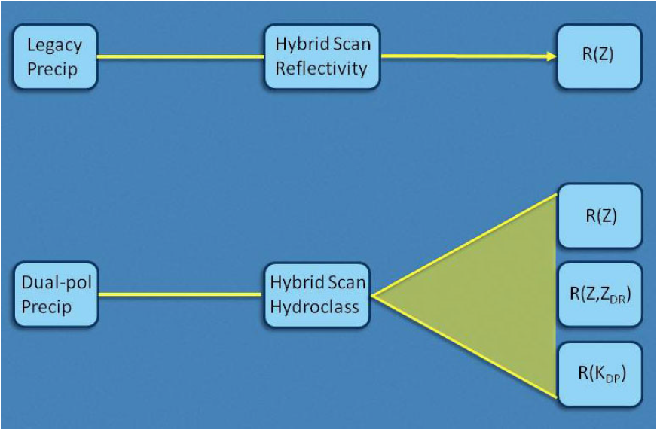
Dual Pol QPE “Precip” Products
The HHC product is used as input for a variety of rainfall rate relationships used for a particular location that is specific to the dominant hydrometeor type at that location, potentially improving rainfall rate compared to estimations based only on reflectivity.

Slide 44
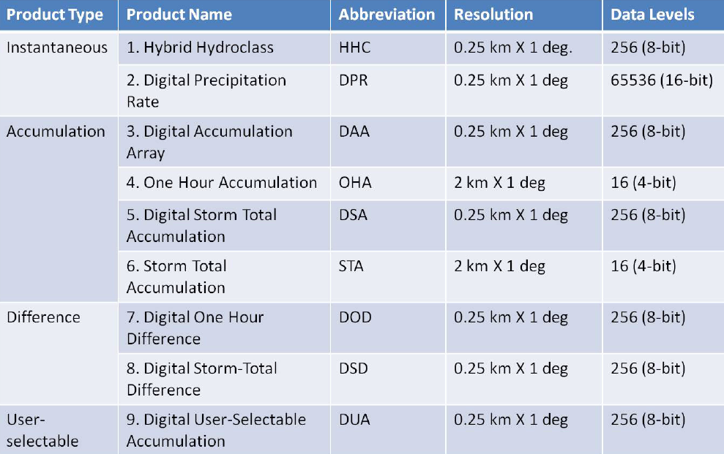
9 “Newer” QPE Products
1,2,3,6,12,24

Slide 45
Dual Polarization Summary
Dual Pol data helps improve hydrometeor detection, shape, distribution and orientation
Identification of non-meteorological targets more easily
Improvement on the detection of hail in a thunderstorm (Large Hail, Hail vs. Rain, etc.)
Differentiate between rain, snow, and mixed pcpn
Detection of areas of heavy rain/flooding better
Tornado Debris Signature (TDS) identification
Identification of the melting layer/bright band

