Slide 1
National Weather Service Careers…
Getting Started
Raymond G. O’Keefe
Meteorologist in Charge
National Weather Service
Albany, NY
raymond.okeefe@noaa.gov
Notes:
*

Slide 2
Outline
Who We Are
What We Do
NWS Careers
Questions

Slide 3
NWS Mission
Provide weather, water, and climate data, forecasts and warnings for the protection of life and property and enhancement of the national economy.

Slide 4
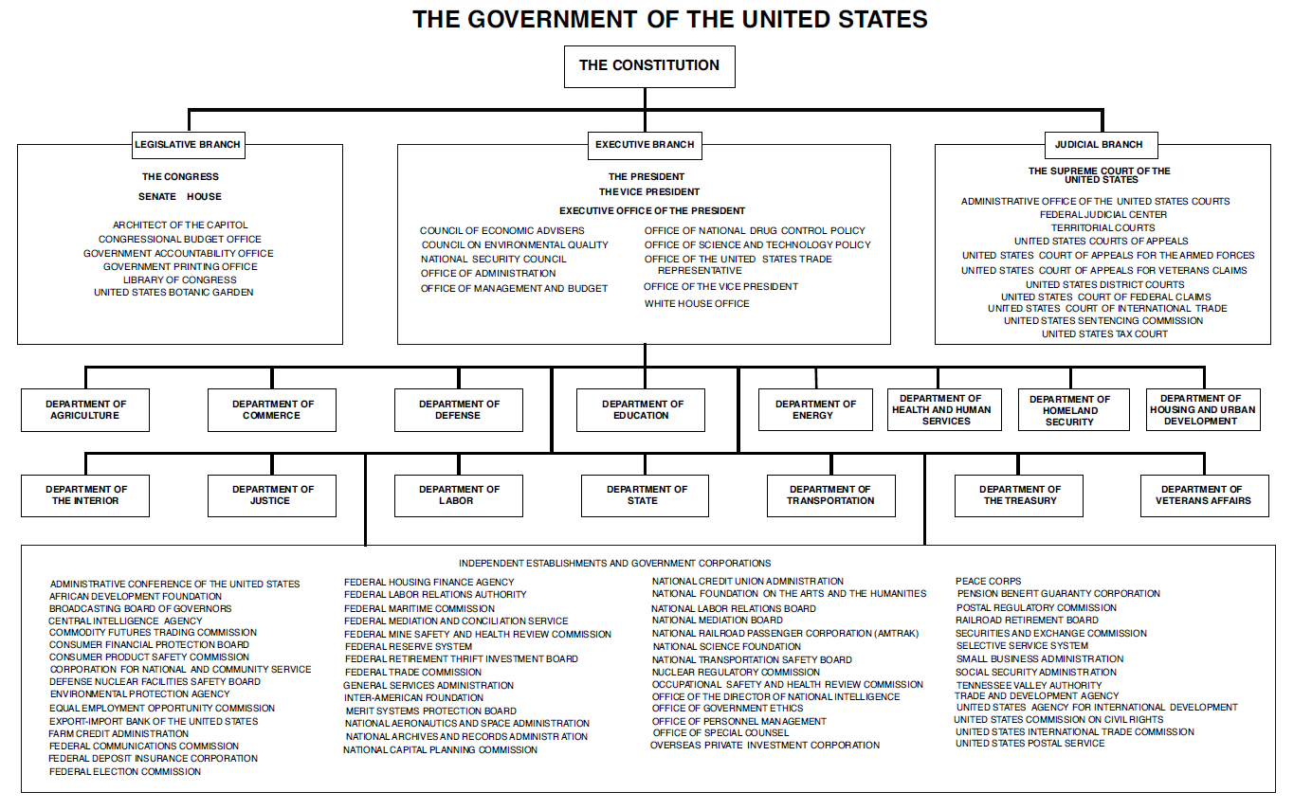
Who We Are?
Notes:
122 offices

Slide 5
Who We Are?
Department of Commerce
National Oceanic and Atmospheric Administration
National Weather Service
Notes:
122 offices

Slide 6
Who We Are
National Headquarters
Regional Headquarters
Weather Forecast Offices
River Forecast Centers/National Water Center
National Centers
Center Weather Service Units
Notes:
4000 people in nws, 2000 mets

Slide 7
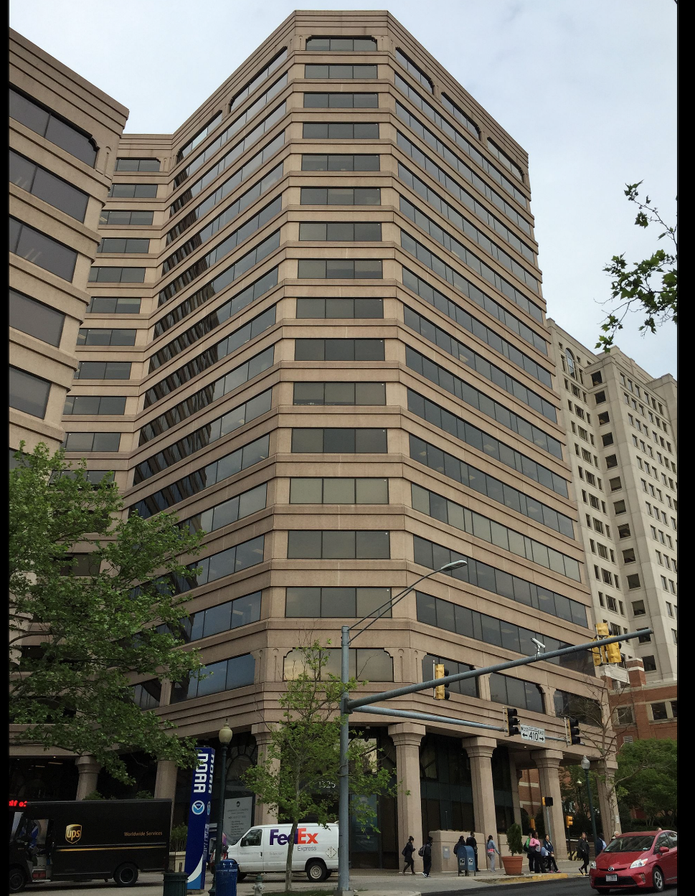
Who We Are – HQ

Slide 8
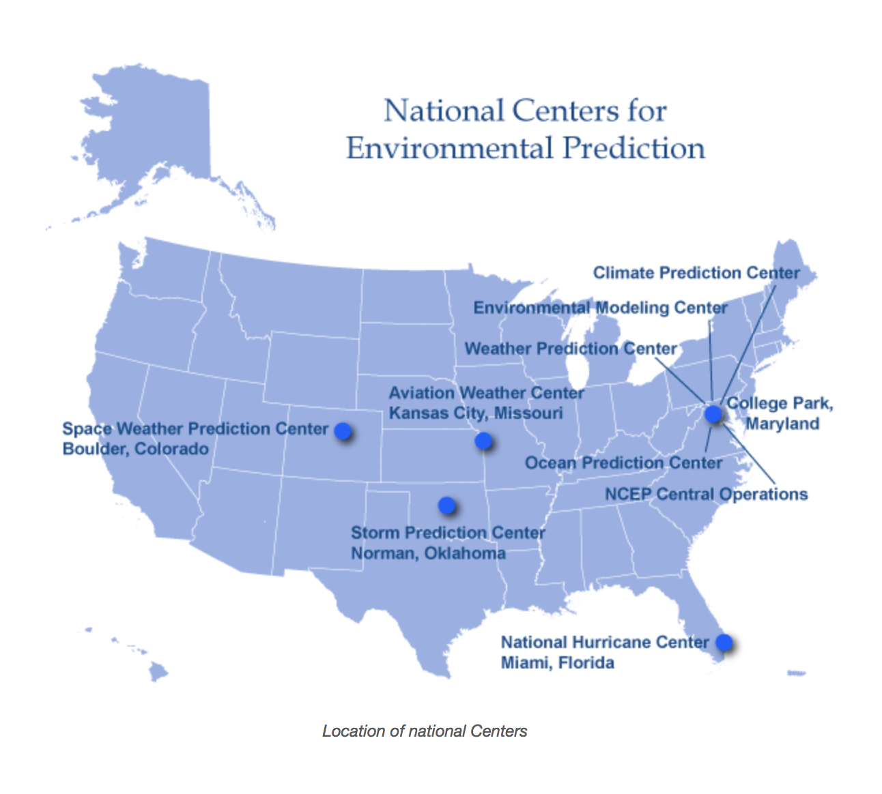
Who We Are - Centers

Slide 9
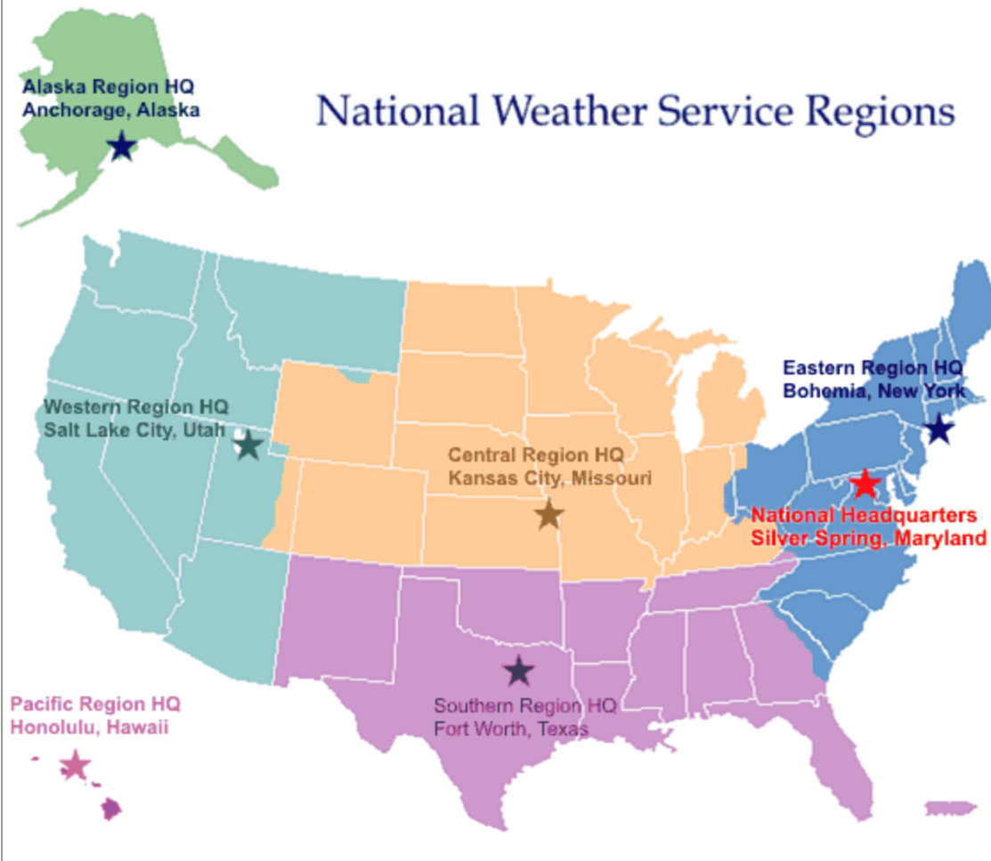
Who We Are – HQ

Slide 10
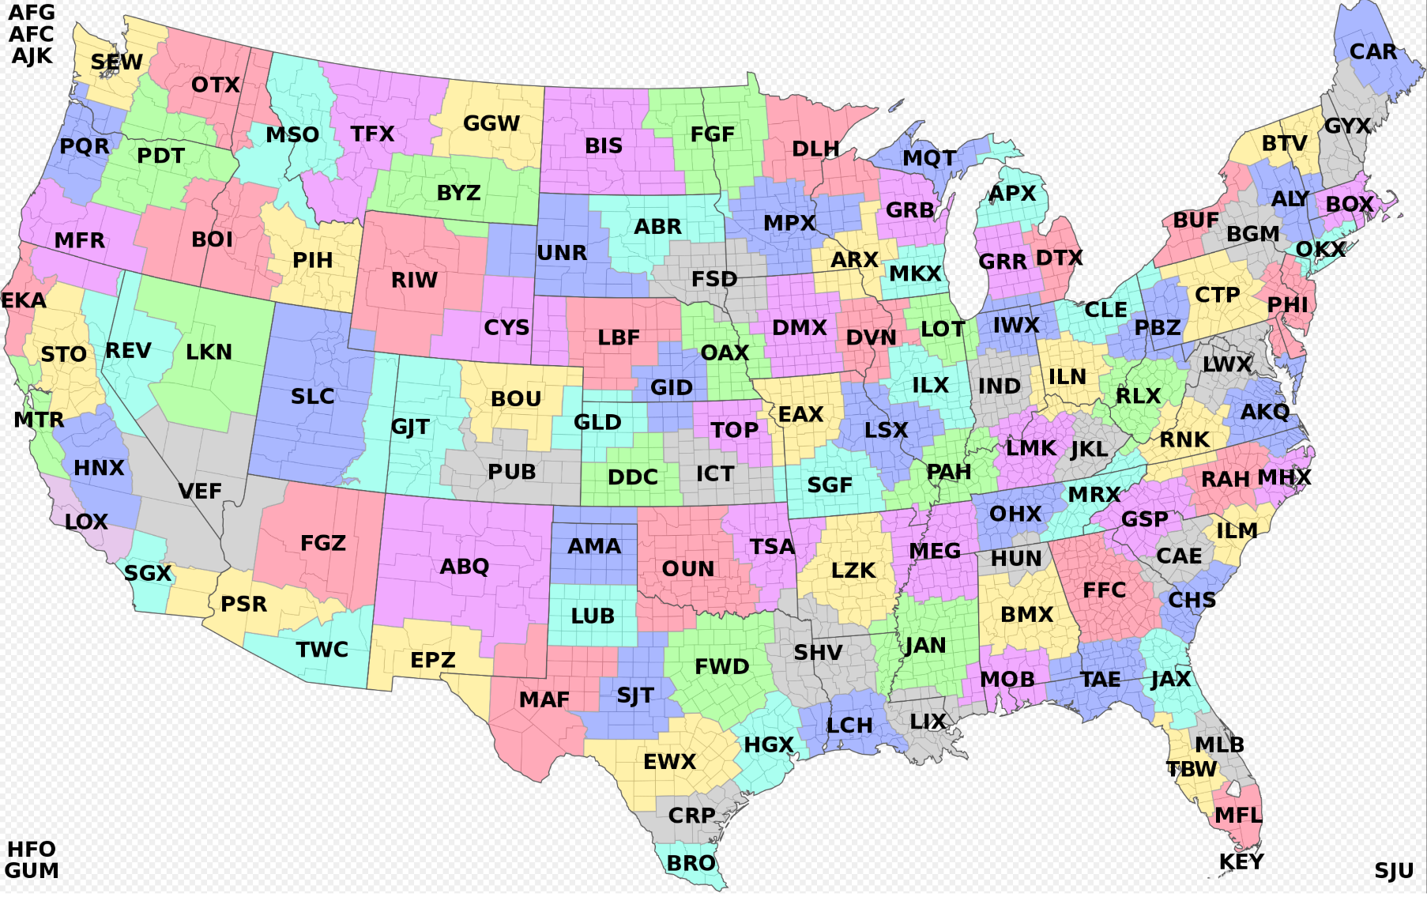
Who We Are – Weather

Slide 11
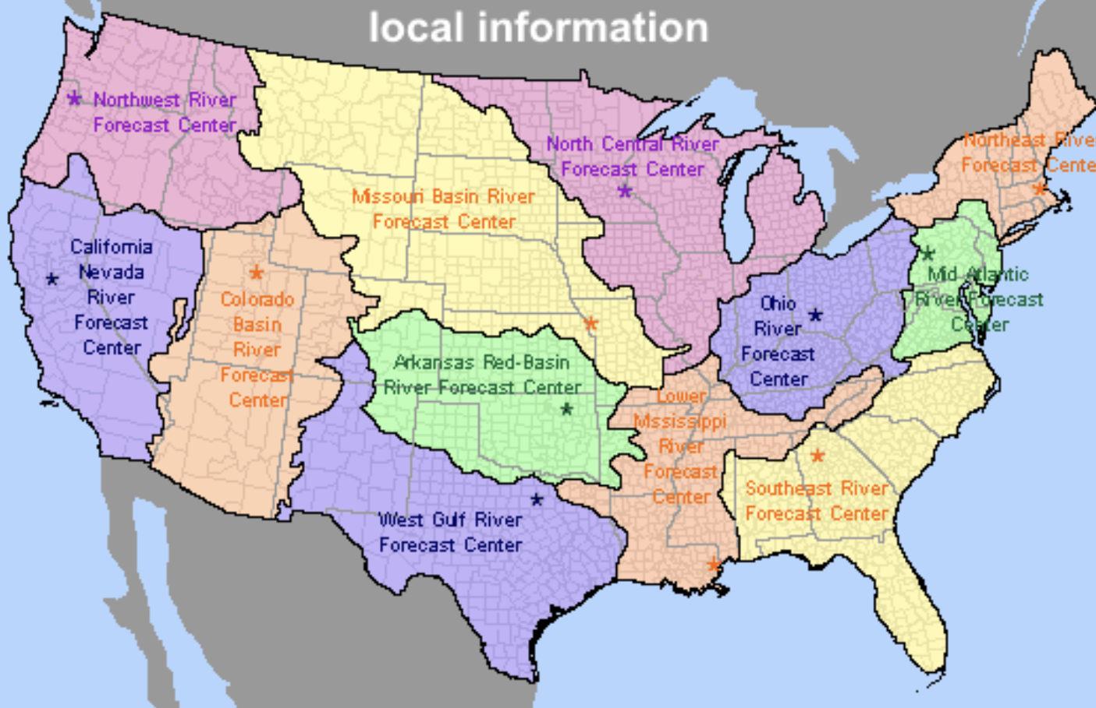
Who We Are - Water

Slide 12
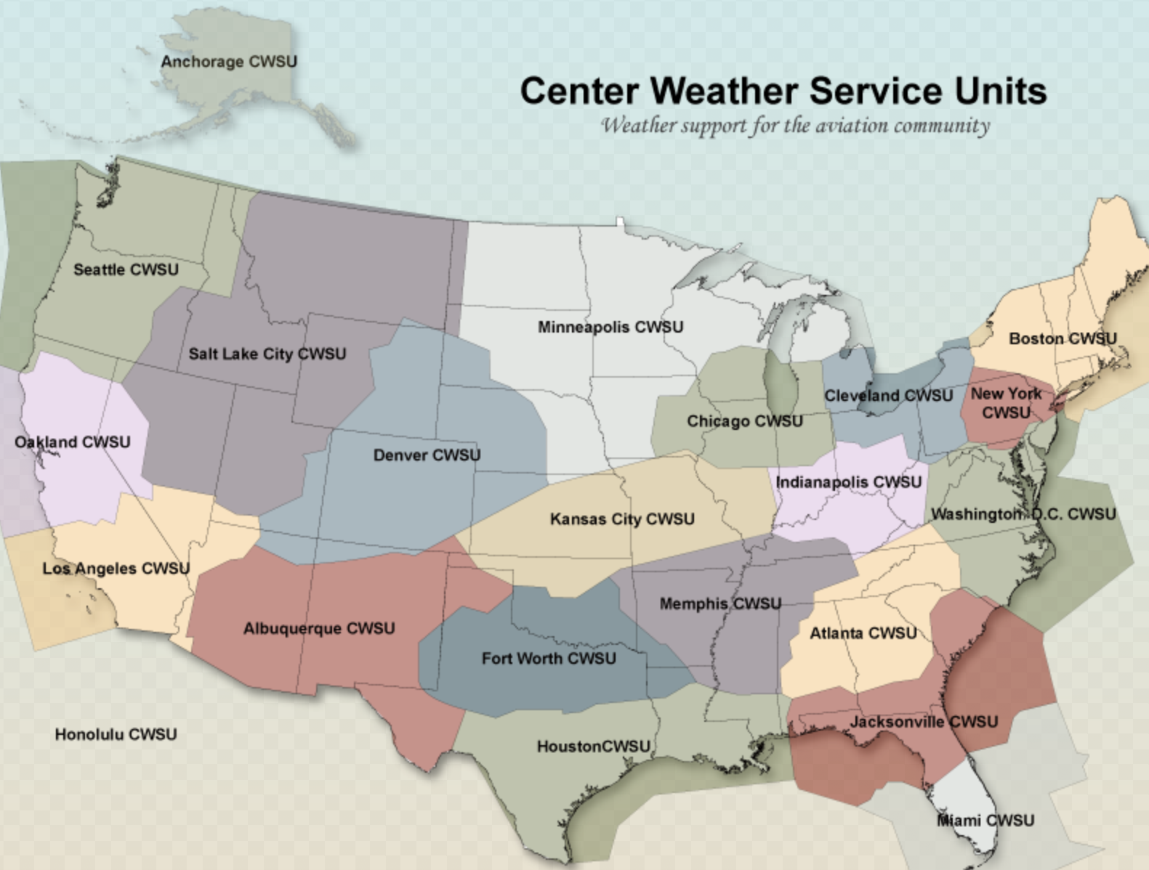
Who We Are - CWSU
Notes:
A Center Weather Service Unit (CWSU) is a National Weather Service (NWS) unit located inside each of the Federal Aviation Administration's 22 Air Route Traffic Control Centers(ARTCC).

Slide 13
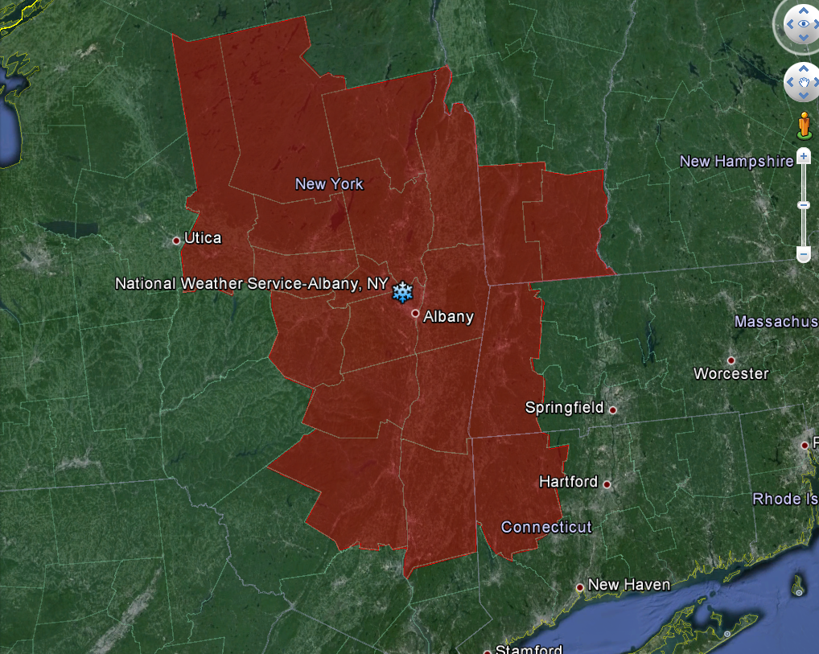
Who We Are – Albany
Notes:
Serves 19 counties in Eastern New York and Western New England
Population - about 2 million (about 1 million seasonal visitors)
Area – around 15,000 square miles
Staff – 24

Slide 14
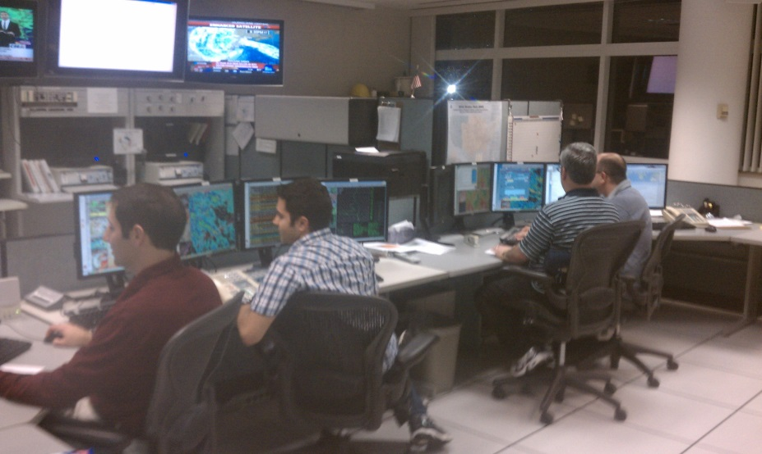
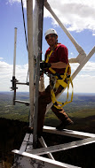
Who We Are – ALY
1 Meteorologist in Charge
1 Science and Operation Officer
1 Warning Coordination Meteorologist
1 Senior Service Hydrologist
1 Electronic Systems Analyst
1 Information Technology Officer
1 Observing Program Leader
5 Lead Meteorologists
8 Meteorologists
3 Electronics Technicians
1 Administrative Support Assistant
6/3 Student Volunteers (Academic Year/ Summer)
0 Observing Program Leader
4 Lead Meteorologist
1 Electronics Technician
Notes:
Fully staffed – 24 Mission first people always. NOAA Administrator

Slide 15
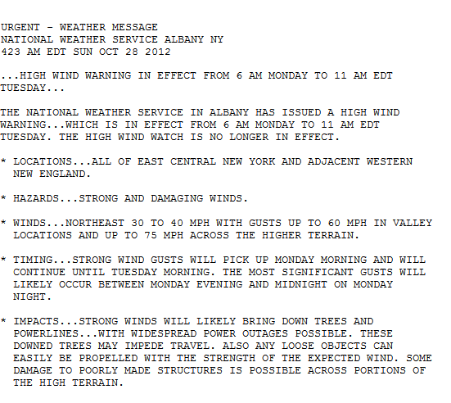
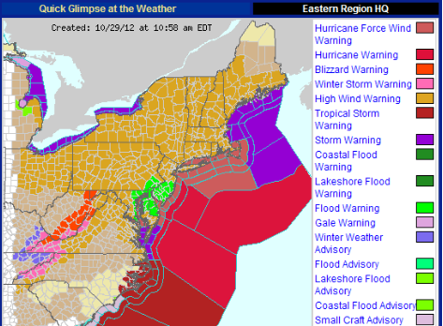
What We Do
…Protect Life and Property…
Notes:
Warnings for Sandy from Hurricane to Blizzard; High wind warnings in NY

Slide 16
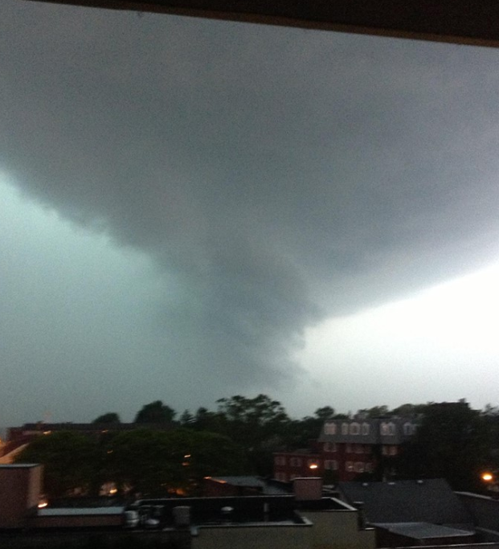
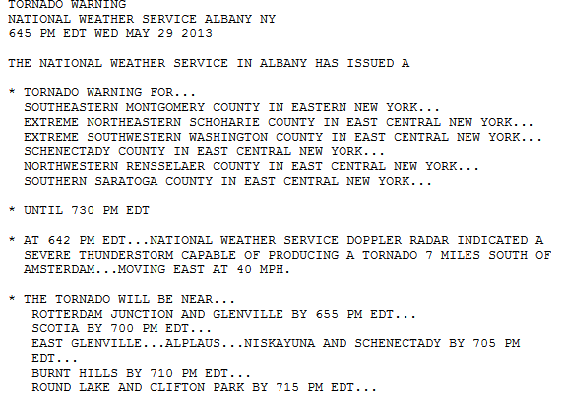
What We Do
…Protect Life and Property…
Notes:
Tornado over Schenectady, NY. Tornado rated an EF2. Strongest tornado in the Albany area since July 21, 2003 (F2). Average lead time about 8 minutes.

Slide 17
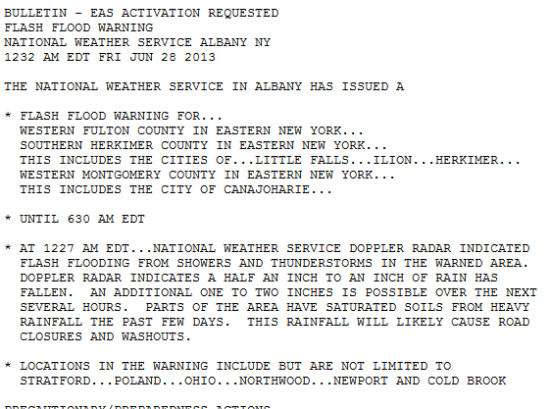
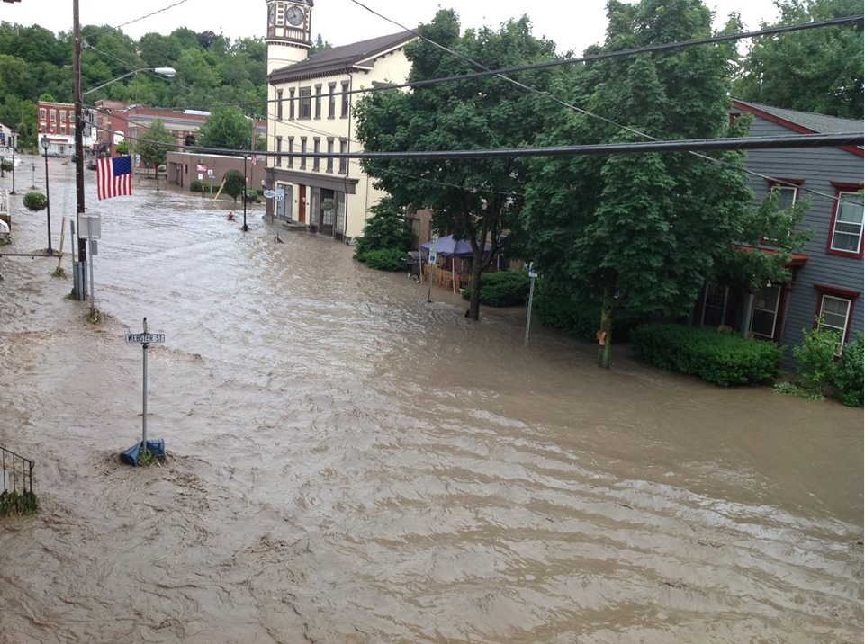
What We Do
…Protect Life and Property…
Notes:
Flash Flooding in Fort Plain, NY
Flooding…probably our most significant threat; 4 season threat
Flash Flood Warning issued for parts of Fulton, Herkimer, and Montgomery Counties, NY valid 12:32 am June 28
Flash Flood Emergency issued for parts of Fulton, Herkimer, and Montgomery Counties, NY valid 5:12 am June 28
Verification: Flash Flood Warning:
First report of flash flooding received at 4:30 am June 28 in Ilion, NY, Herkimer County. Flash Flood Warning lead time: 3 hours 58 minutes

Slide 18
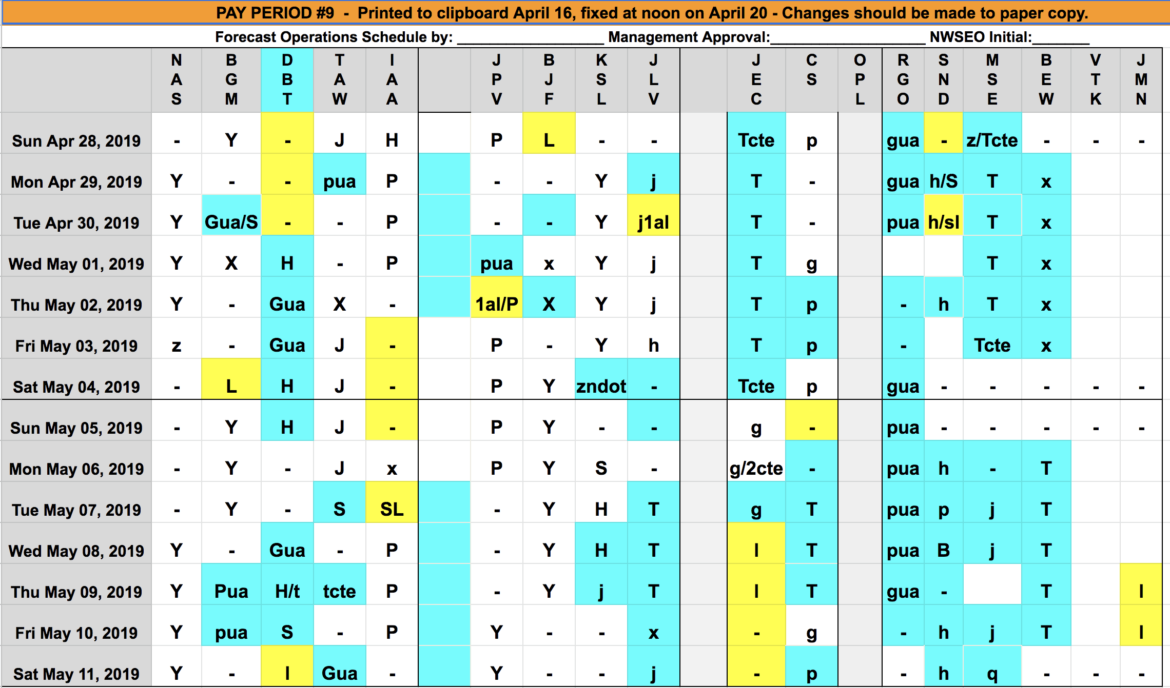
What We Do

Slide 19
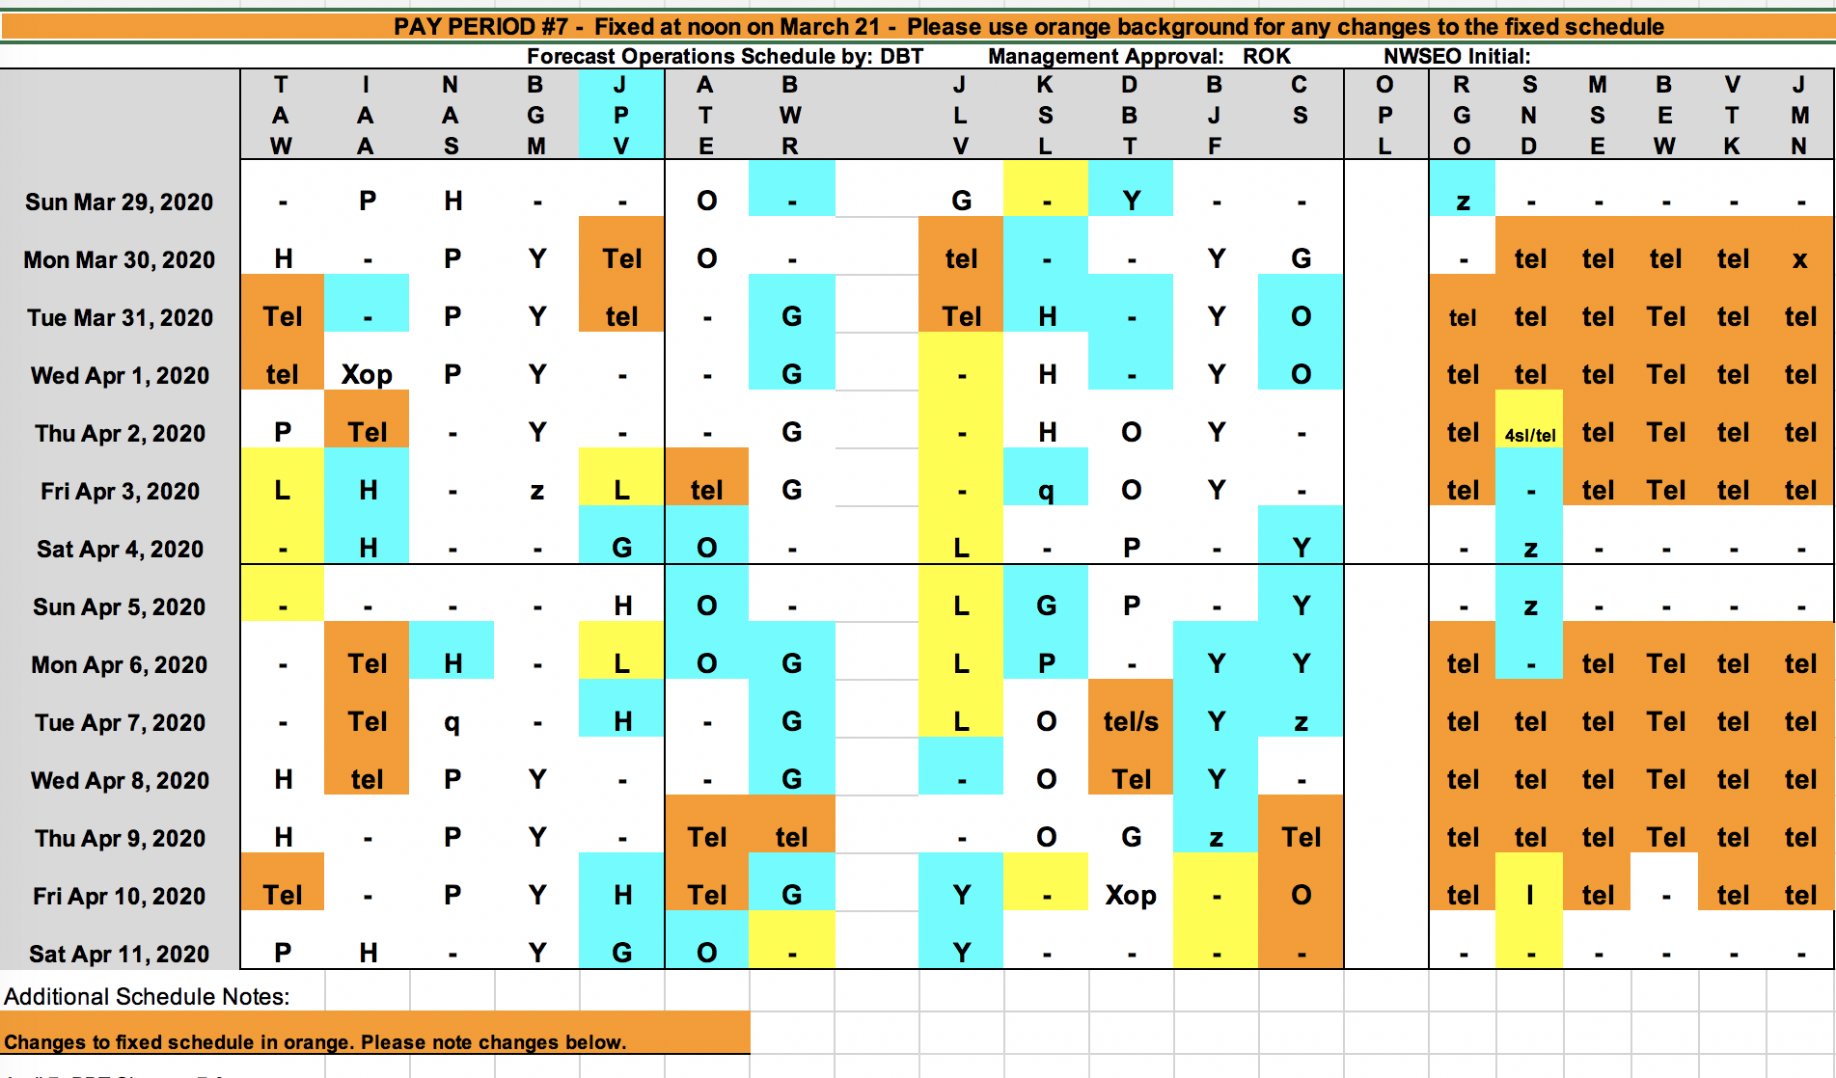
What We Do

Slide 20
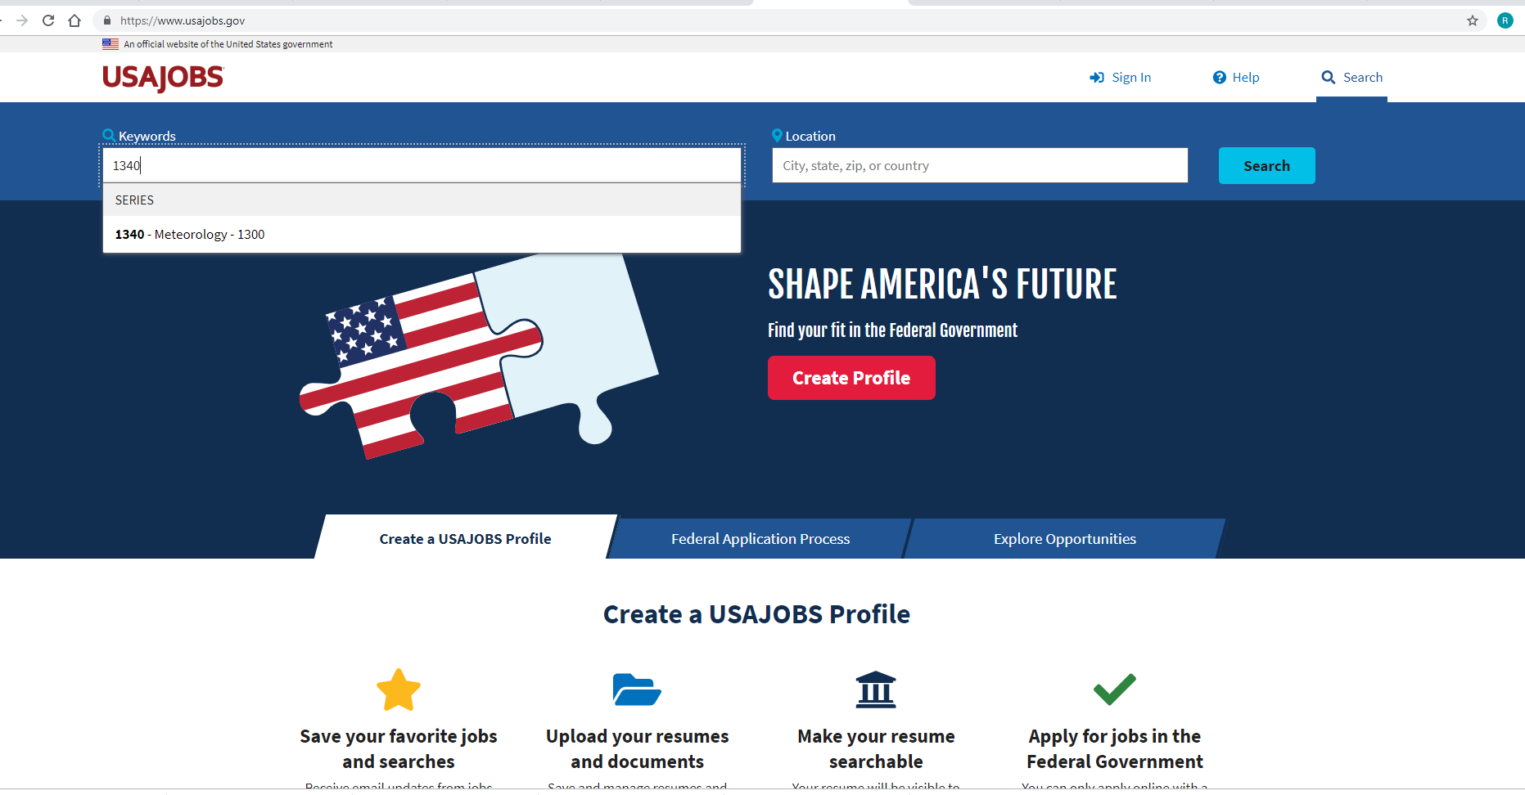
NWS Careers
https://www.usajobs.gov

Slide 21
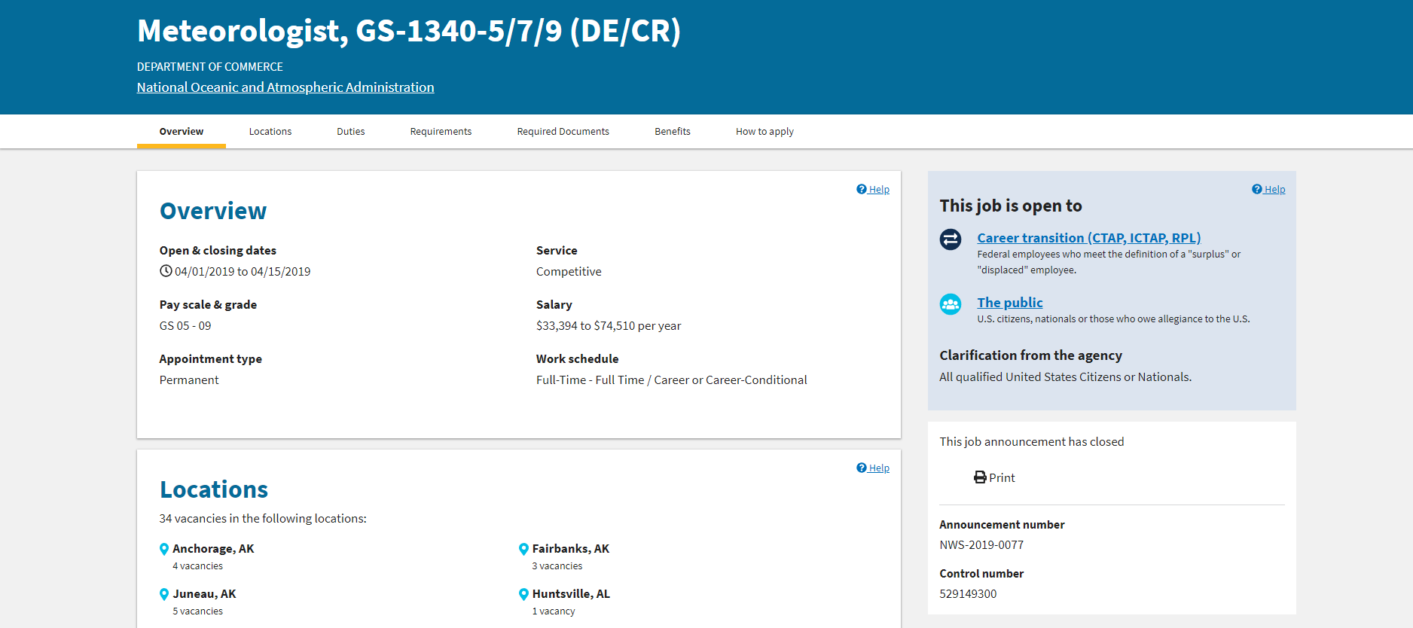
NWS Careers

Slide 22
NWS Careers

Slide 23
NWS Careers

Slide 24
NWS Careers

Slide 25
NWS Careers
Notes:
Make it easy on me – references.
Call selecting official

Slide 26
NWS Careers
Vacancy Questions
Notes:
Make it easy on me – references.
Call selecting official

Slide 27
NWS Careers
Vacancy Questions…Thus…
Which of the following best describes your experience with National Weather Service Doppler radar?
What’s radar?
Xxxxx
Xxxxx
I invented radar.
On your resume better be…
“I won the Nobel Prize for Physics for the invention radar”
Notes:
Make it easy on me – references.
Call selecting official

Slide 28
NWS Careers
Resume
Resume must validate answers to vacancy questions
Don’t be afraid to tell how great you are
List Detail your accomplishments
numerous, many, a lot… – Be specific!
References – include them – Make my job easy
Have someone read it over – Preferably someone who got an “A” in English grammar
IF IT IS NOT IN THE RESUME IT DOESN’T COUNT
Notes:
Make it easy on me – references.
Call selecting official

Slide 29
NWS Careers
Cover Letter
Notes:
Make it easy on me – references.
Call selecting official

Slide 30
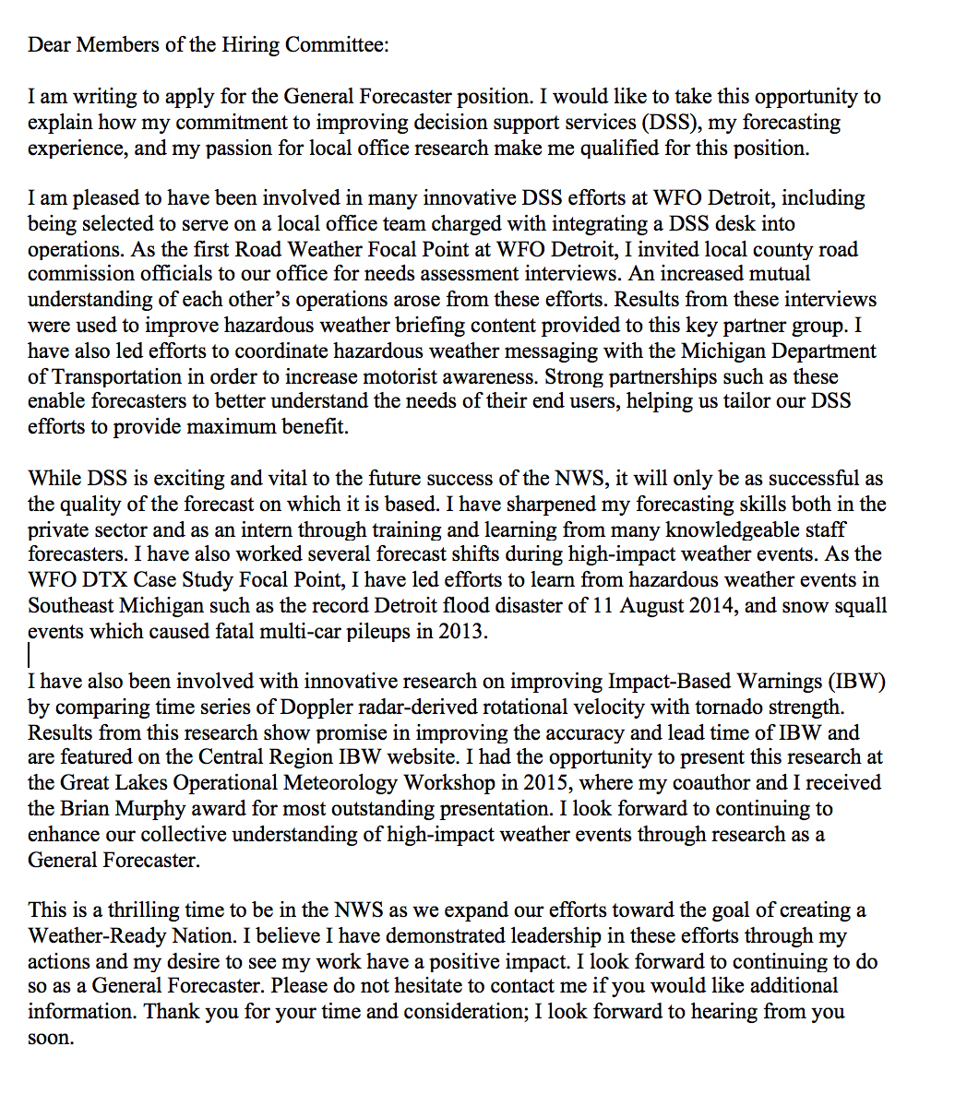
NWS Careers
Cover Letter
Notes:
Make it easy on me – references.
Call selecting official

Slide 31
NWS Careers
Cover Letter
Notes:
Make it easy on me – references.
Call selecting official

Slide 32
NWS Careers
Cover Letter
Notes:
Make it easy on me – references.
Call selecting official

Slide 33
NWS Careers
Cover Letter
Notes:
Make it easy on me – references.
Call selecting official

Slide 34
NWS Careers
Cover Letter
Notes:
Make it easy on me – references.
Call selecting official

Slide 35
NWS Careers
https://www.usajobs.gov
Interview
Notes:
Make it easy on me – references.
Call selecting official

Slide 36
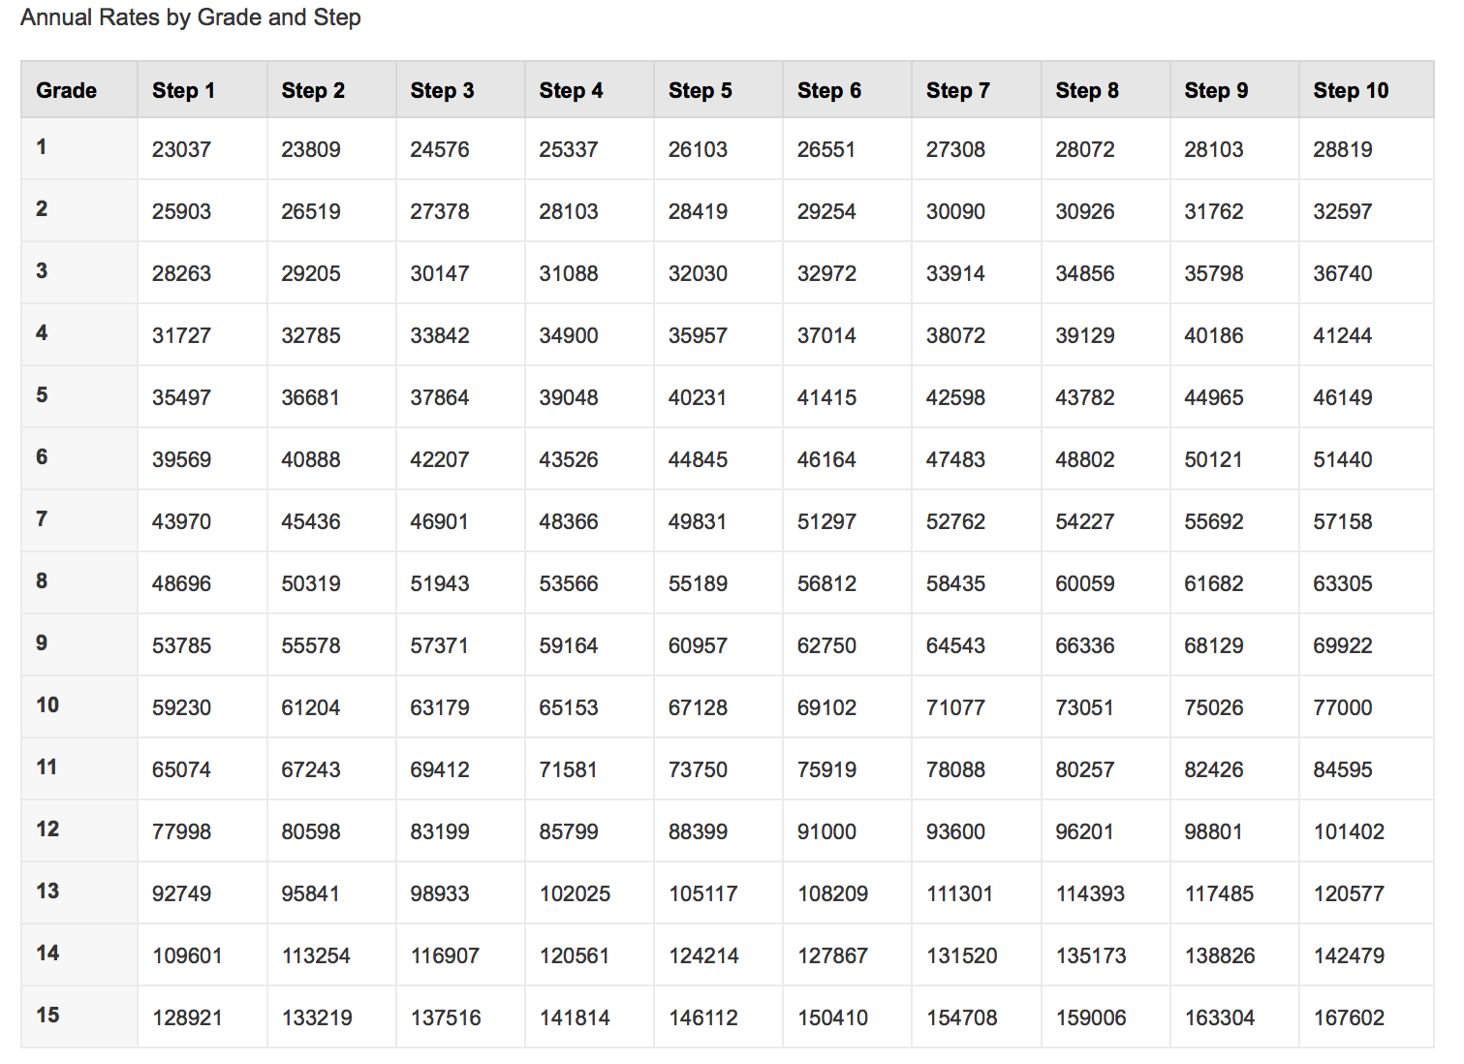
NW$ Career$
Notes:
Make it easy on me – references.
Call selecting official

Slide 37
Your First Day
Notes:
Make it easy on me – references.
Call selecting official

Slide 38
Questions?
Notes:
Make it easy on me – references.
Call selecting official

Slide 39
53% MS
33% BS
13% BS + experience

