Slide 1
Severe Weather Applications of Dual-Pol Radar
Brian Frugis & Tom Wasula
NWS Albany
ATM362: Forecasting & National Weather Service Operations
March 9, 2020

Slide 2
Numerous Applications for Dual-Pol Radar With Severe Local Storms
Locating hail & differentiating between severe and non-severe hail
Identifying tornadic debris
Helping predict the possibility of significant severe wind gusts

Slide 3
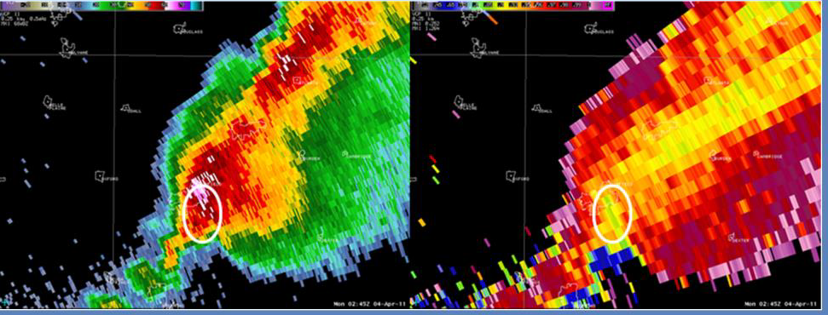
Locating Hail & Differentiating Between Severe & Non-Severe Hail
With cross-sections of reflectivity (Z), very high values (50+ dBZ) can be used to locate possible areas of hail
Correlation Coefficient (CC) can be used to help determine hail or hail/rain mix compared to just rain

Slide 4
Use of Radar During the Warning Decision Process
NWS Meteorologists must make decisions for warnings knowing the size of the hail
But how we do we know how big the hail is?

Slide 5
Motivation for Local Hail Study
The official National Weather Service criterion for severe hail was changed from 1.9 cm (0.75 in) to 2.5 cm (1.00 in) on 5 January 2010.
Previous local severe hail warning guidance was based off the legacy criterion and other previous local studies have only focused on pulse thunderstorms, while the majority of hail producing storms in the Albany County Warning Area (CWA) are from multicells or supercells.
Other national studies for hail have not focused on the Northeast, whose thunderstorms generally do not grow as tall as storms occurring across the Plains.
Differentiating between severe and non severe hail in the Northeast can be difficult due to many storms only containing marginally strong updrafts. Also, radar coverage is compromised in areas of high terrain and verification can be difficult in rural and mountainous areas.

Slide 6
Data and Methodology
384 hail events from 2005-2010 from the Albany CWA were compiled in a database. Hail events were obtained from local storm reports entered into StormData. 177 of these events would be considered severe under the new criterion.
Radar data (mainly from KENX) was examined for each hail event on the Weather Event Simulator (WES) using both the Four-Dimensional Storm Investigator (FSI) and plane view graphics from Display Two-Dimensions (D-2D).
The height of the top of 50, 55, 60 and 65 dBZ echoes were recorded from the radar time closest to the hail report for the location in which it occurred. In addition, these values were also examined in relation to the 0°C and -20°C levels, as obtained from the most recent Albany, NY (KALY) upper air sounding.

Slide 7
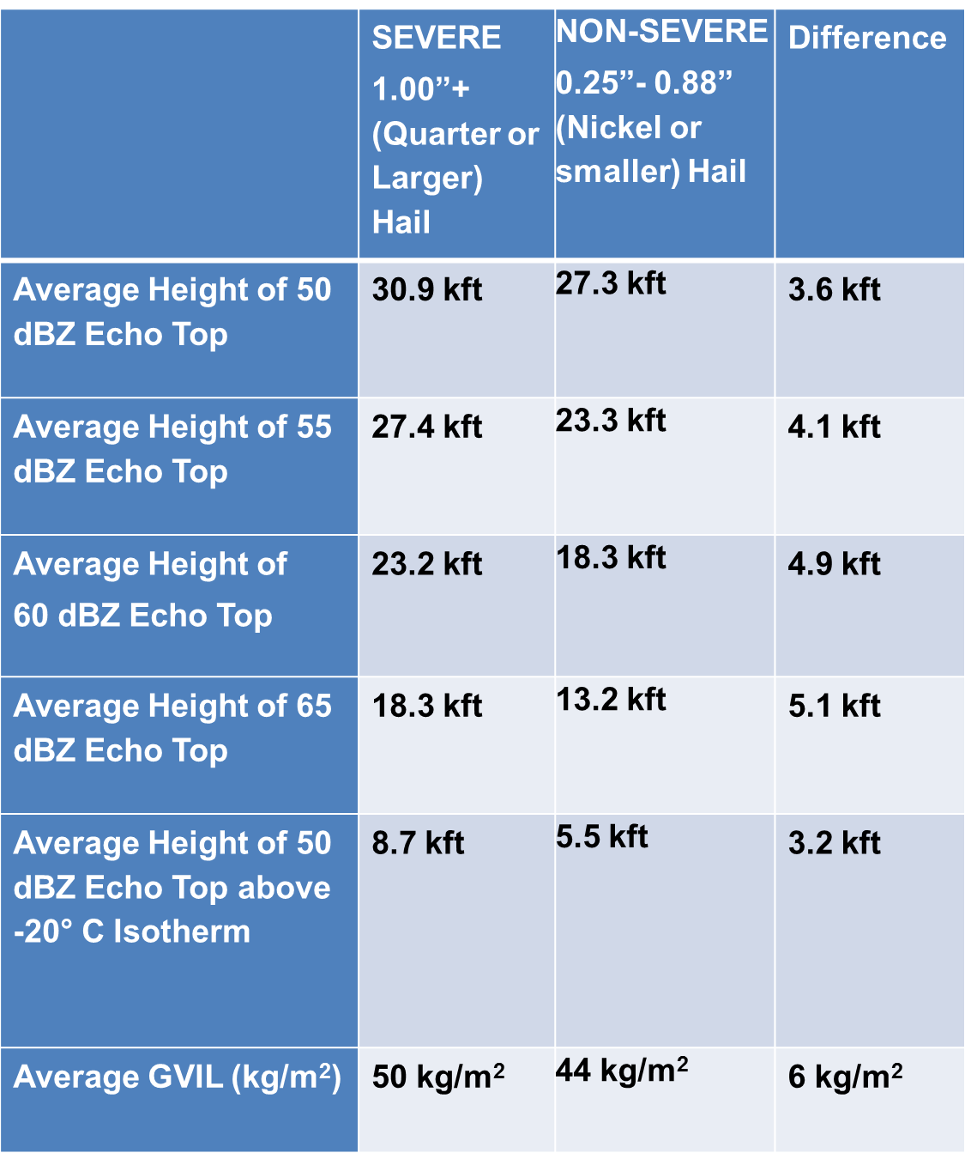
Charts for Operational Use:
Average Values

Slide 8
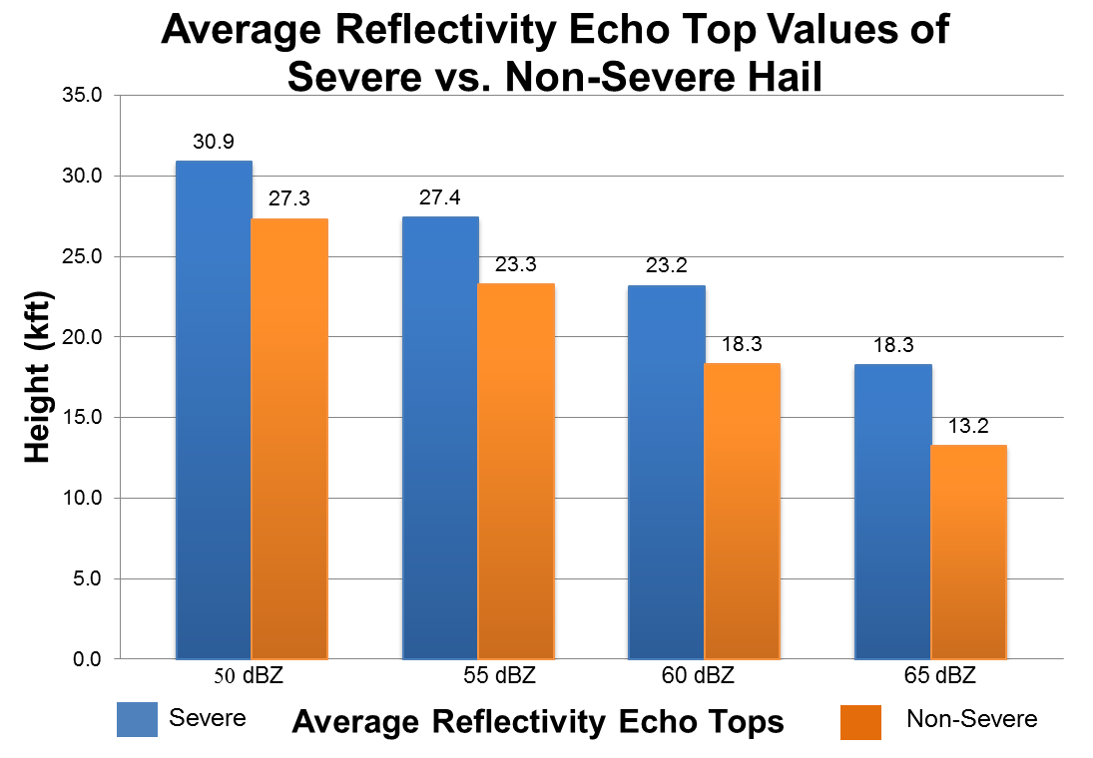
Charts for Operational Use:
Average Values

Slide 9
Charts for Operational Use:
Box and Whisker Plot

Slide 10
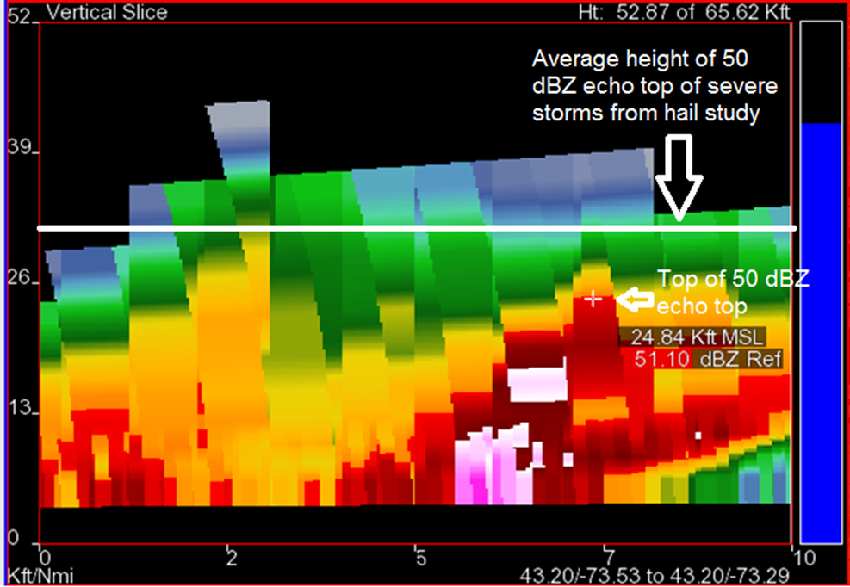
16 May 2012
Vertical Cross-Section Reflectivity (Z)
A vertical cross-section of a thunderstorm over Washington County, NY from 2135Z (5:35 pm EDT) on 16 May 2012. Using information from the ALY Hail Study would suggest that severe hail would occur when the 50 dBZ level reached 8.7 kft higher than the -20°C level (28.9 kft in this case). The 50 dBZ values only reached an echo top of around 24.8 kft. This level, also short of the hail study’s average 50 dBZ height of 30.9 kft, would suggest severe hail is unlikely from this storm.

Slide 11
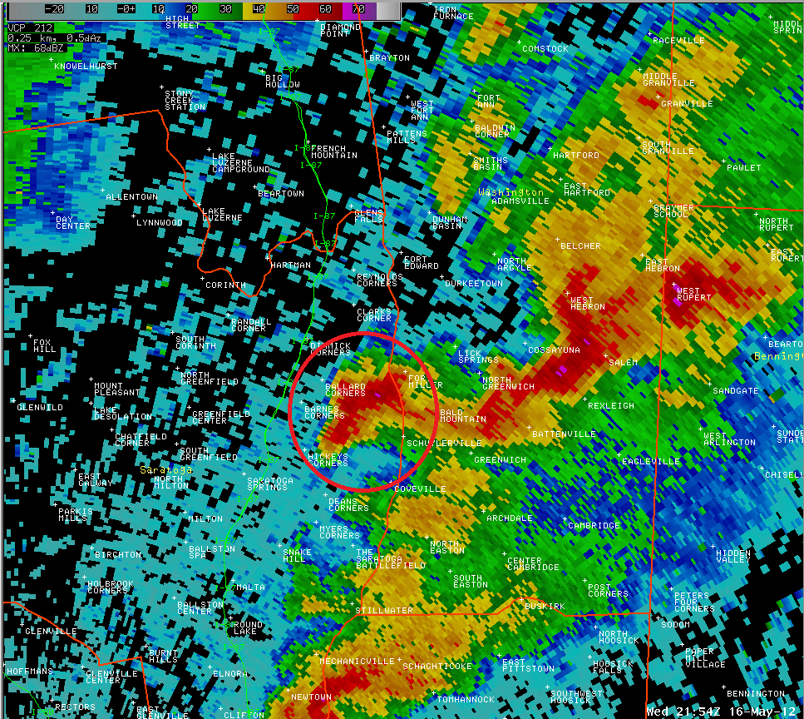
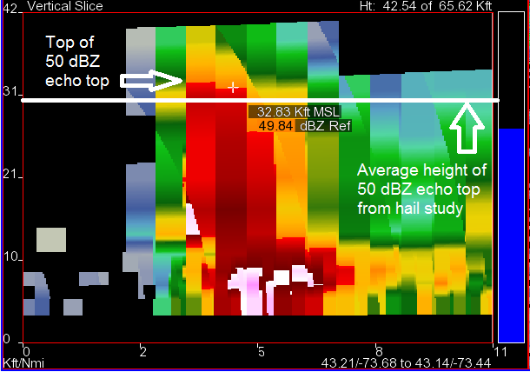
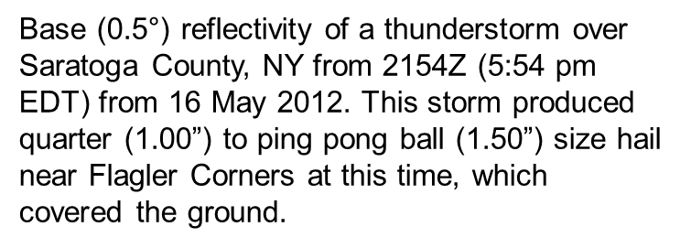
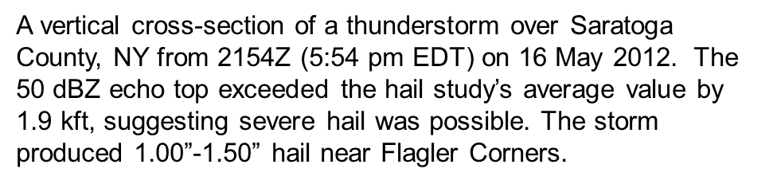
16 May 2012
Reflectivity (Z)

Slide 12
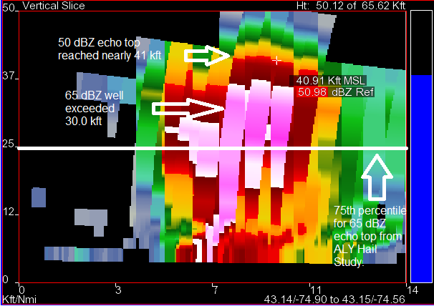
29 May 2012
Vertical Cross-Section Reflectivity (Z)
A vertical cross-section of a thunderstorm over Fulton County, New York from 1649z (12:49 pm edt). The 65 dBZ echo top exceeded the hail study’s 75th percentile by about 10.0 kft, suggesting severe hail was extremely likely and potentially very large. Hail reached the size of a baseball, which is considered very rare for Upstate New York.

Slide 13
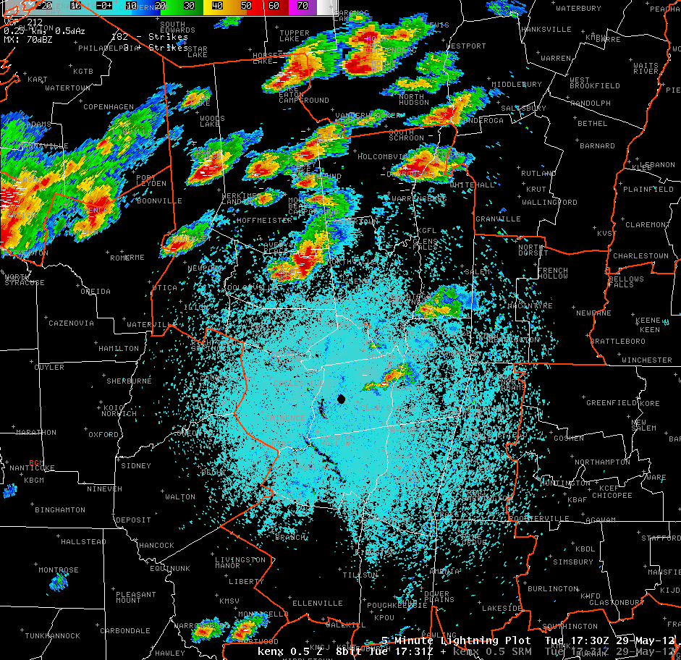
29 May 2012 1731 UTC
KENX 0.5° Reflectivity (Z)

Slide 14
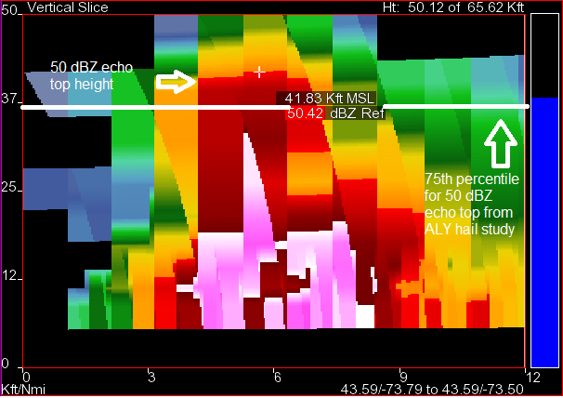
29 May 2012 1731 UTC
Cross-section near Bolton, NY
Hail stones of at least golf-ball size (1.75” expected) !!!
-20°C height=
23.7 kft AGL
-30°C height=
27.9 kft AGL

Slide 15
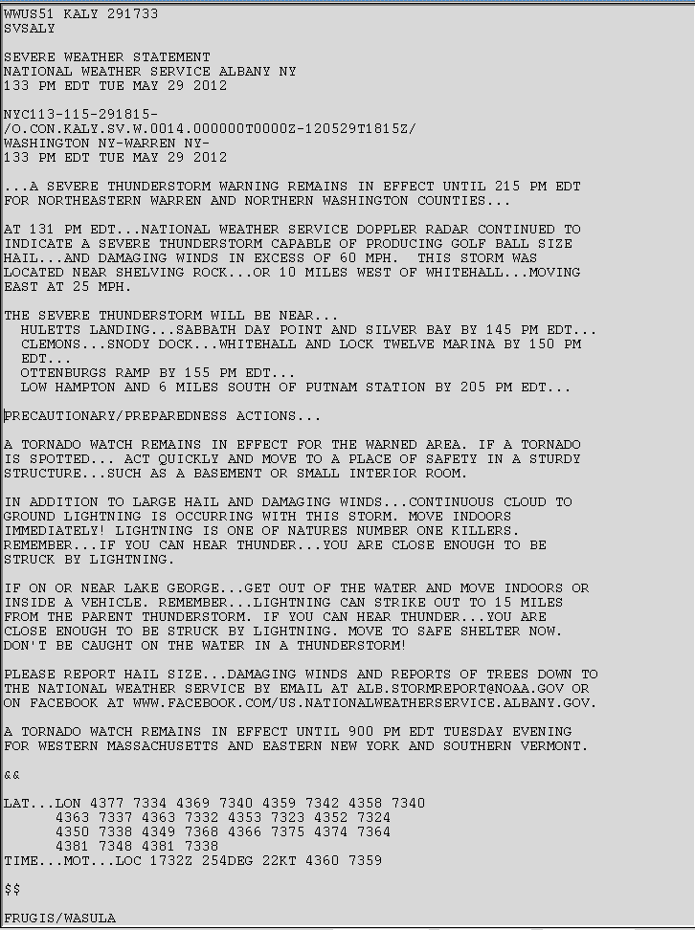
Hail Size was increased based on FSI cross-section and application of research

Slide 16
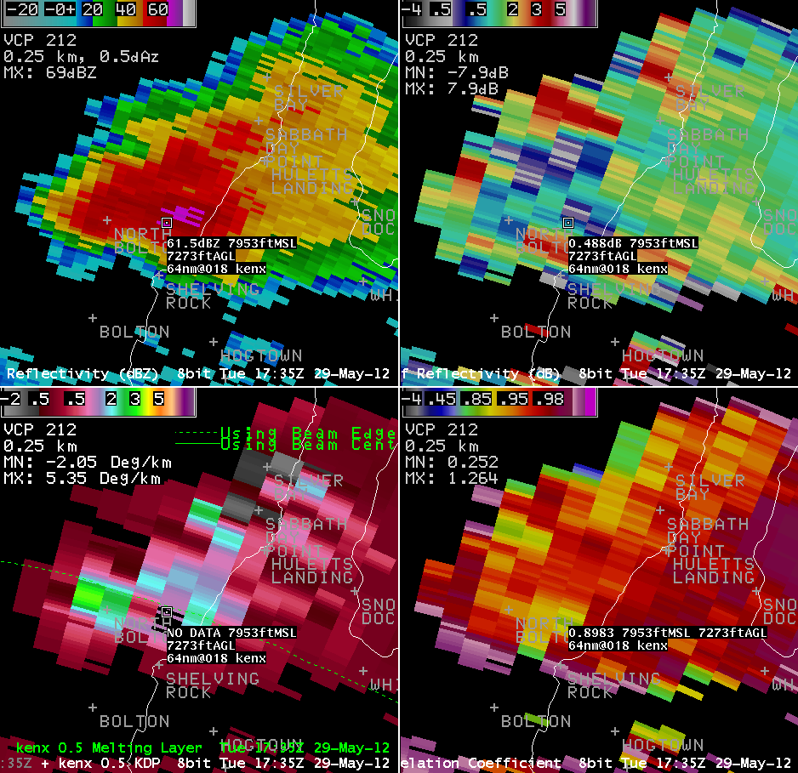
29 May 2012 1735 UTC
0.5° Z, ZDR,KDP,CC near Bolton, NY
0.5° Z
Differential Reflectivity (ZDR)
Specific Differential Phase
(KDP)
Correlation Coefficient (CC)

Slide 17
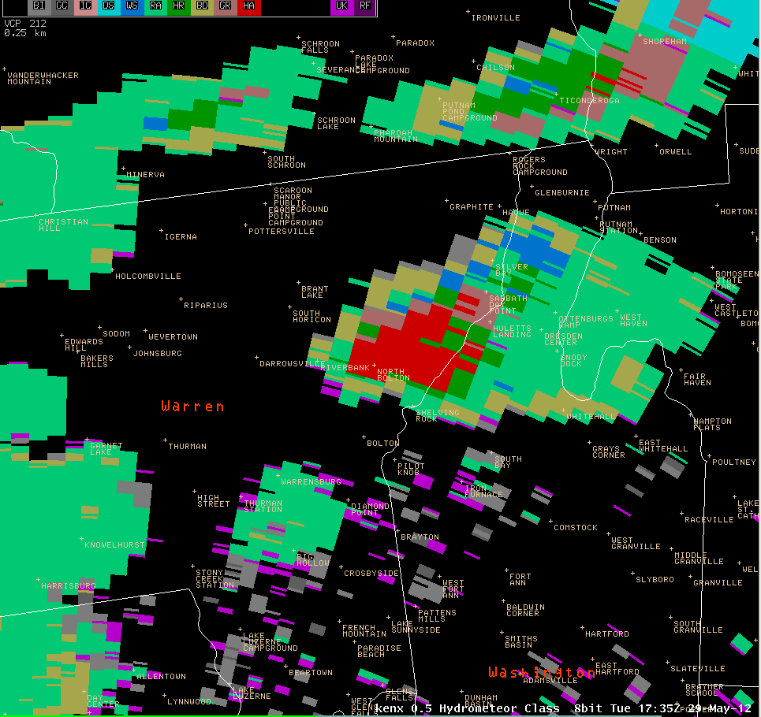
29 May 2012 1735 UTC
Hydrometeor Classification 0.5°

Slide 18
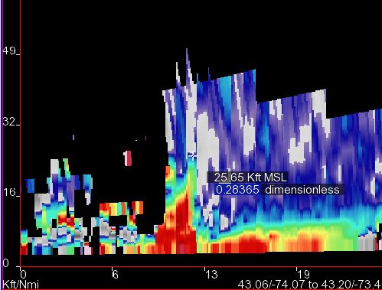
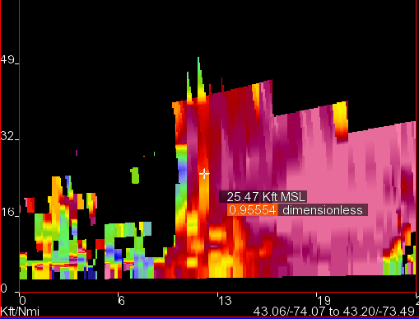
29 May 2012 1735 UTC
Differential Reflectivity (ZDR) & Correlation Coefficient Vertical Cross-sections
ZDR
Correlation Coefficient
-20°C height
-10°C height
0°C height
ZDR Column extends above -20°C height (23.7 kft), and CC values in the 0.90-0.95 range in the hail growth zone. Based on local research by Ian Lee, this indicates supercooled hydrometeors have transitioned to frozen hydrometeors (large hailstones). Hailstones fallen to ground (white circle area). The strength of the updraft is indicative by the ZDR column.

Slide 19
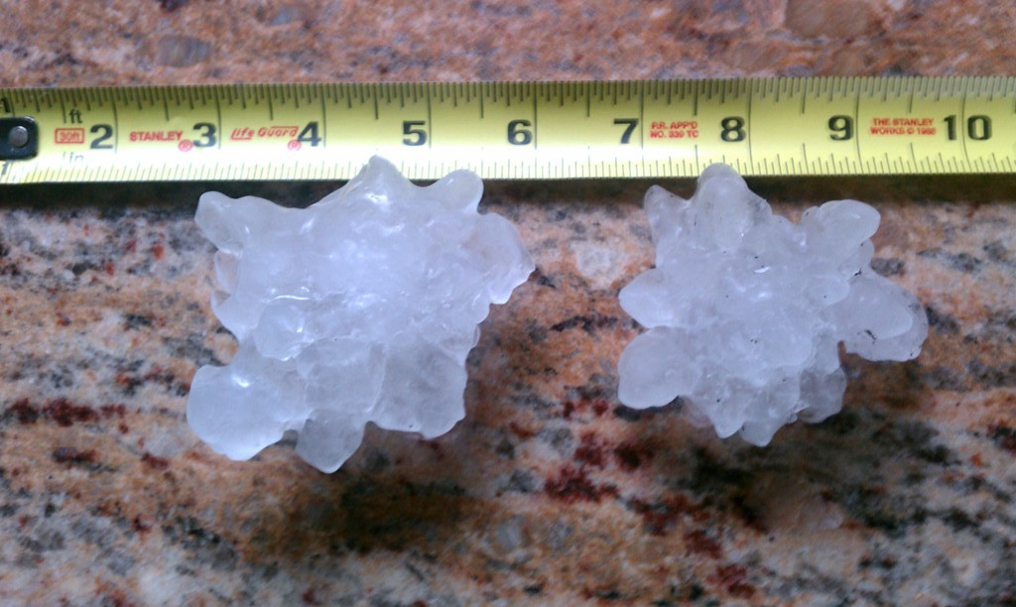


May 29, 2012: Bolton 3.5” hail stones in Lake George, Warren County

Slide 20
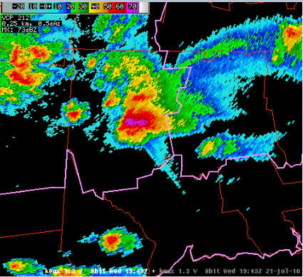
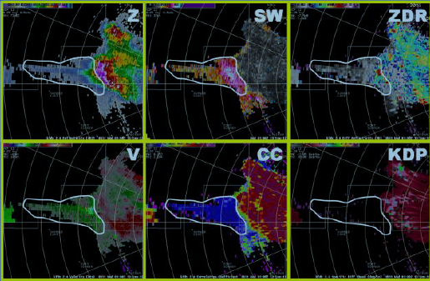
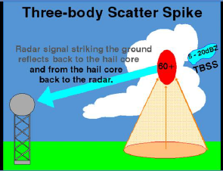
Three-Body
Scatter Spike
Three-body Scatter Spikes (TBSS) are a radar artifact caused by the radar beam interacting with large hail within a thunderstorm. These can be a clue to the warning forecaster that large hail is present.
KENX 1.3° Z from 21 Jul 2010 19:43 UTC

Slide 21
Identifying Tornadic Debris
Dual-pol radar can be used to determine if debris is present within a thunderstorm
  This would suggest a tornado is occurring or has recently occurred and has caused damage
A Tornadic Debris Signature (TDS) helps confirm tornadoes and help suggest how strong they may be
  Provides info for Tornadic Warning Update Statements
  Does NOT help you initially warn on the tornado

Slide 22
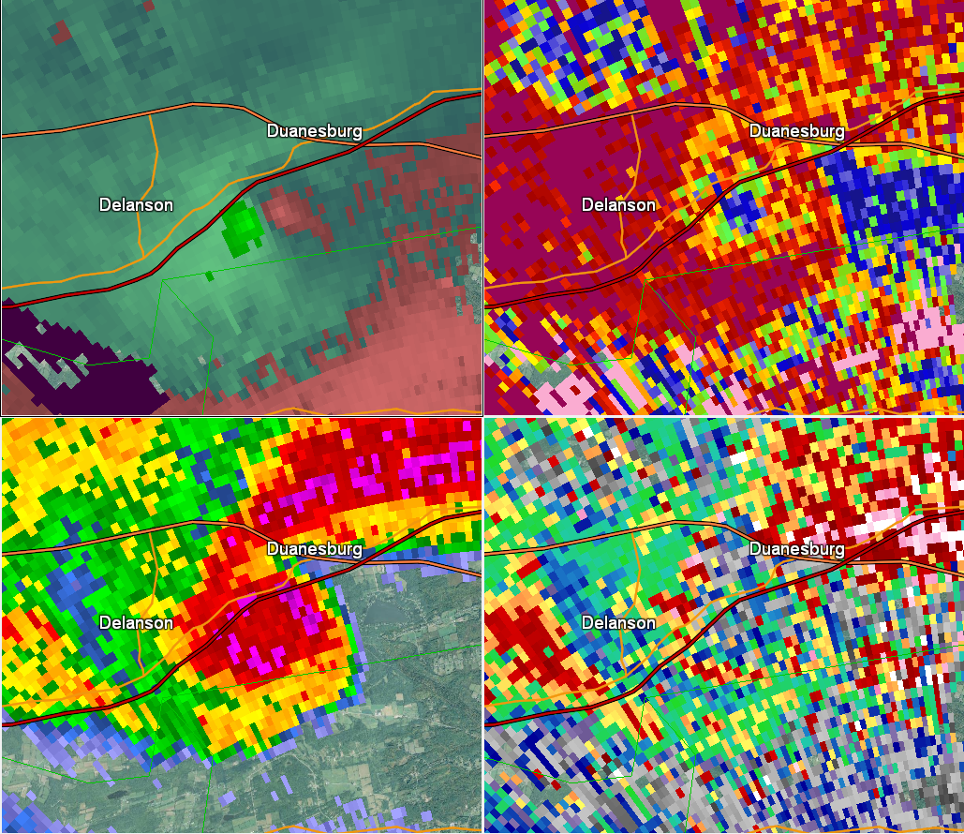
Tornadic Debris Signature Detection (TDS) Methodology
(Adapted from Entremont and Lamb 2015)
Find a tornadic couplet in SRM with gate-to-gate rotation.
Have Correlation Coefficient (CC) less than 0.90 co-located with the couplet.
Have Reflectivity (Z) values 35 dBZ or greater co-located with the couplet.
Have Differential Reflectivity (ZDR) values around zero co-located with the couplet.
If all these criteria are met, check next radar elevation slice above and continue the process until they are not met anymore. The top slice where all criteria is met is the Max TDS Height.
1951 UTC 22 May 2014 Duanesburg-Delanson, NY EF3 KENX Radar 0.5° Elevation Angle
Top-left: SRM (kts), Top-right: CC
Bottom-left: Z (dBZ), Bottom-right: ZDR (dB)

Slide 23
Tornadic Debris Signature Statistics
Northeastern US Events 2012-2015
EF-0 | EF-1 | EF-2 | EF-3 | EF-4 | EF-5
5 | 14 | 4 | 1 | 0 | 0
69 tornadic events from 2012-2015 from the Northeastern United States were examined for the presence of a Tornadic Debris Signature (TDS).
Out of those 69 tornadoes, a TDS was present in 24 of them (35%).
Of these 24, 12 tornadic events occurred within supercell thunderstorms and 12 were within Quasi-Linear Convective System (QLCS) thunderstorms.
All EF2+ strength tornadoes occurring in the Northeastern US between 2012-2015 displayed a TDS.

Slide 24
Maximum Height of TDS
Average & Median Values
For the 24 events examined between 2012-2015, the average & median values increase with increasing tornadic strength, especially once reaching the EF2 level.
This is similar to results found by Entremont and Lamb (2015).
More storms will be examined in future years as the dataset expands to see if these trends continue.

Slide 25
Maximum Height of TDS vs. EF Scale Strength vs. Range
Weak tornadic events (EF0) were generally only see close to the radar, as debris generally didn’t get very high and beam height rising over distance would prevent these further away storms from being seen.
Hard to seen much difference between EF0/EF1 storms with this plot.

Slide 26
Maximum Height of TDS
Northeastern US Tornados 2012-2015
Box and Whisker Plot
EF0/EF1 are similar, but jump up seen with EF2+ events. Entremont and Lamb (2015) also saw a similar signal in their data as well (which contained 181 events).

Slide 27
Determining Significant Severe Wind Gusts
Typically, velocity (V) is used to help determine how strong thunderstorm wind gusts will be
However, velocity doesn’t always show the full potential of the wind due to some limitations
  Beam blockage, too large of an angle, distance from radar site can all play a role in this
Local research has determined that dual-pol product Specific Differential Phase (KDP) may be useful in helping predict significant severe wind gusts

Slide 28
Motivation for Research
Determining severe vs. significant severe thunderstorms can be difficult for a warning meteorologist.
This has been a challenge for NWS Albany (ALY) forecasters on several occasions during the summers of 2016 & 2017. Several significant thunderstorms were either missed or under warned.
Impact-based warnings requires the warning forecaster to have specific knowledge of wind speeds & damage potential for warning text/graphics.
New technology and warning techniques being investigated in research need to be implemented into operations.

Slide 29
What is a Significant Severe Thunderstorm?
SPC considers thunderstorms that produce wind gust of 65 kts (75 MPH), hail two inches in diameter or greater, and/or an EF2+ tornado to be significant
For the purpose of this study, will also consider thunderstorms that produce injuries or deaths to be significant as well

Slide 30
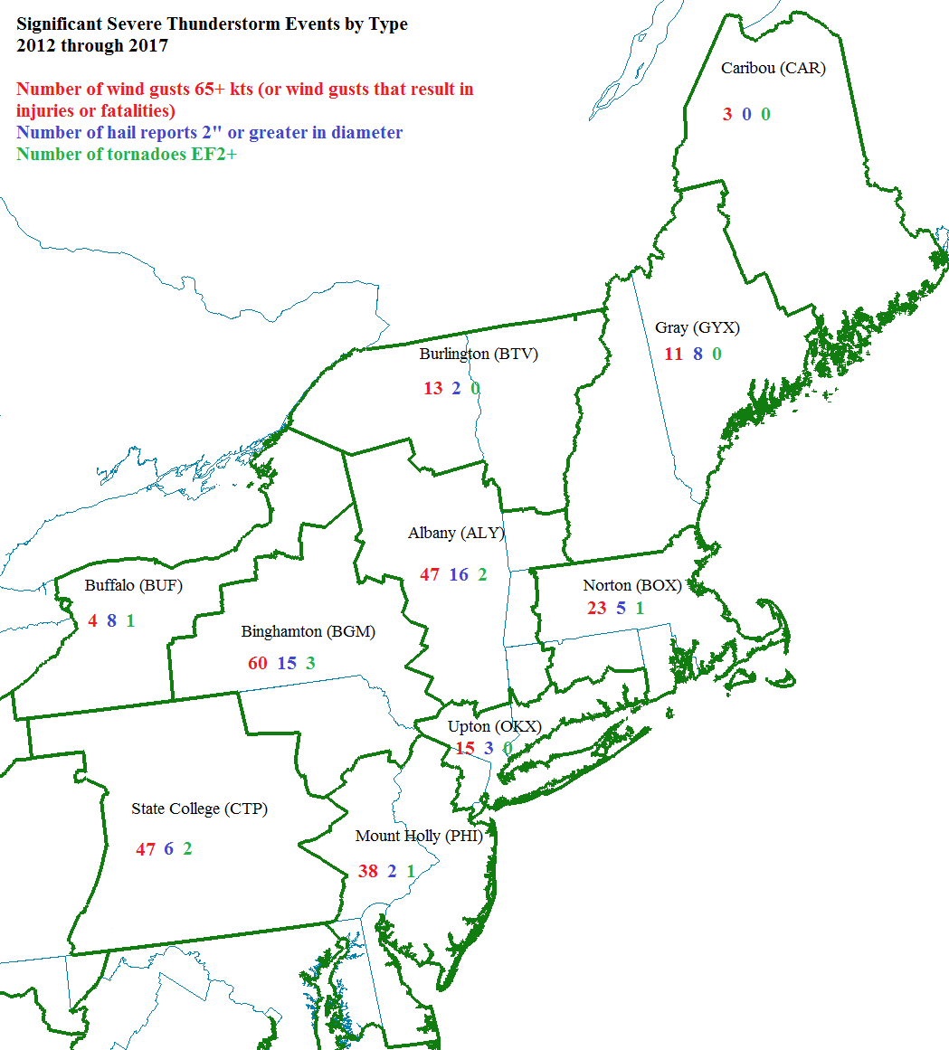
Significant Severe Thunderstorm Climatology for Northeast*
*For the purpose of this study, Northeast is considered New England, New York, New Jersey, Delaware, northeastern Maryland & Central and Eastern Pennsylvania

Slide 31
Radar Analysis of Significant Severe Thunderstorms
Radar data from the Albany KENX WSR-88D was examined for the 46 thunderstorms that produced significant wind damage across the Albany WFO CWA from 2012 to 2017.
Several radar-based parameters, such as storm type, radial velocity and Specific Differential Phase (K_{DP}), were collected at the time of and just prior to the time of the damage report via GR2Analyst software.

Slide 32
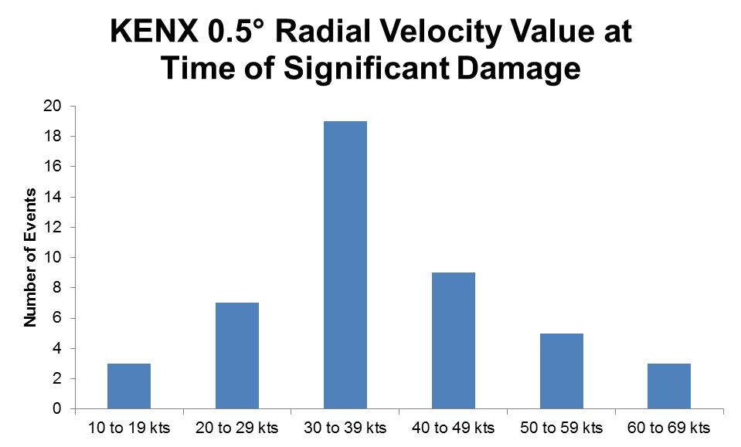
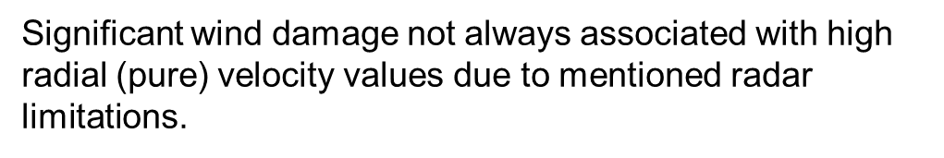
Radial Velocity Analysis

Slide 33
Specific Differential Phase (K_{DP})
Out of the 46 storms analyzed, 30 of them showed an elevated K_{DP} column suspended aloft for several scans before the wind damage occurred.
This K_{DP} column collapsed towards the surface at the time of the wind damage report as a result of a wet microburst.
Within the 30 times this was noted, 22 of those events were associated with supercell thunderstorms.
The highest K_{DP} value within the suspended column aloft averaged to be 7.6 deg/km within these thunderstorms & the median value was 7.0 deg/km.

Slide 34
Max K_{DP} Height Over Time
Typical Radar Volume Scan Lasts 4 to 6 minutes

Slide 35
Max K_{DP} Value Over Time
Typical Radar Volume Scan Lasts 4 to 6 minutes

Slide 36
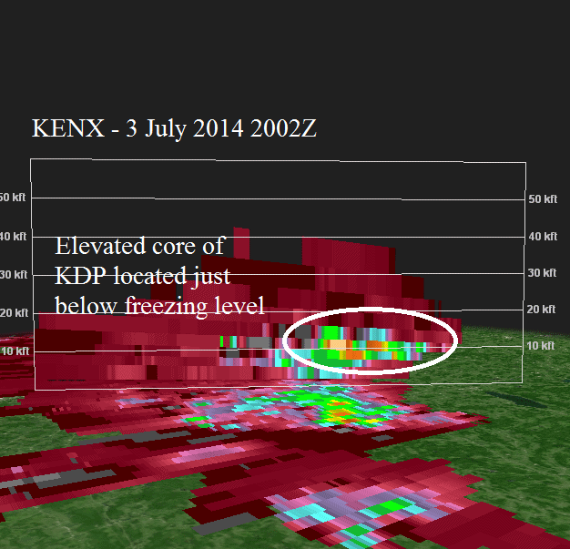
Example of Lowering K_{DP} Core
3 July 2014 over southern Herkimer County, New York
Type of storm: Supercell
Max KDP Value: 8.8 deg/km
Significant damage occurred at 2014Z in hamlet of Jordanville.
Elevated KDP core was seen at least 12 minutes before significant damage occurred

Slide 37
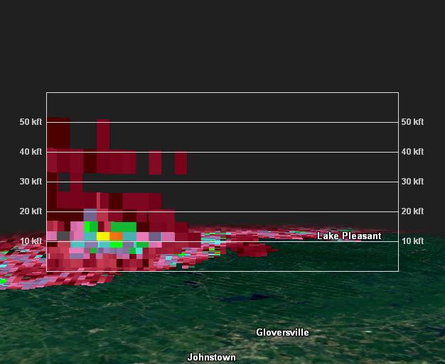
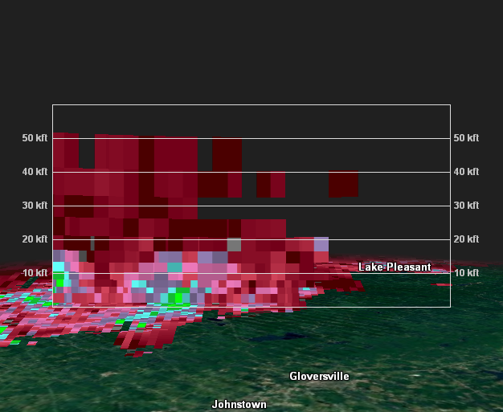
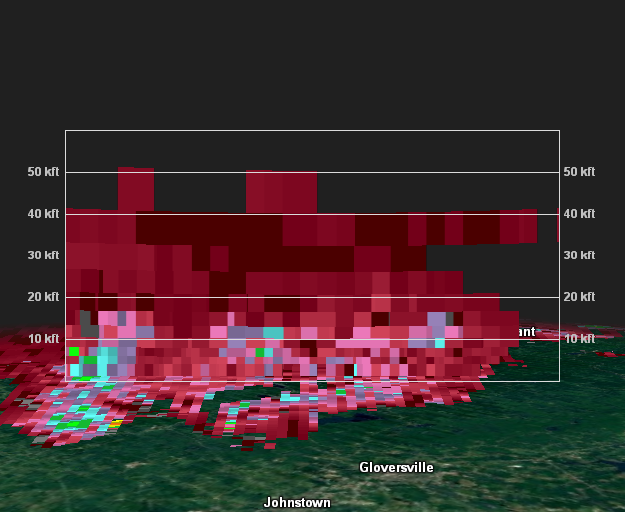
Descending K_{DP} Column During a Squall Line Event
KENX K_{DP} Cross-section
13 Aug 2016 2214Z
KENX K_{DP} Cross-section
13 Aug 2016 2220Z
KENX K_{DP} Cross-section
13 Aug 2016 2226Z
Cross-section of K_{DP} from KENX show the elevated K_{DP} column falling down to the surface on 13 August 2016 thanks to a strong microburst within a severe squall line. Significant damage occurred at 2225Z at the Pine Lake Campground in the town of Caroga in Fulton County, New York. The max value of the K_{DP} within the elevated column was around 5.6 deg/km.

Slide 38
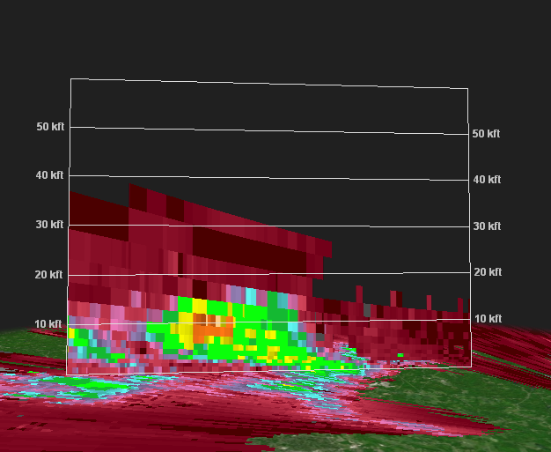
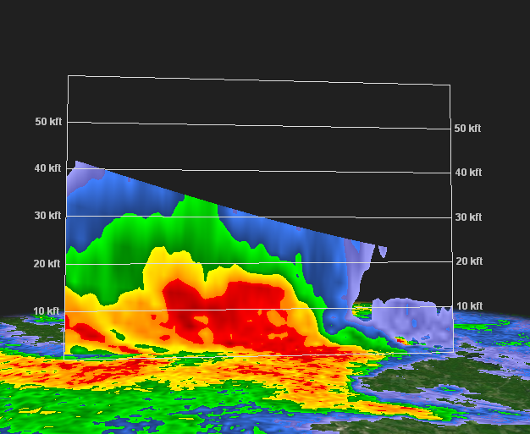
K_{DP} vs. Z
A comparison of vertical cross-sections of K_{DP} and Z from 30 June 2017 at 2016Z near Ravena, NY. This storm would go on to produce significant damage in South Schodack, NY at 2028Z. The elevated K_{DP} core was around 8 deg/km around 10,000 ft. The K_{DP} core aloft is easier to pick out for a warning forecaster compared to the broad area of 50+ dBZ within the Z cross-section.

Slide 39
Use During Warning Process
While a warning forecaster is interrogating other base data products, they can look for building columns of K_{DP} within a thunderstorm.
If values appear to remain elevated and reach critical values (around 6 deg/km based off this study), a warning decision forecaster can anticipate an increased chance for significant damage when this column collapses towards the surface.
While base velocity can have its flaws based on beam angle and direction, K_{DP} columns can help alleviate this limitation.
Still, inherent issues with beam width and terrain blockage will cause issues when evaluating K_{DP} as well.
In addition, storms that contain large hail may not always show K_{DP} columns, as K_{DP} is not plotted when associated with low values of correlation coefficient (<0.90).

Slide 40
Thanks for listening!
Any questions?!
Brian.Frugis@noaa.gov
Tom.Wasula@noaa.gov

