Slide 1
Forecasting Topographically-generated winter weather hazards (focus on the eastern U.S.)
Mike Evans SOO / WFO Albany NY

Slide 2
Outline
Snowfall Climatology and Elevation
Cold-air damming
Effects of stability and wind
High resolution model forecasts
Summary
Notes:
This part of the presentation will focus on the effects of topography on winter storms over the eastern U.S. We’ll start with a brief look at the topography of the northeast and mid-Atlantic region, then a quick look at the average annual snowfall in those areas, which highlights the variety in both topography and snowfall across the area. Next, we’ll take a look at cold-air damming, which can impact winter storm affects over large areas of the eastern U.S. Then we’ll work our way down in scale, taking a look at some other, smaller-scale topographical factors that can impact winter storms.

Slide 3
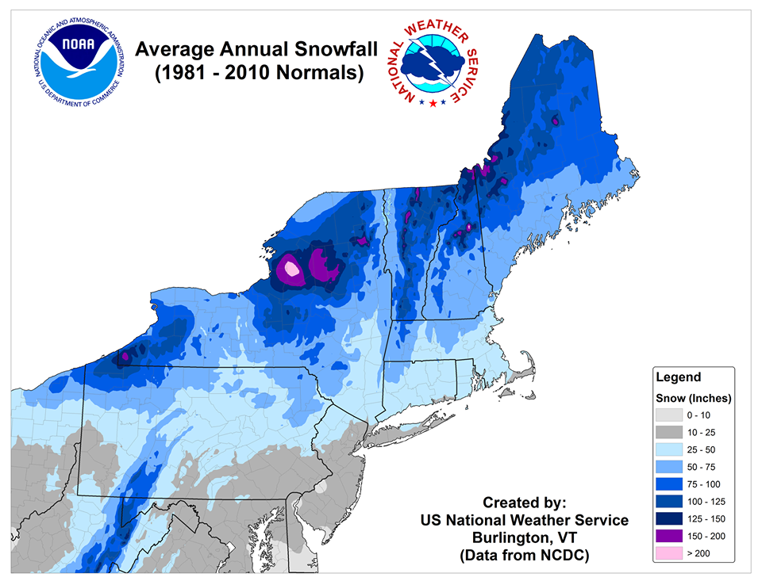
Elevation vs. annual snowfall
Eastern U.S. topography
Average annual snowfall
Notes:
The topography of the eastern U.S., shown on the left, is dominated by the coastline stretching from Maine to Florida, also by the Appalachian mountains which run from southwest to northeast approximately 100 to 250 miles inland from the coast. The Great Lakes are located farther to the north and west, and play a large role in patterns of average annual snowfall observed across the area. The average annual snowfall, shown on the right varies widely across the area. Snowfall generally increases from south to north but with lots of variations; for example one can easily see the enhancement of the snowfall east and southeast of the Great Lakes on these maps, and also the enhancement of snowfall at higher elevations.

Slide 4
Eastern U.S. topographic factors
Northwest flow upslope
Lake effect
Coastal fronts
Northwest flow
upslope
High elevations
Valley shadows
Notes:
Some topographic impacts on snowfall are highlighted on this map. Maxima can be seen east of Lakes Erie and Ontario due to impacts from those lakes. In both of snow belts highlighted in this area, the heaviest snow falls east of the lakes in areas of higher terrain, specifically the Tug Hill plateau east of Lake Ontario and the Chautauqua ridge southeast of Lake Erie. Higher terrain also plays a major role in enhancing the snowfall across areas from southwest Pennsylvania southwest along the central and southern Appalachian mountains, and also over higher elevations in New England. Relative minima in snowfall can also be seen east of these terrain features, in places like eastern West Virginia and portions of central New York. Coastal fronts also play a large role in determining precipitation type and snowfall amounts near the east coast from New England southward.

Slide 5
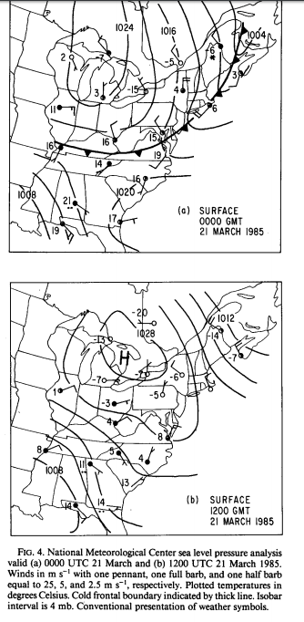
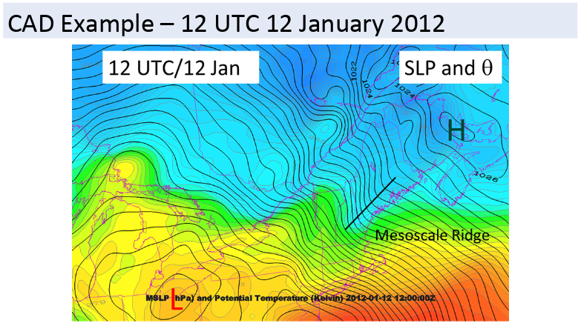
Cold-air damming
Bell and Bosart 1985
Hoffman et al. – NESC - 2018
Notes:
The first factor that we will briefly describe is cold-air damming which was also discussed

Slide 6
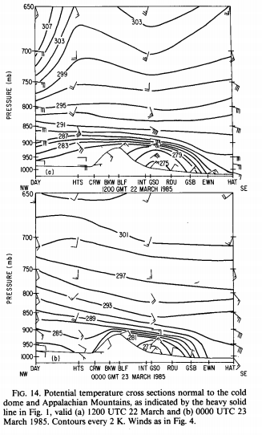
Cold-air damming
Keeter et al. 1995

Slide 7
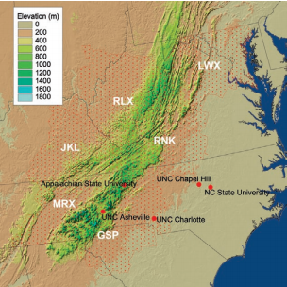
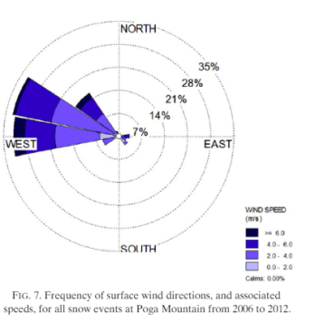
Northwest flow upslope
Most often occur with shallow moisture / subsidence inversion.
Moisture often in the -10 to -20 C snow growth zone.
Can occur with deeper moisture (next slide).

Slide 8
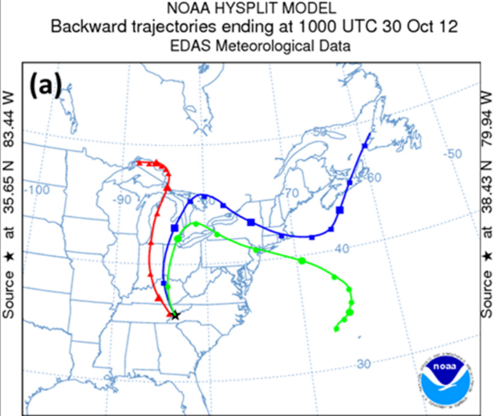
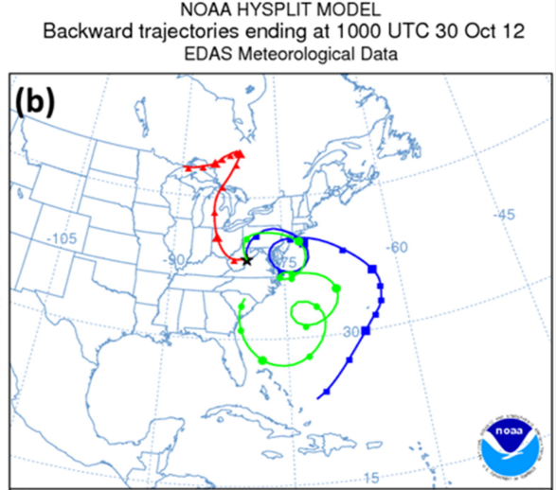
Northwest flow upslope and Sandy

Slide 9
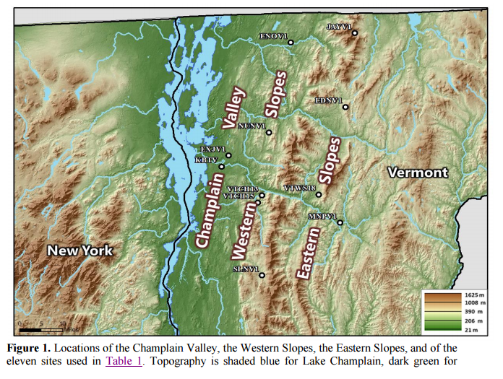
Local effects – northern Vermont
Blocked flow – heavy snow upstream from the mountain barrier.
Unblocked flow – heavy snow over and downstream from the barrier.

Slide 10
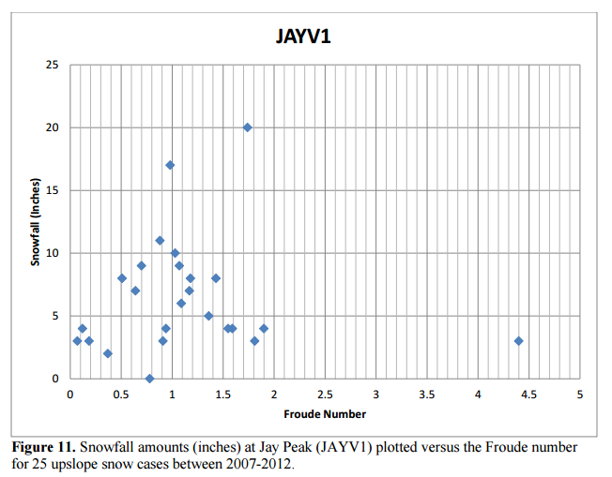
Froude number and snowfall
Froude number = (Wind Speed) / (Stability) x (Barrier Height)
Fr < 1 – Blocked Flow. Fr > 1 – Unblocked Flow
Burlington (in the valley) gets heavy snow with blocked flow
Jay Peak gets heavy snow over a wider range of flow patterns

Slide 11
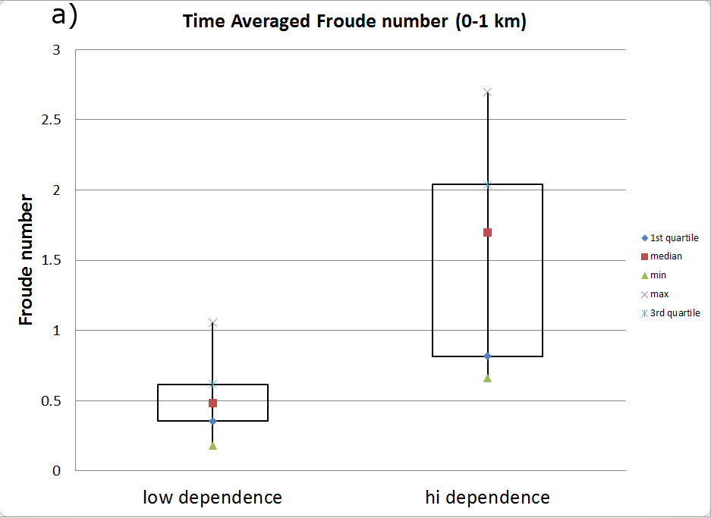
Local effects – northeast Pa
Blocked Flow (stable / light winds) associated with lower orographic ratio
Unblocked Flow (less stable / stronger winds) associated with larger orographic ratio
Other factors – included surface temperature (near 32 associated with larger ratio)

Slide 12
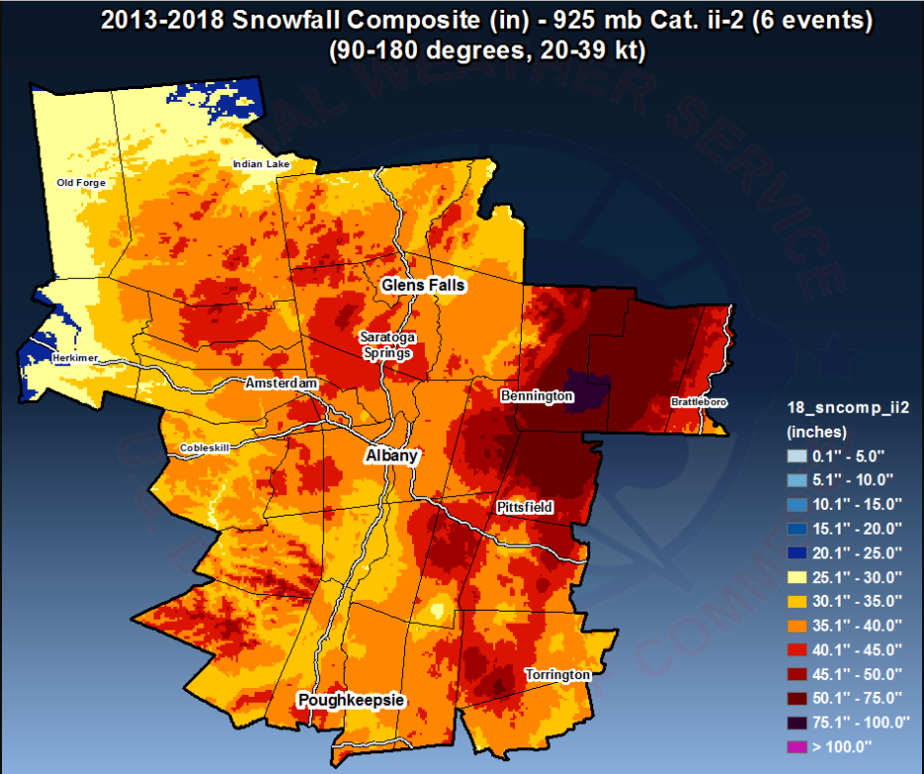
Terrain and composite snowfall – southeast flow

Slide 13
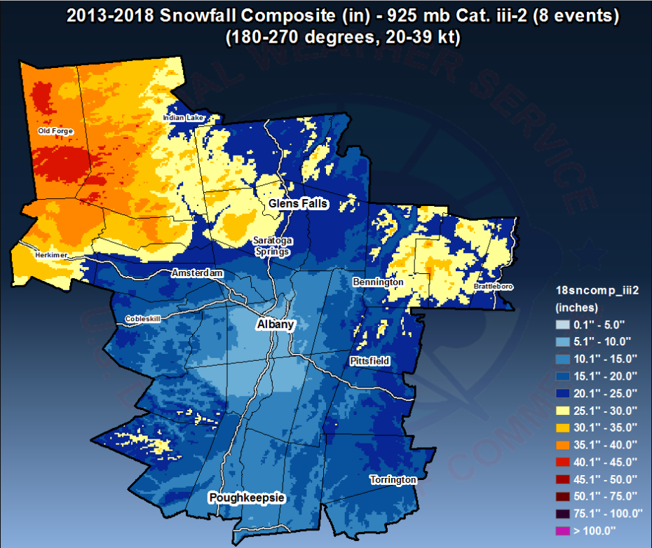
Terrain and composite snowfall – southwest flow

Slide 14
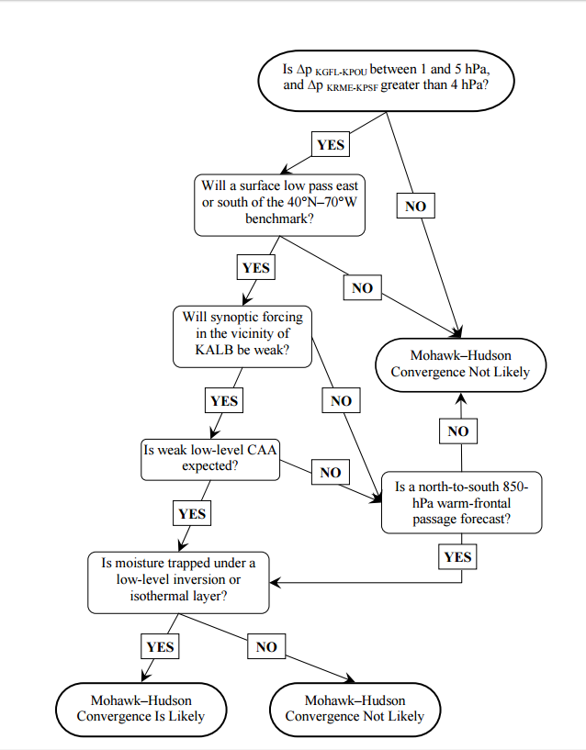
Local effects – Hudson / Mohawk convergence

Slide 15
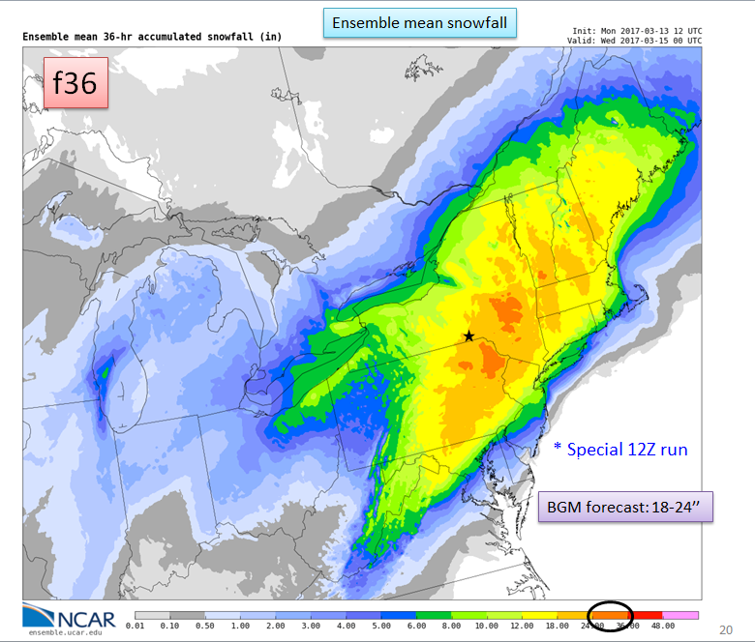
High resolution model snowfall forecasts – March 14, 2017 blizzard

Slide 16
Examination of high resolution model performance – Gowan et al. 2018

Slide 17
Model biases at SNOTEL stations

Slide 18
Frequency biases

Slide 19
Localized biases – too much precipitation downstream from the Sierra crest

Slide 20
Local WFO Albany Study
Examine several winter storms from 2017-2019.
Compare observations to high resolution model forecasts.
Partition cases into categories such as high / low stability, northeast / southeast flow, high / low Froude number, high / low orographic number.
Do these factors contribute to model performance?
Do models have biases related to elevation / topography?

Slide 21
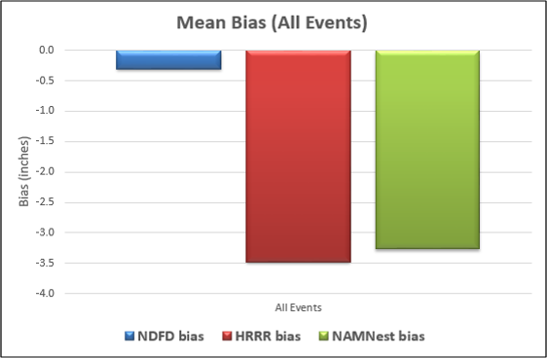
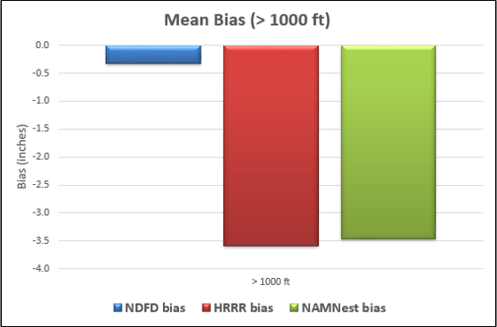
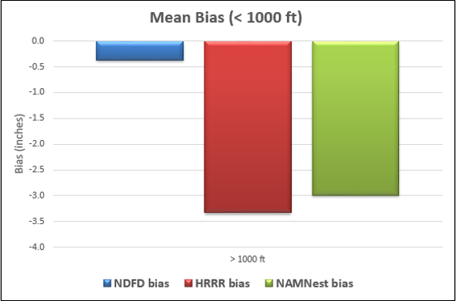
Initial results from 12 events 2017-2018
Average elevation ratio was 1.3
Strong correlations between stability, Froude number and elevation ratio (weaker with sfc temp)
Model bias of snow depth change

Slide 22
Summary
Complex terrain results in a myriad of topographically enhanced winter weather hazards.
Many of these hazards occur at small-scales.
High-resolution models can be very helpful to determine impacts of terrain, but biases and errors exist.
Local experience and expertise is critical for effective forecasts, warnings and decision support.

Slide 23
References
Bell, G.D., and L. F. Bosart: Appalachian cold-air damming, MWR 1987.
Evans, M.S, M. Jurewicz and R. Kline: The elevation dependance of snowfall in the Appalachian Ridge and Valley region of northeast Pennsylvania, Journal of Operational Meteorology, 2017.
Gowan, T.M., J.W. Steenburgh and C.S. Schwartz: Validation of mountain precipitation forecasts from the convection-permitting NCAR ensemble and operational forecast systems over the western United States. WAF 2018.
Keighton, S., D. Miller, D.K. Holtz, P.D. Moore, L.B. Perry, L.G. Lee and D.T. Martin: Northwest flow snow aspects of hurricane Sandy, WAF, 2015.
Muccilli, M.: Using the Froude number to improve orographic snow forecasts in the Green Mountains of Vermont. ER Tech Attachment, 2015.

