Slide 1
GIS Applications in NWS Operations & Lake Effect Snow Forecasting
ATM 362 – Forecasting & NWS Operations Course
Joe Villani
Meteorologist - WFO Albany NY
March 2, 2020

Slide 2
Outline
Introduction to GIS
Elevation mapping
Flash Flood Potential Index
Rainfall/Snowfall analysis maps
NWS zone-based verification
NWS forecast error maps
Snowfall composites stratified by flow regime
Hi-res model verification
Automation → “GAZPACHO” program
Forecasting Lake Effect Snow (Albany forecast area)

Slide 3
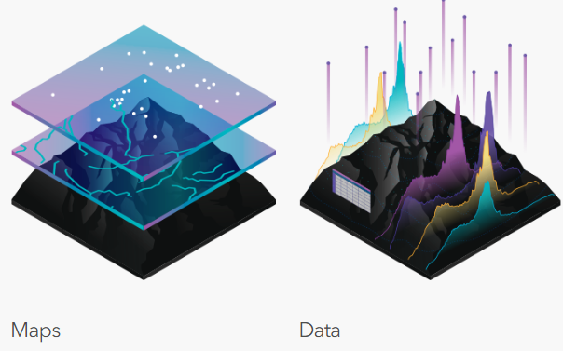
Introduction to Geographic Information Systems
What is GIS?
From ESRI.com: “A geographic information system (GIS) is a framework for gathering, managing, and analyzing data. Rooted in the science of geography, GIS integrates many types of data. It analyzes spatial location and organizes layers of information into visualizations using maps and 3D scenes. ​With this unique capability, GIS reveals deeper insights into data, such as patterns, relationships, and situations—helping users make smarter decisions. “

Slide 4
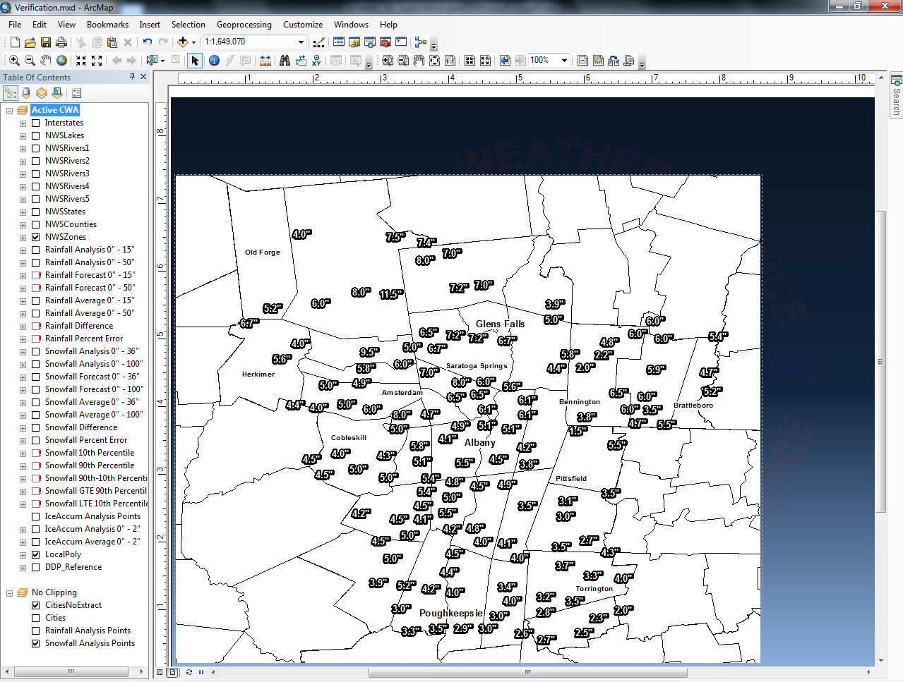
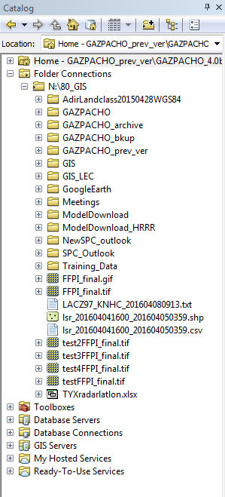
Introduction to GIS
ArcMap is the main ArcGIS software used at NWS Albany (contains ArcCatalog for organizing GIS files)
Powerful mapping application: creation of shape files → rasters (digital dataset made up of grid points)
Crucial aspect of Rasters → can be mathematically manipulated

Slide 5
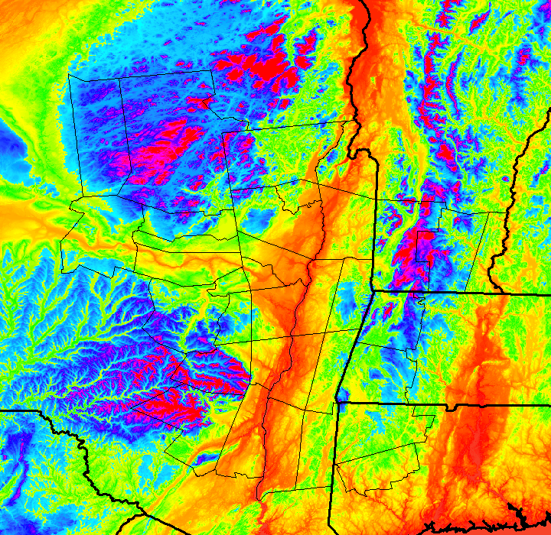
Local Applications: Elevation Maps
Uses USGS Digital Elevation Model (DEM) data 30 meter resolution
Download in tiles, then mosaic using ArcMap
DEM Mosaic in ArcMap

Slide 6
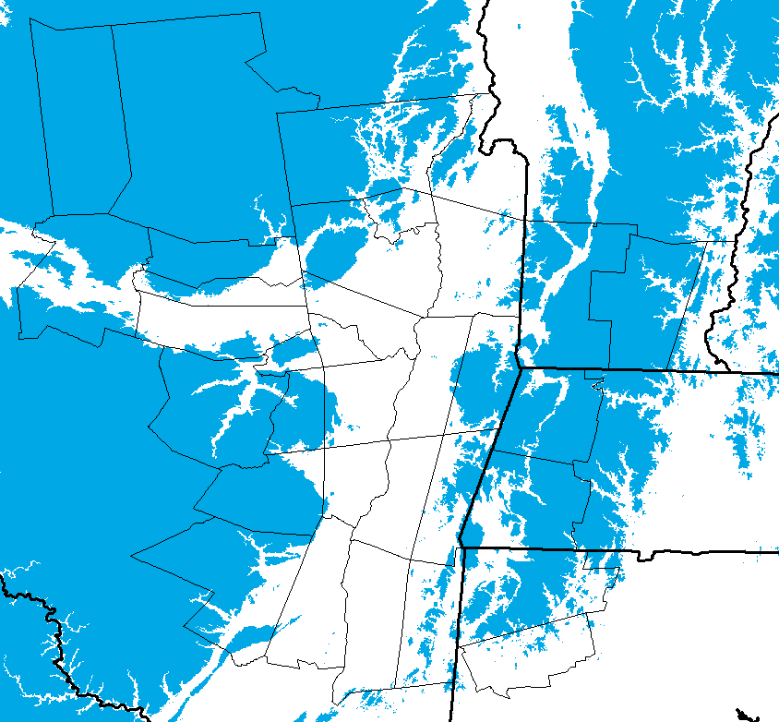
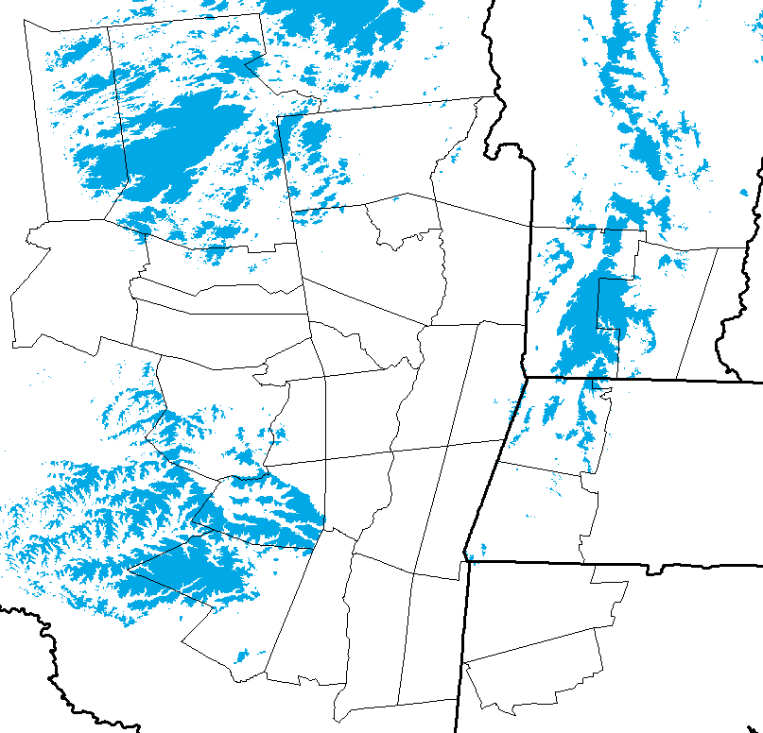
Local Applications: Elevation Maps
Delineate elevation thresholds in 500 ft increments for elevation-specific maps
> 1000 ft
> 2000 ft

Slide 7
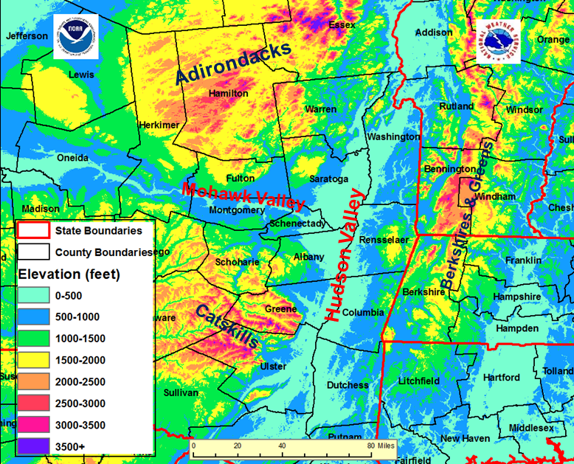
Local Applications: Elevation Maps
Create contoured elevation map with 500 ft range bins
Select different color for each range bin
Useful for visualizing key topographic features in the Albany forecast area

Slide 8
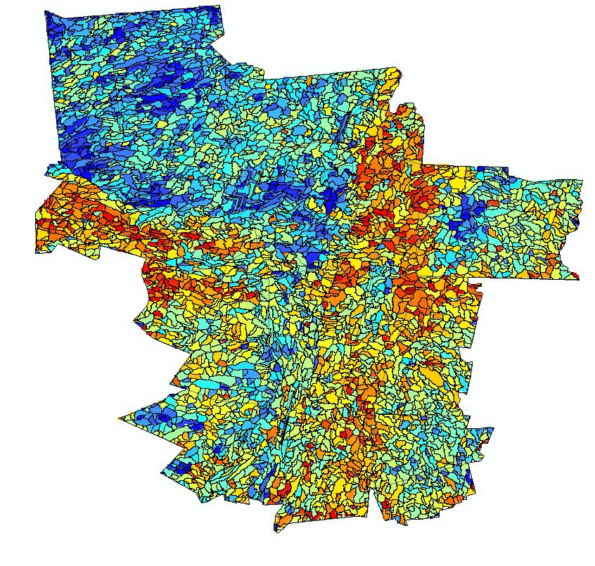
Flash Flood Potential Index (FFPI)
The FFPI incorporates physiographic characteristics of an individual drainage basin to determine its hydrologic response
For Flash Flooding, hydrologic response influenced by four main factors:
Soil type
Terrain slope
Vegetation and forest canopy
Land use, especially urbanization

Slide 9
Flash Flood Potential Index (FFPI)
High resolution maps obtained and converted to raster datasets using GIS software (ArcMap)
Data processed over the domain of interest (ALY forecast area)
Use ArcMap tools to resample, reclassify and combine the data
Result is a numerical index of flash flood potential specific to the ALY forecast area
Lowest Flash Flood potential
Highest Flash Flood potential

Slide 10
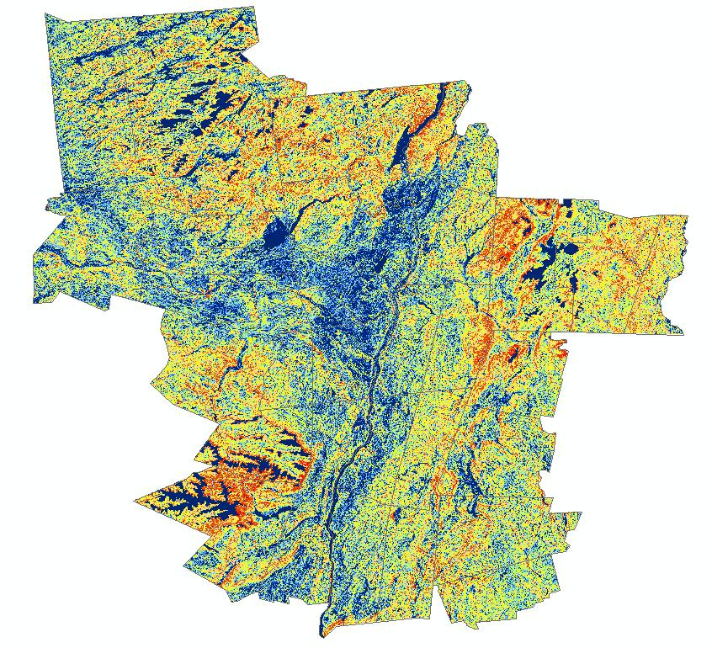
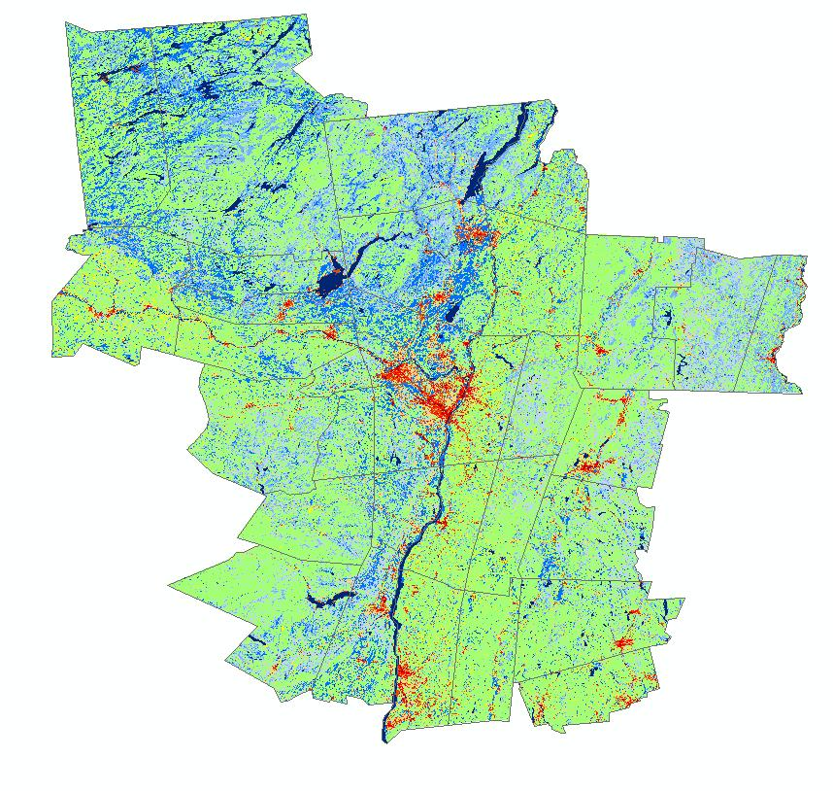
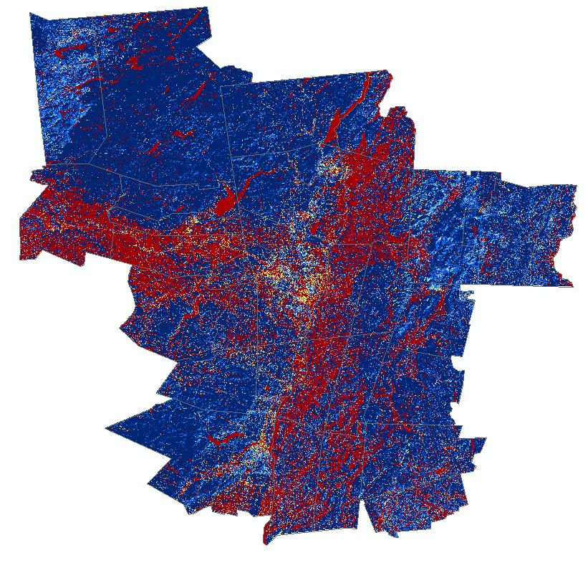
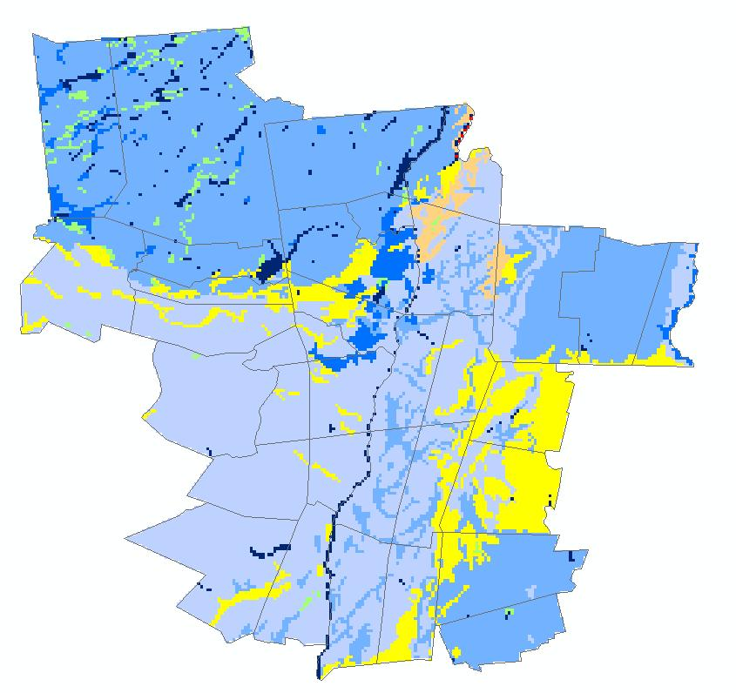
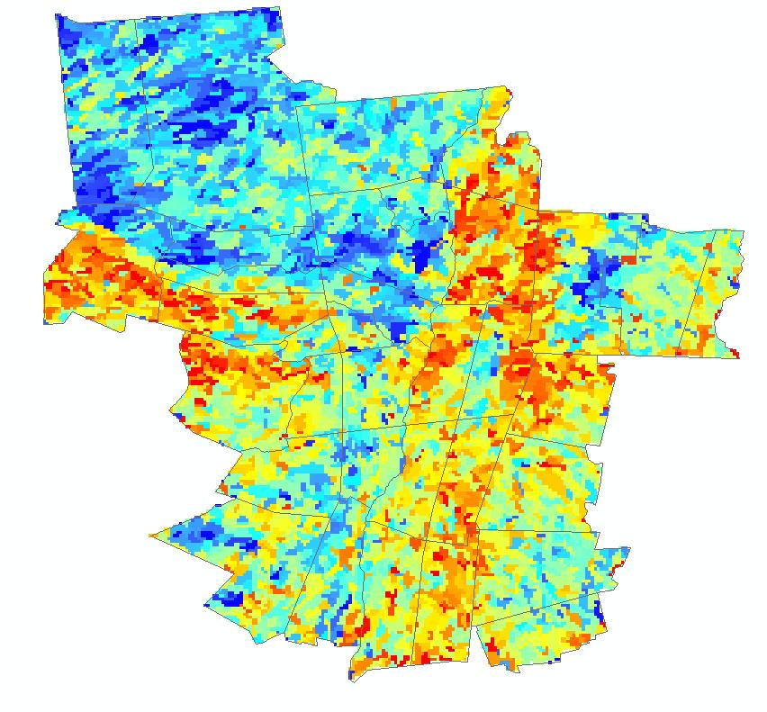
Flash Flood Potential Index (FFPI)
Combine slope, land use, soil type and forest density using the following formula:
FFPI=(1.5*Slope + LU + FD + Soil)/ N
Average the index over each basin

Slide 11
Flash Flood Potential Index (FFPI)
Helps identify areas of greater/lesser Flash Flood Potential
Areas of steep slope, agricultural use, and urban areas have higher FF potential
Areas of dense forest, lakes/ponds, and less slope have lower FF potential

Slide 12
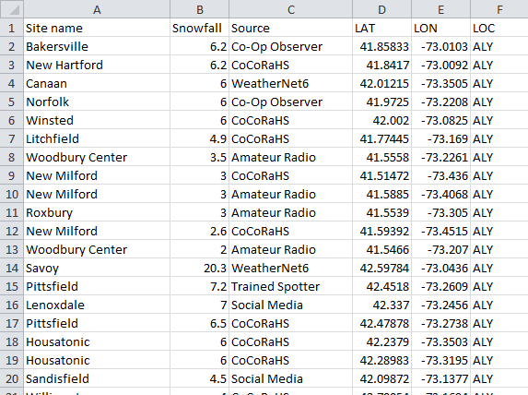
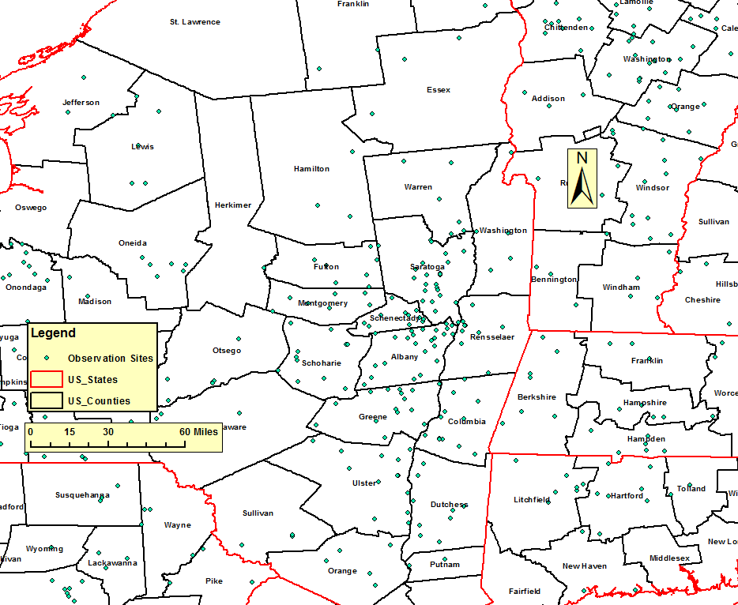
Rainfall/Snowfall Analysis Maps
Create interpolated rainfall/snow maps from observations
Compile snow/rain reports from Public Information Statement
Generate GIS shape file of snowfall reports from spreadsheet using ArcCatalog
Import into ArcMap

Slide 13
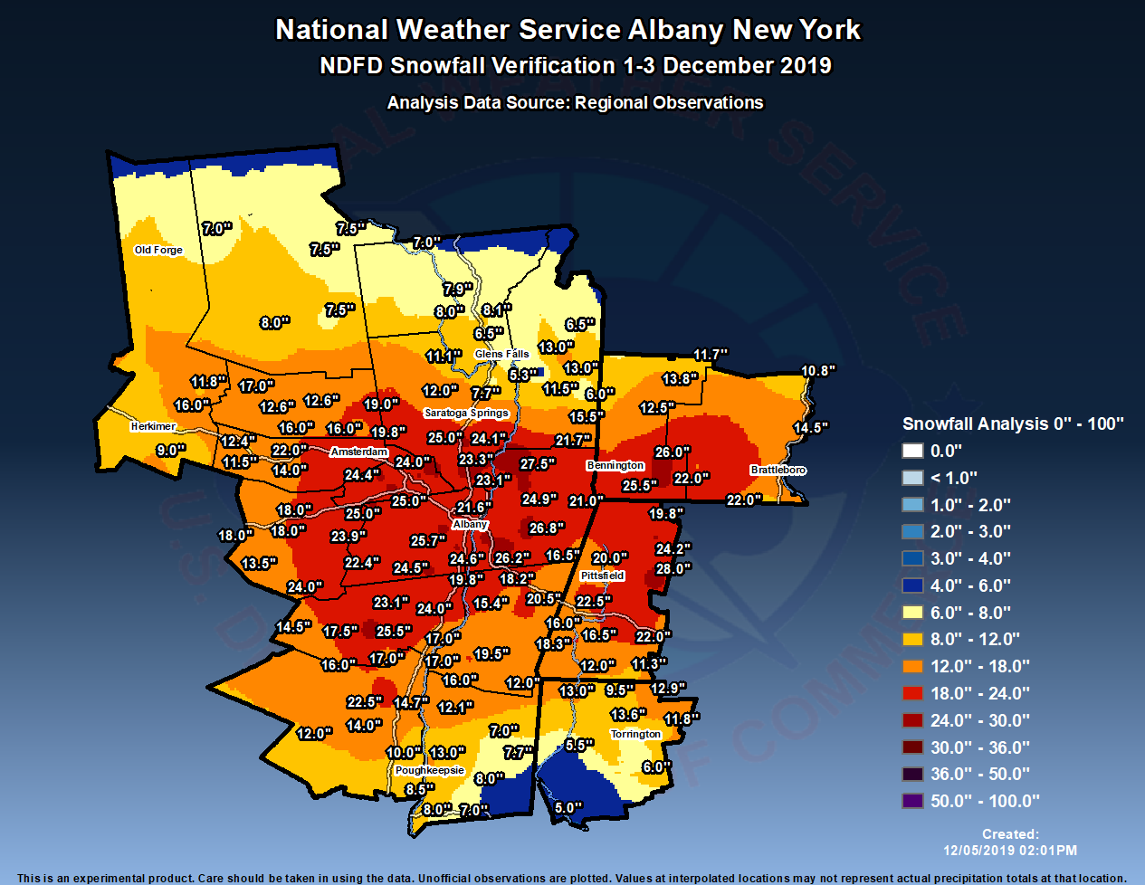
Rainfall/Snowfall Analysis Maps
Run an Inverse Distance Weighting (IDW) function in ArcMap
IDW takes into account distance between points & interpolates
Creates a Raster (digital) dataset and contoured rainfall or snowfall map
Snowfall Example

Slide 14
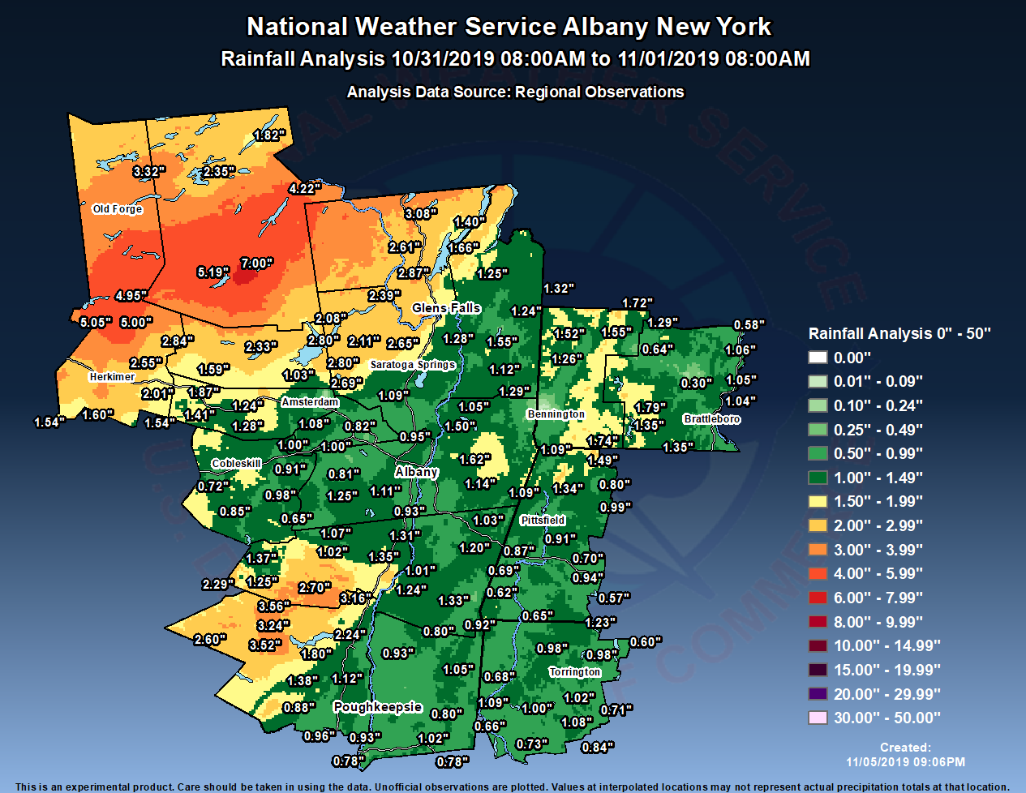
Rainfall/Snowfall Analysis Maps
Run an Inverse Distance Weighting (IDW) function in ArcMap
IDW takes into account distance between points & interpolates
Creates a Raster (digital) dataset and contoured rainfall or snowfall map
Rainfall Example

Slide 15
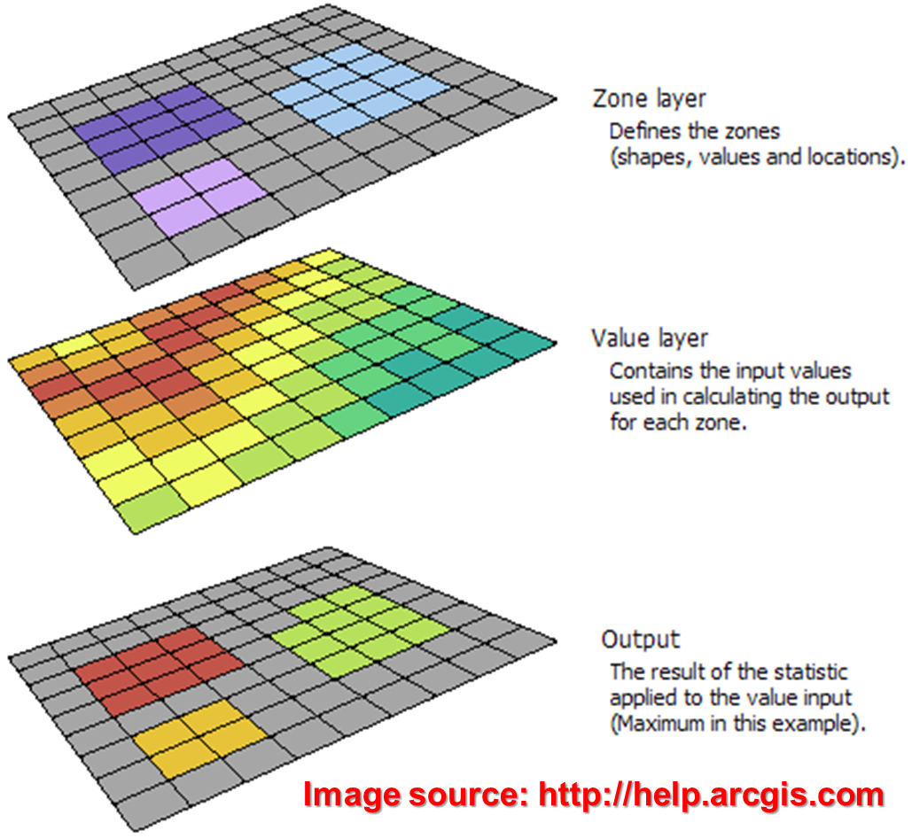
Zone-based Snowfall Verification
NWS Verification computed from mean snowfall in each forecast zone
Run Zonal Statistics in ArcMap (including mean) on the observed snowfall analysis Raster

Slide 16
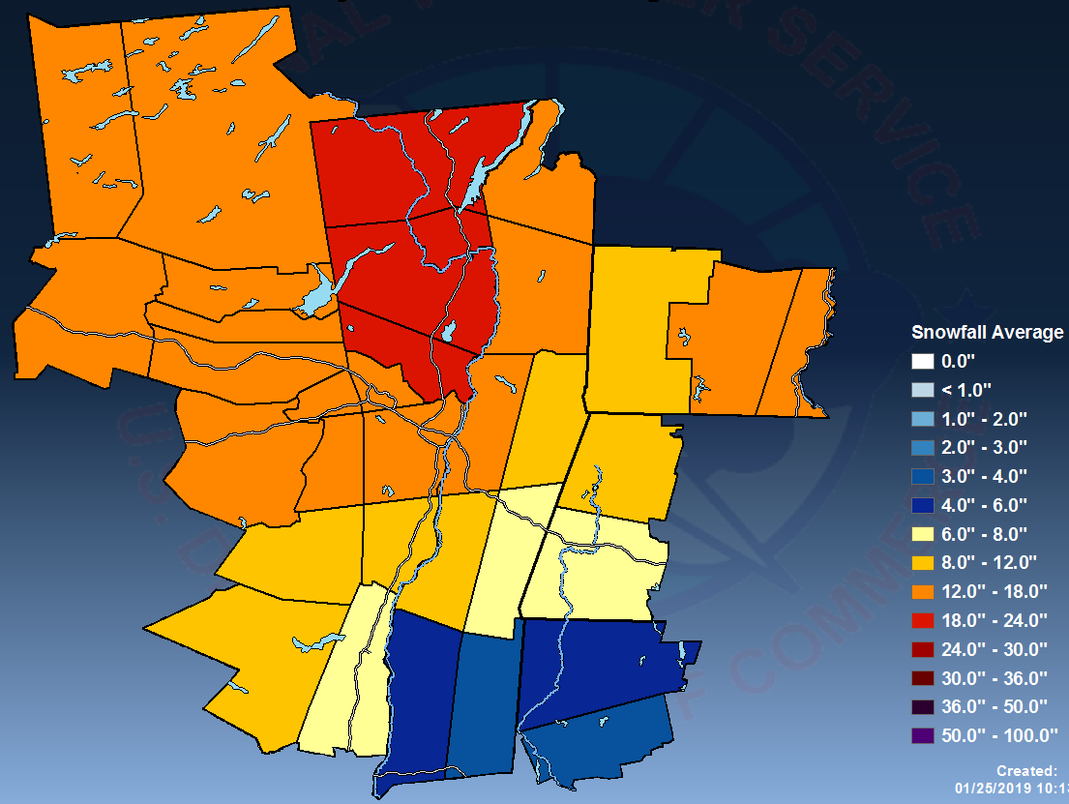
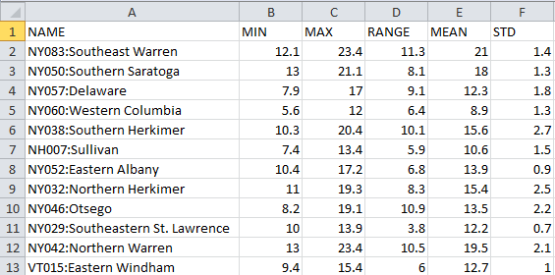
Zone-based Snowfall Verification
Output via map, with more specific data in spreadsheet format
Mean snowfall for each zone used for NWS snowfall verification

Slide 17
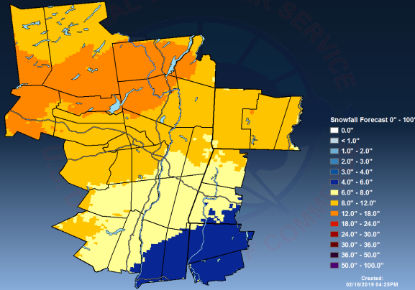
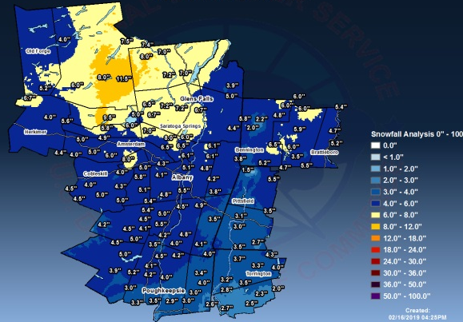
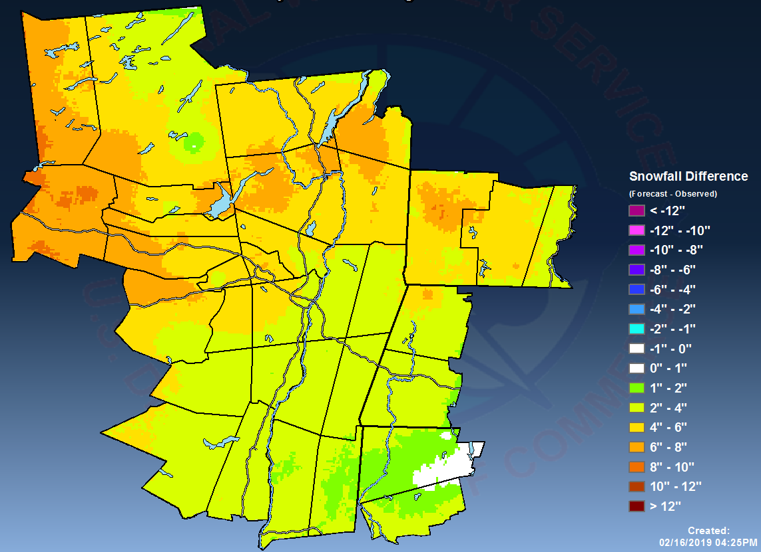
Creation of Forecast Error Maps
NDFD Forecast Snow
Methodology: Create gridded observed snowfall map after an event, then subtract from the forecast snowfall (obtained via NWS National Digital Forecast Database)
Minus
Observed Snow
Difference

Slide 18
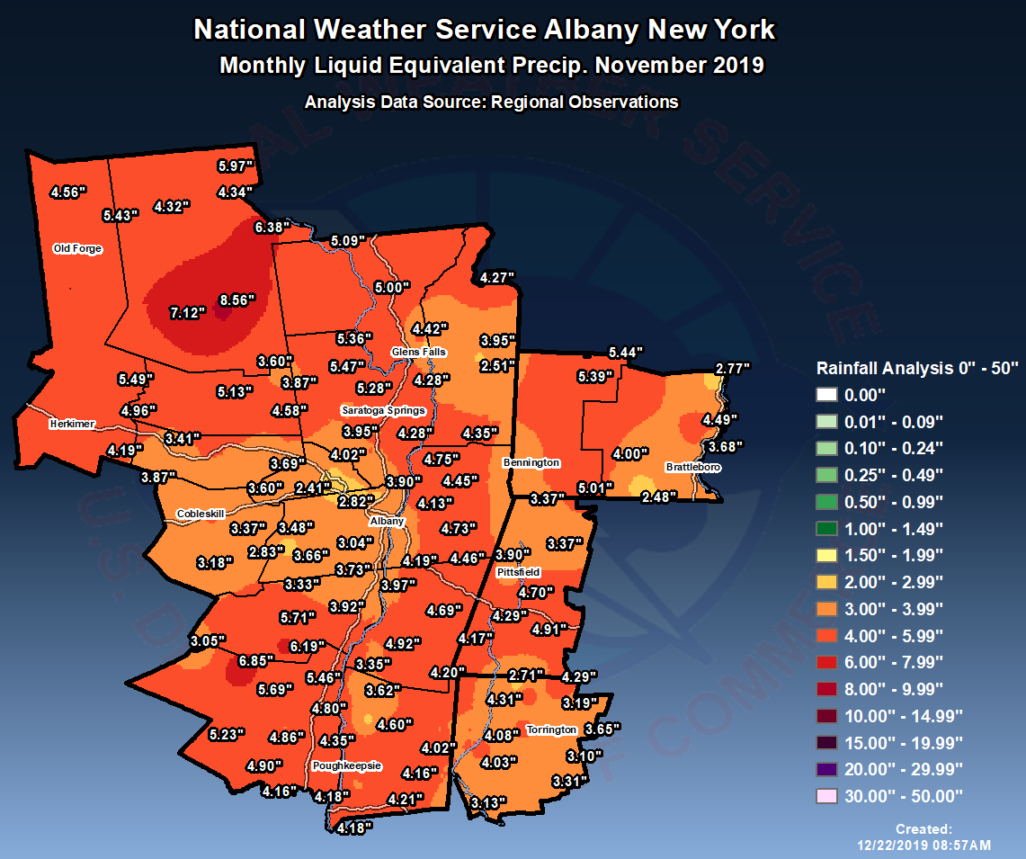
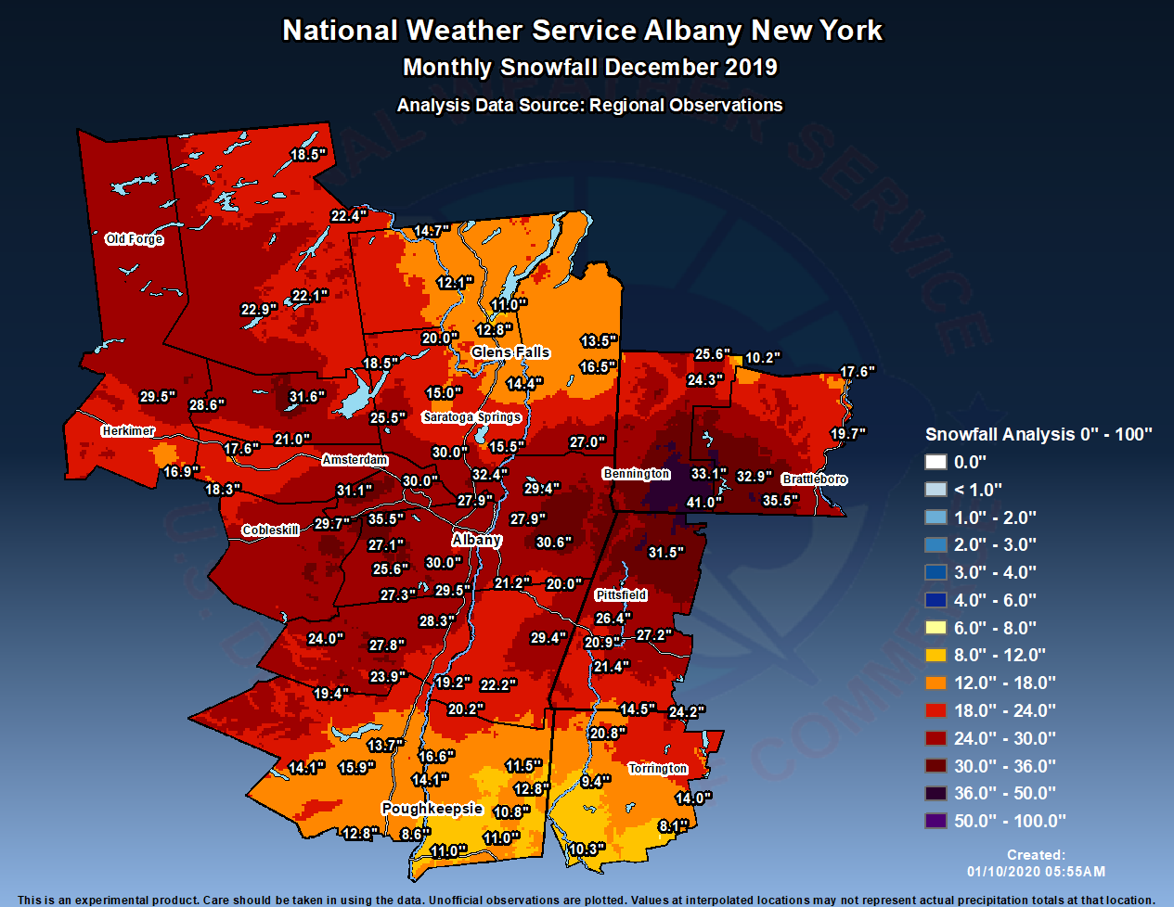
Monthly Rainfall/Snowfall Maps
Rainfall
November 2019
Snowfall
December 2019
Same method used for event precipitation analysis maps, but instead using monthly rainfall/snowfall reports (based on local reports from observers)

Slide 19
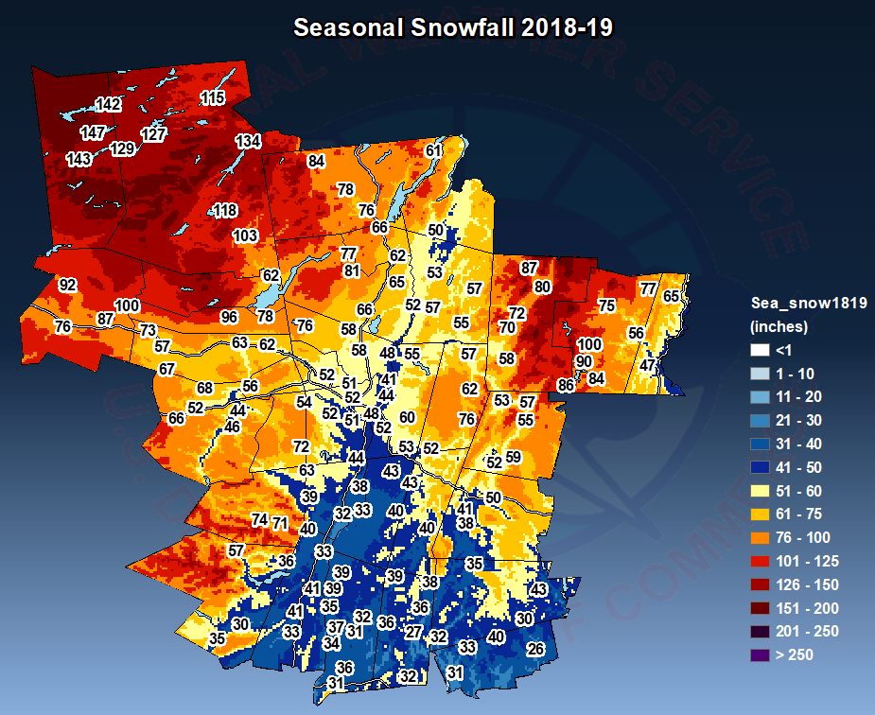
Seasonal Snowfall Map
Methodology: Compile (SUM) monthly observed snowfall maps from October through April using ArcMap
Color scale & range bins must be altered to account for large snow totals
2018-19 Seasonal Snowfall

Slide 20
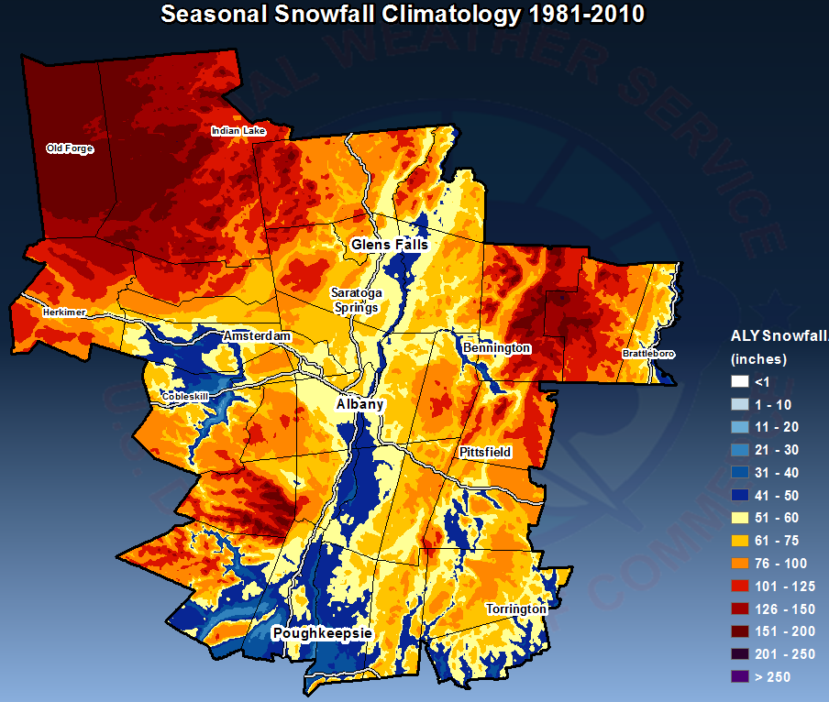
Climatology Snowfall Map
1981-2010 Seasonal Snowfall Climatology
Use 30-year climate normals from Cooperative Weather Observers to create a snowfall analysis

Slide 21
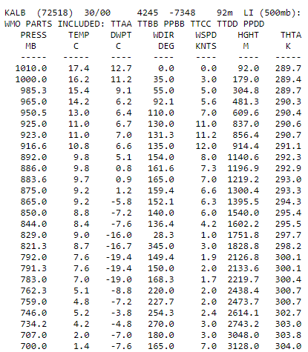
Snowfall Composites Stratified by 925mb Flow Regime
Identify patterns of snowfall distribution based on low level flow regime
Use Albany, NY sounding data to determine wind at 925 mb
Sounding time (0000 UTC or 1200 UTC) closest to midpoint of each event
Example of Data Selection

Slide 22
Snowfall Composites Stratified by 925 mb Flow Regime
Stratify by wind direction & speed at 925 mb:
4 quadrants for wind direction
3 categories for speed
= 12 combined categories
0°
270°
90°
180°
Speed category
1 | 0-19 kt
2 | 20-39 kt
3 | 40+ kt

Slide 23
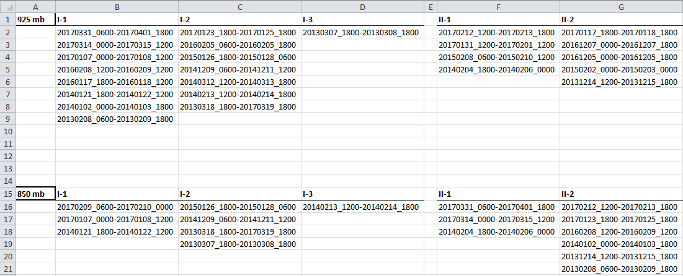
Snowfall Composites Stratified by 925 mb Flow Regime
Separate events into the 12 categories using a spreadsheet
81 total events from 2014-2019 winter seasons

Slide 24
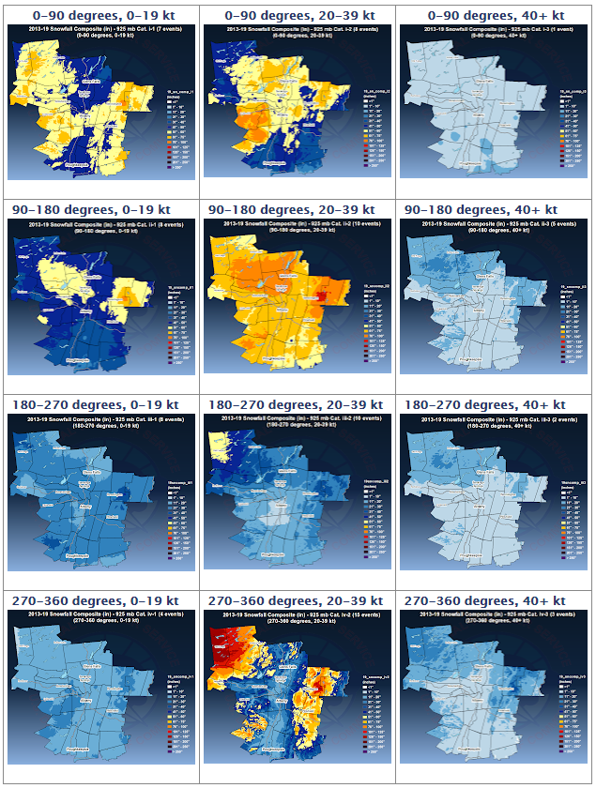
Snowfall Composites Stratified by 925 mb Flow Regime
Sum the snowfall analyses for events in each of the 12 categories using 925 mb wind at Albany

Slide 25
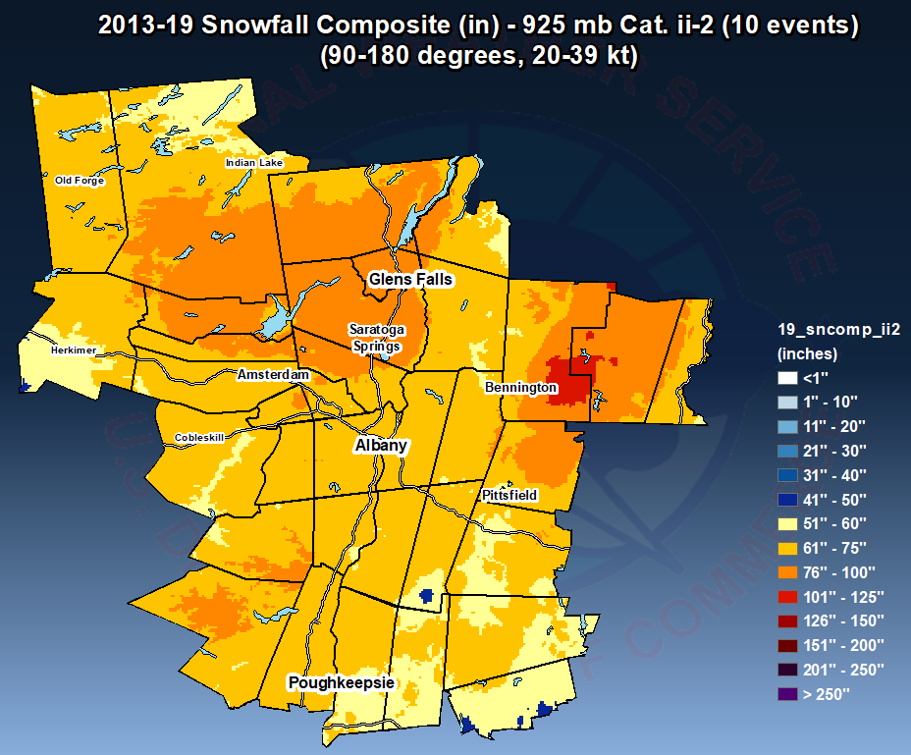
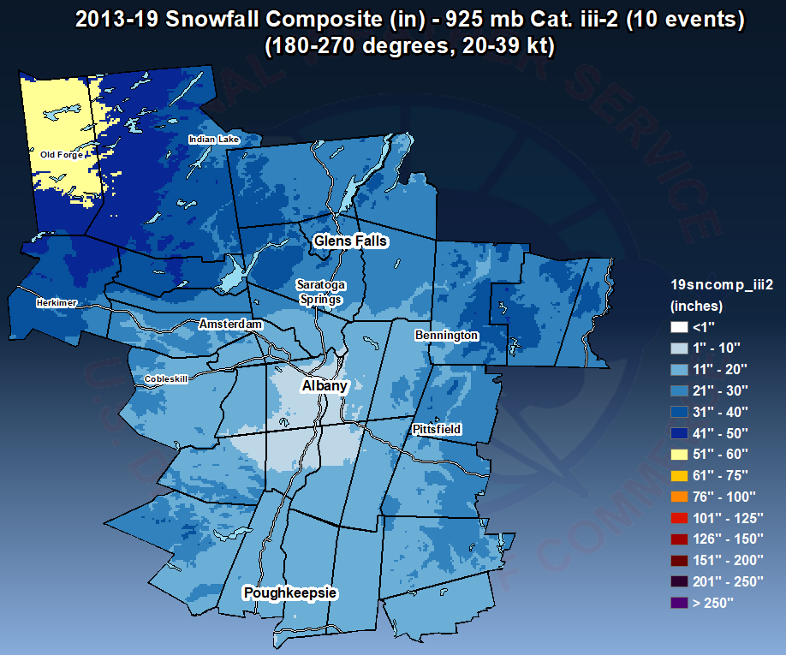
Snowfall Composites: Notable Regimes
Moderate SE Flow
Moderate SW Flow
Maximum snowfall in favored upslope areas north and east of Albany
“Snow hole” in Capital District due to down-sloping off Catskills

Slide 26
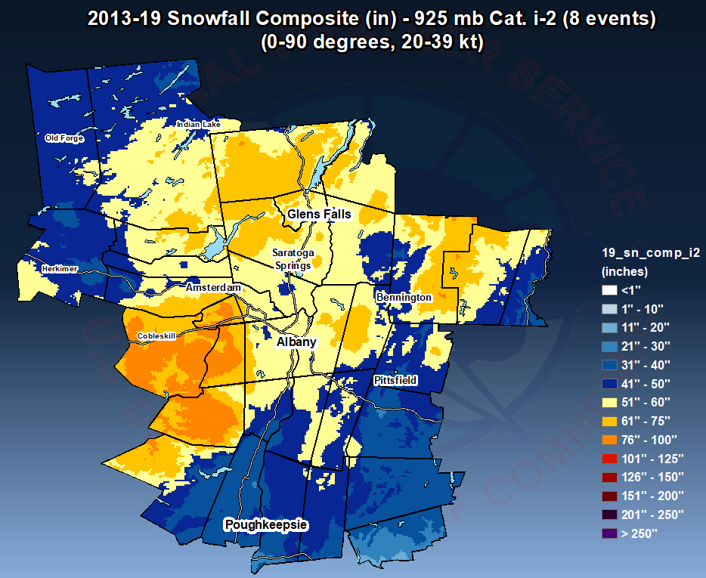
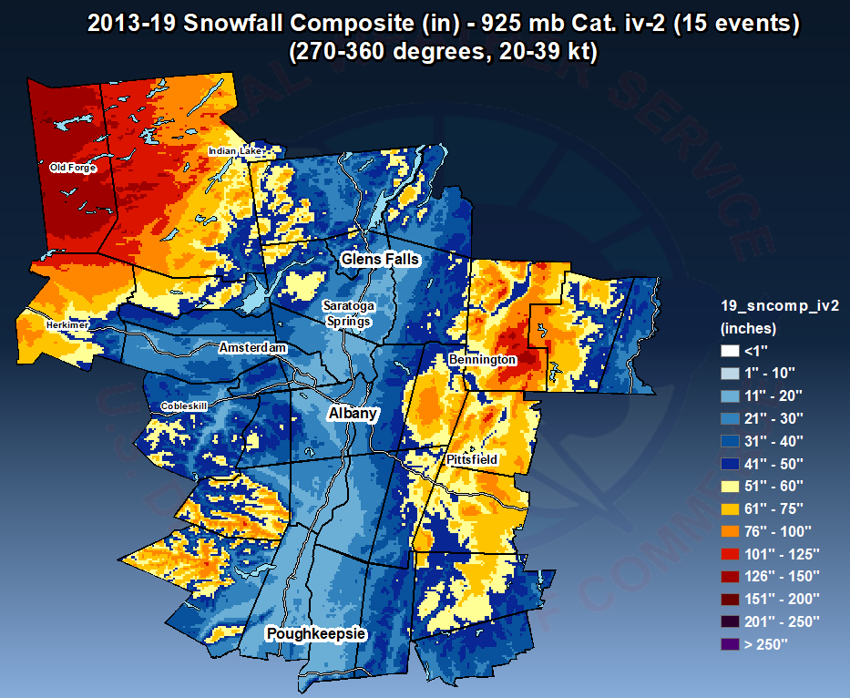
Snowfall Composites: Notable Regimes
Moderate NE Flow
Moderate NW Flow
Snowfall dominated by Nor’Easters
Maximum snowfall in favored upslope areas of Adirondacks and Taconics, Green Mountains & Berkshires

Slide 27
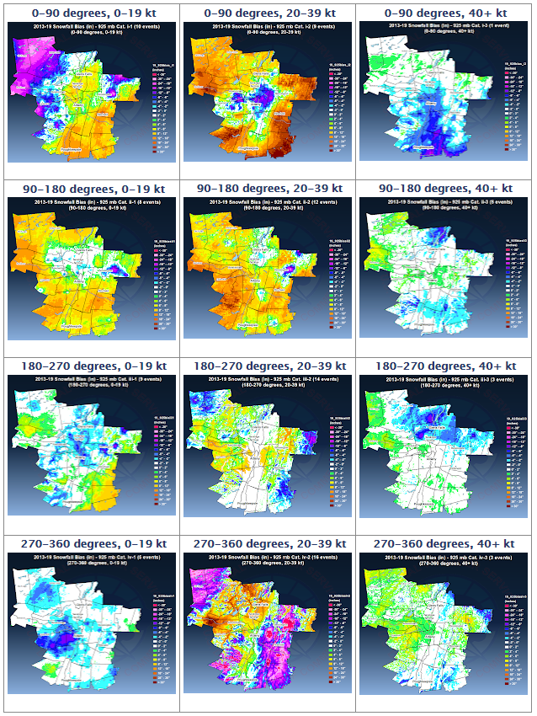
Snowfall Error Maps Stratified by Flow Regime
Same methodology as snowfall composites, but summing difference maps for events in each of the 12 categories using 925 mb wind at Albany
Used for assessing +/- forecast biases

Slide 28
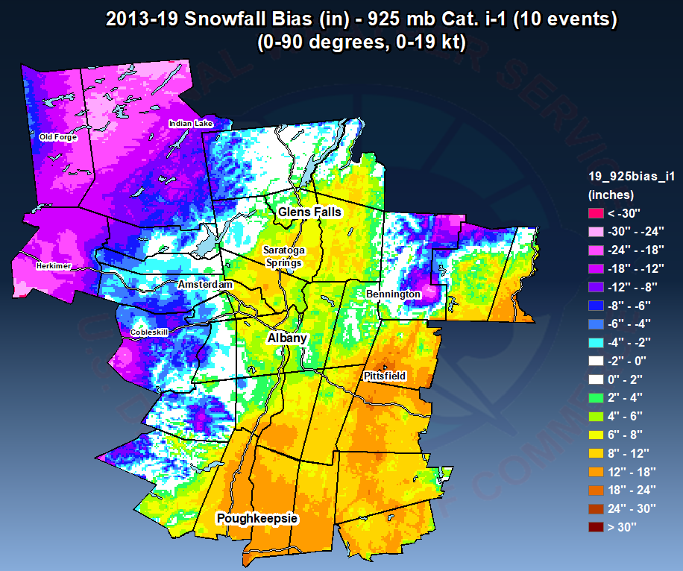
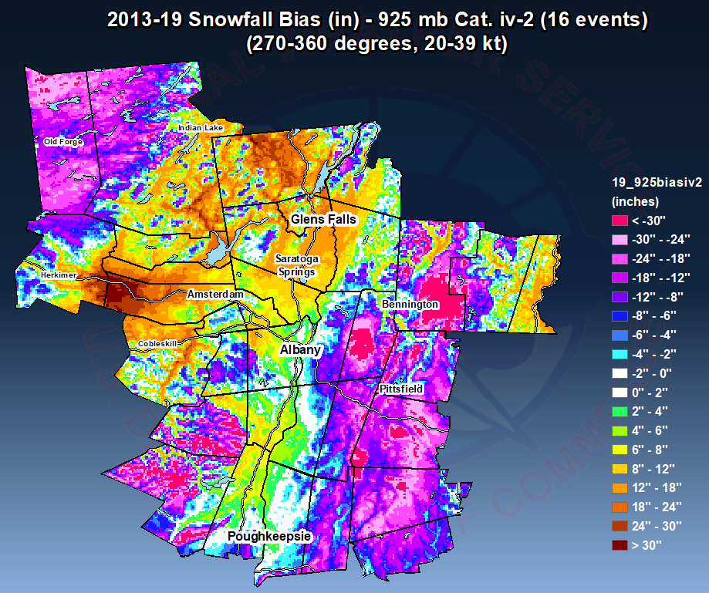
Error Maps: Notable Regimes
Weak NE Flow
Moderate NW Flow
Negative/positive snowfall forecast errors likely due to max QPF displacement error
Under-forecast of upslope and lake effect snow
Over-forecast in “snow shadowing” areas

Slide 29
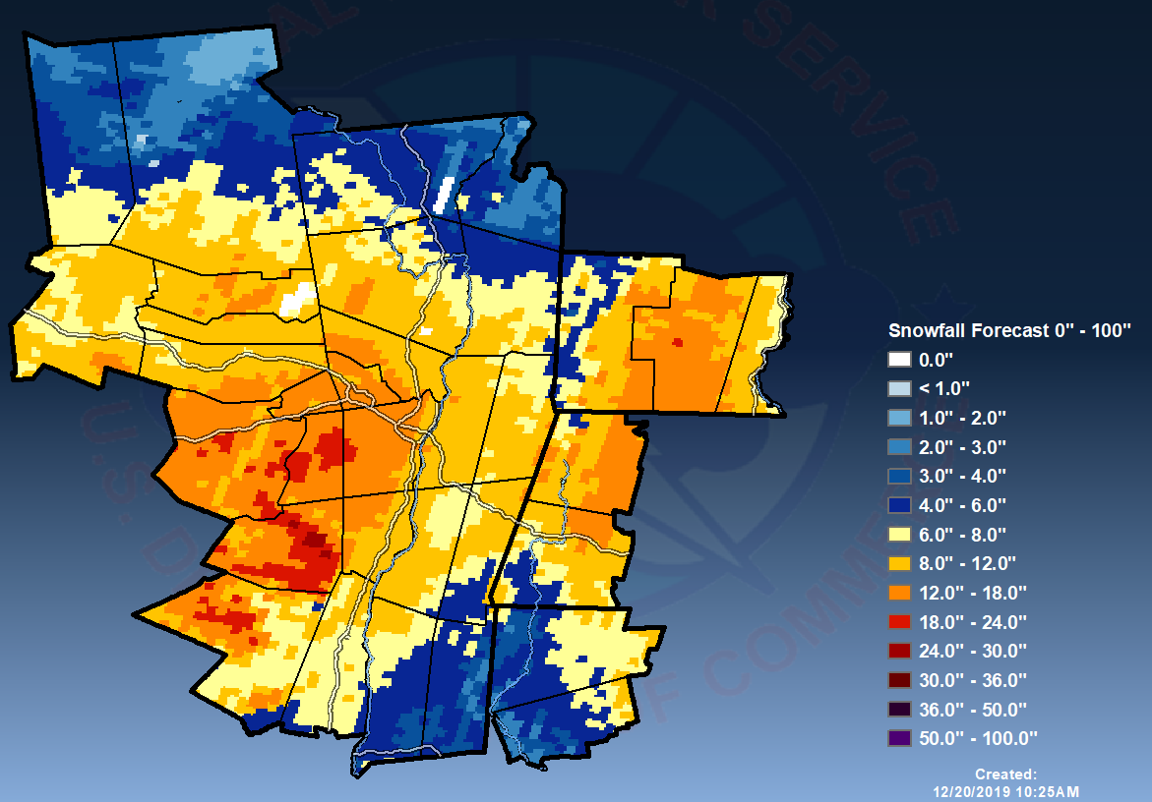
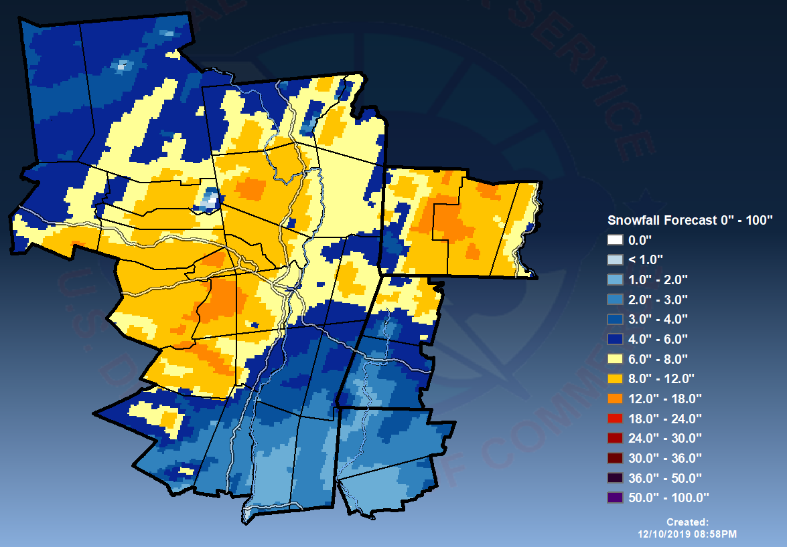
HRRR and NAMNest Snowfall Verification
NWS Albany verifies snowfall from high-resolution models such as the 3 km HRRR and NAMNest
Use positive snow depth change from beginning to end of an event
HRRR
1-3 Dec 2019
NAMNest
1-3 Dec 2019

Slide 30
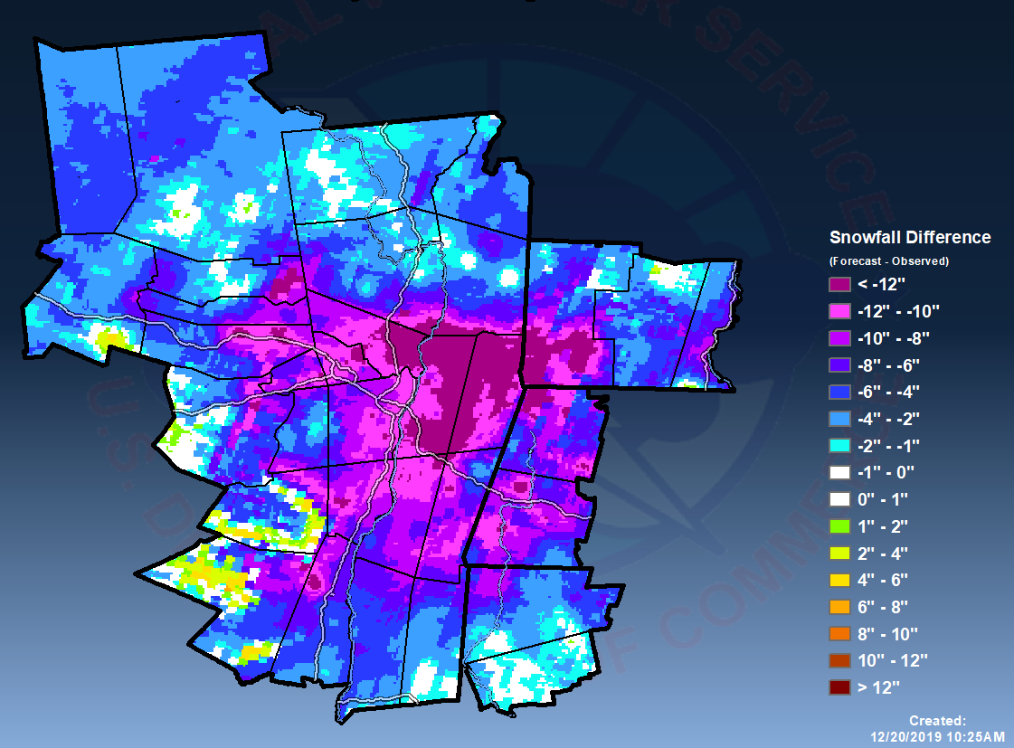
HRRR and NAMNest Snowfall Verification
The change in snow depth more accurately depicts model snowfall (correspondence with EMC)
Subtract observed snowfall from model positive snow depth change (using ArcMap) for each event to determine model forecast error
HRRR Pos SD Change
Minus
Observed Snow
Difference

Slide 31
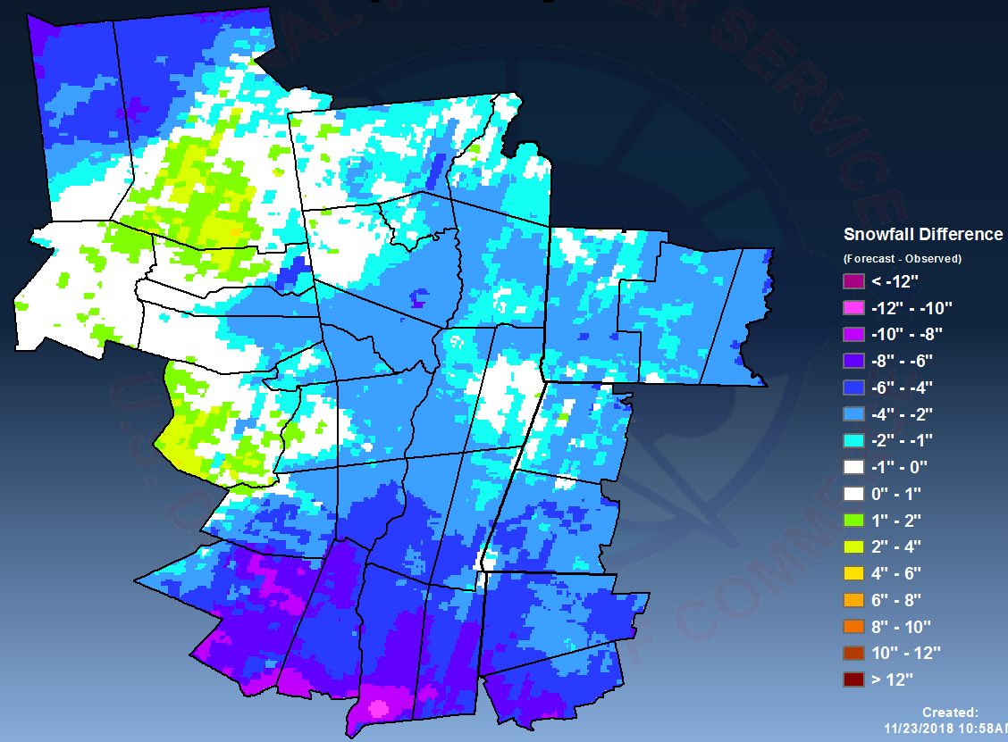
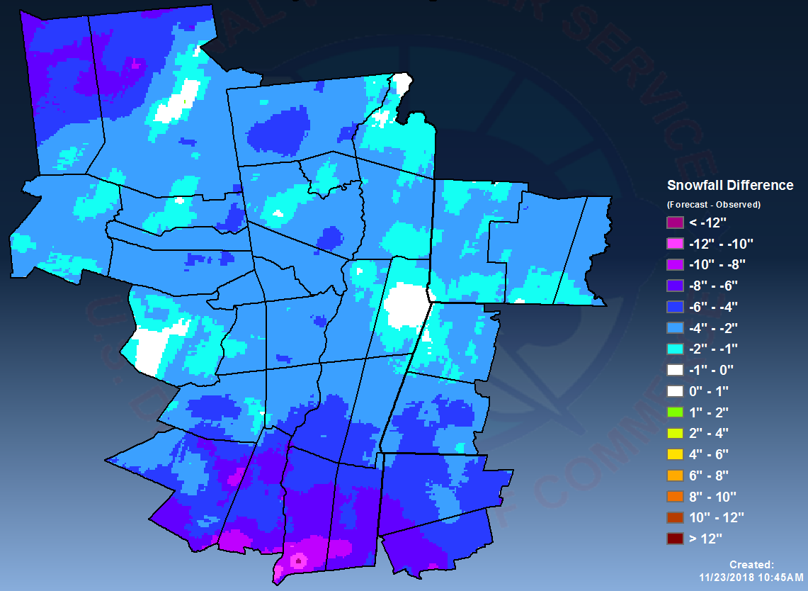
HRRR and NAMNest Case Study
HRRR error
15-16 November 2018
NAMNest error
15-16 November 2018
The positive SD change from both HRRR and NAMNest severely underestimated snowfall during the 14-15 Nov 2018 snowfall event
Models likely forecasted SLR to be much too low across southern part of the area, where the heaviest snow fell

Slide 32
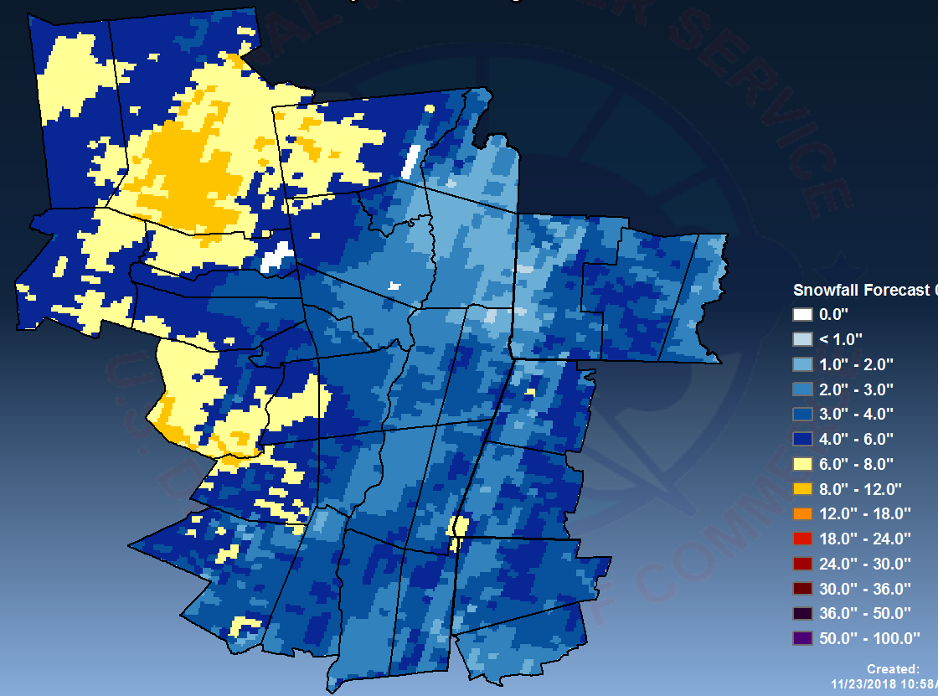
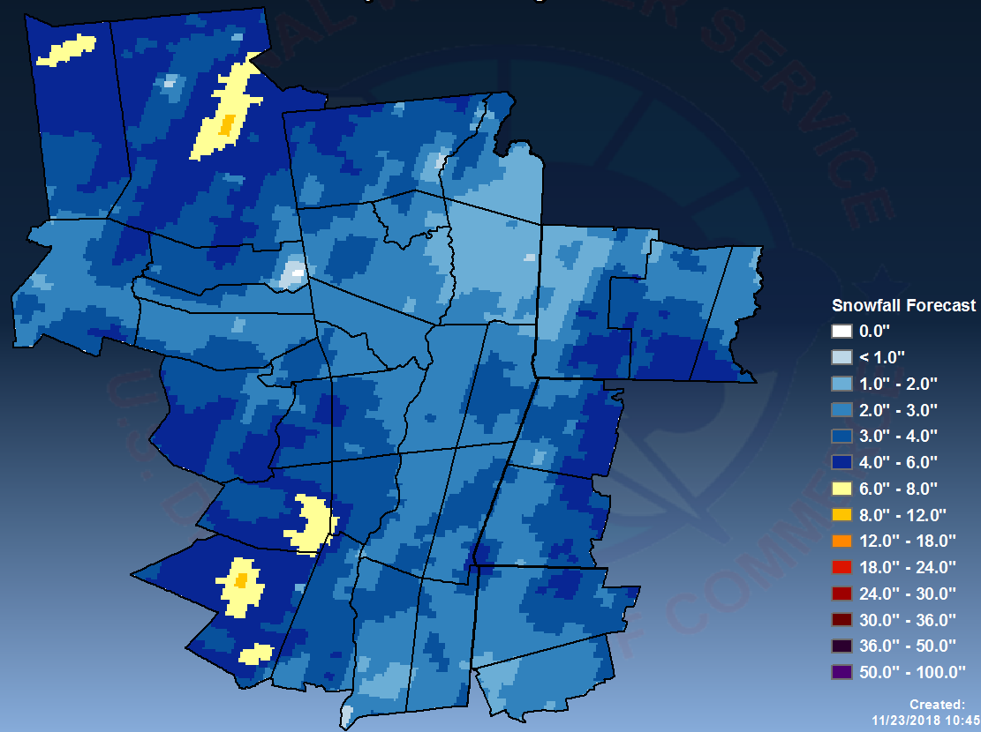
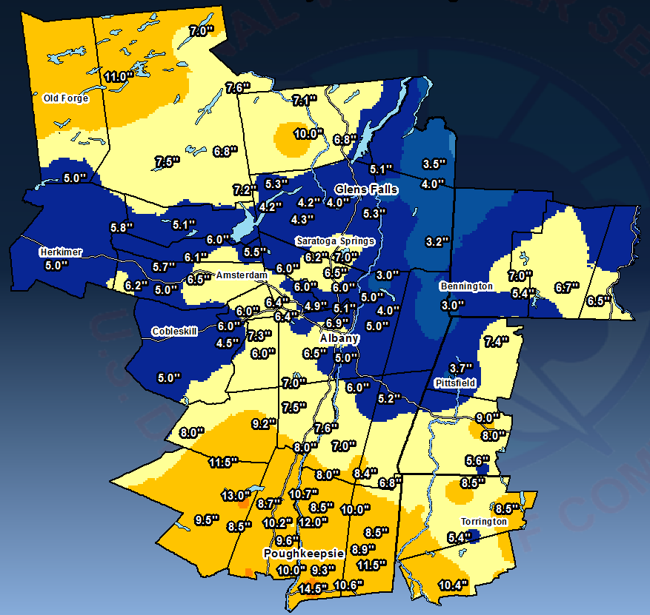
HRRR and NAMNest Case Study
HRRR Positive SD Change
15-16 November 2018
NAMNest Positive SD Change
Observed Snowfall
15-16 November 2018

Slide 33
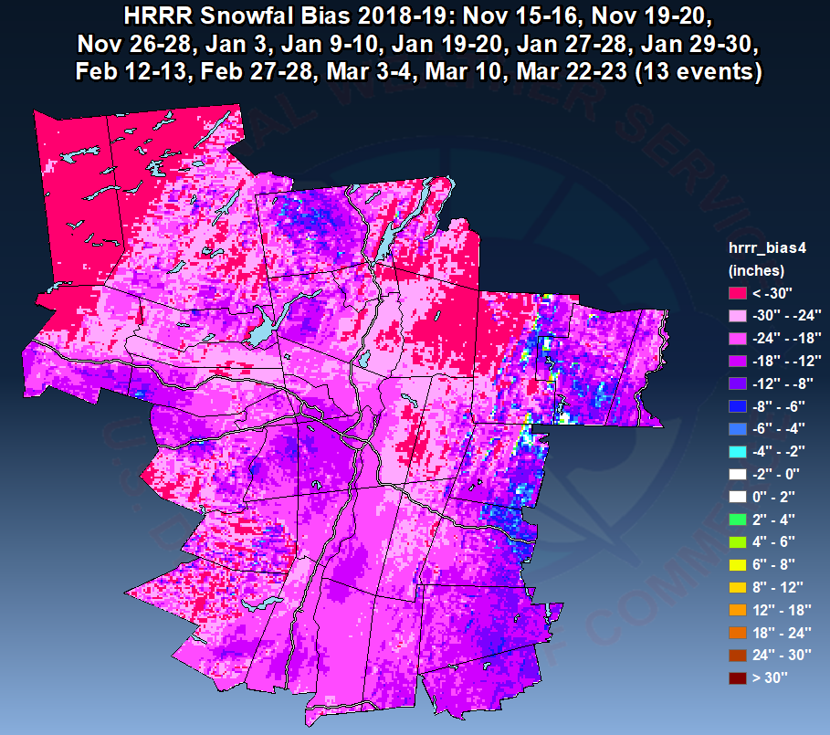
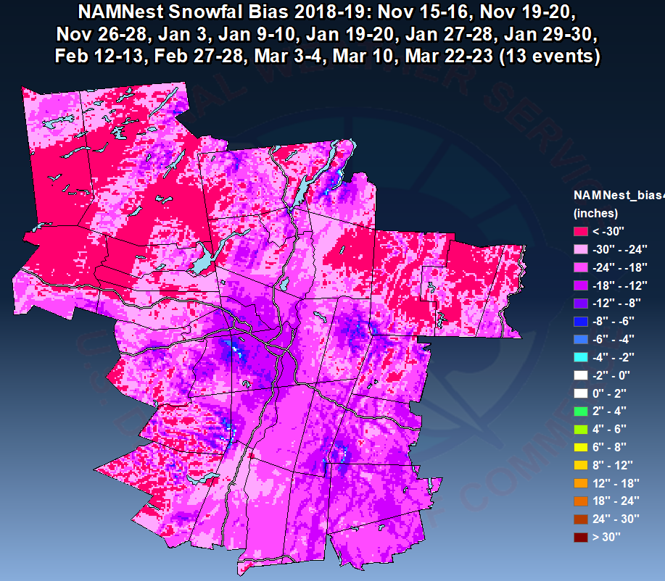
HRRR and NAMNest Snowfall Verification
HRRR composite bias
(13 events)
NAMNest composite bias
(13 events)
Sum difference maps (using ArcMap) to get seasonal composite snowfall bias for the HRRR and NAMNest
Noticed a large negative (under-forecast bias). Seemed most extreme with early season events and lake effect

Slide 34
Automation using GIS Scripting: The “GAZPACHO” Program
Not talking about cold soup here…
GAZPACHO = Gridded Automated Zonal Precipitation And Complete Hi-res Output
GAZPACHO is a program that was created to assist NWS Weather Forecast Offices with snowfall verification (rainfall added)

Slide 35
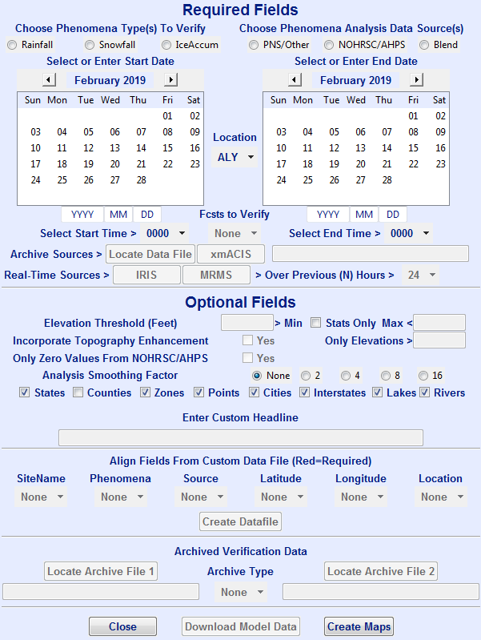
Automation using GIS Scripting: The “GAZPACHO” Program
Created by Danny Gant (Morristown, TN), Vasil Koleci & Joe Villani (Albany, NY)
Uses ArcGIS software and Python scripts
GAZPACHO is run on a PC (with ArcGIS 10.7 installed) via a simple GUI

Slide 36
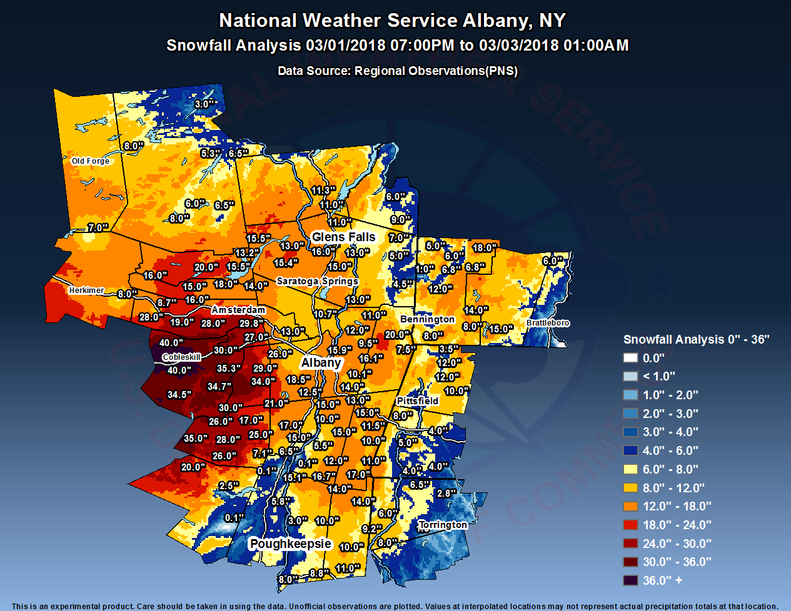
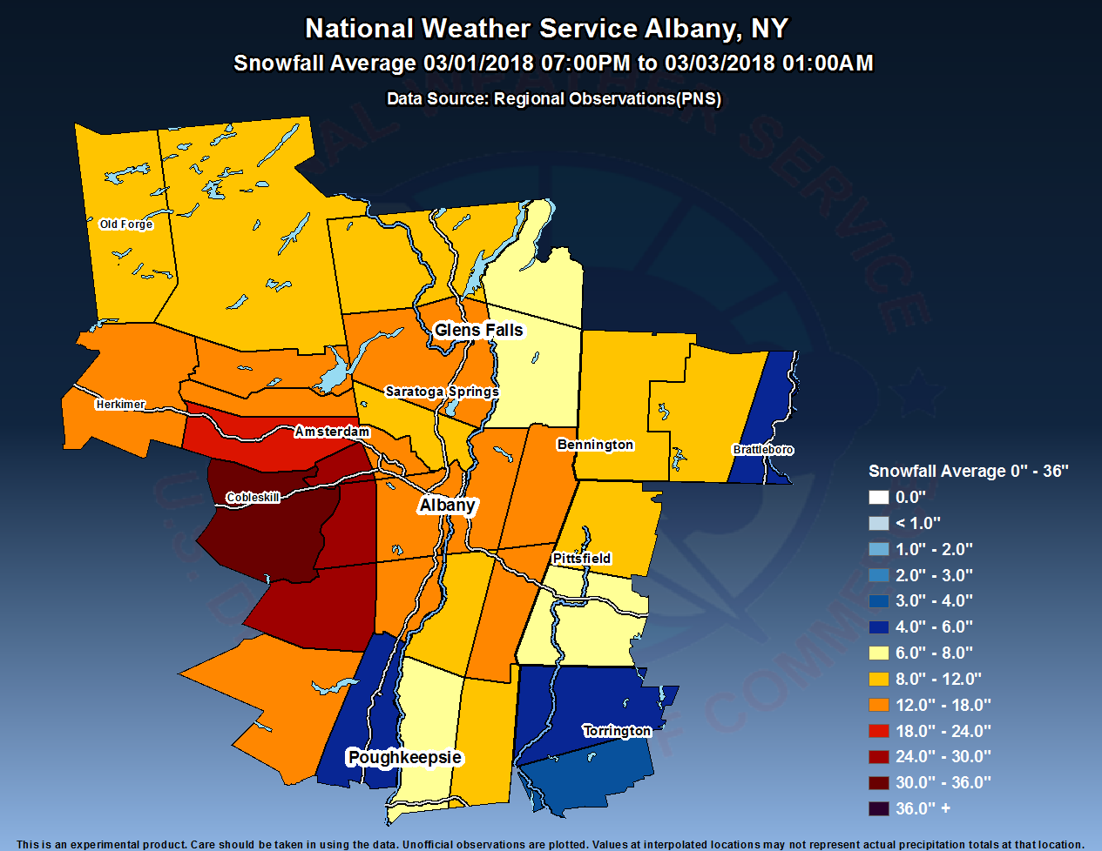
What is GAZPACHO
Creates maps of:
Observed precipitation (rain or snow)
Zone-average rain/snow
NWS forecast or model rain/snow (HRRR, NAMNest and NAM)
Difference (or error) maps of forecast minus observed rain/snow (inches and %)
Spreadsheet table of zone-average statistics

Slide 37
Case Study using GAZPACHO
Snowfall analysis based on interpolated observations from 14-15 March 2017 Nor’easter (Pi Day Storm)
Observed Snowfall
14-15 March 2017

Slide 38
Case Study using GAZPACHO
Difference map computed from official NWS Albany forecast minus observed analysis
Large under-forecast error across areas west of the Hudson Valley
Mesoscale snow band position & magnitude errors
Forecast Error
14-15 March 2017

Slide 39
Case Study using GAZPACHO
Snowfall analysis based on interpolated observations from 02 March 2018 Nor’easter
Observed Snowfall
02 March 2018

Slide 40
Case Study using GAZPACHO
Difference map computed from official NWS Albany forecast minus observed analysis
Large under-forecast error in the Capital District due to poor model representation of boundary layer temps (esp. GFS)
Heavy mesoscale snow band just west of Capital District
Forecast Error
02 March 2018

Slide 41
Forecasting Lake Effect Snow
Instability Class (derived from lake/air temp differences) used to assess potential strength of lake effect snow bands
Three main categories:
1) Conditional
2) Moderate
3) Extreme
Niziol Instability Class

Slide 42
Forecasting Lake Effect Snow
From Niziol, 1987
Conditional: Heavy snowfall rates possible with trajectories along the longest fetch of the lake and 500 mb cyclonic vorticity advection (CVA)
Moderate: Heavy snowfall rates can occur with moderately long trajectories & 500 mb CVA
Extreme: Heavy snowfall rates possible with little dependence on fetch or CVA
BUFKIT – Instability category (must obtain observed lake temperature too)

Slide 43
Forecasting Lake Effect Snow
Inversion heights also used to determine potential strength of lake effect snow bands
Higher inversion heights result in a deeper mixed layer and taller convective plumes
Inversion heights of 750 mb (~2.5 km) and higher can be associated with intense snow bands, assuming other favorable factors are present
Inversion
BUFKIT – KRME NAM 26 December 2017

Slide 44
Forecasting Lake Effect Snow
Flow trajectory can be determined by using the mean wind in the mixed layer. Flow trajectory and fetch modulate the location and classification of snow bands as:
Single Band: wider in shape; typically more intense
Multi Band: narrower; typically weaker due to smaller fetch

Slide 45
Forecasting Lake Effect Snow
Multi bands typically affect the southern Mohawk Valley, Schoharie Valley, and eastern Catskills with a 300° to 310° flow trajectory
Single bands can affect the central and northern Mohawk Valley (even rarely the Capital District), and especially the western Adirondacks with a 260° to 280° flow trajectory
300°-310°
260°-280°

Slide 46
Limiting Factors
Forecast Challenges
Shallow inversion heights result in very weak snow showers/flurries
If the directional wind shear is > 30° snow bands tend to become less organized or break up
Diurnal mode especially early/late season, as bands tend to become cellular during the daylight hours
Inland extent of snow bands: Not always modulated by wind speed; can lead to over-forecasting significant events
Model forecasts of QPF associated with LES can be highly inaccurate at times
Snow to liquid ratios can range from 15:1 to as much as 30:1 (even rare occasions of > 50:1)

Slide 47
Favorable Env. far-reaching Inland Extent
Type A
MLC present (not shown)
Strong 0-1 km shear; weak shear in 1-3 km layer
Conditional lake-induced instability
(a) Example of a Type A sounding (0-hr NAM sounding from near KUCA) featuring strong 0–1-km bulk shear (weak in 1–3-km layer) and conditional instability. (b) Associated 0.5° reflectivity (dBZ) at time of sounding. Sounding and radar image from 1200 UTC 2 January 2012
Notes:
Favorable environments were categorized as Type A, and exhibited conditional to low-end moderate instability and the existence of an MLC. Only the first two most strongly correlated parameters were used for simplification.

Slide 48
Non-Favorable Env. far-reaching Inland Extent
Type B
MLC not present (not shown)
Weak 0-1 km shear; stronger shear in 1-3 km layer
Extreme lake-induced instability
As in previous figure except for a Type B event from 1200 UTC 8 January 2014.
Notes:
Non-favorable environments were categorized as Type B and depicted by time steps that exhibited high-end moderate to extreme instability and no MLC present.

Slide 49
Questions/Comments?
Joe.Villani@noaa.gov

