Slide 1
Convection that caused TMIs
10Z – 13Z
In the DC – NYC corridor
May – Sep 2018
By
Sean Campbell
ZDC CWSU

Slide 2
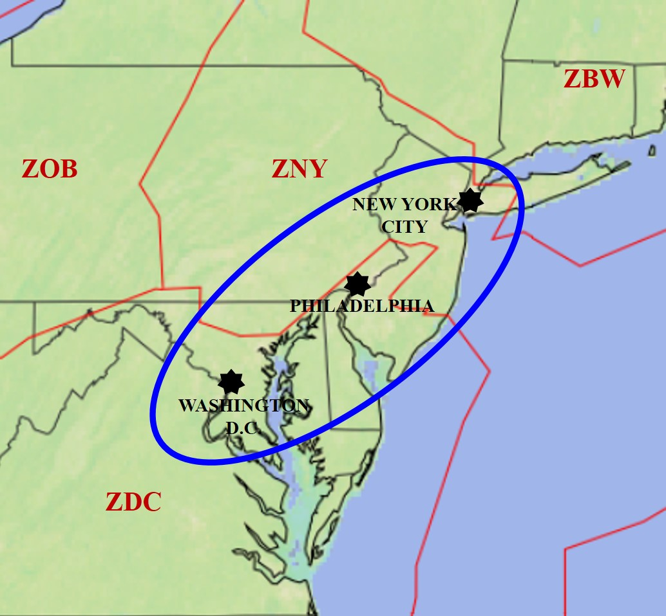
Motivation
7 Core 30 airports (NY Metros, DC Metros, PHL) + TEB and HPN execute early morning air traffic “pushes” from 10Z to 13Z; convection-related TMIs in DC – NYC corridor strain the NAS
What are primary causes of/patterns associated with early AM convection in the DC – NYC corridor? Can we improve our IDSS to increase efficiency of NAS within this corridor?
TCF not always collaborated with NAMs, CWSUs, other aviation forecasters prior to this timeframe
Study Area
General Overview
24 convective events caused TMIs in the 10 – 13Z timeframe May – Sep 2018
17 (71%) occurred along/near a surface boundary
12 (50%) occurred along/near E-W oriented surface front
Back-door cold fronts
Warm fronts
Quasi-stationary fronts
Primary study focus: The 12 events that occurred along/near an E-W oriented front

Slide 3
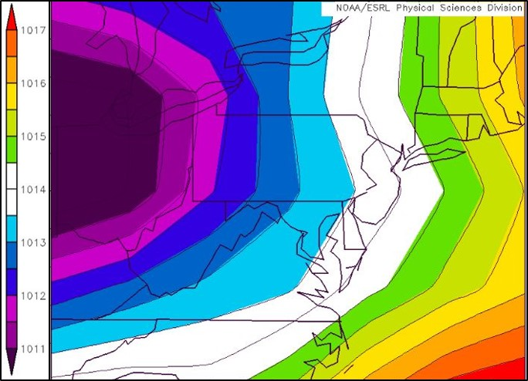
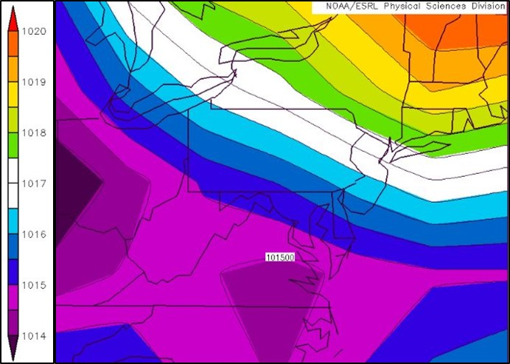
Surface Patterns
2 subsets of surface patterns:
E-W oriented front N 1/2 of study area
7 events:
12 May, 27 May, 1 Jun, 23 Jun, 15 Jul, 1 Aug, 11 Aug
Convection primarily N 1/2 study area
E-W oriented front S 1/2 of study area
5 events:
13 May, 3 Jun, 22 Jun, 31 Aug, 1 Sep
Convection primarily S 1/2 study area
6-hr NCEP/NCAR reanalysis data composite image of surface sea level pressure at 06Z for convection that primarily caused TMIs between 10Z and 13Z across the N 1/2 of the study area. Data courtesy of NOAA/ESRL.
6-hr NCEP/NCAR reanalysis data composite image of surface sea level pressure at 06Z for convection that primarily caused TMIs between 10Z and 13Z across the S 1/2 of the study area. Data courtesy of NOAA/ESRL.

Slide 4
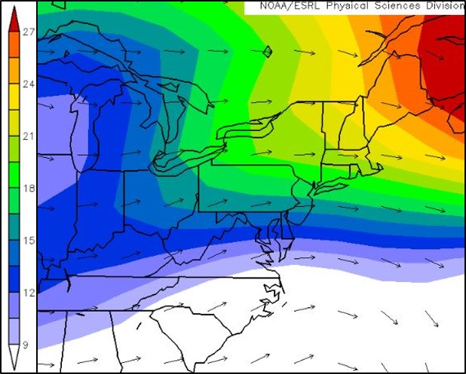
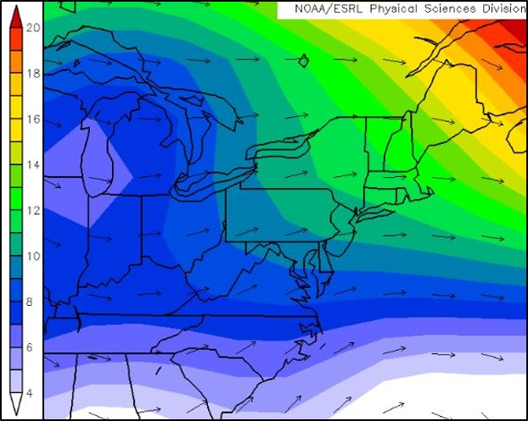
Mid-/Upper-Level Patterns
300 hPa pattern (general)
Discernible jet max present during 8 events; right entrance region was favored for convective development in 7 of the 8 events (observed in composite image below)
But, no discernible jet max in 4 events
500 hPa pattern (general)
W-SW flow ahead of a mid-/upper-level trof was favored (9 events), which is apparent in the composite image below
NW flow during 2 events; mid-level low directly influenced 1 event
6-hr NCEP/NCAR reanalysis data composite image of 300 hPa vector winds (m sˉ²) at 06Z for all 12 convective events that caused TMIs between 10Z and 13Z across the study area. Data courtesy of NOAA/ESRL.
6-hr NCEP/NCAR reanalysis data composite image of 500 hPa vector winds (m sˉ²) at 06Z for all 12 convective events that caused TMIs between 10Z and 13Z across the study area. Data courtesy of NOAA/ESRL.

Slide 5
Important Findings (so far)
Convection reached at least FL320 in all events…FL360 or higher during 11 events (92%)
Instability:
Max MUCAPE ≥ 500 J kgˉ² in 10 events (83%)
Convection developed in MUCAPE gradient in all events
Shear:
Effective bulk shear ≥ 25 kt during 9 events (75%)
Moisture:
All events: Convection developed in regions of 700-500 hPa mean RH ≥ 70%
All events: 850 hPa dewpoint ≥ 10°C
Surface θₑ ≥ 332K throughout 11 events (92%)
Convection developed in a surface θₑ gradient during 11 events (92%)
Mid-upper level forcing (interaction w/surface front):
All events occurred under area of upper-level divergence
All events developed ahead of a mid-level shortwave
Guidance:
WPC: Analyzed E-W oriented fronts through DC – NYC corridor prior to/during all events
Prior evening LAMP convective forecasts (23Z – last available for overnight pre-duty wx brief & TCF collab): Not a huge confidence-booster; using a min threshold of 30%, it ID’d potentially TMI-worthy convection in study area before 6 events (archived data unavailable for 2 events)

Slide 6
Important Findings (so far) continued…
There appeared to be a “seasonality” for the usefulness of some parameters:
Frontogenesis at/below 700 hPa present before/during all 6 events through 22 Jun, then in 2 of 6 events from 23 Jun through 1 Sep (frontal dynamics more important for early AM convection early in the season?)
Max MUCAPE ≥ 1000 J kgˉ² present in none of the May – Jun events, but in all of the Jul – Aug events (instability more important for early AM convection later in the season?)
Max surface θₑ values trended higher as the season progressed; ≥ 340K for all events from Jul – Sep
LAMP convective forecasts (evening prior) worse from mid-Jun to Sep than from May to mid-Jun (less frontal dynamics for LAMP to incorporate into forecasts later in the season?)
Future work…
Continue the study May – Sep 2019
If enough events: Possibly expand study to include convection along/ahead of NE – SW oriented surface fronts/troughs
Compare “null” events (similar set-up, but lack of convection) to determine biggest differences
Might summarize 2-yr study in ER TA or brief results at a conference/workshop in late 2019 or 2020

