Slide 1
STUDY: MODERATE ICING WITH TEMPS < -20ºC
-Sean Campbell (ZDC CWSU)
Motivation: During a visit to AWC, it was mentioned that some AWC meteorologists tend to focus on the 0°C to -20°C layer for icing AIRMETs
So, I decided to gather moderate icing pireps across ZDC from 16 Nov 19 to 3 Jan 20 (+ 16 Oct 19) to discover what parameters may be helpful when determining whether or not to forecast moderate icing where temps are < -20ºC
22 pireps that mentioned moderate icing were included in the study
Meteorological data were from SPC’s Mesoscale Analysis archive
Results:
Temps: Ranged from -21ºC to -40ºC; 19/22 (86% of) reports were in the -21ºC to -30°C layer
Altitudes: Ranged from FL190 to FL305; 19/22 (86%) were in the FL190-270 layer
Mid level moisture (potentially supercooled water which could be lifted above the -20ºC layer):
700-500 hPa average layer RH ≥ 70%: 17/22 (77%)
Lift/forcing:
300 hPa divergence present: 22/22 (100%)
300 hPa jet max present (or a region of strong jet stream winds increasing divergence/lift): 22/22 (100%)
700-400 hPa PVA moving through the area: 22/22 (100%)
Mid-level omega present 17/22 (77%)
The following 4 slides highlight 8 different scenarios within which 14 of the 22 moderate icing reports occurred

Slide 2
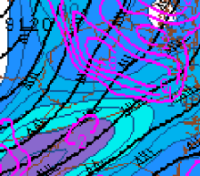
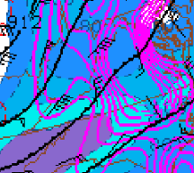
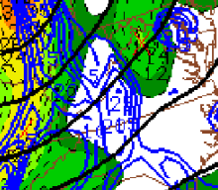
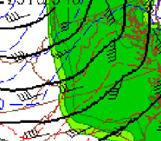
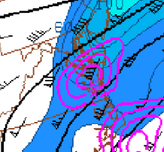
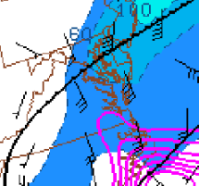
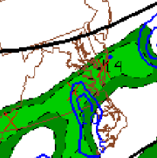
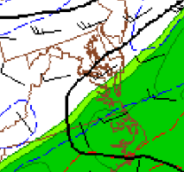
Examples: 16 Oct 2019, 16 Nov 2019
16 Oct 2019: OV LYH217047 / TM 1624 / FL230 / TP B717 / TA M22 / IC MOD RIME (approximate location designated by red star)
16 UTC 300 hPa hgt/divg/wind
16 UTC 300 hPa ageostrophic flow/
700 – 500 hPa layer-avg omega
16 UTC 500 hPa vort / 700-400 hPa diff. vort. advection
16 UTC 700 hPa hgt/wind/700-500 hPa mean RH
16 Nov 2019: OV FKN / TM 0210 / FL260 / TP PC12 / TA M28 / IC MOD MX (approximate location designated by red star)
02 UTC 300 hPa hgt/divg/wind
02 UTC 300 hPa ageostrophic flow/
700 – 500 hPa layer-avg omega
02 UTC 500 hPa vort / 700-400 hPa diff. vort. advection
02 UTC 700 hPa hgt/wind/700-500 hPa mean RH

Slide 3
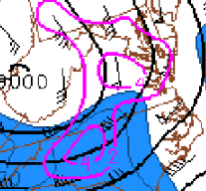
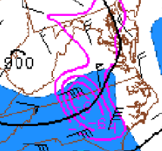
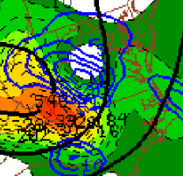
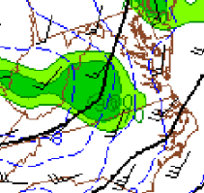
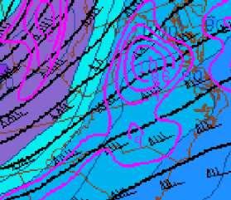
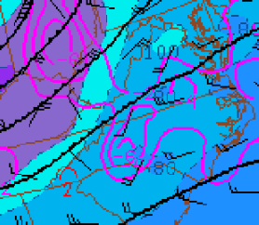
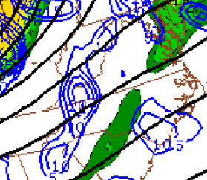
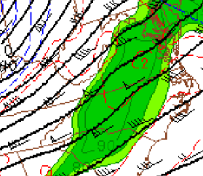
Examples: 18 Nov 2019, 27 Nov 2019
18 Nov 2019: OV BRV225020 / TM 2115 / FL230 / TP PC12 / TA M23 / IC MOD MX (approximate location designated by red star)
21 UTC 300 hPa hgt/divg/wind
21 UTC 300 hPa ageostrophic flow/
700 – 500 hPa layer-avg omega
21 UTC 500 hPa vort / 700-400 hPa diff. vort. advection
21 UTC 700 hPa hgt/wind/
700-500 hPa mean RH
27 Nov 2019: OV LDN / TM 1358 / FL270 / TP A306 / TA M30 / IC LGT-MOD RIME (approximate location designated by red star)
27 Nov 2019: OV GSO360020 / TM 1450 / FL260 / TP A320 / TA M26 / IC MOD MX (approximated location designated by purple star)
14 UTC 300 hPa hgt/divg/wind
14 UTC 300 hPa ageostrophic flow/
700 – 500 hPa layer-avg omega
14 UTC 500 hPa vort / 700-400 hPa diff. vort. advection
14 UTC 700 hPa hgt/wind/700-500 hPa mean RH

Slide 4
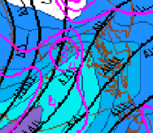
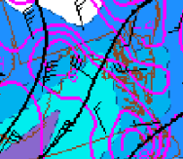
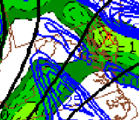
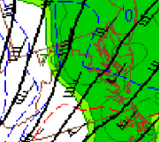
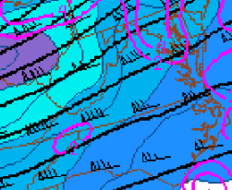
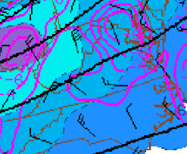
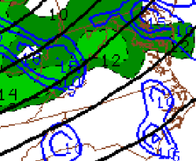
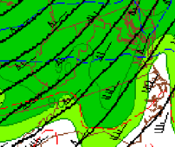
Examples: 1 Dec 2019, 9 Dec 2019
1 Dec 2019: OV AML / TM 1532 / FL230 / TP H25B / TA M30 / IC MOD RIME 230-260 (approximate location designated by red star)
1 Dec 2019: OV EMI270020 / TM 1647 / FL300 TP LJ45 / TA M40 / IC LGT-MOD MX (approximate location designated by purple star)
16 UTC 300 hPa hgt/divg/wind
16 UTC 300 hPa ageostrophic flow/
700 – 500 hPa layer-avg omega
16 UTC 500 hPa vort / 700-400 hPa diff. vort. advection
16 UTC 700 hPa hgt/wind/700-500 hPa mean RH
9 Dec 2019: OV HPW / TM 1823 / FL250 / TP B737 / TA M29 / IC MOD RIME (approximate location designated by red star)
9 Dec 2019: OV AML / TM 2006 / FL230 / TP B737 / TA M24 / IC MOD RIME (approximated location designated by purple star)
19 UTC 300 hPa hgt/divg/wind
19 UTC 300 hPa ageostrophic flow/
700 – 500 hPa layer-avg omega
19 UTC 500 hPa vort / 700-400 hPa diff. vort. advection
19 UTC 700 hPa hgt/wind/700-500 hPa mean RH

Slide 5
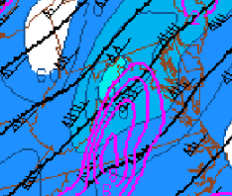
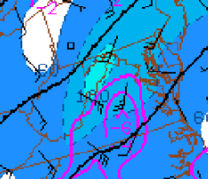
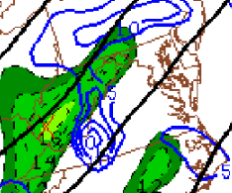
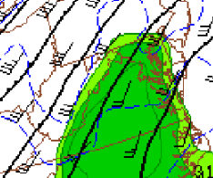
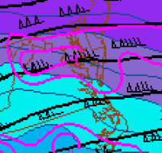
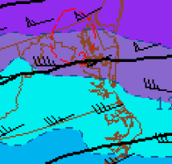
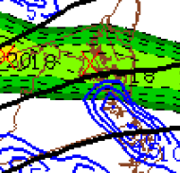
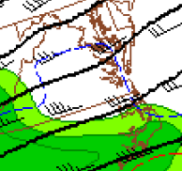
Examples: 13 Dec 2019, 2 Jan 2020
13 Dec 2019: OV ENO240010 / TM 1235 / FL190 / TP E75 / TA M21 / IC MOD RIME (approximate location designated by red star)
13 Dec 2019: OV MOL / TM 1515 / FL210 / TP B738 / TA M23 / IC LGT-MOD MX 230-260 (approximate location designated by purple star)
14 UTC 300 hPa hgt/divg/wind
14 UTC 300 hPa ageostrophic flow/
700 – 500 hPa layer-avg omega
14 UTC 500 hPa vort / 700-400 hPa diff. vort. advection
14 UTC 700 hPa hgt/wind/700-500 hPa mean RH
2 Jan 2020: OV HCM / TM 1759 / FL240 / TP B737 / TA M31 / IC LGT-MOD RIME FL240-260 (approximate location designated by red star)
2 Jan 2020: OV RIC / TM 1820 / FL250 / TP B738 / TA M22 / IC MOD RIME (approximate location designated by purple star)
2 Jan 2020: OV GVE /240028 / TM 2111 / FL240 / TP A321 / TA M24 / IC MOD MX (approximate location designated by dark blue star)
19 UTC 300 hPa hgt/divg/wind
19 UTC 300 hPa ageostrophic flow/
700 – 500 hPa layer-avg omega
19 UTC 500 hPa vort / 700-400 hPa diff. vort. advection
19 UTC 700 hPa hgt/wind/700-500 hPa mean RH

