Slide 1
A case of unexpected VFR
Aviation forecast issued 12Z for December 30, 2010
Notes:
This is a case when TAFs were forecasted to barely reach MFFR category. But instead rose well into the VFR Category.

Slide 2
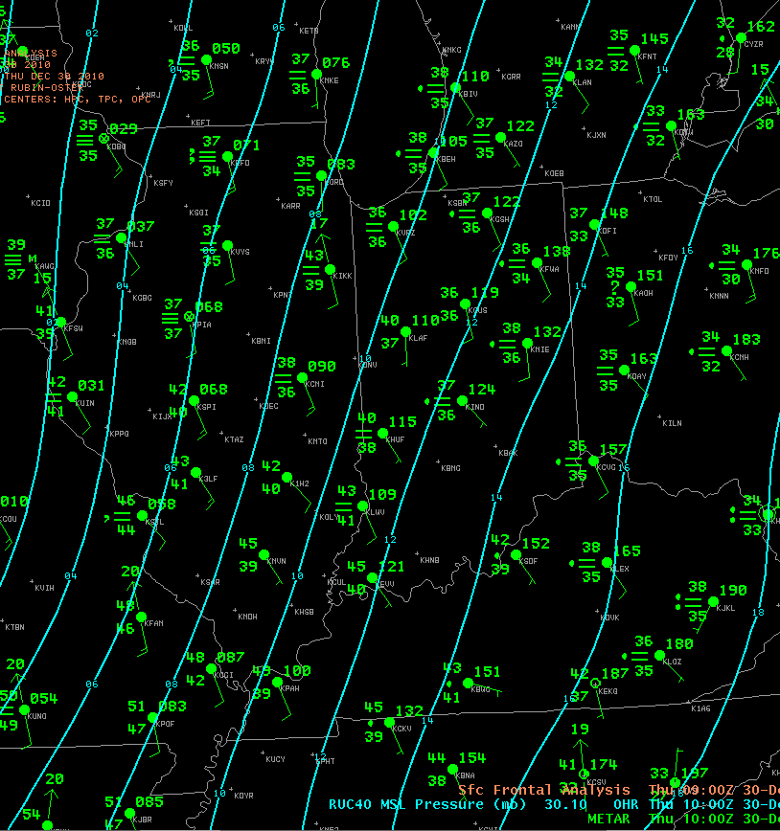
10Z surface chart 12/30/2011
A southerly flow was across the region. Dew points were in the mid 30s across Central Kentucky and Indiana. But they were much higher to the west.

Slide 3
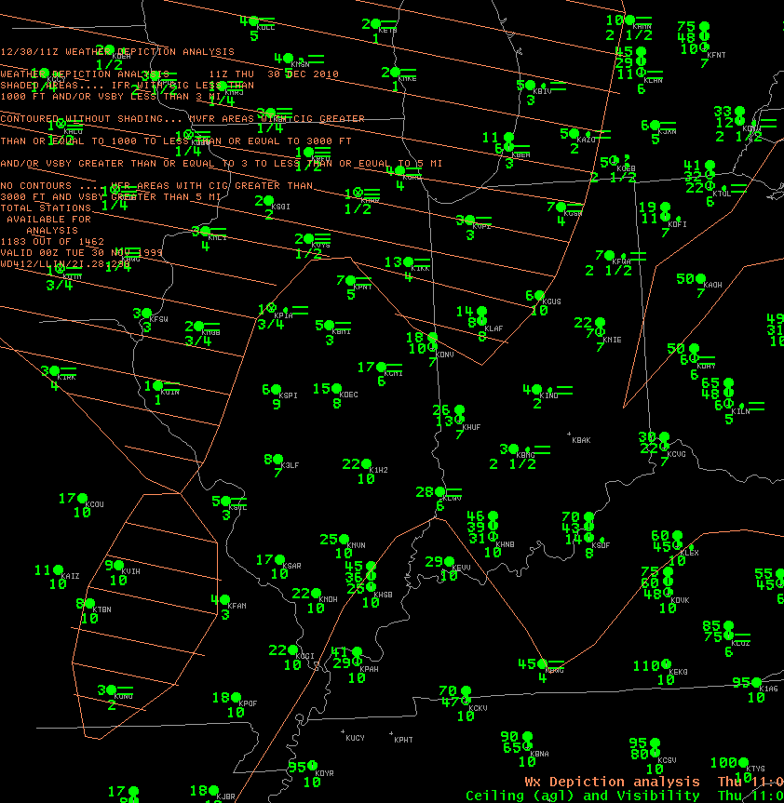
WX depiction at 11Z 12/30/2011
Note IFR conditions from Central Indiana and north while VFR conditions were occurring south of the Ohio river

Slide 4
MOS Category forecasts for Indy
This is from the MAV/MET MOS issued 00Z 12/30/2010 for Indianapolis.
DT /DEC 30 /DEC 31
HR 06 09 12 15 18 21 00
CIG 2 2 2 2 2 4 4 MAVIND
VIS 3 5 3 4 5 6 7 MAVIND
CIG 5 6 7 7 8 7 6 METIND
VIS 7 5 5 6 7 7 7 METIND

Slide 5
TAF’s Issued at 12Z 12/30/10
KIND 301133Z 3012/3118 15010KT 3SM BR OVC004 WS020/20045KT
FM301400 16012KT 3SM BR BKN006 OVC012 WS020/20045KT
FM301700 16012KT 5SM BR BKN010 OVC030
FM310000 17012KT 3SM BR BKN007 OVC012
FM310400 16012KT 3SM BR BKN008 OVC015 WS020/22050KT=
KLAF 301133Z 3012/3112 17009KT 4SM BR BKN007 OVC012 WS020/20050KT
FM301600 16011KT 5SM BR BKN008 OVC015
FM310000 17011KT 3SM BR BKN007 OVC012
FM310400 16011KT 3SM BR BKN008 OVC012 WS020/22055KT
AMD LTD TO CLD VIS AND WIND TIL 301400=
KHUF 301133Z 3012/3112 16010KT 5SM BR BKN010 OVC020
FM301600 16012KT 5SM BR BKN012 OVC025
FM302200 15011KT 4SM BR BKN007 OVC012
FM310300 16011KT 4SM BR BKN007 OVC012 WS020/22050KT=
KBMG 301133Z 3012/3112 15009KT 3SM BR BKN005 OVC012
FM301600 16011KT 6SM BR BKN012 OVC030
FM310000 16010KT 3SM BR BKN008 OVC012
FM310400 17011KT 4SM BR BKN012 OVC025 WS020/22050KT
AMD LTD TO CLD VIS AND WIND TIL 301400=

Slide 6
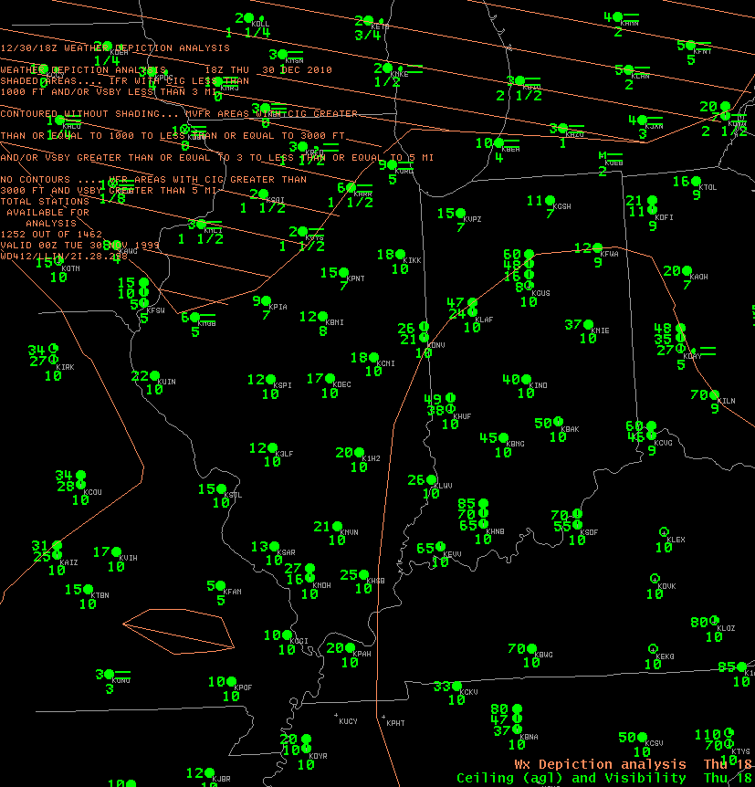
What happened
At 18Z Indianapolis, Bloomington and Terre Haute have improved to VFR while Lafayette had improved to MVFR.

Slide 7
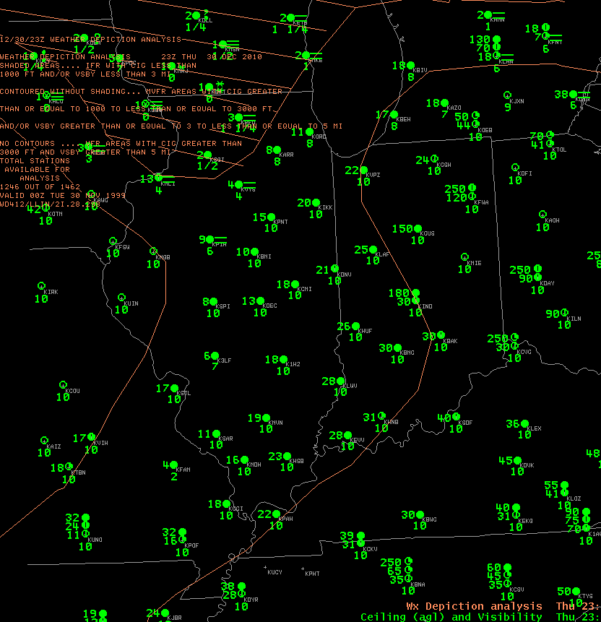
What happened
At 23Z Ceilings at Indianapolis and Bloomington were about 3 thousand feet and slightly less at Lafayette and Terre Haute.

Slide 8
IND improves to VFR by 16Z
Time Temp DP Wind Vsby Ceilings Flight Category
6:54 AM 37 36 SE 9 2.0 -DZ BR OVC004 LIFR
7:22 AM 37 36 SE 9 2.0 BR OVC007 IFR
7:54 AM 37 36 SE 9 2.0 BR OVC007 IFR
8:10 AM 37 36 SE 10 2.0 BR BKN004 OVC009 LIFR
8:54 AM 38 37 SE 9 2.0 BR BKN004 OVC010 LIFR
9:13 AM 37 37 SE 10 2.0 BR FEW004 OVC012 IFR
9:54 AM 39 37 SE 9 2.0 BR SCT004 OVC010 IFR
10:19 AM 39 37 SE 8 3.0 BR FEW004 BKN011 MVFR
10:31 AM 39 37 SSE 9 4.0 BR SCT011 BKN033 MVFR
10:54 AM 42 39 SE 9 6.0 BR FEW013 SCT033 VFR
11:54 AM 45 40 SSE 13 10.0 FEW018 SCT050 VFR
12:54 PM 45 40 SSE 9 10.0 OVC040 VFR
1:54 PM 47 41 SSE 9 10.0 SCT041 BKN050 VFR
2:54 PM 50 41 SSE 12 10.0 FEW050 SCT180 VFR
3:54 PM 52 41 SSE 14 10.0 FEW100 BKN180 VFR
4:54 PM 51 40 S 15 10.0 FEW130 BKN180 VFR
5:54 PM 50 39 S 13 10.0 BKN030 OVC180 MVFR
6:54 PM 49 40 SSE 13 10.0 SCT030 BKN180 VFR

Slide 9
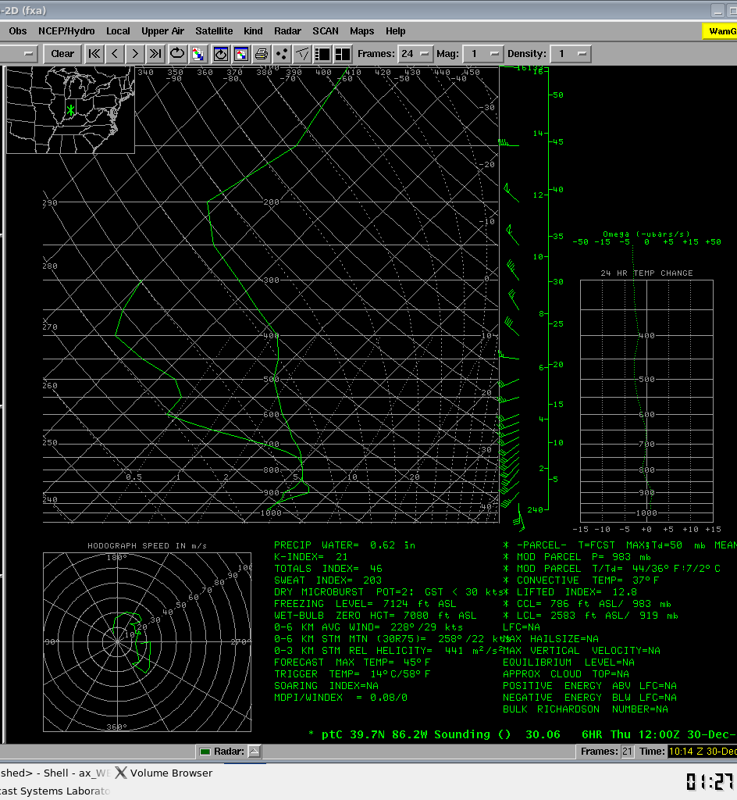
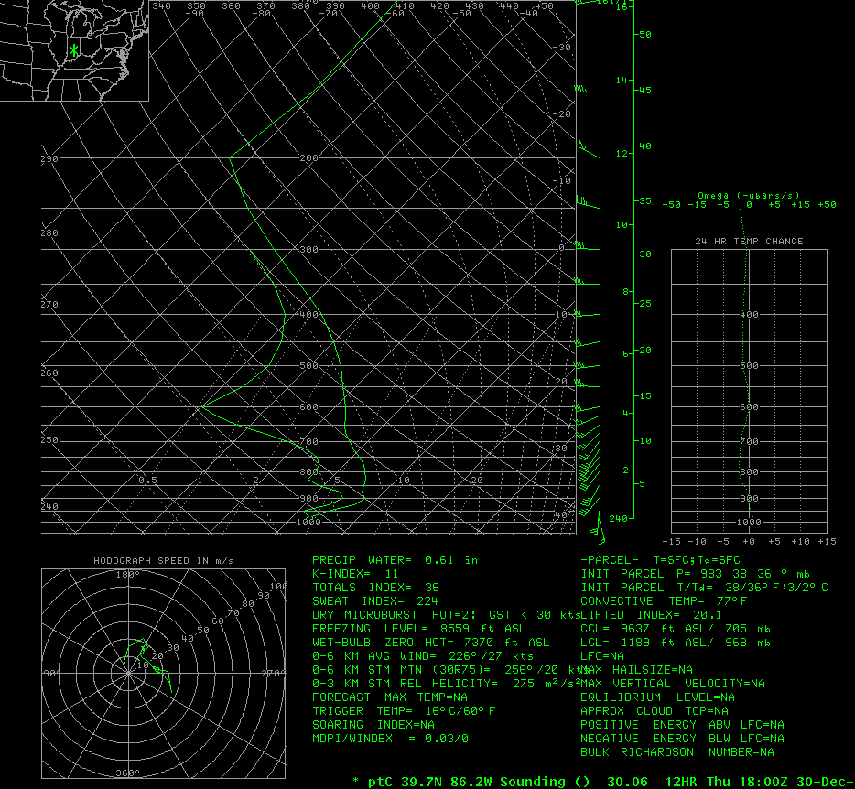
Note drying in lower levels at 18Z
12Z NAM for IND
18Z NAM for IND

Slide 10
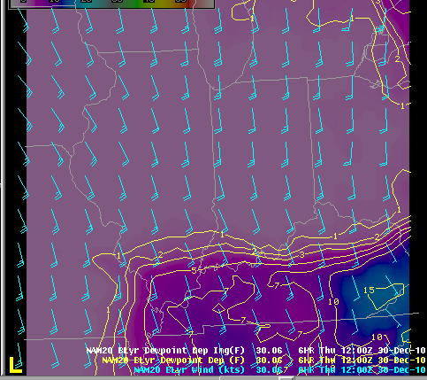
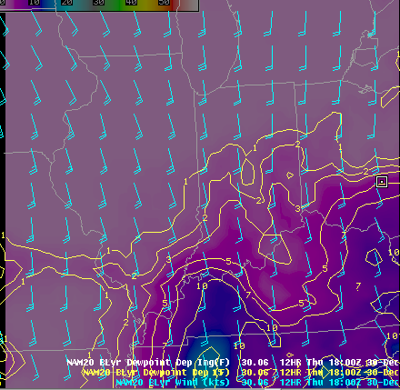
Drying spreads north from Ohio River
12 Boundary Dew point Depression
18Z Boundary Dew point Depression

Slide 11
Some things that forecasted improving to VFR.
MOS aviation category show improvement. Although the MET started out VFR which was not correct.
18Z sounding indicates drying in lower levels
Strong southerly low level flow in soundings which would help VFR conditions spread north.
VFR south of Ohio river at 11Z and boundary dew point depressions decrease south to north by 18Z.
By following some of the above rules. We may have avoided the following:
The END!

