Slide 1

A.S.O.S
AUTOMATED SURFACE OBSERVATION SYSTEM
Michael Samuelson
Electronics Technician
NWS Lubbock, TX
Private Pilot

Slide 2
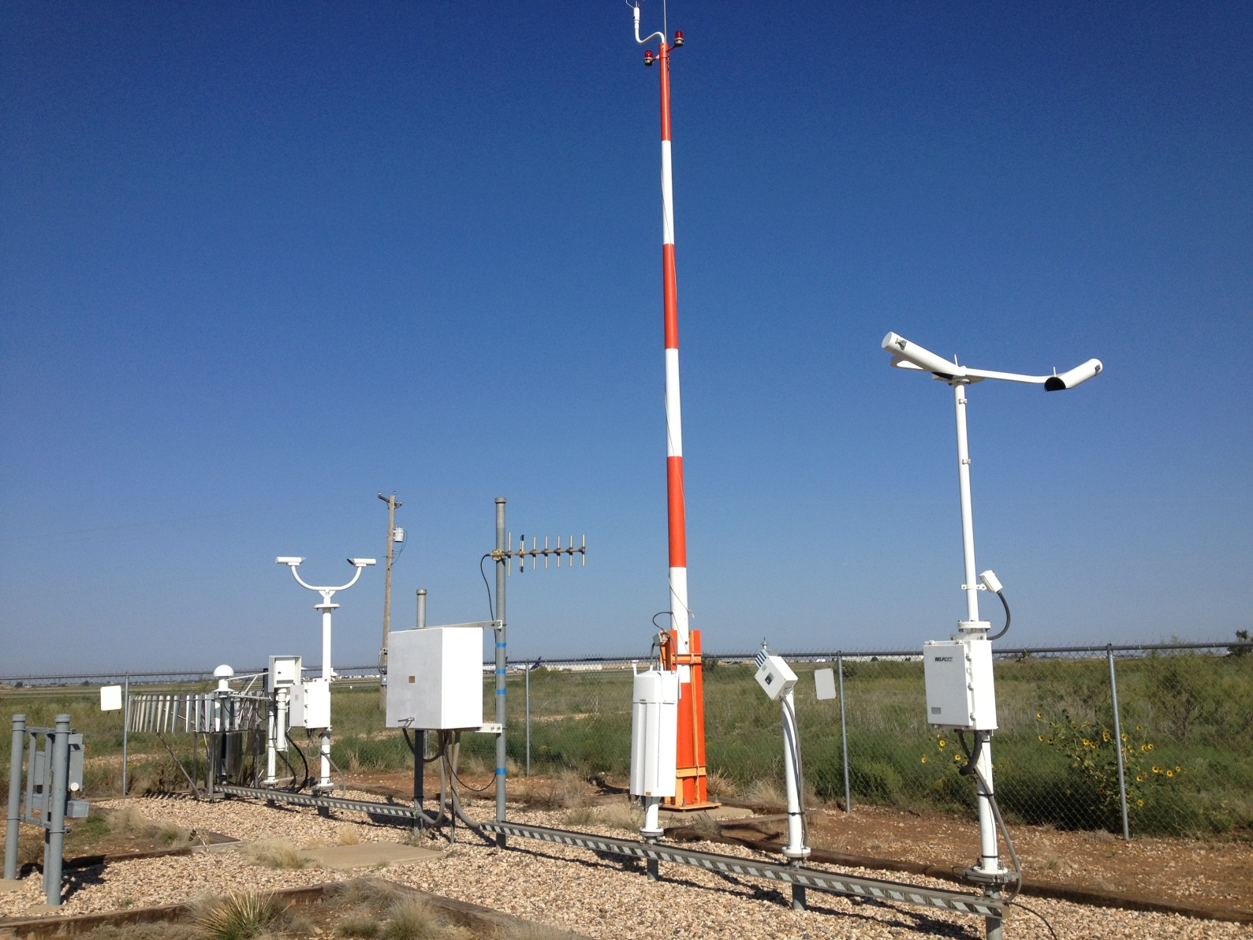
KLBB ASOS

Slide 3
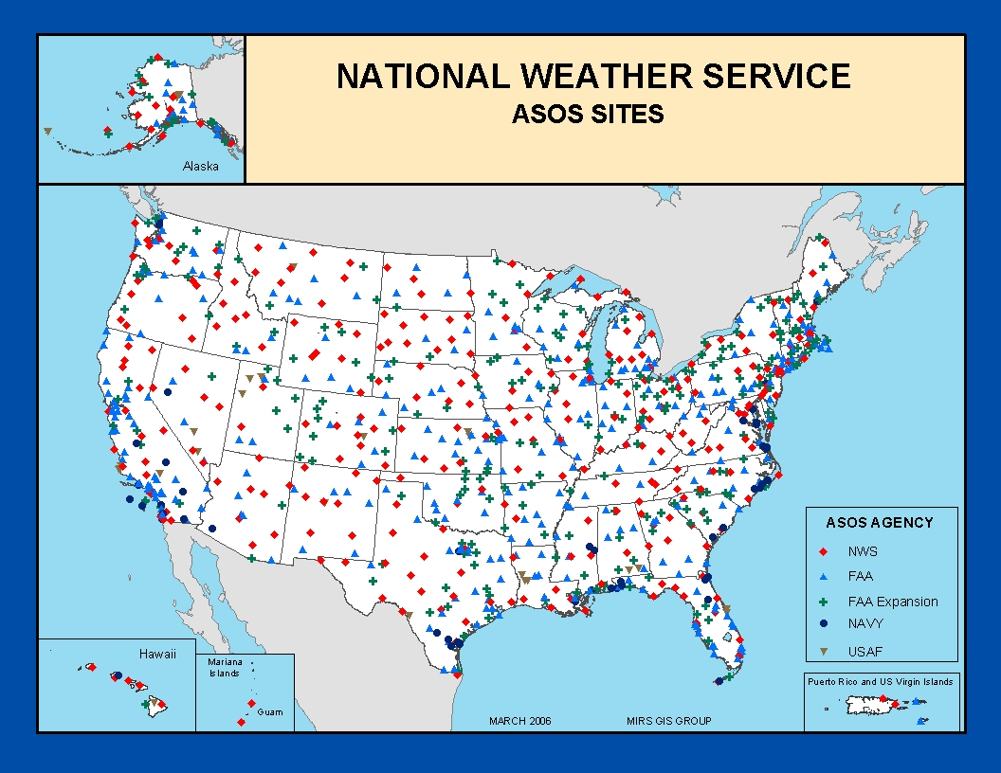
ASOS NETWORK

Slide 4
What does the ASOS do?
Measures:
  Wind Speed/Direction
  Visibility
  Present Weather
  Freezing Rain
  Cloud Conditions
  Temperature
  Dew Point
  Pressure
  Precipitation Accumulation
Produces Reports
  METAR
  SPECI
Disseminates Data:
  FAA
  NWS
  GTA Radio
  Phone

Slide 5
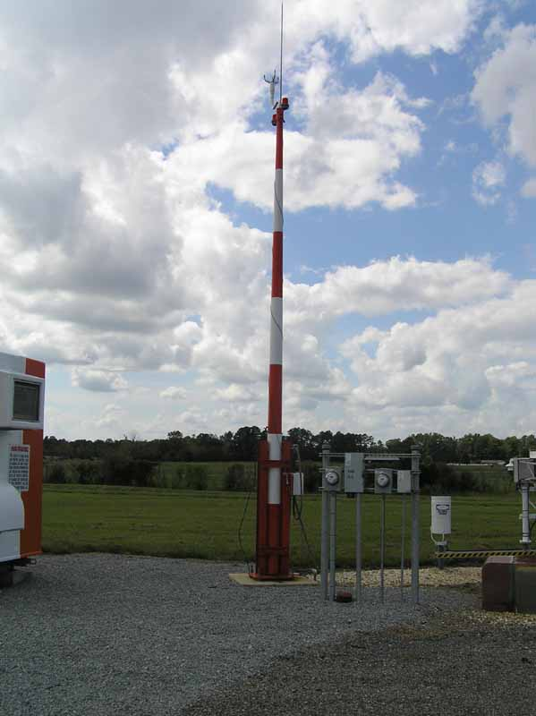
Wind
Wind Tower: 30ft Tall
Speed
  Between 0-125 knots
  ±2 knots accuracy
Direction
  Reports to nearest 10°
  Measures in relation to True North

Slide 6
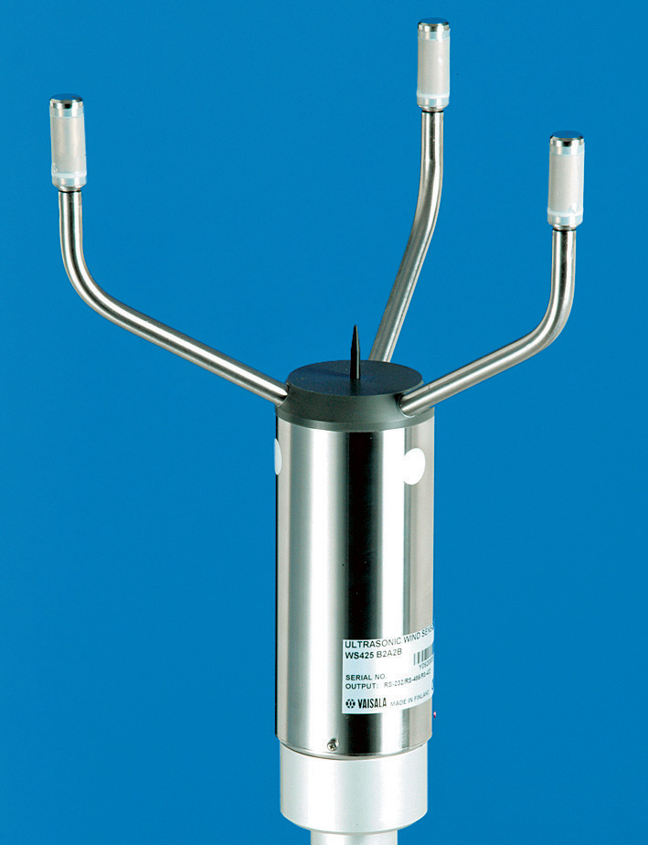
Ice Free Wind Sensor
Ice Free
  Heated
  No moving parts
Uses 3 Ultrasonic Sensors
  Total of 6 paths
Birds can cause interference in ultrasonic paths
  Bird=$

Slide 7
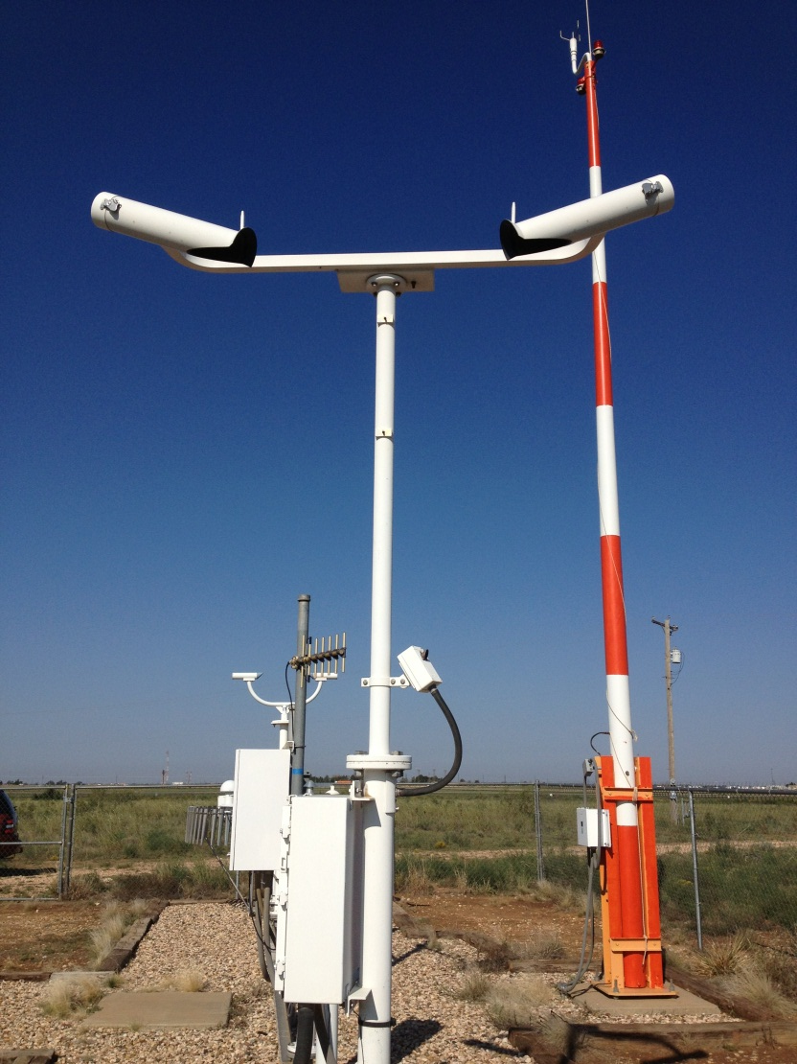
Visibility
Reports in Statute Miles
  <¼ , ¼, ½, ¾, 1, 1¼, 1½, 1¾, 2, 2½, 3-10, 10+
Uses Xenon light to measure visibility in 0.75 ft³ volume of air
Transmitter/Receiver 45° apart

Slide 8
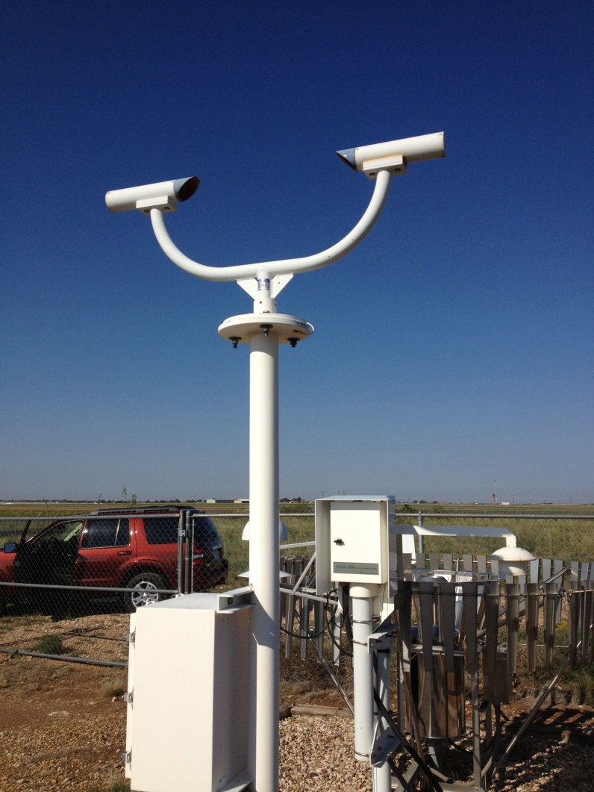
Present Weather
Light Emitting Diode Weather Identifier (LEDWI)
Determines precipitation type and density
  R-, R, R+, S-, S, S+.
Uses Infrared Emitting Diode
Calibrated Quarterly

Slide 9
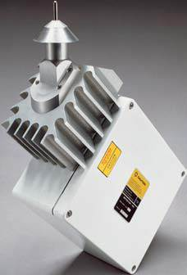
Freezing Rain Sensor (ZR)
Measures accumulation as low as 0.01 in/hr
Oscillates at 40kHz
Enters heat cycle at ¼ inch of accumulation
Eliminates snow by cross checking PWI for rain/snow indication

Slide 10
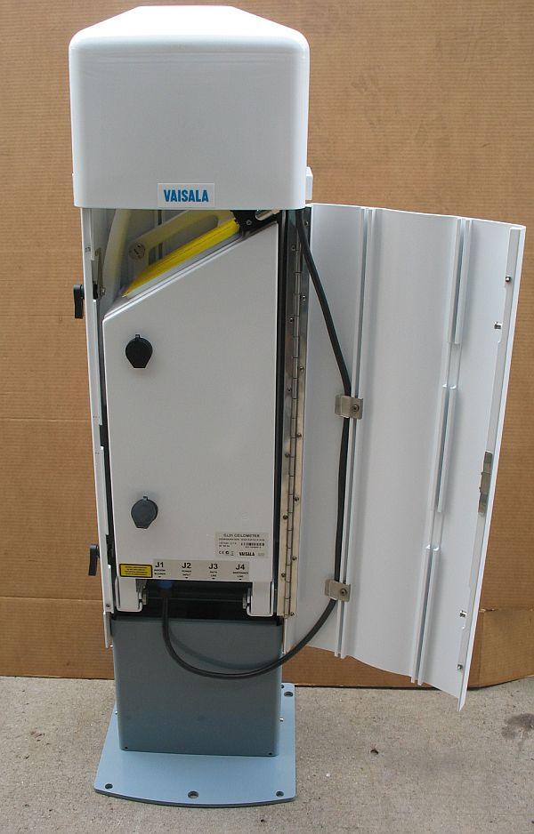
Ceilometer
Measures cloud height and density
Able to detect up to 3 cloud layers simultaneously
Up to 12,650 feet
  50 ft. resolution
Evaluates 30 minutes of data

Slide 11
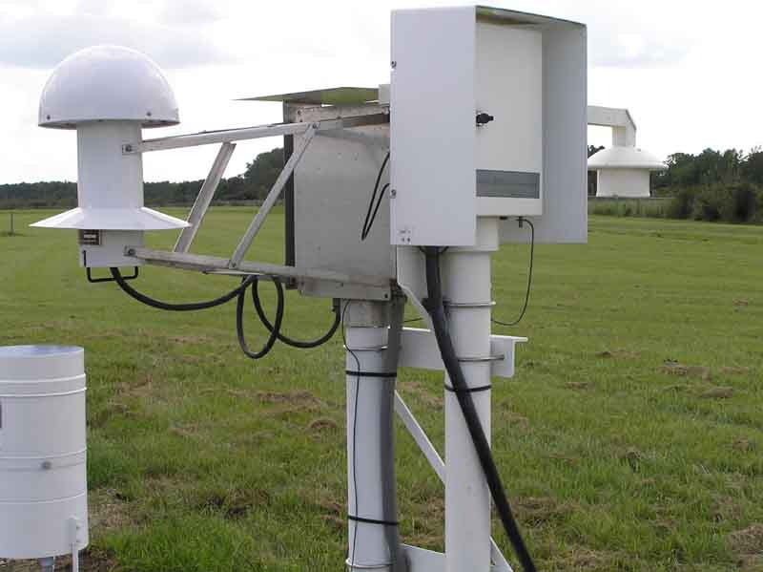
Temperature/Dew Point
1088 sensor
  Ambient Temp
  Dew Point Temp
Uses chilled mirror to measure dew point
This dewpoint sensor is used as a backup

Slide 12
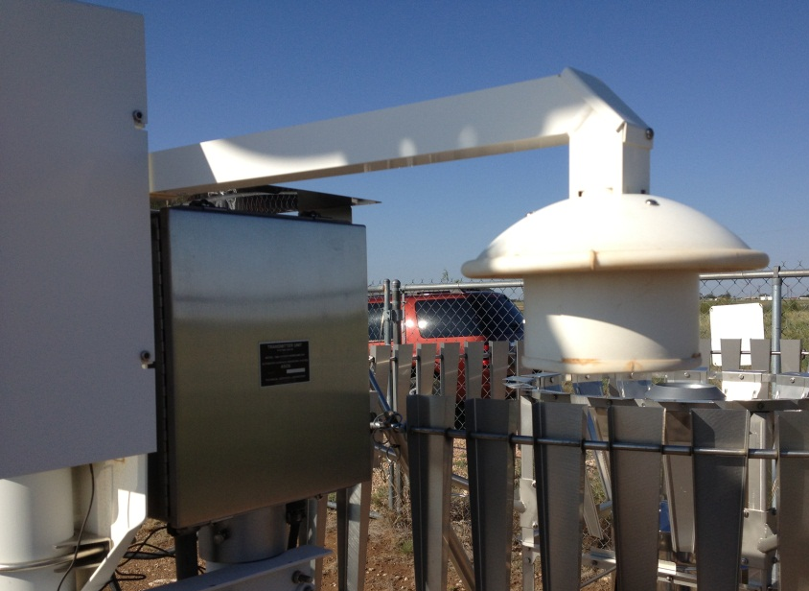
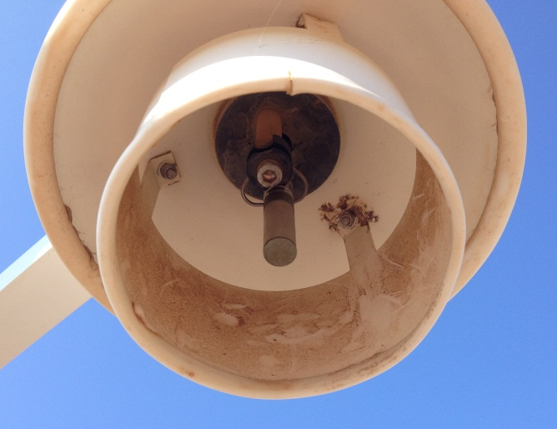
Dew Point (DTS-1)
Primary sensor for dew point
Measures relative humidity
  Calculates DP from RH and temp
Uses HUMICAP
  Determines RH by measuring capacitance of air

Slide 13
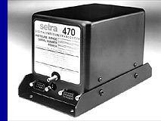
Ambient Pressure
Digital pressure transducer
Double or triple redundant depending on location
Located indoors in ACU cabinet
Accurate to 0.02%
Checked quarterly for accuracy

Slide 14
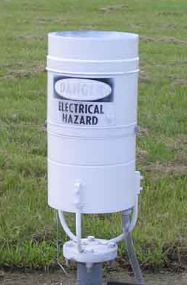
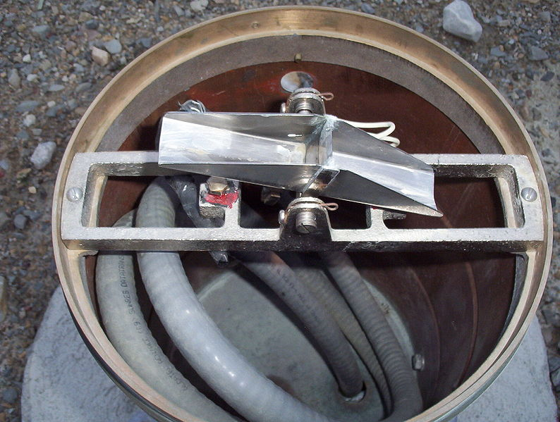
Tipping Bucket
Used at FAA owned ASOS sites
Heated to prevent ice build up
Bucket tips at 0.01” of accumulation

Slide 15
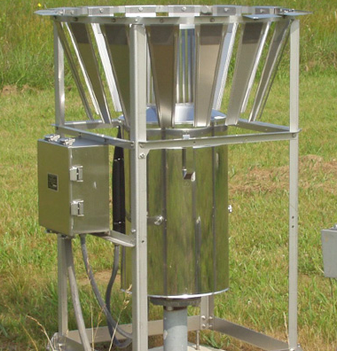
All Weather Precipitation Accumulation Gauge
AWPAG
Measures accumulation by weight and converts to 0.01” increments
Heated to prevent icing
Uses a precision load cell to measure weight

Slide 16
Processing
Acquisition Control Unit
Data Collection Package
Receives data from DCP
Processes, stores and disseminates data
Provides interface with FAA, NWS and/or GTA radio
Data Quality Checks
Provides power to sensors
Interfaces between ACU and sensors
Collects data from all sensors (except pressure)
Sends data to ACU via RF link

Slide 17
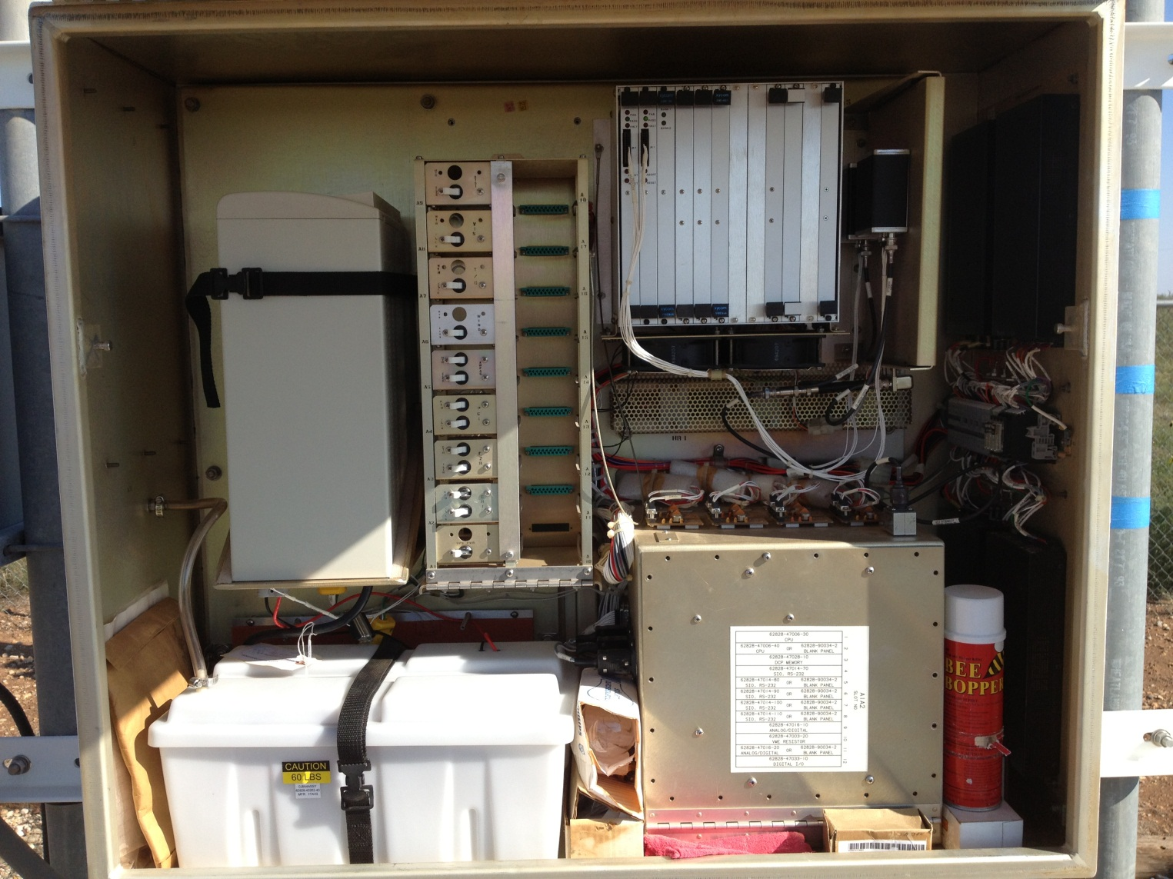
DCP

Slide 18
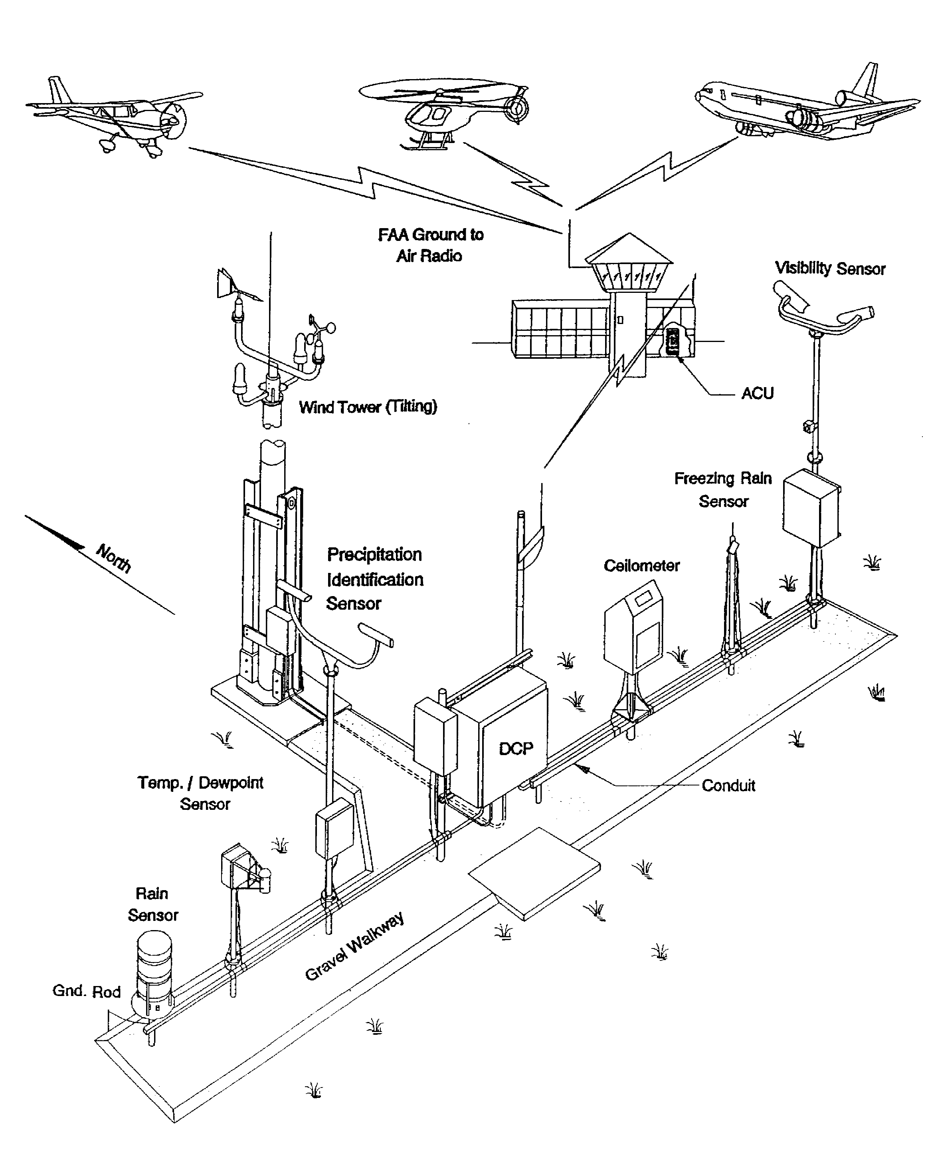

Slide 19
$
Used as an indicator of required maintenance
Data potentially missing from METAR
Quality of any data in METAR is unaffected
Could be caused by ongoing maintenance on any sensor
Remains in METAR until cleared out by technician

Slide 20
Data Quality Checks
If a sensor fails it’s data quality check the data will not be included in METAR
  METAR can be amended by observer
After data quality checks pass the data will be included in METAR
  $ will remain until cleared by technician
Examples of data quality check:
  Visibility: must be >2 mi. if TA-TD is >5°F
  Pressure: sensors must be within ±0.04 in./Hg of each other

Slide 21

ANY QUESTIONS?

