Slide 1
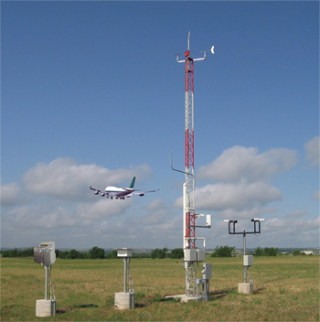
ASOS and AWOS – What Pilots need to know about weather observations
Richard Mamrosh – NWS Green Bay
Stephanie Haynes – Vaisala Corp

Slide 2
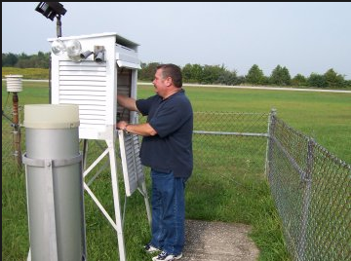
Surface Weather Observing
Weather observing changed dramatically around 20 years ago with the advent of automated weather observing equipment.
Before automation, airport weather observers measured pressure, temperature, humidity, wind, ceiling height, visibility, and precipitation at least once each hour.

Slide 3
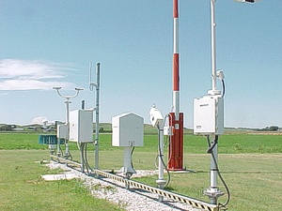
Surface Weather Observing
Today’s automated systems have the advantage of being able to constantly monitor the weather, but have some disadvantages compared to human weather observers.
Knowing how these systems work can help you use them effectively for a safe flight!

Slide 4
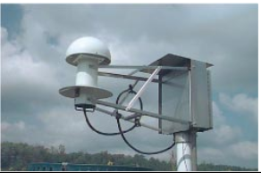
Temperature and Dewpoint
ASOS uses a hygrothermometer to measure temperature and dewpoint.
A five minute average temperature is produced and available each minute.
The five minute average is reported in the METAR.

Slide 5
Temperature Lag
Let’s say a cold front moved through at 2145Z and the temperature dropped from 10C to 4C in two minutes. ASOS would report something like
KGRB 122145Z 18012KT P6SM SKC 10/08
KGRB 122146Z 32018KT P6SM SKC 10/08
KGRB 122147Z 33019KT P6SM SKC 09/07
KGRB 122148Z 34020KT P6SM SKC 08/06
KGRB 122149Z 35023KT P6SM SKC 07/05
As you can see, the use of a five minute average causes the reported temperature to lag behind the actual temperature. This may be important when temperatures are near freezing. It may take up to 10 minutes to report the true temperature.

Slide 6
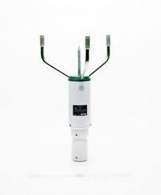
Wind Speed and Direction
ASOS units employ a sonic anemometer to measure wind speed and direction.
A two minute average wind speed is obtained from 24 five second averages.
Gusts and peak winds are the highest three second averages.
ASOS uses a two minute average of five second averages for wind direction.
The lag in wind measurements is usually not as extreme as temperature.

Slide 7
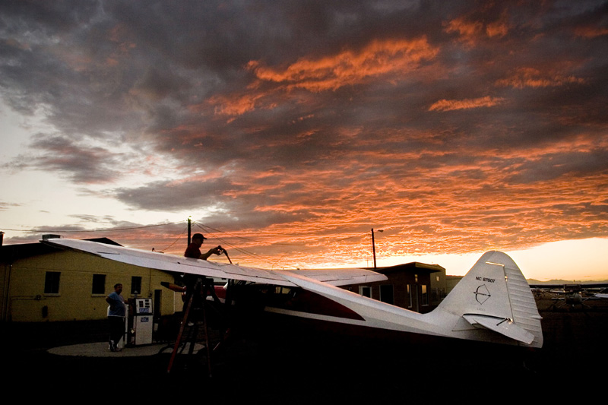
Clouds

Slide 8

Cloud Cover - Observer
ASOS/AWOS determines cloud cover MUCH differently than a human observer.
A weather observer could look around the horizon and get a quick idea of how much of the sky is covered by clouds.
Since ASOS/AWOS can only look straight up, it uses a time averaging method to determine cloud cover.

Slide 9
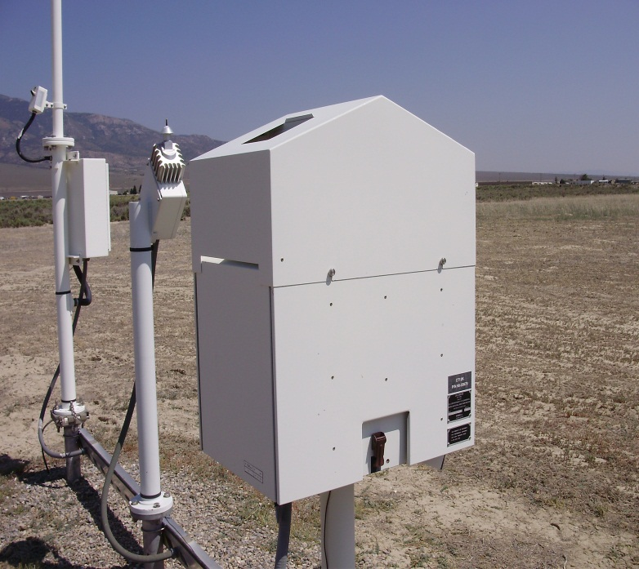
Cloud Cover – ASOS/AWOS
ASOS/AWOS uses a laser beam ceilometer that points straight up from the ground.
An algorithm processes data from the last 30 minutes, but weights the most current 10 minutes of data twice as much.

Slide 10
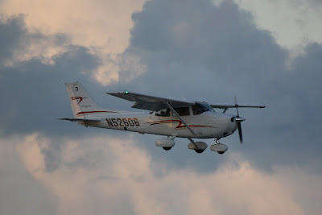
Cloud Cover – ASOS/AWOS
It is important for a pilot to know that if a clear sky quickly becomes overcast it will take two minutes to report scattered clouds and 10 minutes to report a broken layer (ceiling)!
It takes a similar amount of time when a cloudy sky quickly clears.
If ceilings are marginal and clouds are reported as scattered, try to look for trends to determine if the sky might actually be broken or overcast.

Slide 11
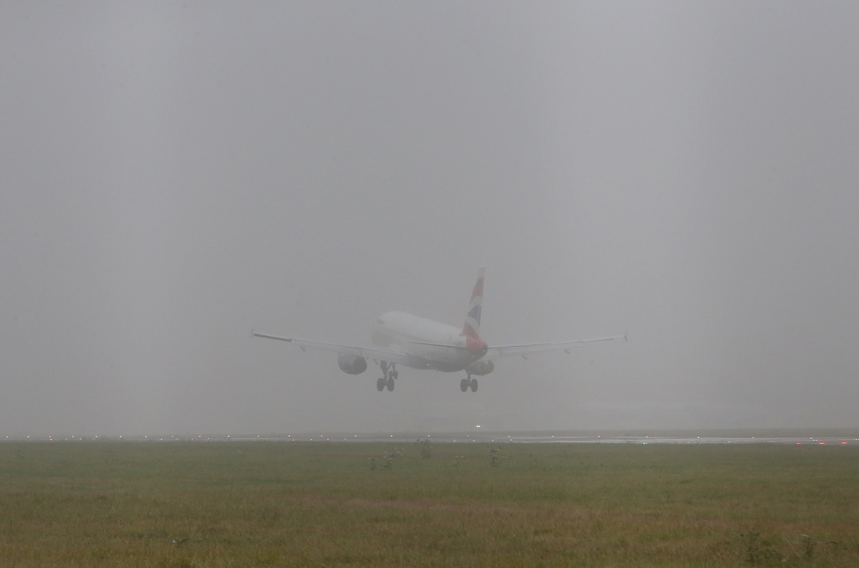
Visibility

Slide 12
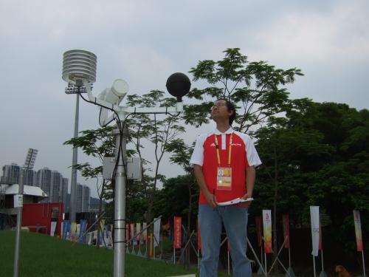
Visibility - Observer
A weather observer can go outside and look in all directions to determine a prevailing visibility.
He can also mention areas of locally higher or lower visibility.

Slide 13
Visibility
ASOS/AWOS use a sensor that measures the clarity of the air in a small space, right at the sensor, in order to determine visibility.
The measurements are time averaged, so there is a lag in reporting quickly changing visibilities.
If the visibility improves quickly from 1 mile to 7 miles, it will take ASOS three minutes to report 3 miles, and 9 minutes to report 7 miles.

Slide 14
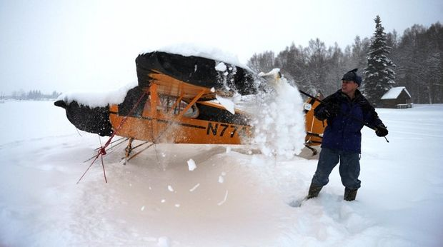
Weather Types

Slide 15
Weather Types
While human observers could simply go outside and observe fog, haze, smoke, blowing snow, and various precipitation types, it is a bit more difficult for automated systems.
Automated systems generally cannot identify smoke, ice pellets, ice crystals, hail, or blowing snow, sand or dust.
Most report fog, haze, rain, snow, freezing rain and unknown precipitation.

Slide 16
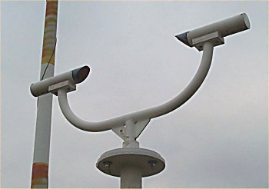
Precipitation Type
ASOS/AWOS use Light Emitting Diodes to measure the reflectivity of light, which varies with different types of precipitation.
An algorithm using temperature and visibility is used to help determine precipitation type.
Light emitting diode weather detector

Slide 17
Precipitation Type
Some ASOS/AWOS units have a freezing rain sensor that measures the frequency change of a moving wire.
When the wire gets coated with ice, it becomes heavier and moves slower.
If the sensor becomes unreliable, algorithms are used to ensure freezing rain is not reported when its warm outside, or if the precipitation sensor says it is not precipitating.

Slide 18
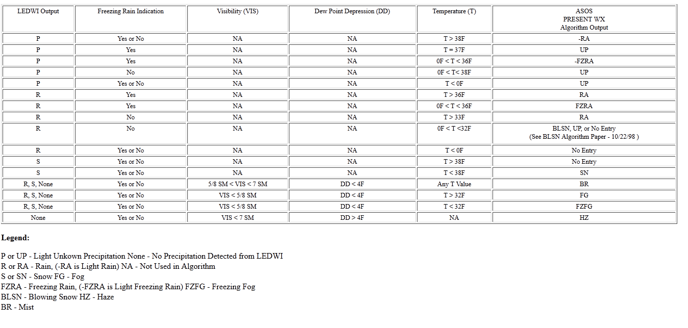
Precipitation Type
Example: If the weather sensor reports rain, the
Freezing rain sensor indicates freezing rain, but the temperature is above 36F, the unit reports rain.

Slide 19
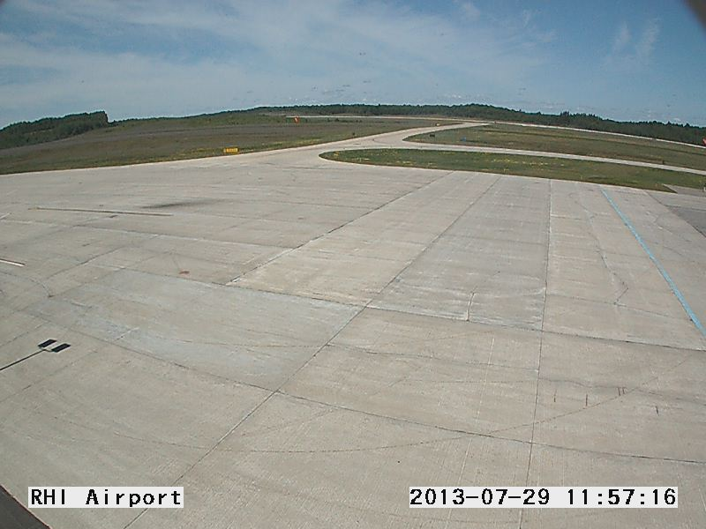
Precipitation Type
While ASOS/AWOS are generally reliable, you might consider calling the FBO or airport manager when unknown precipitation is reported, or any of the weather elements are questionable.
Airport webcams may also be helpful.

Slide 20
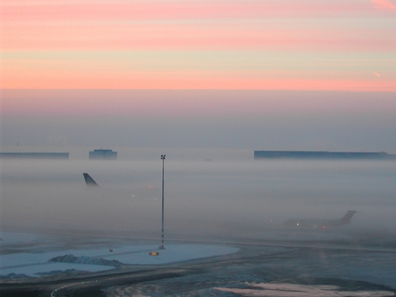
Location at Airport
AWOS/ASOS observations can sometimes seem unrepresentative due to their location on an airfield.
Dense fog may be present at the sensor site, but not over one or all of the runways.

Slide 21
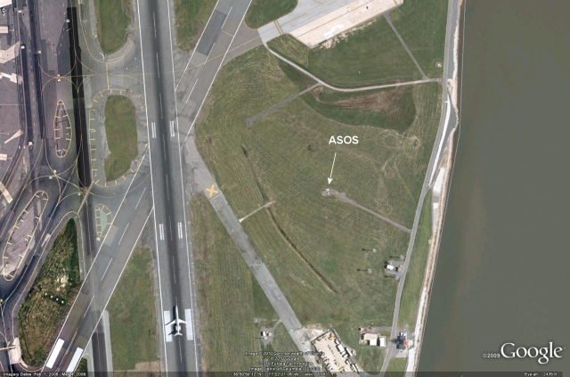
Location of ASOS/AWOS
Reagan National Airport
Fog can straddle river
but remain clear of
Runways
Potomac
River

Slide 22
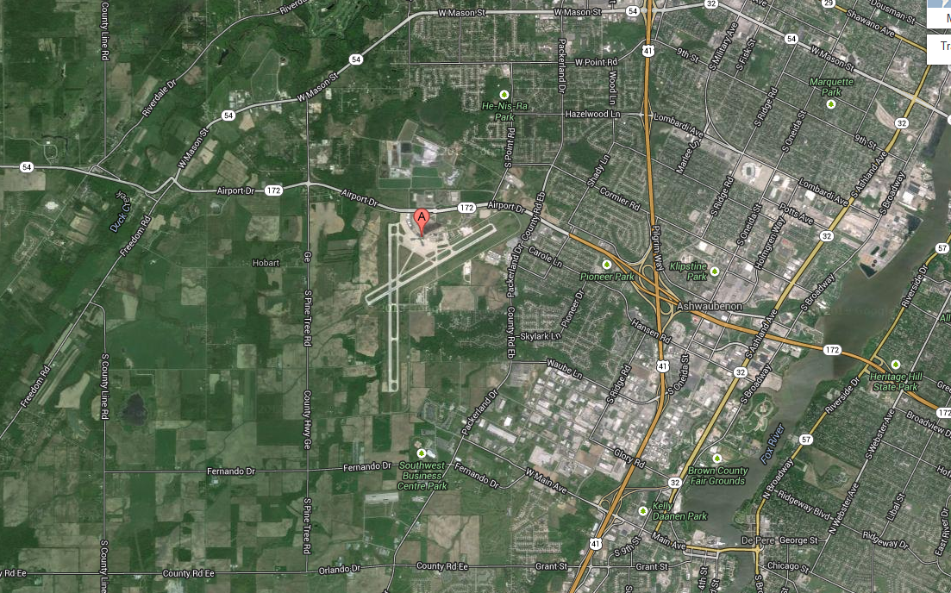
Location of ASOS/AWOS
Austin Straubel Airport
Green Bay metro area
Fields and swampy areas
ASOS
Line shows frequent eastern extent of fog

Slide 23


Thanks for attending!

Slide 24
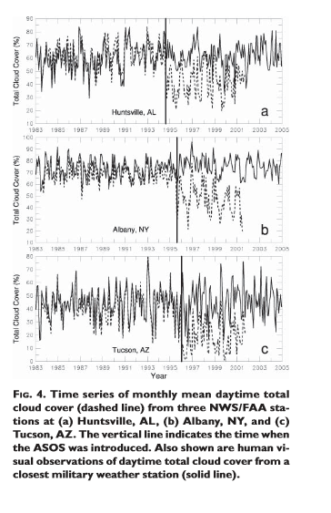

Slide 25
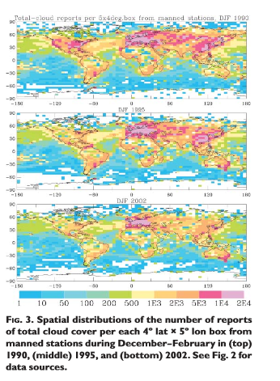
Cloud cover

