Slide 1
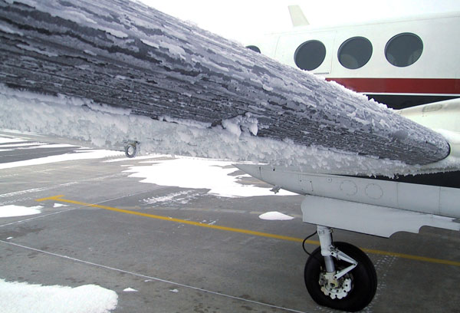
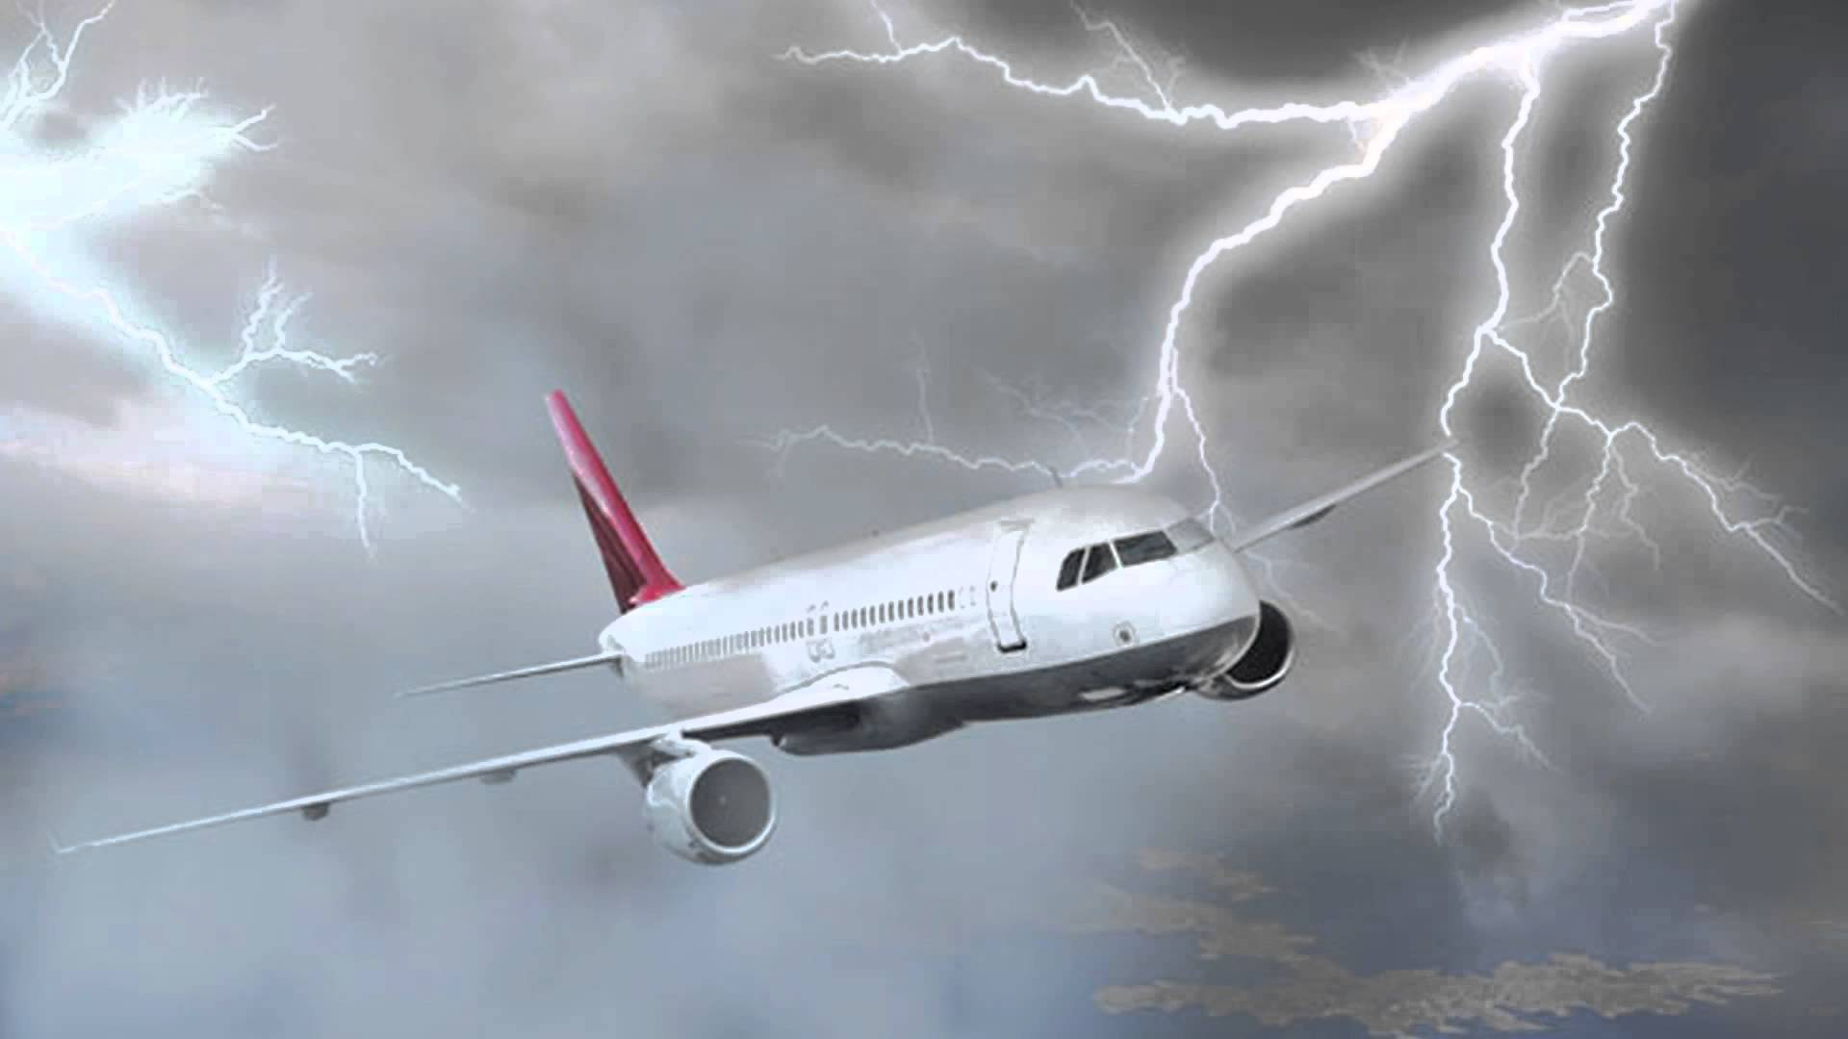


Aircraft Icing and Thunderstorms
US Coast
Guard Auxiliary
Notes:
This two part presentation will cover the basics of local weather most hazardous to pilots in the Great Lakes. Icing during the cool season and thunderstorms in the warm season.

Slide 2
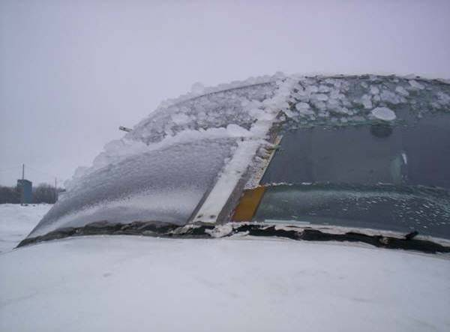
Part 1 Icing
Notes:
Part 1 will cover the basics of aircraft icing.

Slide 3
Categories of Icing
Structural Icing
  Forms on the surface of the airframe
Induction Icing
  Forms in air intakes of engines
Instrument Icing
  Forms on pitot tube and other exterior instruments
Notes:
This presentation will focus on Structural Icing. Note induction icing (also known as carburetor icing) occurs when moist air is drawn into the engine and cools due to a drop in air pressure.

Slide 4
Necessary Conditions
Temperature of 0 Celsius or colder
Supercooled liquid droplets
  Liquid cloud or precipitation droplets at below freezing temperatures
Wet snowflakes
  Snowflakes at temperatures near 0C
  Mixture of ice particles and supercooled water droplets
When the supercooled liquid hits the airframe, the airframe acts like an ice condensation nuclei and allows the liquid to rapidly freeze
Notes:
Super cooled water droplets are the key to icing.

Slide 5
The Cause of Icing
NOT caused by ICE in clouds.
Is caused by “Super-cooled” liquid water droplets
  Strike the leading edge of an airfoil
  Freeze on impact
Notes:
Stress that it is not ice particles in the cloud that causes icing, it is water droplets present in the atmosphere at sub freezing temperatures.

Slide 6
Supercooled Droplets – Why do they exist?
Ice Condensation Nuclei typically do not exist at temperatures warmer than -10C
Ice Condensation Nuclei levels are present at 50% between -10C and -14C
Ice Condensation Nuclei are present nearly to 100% by -20C
Several types of clay particles are common ice nuclei, silver iodide is another.
Notes:
In order for ice to develop, you need ice condensation nuclei present which will allow water droplets to adhere into that of the molecular structure of ice. Ice nuclei are actually not typically present at temps warmer than -10C and only 50 percent present at temps between -10C and -14C. The frame of the aircraft will act as ice nuclei, allowing the water droplets to become ice once they impact the aircraft. NOTE: They use silver iodide in cloud seeding experiments as it will activate ice nucleation at temps warmer than -10 C.

Slide 7
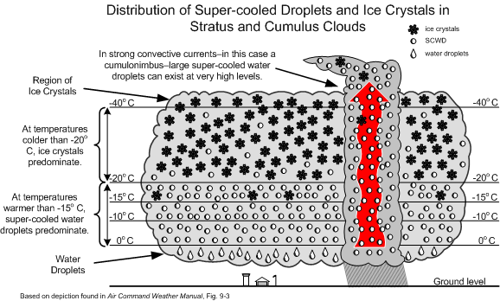
Notes:
Note how a convective updraft (thunderstorms) rapidly transports super cooled droplets into colder regions of the clouds. This is one of the many reasons why thunderstorms need to be avoided.

Slide 8
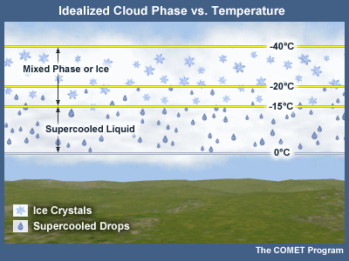
Notes:
This is the standard distribution of ice and liquid droplets within a stratus cloud. Again, in convective clouds, the updrafts will force supercooled droplets to higher altitudes and thus colder temperatures.

Slide 9
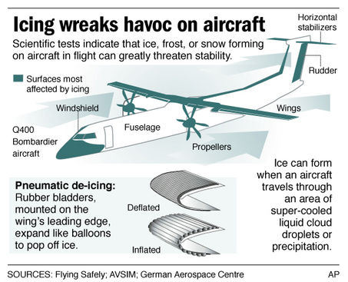
Notes:
NOTE: the rubber bladders (bottom central picture) are effective in getting ice off the front of the wing, but often times do not get it off other parts of the wing. The rubber bladders work best with rime icing, which we will talk about in later slides.

Slide 10
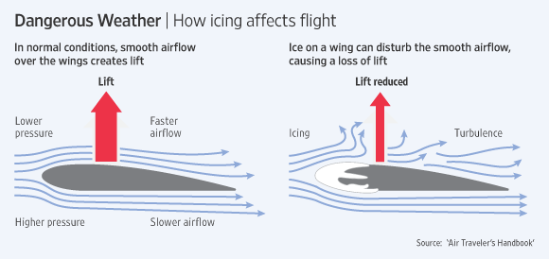
Notes:
Note that it really does not take much ice buildup to affect the lift.

Slide 11
ICING INTENSITIES
TRACE - PERCEPTIBLE, NO SIGNIFICANT ACCUMULATION
LIGHT - SIGNIFICANT ACCUMULATION FOR A PROLONGED FLIGHT (OVER 1 HOUR)
MODERATE - SIGNIFICANT ACCUMULATION FOR SHORTER PERIODS OF FLIGHT
SEVERE - RAPID, DANGEROUS ACCUMULATIONS
Notes:
This is how the NWS and FAA define icing intensities.

Slide 12
CLEAR ICING
FAVORABLE CONDITIONS
LARGE DROPLETS IN CUMULIFORM CLOUDS OR FREEZING RAIN
TEMPERATURES 0°C TO -20°C
Notes:
Clear icing usually causes moderate to severe icing. Note that freezing drizzle is also very effecting in aircraft icing.

Slide 13
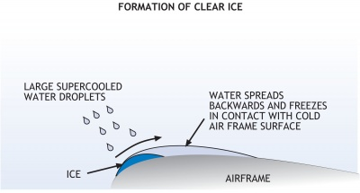
Notes:
When we say large droplets, it is in a relative sense, as even some of the larger supercooled droplets can be difficult to see with the human eye.

Slide 14
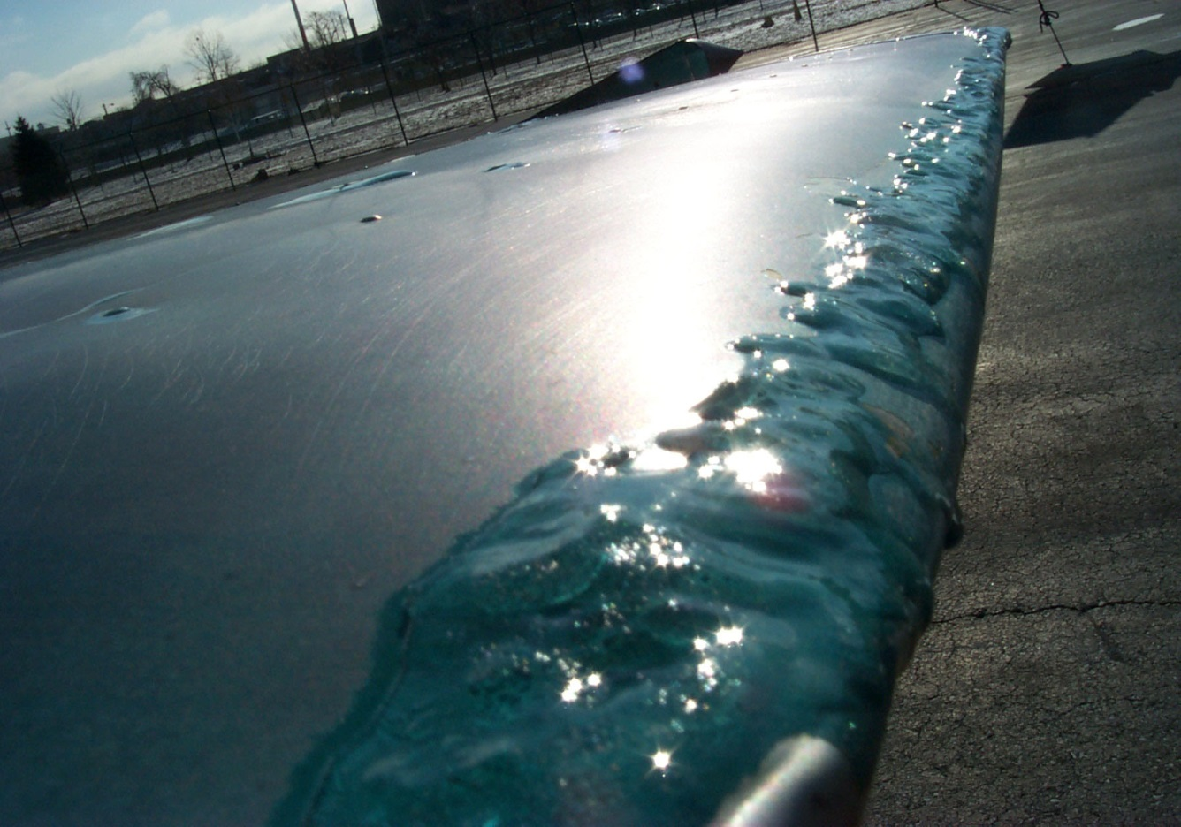
Clear Icing - Characteristics
Rapid accumulation
  Droplets are large
  Droplets are highly concentrated
Smooth surface
Hard
Difficult to remove

Slide 15
RIME ICING
FAVORABLE CONDITIONS
SMALL SUPERCOOLED DROPLETS IN STRATIFORM CLOUDS
TEMPERATURES 0°C TO -20°C
Notes:
Most common type of icing. This is usually light icing from this process.

Slide 16
Rime Icing
White, frosty appearance
Favorable conditions
  Small water droplets
  Stratiform clouds
  Temperatures 0 to -20 C
Formation Process
  Droplets freeze on impact
  Air is trapped between frozen particles
Notes:
Because of the trapped air, the icing is the easiest for deicers to remove.

Slide 17
Rime Icing - Characteristics
Accumulates more slowly than clear icing
  Droplets are smaller
  Droplets are less concentrated
Irregular, pebble-like surface
Structurally weaker than clear icing
  Effect of trapped air

Slide 18

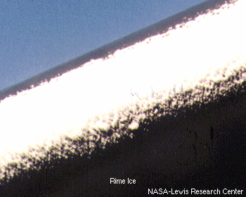
Notes:
Formation of rime icing on an aircraft. The picture was taken from a NASA research lab.

Slide 19
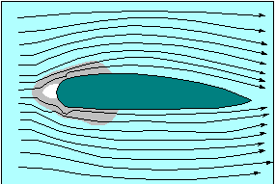
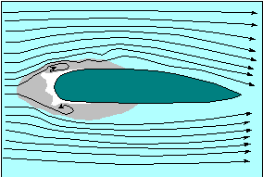
Rime Icing
Gray is region where air is stagnant
Tends to form at leading edge of airfoil
More easily for de-icing equipment to remove
Rime
Compare with “horns” of Clear icing
Clear
Notes:
Note how the deicing bladders or boots on the wing are usually unable to remove the horns formed from clear icing.

Slide 20
MIXED ICING
FAVORABLE CONDITIONS
LARGE AND SMALL DROPLETS COEXIST
LIQUID AND FROZEN PARTICLES COEXIST
WET SNOW
FREEZING TEMPERATURES
Notes:
This type of icing is usually going to be moderate to severe and typically occurs with wintery precipitation or within the updrafts of thunderstorms.

Slide 21
Mixed Icing
Glossy white appearance
Associated with strong upward motion
Favorable conditions
  Large and small droplets coexist
  Liquid and frozen particles coexist
  Wet snow
  Freezing temperatures (Often much colder than -10C)
Formation Process
  Combines clear and rime icing processes and/or wet snowflakes
Notes:
Note that thunderstorm updrafts displace large and small super cooled droplets to higher altitudes and much colder temperatures.

Slide 22
Mixed Icing - Characteristics
Rapid accumulation
  Particles are large
  Particles are highly concentrated
Rough surface
  Creates turbulent flow over wing
  Most effective in reducing aerodynamic efficiency (turbulent flow over wing reduces lift)
  Difficult to remove

Slide 23
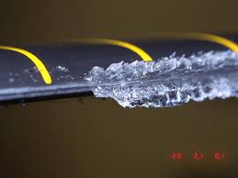
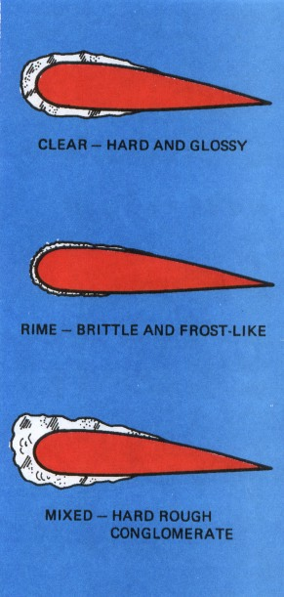
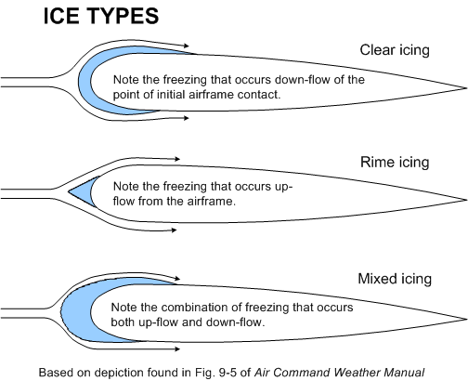
Notes:
This picture is mixed icing from a NASA research lab.

Slide 24
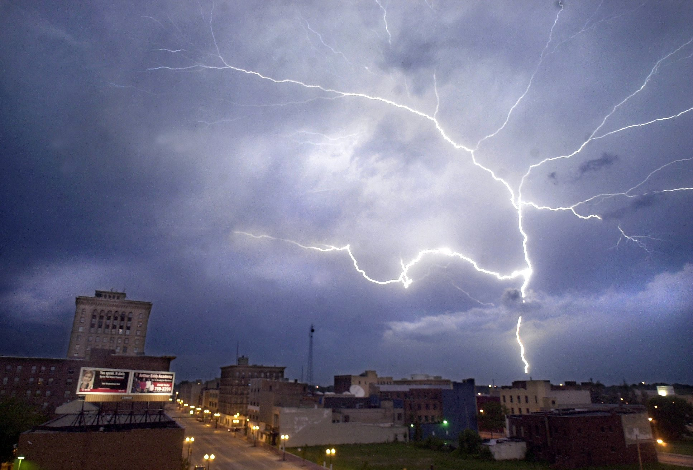
Part 2 Thunderstorms
Notes:
The second section will give some basics on thunderstorm processes.

Slide 25
The Dangers in and Near Thunderstorms
Wind shear
Turbulence
Icing
Lightning
Hail
Notes:
These are why thunderstorms need to be avoided in flight.

Slide 26
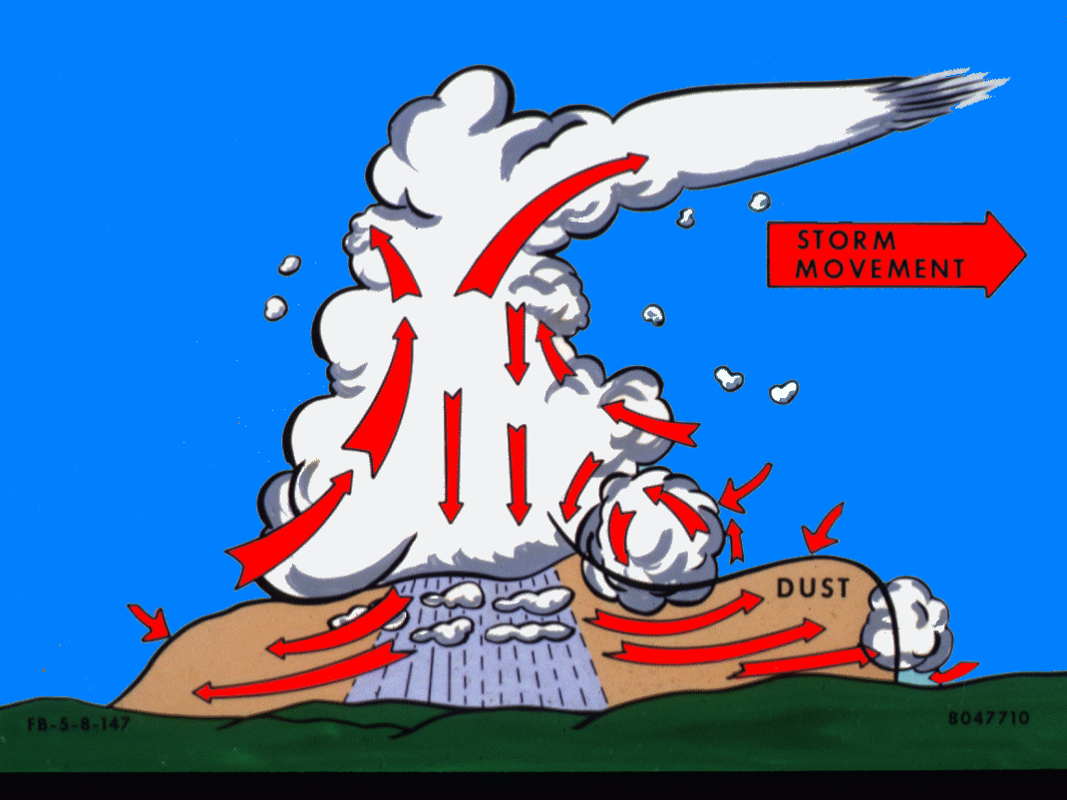
TURBULENCE and WIND SHEAR
CAT
BLOWOFF
ROLL CLOUD
WIND SHEAR
TURBULENCE
WIND SHEAR
TURBULENCE
FIRST
GUST
Notes:
Note the wind shear and turbulence at the gust front and within the storm tower. Also point out the potential areas of icing. Note how the anvil is pointing in relation to the storm movement.

Slide 27
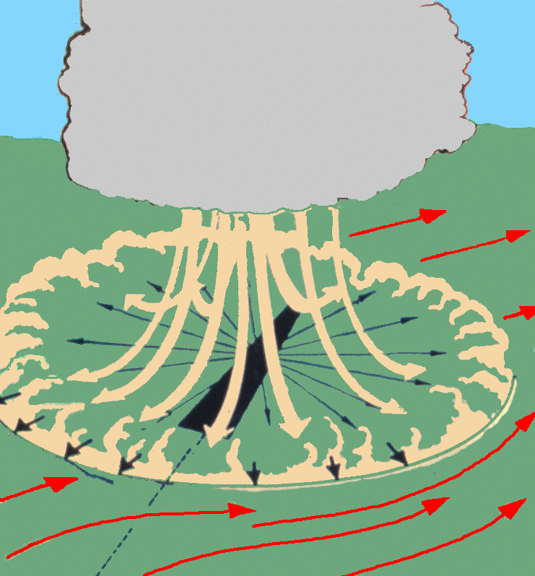
GUST FRONT
Notes:
Illustrate the extreme low level wind shears in and near thunderstorms. This image focusses on the downburst from a mature thunderstorm, the sinking current of air which hit the ground and spread outward away from the point of impact. Wind speeds in these downbursts can exceed 45 MPH.

Slide 28
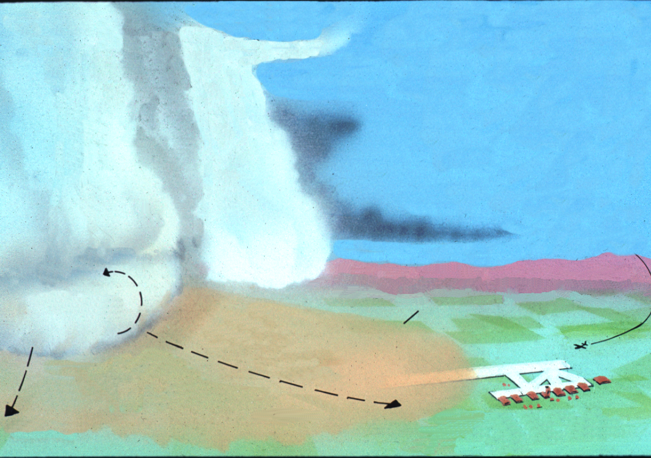
STORM DIRECTION
Cb
Cb
First gust, windshear turbulence, and rapid wind changes up to about 6000’ A.G. L.
ROLL CLOUD
Up to 10 miles.
Clear or possibly wind blown dust within turbulent air.
Up to 100 Kts 150 ft. A.G.L.
Notes:
Point out that the pilot thinks he/she has plenty of time to land at the airport before the thunderstorm arrives. However the lead push of rain cooled outflow air from the thunderstorm downburst has already arrived at the airport. So this pilot is going to encounter a tremendous amount of low level wind shear when trying to land at this airport.

Slide 29
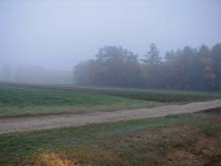
Ingredients for Thunderstorm Development - Moisture
Low and Mid Level Moisture
High Humidity
Notes:
You need to have moisture available to feed into the storm. Meteorologists tend to look at surface dewpoints. Dewpoints above 60F are good and above 68 are very good.

Slide 30
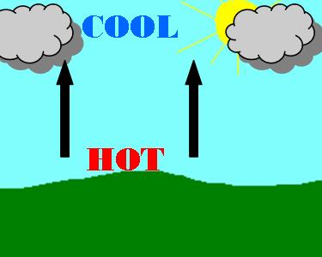
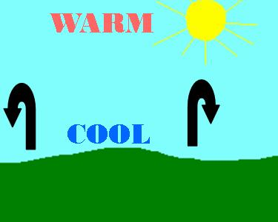
Thunderstorm Ingredients - Instability
Unstable
  Heat rises
  Moisture Condenses into clouds as air rises
  Common with Low Pressure Systems
Stable
  Air sinks
  Commons with High Pressure Systems
Notes:
Note that we need an unstable atmosphere for thunderstorm development. In an unstable atmosphere, if an air parcel is lifting upward, that air parcel will continue to rise as it will remain warmer than the ambient airmass. Remember warmer air is less dense. In a stable atmosphere, if an air parcel is lifted upward it will become colder than the ambient airmass, thus more dense and will then sink back to the surface. We need to get rising currents of air. As air rises, the moisture condenses into cloud droplets. Continued cooling as a result of rising air currents will then lead to liquid cloud droplets.

Slide 31
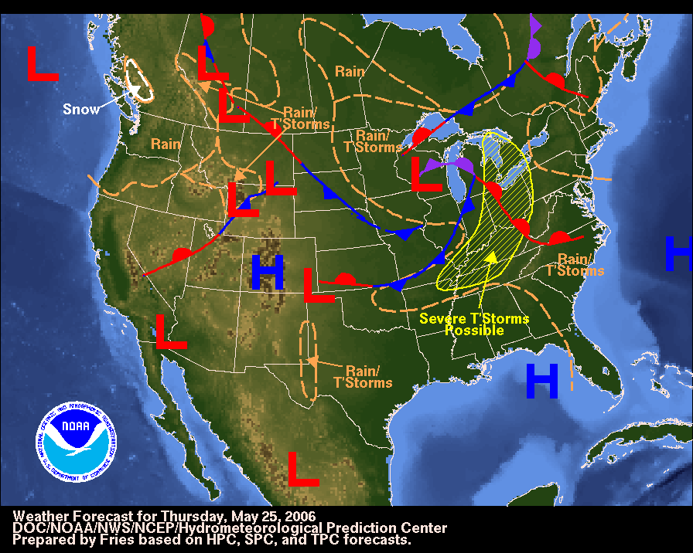
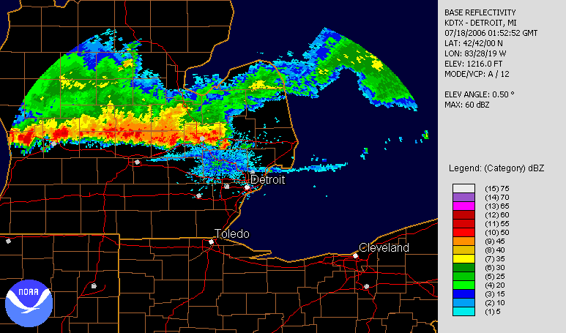
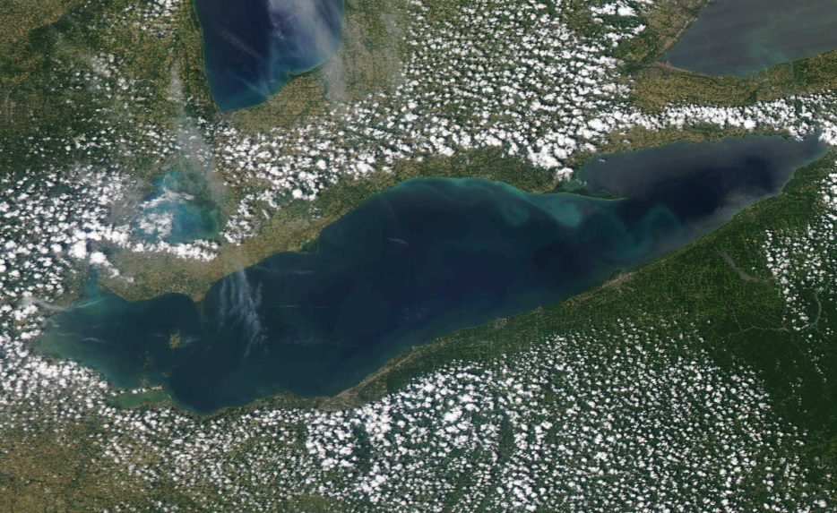
Thunderstorm Ingredients – Source of Lift
Warm /Cold Fronts
Thunderstorm Outflow Boundaries
Lake Breezes
Notes:
There needs to be some mechanism in the atmosphere to lift air parcels near the surface upward. Cold and Warm fronts are most common. Thunderstorm outflow are common in large thunderstorm clusters and lake breeze fronts common in the Great Lakes. Note the added amount of convergence /additional source of lift/ along the collision region of the Lake Erie/St Clair/Huron boundaries.

Slide 32
Thunderstorms Ingredients
Varying degrees of the 3 main elements will affect strength of thunderstorms
Additional ingredients that affect strength of thunderstorms include
  Wind Shear
  Location of Jet Streams
  Large Scale Weather Pattern
Notes:
Thunderstorm forecasting is not an exact science. There are many other factors that go into forecasting thunderstorm development, coverage and intensity. Listed above are some of these other factors.

Slide 33
Thunderstorm Development – Three Stages
Cumulus
Mature
Dissipation
Notes:
Once we have those ingredients in place, lets talk about the lifecycle of a thunderstorm.

Slide 34
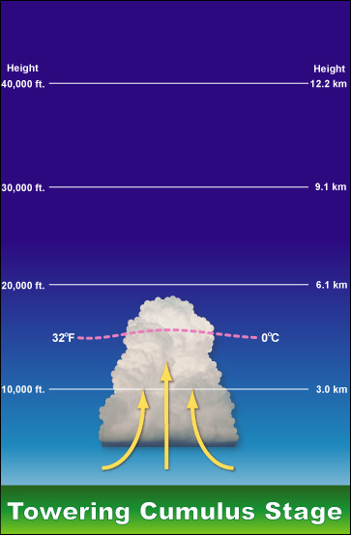

Basic Thunderstorm Evolution
Rising currents of air are referred to as an Updraft. When combined with sufficient moisture, towering cumulus clouds develop.
Notes:
Note the cloud is dominated by updrafts. As the air parcels rise, moisture condenses into cloud droplets, then eventually rain droplets. Note the crisp well defined cumuliform cloud tops. When watching these, you can actually see them getting taller (towering cumulus). This marks the beginning of a developing thunderstorm.

Slide 35
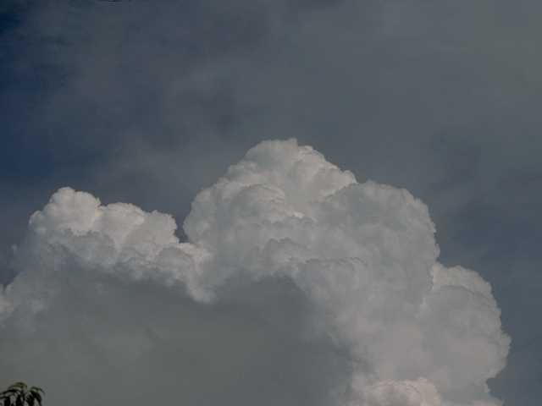
Notes:
Note the well-defined crisp cloud tops. This cloud will continue to develop and may lead to a thunderstorm.

Slide 36
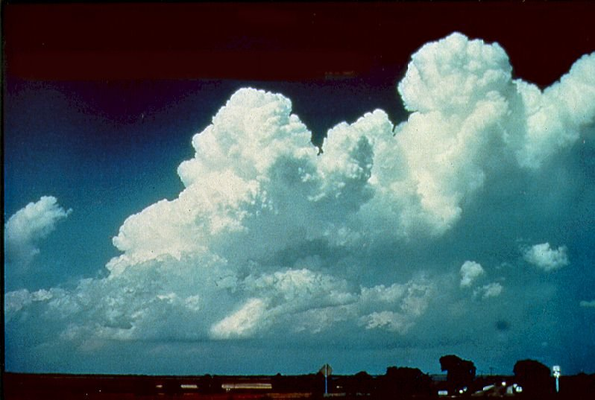
Copyright Charles A. Doswell, III
Notes:
Again, note the crisp, well defined cloud tops and the vertical extent of these clouds. When you see this, know that a thunderstorm is quickly developing.

Slide 37

Photo courtesy of Jimmy Deguara
Australiasevereweather.com
Notes:
Alto cumulus castellanus. High based cumulus. Note that seeing these means there is instability in the atmosphere. These clouds will not develop into a thunderstorm directly, when seen in the morning, they often signal impending afternoon thunderstorms. So basically, they denote good atmospheric instability.

Slide 38
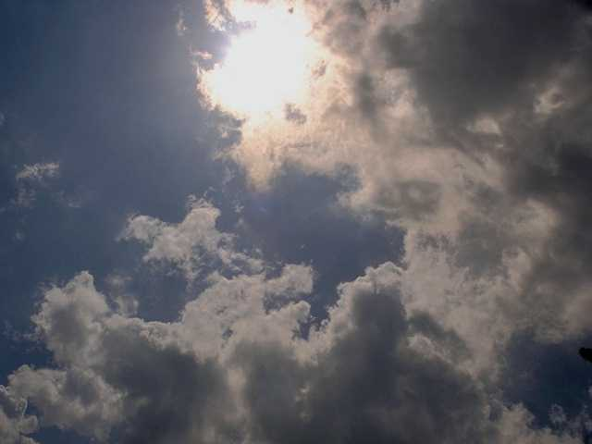
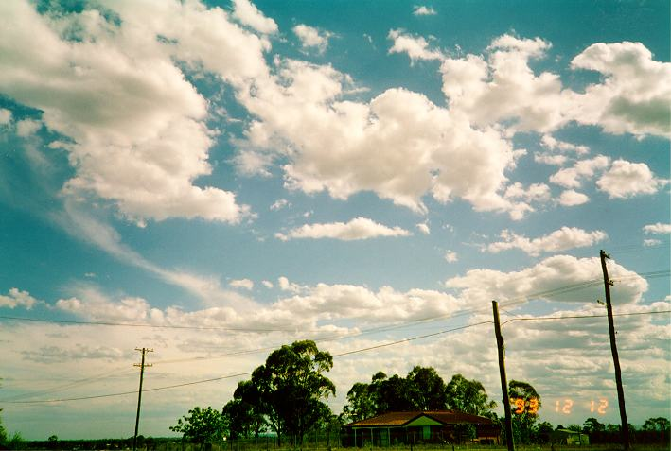
Fair Weather Cumulus – Not Enough Instability or Lift to Generate Thunderstorms
Notes:
Note the raged, ill defined tops to the clouds, indicative of high atmospheric stability. These clouds will likely not develop into storm. Flat-like cumulus, almost pancake-like in appearance will also not lead to development.

Slide 39
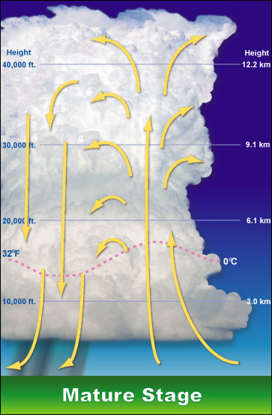
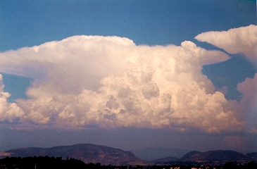
Basic Thunderstorm Evolution
Moisture will condense out of the cloud causing rain, thunder, and lightning. This marks the Mature Stage of the thunderstorms when the updraft and downdraft co-exist together.
Notes:
Continued condensation as a result of the rising currents of the updraft lead to rain and ice being suspended in the top of the cloud. This is where you start getting a charge separation between cloud top, cloud base and the ground, meaning lightning discharges. The weight of the liquid droplets in the top of the cloud will eventually become too heavy to be sustained by the updraft and they will fall to the ground in the form of a downdraft. This is when the storm moves into the mature phase.

Slide 40
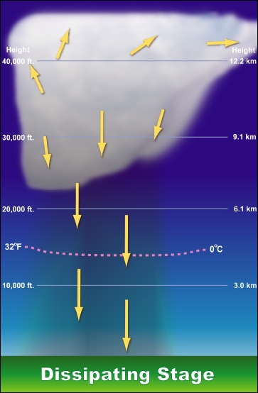
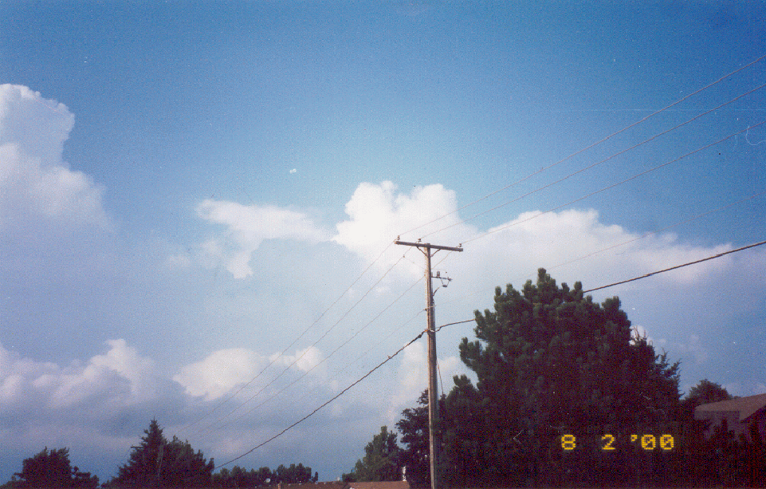
Basic Thunderstorm Evolution
The downdraft will eventually overcome the updraft, causing the thunderstorm to weaken. The thunderstorm is now in the Dissipation Stage.
Notes:
Eventually the rain cooled downdraft cuts off the updraft region to the storm. Once the updraft is cut off, the thunderstorm can no longer sustain itself. It then enters the dissipation phase. Note the cloud tops become flatter and the edges not very well defined as in the cumulus stage. This entire process of what is known as a single cell storm typically lasts between 20 and 30 minutes.

Slide 41
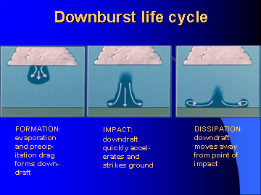
Notes:
Briefly explain what a downburst is. The initial outpouring of rain cooled air at the lead edge of the updraft. The stronger the updraft, the higher up the rain and ice droplets get suspended. Once they fall, they accelerate toward the ground. There is also a little bit of evaporative cooling which occurs as they fall. Cooler air is more dense, so the rain cooled air falls with greater velocity, causing strong winds at the surface when the rain cooled air impacts. This causes a lot of low level wind shear near the ground. The lead edge of the rain cooled air is the gustfront. Note that the stronger the updraft, the higher distance the raindrop have to fall, thus the greater evaporational cooling potential and therefore stronger winds reach the surface.

Slide 42
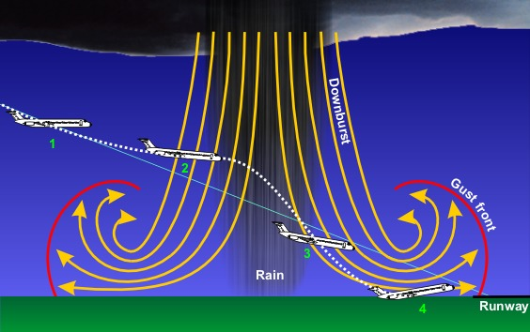
Notes:
Example of why they are hazardous in flight.

Slide 43
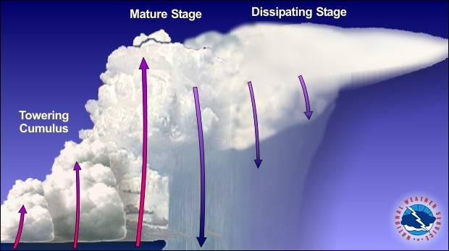
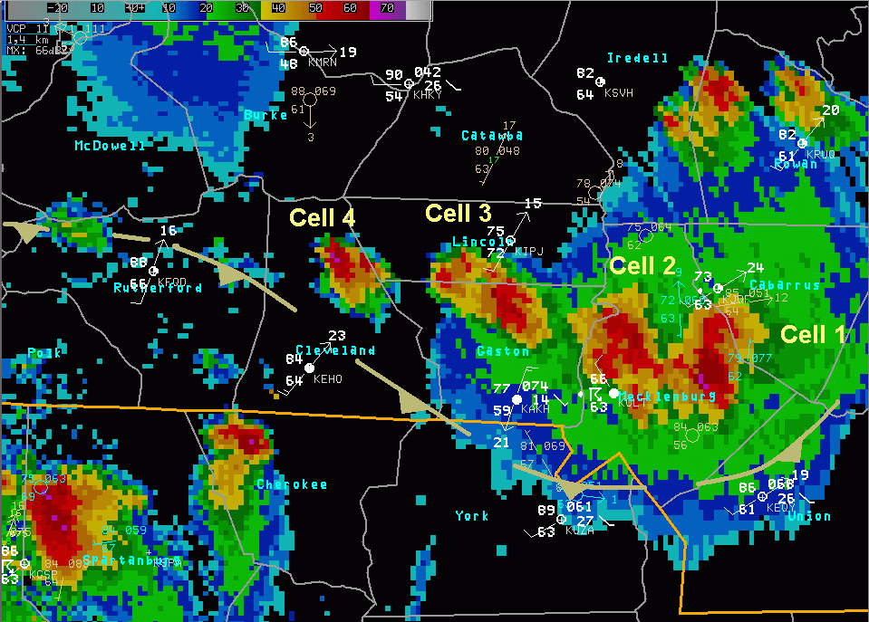
Special Types of
Thunderstorms
Multi Cell Cluster – These are a family of single cell storms occurring at the same time but in different stages of their lifecycle.
  These typically occur in moisture rich unstable environments.
Notes:
New cells typically develop along the outflow from the mature storm. They can also form with persistent low level convergence, typically north of an E-W oriented surface front. While individual storm cells may only last 20 to 30 minutes, continued development means that these storm clusters can be quite long lived, last for several hours in some cases. These types of storms are also common at night north of a surface warm or stationary front. Because of the erratic development, it is nearly impossible to predict how storm evolution will occur. So it is best not to try to fly through these systems.

Slide 44
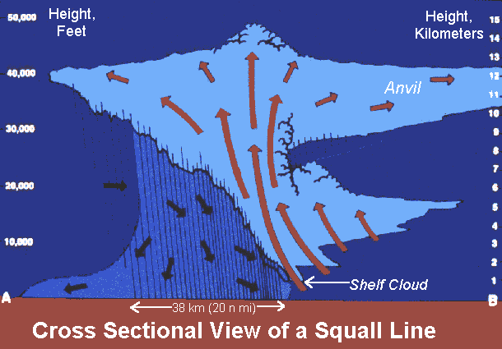
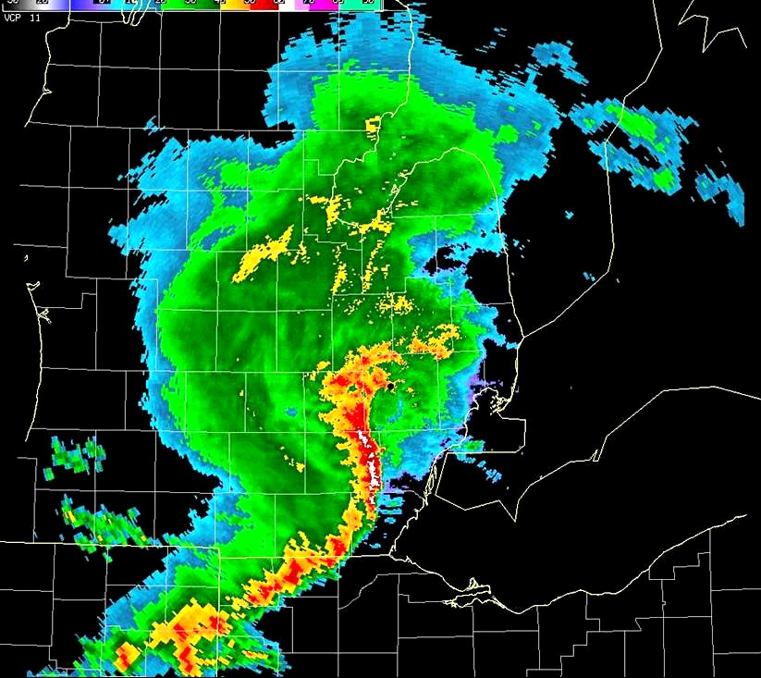
Special Types of
Thunderstorms
Multi Cell Line/Squall Line – These are storms organized into a line, often being long lived.
  These typically occur in an atmosphere high in instability and wind shear (strengthening winds aloft)
Notes:
These type of storms typically develop along/ahead of a cold front or in some cases with a lot of instability north of a warm front. These storms form into line segments (sometimes they can stretch for hundreds of miles from north to south). The wind shear causes a tilting of the updraft region which makes it more difficult for the rain cooled downdraft to cut off the updraft. So these system can be quite long lived (several hours in most cases). Pilots will sometimes try to find a break in the line based on radar. Not good to do this as these breaks can fill in very quickly. It is best to land somewhere and not try to fly through these. These system are commonly associated with very strong winds near the surface due to the strong and persistent updraft.

Slide 45
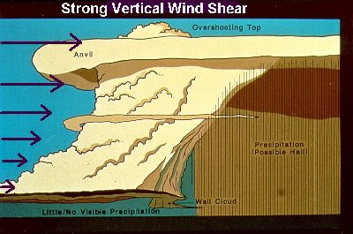
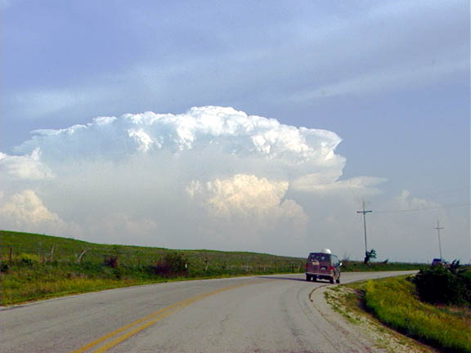
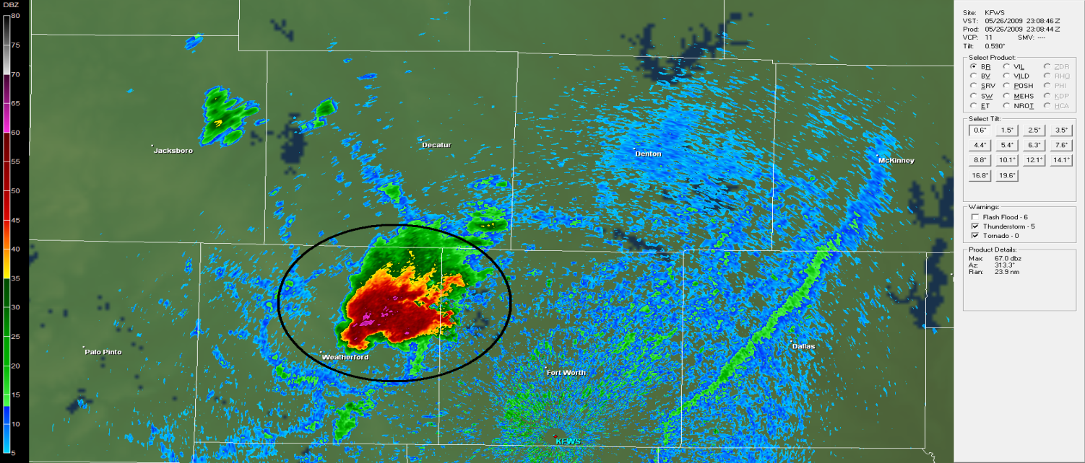
Special Types of
Thunderstorms
Super Cell – A long lived single cell storm with a rotating updraft. Typically the strongest of the types.
  These occur in an atmosphere high in instability and directional wind shear (strengthening and turning winds aloft)
Notes:
These storms are most often associated with tornadoes and very large hail. The wind shear causes the updraft to get tilted into the vertical. This in turns leads to a strong updraft region and thus very strong storm system. Classic supercell storms are typically more easy to navigate around (although east of the Mississippi they often occur in combination with multi cell lines and clusters). Due note that these storms can produce a good deal of clear air turbulence aloft. Like squall lines, these storms can also be very long lived.

Slide 46
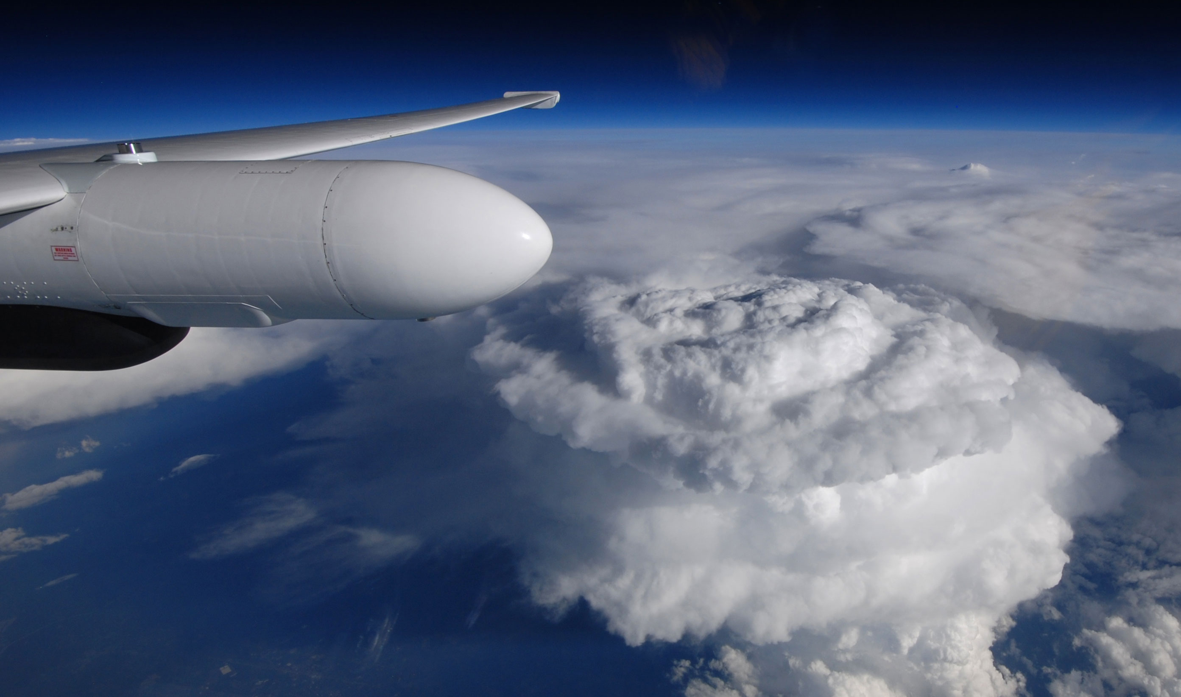
THE END

