Slide 1
D21 Convective season prep

Slide 2
Contents
DTW New Approach Procedures
STARS (Standard Terminal Arrival Route)
SIDS (Standard Instrument Departure)
Coordination with CWSU/AWC
TCF
Gate Forecasts
D21 Slides
Thunderstorms in the TAFs
Crosswinds and Compression

Slide 3
New DTW/Cle metroplex procedures
Was implemented September 2018
Developed to improve efficiency not airport capacity
Goal was to make optimal use of airspace, enhance safety and improve traffic flow

Slide 4
DTW Approach

Slide 5
DTW – Old Arrival fixes

Slide 6
DTW – New Arrival fixes

Slide 7
DTW – South Flow Arrivals

Slide 8
DTW – North Flow Arrivals

Slide 9
DTW Departures

Slide 10
DTW – Old departure procedures

Slide 11
DTW – New departure procedures

Slide 12
DTW – South Flow departures

Slide 13
DTW – north flow departures

Slide 14
Satellite airport arrivals

Slide 15
Satellite airport departures

Slide 16
Coordination – Aviation weather center (awc)
TCF – Traffic flow management (TCM) Convective Forecasts
The TCF is a high confidence graphical representation of forecasted convection meeting specific criteria of coverage, intensity, and echo top height. The TCF graphics are produced every 2 hours and valid at 4-, 6-, and 8- hours after issuance time.
Areas of convection in the TCF include any area of convective cells containing (at a minimum):
Composite radar reflectivity of at least 40 dBZ;
Echo tops at or above FL250;
Coverage (a & b) of at least 25% of the polygon area;
Forecaster confidence of at least 50% (High) that criteria (a, b, & c) will be met.
Lines of convection in the TCF include any lines of convective cells:
Composite radar reflectivity of at least 40 dBZ having a length of at least 100 nautical miles (NM); and
Having a linear coverage of 75% or greater; and
Having echo tops at or above FL250.
Forecaster confidence of at least 50% (High) that criteria (a, b, & c) will be met.
All four of the threshold criteria listed above for both areas and lines of convection are required for inclusion in the TCF. This is defined as the minimum TCF criteria.
The TCF domain is the Flight Information Regions (FIR) covering the 48 contiguous states and adjacent coastal waters. It also includes the Canadian airspace south of a line from Thunder Bay, Ontario to Quebec City, Quebec.

Slide 17
TCF - Example

Slide 18
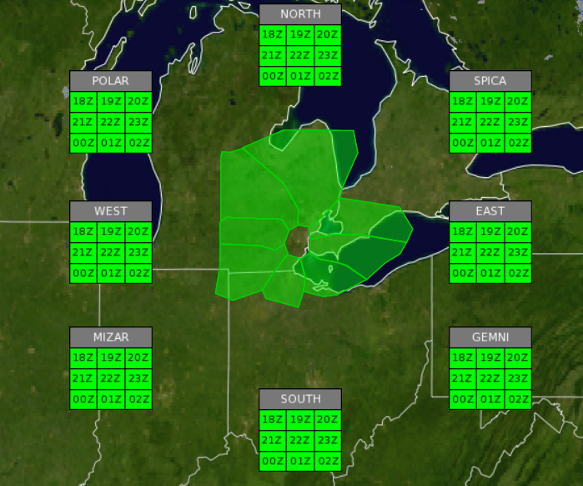
Coordination – Aviation Weather Center (AWC)
Experimental Gate Forecasts for DTW- https://testbed.aviationweather.gov/trafficflowmgmt/gate/site?id=KDTW
Gives timing and probabilities for each region of the airspace (in terms of STARS and SIDS)

Slide 19
TSRA Coordination – CWSU ZOB
Anytime convection is a concern in metro airspace; especially within the first 12 hours of the TAF.
WRK TAF through chat
D21
General discussion through chat
Phone calls
Whenever there is disagreement between us and the TCF from the AWC
Also note that the CWSU produces a brief online web briefing for air traffic controllers three times a day. https://www.weather.gov/zob/predutyweatherbriefing

Slide 20
D21 Convection Best Practices
TSRA probability graphics (not just metro but D21 airspace as a whole)
CAMS output
Extrapolation from current radar imagery if convection is in near term
Forecast instability parameters
Need not put:
SPC convective outlooks
AWC TCF output

Slide 21
D21 Examples

Slide 22
TSRA in Taf best practices
VCTS can be used if there is a high chances of convection in the D21 airspace. Can consider VCTS in the outlook period of the TAF (beyond 12 hours) when convective chances are high.
Limit the time period of VCTS to less than 6 hours; preferably 4 hours or less. Can be a little longer during the outlook period (beyond 12 hours).
It is OK to use TEMPO for convection when probabilities are high, just try to limit duration of Tempo to 4 hours or less.
Prevailing convection can also be used when probabilities are high. Time duration should be pretty limited, 3 hours or less.
If the TCF has convection impacting metro, it should be in the TAF. If you disagree with the TCF, let CWSU know why so they can brief the controllers (the manager looks at the TCF closely)
If doing a TAF from aviation grids, be careful as the formatter will blast VCTS for several hours.

Slide 23
crosswinds
Crosswinds are the component of the wind perpendicular to the runway. When the crosswind component is 25 knots or greater, landings and take offs become more difficult. In some instances, this forces the aircraft to use another runway with an orientation with a weaker crosswind component. This then causes the TRACON to have to adjust all the aircraft into and out of metro airspace.
At metro, there is a concern when the crosswinds affect the 4 NE/SW oriented runways (030 & 210), forcing the airport to switch to the 2 E-W runways, thus reducing capacity.
https://www.ivao.aero/db/xw/default.asp can be used to calculate the crosswind component; just enter 21 for the runway number. Keep in mind, thresholds may be a little lower if the runway is wet.
Doc’s flow probability graphics can also be used.
Metro has been pushing things with respect to crosswind thresholds, usually not flipping the airport around until they start receiving pilot complaints
The noise abatement program in place limits the time metro is to use a north flow configuration (south flow is preferred). However, during north to east-northeast winds, they are forced to use this configuration. They seem to be much more liberal in going to a north flow these days compared to recent years.

Slide 24
compression
Compression is an ATC phenomena that occurs when aircraft flying Standard Terminal Arrivals (STARS) usually following one behind the other (nose to tail or in air traffic known as Miles in Trail (MIT)), lose adequate horizontal separation from each other. The phenomenon that creates this is usually a change in wind direction and speed between the two aircraft. Compression can occur when an aircraft, during descent, transitions from a tailwind, or a weak headwind, to a stronger headwind over a small change in altitude. This change could also occur with a heading change of the aircraft during its approach.
This will result in a reduction in arrival rates.
Not something we forecast but is a concern for CWSU forecasts in briefing air traffic control.

