Slide 1
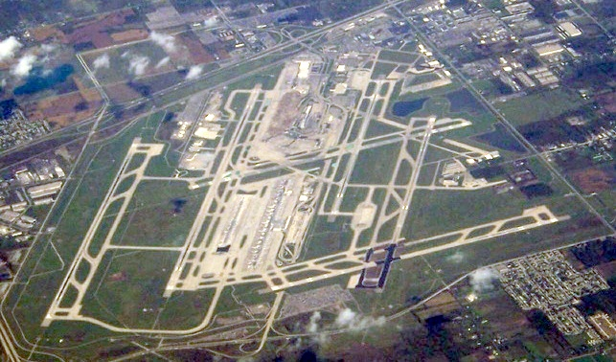

Slide 2
definitions
Crosswind - the component of wind that is blowing across the runway making landings and take-offs more difficult than if the wind were blowing straight down the runway. If a crosswind is strong enough it may exceed an aircraft's crosswind limit and an attempt to land under such conditions could cause structural damage to the aircraft's undercarriage.
Headwind – Blows against the direction of travel.
Tailwind – Blow in the direction of travel.
In aeronautics, a headwind is favorable in takeoffs and landings because an airfoil moving into a headwind is capable of generating greater lift than the same airfoil moving through tranquil air or a tailwind at equal ground speed. As a result, aviators and air traffic controllers commonly choose to take off or land in the direction of a runway that will provide a headwind.

Slide 3
DTW RUNWAY Headings
Runway 4R/22L
Runway 4R – 029 Deg
Runway 22L – 209 Deg
Runway 3R/21L
Runway 3R – 029 Deg
Runway 21L - 209 Deg
Runway 4L/22R
Runway 4L – 029 Deg
Runway 22R – 209 Deg
Runway 3L/21R
Runway 3L – 029 Deg
Runway 21R – 209 Deg
Runway 9L/27R
Runway 9L – 089 Deg
Runway 27R – 269 Deg
Runway 9R/27L
Runway 9R – 089 Deg
Runway 27L – 269 Deg

Slide 4
General cross wind thresholds
Landing Towards SSW Landing Towards SSW Landing Towards NNE Landing Towards NNE
300/25kts 110/25kts 290/25kts 120/25kts
290/25kts 120/26kts 300/25kts 110/25kts
280/26kts 130/26kts 310/26kts 100/26kts
270/28kts 140/28kts 320/28kts 090/28kts
260/30kts 150/31kts 330/31kts 080/30kts
250/35kts 160/36kts 340/36kts 070/35kts

Slide 5
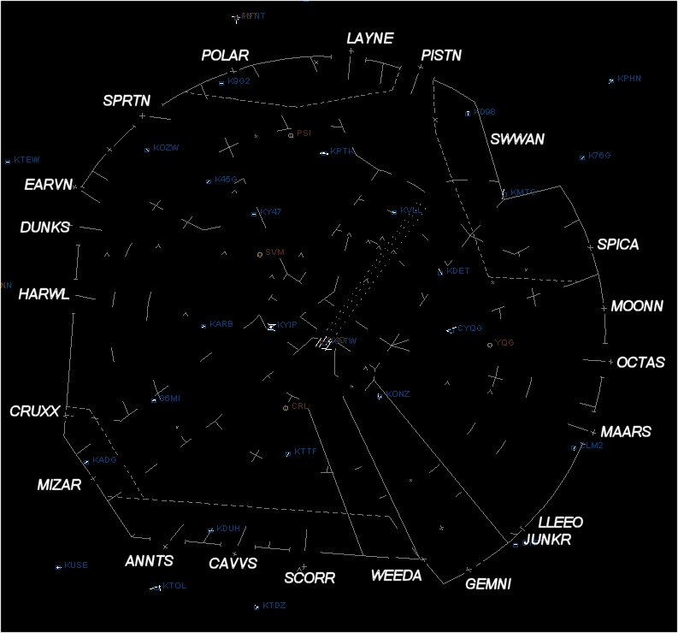
Standard Terminal Arrival Fixes (STARs)
Satellite Airport Arrival Procedures (STARs)
Departure Procedures (DPs)

Slide 7
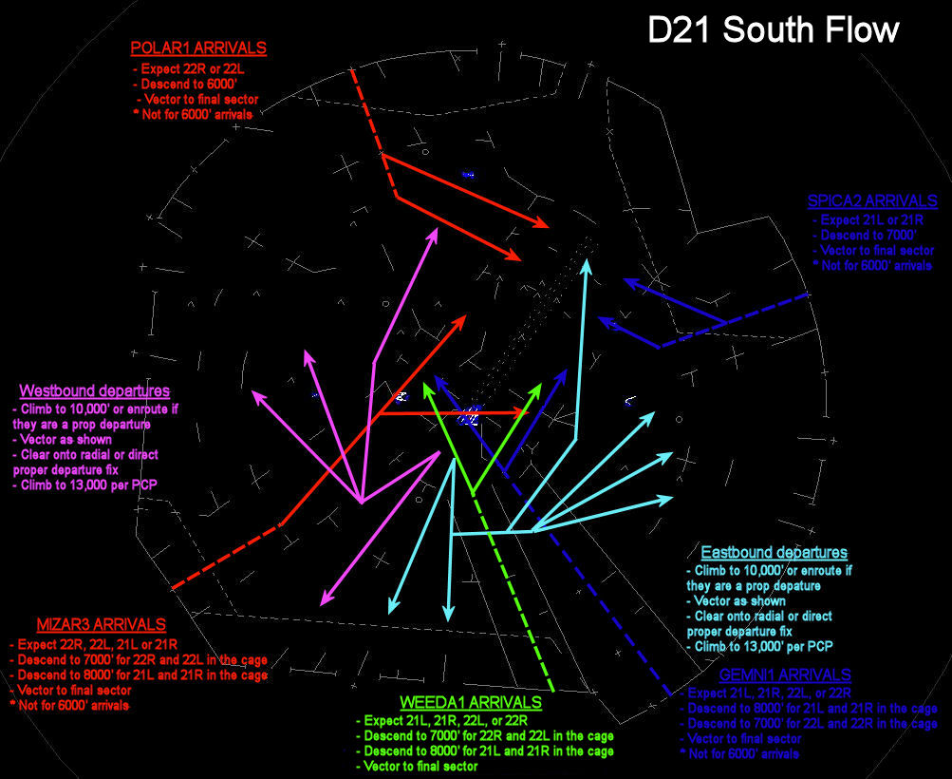

Slide 8
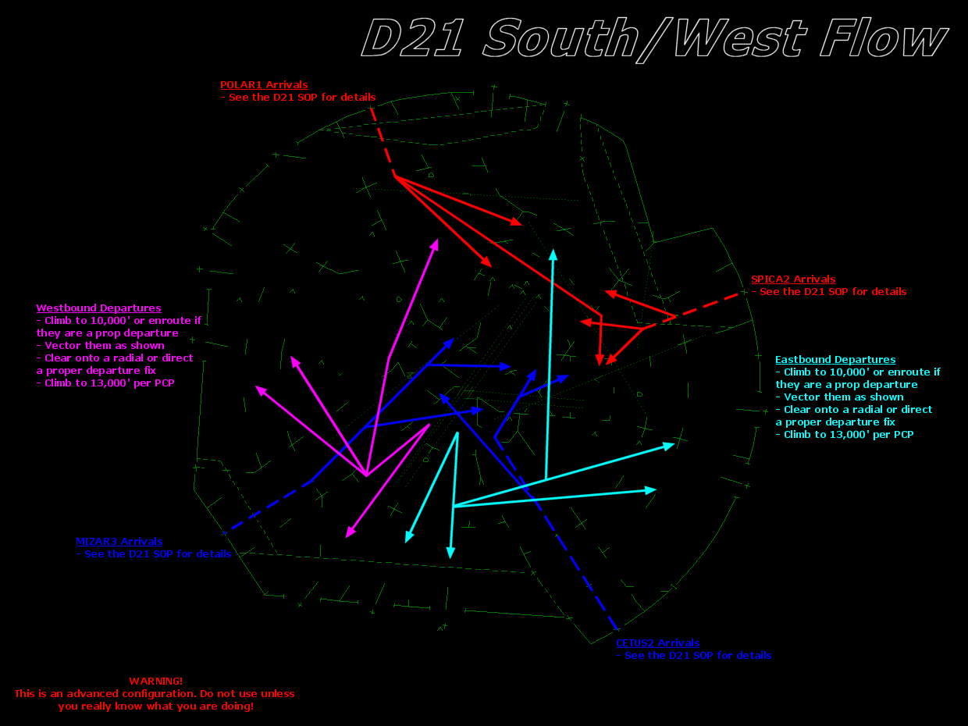

Slide 9
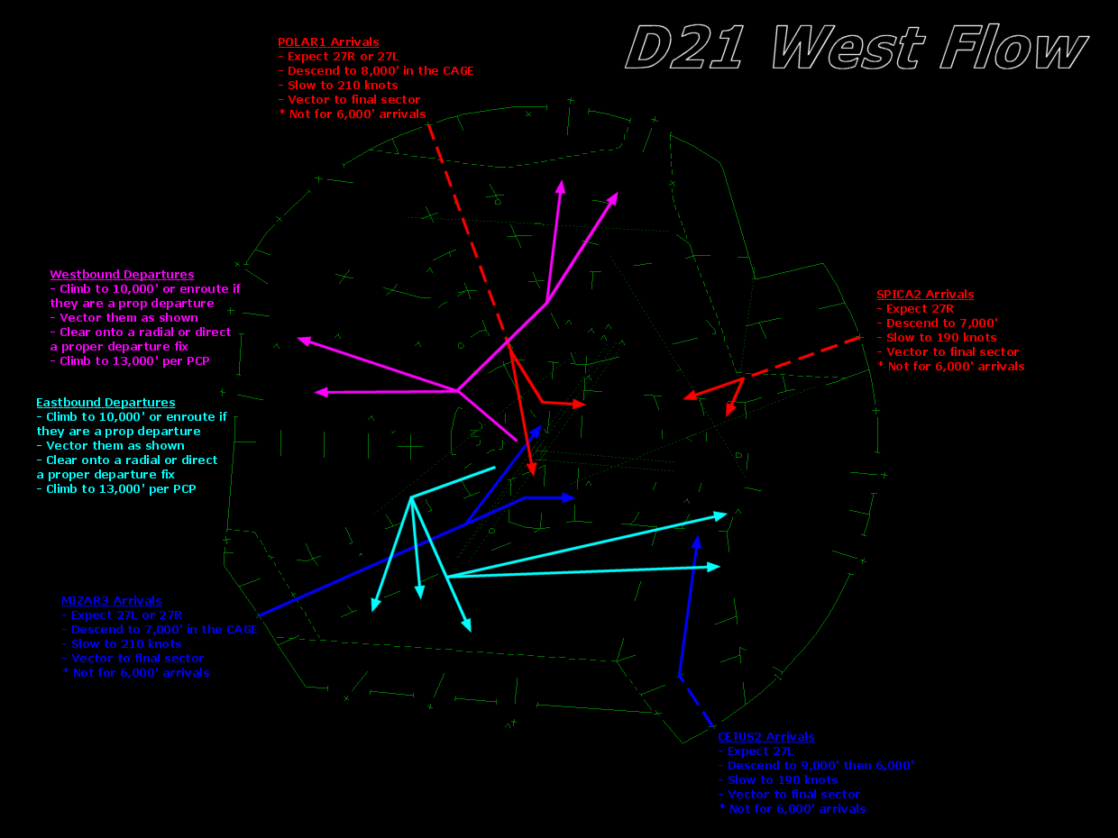

Slide 11
Crosswind concerns at dtw
Excessive crosswinds on the 4 NE-SW runways will force operations to use the 2 E-W runways, greatly reducing the capacity of the airport.
When crosswind thresholds are not properly planned for, the consequence will likely be a ground stop.
Both the speed of the gusts and sustained winds factor into the crosswinds.
Cross wind thresholds are also dependent upon several factors including:
Wet versus dry runways
Type of aircraft
Pilot preference and/or experience

Slide 12
DTx best practices
Pay very close attention to wind speeds, gusts and directions when we are near crosswind thresholds. Make note of the DTW VDU display. (Can also look at the crosswind calculator links on the aviation wiki page).
Be quick to amend, but be careful not to chase obs (exact wind speeds and direction can be quite difficult to forecast).
As a general rule, if wind speeds and/or frequent gusts will reach or exceed 25 knots, amend DTW if:
Wind direction varies by 20 degrees or more.
Wind speed varies by 5 knots or more.
These criteria are most important during peak air traffic times (7 AM to 9 AM; 11 AM to 1 PM; 4 PM to 6 PM)
Pay particularly close attention to timing of a wind shift during strong winds.
During these situations, the TAF and 3-hourly TAF AMD should be very precise in the first 6 hours. Be more general beyond 6 hours.

