Slide 1
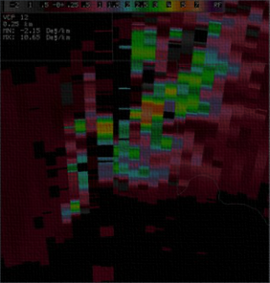
Dual pol
for the
WSR-88D
Introduction and Imagery
Jody James
Warning Coordination Meteorologist Private Pilot National Weather Service Lubbock
Notes:
Welcome to the Introduction to Categorical Amendment Criteria (CAC). This is Part 1 of CAC Training, which deals with the “why’s and how’s” of Categorical Amendment Criteria. Part 2 details how to find CAC for each of your TAF sites.

Slide 2
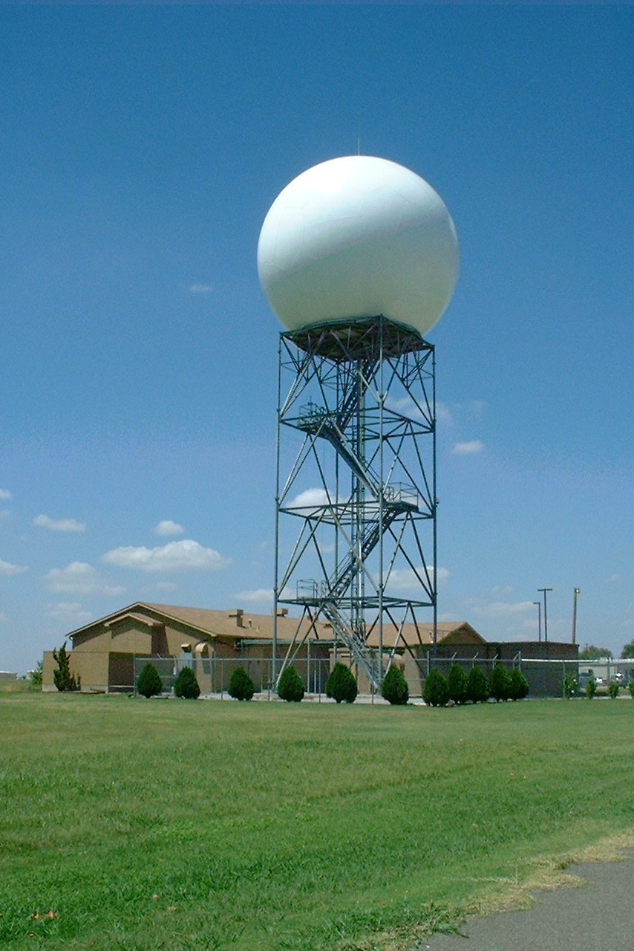
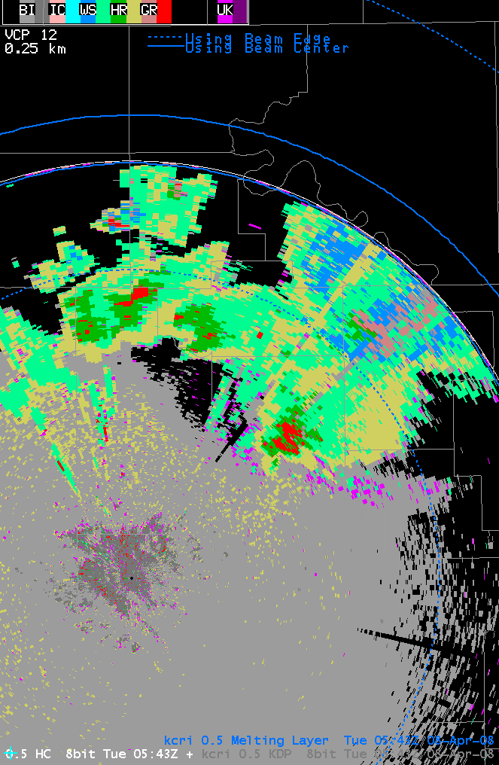
Dual-Polarization Radar Technology
Coming Soon to a WSR-88D Near You!
Photo courtesy of NSSL
Notes:
Key Point: Introduce to audience that dual-polarization radar technology is coming, although it may be a year or two before it’s installed at your local WSR-88D
Notes to Presenter: This presentation uses the “official” NWS slide background. I imagine many of you will splice and dice the presentation to add the content you need to an existing PowerPoint file. If you have any issues converting the slides to your layout, please contact Andy Wood (Andrew.C.Wood@noaa.gov). If I can make changes to the presentation file that make it easier for folks to import the slides, I want to do so.
The presentation file is broken up into two main parts. The first part is a standalone presentation on dual-polarization radar technology developed for an emergency management/spotter talk audience. The second part consists of extra slides that WCMs & SOOs might find useful for their various outreach and training activities.
In these slides, you will see the phrase “dual-polarization technology”, or “dual-polarization radar technology”, used a lot. For outreach purposes, we’re encouraging folks to use this terminology. I know it’s a mouthful, but we don’t want to turn people off using all of the jargon such as “dual-pol”, “polarimetric radar”, etc. If you talk about this subject for more than a few minutes, it’s inevitable that you’ll say dual-pol once or twice. We just want to avoid the confusion of people using multiple terms for the same technology.
Animations: 0

Slide 3
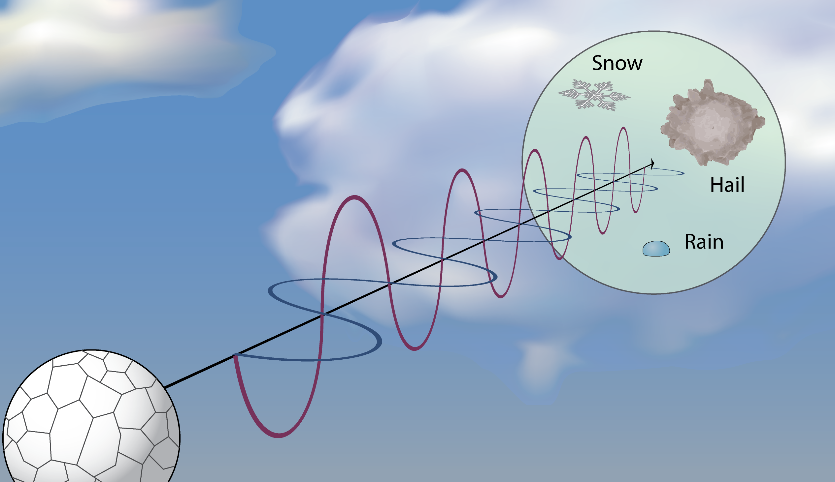
What Is Dual-Polarization Radar Technology Exactly?
Notes:
Key Points:
1. Conventional radar uses a horizontally polarized beam
2. Dual-polarization radar technology uses a radar beam polarized in both the vertical and horizontal directions
Notes to Presenter: This slide is the first part of a two-part explanation of dual-polarization radar technology. The first part of the explanation focuses on how the new technology is different from the old technology. The next slide gets into why the technology is important.
This slide is a good place for a story or analogy on what polarized electromagnetic waves are. In our discussions here at WDTB, the most common analogy that people will get is probably polarized sunglasses or windows. However, if you can think of a better one, please use it. And – while you are at it – send your idea to us and we may include it in the online training we produce for later in 2010.
Animations: 0

Slide 4
Why Is Dual-Polarization Technology Important?
Conventional Radar
Dual-Polarization Radar
– = Size
(| + –) = Shape
σ_{(| + –)} = Variety
– = Size
Conventional radar tells us about the size of objects
Dual-polarization radar tells us about the size, shape, & variety of objects
Notes:
Key Point: Conventional radar tells us about the size of targets while dual-polarization radar technology tells us about the size, shape & variety of objects in the radar beam
Notes to Presenter: This is the second part of the two-part explanation. Here is where we discuss dual-polarization technology’s importance. The current WSR-88D only gives you an understanding of the size of targets in the radar beam volume at that point. There is no explicit measurement of shape or hydrometeor variety (i.e., drop-size distribution).
Dual-polarization technology collects information on both the horizontal and vertical size (i.e., Differential Reflectivity). These data give us an understanding of the hydrometeor shape as well as size. The Correlation Coefficient and Specific Differential Phase products also give forecasters a better understanding of the variety of targets in the radar volume. It’s the collection of all these new data that allow forecasters to more clearly identify whether a range gate is filled primarily with snow, hail, rain, or other target.
I need to make one last point on this slide. I use sigma as a symbol to represent variety since it is the character for standard deviation in statistics. I realize that many people will not get this at all. Unfortunately, there is no easy, symbolic way to suggest a distribution that comes to mind other than using a sigma or showing an actual distribution. I thought the latter would be way too confusing. As a result, you will likely need to explain to people verbally what the sigma means.
Animations: 0

Slide 5
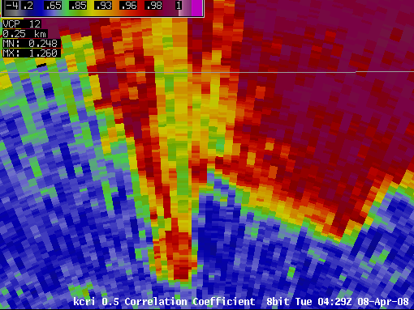
WSR-88D Improvement #1: Detection of Hail Cores
Can you find
the hail?
Hail
How about now?
Hail
Hail
Notes:
Key Point: The addition of the dual-polarization radar base products should help NWS forecasters better identify hail, possibly even the presence of very large hail, in thunderstorms
Notes to Presenter: The example images on this slide are probably a little too easy. The pool of example cases is still pretty small at this point. We figured it’s better to include an example that’s obvious than one where the audience may not understand what you’re pointing out. You may want to add some local anecdotes here about how a clearer picture of hail in thunderstorms would specifically benefit your CWA.
If you want to make things a little more challenging, ask the audience whether or not they think there is hail in the high reflectivity appendage west of the inflow notch. The ZDR values are similar to the other rain areas, but the Correlation Coefficient is similar to the hail core. The answer is there is probably some small hail/graupel mixed with rain in this area, but not to the extent as there is in the hail core.
Animations: 2
#1: Shows Correlation Coefficient and Differential Reflectivity images with “How about now” text
#2: Circles over area of hail (with labels) in each product appears

Slide 6
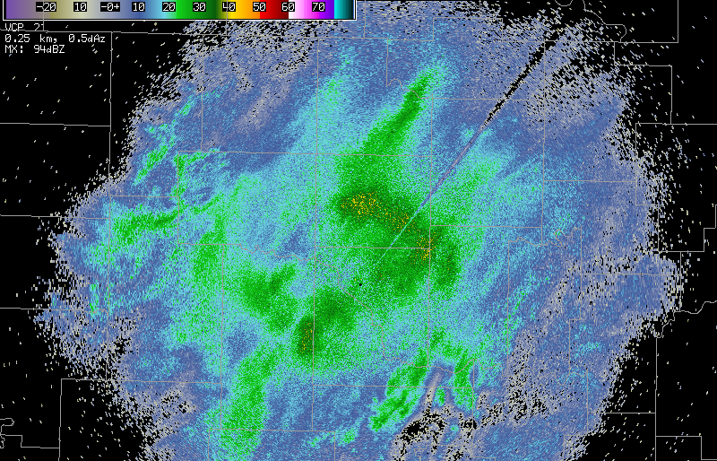
WSR-88D Improvement #2: Differentiate between Rain & Snow
What precipitation is liquid,
frozen, or mixed
Frozen
Melting
Liquid
2.4º Correlation Coefficient Product
2.4º Reflectivity Product
Notes:
Key Point: Adding dual-polarization technology allows forecasters to better identify areas where frozen precipitation melts.
Notes to Presenter: The Reflectivity and Correlation Coefficient products allow for a nice contrast on this point. It’s pretty clear that Correlation Coefficient detects the melting layer much better than relying on a bright band being visible in Reflectivity. A personal “horror” story about detecting the rain-snow line or bright-band contamination might help here.
Animations: 2
#1: Transition from Base Reflectivity to Correlation Coefficient product w/label
#2: Add text labels for frozen, mixed phase, and liquid precipitation

Slide 7
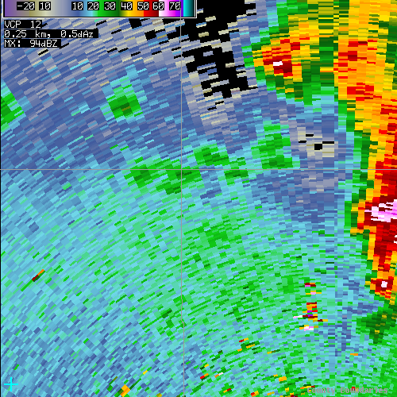
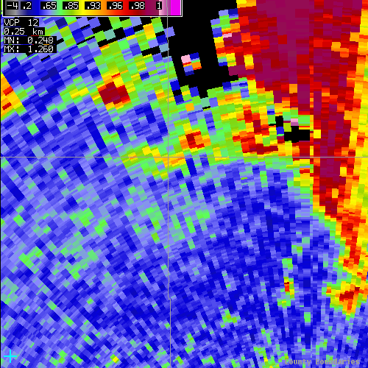
WSR-88D Improvement #3: Identify Non-Weather Echoes
Developing Showers
Biological Targets
0.5º Base Reflectivity
0.5º Correlation Coefficient
Notes:
Key Point: Adding dual-polarization technology will help with detecting biological, ground clutter, and other non-weather targets.
Notes to Presenter: This example shows some developing showers located near an area of biological targets. The showers are further to the north along the county boundary while the biological returns are further to the south. While both regions have similar Reflectivity values, the Correlation Coefficient values are very different. Rain returns often have high Correlation Coefficient values (0.9-1.0) while biological scatterers generate lower values (0.6-0.9).
The biological returns in this example are likely migrating birds. This event occurred around their peak migration period through the area.
Animations: 0

Slide 8
WSR-88D Improvement #4: Detect Lofted Tornado Debris
Base Reflectivity
Differential Reflectivity
Correlation Coefficient
Debris from EF2 Tornado at 0.5º
Notes:
Key Point: Dual-Polarization technology will allow radar to distinguish the presence of debris lofted by a tornado
Notes to Presenter: The debris signature will not detect every tornado. It’s range dependent (best within 30 nm…may work for strong tornadoes out to 50 nm or so) due to beam broadening and curvature effects. What this signature does do is give the forecaster the ability to “detect” a tornado lofting debris when spotter reports are absent. For instance, if a tornado hits a subdivision in a rural area. Or if a tornado spins up, causes significant damage, and reports are not available due to phone lines & cell towers being damaged/filled up. It’s possible that inflow with a lot of dust, insects, etc. could produce a similar signature. Such a signature would be much broader in area than a tornadic debris signature and the Correlation Coefficient values wouldn’t be as low (~0.7-0.8 in inflow vs ~0.4-0.5 for a TDS).
HOWEVER, we do have some concern that spotters and emergency managers in your audience may take this information the wrong way – or ways. It’s really important that they not think we don’t value their reports. It’s also really important that they not think that spotters near the radar are somehow less necessary than spotters far from the radar. Ultimately, you’re just going to have to feel out your audience. If you sense that they think they have a diminished role in a dual-polarization technology world, please take your time to correct them of this misnomer.
Lastly, we want to make sure people realize that this signature has no predictive capability for warning issuance. We’ll touch on this subject more on Slides 17 & 32.
Animations: 1
#1: Fade in circles, arrows, and text for tornadic debris signature

Slide 9
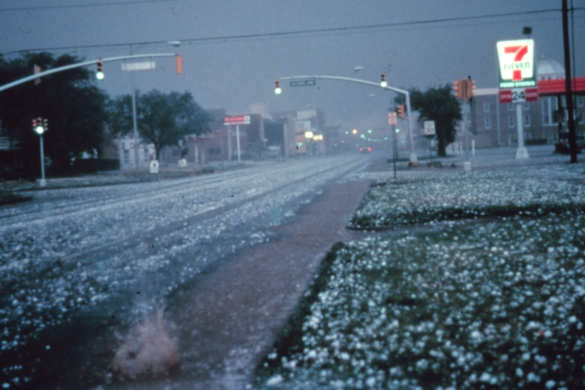
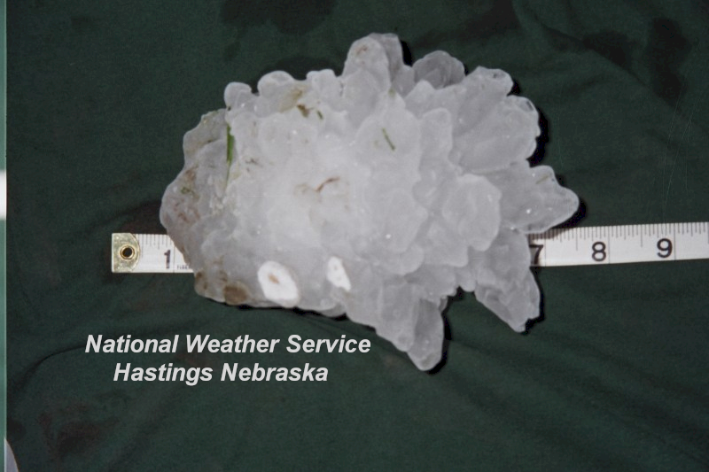
Better Hail Detection Could Lead to Better Severe T-Storm Warnings
Benefit: Better data should make warning decision-making clearer when hail is the primary threat


Issue: Dual-polarization technology CANNOT directly measure hail diameter
Notes:
Key Point: Since dual-polarization technology can better detect hail than conventional radar, the NWS should make better warning decisions for Severe Thunderstorm warnings based on hail threat
Notes to Presenter: The benefit listed on the slide should be pretty obvious. What you will likely spend most of your time explaining to people is that there is a difference between detecting hail in a thunderstorm and knowing how big that hail is when it hits the ground. NWS forecasters will still need to rely on current techniques to forecast/identify the maximum hail size likely with a specific thunderstorm.
There is one caveat to this issue. Research suggests that range gates with very large hail stones may have distinguishable differences from other data where hail is detected. The specifics of the “monster” hail signature will be covered in the dual-polarization operations course WDTB is developing.
Animations: 2
#1: “Benefit” text
#2: “Issue” text

Slide 10
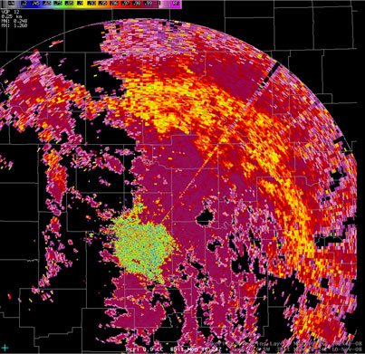
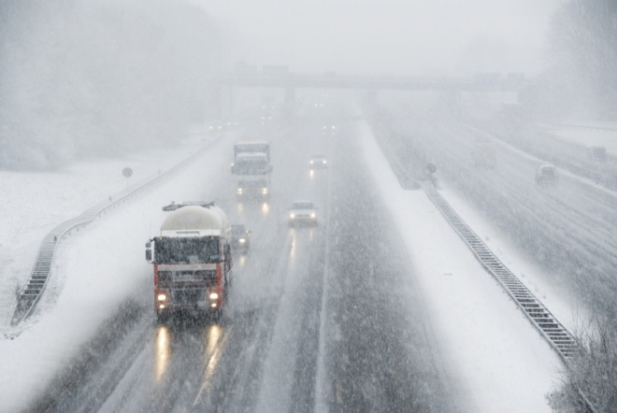
Melting Layer Detection Helps Support Transportation Needs
Frozen
Melting
Liquid
Cannot: Identify surface precipitation type definitively
Can: Help both aviation & surface transportation better resolve precipitation type issues
Notes:
Key Point: Dual-polarization technology should help NWS forecasters better identify transitions in precipitation type aloft, benefiting both aviation and surface transportation
Notes to Presenter: The upgraded WSR-88D radars will be able to identify melting layers – when present – very accurately every volume scan. By discretely measuring the melting layer aloft, the radar will be a huge benefit to aviation interests who want to know about in-flight icing conditions. These same data should have some benefit in determining the location of the rain-snow line at the surface – or even snow level in mountainous areas. This information should likewise benefit surface transportation interests during winter weather.
It’s important to highlight that these data will not definitively identify surface precipitation. For example, radars cannot detect freezing rain. There’s a good chance that dual-polarization technology will not provide a significant benefit in differentiating sleet from rain. So, use of these data for surface precipitation type forecasting can still be tricky.
Animations: 2
#1: “Cannot” text
#2: “Can” text

Slide 11
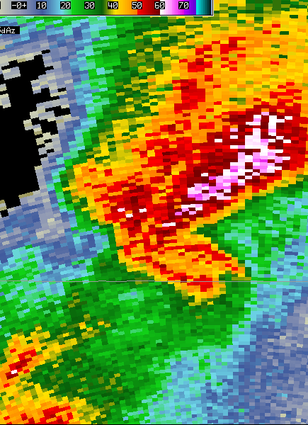
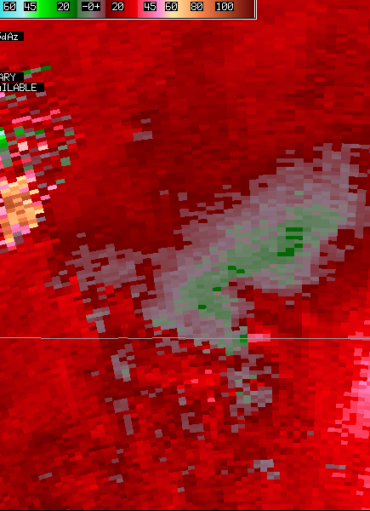
Debris Signature Helps NWS When Reports Are Unavailable
Tornadic Debris
Signature
Cannot: Observe every tornado
Can: Provide more confidence a tornado is causing damage at locations relatively close to the radar
Photo courtesy of Jim LaDue
Notes:
Key Point: Debris signature will help forecasters have more confidence that a tornado is occurring when visual confirmation not available
Notes to Presenter: It’s important that your audience realize that their spotter reports will still confirm a tornado the vast majority of the time. The debris signature will help forecasters the most when:
1. A tornado relatively close to the WSR-88D doesn’t produce any spotter reports (e.g., rural area, heavily forested area, nocturnal tornadoes, rain-wrapped tornadoes) or
2. Forecasters are concerned about a “significant” tornado (EF2 or higher) in a highly urban area.
For the debris signature to work, the tornado has to loft highly reflective debris high into the air. Insulation is considered to be the best candidate for the debris signature, but other large, lightweight debris may also be detected.
Animations: 2
#1: “Cannot” text
#2: “Can” text

Slide 12
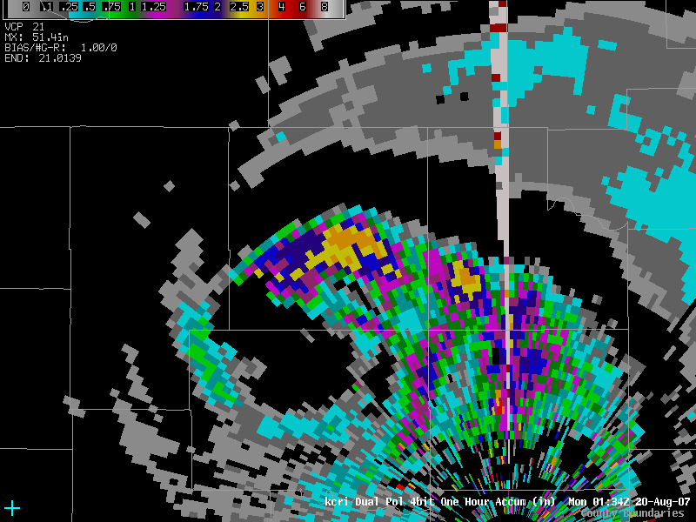
Better Rainfall Data Could Lead to Better Flood Products
Severe
Flooding
Cannot: Provide perfect rainfall estimates
Can: Improve precipitation estimates for Flash Flood Warning decision-making
Photo courtesy of Jim LaDue
Notes:
Key Point: Better rainfall estimates should lead to better hydrologic data and flood-related products
Notes to Presenter: Since Areal and Flash Flood Warnings are very dependent on observed rainfall, better radar-derived estimates should make them more accurate. How much remains to be seen because there are so many different variables that go into flooding potential. More accurate data shouldn’t hurt.
The dual-polarization rainfall estimates primarily improve on conventional estimates because they filter out hail or melting layers. So, flash floods that occur with training thunderstorms (especially supercells) and widespread isentropic lift events should especially benefit from the improved data.
Animations: 2
#1: “Cannot” text
#2: “Can” text

Slide 13
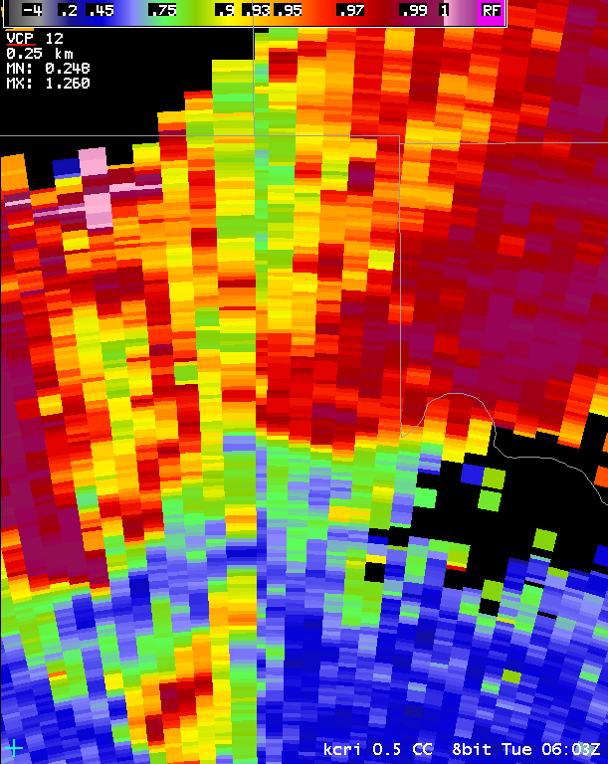
Correlation Coefficient (CC)
Simple definition:
Measure of similarity between the horizontally and vertically polarized pulses in a volume
Lower CC values useful for identifying:
Non-weather targets
Melting layer
Very large hail
Tornadic debris
Notes:
Key Point: Here is a basic overview of the Correlation Coefficient product
Notes to Presenter: Correlation Coefficient provides data on how similar the horizontal and vertical pulses are in a volume. When the targets in the volume have roughly the same size and shape, Correlation Coefficient will be near 1. When there is more diversity among the targets in a volume, then Correlation Coefficient will be lower.
Looking at the legend of the graphic, you’ll see that many precipitation areas will have CC values at or above 0.9. Examples of significant targets that often have CC values below 0.9 are non-weather targets (ground clutter, biological returns), the meting layer, very large hail, and tornadic debris.
Animations: 2
#1: First set of bullets
#2: Second set of bullets

Slide 14
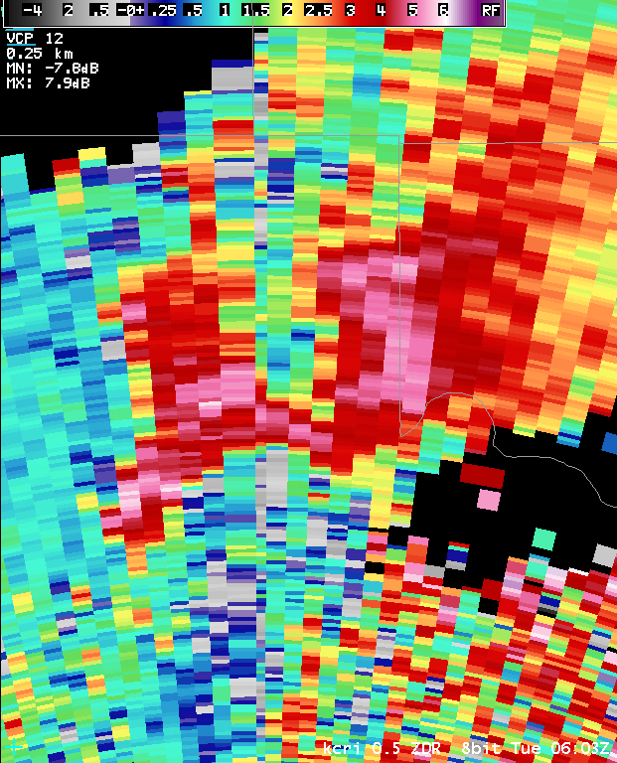
Differential Reflectivity (ZDR)
Simple definition:
Measures the relationship between the horizontal and vertical power returns
ZDR is useful for:
Detecting the presence of liquid drops (especially large drops)
Detecting severe-sized hail
Hail shafts with little-to-no liquid water
Notes:
Key Point: Here is a basic overview of the Differential Reflectivity product
Notes to Presenter: Differential Reflectivity measures the relationship between the power returns for the horizontal and vertical pulses. In other words, it’s the ratio of the average vertical and horizontal cross-sections for targets in the volume. Combining Differential Reflectivity with Base Reflectivity and Correlation Coefficient allows forecasters to determine the shape of the predominant target the radar detects. Higher ZDR values (≥ 3) often are associated with rain, very wet hail, chaff, or biological targets.
The WSR-88D dual-polarization upgrade will actually result in the beam transmitting at a 45° angle, but trying to explain that might confuse your audience. I would stick with the traditional illustration provided on Slide 5 of Part 1 of this presentation.
Animations: 2
#1: First set of bullets
#2: Second set of bullets

Slide 15
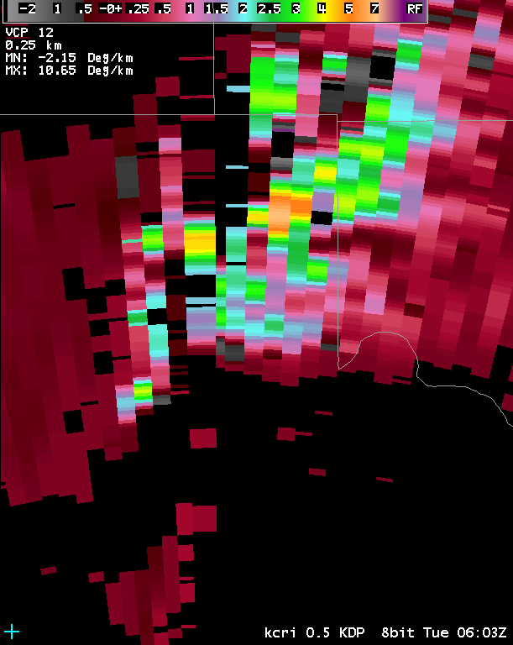
Specific Differential Phase (KDP)
Simple Definition:
Measures change in the phase shift difference between the horizontal and vertical pulses
KDP is useful for:
Measuring where liquid is present even when the following exist:
Beam blockage (<40%)
Attenuation
Hail
Rainfall estimation, primarily
Notes:
Key Point: Here is a basic overview of the Specific Differential Phase product
Notes to Presenter: Specific Differential Phase (aka: KDP) measures the difference in phase shift between the horizontal and vertical pulses. The phase shift in each pulse is impacted by the amount of liquid precipitation. Ice crystals and hail rarely impact KDP because they usually have a random orientation in the volume. Attenuation or partial beam blockage (as long as it’s less than 40% or so) also have little impact on KDP.
As you might guess, this makes KDP very useful for rainfall estimation. KDP values greater than 1.0 are almost exclusively rain. KDP is not the primary product used for calculating rainfall estimates. It is used primarily when Base and Differential Reflectivity products indicate hail contamination, signal attenuation, or partial beam blockage is occurring.
Animations: 2
#1: First set of text bullets
#2: Second set of text bullets

Slide 16
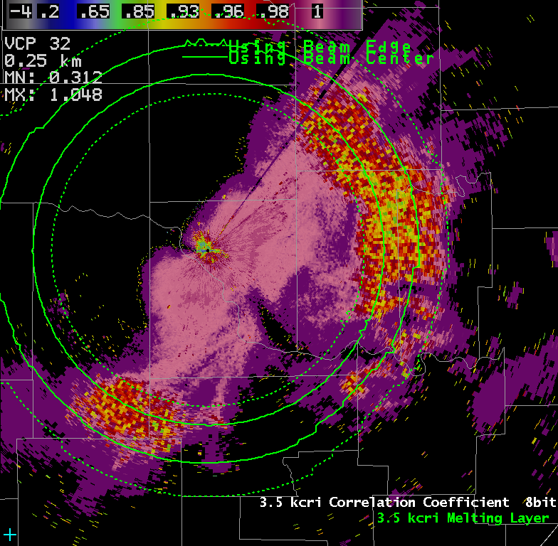
Melting Layer Detection Algorithm
Simple Definition:
Uses Reflectivity & dual-polarization products to measure heights of precipitation melting layer on each elevation scan
Melting Layer useful for:
Classifying precipitation type
Aviation forecasting
Improved rainfall estimation
Notes:
Key Point: Here is a basic overview of the Melting Layer Detection Algorithm product
Notes to Presenter: The Melting Layer Detection Algorithm uses Base Reflectivity, Correlation Coefficient, and Differential Reflectivity to measure the height of the melting layer along each radial of the current elevation angle. This product is generated every volume scan, which can be very helpful for monitoring the freezing level during rapidly changing conditions.
There are several situations where the Melting Layer Detection Algorithm will be helpful. Obviously, knowing the height of the melting layer will help with classifying precipitation type – especially aloft. This tool will be very beneficial to the aviation sector because it will allow real-time monitoring of in-flight icing conditions every 5-10 minutes. This algorithm will also help greatly with precipitation estimation as bright band contamination is one of the biggest sources of error and overestimation of accumulated precipitation.
Animations: 2
#1: First set of text bullets
#2: Second set of text bullets

Slide 17
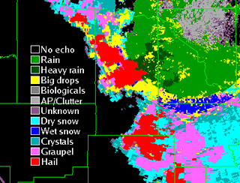
Hydrometeorological Classification (HC)
10 Different Types
BI – Birds/Insects
GC – Ground Clutter
IC – Ice Crystals
DS – Dry Snow
WS – Wet Snow
RA – Light to Moderate Rain
HR – Heavy Rain
BD – Big Drops
GR – Graupel
HA – Hail (mixed with rain)
UK – Unknown
RF – Range Folding
Notes:
Key Point: Here is a basic overview of the Melting Layer Detection Algorithm product
Notes to Presenter: The Melting Layer Detection Algorithm uses Base Reflectivity, Correlation Coefficient, and Differential Reflectivity to measure the height of the melting layer along each radial of the current elevation angle. This product is generated every volume scan, which can be very helpful for monitoring the freezing level during rapidly changing conditions.
There are several situations where the Melting Layer Detection Algorithm will be helpful. Obviously, knowing the height of the melting layer will help with classifying precipitation type – especially aloft. This tool will be very beneficial to the aviation sector because it will allow real-time monitoring of in-flight icing conditions every 5-10 minutes. This algorithm will also help greatly with precipitation estimation as bright band contamination is one of the biggest sources of error and overestimation of accumulated precipitation.
Animations: 2
#1: First set of text bullets
#2: Second set of text bullets

Slide 18
Radar Limitations: Some Things Stay the Same w/WSR-88D Upgrade
Same scanning strategies
Products will not update faster
Same product resolution
Higher resolution web images a product of previous WSR-88D upgrades
Range dependency of data
Tornadic debris signature range: ~30-50 nm
Below beam effects
Radar can detect precipitation type aloft only
Photo courtesy of Clark Payne
Notes:
Key Point: Although dual-polarization technology can do some impressive things, basic radar limitations still exist.
Notes to Presenter: This slide covers some basic things that haven’t changed with the installation of dual-polarization technology. One example: The same VCPs will be used, so data will not update faster. This statement is important because our surveys found some people in the media were getting dual-polarization confused with phased array technology.
The next point highlights that dual-polarization technology doesn’t improve product resolution. This point is significant because the RIDGE web site and RPCCDS will soon make 8-bit products available. This change should occur before the dual-polarization beta test begins in the Fall of 2010. However, we don’t want people thinking that this change in data resolution is due to the radar upgrade.
The third point is just a reminder that the radar data has a range dependency. If you have included a slide on the tornadic debris signature previously, you may have already made the point in the sub-bullet. If not, you can make it here.
The last point is relevant to all radar-related topics, but especially precipitation type. It’s important that people realize that the radar can tell where snow turns over to rain along the beam, but it cannot explicitly detect precipitation type at the surface.
Animations: 4
#1: First set of bullets
#2: Second set of bullets
#3: Third set of bullets
#4: Fourth set of bullets

Slide 19
Misconception #1: Faster Update Times w/ Dual-Polarization Radar
Multifunctional-Use Phased Array Radar (MPAR)
WSR-88D Dual-Polarization Radar
The WSR-88D upgrade to dual-polarization technology will not result in more rapid scanning strategies like those seen with the MPAR
Photos courtesy of Clark Payne
Notes:
Key Point: The WSR-88D dual-polarization radar will use the same VCPs as the conventional WSR-88D, at least initially.
Notes to Presenter: Our survey of NWS customers found that some people were getting the dual-polarization technology upgrade confused with the MPAR technology being used by the National Severe Storms Laboratory. Several folks commented about how exciting it would be when dual-polarization technology allowed for faster volume scans. This issue may not be a problem in your area of the country, but if you think some partners in your area may be familiar with MPAR then this slide is for you.
Animations: 0

Slide 20
Misconception #2: Higher Resolution Data after Upgrade
Current RIDGE: 16 Data Levels
Combination of multiple issues
Previous WSR-88D upgrades from 16 to 256 data levels & super-res
Upcoming dual-polarization upgrade
Upcoming updates to NWS web radar displays
Increase in data resolution independent of dual-polarization upgrade
Future RIDGE: 256 Data Levels
Notes:
Key Point: Changes to the RIDGE web site in the coming year will result in higher resolution data becoming available; this change is unrelated to your local radar being upgraded to dual-polarization technology
Notes to Presenter: I have to be careful how I word this explanation. Part of the reason that the higher resolution data is being made available is related to dual-polarization data becoming available. The increase in bandwidth that makes the 8-bit data display a possibility has been needed for quite some time. With the fielding of dual-polarization technology, enough money was freed up to make displaying the higher resolution a reality.
The point you want to make is that dual-polarization technology –in and of itself – doesn’t result in higher resolution data. Even with 8-bit data available on RIDGE, those users are still not seeing the same level of detail that NWS forecasters (and Level II feed users) get with Super Resolution products.
Animations: 2
#1: First set of bullets
#2: Second text bullet

Slide 21
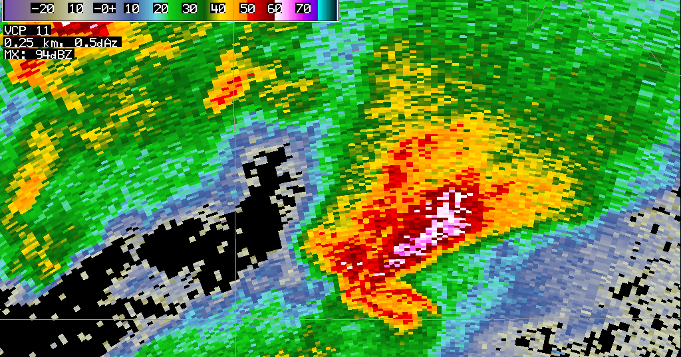
Misconception #3: Debris Detection Will Increase Lead Times
Tornado Debris Signature
Tornado Vortex Signature
Debris signatures have no predictive capabilities (unlike a TVS) because they indicate a damaging tornado is occurring
Notes:
Key Point: The tornado debris signature will help detect some tornadoes, but has little predictive value for increasing Tornado Warning lead times
Notes to Presenter: This subject also requires some careful wording. For all practical purposes, the debris signature shouldn’t increase warning lead times across the board.
It’s possible – in a given situation – that forecasters may have more confidence to reissue a Tornado Warning, which could lead to an increase in lead time. Similarly, it’s possible that a debris signature might lead to warning issuance earlier than would otherwise occur. If that happened – and the tornado was long lived – it could lead to a longer average lead time. However, I doubt this signature will lead to any significant changes in lead time like what was seen with the fielding of the original WSR-88D network.
Animations: 0

Slide 22
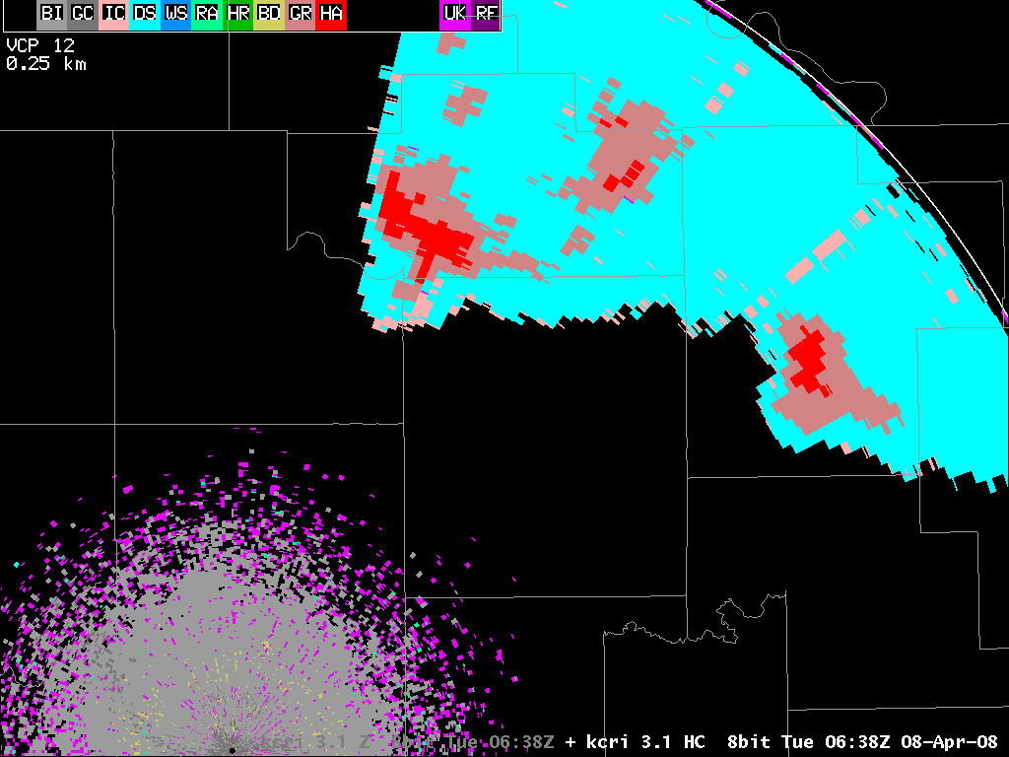
Misconception #4: Hail Detection Improves Tornado Lead Times
≠
Hail Detection
Tornadoes are more likely
While supercells tend to have hail more often than non-rotating storms, detecting hail in a storm does NOT mean that tornado formation is more likely
Notes:
Key Point: Just because a storm (or even a supercell) has hail, doesn’t mean there’s a significantly greater likelihood of it producing a tornado.
Notes to Presenter: In the user surveys conducted by CIMMS, a handful of people commented about storms with hail being more likely to produce tornadoes. I think the reasoning is rotating storms are more likely to produce hail than non-rotating storms. And rotating storms are more likely to produce tornadoes. Conclusion: storms with hail are more likely to be rotating. No, but thanks for playing “I want to be a NWS warning forecaster”. ☺
Animations: 0

Slide 23
Confusion about Radar Limitations & P-Type
Dual-polarization radar can identify snow & rain aloft, but below beam effects limit knowledge of exact surface precipitation type
Notes:
Key Point: Below beam effects are a significant factor in determining precipitation type at a particular surface location.
Notes to Presenter: The graphic & text are pretty self-explanatory. I added the yellow lines to make it even more obvious where the problematic areas are most likely to be. I thought about doing more with this graphic (i.e., fade in reflectivity colors along the beam to show the bright-band), but I think that would take away from the primary message.
Animations: 0

Slide 24
So what about West Texas?
The only operating dual-pol site in West Texas currently is Amarillo.
Schedule (as of April 1)
KSJT 15 April 2012
KFDX 29 April 2012
KTLX 14 Oct 2012
KFDR 28 Oct 2012
KLBB 08 – 19 April 2013
KMAF 5 May 2012

Slide 25
Dual pol for the
WSR-88D
Introduction and imagery
Questions?
Jody James
Warning Coordination Meteorologist Private Pilot National Weather Service Lubbock
Notes:
Welcome to the Introduction to Categorical Amendment Criteria (CAC). This is Part 1 of CAC Training, which deals with the “why’s and how’s” of Categorical Amendment Criteria. Part 2 details how to find CAC for each of your TAF sites.

Slide 26
Dual pol for the
WSR-88D
Introduction and imagery
Thank You
Jody James
Warning Coordination Meteorologist Private Pilot National Weather Service Lubbock
Notes:
Welcome to the Introduction to Categorical Amendment Criteria (CAC). This is Part 1 of CAC Training, which deals with the “why’s and how’s” of Categorical Amendment Criteria. Part 2 details how to find CAC for each of your TAF sites.

