Slide 1
National Weather Service Aviation Forecast Products

Slide 2
Outline
National Weather Service Aviation Program
Aviation Weather Center Products
Storm Prediction Center Products
National Hurricane Center
National Weather Service Detroit/Pontiac Products
Common Weather Products and Forecast Information

Slide 3
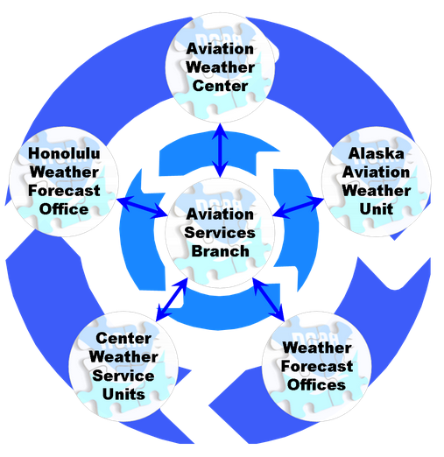
NWS Aviation Program

Slide 4
NWS Aviation Program
Aviation Services Branch (ASB) – Located at NWS headquarters in Silver Spring, MD. Oversee the entire NWS aviation program. Main liaison between NWS, FAA and GA (AOPA).
Aviation Weather Center (AWC)– Located in Kansas City, MO. Provide forecast across the continental US and Caribbean. This includes area forecast, airmets, sigmets, turbulence and icing forecasts, winds aloft. They operate the ADDS Website.
Alaska Aviation Weather Unit – (AAWU) Located in Anchorage, AK. Provides forecasts across the complex terrain and weather features of Alaska and Gulf of Alaska.
Honolulu Weather Forecast Office – Provides forecast across the Hawaiian Islands and the central and eastern Pacific Ocean.
Center Weather Service Units (CWSU) – Located within Air Route Traffic Control Centers. Cleveland Center services SE Mi. They brief the air traffic controllers and area TRACONs on regional weather conditions. They also issue Meteorological Impact Statements and Center Weather Advisories.
Weather Forecast Offices (WFO) – 122 spread out across the country. Issue Terminal Aerodome Forecasts (TAFs) for a select number of airports in their forecast area. WFO Detroit/Pontiac is located in White Lake Twp (Oakland Co), Mi. Issue TAFs for DTW, YIP, DET, PTK, FNT, MBS.

Slide 5
Aviation Weather Center - ADDS
Advisories – Airmets and Sigmets
Graphical Forecasts
Turbulence
Icing
Winds Aloft
Area Forecasts
Thunderstorms
Observations
Surface Observations (METAR)
Pireps
Radar
Satellite
Tools (Flight Path Tools and others)

Slide 6
Storm Prediction Center (SPC)
Convective Outlooks (Day 1, 2, 3)
Meso Scale Discussions
Convective Watches
Forecast Tools
Storm Reports

Slide 7
Tropical Prediction Center (National Hurricane Center)
Routine forecast for the tropics, including the entire Caribbean.
Tropical cyclone outlooks
Track and Intensity forecasts for tropical storms and hurricanes

Slide 8
National Weather Service Forecast Offices
Local Forecast Information
Aviation Forecast (TAFS)
Area Forecast Discussion (includes an aviation section)

Slide 9
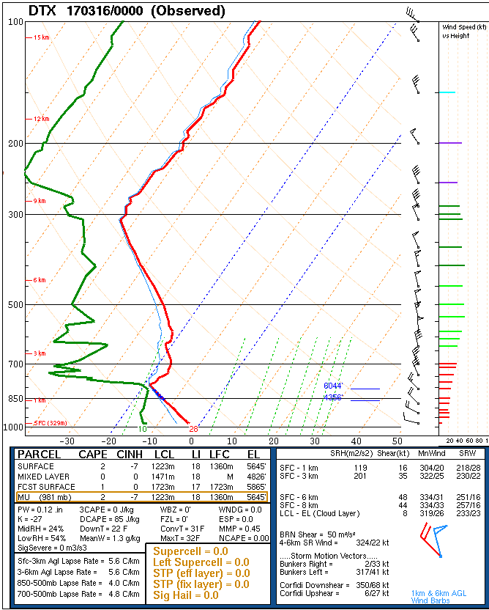
Atmospheric Soundings

Slide 10
Computer Models
Medium to Long Range Models
NAM
GFS
ECMWF (European)
Canadian
Hi Resolution Short Range Models
RAP
HRRR
ARW

Slide 11
MOS (Model Output Statistics)

Slide 12
MOS (Model Output Statistics)

Slide 13
MOS (Model Output Statistics)

Slide 14
Convection

Slide 15
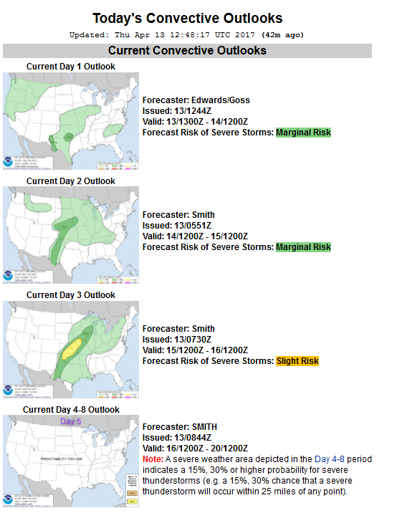
Convection

Slide 16
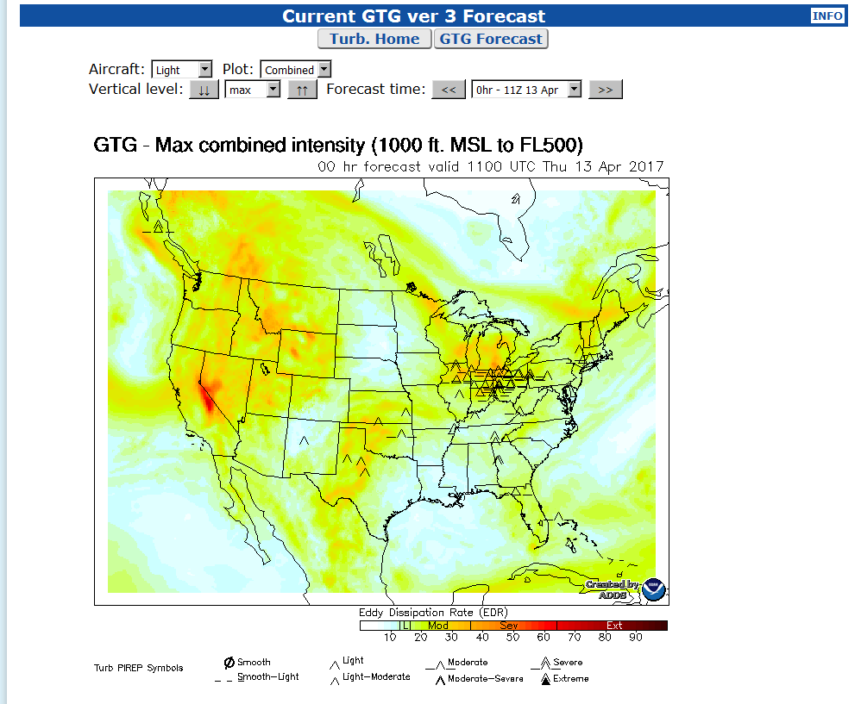
Turbulence

Slide 17
Icing

Slide 18
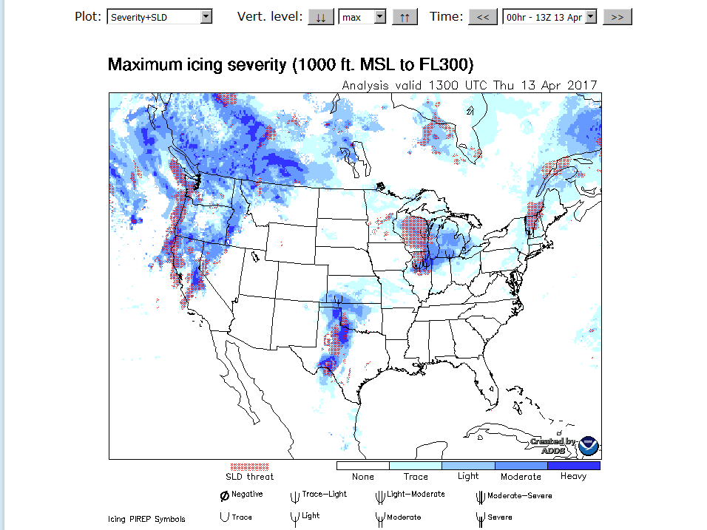
Icing

Slide 19
In Flight Advisories

Slide 20
Graphical Airmets

Slide 21
Prog Charts

Slide 22
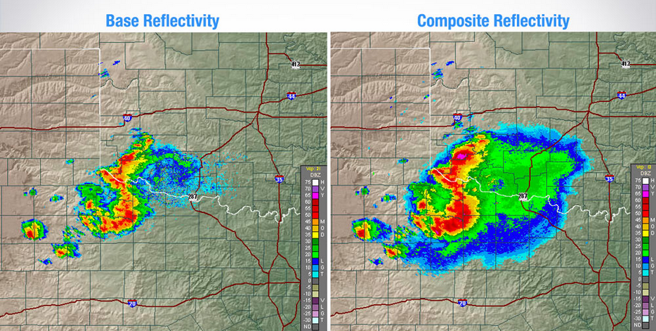
Base VS Composite Reflectivity
0.5 Degree Elevation Angle
Highest Reflectivity from every
elevation angle

Slide 23
Pressure Levels
1000 MB; <1k feet
925 MB; 2-4k feet
825 MB; 4-6K feet
700 MB; 8-12K feet
500 MB; 16-22K feet
300 MB; around 30k feet
250 MB; around 34k feet

Slide 24
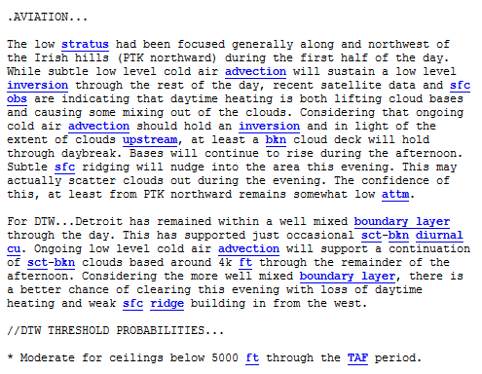
Local Aviation Forecast Discussion

