Slide 1
New DTW Approach and Departure Procedures

Slide 2
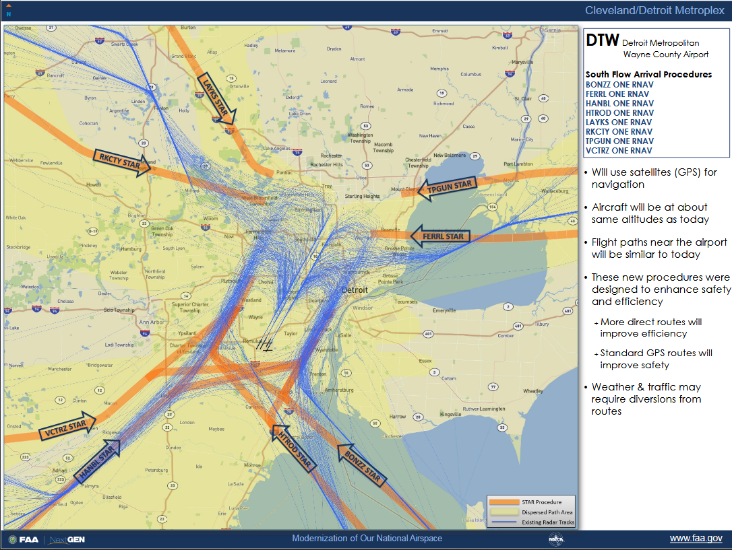
South Flow Arrival Procedures
Old routes in blue and new routes in orange (with the new STARS).

Slide 3
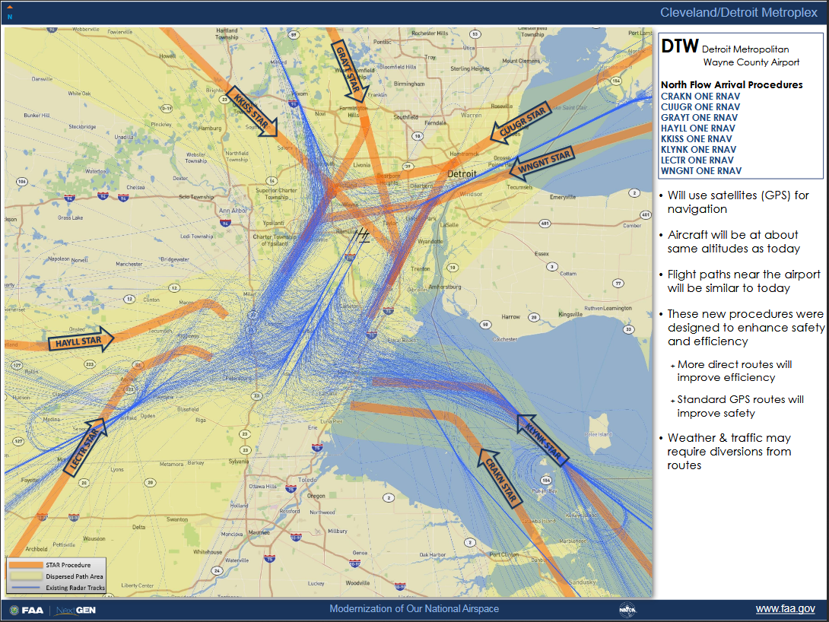
North Flow Arrival Procedures
Old routes in blue and new routes in orange (with the new STARS).

Slide 4
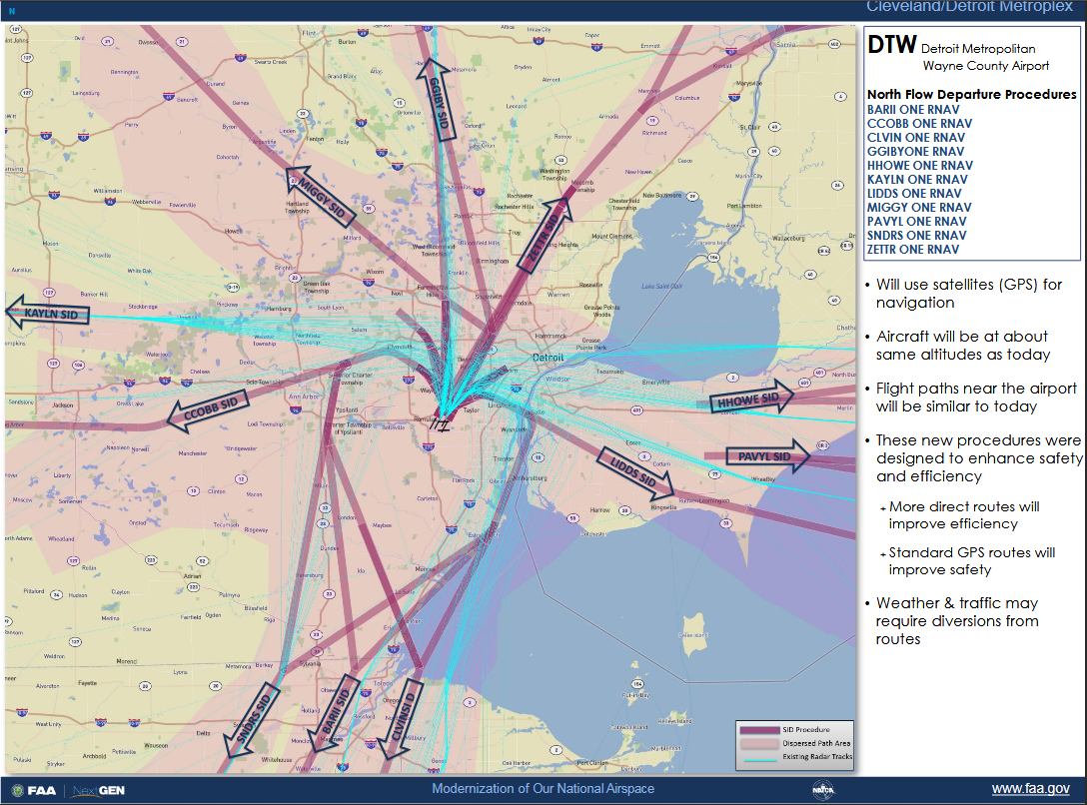
North Flow Departure Procedures
Old routes in blue and new routes in red (with the new SIDS).

Slide 5
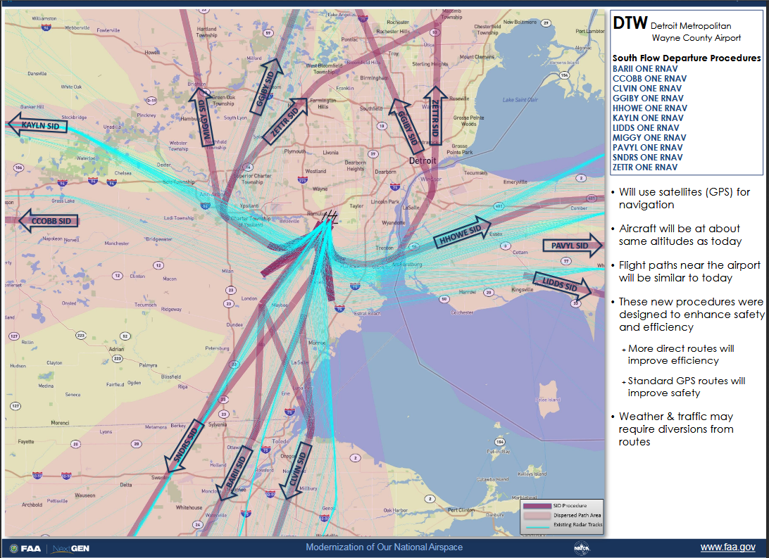
South Flow Departure Procedures
Old routes in blue and new routes in red (with the new SIDS).

Slide 6
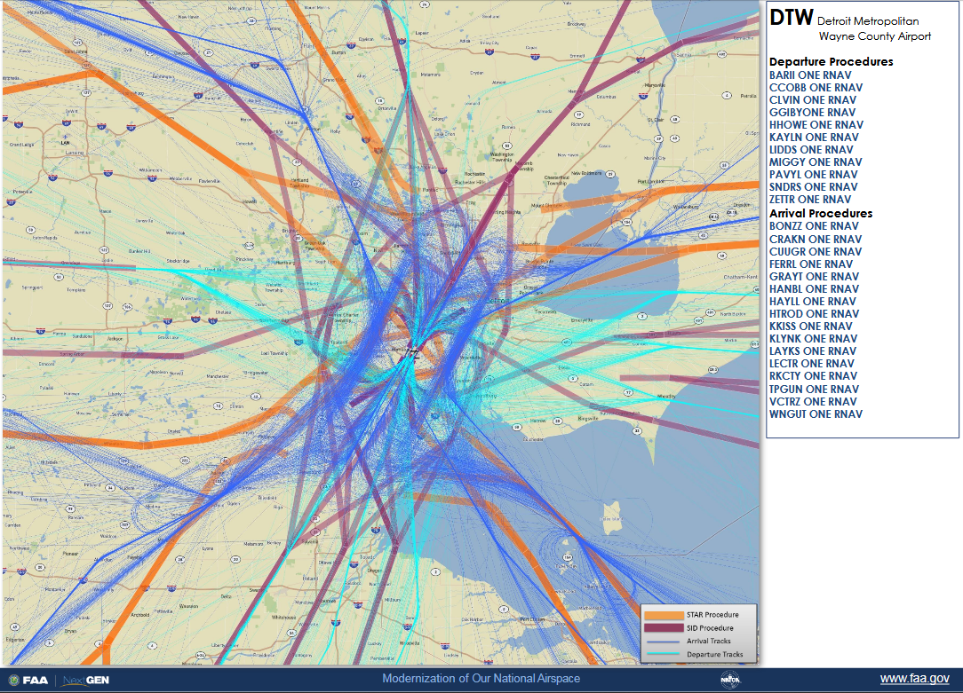
South Flow Departure and Arrival Procedures
Old routes in blue and new routes in orange and red

Slide 7
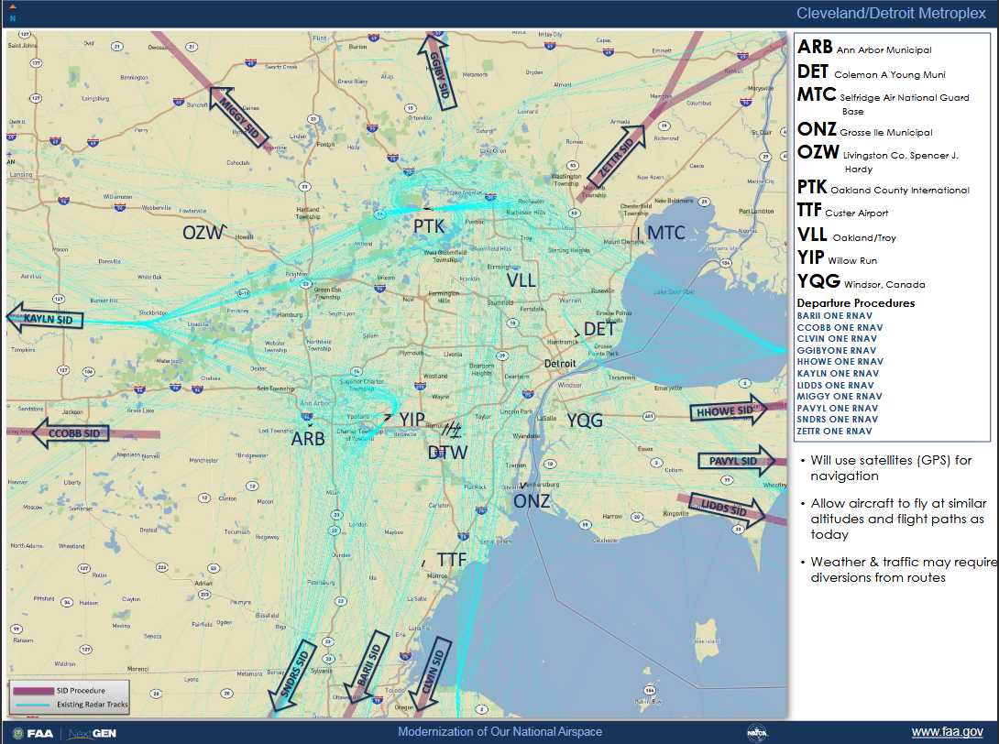
Satellite Departure Routes
Old routes in blue and new routes in red

Slide 8
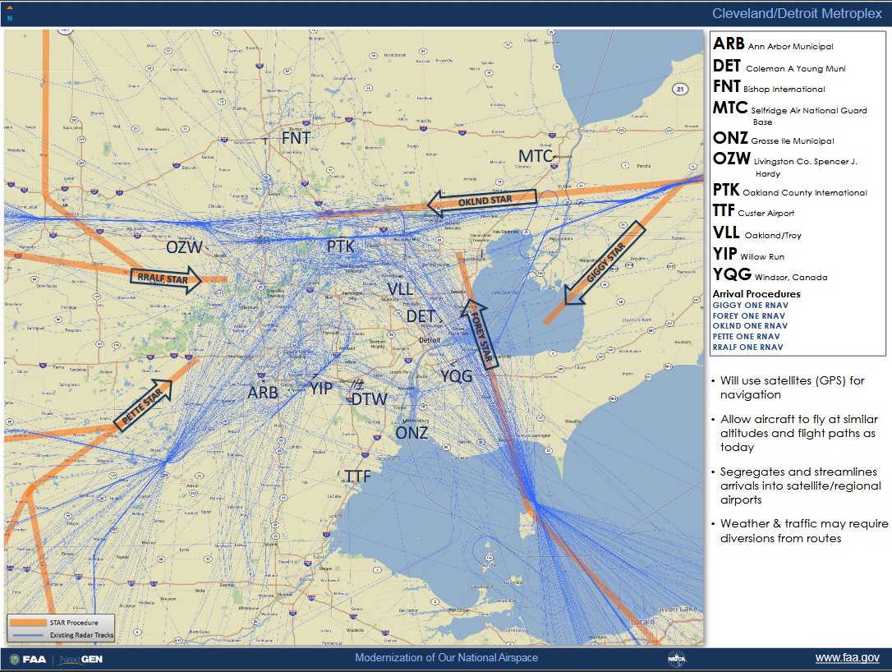
Satellite Arrival Routes
Old routes in blue and new routes in orange

