Slide 1
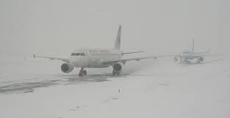
Cool Season TAFs

Slide 2
Contents
Stratus
Forecasting
Marine Stratus
Model Biases
Fog
Radiation
Advection
Stratus Build Down
Winter Weather Best Practices
Forecasting Tips
General Rules of Thumb
Aviation AFD
Coordination
Verification Stats

Slide 3
Stratus - Formation
Low level moisture becomes trapped underneath an inversion
Cyclonic flow below 800mb
Low level lift/convergence
Weak instability below the base of the inversion
Warm/moist air advection above the inversion and cold air advection below the inversion
Subsidence (not too strong) above the inversion

Slide 4
Stratus - Formation
Large-Scale conditions favorable for stratus
Overriding of warm, moist air along and north of a warm/stationary front, often in advance of an approaching surface low
In the wake of a cold front where shallow cold air undercuts warm and moist air

Slide 5
Stratus - Formation
Lake effect stratus/strato cu
Nocturnal lake-effect stratocumulus will propagate eastward from LM once surface-based mixing ceases (decoupling)
Elevated moist mixed layer is the duct for cloud advancement
Layer is capped above and below by highly stable layers (usually surface and subsidence temperature inversions)

Slide 6
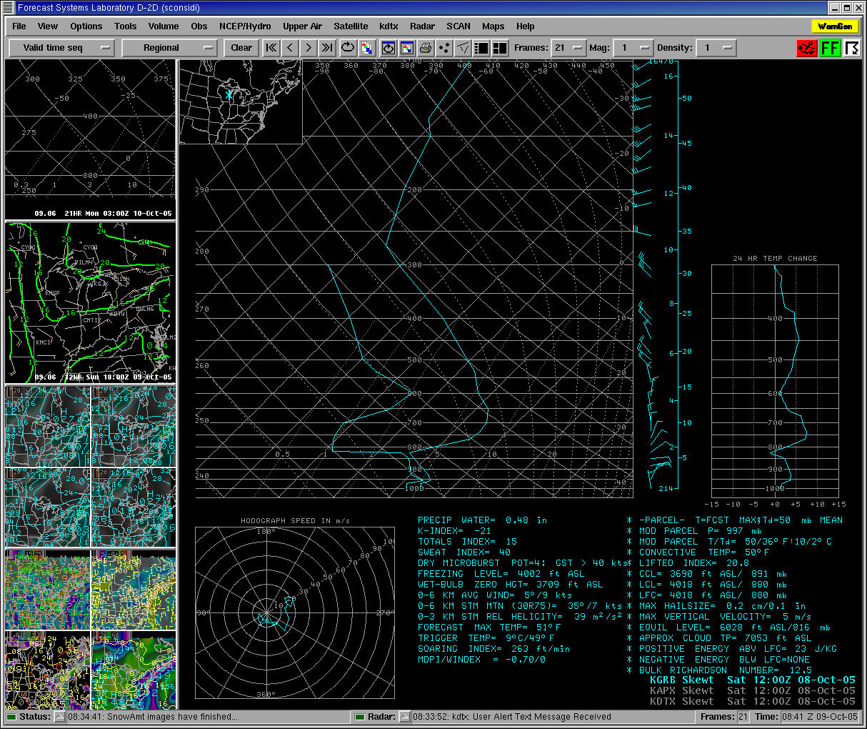

Slide 7
Stratus - Formation
Lake effect stratus/strato cu
Sufficient low level instability over the lake capped by a stable layer (cool season)
Advection of moist air over cold water (Td > Tw)

Slide 8
Stratus - Formation
- Frictional Convergence
Air moving from relatively smooth water to rough land leads to more cross isobaric flow, lighter wind speeds, speed/directional convergence, and enhanced lift.
Over Water
Over Land
F
F
PGF
PGF
Wind
Wind
C
C

Slide 9
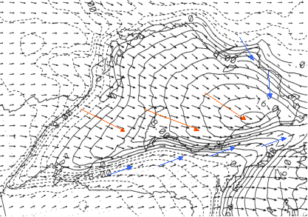
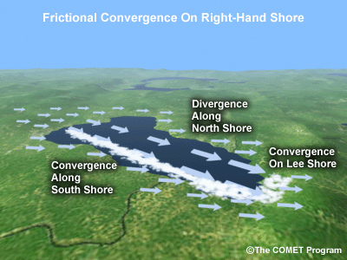

Slide 10
Stratus - Dissipation
Advection of cold air aloft or warm air at the surface (weaken the inversion)
Dry air advecting into the lower levels
Solar heating to mix out the inversion (warm season)
Strong subsidence forcing the inversion to ground
Anticyclonic flow/low level divergence

Slide 11
Stratus - Dissipation
Mechanical mixing
Shear induced mixing promotes momentum transport
This increases the mixing
The inversion layer lowers and weakens

Slide 12
Stratus - Model Parameters
Low level cyclonic vorticity
Ekman layer develops which leads to cyclonic flow with low-level lift
Boundary layer convergence

Slide 13
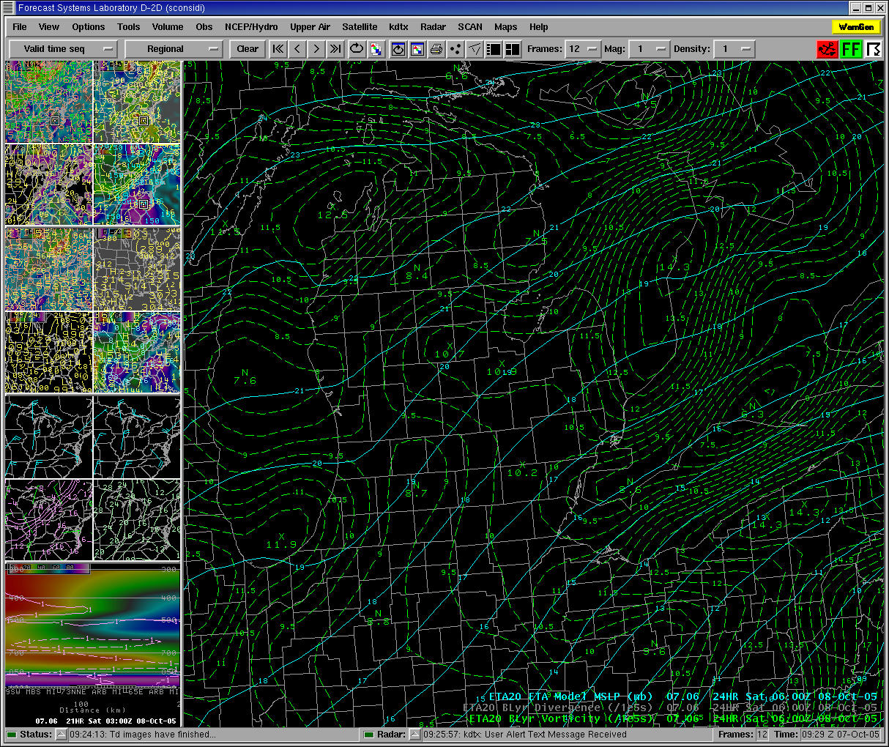

Slide 14
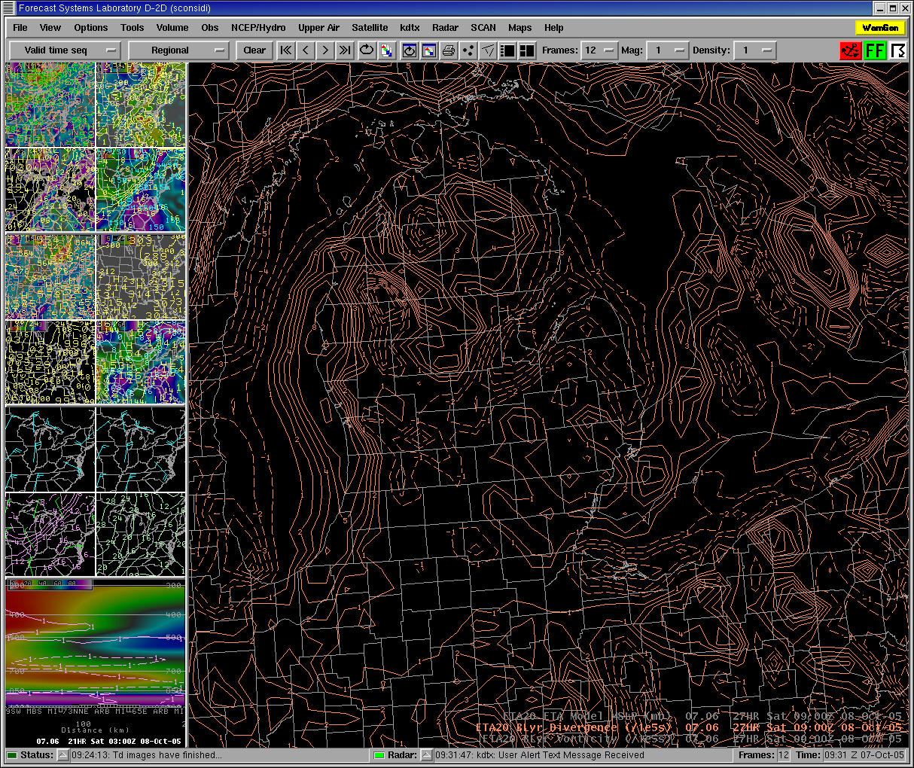

Slide 15
Stratus - Model Parameters
Presence of moisture below 800mb
Moist isentropic ascent in the lower levels of the atmosphere
Lapse rates near the inversion level
Weak low level dry air advection will likely not be enough to diminish the stratus without a change in the inversion

Slide 16
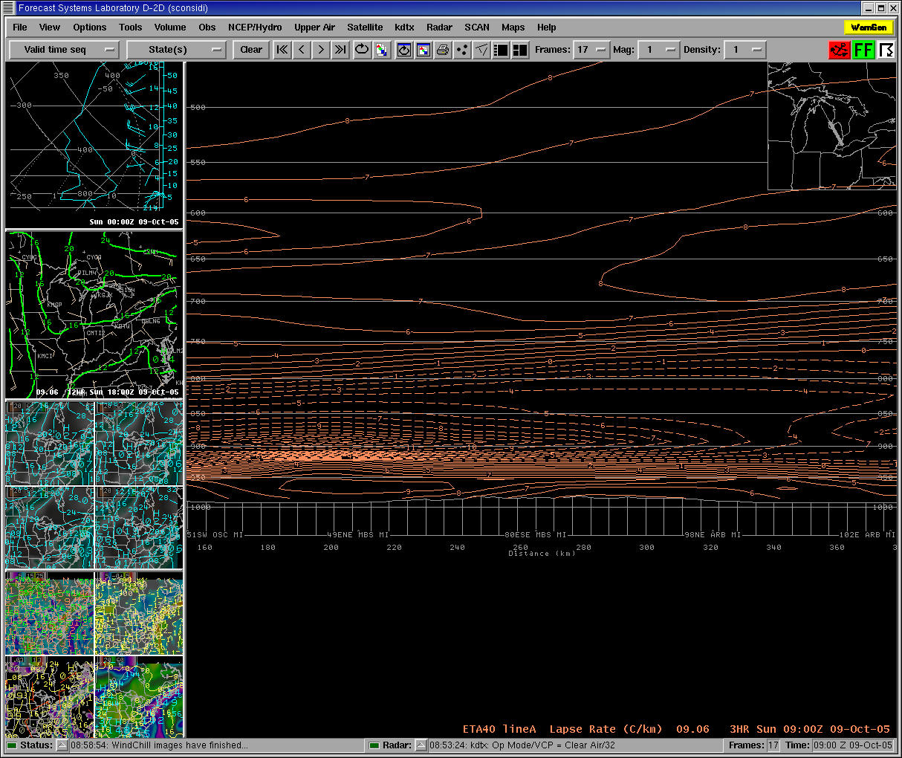

Slide 17
Stratus - Model Parameters
Differential temperature advection centered on the inversion level
In winter, temperature advection is the most efficient way to weakening the inversion

Slide 18
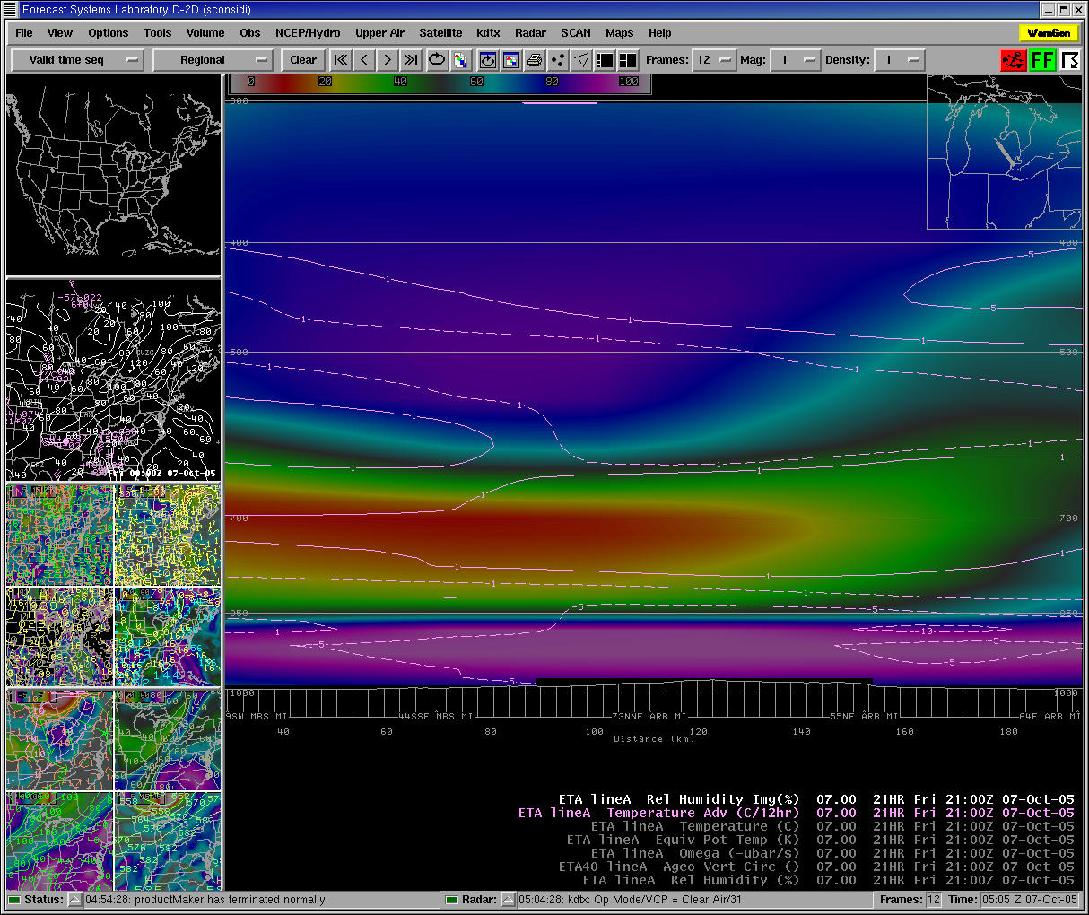

Slide 19
Stratus - Model Parameters
Time sections of omega/theta e to diagnose mid-level subsidence
Strong subsidence will cause dry air entrainment at cloud top and will push the inversion to the ground
Weak subsidence however may not be enough to break up the clouds, but can lower inversion causing lowering of the cloud bases.

Slide 20
Stratus - Model Parameters
Model soundings to diagnose the height and strength of the inversion

Slide 21
Stratus - Model Tendencies
Tendency to dry out the low level RH too fast
Compare 24-hour forecast differences in RH
Look for gradients in RH rather than forecasting a specific value

Slide 22
Stratus - Model Tendencies
Tendency to lower or weaken the inversion too fast
Compare temperature advections
Compare observed soundings to model soundings

Slide 23
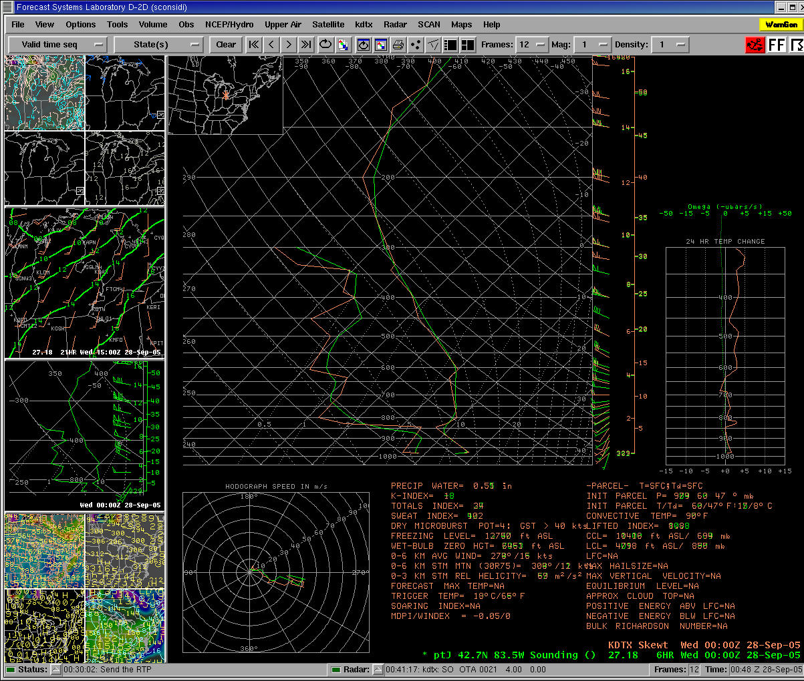

Slide 24
Stratus - Forecasting Tools
Observed soundings
Compare postfrontal sounding to “near front” sounding
Examine the changes in inversion depth
Compare observed sounding to model sounding
Is the inversion as strong in the model as the observed
Does the model have the sub-inversion layer as saturated as the observed soundings?

Slide 25
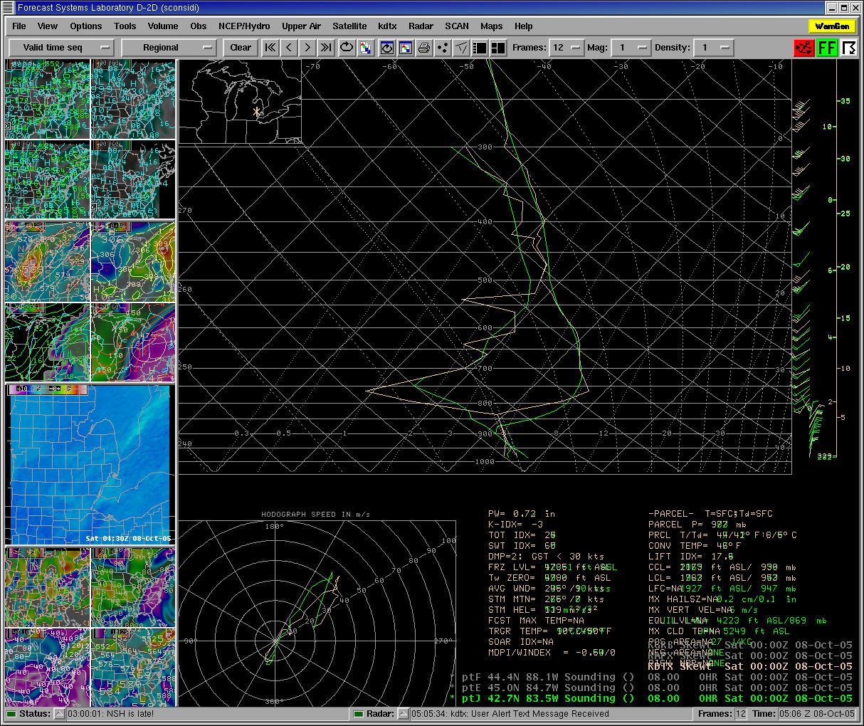

Slide 27
Stratus - Forecasting Tools
Satellite imagery
Compare location of cloud edge to low level RH in models
Compare evolution of cloud edge movement to changes in RH field in the models

Slide 28
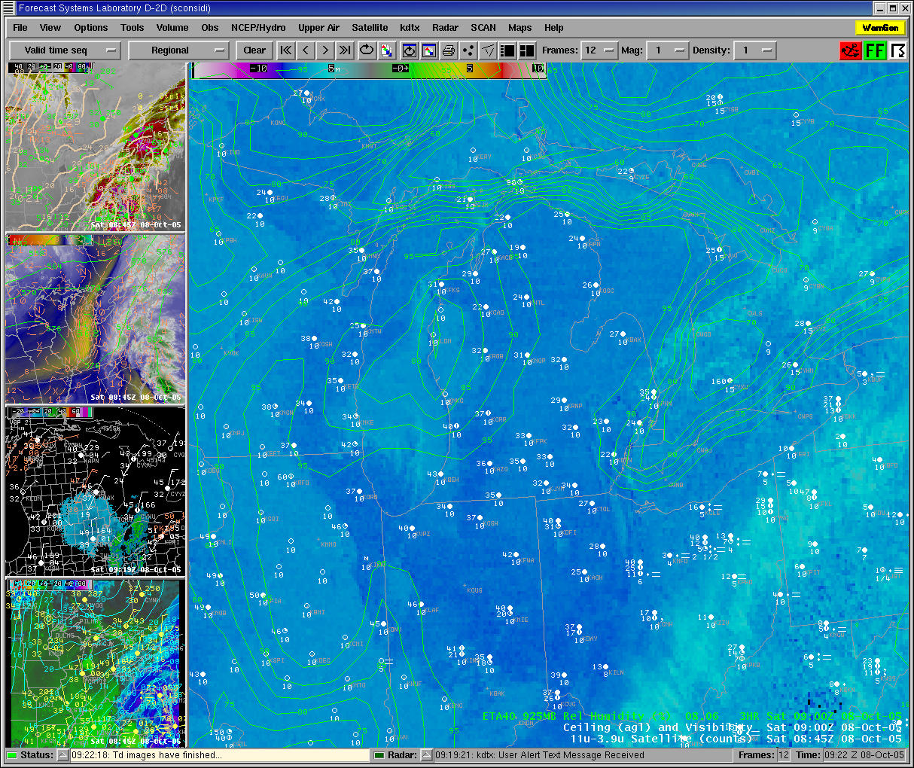

Slide 29
Stratus – Conditions to Watch Out For
Models solutions which develop low clouds/fog as a result of warm air flowing over a melting snow pack.
If the airmass is dry, models usually overestimate the low cloud development
This can result in an overly pessimistic cig/vsby forecast
Play very close attention to conditions upstream, particularly how well models are handling moisture in the boundary layer.

Slide 30
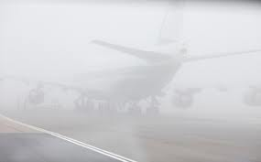
Fog
Radiation Fog
Advection Fog
Stratus Build Down

Slide 31
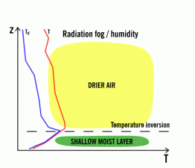
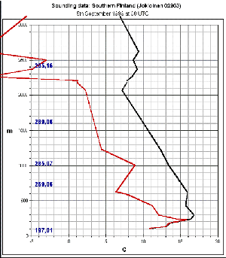
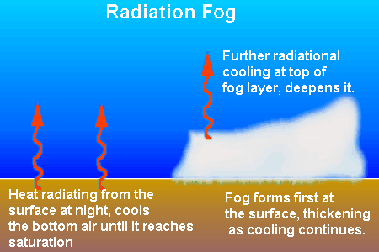
Radiation Fog - Development
Clear Skies, Light or no Wind, Shallow Low Level Moisture
Conditions that will promote radiation fog
Saturated Soils
Snow Cover

Slide 32
Minimum Wind Speed for Sustainable Turbulence in the Nocturnal Boundary Layer
It was found that there was a critical wind threshold to predict the development of a stable boundary layer.
If the geostrophic wind falls in the range of 5-7 m/s (~10 knots) at the crossing point in the velocity profile, usually 30-60m (100-200 ft), a very stable nocturnal boundary layer is anticipated.
Crossing point in the velocity profile – point at which wind speeds tend to remain relatively stationary in magnitude compared to higher level winds which experience inertial accelerations and near surface winds which tend to weaken.
On AWIPS, use geostrophic wind on a time height series or geostrophic wind around 1000 or 975 mb.
Assumes surfaces with relatively small heat capacity (likely does not work over water).

Slide 33
UPS FOG Technique
Uses the Crossover Temp – The Dewpoint during the hottest part of the day.
If the overnight low is forecast to drop near the crossover temp, then forecast MVFR type vsbys.
If the overnight low is forecast to drop below the crossover temp, then forecast IFR or below.
This technique assumes no advection of moisture into the boundary layer and/or no low level dry air advection.
Tries to represent a low level profile where moisture is constant or increases with height.
This tool is built into BUFKIT (pay close attention to the MRi number, representing mixing in the boundary layer).

Slide 34
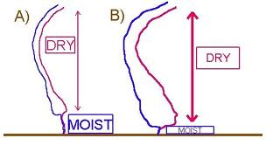
Radiation Fog - Dissipation
Daytime heating/mixing (Remember in late fall/winter, this may take until after 15Z or so).
Depth of fog will also determine time of dissipation.
Increased mixing atop the fog layer caused by strengthening winds aloft.
Relatively warm ground temperatures to help induce mixing.

Slide 35
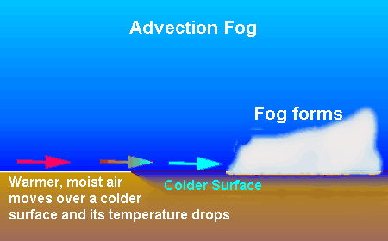
Advection Fog - Formation
When the boundary layer gets moistened by the advection of a warm marine layer inland. This then primes the boundary layer for fog under ideal radiational cooling conditions.
Most likely to occur from September through December.
In most instances, the fog will first develop near the shoreline (shoreline convergence), then advect inland (typically toward the direction of the wind just atop the shallow stable layer, usually around 950 mb)

Slide 36
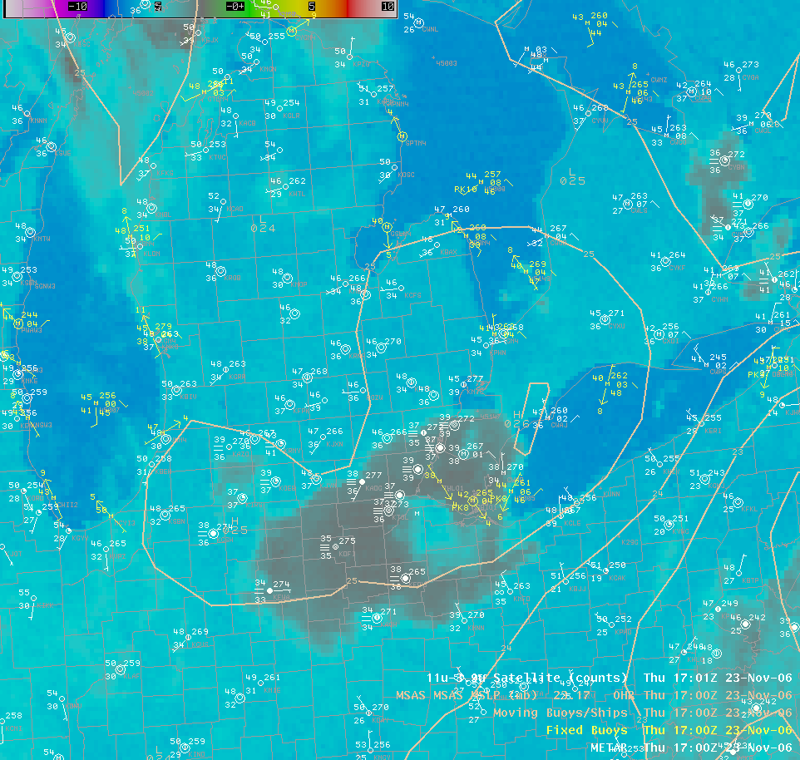
Satellite View
IR Imagery of an event which resulted from east flow off Lake Erie. Image is actually from 17z Nov 23, 2006

Slide 37
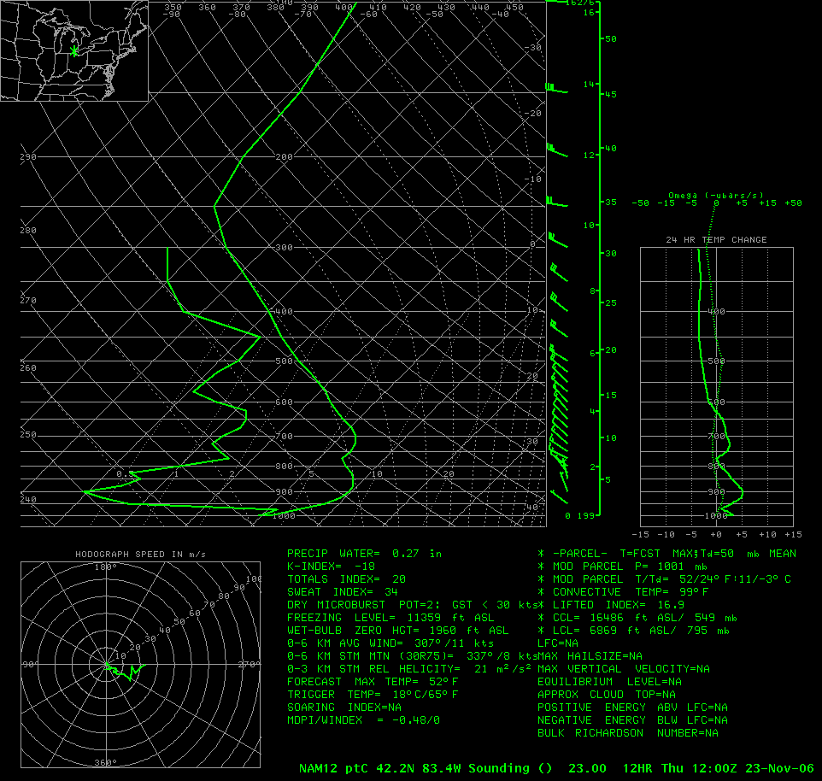
Sounding Profile
Example of a how a model sounding would look like during these events (assuming the model is handling the boundary layer moisture reasonably well which is not always going to be the case). Note the layer of moisture trapped under a strong inversion and capped by a deep layer of extremely dry air (Dewpoint depressions greater than 30 deg).

Slide 38
Advection Fog - Characteristics
The depth of this fog can grow substantially, especially in late fall and early winter when nights are very long.
The low sun angle will also make it difficult to induce mixing in the boundary layer.
These events have produced extremely dense fog (near zero visibility).
950 to 850mb winds are typically 15 knots or less (strong enough to advect the fog inland but not too strong as to mix the low level moisture out).
In late fall, the boundary layer may not mix out well after one of these events, which may actually prompt fog redevelopment the next night, sometimes as early as midnight.
These events typically occur in the presence of a mid level ridge and strong low level anticyclone.

Slide 39
Stratus Build Down
This is when an initial stratus deck develops, then the ceilings lower and eventually reach the ground.
These events are very difficult to forecast due to the complex nature of the processes going on and poor handling by the models.
Some things to look for include:
A strengthening and lowering inversion above the stratus deck (very dry air should be present above the stratus deck).
Most typical with cold ground temps and/or snow cover.
Look for high RH between the base of the stratus and the ground.
Most typical under a light gradient (ie you do not want to have too much mixing).
Can occur with warm ground temps under very high humidity (rainfall or thunderstorms often help).
Sometimes this will form on the edge of a stratus deck within the region of clear skies.
This type of fog is most common at PTK due to its higher elevation.

Slide 40
Winter Weather Best Practices - TAFs
The most detail should be placed in the first 6-8 hours of the TAF. The last 12 hours should be considered an outlook.
If you are confident heavy snow will impact the terminal (i.e. a winter storm warning is in effect), forecast vsbys down to 1/4SM.
If confidence of heavy snow is not that high, keep vsbys at or above 3/4SM and be ready to amend as needed (preferably a couple hours prior to the onset of heavy snow).
Anytime sleet, freezing rain or freezing drizzle are in the TAFs, it has huge impacts on aviation. So be highly confident before placing this in the TAFs, especially DTW. Our FAR for Freezing Precip is very very high.

Slide 41
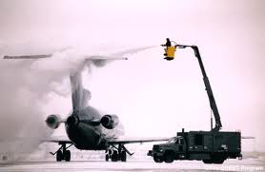
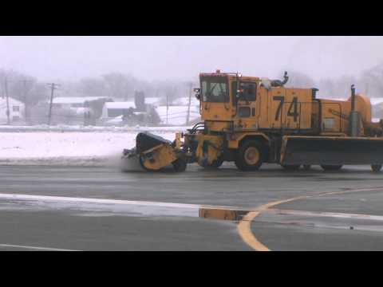
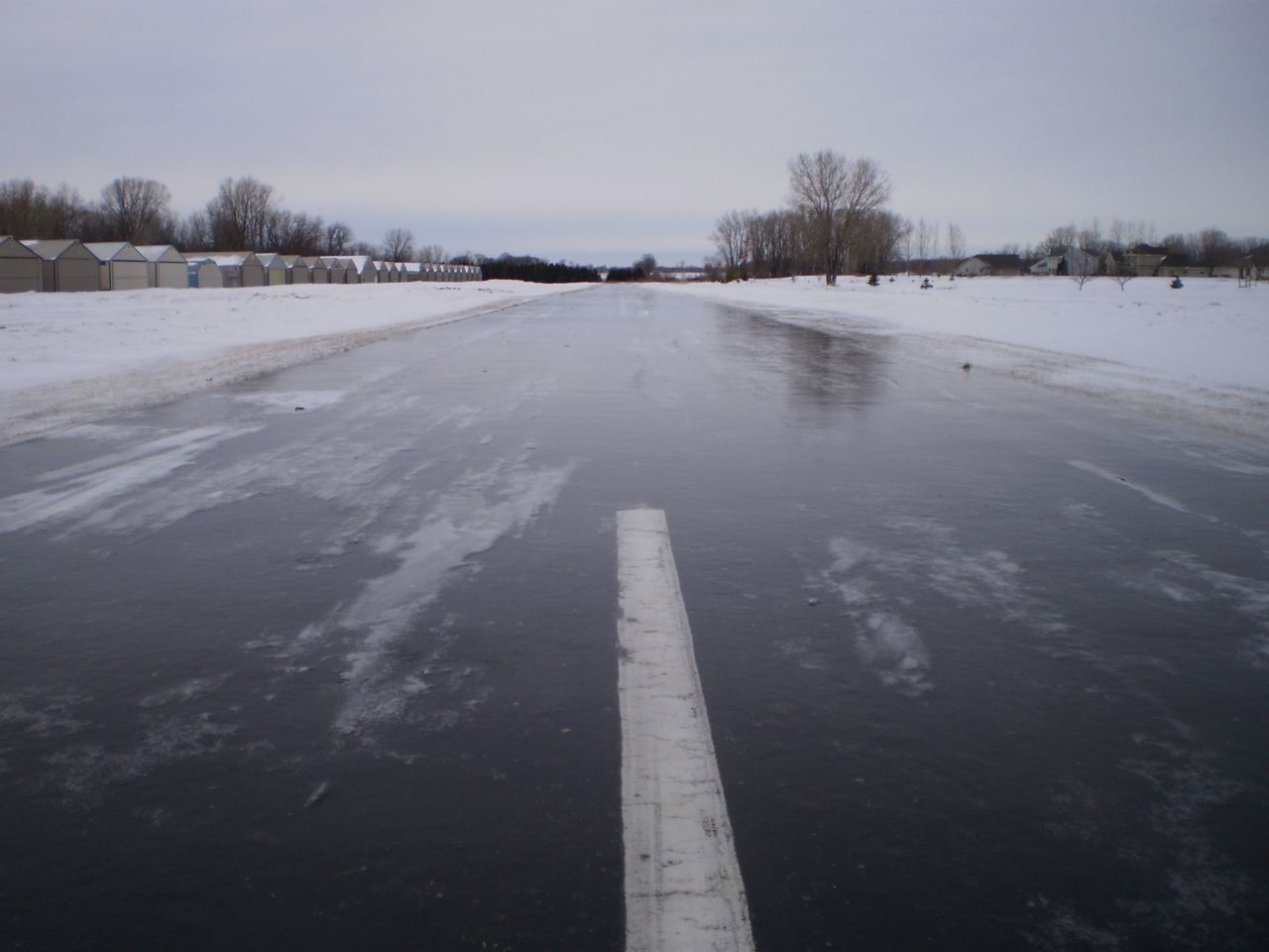
Freezing Precip and Airport Operations
Deicing Aircraft
Clearing ice off runways
Potential for huge delays
Cost factor involved in using deicing fluid
When IP and/or FZRA are forecast or occurring deicing is mandated

Slide 42
Winter Weather – General Rules of Thumb
Ceilings and visibilities tend to drop very quickly once accumulating snow begins.
Much like dense fog, heavy snow typically has vertical visibilities of 200 ft or less.
Often times, upstream observations can be very helpful in determining what ceilings and visibilities should be in approaching snowfall.

Slide 43
Winter Wx Forecast Tips
Utilize model sounding data and tools available on the wiki to get an idea of snowfall amounts and liquid water content of the snow.
Hourly PQPF/Psnow
BUFKIT Snow Ratio Calc
Internal DTX ProbSnow
Use model soundings and BUFKIT data to help gain understanding of what precip type might occur.

Slide 44
TAF Amendments
Be proactive in amending the TAFs when freezing rain and/or sleet occurs unexpectedly OR when it is forecast to occur and it becomes apparent that it will not occur.
Unexpected changes in snowfall intensity also need quick amendments.
Be sure to amend with the 2 to 6 hour time period in mind (i.e. don’t wait until the TAFs go bad to amend).
During winter storms, if possible, have two short term forecasters; one to focus on the public aspect of the storm and the other to focus on the aviation aspect.

Slide 45
AFD Best Practices
It is beneficial to the aviation community that we use the AFD to express certainty levels.
A general statement on the water equivalent of the snow and snow accumulations would also be good. Wet snow has a much bigger impact then dry snow.
During complex winter situations, try to focus on the main impacts (usually precip and wind) so as not to make the discussion excessively long.

Slide 46
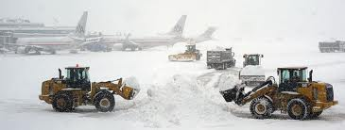
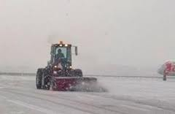
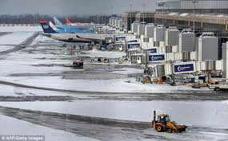
Coordination
Remember to give CLE CWSU a call whenever we are forecasting sleet, freezing rain or accumulating snow.
DTW ground maintenance will call frequently. They will want to know start and end times of the snow (end time is very important), how much snow is expected to fall and the characteristics of the snow (heavy wet/light dry) and temperatures.

Slide 47
Cool Season Stats for Cigs < 1000 FT

Slide 48
Cool Season Stats for Vsby < 1 Mile

Slide 49
CIGs < 1000 FT 2011-2012

Slide 50
VSBY < 1 SM 2011 - 2012

Slide 51
CIGs < 1000 FT 2011-2012

Slide 52
VSBY < 1 SM 2011-2012

Slide 53
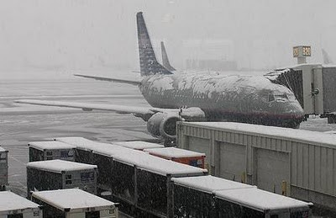
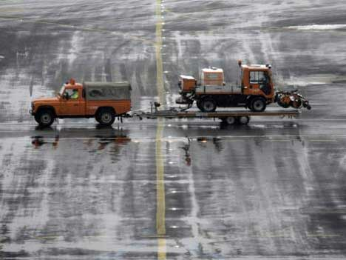
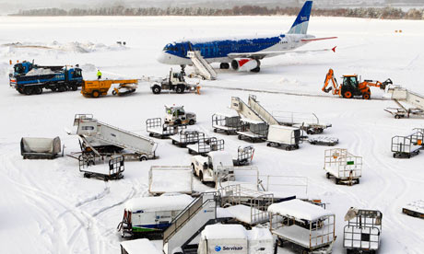
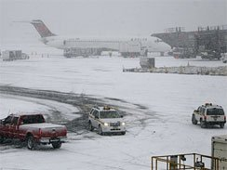
THE END

