Slide 1
Thunderstorm Study 00Z TAF July 29, 2010

Slide 2
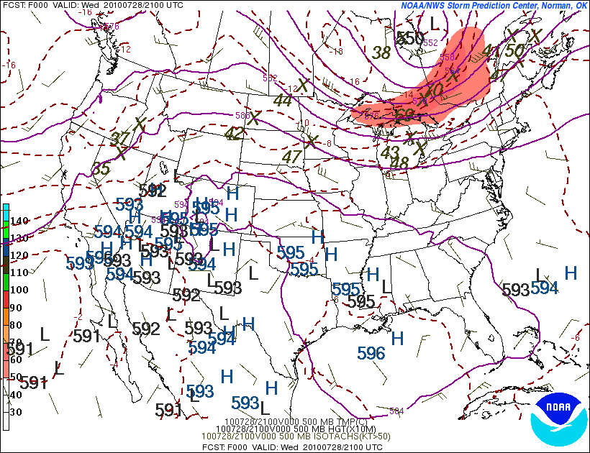
Thunderstorm Study Synoptic Pattern – 500mb
Notes:
The 500mb map for that evening showed a trough across the Great Lakes, along with a speed max lifting northeast away from the area.

Slide 3
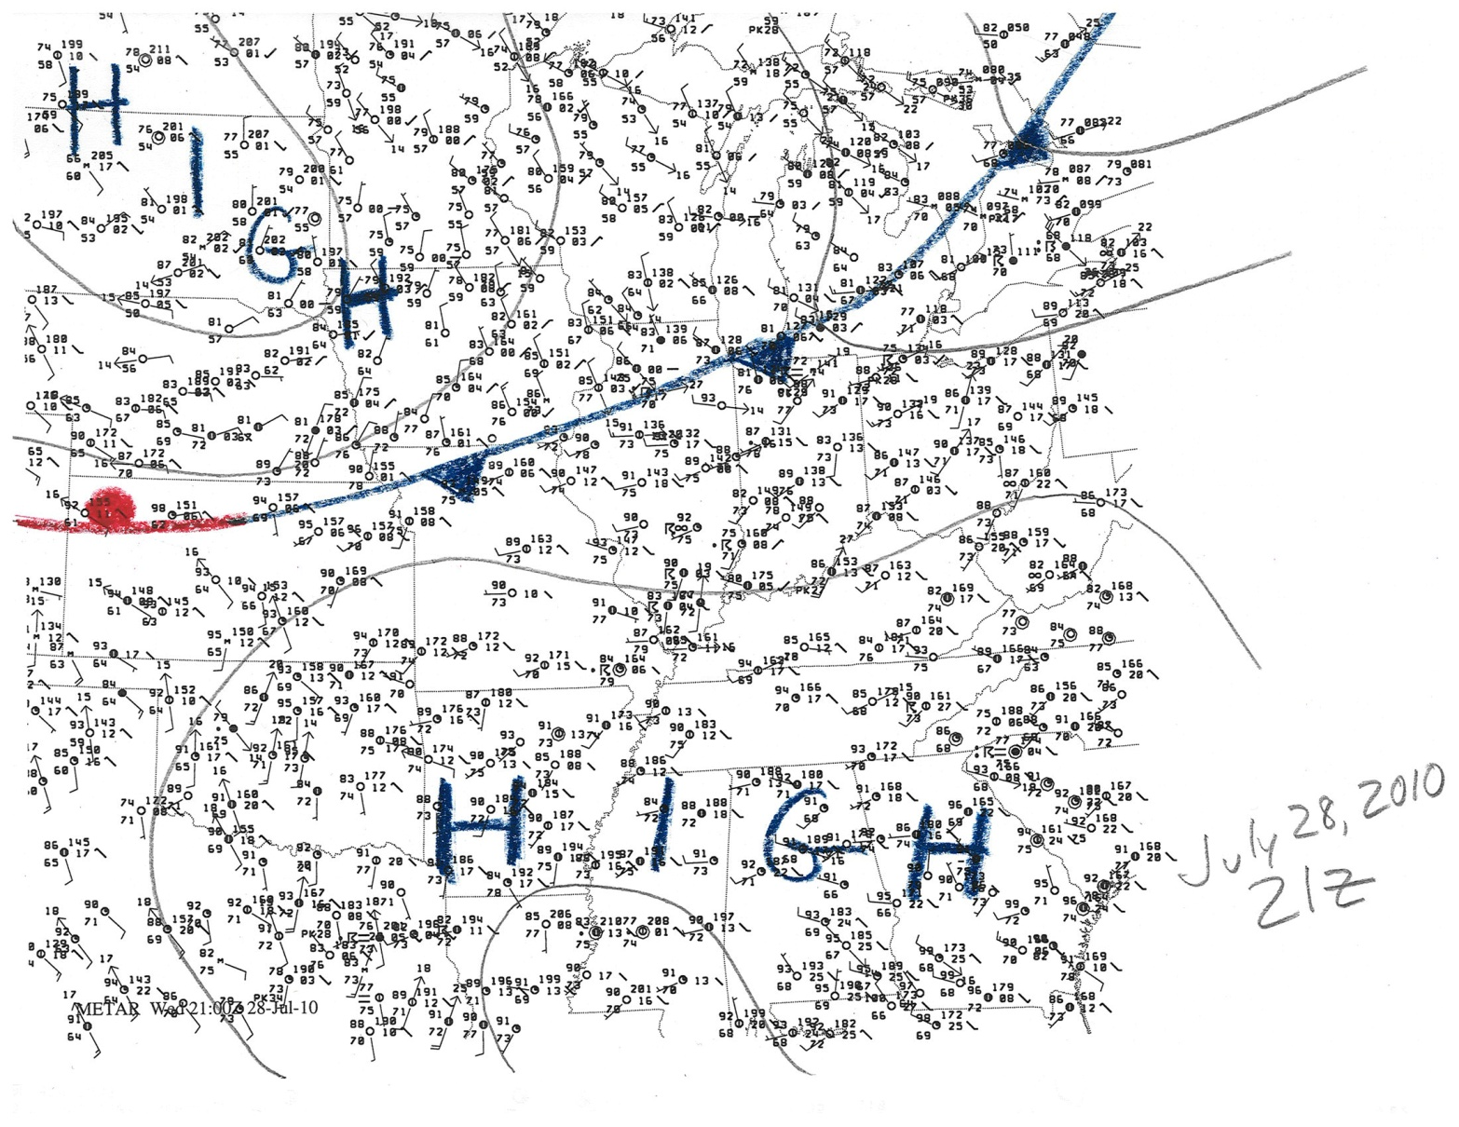
Thunderstorm Study Surface Map 21Z
Notes:
The surface map indicated a cold front dropping down from the Great Lakes. Dewpoints were generally in the middle 70s across the local area.

Slide 4
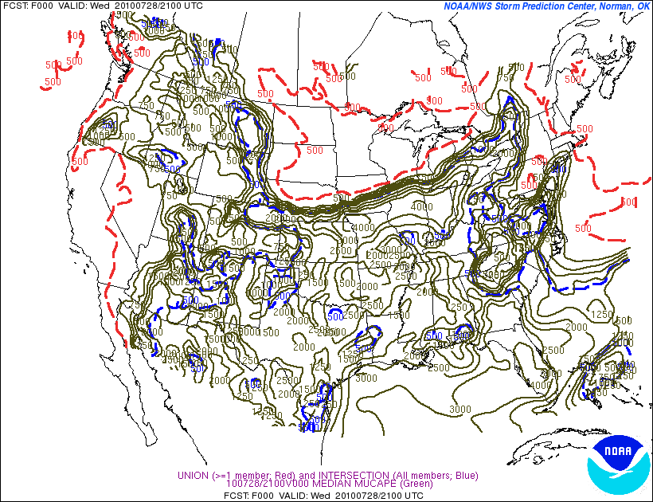
Thunderstorm Study Instability 21Z
Notes:
The air mass ahead of the front was unstable, with multi level CAPE in the 3000-4000 range.

Slide 5
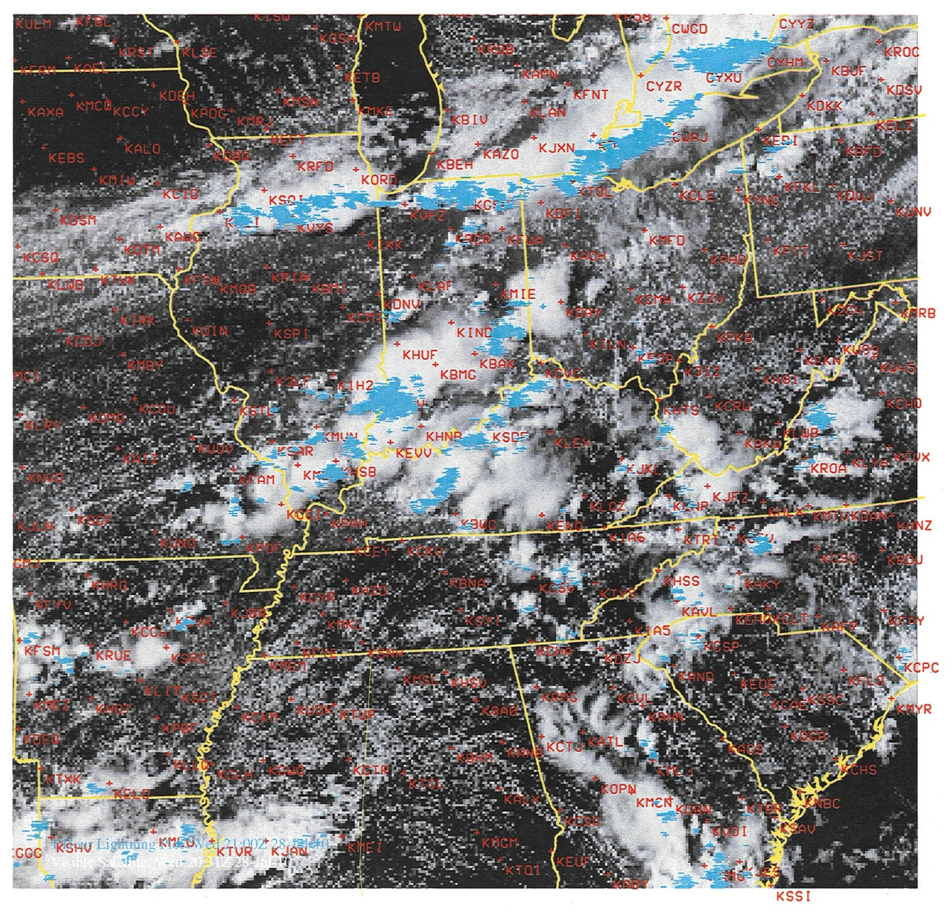
Thunderstorm Study Satellite & Lightning 21Z
Notes:
Satellite and lightning data indicated a broken line of storms along the front. Other less organized storms were occurring across the area in the unstable air mass to the south of the front. The question is: “Will the storms along the cold front hold together long enough to impact the KIND terminal?” Let’s look at some model data.

Slide 6
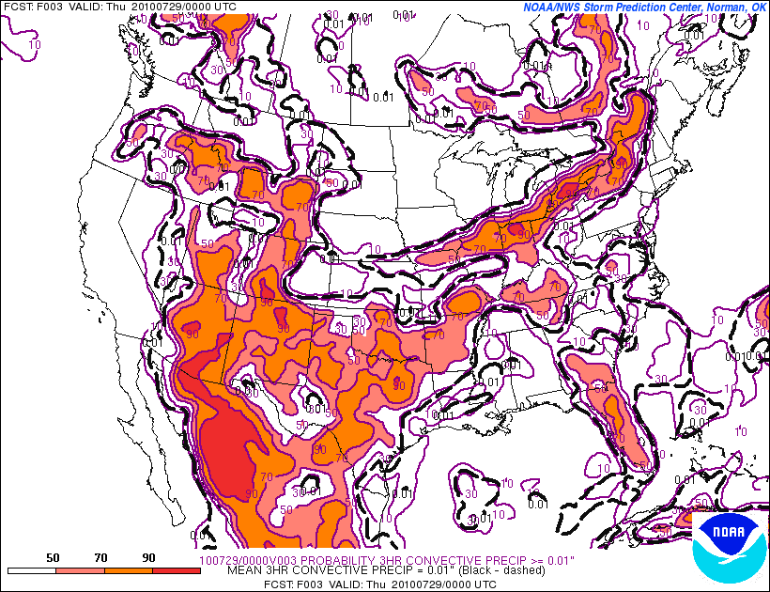
Thunderstorm Study Probability of Convective Precipitation 00Z
Notes:
This is a forecast of the probability of convective precipitation at 00Z from the SREF model. It appears to be handling the situation well, with high probabilities along the cold front.

Slide 7
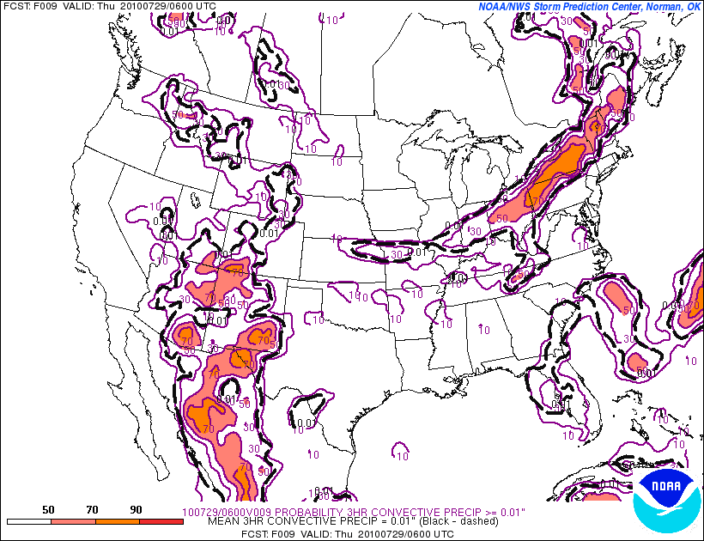
Thunderstorm Study Probability of Convective Precipitation 06Z
Notes:
By 06Z, the probabilities drop off quite a bit as the front sags into central Indiana.

Slide 8
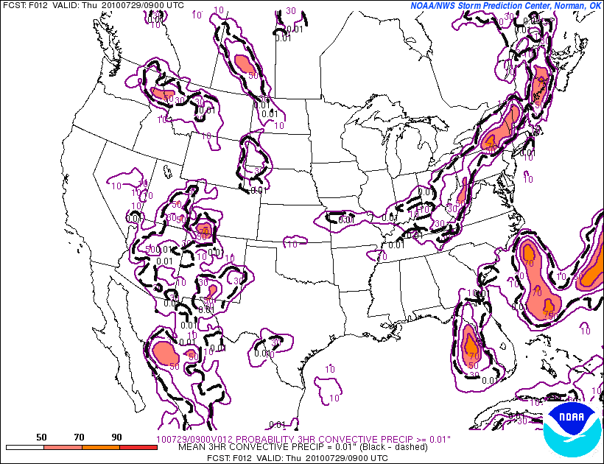
Thunderstorm Study Probability of Convective Precipitation 09Z
Notes:
By 09Z, the probabilities have dropped to around 10% as the front drops into southern Indiana. This set of model data suggests the line of storms will weaken as the front moves south through the evening.

Slide 9
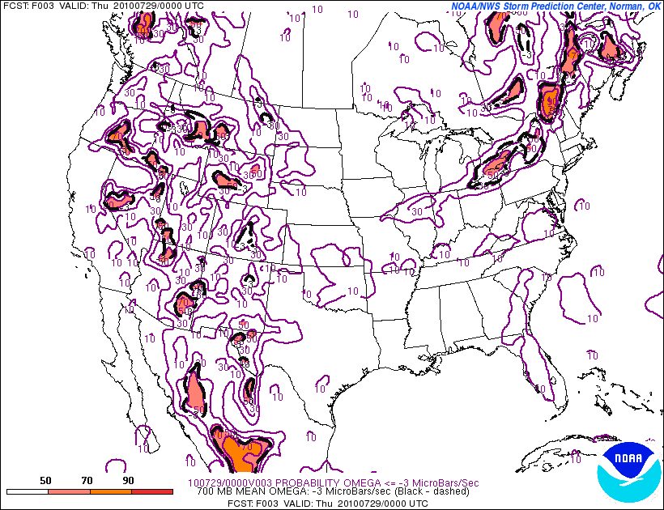
Thunderstorm Study Probability 700mb Omega <= 3 microbars/sec 00Z
Notes:
This is a map of the probability of the 700mb omega reaching values up to 3 mbars/sec at 00Z. During the convective season, I like to look at the omega field for areas of organized lift even in the absence of precipitation. On this map, it shows some small probabilities in the area where the line of storms are occurring.

Slide 10
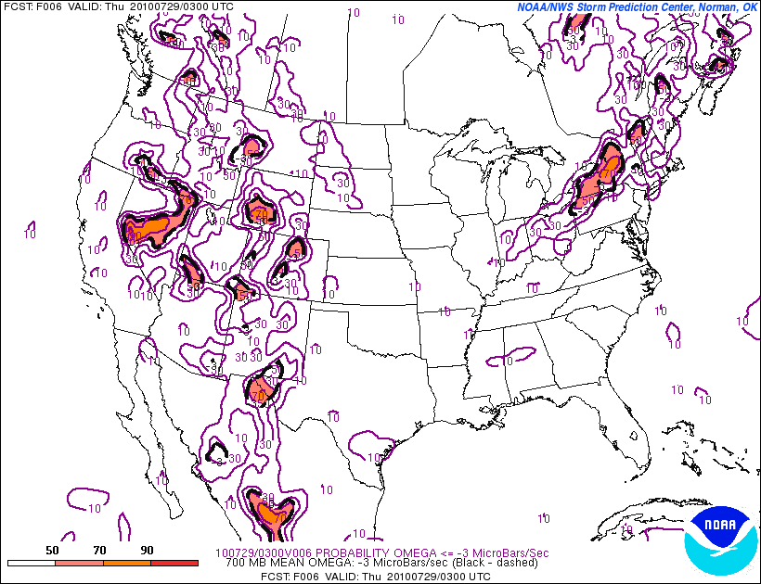
Thunderstorm Study Probability 700mb Omega <= 3 microbars/sec 03Z
Notes:
By 03Z, the zone of small probabilities shifts south into central Indiana.

Slide 11
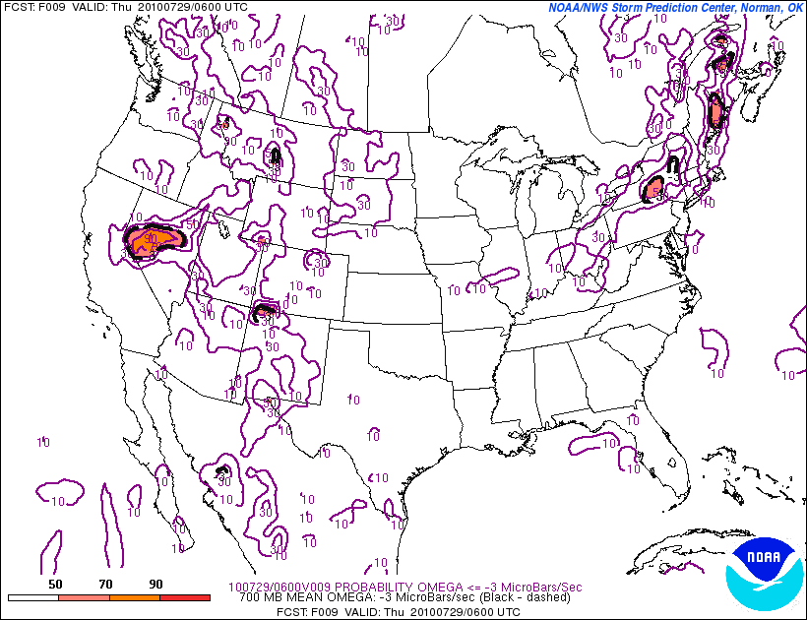
Thunderstorm Study Probability 700mb Omega <= 3 microbars/sec 06Z
Notes:
By 06Z, the model suggests the lift will continue to weaken as it moves south, with probabilities barely 10%.

Slide 12
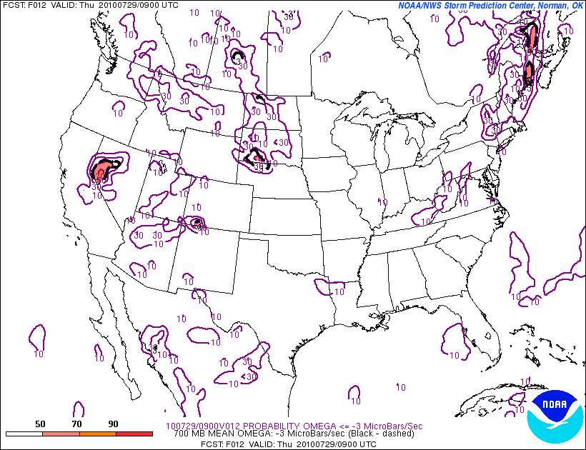
Thunderstorm Study Probability 700mb Omega <= 3 microbars/sec 09Z
Notes:
By 09Z, the probabilities continue to drop, suggesting lift is weakening.

Slide 13
Thunderstorm Study Climatology
Notes:
A useful thing to keep in mind is climatology. This graph helps to illustrate the climatologically favored times for thunderstorms in central Indiana during the months of July and August. The graph shows a steady increase in thunderstorm occurrence after 18Z, peaking at 03Z. The frequency of thunderstorm occurrence remains quite high into the early morning hours, dropping off after 09Z. The lowest climatologically favored times for thunderstorms in July and August is from 12Z-18Z, with a minimum at 15Z.

Slide 14
Thunderstorm Study Will T-Storm Line Hold Together Long Enough to Impact KIND?
Pros (maintain or increase intensity/coverage)
Moving into instability axis
Approaching the climatologically favored max
Cons (diminish in intensity/coverage)
500mb short wave energy moving away
Past peak heating (increasing stability)
Model data suggest line will weaken as it moves south
Notes:
So, the main arguments for the line maintaining intensity/coverage is that the line is moving into an area of high instability, and that the line will arrive near the climatologically favored maximum. The points in favor of this line weakening include the fact that the 500mb short wave energy is moving away, we are past peak heating, and model data suggests the line will weaken.

Slide 15
So What Would You Do?
Notes:
?

Slide 16
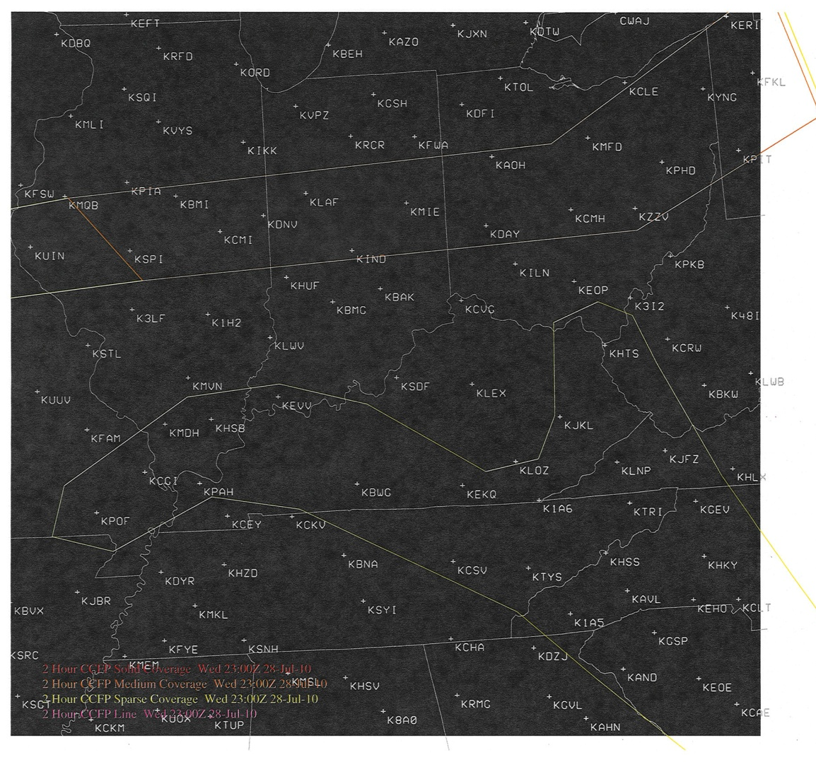
Thunderstorm Study CCFP Valid 01Z
Notes:
When I am faced with conflicting info on thunderstorm potential, I like to look at the Collaborative Convective Forecast Product (CCFP). These charts are 6 hourly maps that highlight areas of expected organized convection. They are available in AWIPS and at the Aviation Weather Center website. Every 2 hours, all the CWSU meteorologists, along with an Aviation Weather Center meteorologist, and meteorologists from private airline companies, all gather in a big chat room to hammer out a national map of expected organized convection. These maps are mainly used by people that plan air traffic patterns, but they can be useful here as well. I have found that more often than not, when a terminal is under an area outlined for thunderstorms, storms do occur at that terminal. Here, at 01Z, the CCFP has outlined an area of organized convection along the front just north of KIND.

Slide 17
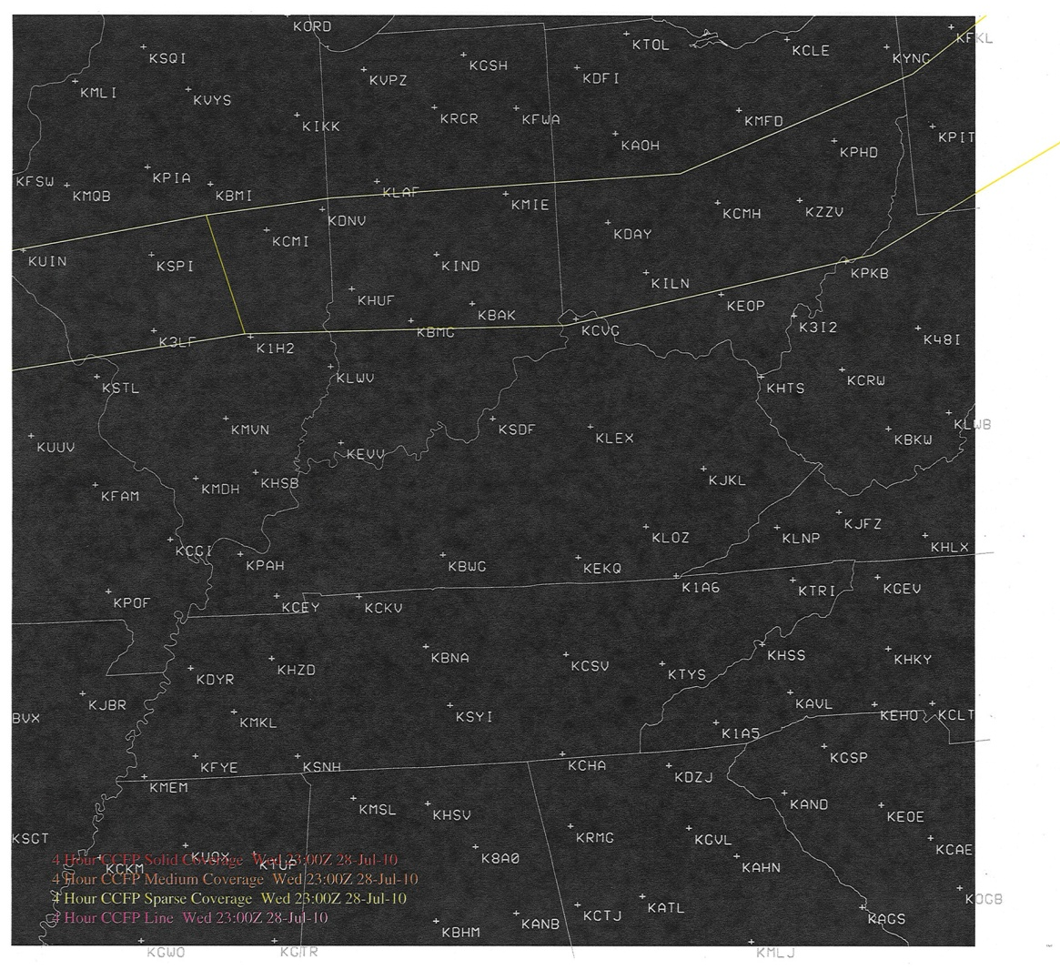
Thunderstorm Study CCFP Valid 03Z
Notes:
By 03Z, that area shifts south to include KIND.

Slide 18
Thunderstorm Study CCFP Valid 05Z
Notes:
By 05Z, the area shifts south of KIND. So, this product suggests that the line will continue to hold together, impacting KIND between 01Z-05Z.

Slide 19
Thunderstorm Study My Decision
Notes:
So, I decided there is enough support to warrant an inclusion of thunderstorms in the TAF that evening, from 01Z-04Z. I narrowed the Tempo range to a 3 hour period to keep restrictions due to forecasted convection to minimum, despite the CCFP suggesting 01Z-05Z might be better.

Slide 20
Thunderstorm Study Actual Obs
TS 0226Z – 0501Z
About 44% Tempo Time
Notes:
As history will show, the line held together despite the weakening dynamics and loss of heating. Thunder commenced at KIND at 0226Z, and continued without a break until 0501Z. There was also a significant wind shift at the leading edge of the line with a gust to 23 kts, and a brief period of IFR.

Slide 21
Thunderstorm Study Parting Thoughts
Keep in mind climatologically favored times for TS
When in doubt, check out the CCPF products
(usually good in forecasting organized convective areas)
Notes:
What to take away from this? First off, when you are thinking about potential convection, take a look at the CCFP. Following the CCFP would have led to a very accurate thunderstorm forecast that evening. Many meteorologists are involved in this product, so it tends to be quite accurate. Second, keep in mind the climatologically favored time for thunderstorms in this area during the particular time of year it happens to be. In this case, thunderstorm climatology suggests nocturnal forces drive the majority of convection in this area during the summer, rather than surface heating. So, don’t be too quick to assume that just because a potential trigger is moving into the area after dark, that convection will weaken or fail to develop.

