Slide 1
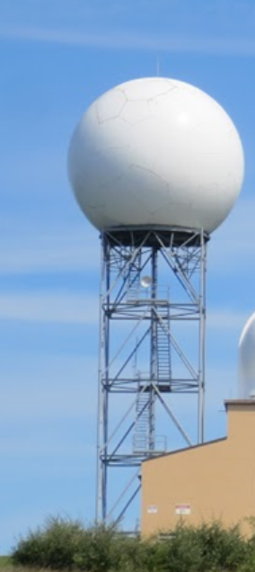
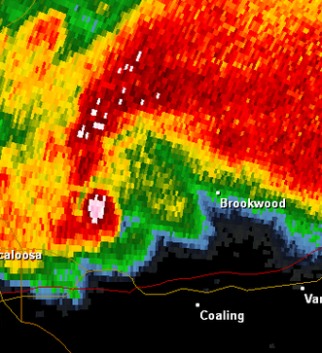
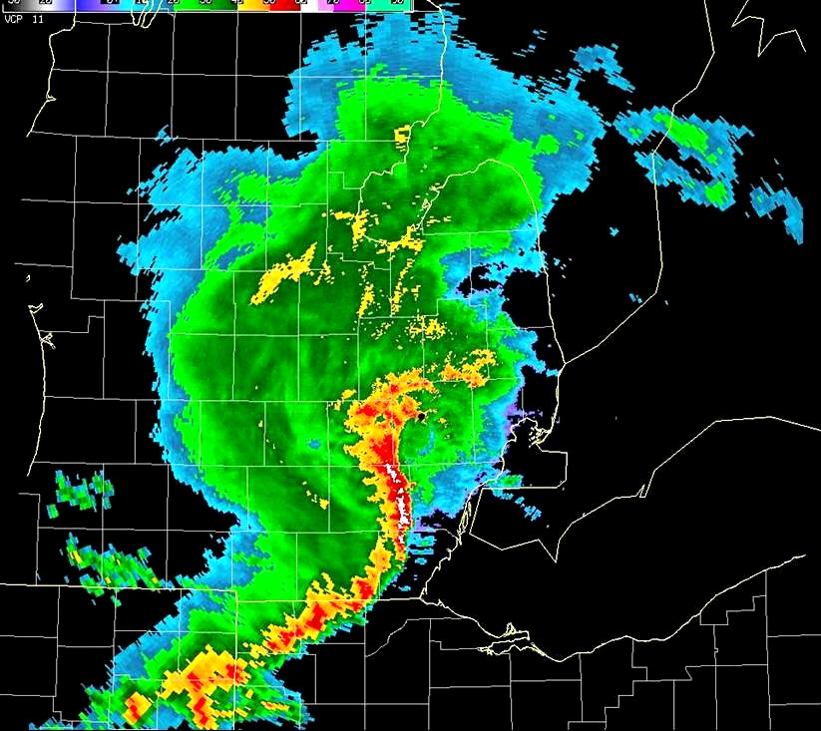
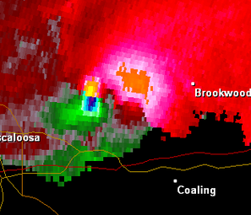


Thunderstorms And Radar Basics

Slide 2
Table of Contents
Thunderstorm Ingredients
Thunderstorm Microbursts
Thunderstorm Types
Great Lakes influence on Thunderstorms
Basic Principals of Radar
  Reflectivity
  Volume Coverage Pattern
  Common Radar Signatures
  Velocity
  Dual Polarization

Slide 3

Thunderstorm Ingredients - Moisture
Low and Mid Level Moisture
High Humidity
Notes:
Meteorologists tend to look at surface dewpoints. Dewpoints above 60F are good and above 68 are very good.

Slide 4
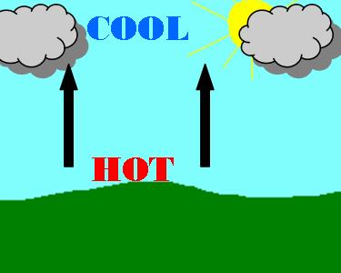

Thunderstorm Ingredients - Instability
Unstable
  Heat rises
  Moisture Condenses into clouds as air rises
  Common with Low Pressure Systems
Stable
  Air sinks
  Commons with High Pressure Systems
Notes:
Note that we need an unstable atmosphere for thunderstorm development. We need to get rising currents of air.

Slide 5
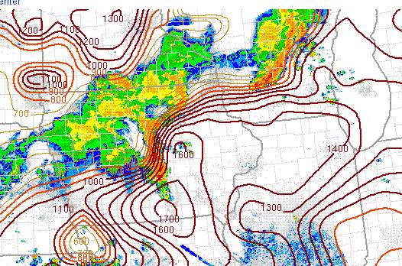
CAPE
Notes:
Convective available potential energy – the potential energy air parcels will have if they rise above the level of free convection (probably want to simplify this a bit) Values of 1000 to 2000 are high. Values over 2000 are extremely high.

Slide 6
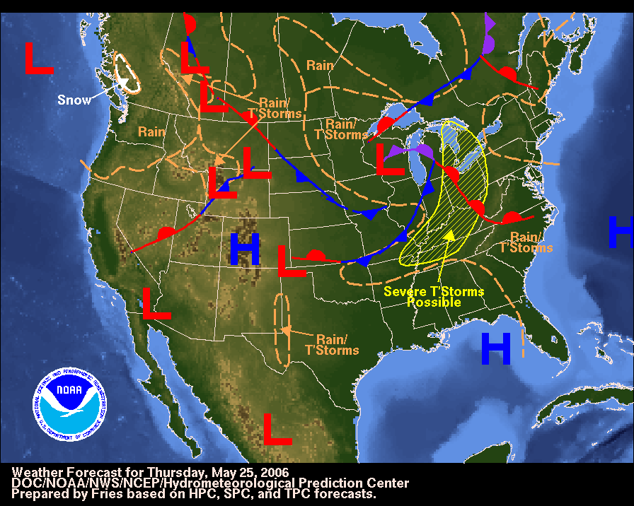
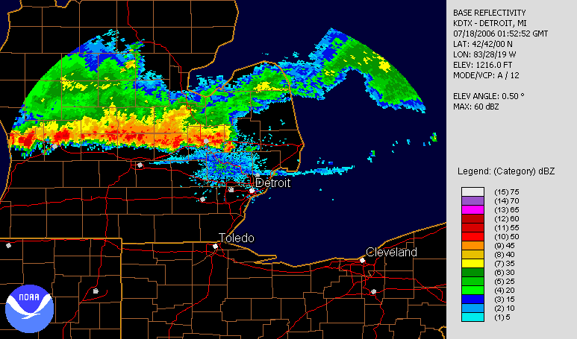
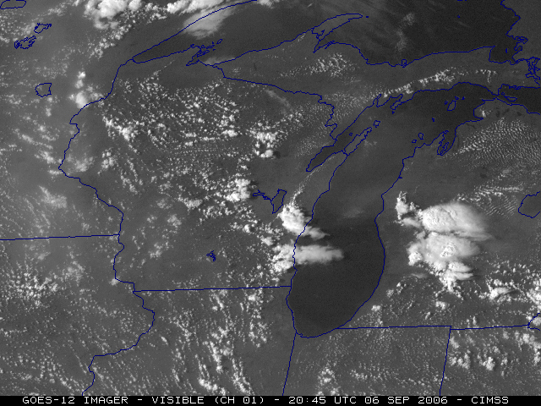
Thunderstorm Ingredients – Source of Lift
Warm /Cold Fronts
Thunderstorm Outflow Boundaries
Lake Breezes
Notes:
Need something to lift air parcels upward.

Slide 7
Thunderstorm Ingredients
Varying degrees of the 3 main elements will affect strength of thunderstorms
Additional ingredients that affect strength of thunderstorms include
  Wind Shear
  Location of Jet Streams
  Large Scale Weather Pattern

Slide 8
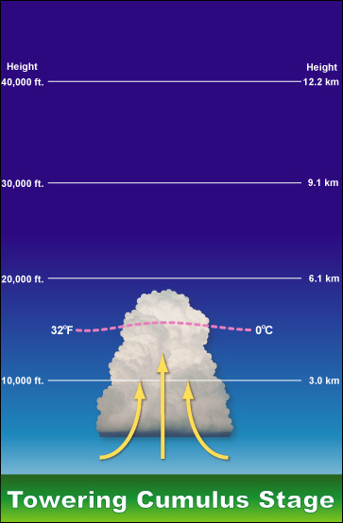

Thunderstorm Development Stages – Towering Cumulus
Rising currents of air are referred to as an Updraft. When combined with sufficient moisture, towering cumulus clouds develop.
Notes:
Note the cloud is dominated by updrafts.

Slide 9
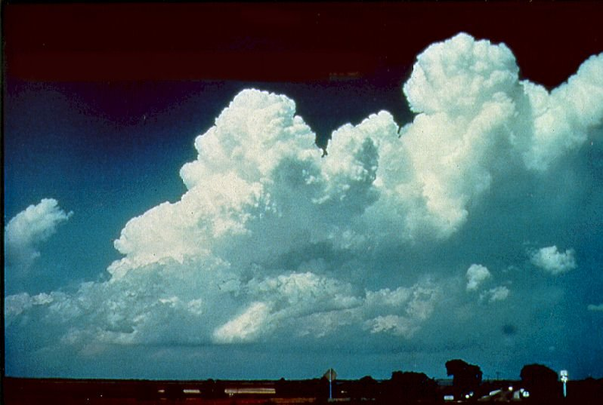
Copyright Charles A. Doswell, III
Notes:
Again, note the crisp, well defined cloud tops and the vertical extent of these clouds.

Slide 10
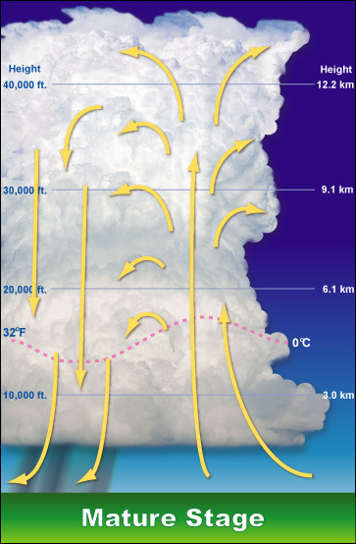
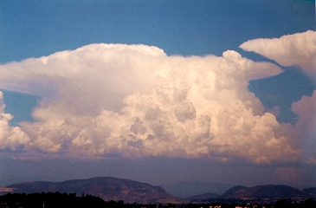
Thunderstorm Development Stages - Mature
Moisture will condense out of the cloud causing rain, thunder, and lightning. This marks the Mature Stage of the thunderstorms when the updraft and downdraft co-exist together.

Slide 11
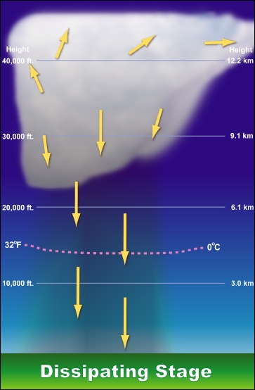
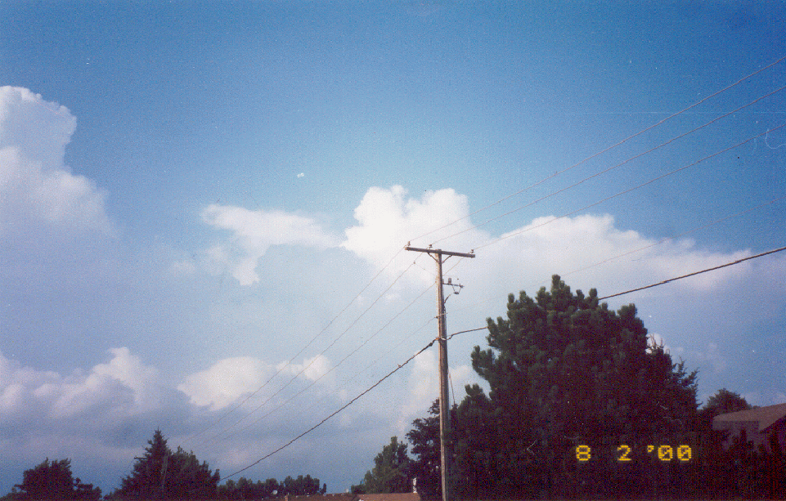
Thunderstorm Development Stages - Dissipation
The downdraft will eventually overcome the updraft, causing the thunderstorm to weaken. The thunderstorm is now in the Dissipation Stage.
Notes:
Note once the updraft is cut off, the thunderstorms can no longer sustain itself.

Slide 12
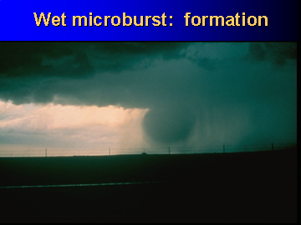
Wet Microburst - Formation

Slide 13
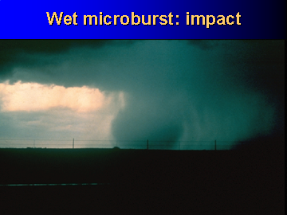
Wet Microburst - Impact

Slide 14
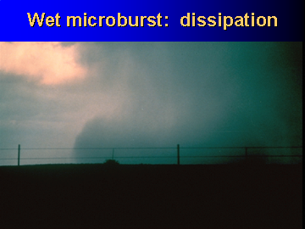
Wet Microburst - Dissapation

Slide 15
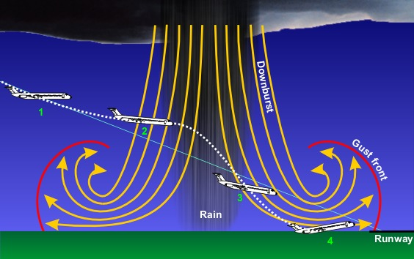
Notes:
Example of why they are hazardous in flight.

Slide 16
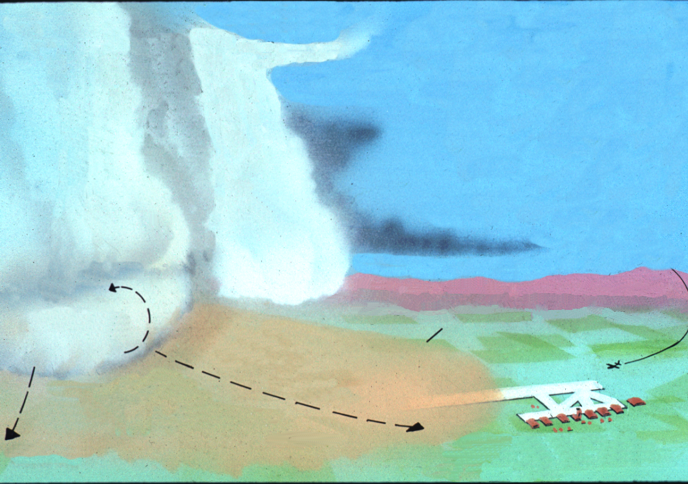
STORM DIRECTION
Cb
Cb
First gust, windshear turbulence, and rapid wind changes up to about 6000’ A.G. L.
ROLL CLOUD
Up to 10 miles.
Clear or possibly wind blown dust within turbulent air.
Up to 100 Kts 150 ft. A.G.L.
Notes:
Point out that the pilot thinks he/she has plenty of time to land at the airport before the thunderstorm arrives.

Slide 17
Thunderstorm Types
Single Cell
Multicell Cluster
Linear Multicel (Squall Line)
Supercell
Notes:
These will form the main topics of the thunderstorm discussion.

Slide 18
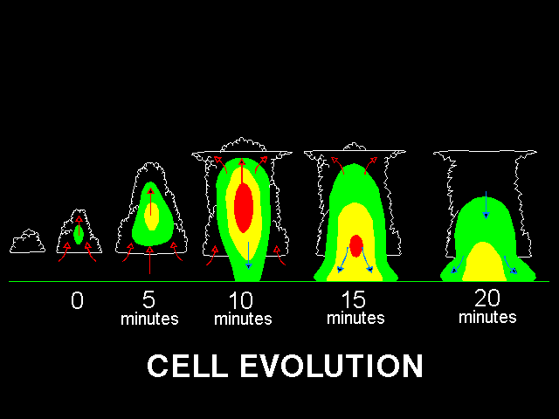
CELL EVOLUTION
SINGLE CELL
Notes:
Discuss the three stages of development. This is the classic garden variety with the cumulus stage to mature stage to dissipation.

Slide 19
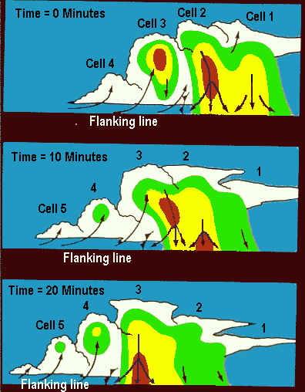
Multi Cell Cluster
Notes:
Note the stages of each cell. The atmosphere has a little more moisture and a little higher wind shear. New thunderstorms develop off the outflow from the mature cell. The new cell than goes through its lifecycle and decays, with new cell development occurring off the outflow. This type can essentially be thought of as a family of single cell storms all occurring at different stages of their lifecyle.

Slide 20
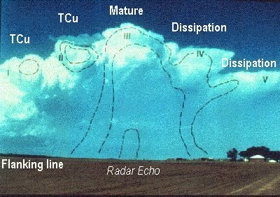
Copyright Alan R. Moller
Notes:
Note that the strongest turbulence and wind shears are in the mature cell.

Slide 21
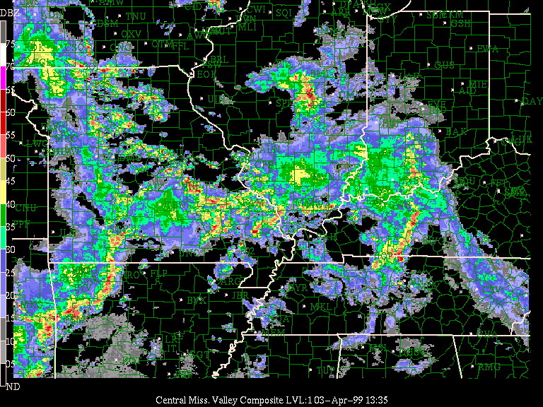
Notes:
The big hazard with multi cell clusters is that you can not navigate around them due to the constant development.

Slide 22
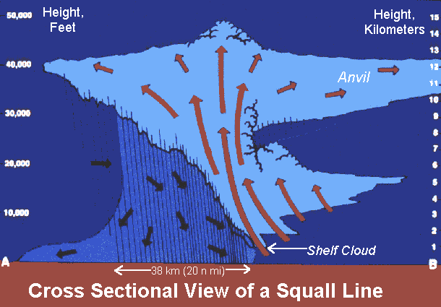
SQUALL LINE - CROSS SECTIONAL VIEW
Multi Cell Linear
Notes:
Note where the gust front is and note the anvil in relation to the movement of the storm. These occur with much higher instability and stronger atmospheric wind shear. The wind shear causes the updraft to become titled, thus displacing the rain cooled downdraft air away from the updraft region. This leads to a long lived and intense thunderstorm.

Slide 23
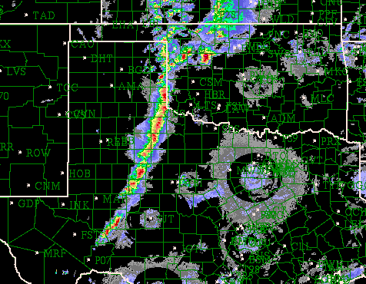
Notes:
You can not attempt to fly through apparent weaknesses in the line as they can fill in very quickly.

Slide 24
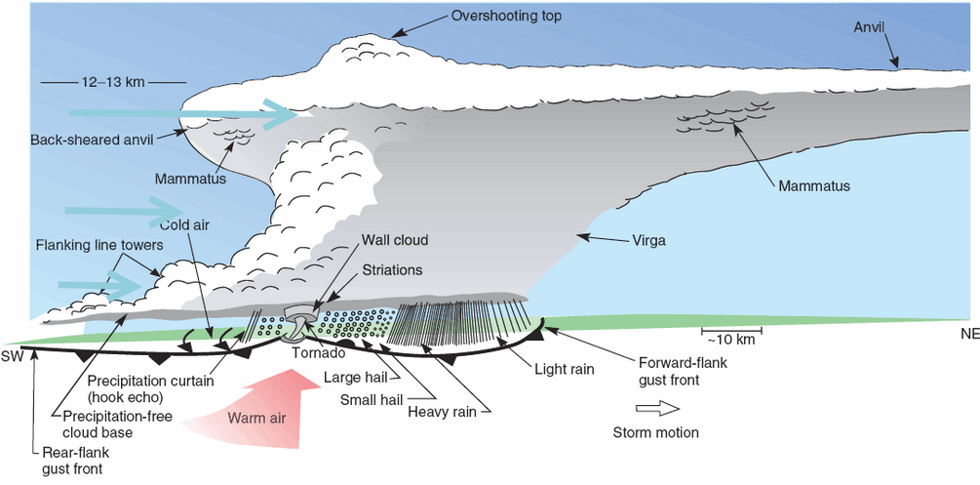
Supercell
Notes:
Note the updraft rotates. Wall clouds will be discussed in later slides. The region near the wall cloud and tornadic formation is called the meso cyclone. Note the rain free cloud base and how the precipitation falls in the forward flank region while some wraps around the rear flank downdraft. Strongest straight line winds are along the rear flank gust front. Strong winds do still occur along the forward flank downdraft. The strong updraft creates the overshooting top. The air often rises with such momentum that is creates the back sheared anvil, ie some of the updraft debris gets displaced upstream.

Slide 25
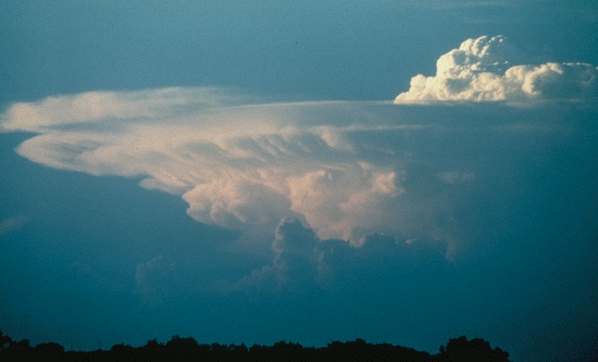
Supercells – upper level features
Notes:
Note the large, persistent overshooting top and thick, crisp-edged anvil. Storms with weaker updrafts will usually have an anvil that is thin, wispy, and fuzzy. Probably looking north at a strongly backsheared anvil.

Slide 26
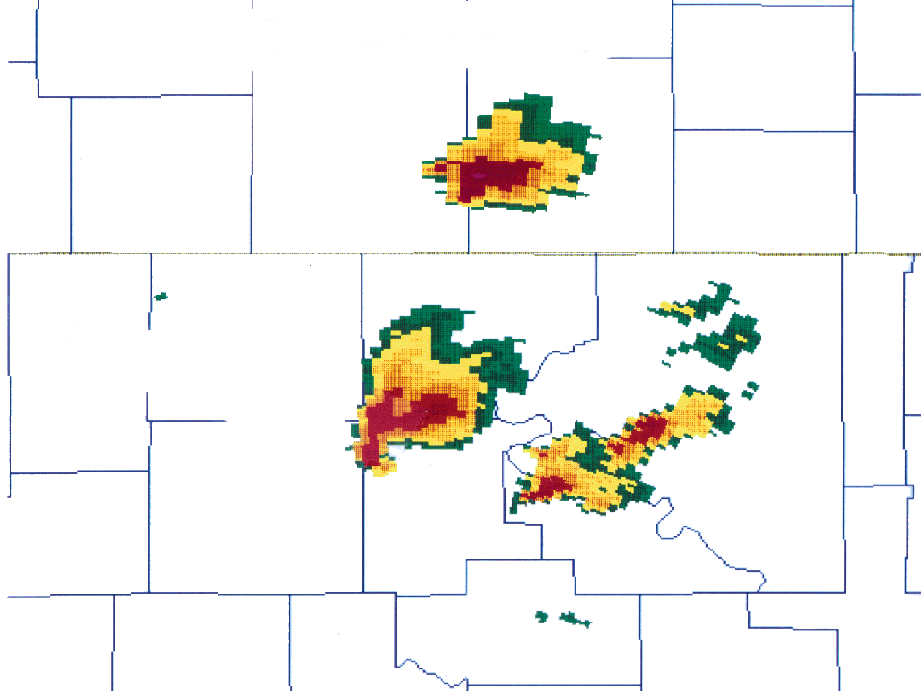
Notes:
Appearance on radar.

Slide 27
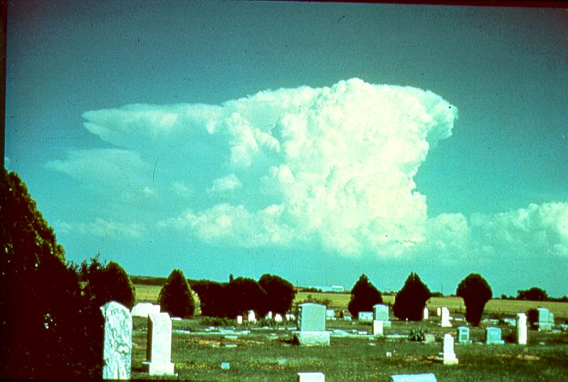
Notes:
Note what direction this storm is moving from the way the anvil is pointing. Yes there is some symbolism in this photo.

Slide 28
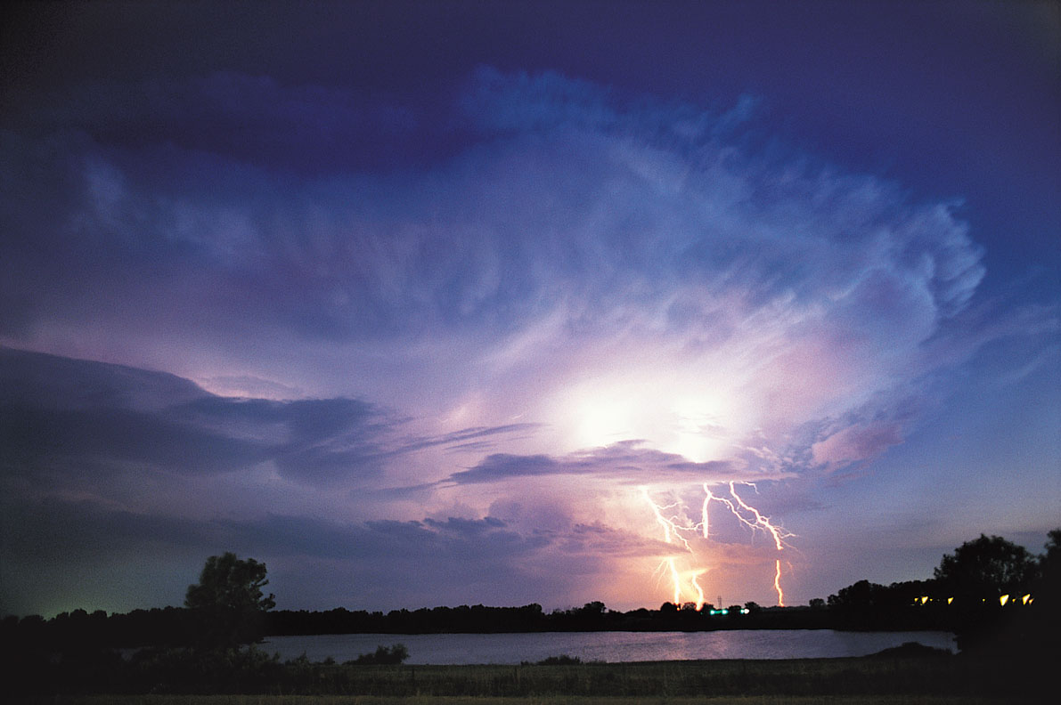
Impacts of the Great Lakes on Thunderstorms
Notes:
The final section will briefly touch on the complexities of how the Great Lakes influence thunderstorms.

Slide 29
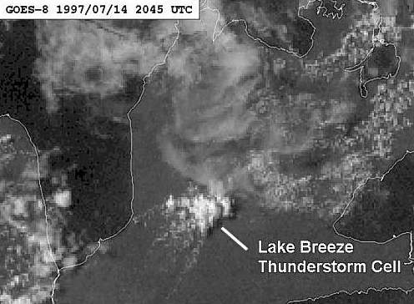
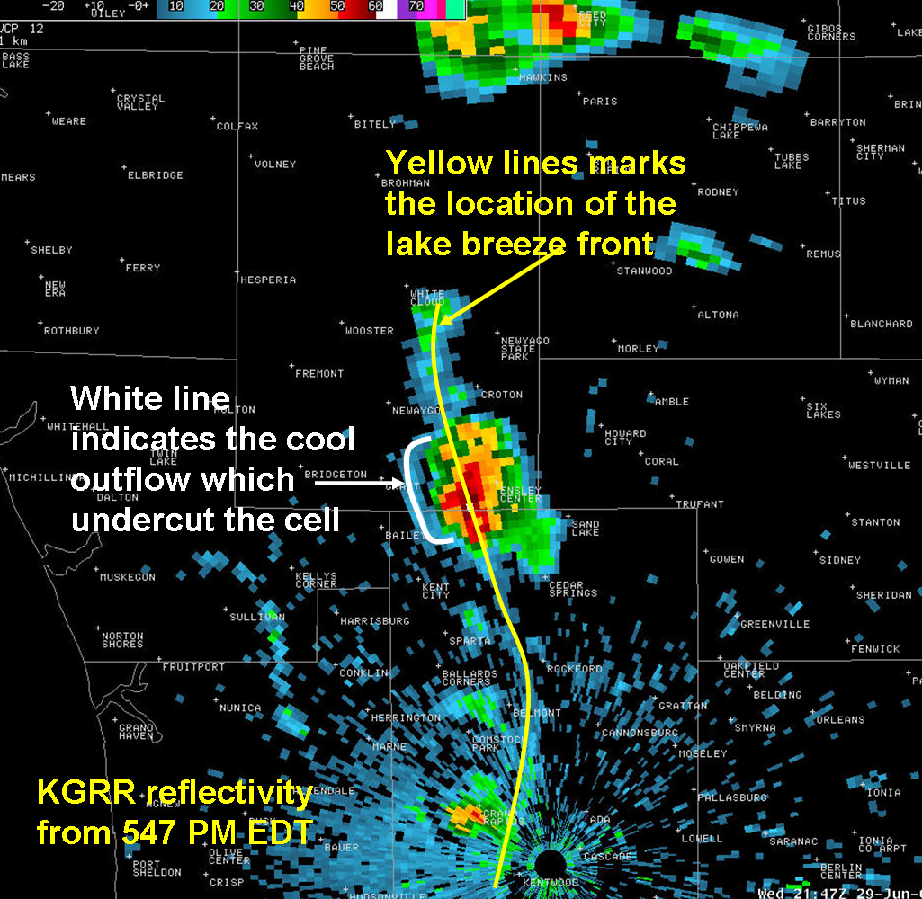
Development Off the Lake Breeze
Notes:
Lake Breeze fronts act like a cold front and provide a source of lift for air parcels and thereby can trigger thunderstorm development. The image on the left is over the Niagara peninsula in Ontario. The collision of two lake breezes caused enough lift to develop a thunderstorm.
The image on the right are storms that developed over western Michigan along the lake breeze convergence from Lake Michigan.

Slide 30
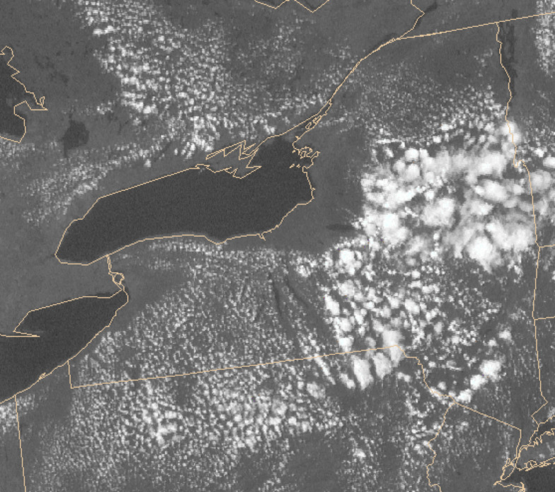
Lake Shadows
Cool Stable
Marine Layer
Notes:
Cooler and much more stable air advances in behind the lake breeze, hindering thunderstorm development. You can see in the image above how this stable air around Lake Ontario has even suppressed afternoon cumulus development.

Slide 31
Great Lakes and Thunderstorms
Aid in thunderstorm development
  Convergence along the lake breeze front over western Michigan may enhance storms moving into eastern Michigan.
  The warmer lake temperatures in the fall can enhance thunderstorms.
  Shoreline convergence on the downwind side of the lake can cause storms crossing Lake Michigan to rapidly intensify once they reach the western Michigan shoreline.
Suppress thunderstorm development
  Strong storms over Wisconsin often weaken once they reach the cold stable waters of Lake Michigan.
  Strong westerly winds sometimes bring the Lake Michigan stable layer well inland, greatly reducing the chances for storms over Lower Michigan.
Large thunderstorm complexes and squall lines
  These typically occur with high instability aloft (often very unstable above the shallow marine stable layer).
  The result is that the storms are usually not impacted much by the lakes.
Notes:
From this slide it should be obvious that forecasting thunderstorms in the Great Lakes region is actually very complex. There are a lot of influences created by the lakes that can both weaken storms and actually enhance them.

Slide 32
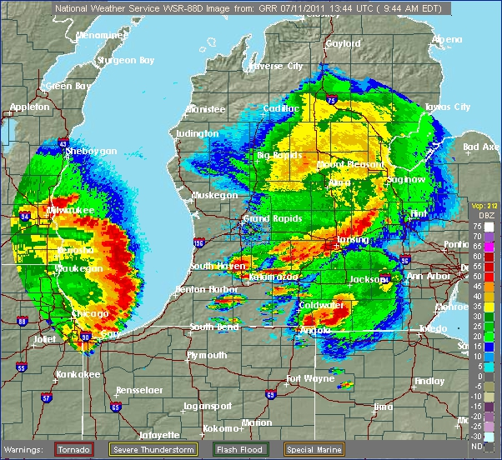
Notes:
This is a still radar image from July 11, 2011. Strong storms developed in the lee of Lake Michigan (around Kalamazoo and Grand Rapids) and moved east. Meanwhile, Lake Michigan is having no effect in weakening the squall line which move in from the Chicago/Milwaukee regions.

Slide 33
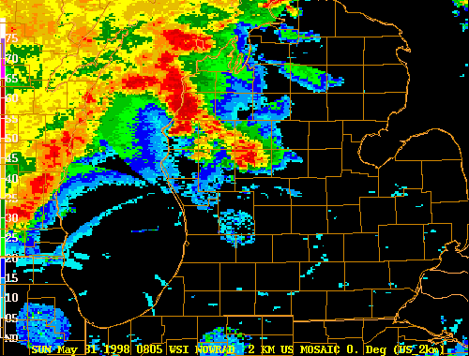
Notes:
This is a loop from a severe line of storms from May 31, 1998. Note how convergence on the west Michigan shoreline actually intensifies the storms.

Slide 34
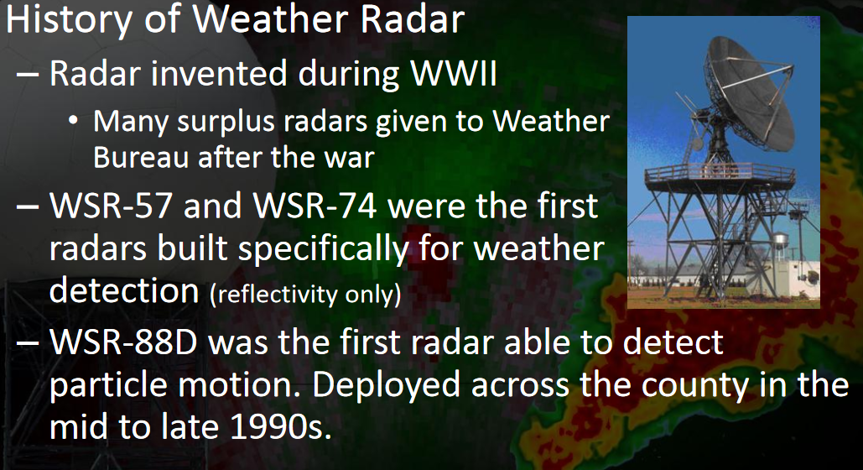
Notes:
WSR-57 was deployed between 1959 and 1963. Detroit received the WSR 57 Sep 12, 1961. WSR-74 was deployed from the mid 70s to mid 80s. Detroit was commissioned March 9, 1984. The 88D was commissioned in White Lake in 1995.

Slide 35
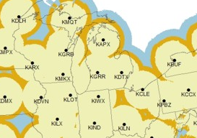
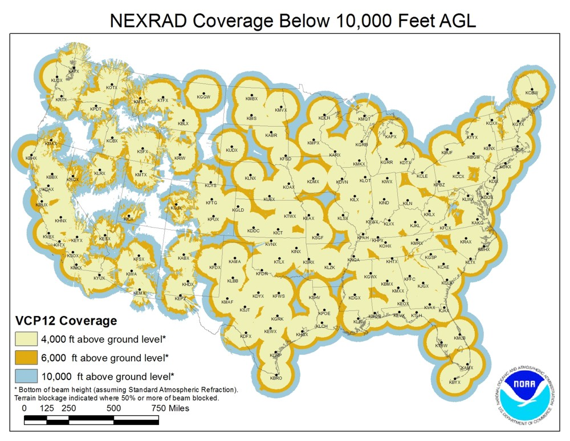
NEXRAD Locations
KDTX – Detroit
KGRR – Grand Rapids
KAPX – Gaylord
KMQT – Marquette
KLOT – Chicago
KIWX – Northern Indiana
KCLE - Cleveland

Slide 36
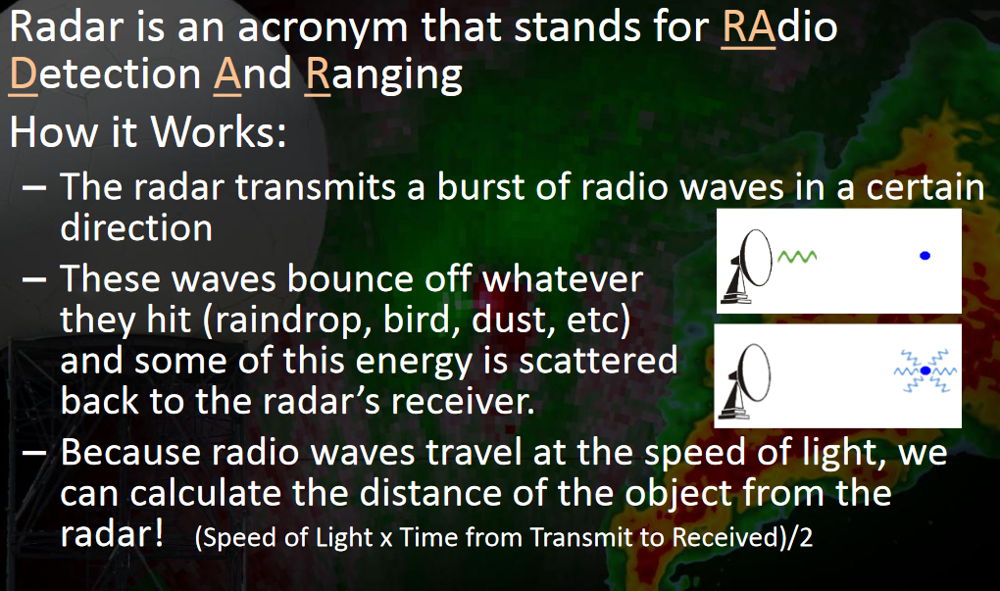
RADAR Basics

Slide 37
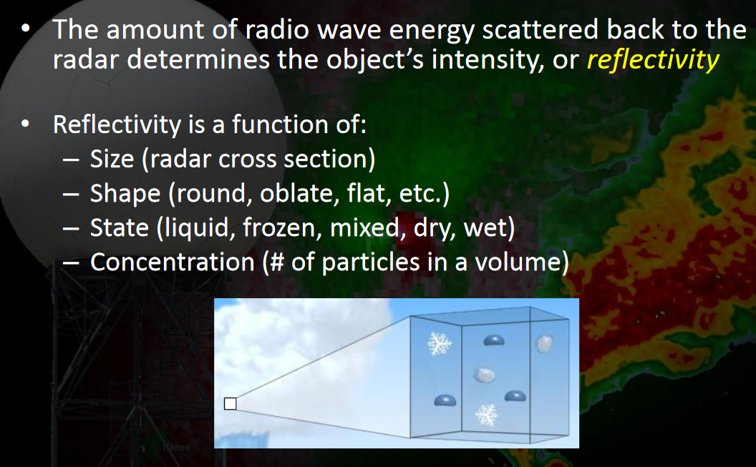
Radar - Reflectivity
RADAR Reflectivity

Slide 38
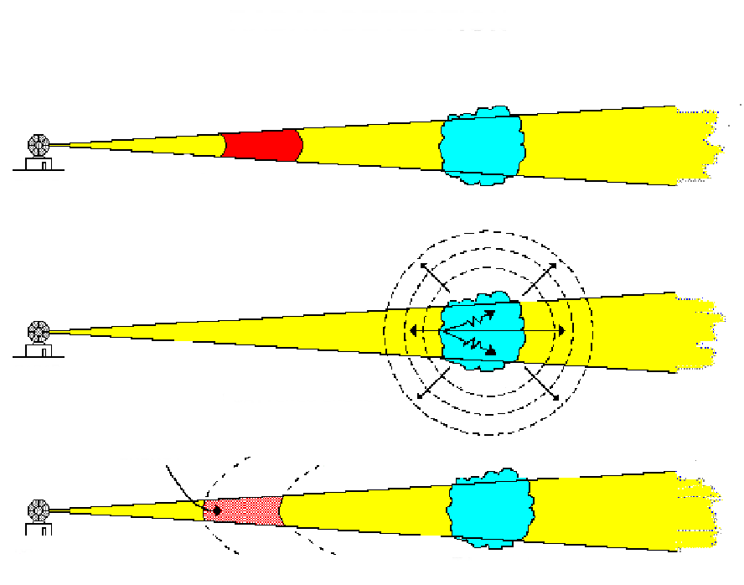
BACKSCATTERED ENERGY
TRANSMITTED PULSE
RADAR
TARGET
RADAR
TARGET
BACKSCATTERED ENERGY
RADAR
TARGET
Notes:
The antenna emits electromagnetic waves. Targets scatter the energy in all directions. Backscattered energy is the energy that is scattered directly back to the antenna from a target. Only a small fraction of the energy that strikes a targets gets backscattered. Targets may include precipitation, clouds, dust, birds, insects, buildings, density boundaries, terrain features, etc.
Reflectivity is a measurement of the amount of backscattered energy.

Slide 39
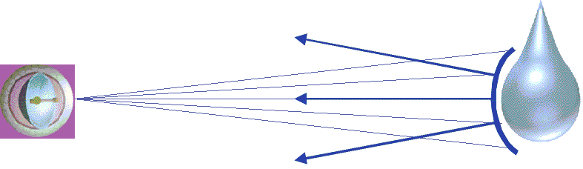
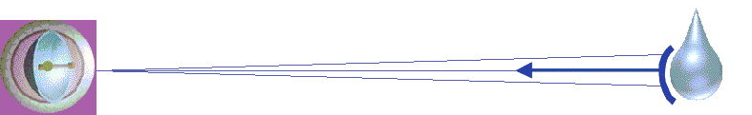
Reflectivity
LARGER PARTICLES - HIGHER REFLECTIVITY
SMALLER PARTICLES - LOWER REFLECTIVITY
Notes:
Determined from the amount of energy reflected by precipitation .Reflectivity is determined by:
The size of the precipitation particle.
Precipitation state (liquid or solid)
.Concentration of precipitation (particles per volume).
Shape of the precipitation.
The most important factor in determining the reflectivity is the size of the precipitation particle.

Slide 40
WSR-88D DBZ RANGES (I.E., REFLECTIVITY)
PRECIPITATION INTENSITY
15 TO 29 LIGHT
30 TO 39 MODERATE
40 TO 44 HEAVY
45 TO 49 VERY HEAVY
50 TO 54 INTENSE
55 AND ABOVE EXTREME

Slide 41
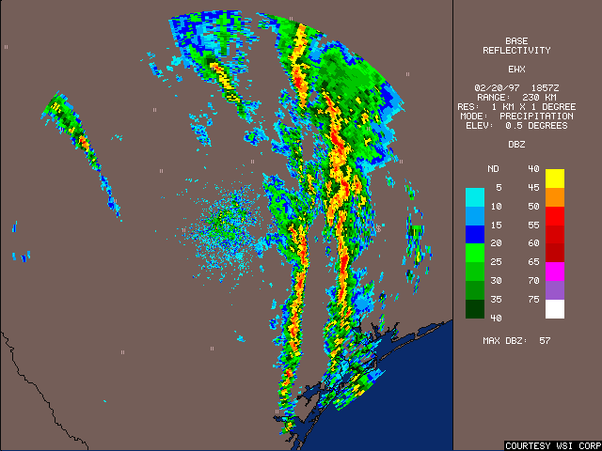
Notes:
The update rate is 4.5 minutes for VCP 12 and 6 minutes for VCP 21.

Slide 42
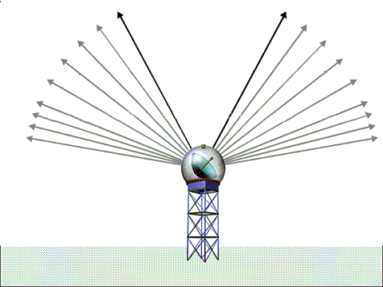
VOLUME COVERAGE PATTERN
Notes:
The WSR-88D's antenna/beam scans at many different elevation angles in the atmosphere.
This scanning is computer controlled. The combination of all of the angles scanned sweeps out a volume of the atmosphere.

Slide 43
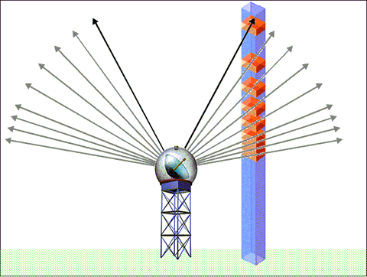
CREATING COMPOSITE REFLECTIVITY
Notes:
Displays the highest dBZ (reflectivity) value detected in a column of the atmosphere above a location
The radar scans through all of the elevation slices to determine the highest dBZ value in the vertical column.

Slide 44
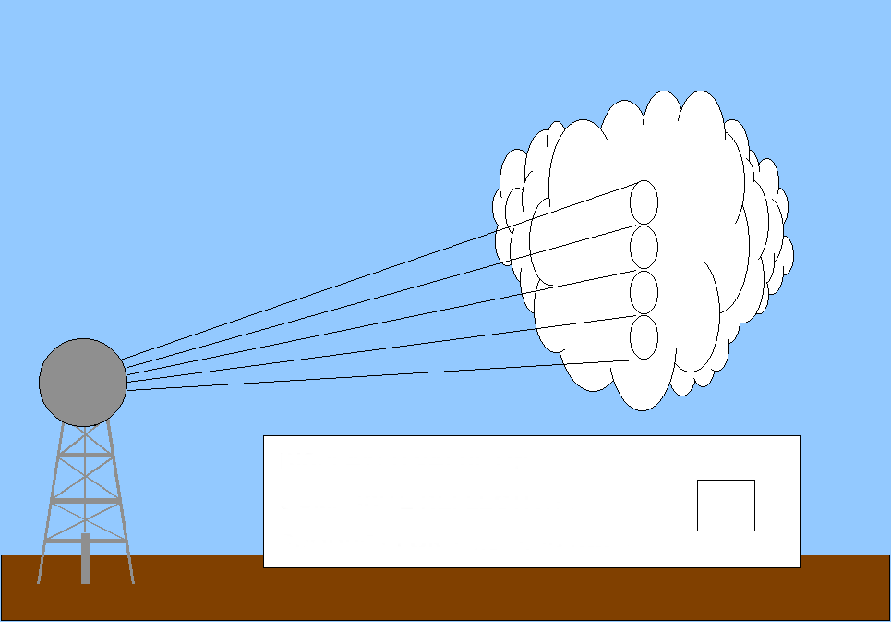
COMPOSITE REFLECTIVITY
30
50
40
15
THE DISPLAYED VALUE ON THE COMPOSITE REFLECTIVITY IMAGE IS:
50
Notes:
The highest reflectivity value in the column was measured as 50 dBZ.
50 dBZ will be displayed on the product

Slide 45
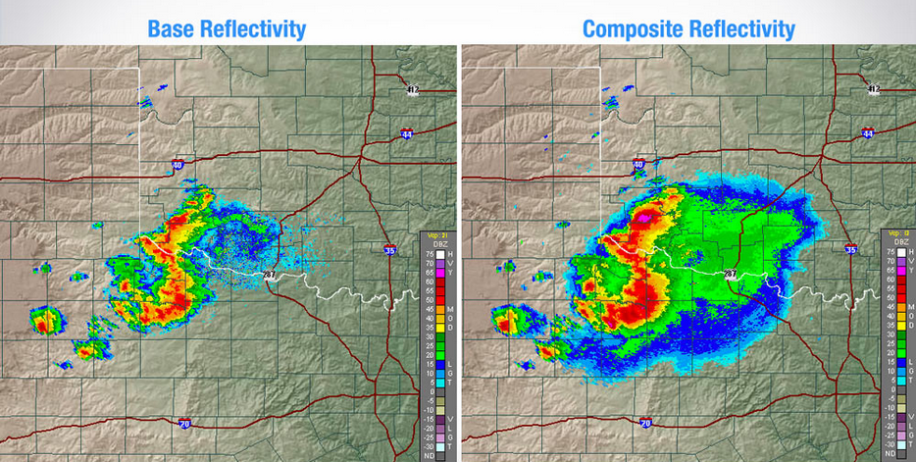
Base VS Composite Reflectivity
0.5 Degree Elevation Angle
Highest Reflectivity from every
elevation angle

Slide 46
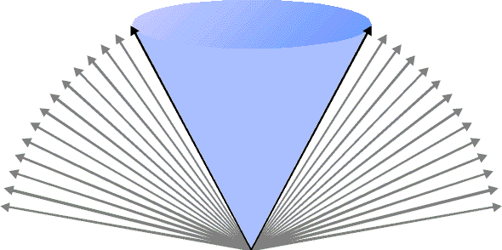


CONE OF SILENCE
19.5º
19.5°
Notes:
The cone of silence is an area above the radar, shaped like a cone, where the beam cannot measure targets.
The highest WSR-88D antenna elevation is 19.5 degrees.

Slide 47


Radar Cone Of Silence

Slide 48


Radar Beam Propagation
Notes:
This refers to the bending of the radar beam through the atmosphere. Sub refraction is less common, occurring when temperature decreases rapidly with height or moisture increases with height. Superrefraction is from a temperature inversion. Strong inversions lead to ducting and thus AP.

Slide 49

Ground Clutter Example

Slide 50


Ground Clutter Examples

Slide 51

Thunderstorm Outflow
Notes:
Strong thunderstorm outflow winds stir up dust and insects which act as scatterers, leading to reflectivity returns.

Slide 52

Lake Breeze Front
Lake Breeze
Notes:
Dust and insects also get caught up in the lake breeze. (sea breeze near the Ocean)

Slide 53

Birds On Radar
Notes:
Flocks of birds taking off in the morning usually look like this. During the evening, bats can give similar reflectivity signatures (very common in Texas).

Slide 54


Virga And Radar

Slide 55

Sunrise/Sunset Spike
Notes:
The sunrise or sunset "spike" on the NEXRAD radar occurs when the sun shines directly into the 1-degree beamwidth of the antenna. Even though the majority of the sun's radiation comes to us as visible light, some energy comes to us at microwave wavelengths, including specifically the wavelength of NEXRAD.

Slide 56

Radar - Velocity

Slide 57

Radar Velocity Data
Radar Measure The Return Frequency

Slide 58
Radar - Velocity
RADAR - Velocity
Base Velocity: The velocity of precipitation moving either toward or away from the radar (in a radial direction).
Storm Relative Velocity: The same as base velocity only the storm movement is subtracted out.
Spectrum Width: The distribution of velocities within a single radar pixel (the higher the number, the less accurate the velocity data is going to be). NOTE: This parameter is not widely used.

Slide 59

Radar Base Velocity
Notes:
Base velocity can be used to give typical wind flow relative to the radar. The example above is an east-northeast wind.

Slide 60

Radar - Velocity
Notes:
Storm Relative SRM is used highly in tornado dectection.

Slide 61

Radar
Reflectivity vs Storm Relative Velocity

Slide 62

F-11-4-73
Notes:
Displays a time series of the vertical wind profile above the radar
Winds are plotted in standard wind barb notation. Calm winds are denoted with a circle.Point out several examples of winds on the image.
Zoom in on image as necessary.Time is plotted along the lower “X” axis.Time units are UTC.
The most current time is on the right side of the image.Altitudes are plotted on the left side “Y” axis. −
Altitudes are thousands of feet (MSL).
Uses of the product
Determine altitude for most favorable tail wind or least amount of headwind.
Determine wind shear zones.
− Wind shear zones are areas of possible turbulence.
Verification of winds aloft forecast
Compare radar site winds with winds aloft forecast for same location.

Slide 63

Dual Polarization Radar
Notes:
Note that different precipitation is shaped differently. Dual pol better identifies returns in horizontal vs vertical which helps determine precip type, shape and size.

Slide 64




THE END

