Slide 1
Using Skew-Ts to Assess Icing and Wind Shear
Jonathan Guseman & Joe Jurečka
National Weather Service
Lubbock, TX

Slide 2
What Is a Skew-T?
Formally referred to as a Skew-T Log-P thermodynamic diagram
Uses temperature and pressure as coordinates
Properties of air parcels can be evaluated and forecasted based on this vertical snapshot of the atmosphere at a specified point
Time spent learning this tool will open up a world of insight to improve your flight experience

Slide 3
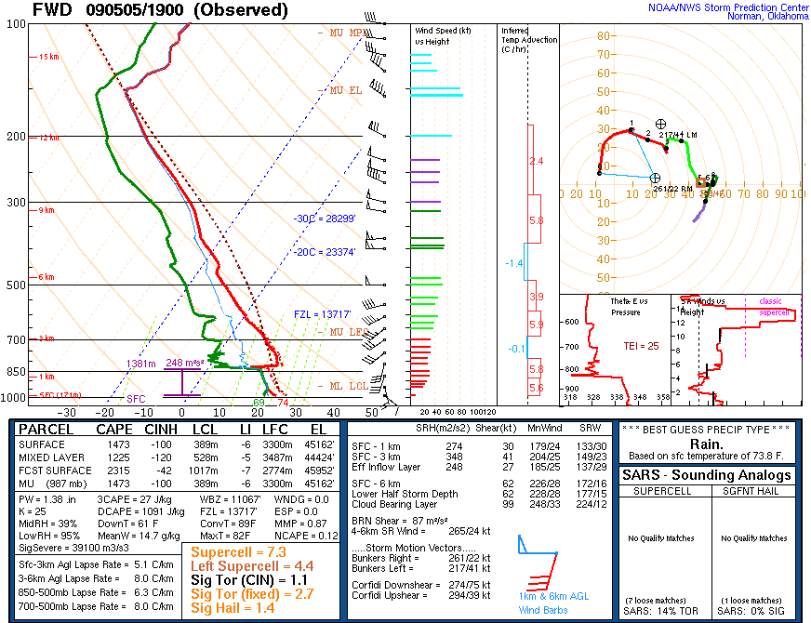
Temperature
Dewpoint
Temperature
Capping Inversion
Wind barbs
Pressure

Slide 4
Approximate Heights of Pressure Levels
Pressure level (mb)
850
700
500
300
250
Height (ft above sea level)
5000
10000
18000
30000
34000

Slide 5
Why Use Skew-Ts for Aviation Purposes?
Balloon soundings are the most comprehensive means to ascertain what’s really going on in the atmosphere
Vertical snapshot of atmosphere acquired twice a day
Viewing of all possible flight levels allows determination of aircraft hazards
Icing and wind shear are two of the most dangerous threats which are both easily identifiable
What can Skew-Ts do for you?
See where air is smooth (avoid near-surface thermal turbulence and turbulence produced by wind shear)
Save money by changing flight levels (wind optimization)
Increase situational awareness for icing

Slide 6
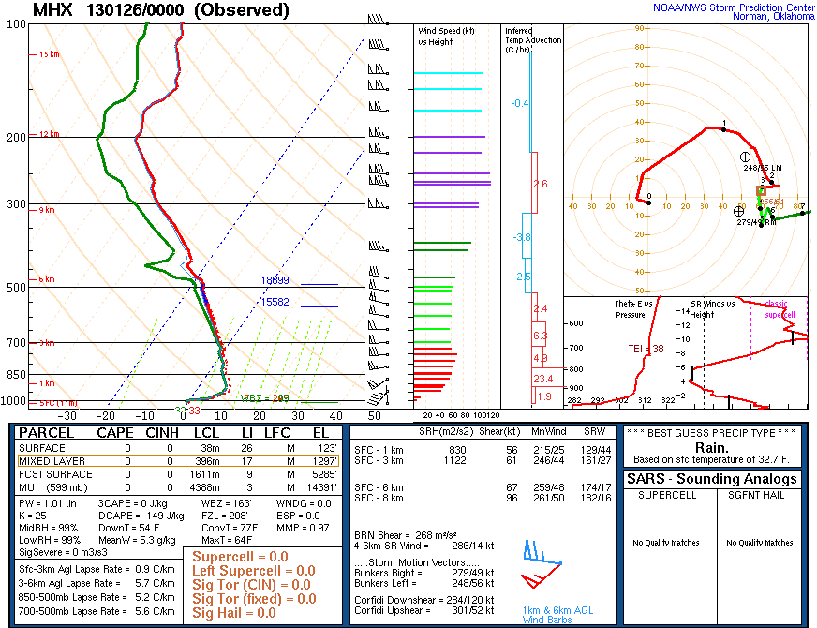
Icing Potential - Morehead City, NC
The closer the temperature and dewpoint lines are together, the higher the degree of saturation (clouds)
Look for saturation to the left of the 0 degree Celsius isotherm (below freezing)
Icing Potential

Slide 7
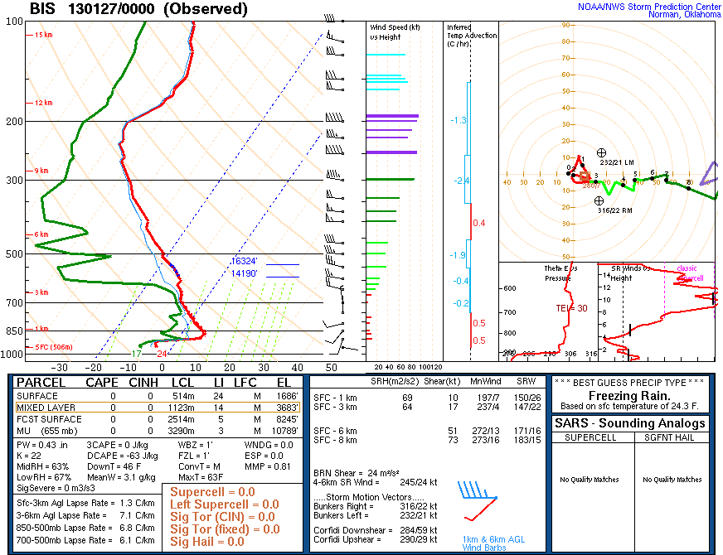
Directional Wind Shear –
Bismarck, ND
Wind barbs indicate wind speed and direction at specified height
Winds up through 700 mb are light at 10 knots or less
Notable direction changes from east to southwest to north to west

Slide 8
Speed Shear - Morehead City, NC
Wind speeds increase from 5 to 55 knots in the lowest 1 km (3280 feet)

Slide 9
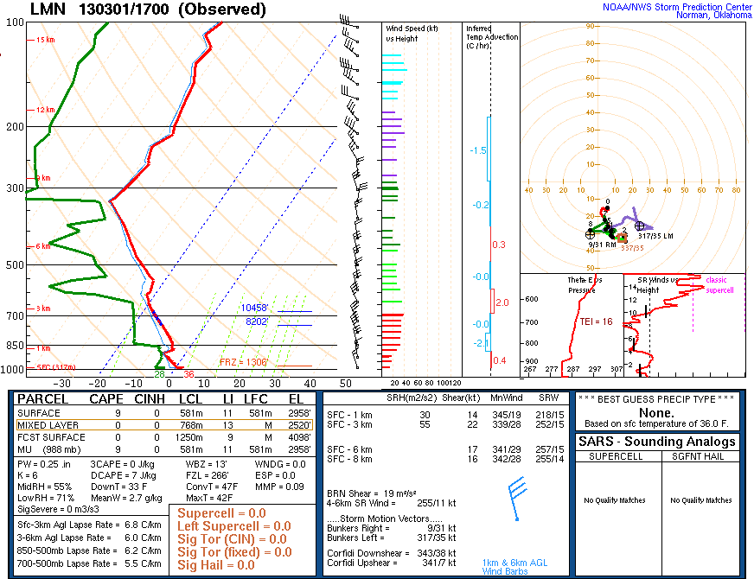
Thermal Turbulence - Lamont, OK
Want to fly above this inversion (or elevated mixed layer) to avoid thermally driven turbulence
Visibility better above inversion

Slide 10
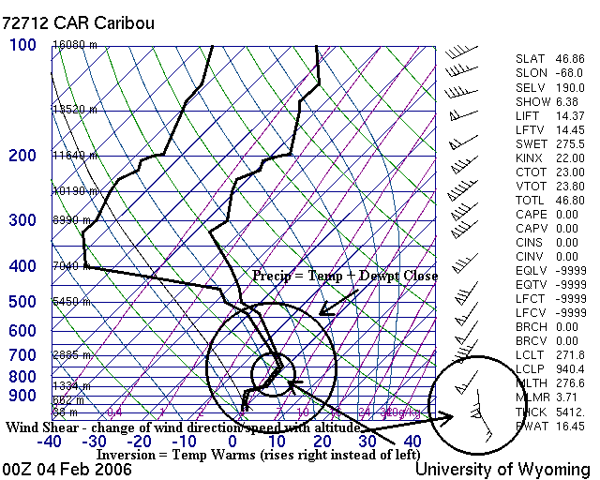
Icing and Shear - Caribou, ME
Icing concerns from the surface up to 5450 meters (17880 feet)
Low-level wind shear present in lowest 2000 feet with winds increasing from 15 to 65 knots
Icing usually worse north of a warm front

Slide 11
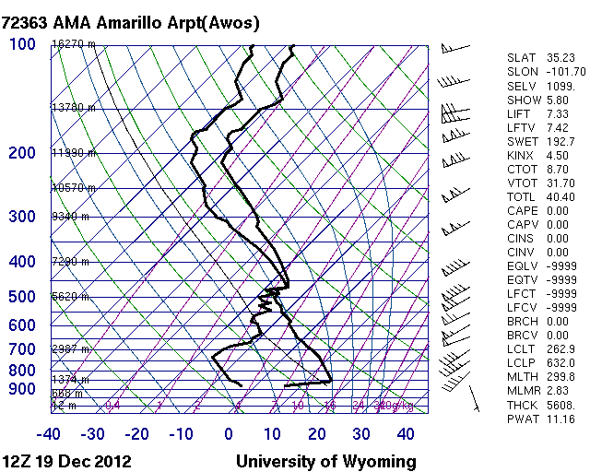
Non-Convective
Low-Level Wind Shear
Low-level wind shear within 2000 feet above ground level
Consider what this would do to your approach
5 to 45 knots

Slide 12
Non-Convective
Low-Level Wind Shear
WS010/22045KT
5 to 45 knots

Slide 13
TAFs
Terminal Aerodrome Forecast (TAF)
Within 5 statute miles of the airport terminal
Issued 4 times per day by National Weather Service Weather Forecast Offices
06, 12, 18, 24 UTC (more if amendments required)
Must now include TS to be able to place CB in TAF

Slide 14
Station Identifier
Current day of month
Start date & time of TAF
End date & time of TAF
Current wind direction
Current
visibility
Current
cloud layers
Current
time
Current wind speed
TAF KLBB 191120Z 1912/2012 21010KT P6SM SCT180 BKN250
FM191500 24015G25KT P6SM SCT150 BKN250
FM191800 26035G47KT 2SM BLDU SCT150 BKN250
FM200100 32026KT P6SM SCT250
Changes in prevailing conditions
TAF KCDS 250520Z 2506/2606 09009KT P6SM FEW015 SCT150
TEMPO 2510/2514 6SM BR SCT010
FM251600 03012KT P6SM SCT150
FM252300 09009KT P6SM SCT120
Tempo group (probability of conditions happening > 50 % and occurring for less than half the allotted time period)

Slide 15
Including Non-Convective Low-Level Wind Shear in TAFs
TAF KLBB 041820Z 0400/0424 21005KT P6SM FEW040
FM040300 22010KT P6SM SCT040 WS015/23050KT
FM191800 26035G47KT 2SM BLDU SCT150 BKN250
FM200100 32026KT P6SM SCT250
Wind shear at 1500 feet above ground level with winds from 230 degrees at 50 knots

Slide 16
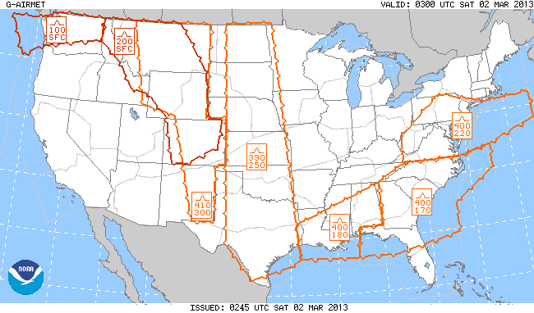
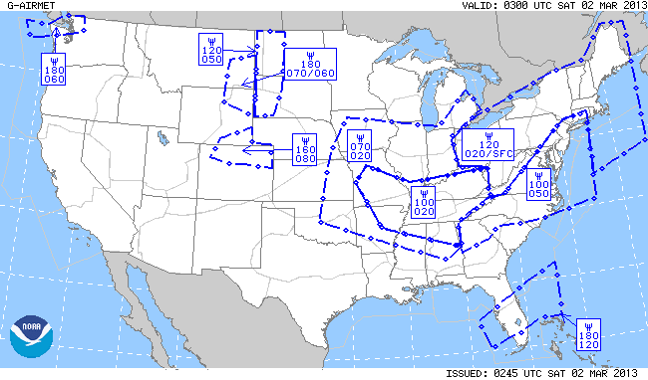
Aviation Weather Center Products
Turbulence
Icing

Slide 17
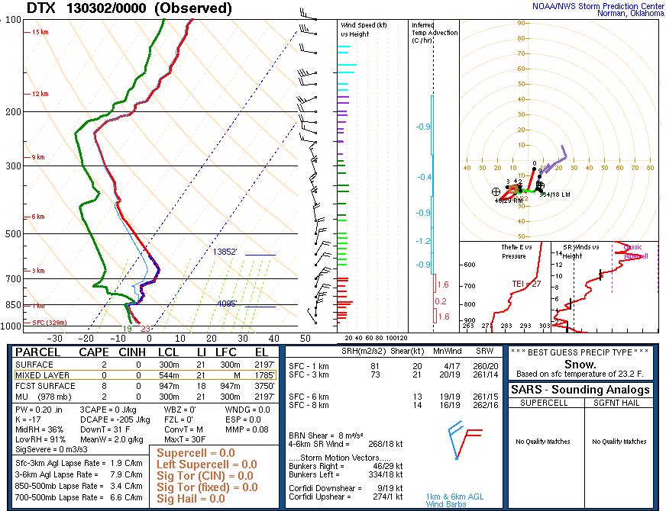
Pilot Reports (PIREPS) – Detroit, MI
PTK UA /OV PTK270005
/TM 2354 /FL050 /TP FA20 /TA UNKN /IC MOD RIME

Slide 18
Limitations
Instrumentation errors
Measurements are only as good as the instruments making them (generally quite good)
No absolute ground/air truth – the balloon is always rising (until it pops)
Forecast model sounding errors
Due to incorrect initial conditions or errors in model processing
If possible, compare multiple models

Slide 19
Sources for Viewing Skew-Ts
Real-time
http://www.spc.noaa.gov/exper/soundings/
Model
http://www.wxcaster.com/etaskewts.htm
Archive
http://weather.uwyo.edu/upperair/sounding.html

