Slide 1
2016 NWS Lubbock Aviation Weather Safety Workshop FOG – A Brief Review and Impacts on Aviation
Felecia Bowser
Meteorologist - NWS Lubbock, TX

Slide 2
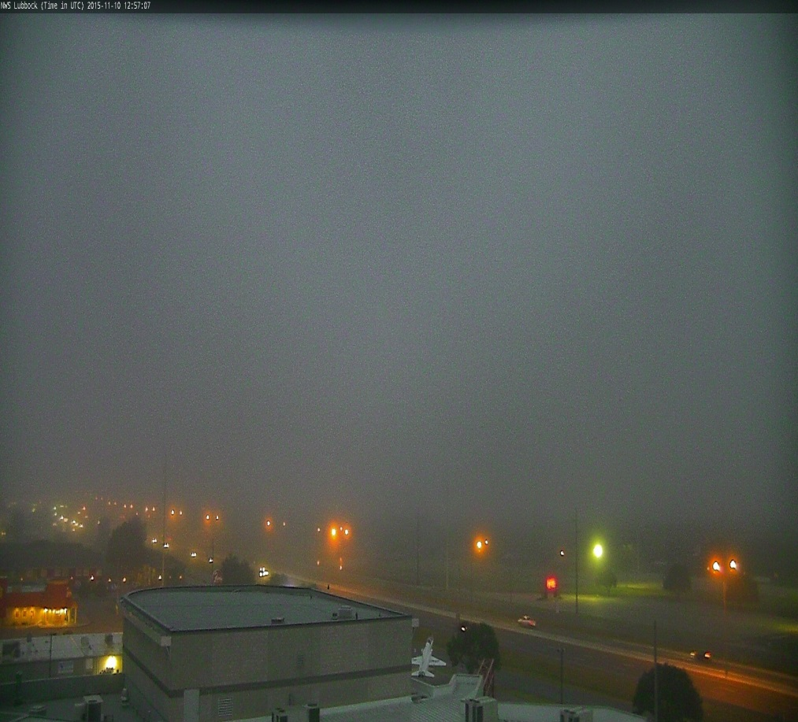
FOG – A Brief Review and Impacts on Aviation Outline
Definition of Fog
Different Types of Fog
Fog Impacts on
Aviation
West TX Fog Statistics
Identifying Foggy
Terminal Aerodrome
Forecasts (TAFs)
Video of plane crash
impacted by fog and/or low ceilings

Slide 3
What is Fog?
It is made up of condensed water droplets suspended in the air, which are the result of the air being cooled to the dewpoint temperature, and condensation occurs (water vapor → suspended liquid droplets)
The cooler air can no longer hold all of the water vapor it contains
converts

Slide 4
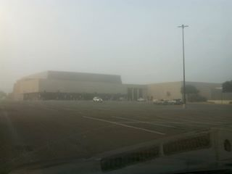
Different types of Fog
Radiation Fog
Advection Fog
Retreating Dryline Fog
Precipitation Fog
Freezing Fog

Slide 5
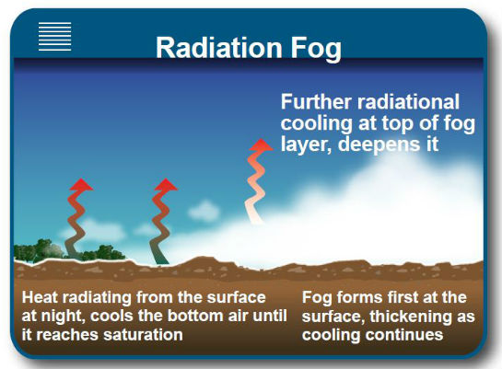
Radiation Fog
At night under clear
skies and high humidity
the ground radiates
its heat away from the
the surface
The cool surface
cools the nearby air
and continues to cool
throughout the night until the air reaches condensation where water vapor condenses to water droplets/cloud allowing fog to form

Slide 6
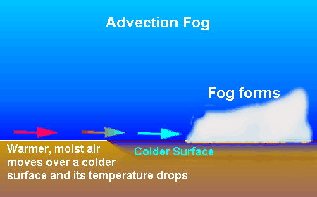
Advection Fog
Forms when warm moist air passes over a cold
surface
The colder surface
cools the warm and moist
air until it reaches
saturation/dewpoint
temperature then fog
forms
A light wind will increase
the likelihood for advection fog to spread as the warm air will have enough time to remain in contact with the cooler air

Slide 7
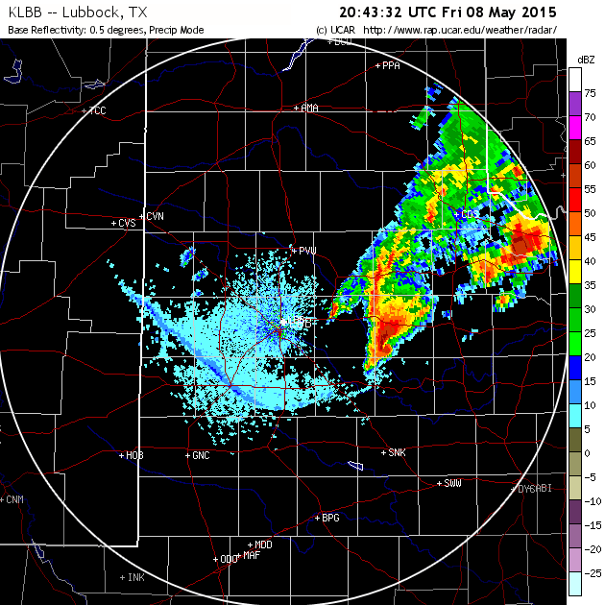
Retreating Dryline Fog
Dryline – separates a dry airmass from a moist
airmass
Usually predominate in the
Spring
During the day the dryline
sloshes east filtering in dry air
(slightly breezy)
At night it typically retreats west
filtering in warm and moist air
(calmer winds)
Temperature cools at night while the increased
moisture will increases the dewpoint temperature where eventually condensation occur

Slide 8
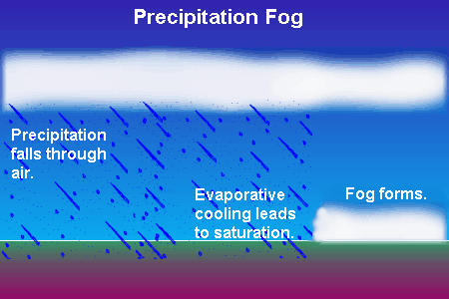
Precipitation Fog
Precipitation falls into drier air below the cloud
thus causing the precipitation to evaporate into
water vapor
The water vapor increases
the moisture content in the air
while also cooling the air which
often saturates the air below
the cloud and allows fog to
form

Slide 9
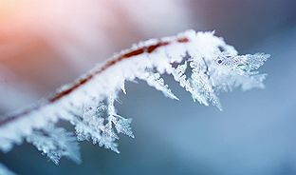
Freezing Fog
Forms the same as
Radiation Fog
But when fog forms in
below freezing temperatures
the water droplets in the air
remain as liquid →supercooled water droplets that will freeze once in contact with a surface
This deposit of supercooled droplets onto a
surface →Rime

Slide 10
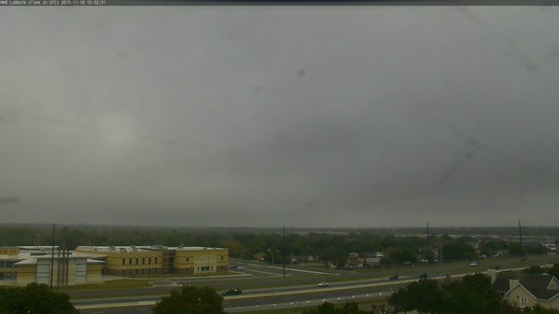
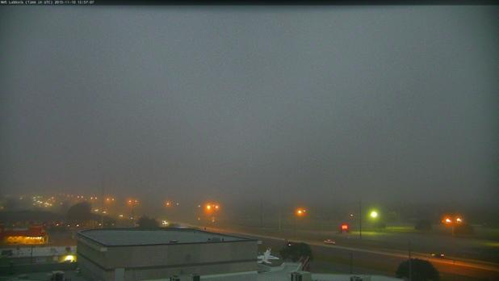
How does Fog Dissipate?
Sunlight penetrates the
foggy layer and warm the
ground
Air near the ground
warms as well
Relative humidity is
lowered (warm air can hold more moisture than cold air)
Warmer, drier air mixes upward with the cooler, moister air → Fog Dissipates

Slide 11
Predicting Fog
Best Conditions
Worst Conditions
Clear to mostly clear skies
High relative humidity
Little to no wind
Moist ground from recent rain/snow
East/Southeast wind component
Overcast skies
Plenty of sunshine to warm the ground =drier atmosphere =low relative humidity
Windy conditions
West/Southwest wind component
No recent rain/snow

Slide 12
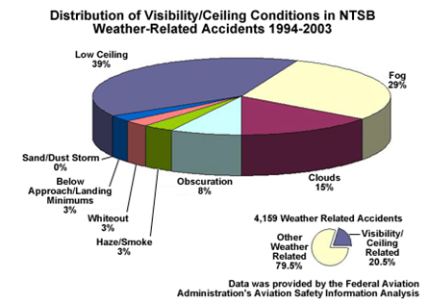
Impacts of Fog on Aviation
Fog may not seem as dramatic as tornadoes and severe thunderstorms but pose just as much as a substantial threat because it occurs more frequently than these other hazards
A 10 year study of aviation accidents by the U.S. National Transportation Safety Board (NTSB) indicated that low ceiling and visibility contributed to over 20% of aircraft accidents
Of those accidents 68% were specifically due to fog and low ceilings

Slide 13
KLBB Foggy days in 2010 vs. 2011
Total Days of VIS less than 3 mi = 65
Total Days of VIS less than ½ mi = 29
Total Days of VIS less than 3 mi = 35
Total Days of VIS less than ½ mi = 13

Slide 14
Terminal Aerodrome Forecast (TAF)
TAF’s are issued every 6 hours → KLBB, KCDS and KPVW
Valid for a 24 hour period
We understand that low ceilings and/or fog reduces the ability to see runway lights and other aircraft while both in flight and on the ground → DELAYS cause aircraft to become grounded
***Try to provide an accurate forecast that is representative of current and future conditions***
***Try not to issue an overly pessimistic forecasts***
Ceiling and fog criteria that grounds aircraft at KLBB:
200 ft. & 1/2 SM

Slide 15
Which TAF is Incorrect and Why?
A. TAF
KLBB 091720 10004KT 1/4SM FG VV001
TAF
KLBB 091720 05009KT 6SM HZ OVC100
C. TAF
KLBB 091720 27015G20KT 3SM BR OVC100

Slide 16
Plane Hit an Apartment Complex -11/10/15

Slide 17
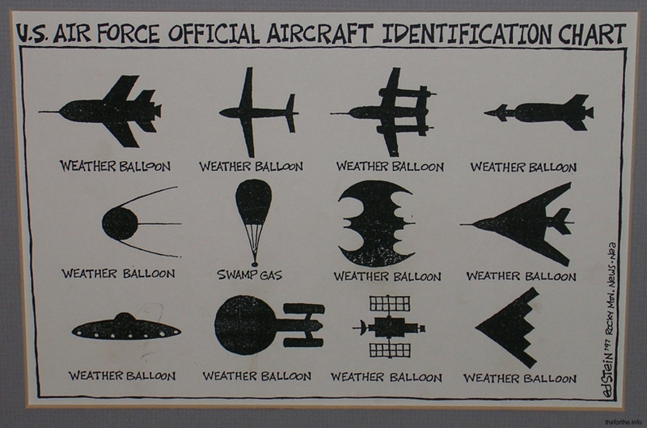
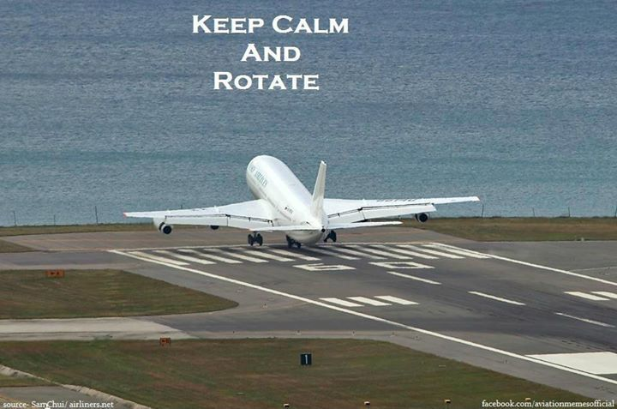
Any Questions?

Slide 19
Plane Hit an Apartment Complex -11/10/15
https://www.youtube.com/watch?v=z9r8YdQn_dA

