Slide 1
Winter Weather Prep
FOG

Slide 2
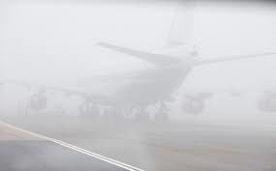
Content
Radiation Fog
Advection Fog
Stratus Build Down

Slide 3
Radiation Fog - Development
Clear Skies, Light or no Wind, Shallow Low Level Moisture
Conditions that will promote radiation fog
  Saturated Soils
  Snow Cover
  The advection of the marine layer inland (see advection fog)

Slide 4
UPS FOG Technique
Uses the Crossover Temp – The Dewpoint during the hottest part of the day.
If the overnight low is forecast to drop near the crossover temp, then forecast MVFR type vsbys.
If the overnight low is forecast to drop below the crossover temp, then forecast IFR or below.
This technique assumes no advection of moisture into the boundary layer and/or no low level dry air advection.
Tries to represent a low level profile where moisture is constant or increases with height.
This tool is built into BUFKIT (pay close attention to the MRi number, representing mixing in the boundary layer).

Slide 5
Radiation Fog - Dissipation
Daytime heating/mixing (Remember in late fall/winter, this may take until after 15Z or so).
Increased mixing atop the fog layer caused by strengthening winds aloft.
Relatively warm ground temperatures to help induce mixing.

Slide 6
Advection Fog - Formation
When the boundary layer gets moistened by the advection of a warm marine layer inland. This then primes the boundary layer for fog under ideal radiational cooling conditions.
Most likely to occur from September through December.
In most instances, the fog will first develop near the shoreline (shoreline convergence), then advect inland (typically toward the direction of the wind just atop the shallow stable layer, usually around 950 mb)

Slide 7
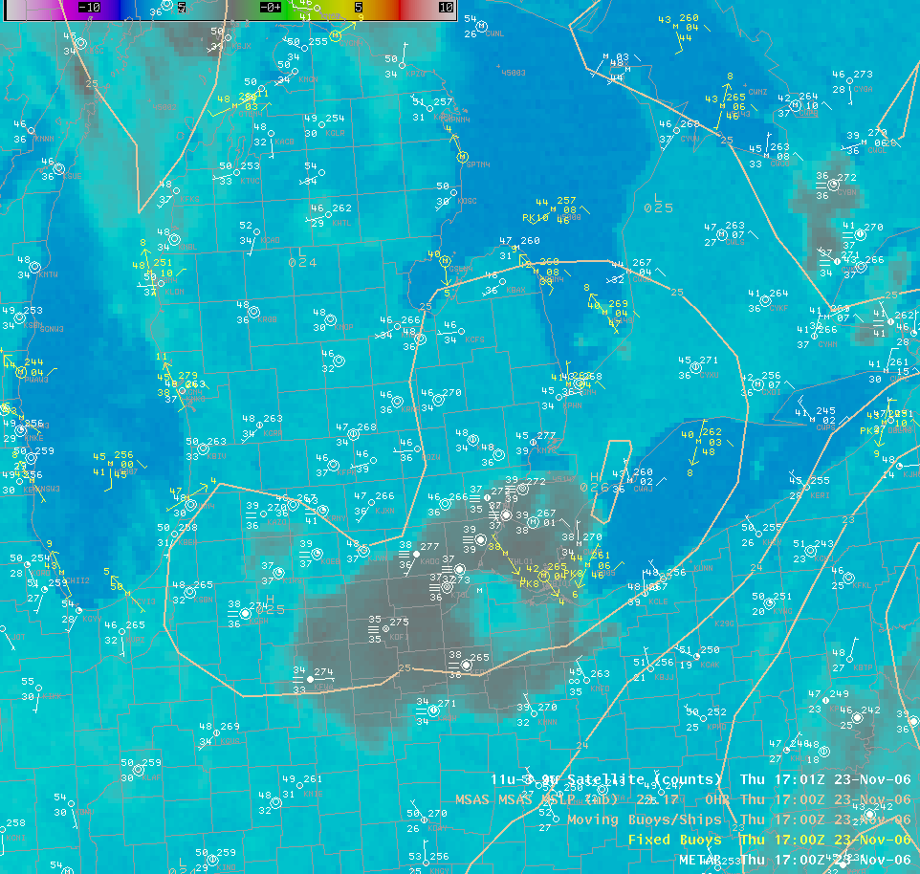
Satellite View
IR Imagery of an event which resulted from east flow off Lake Erie. Image is actually from 17z Nov 23, 2006

Slide 8
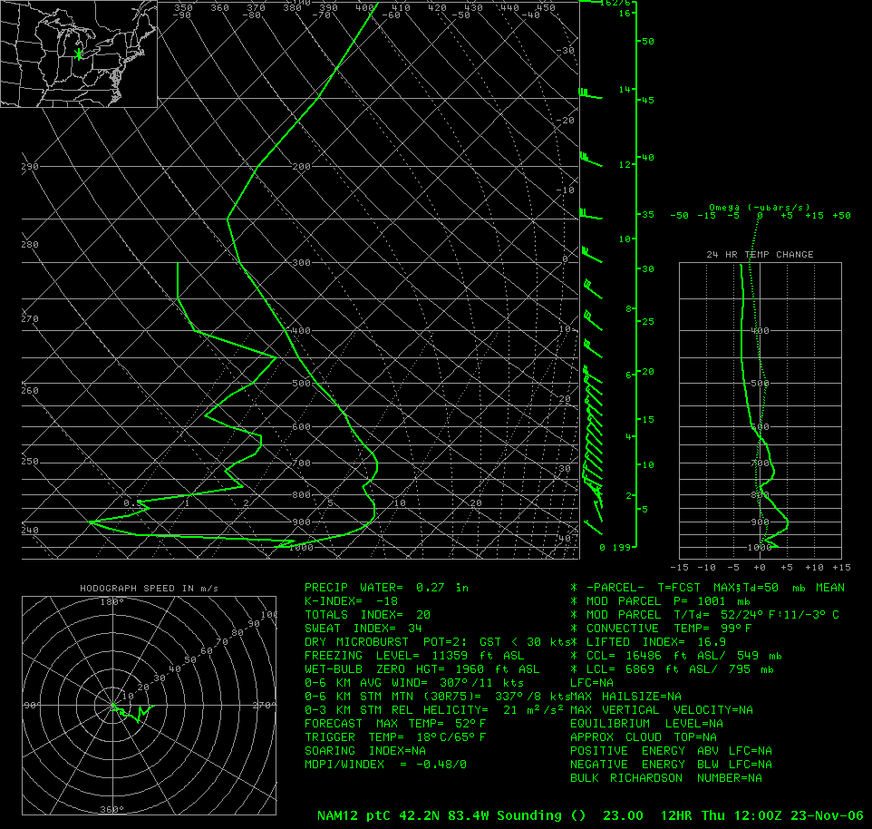
Sounding Profile
Example of a how a model sounding would look like during these events (assuming the model is handling the boundary layer moisture reasonably well which is not always going to be the case). Note the shallow layer of moisture trapped under a strong inversion and capped by a deep layer of extremely dry air (Dewpoint depressions greater than 30 deg).

Slide 9
Advection Fog - Characteristics
The depth of this fog can grow substantially, especially in late fall and early winter when nights are very long.
The low sun angle will also make it difficult to induce mixing in the boundary layer.
These events have produced extremely dense fog (near zero visibility).
950 to 850mb winds are typically 15 knots or less (strong enough to advect the fog inland but not too strong as to mix the low level moisture out).
In late fall, the boundary layer may not mix out well after one of these events, which may actually prompt fog redevelopment the next night, sometimes as early as midnight.
These events typically occur in the presence of a mid level ridge and strong low level anticyclone.

Slide 10
Stratus Build Down
This is when an initial stratus deck develops, then the ceilings lower and eventually reach the ground.
These events are very difficult to forecast due to the complex nature of the processes going on and poor handling by the models.
Some things to look for include:
  A strengthening and lowering inversion above the stratus deck (very dry air should be present above the stratus deck).
  Most typical with cold ground temps and/or snow cover.
  Look for high RH between the base of the stratus and the ground.
  Most typical under a light gradient (ie you do not want to have too much mixing).
  Can occur with warm ground temps under very high humidity (rainfall or thunderstorms often help).
  Sometimes this will form on the edge of a stratus deck within the region of clear skies.
  This type of fog is most common at PTK due to its higher elevation.

