Slide 1

Delta Air Lines Meteorology
Intermountain West
Aviation Weather Safety Workshop

Slide 2
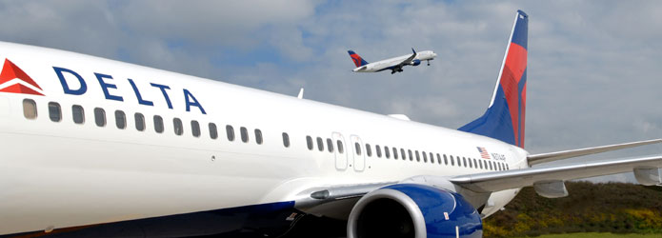
Delta Air Lines
Delta now serves more 600,000 customers EACH DAY.
5000 flights EACH DAY.
  Mainline: 3350 flights/day Delta Connection:
  SLC: 147/day - SLC: 127/day (Compass/Skywest)
  LAX: 129/day - LAX: 37/day (Compass/Skywest)
  SEA: 108/day - SEA: 66/day (Compass/Skywest)
  LAS: 40/day
  SFO: 53/day

Slide 3
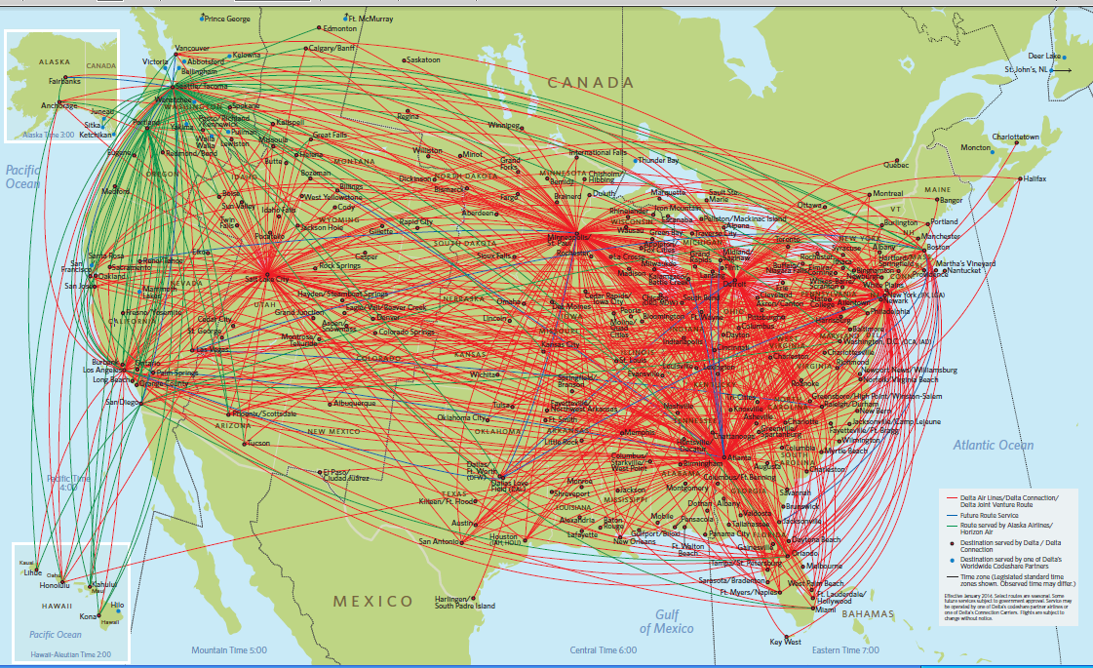
Delta Airlines Domestic Routes

Slide 4
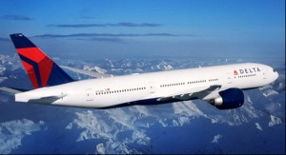
Delta Airlines Meteorology
What can meteorology provide to Delta?
  Provide information to support a SAFE and EFFICIENT Delta operation.
Primary Safety Impacts
  Turbulence/Mountain Waves
  Ozone
  Icing
  Volcanic Ash
  Low Level Wind Shear
Weather Efficiency Impacts
  Thunderstorms
  Ceilings/Visibility
  Winds
  Winter Storms

Slide 5
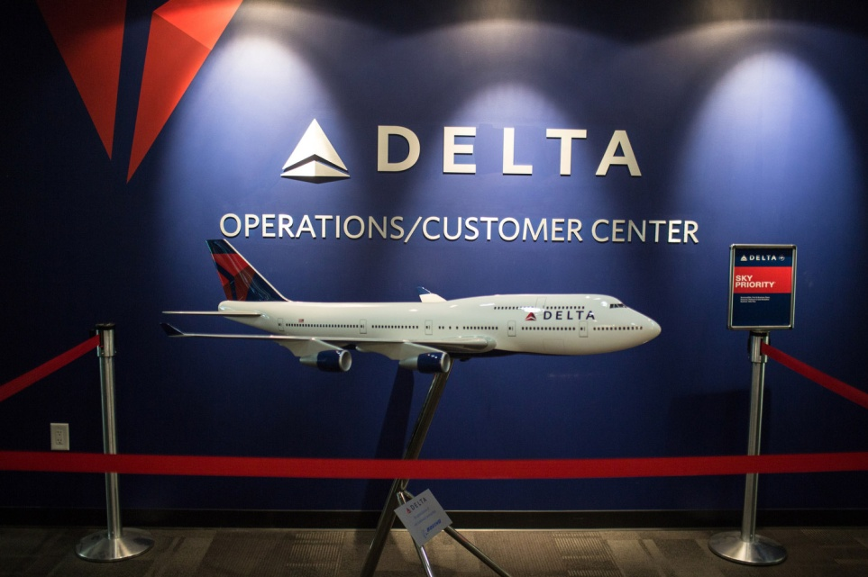
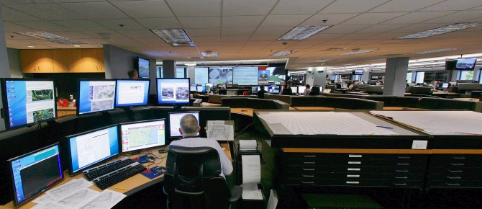
Delta Airlines Meteorology
Located in the Operations/Customer Center (OCC), which is the “nerve center” of Delta Airlines.
25 meteorologists
24/7 staffing
Worldwide coverage
  2 Surface Weather Desks
    Northeast U.S. and the rest of the U.S.
  3 Upper-Air Desks
    Domestic/Canada/Alaska/ Hawaii/Latin America/ Caribbean
    Atlantic/Europe/Mid-East/ Africa/South America
    Pacific/Asia/Australia

Slide 6
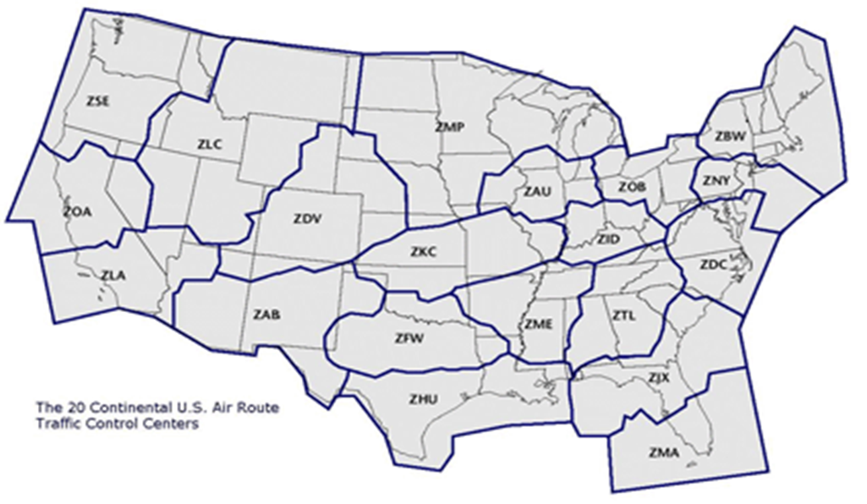
Surface Meteorology
Our surface meteorologists produce TEN domestic TAF’s FOUR times a day for the Delta operation.
  Includes SLC, LAX, and SEA
Delta flies to more cities than that!
  National Weather Service TAF’s available for all airports.
  Flight Dispatchers can request that Delta Meteorology produce a TAF for any station around the world.
  Delta Meteorology also produces several TAF’s for ETOPS alternate stations for oceanic flights.

Slide 7
TAF Product
TAF’s remain the primary tool of the Flight Dispatcher and Pilot to determine if alternate airports need to be added to the flight plan, and thus, if additional fuel (additional cost) needs to be added to the plane.
KSLC 080956Z DAL 0810/0916 17019G29KT P6SM BKN110
FM081200 18018G27KT P6SM -RA BKN030 OVC080
FM081400 20018G26KT 5SM -RASN BKN015 OVC030
FM082000 29016G24KT 5SM -SHRASN BKN012 OVC025
FM082300 32012G20KT P6SM SCT025 BKN040
FM090400 16008KT P6SM SCT040 OVC090
FM091300 15006KT P6SM SCT050 BKN150
RMK DL TAF BY Heying DISCUSSION - LESS THAN AN INCH ACCUMULATION WITH TEMPS SO WARM =
Alternates needed when forecast below 2000ft and 3SM visibility for +/- 1 hr of arrival time.
Delta Exemption: Alternate needed when forecast below 1000ft and 2SM visibility or any thunderstorms for +/- 1 hr of arrival time.
Timely amendment for improving or deteriorating conditions thru these thresholds are very important to the Flight Dispatcher.

Slide 8
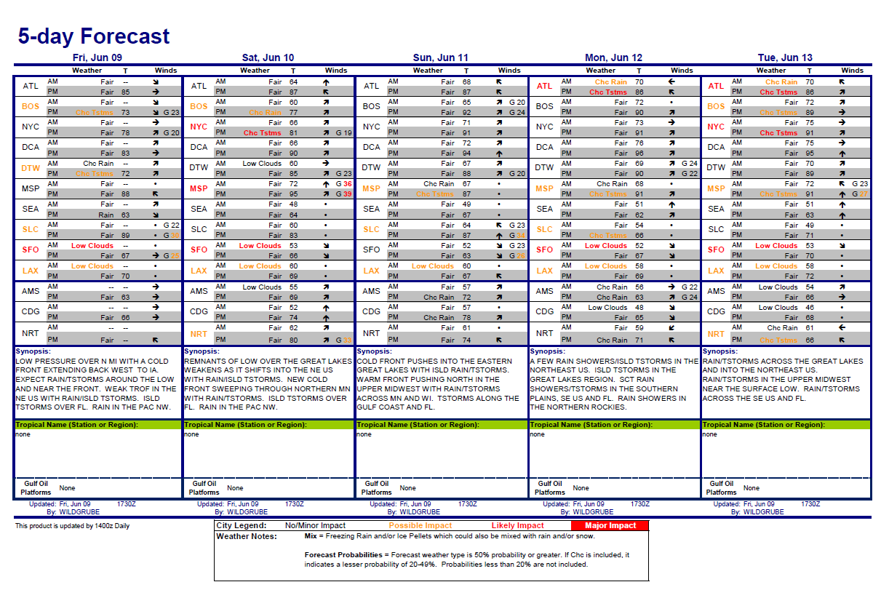
5-day Hub Outlook

Slide 9
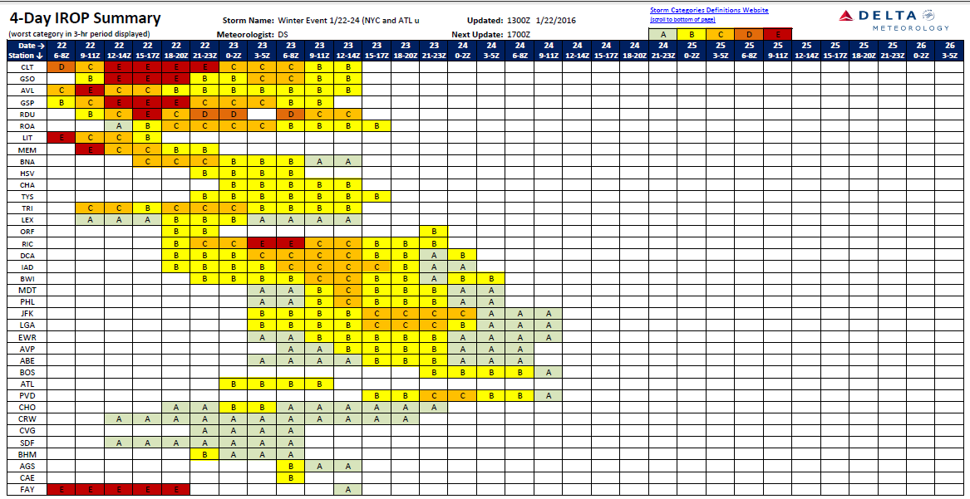
Snow Storm –
Forecast Summary

Slide 10
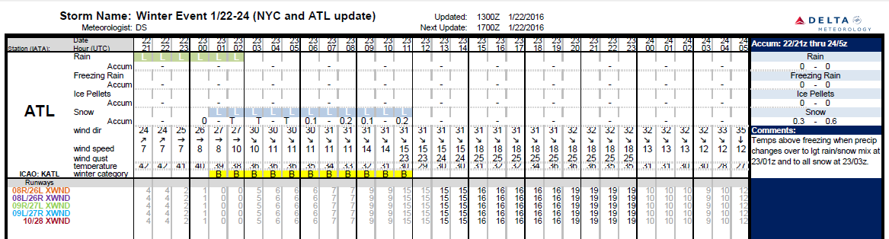
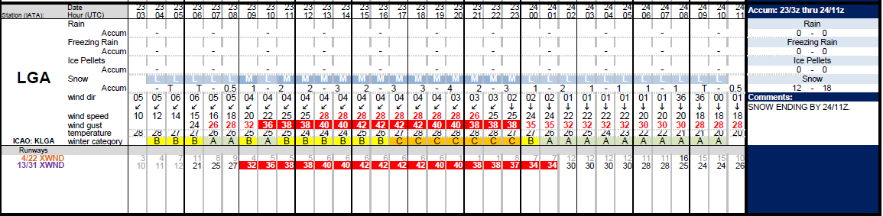
Snow Storm–
Airport Forecast Details
Hour – by – Hour Forecast for each Airport

Slide 11
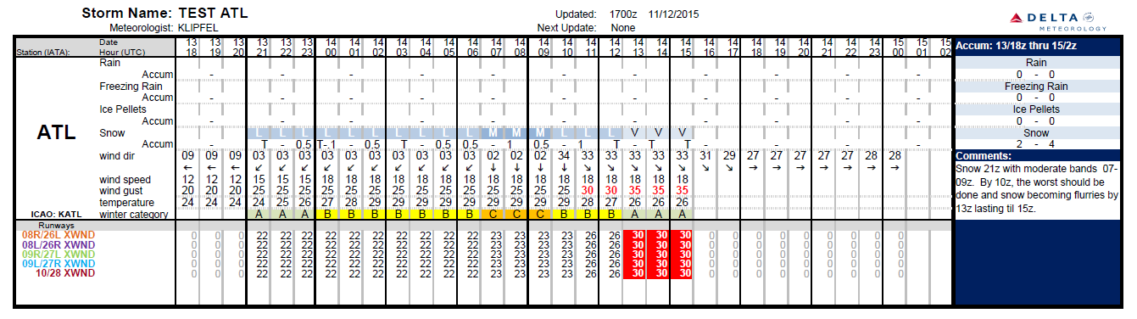
Winter Precip – IROP Event
Our strategic planning team looks at the forecast and our schedule and works with the station leaders to determine if deicing will be a constraint. Things to consider are the precipitation type, intensity, Staffing, deicing equipment, Holdover Times, Runways and Fleet Mix.

Slide 12
What is Upper Air Meteorology?

Slide 13
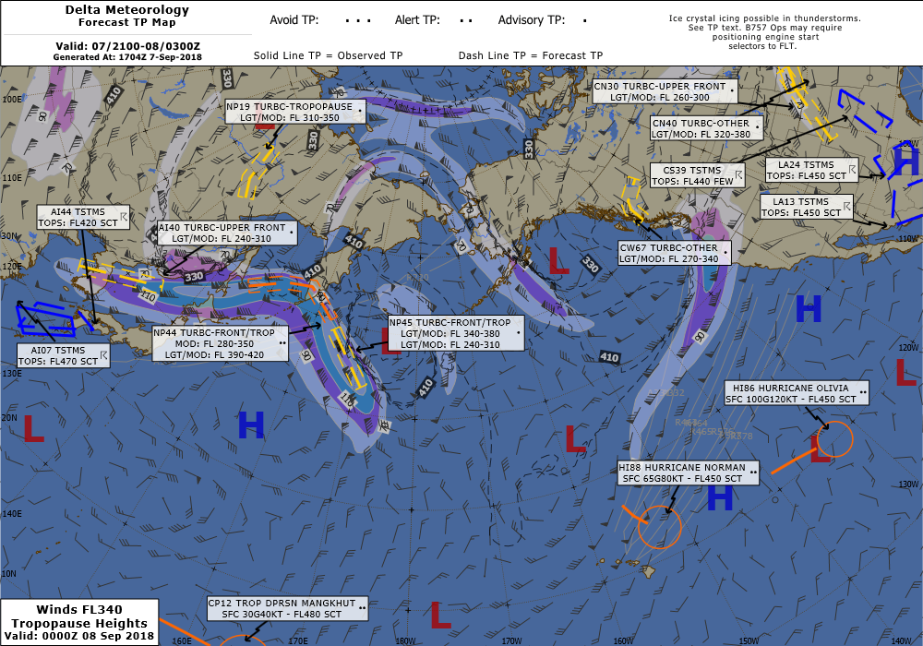
Upper Air Meteorology
Forecasting hazards at flight altitudes so flight decision makers can run a safe and efficient operation.
Initial strategic flight planning tool is the upper air depiction.

Slide 14
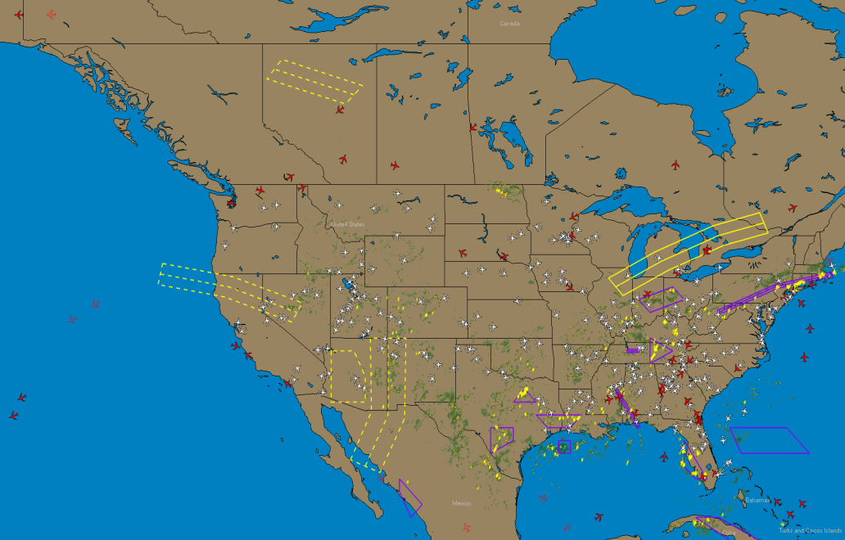
Turbulence Plots (TP’s)
Turbulence Plots (TPs) are a lat/lon based areas to describe hazardous weather. They are updated as conditions warrant and contain the most current information.
Consistent product around the world
All hazards
Tailored for Delta size aircraft
Automatically sent to flights if along their flight path.

Slide 15
TP Types and Hazard Intensity
AVOID
Severe Icing
Strong Mtn Wave
Mod-Sev, Severe Turbc
& Volc Ash Cloud > FL250*
ALERT
Moderate Icing
Moderate Mountain Wave
Moderate Turbulence
Thunderstorms, Ozone, Space Weather, Volcanic Ash*
ADVISORY
Light-Moderate Turbulence
Frontal Wind Shear

Slide 16
Avoidance Policies Based on TP’s
AVOID
Avoid
SEVERE OR
STRONG ALTITUDES
(unless under
emergency authority)
ALERT
Recommend Avoidance if feasible.
Minimize exposure to the
affected altitudes or areas.
ADVISORY
No Restrictions

Slide 17
Mountain Waves

Slide 18
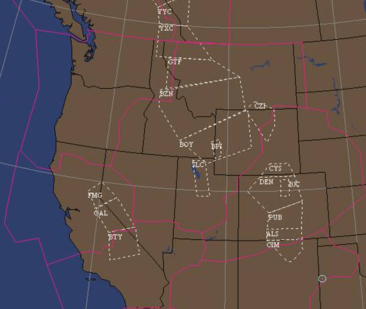
Mountain Wave Forecasting
Pre-defined mountain wave areas in the western United States.
  Northern Rockies
  Southern Rockies
  Sierras
Forecast wave action and turbulence at flight altitudes (around the trop) and rotor zone turbulence (climb and descent) at airports within the areas.

Slide 19
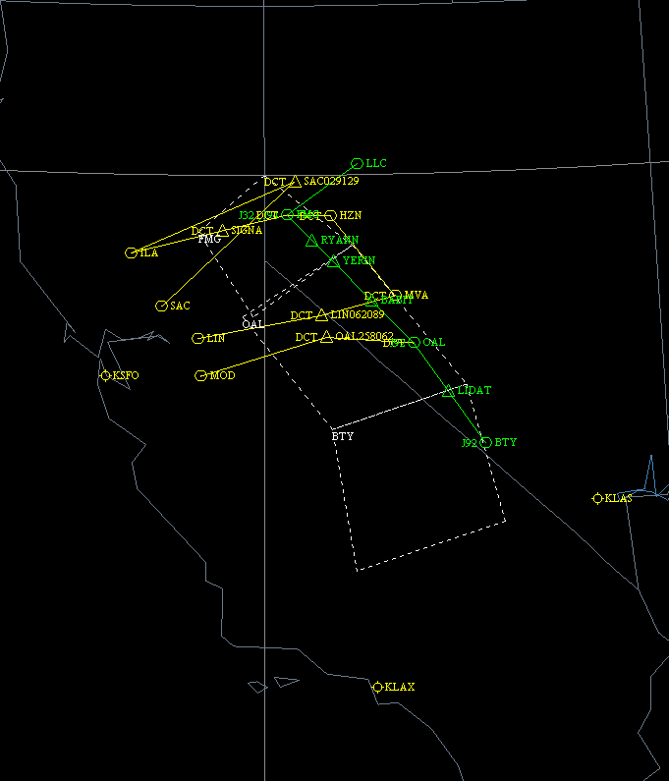
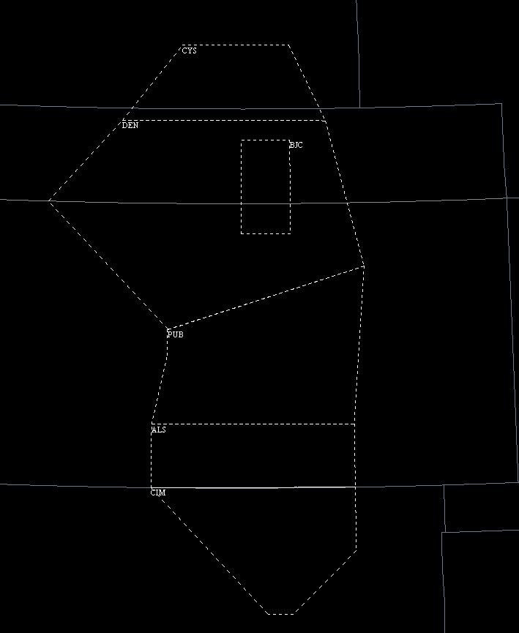
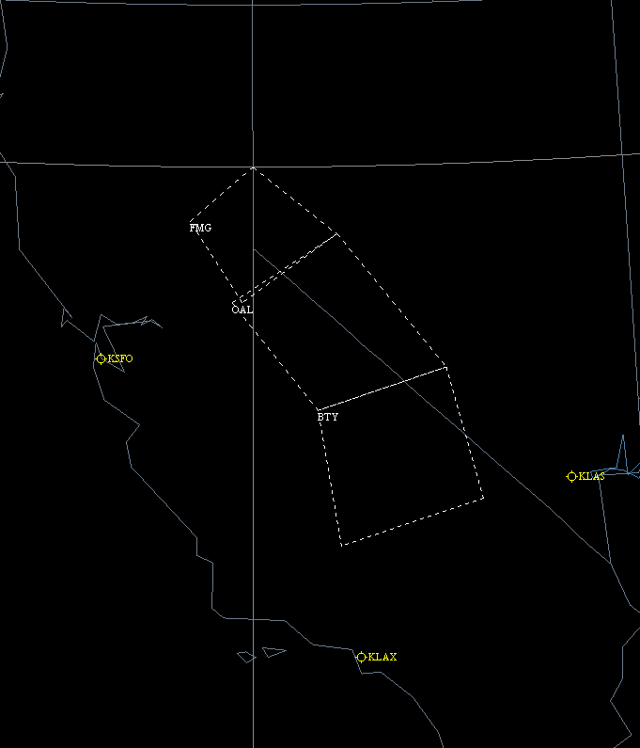
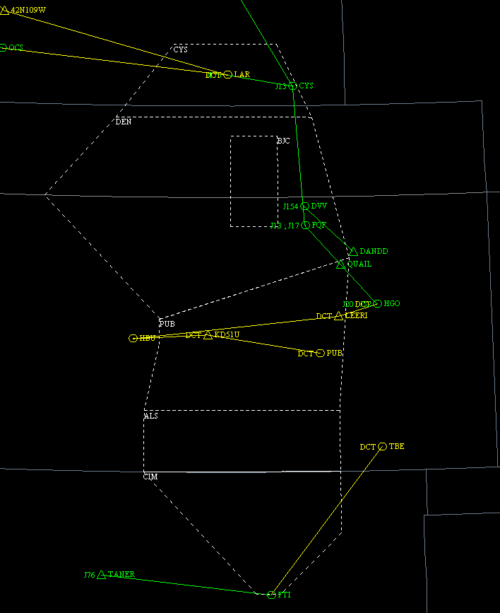
Mountain Wave Forecasting
When a mountain wave area or group of mountain wave areas are expected to be active, flights will be routed:
  Either around the area
  Or through the area with altitude and/or horizontal restrictions.
Deviation Routes are available for some wave areas and can be used to minimize wave action and turbulence.

Slide 20
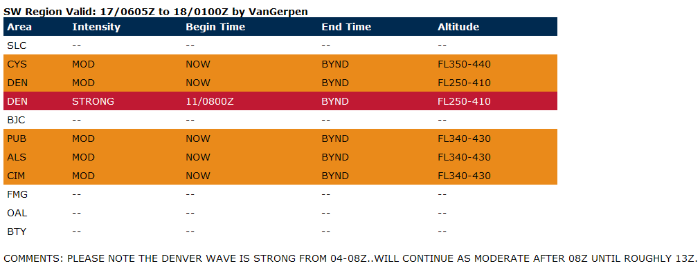
Mountain Wave Forecasting
Delta Meteorology produces a Mountain Wave Outlook multiple times per day
  Used by Delta and FAA for planning purposes.
  Received by FAA Systems Command Center and forwarded onto affected ARTCC’s.

Slide 21
Mountain Wave Forecasting
TP SW04 170019Z
1.WY CO NM
2.* ALERT *
HAZ:MTN WAVE
SOURCE:FORECAST
AREAS:PUB
ALTS:FL340-430 MOD
3.VALID 170300Z/171200Z
4.CANCEL NONE
Mountain Wave TP’s are issued by Delta Meteorology as short term forecasts and real time conditions.
Mountain Wave TP’s are only issued as Alert (moderate) or Avoid (strong).
Mountain Wave TP’s usually are issued as a forecast TP. Then updated to a pireps TP when wave action is confirmed.
TP SW13 170508Z
1.WY CO NM
2.* AVOID *
HAZ:MTN WAVE
SOURCE:PIREPS
AREAS:DEN
ALTS:FL250-410 STRONG
INFO:SEV MTN WAVE
RPTD IN DEN WAVE
FL360 B757.
3.VALID 170508Z/170800Z
4.CANCEL SW10

Slide 22
Other Operational Challenges
-Hot Temps and Seat Caps
-Missing METAR Variables

Slide 23
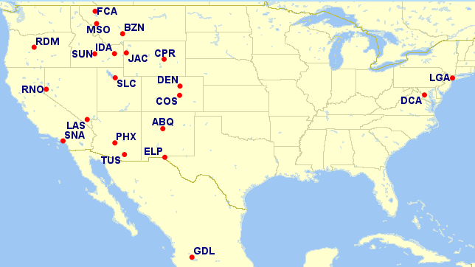
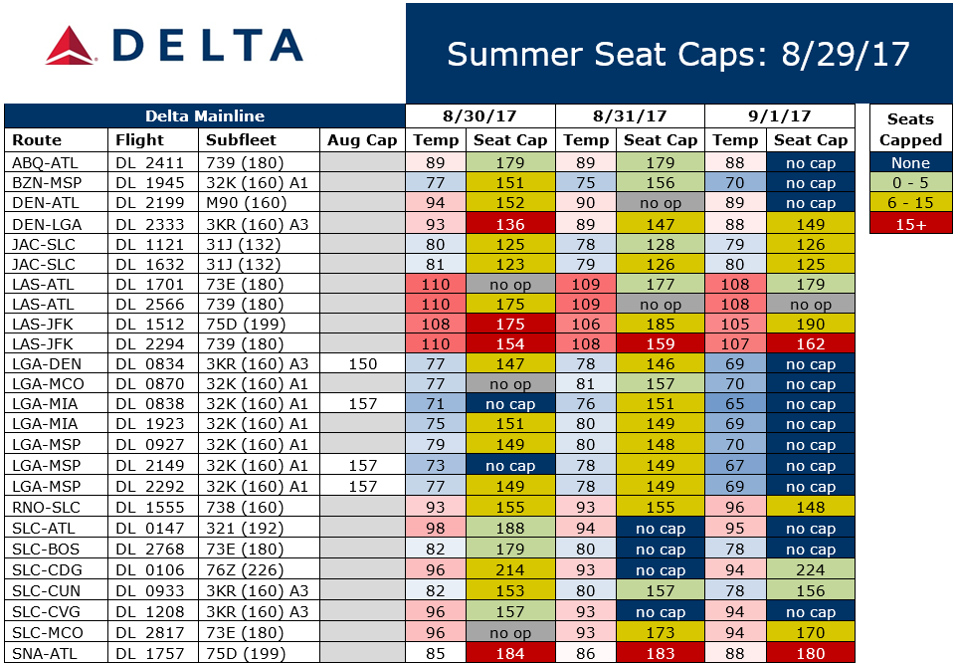
Summer Seat Caps - Process
High Risk Stations (21)
Schedule (All Flights)
Temperature (Hourly) - NDFD
Seat Cap Tables (Assumptions)
  65% Boeing Enroute Winds
  45 min reserve fuel
  0 NM Alternate
  Px weights 220lbs
Daily Report

Slide 24
Summer Seat Caps
Goal
Reduce preventable Denied Boardings due to aircraft performance limitations or Weight & Balance.

Slide 25
Missing METAR Variables
Takeoff Performance: (combination of temp, wind, altimeter, wet rwy etc).
Regulatory: BIG impacts if variable is missing.
70 flights from mid-2016 to mid 2017 due to missing data in METAR.
Commercial regulations are very strict, with very little leeway provided by FAA. Can use RTMA to supplement temps, but other variables are not approved. Working with FAA, NWS and other airlines to come up with back-up procedures when they are missing. VERY SLOW moving effort!
Our study found 0.8% of US surface observations contain at least 1 missing variable. (5 year study).

Slide 26
What weather does the pilot have access to on tablet?

Slide 27
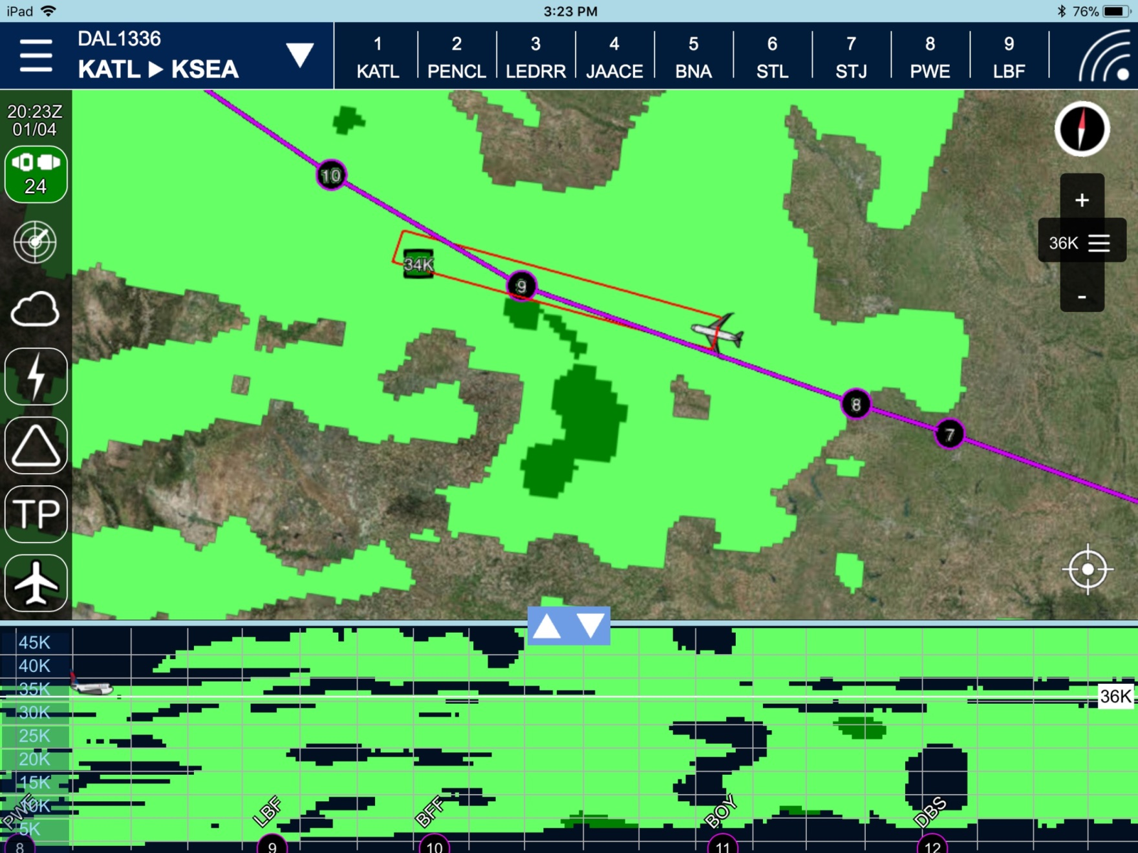
Graphical Turbulence Guidance
Max GTG in next 30 minutes

Slide 28
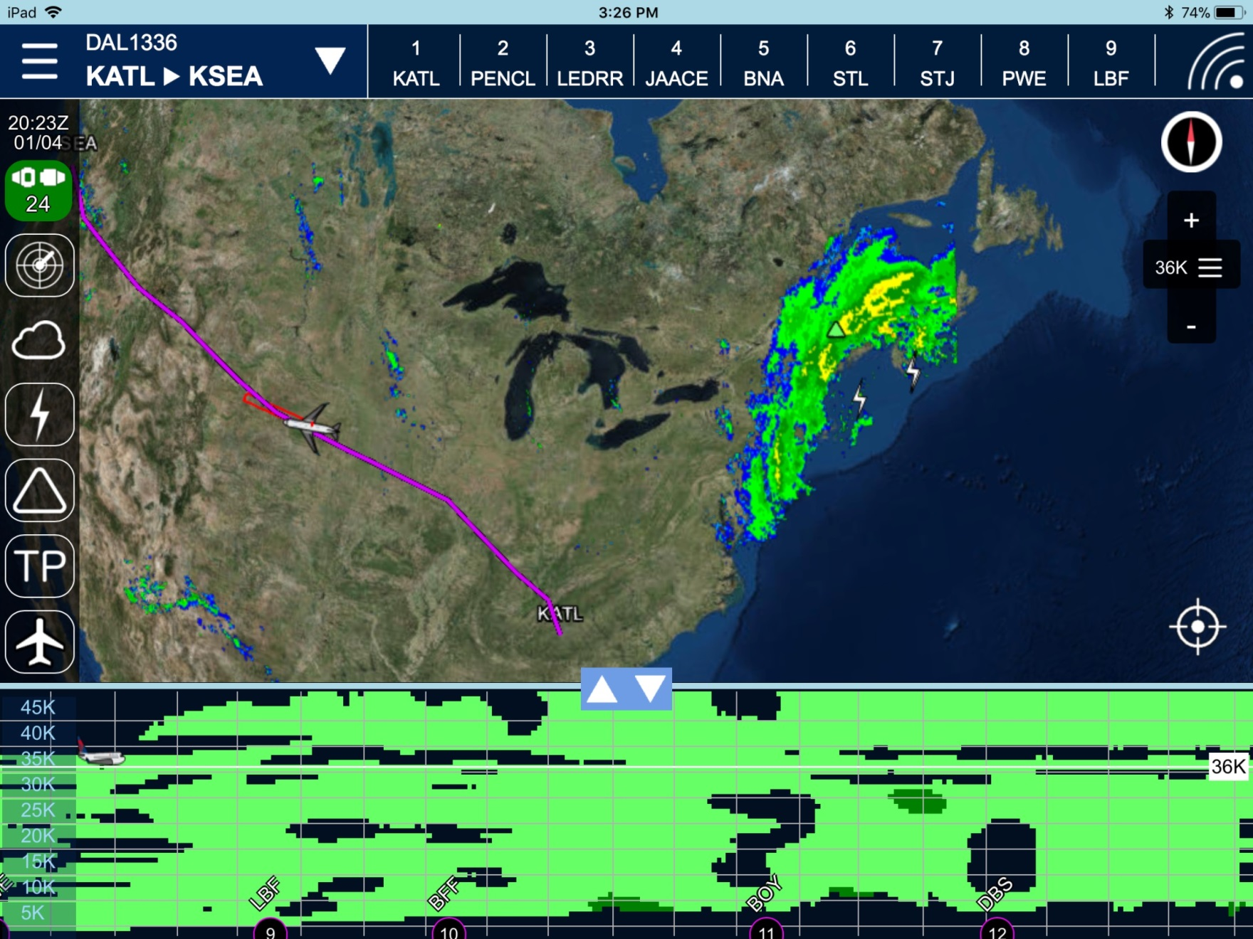
Radar, Lightning & Hail Overlay
US only

Slide 29
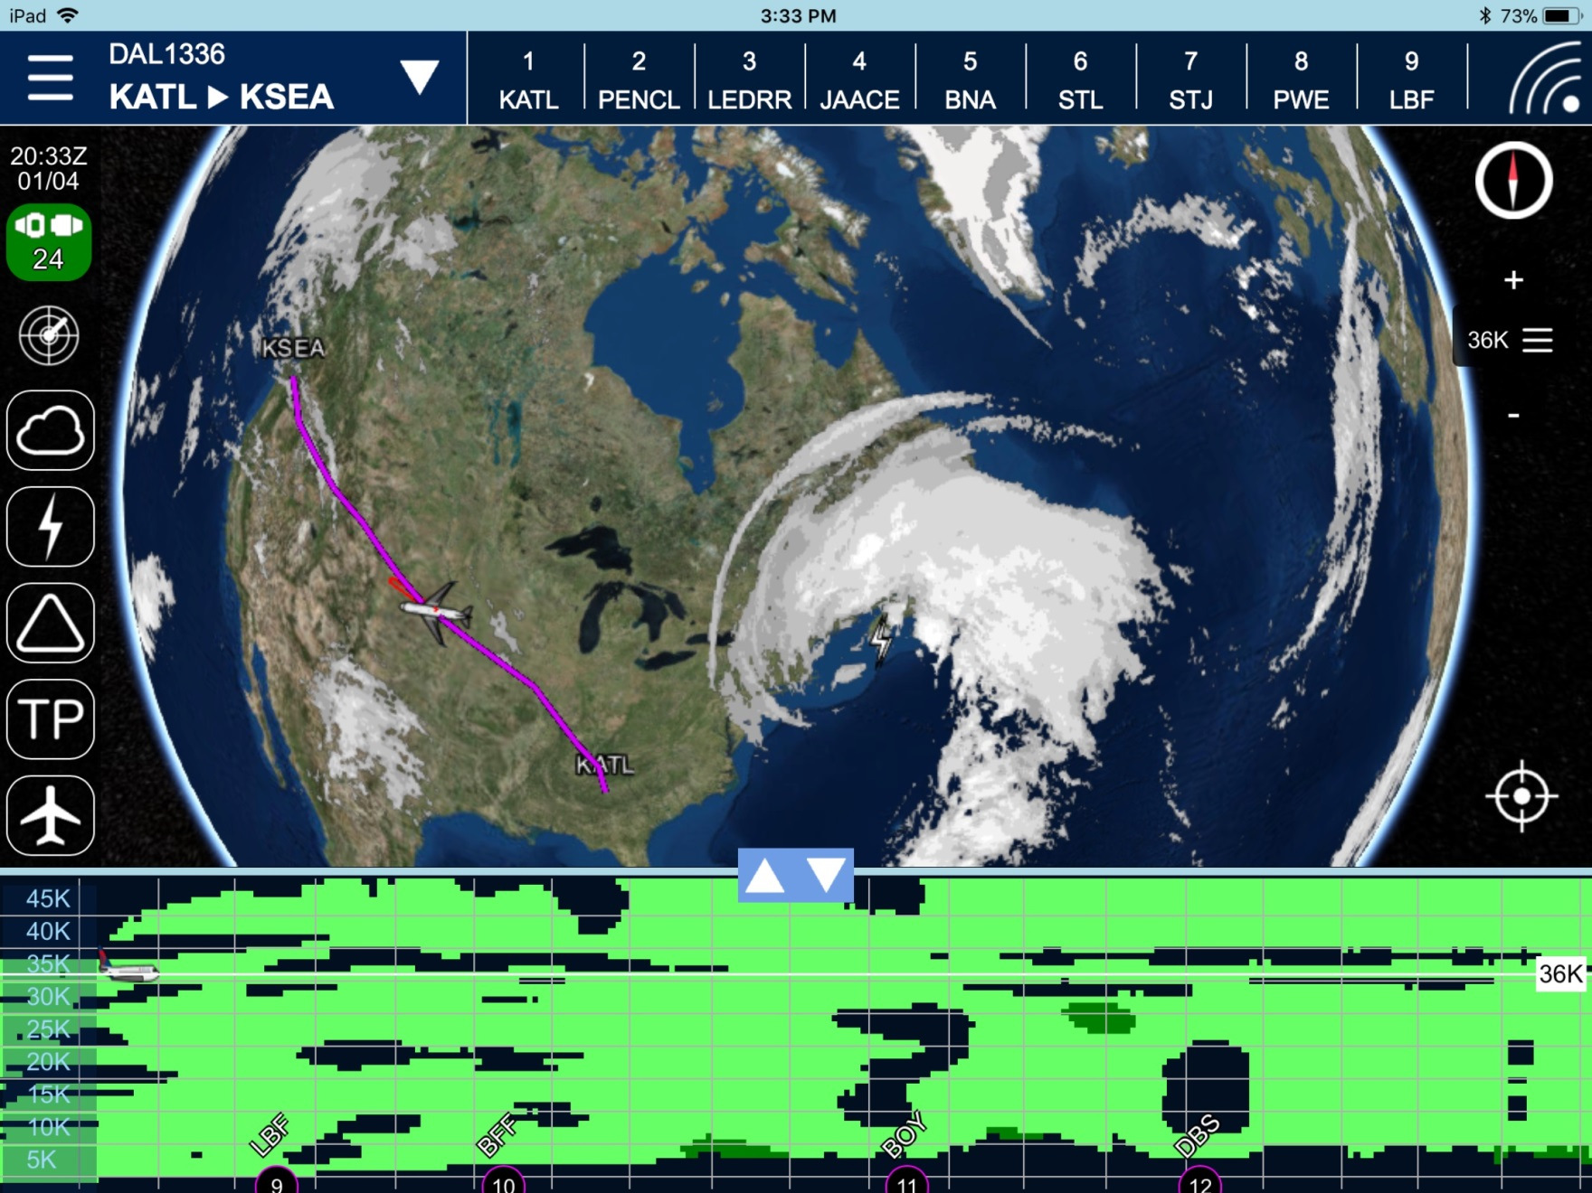
Cloud Top Overlay

Slide 30
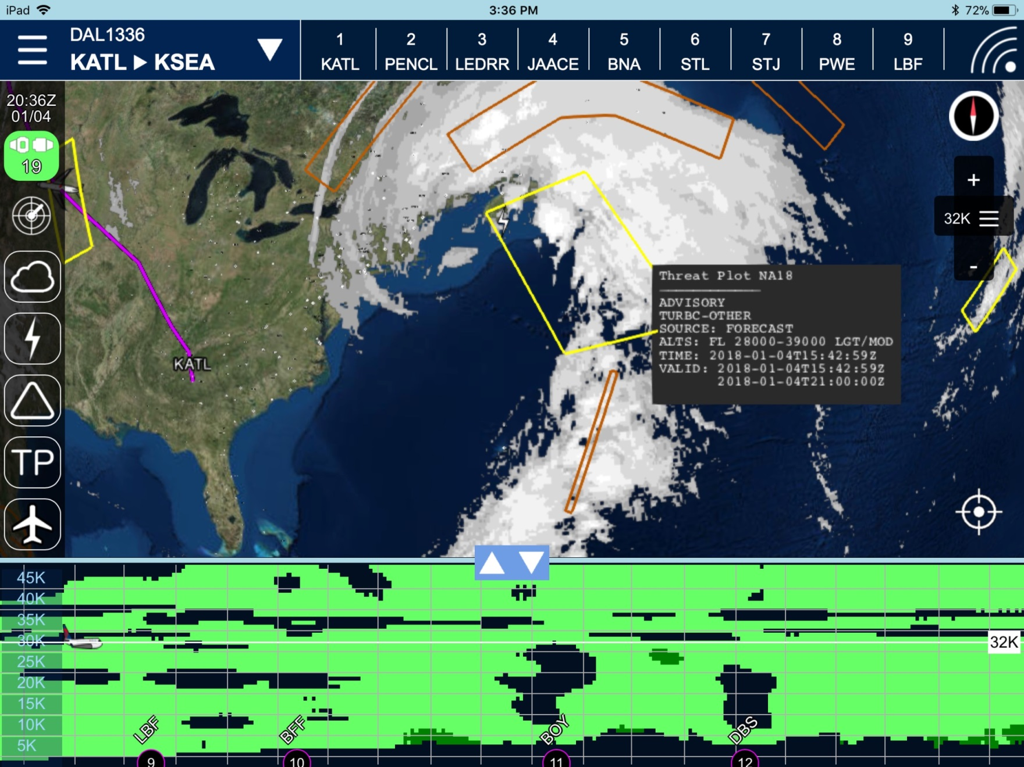
TP Overlay

Slide 31
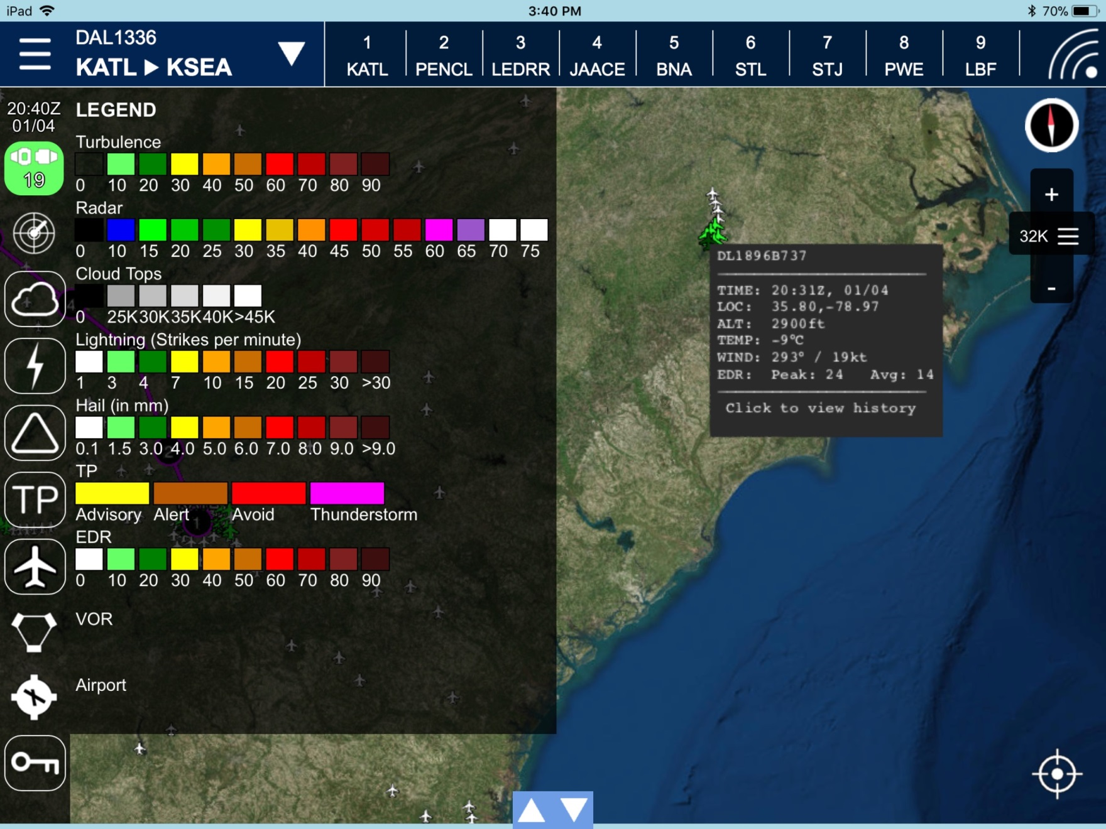
Legends

Slide 32
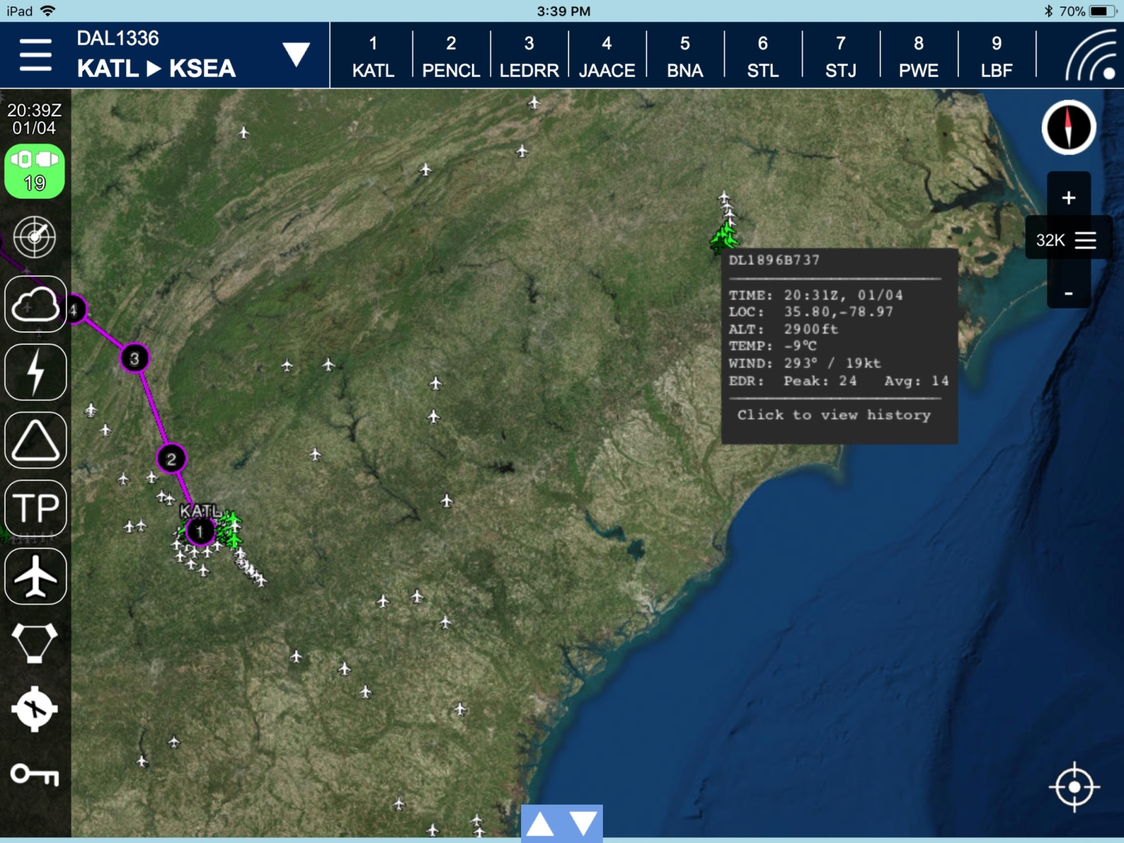
EDR Overlay

Slide 33
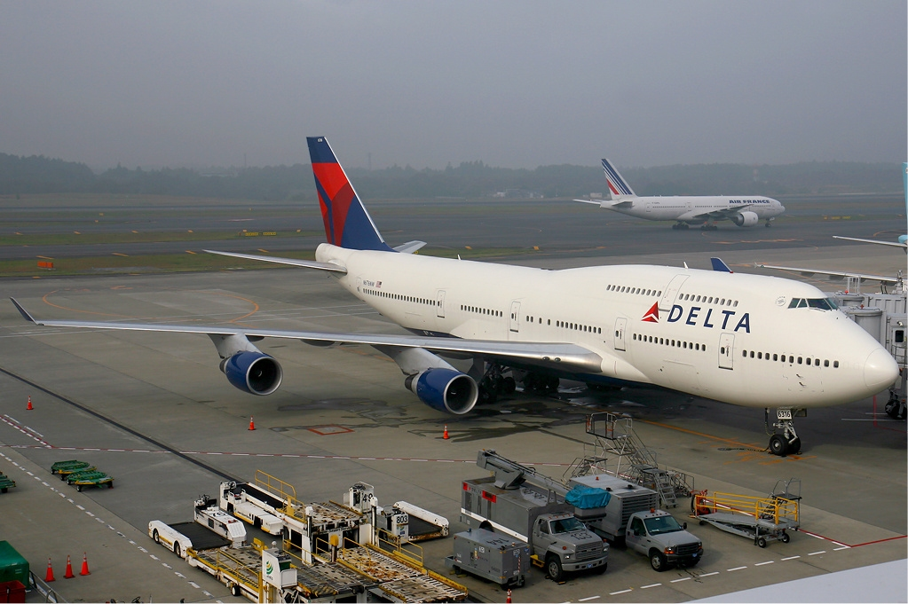
Delta Airlines Meteorology
T. Warren Weston
Senior Meteorologist
Delta Airlines
warren.weston@delta.com

